Slide 1
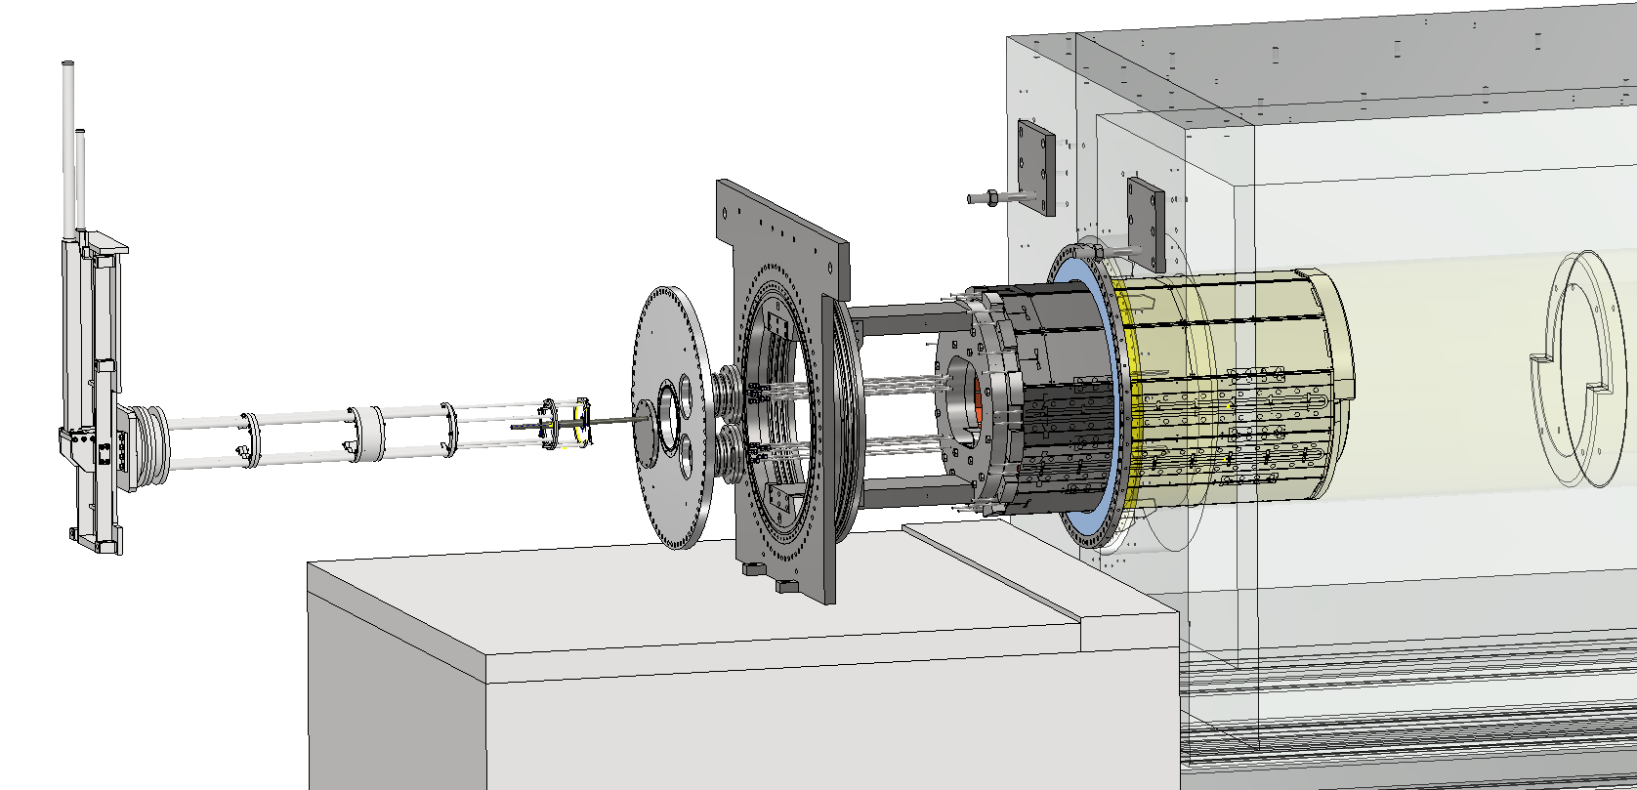
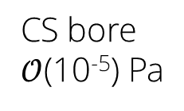
CS return yoke
Target insertion & support
system
1200-mm bore pillow seal
Vacuum flange made of aluminum for low activation
Receiver for the shield load
Pion production target
0.5-mm thick Ti64 beam window
CS bore
$𝒪$(10⁻⁵) Pa
Cooling pipes
CS Inner shield
Pillow seal
Feed-throughs
Mechanical flange,
positioning with 0.5 mm precision

