Slide 1
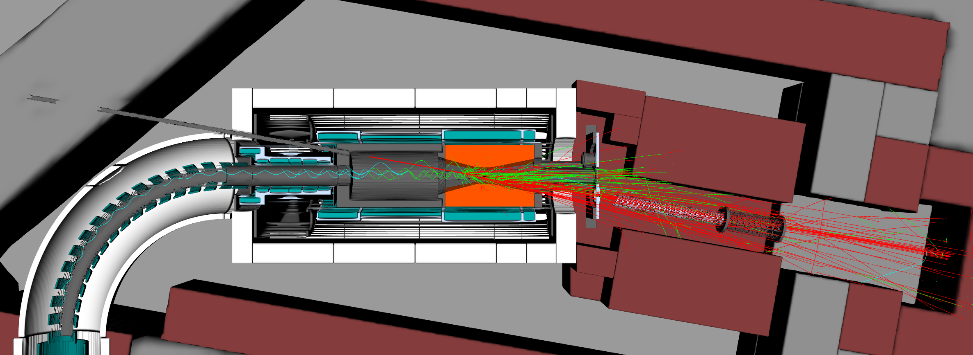

1 m
CS coils
Proton beam from MR
(C-line)
Pion capture solenoid (CS)
COMET beam room
Muon transport
solenoid
$𝒪$(10⁻⁵) Pa
Production target
CS inner shield
to detectors
Beam dump

