Slide 1
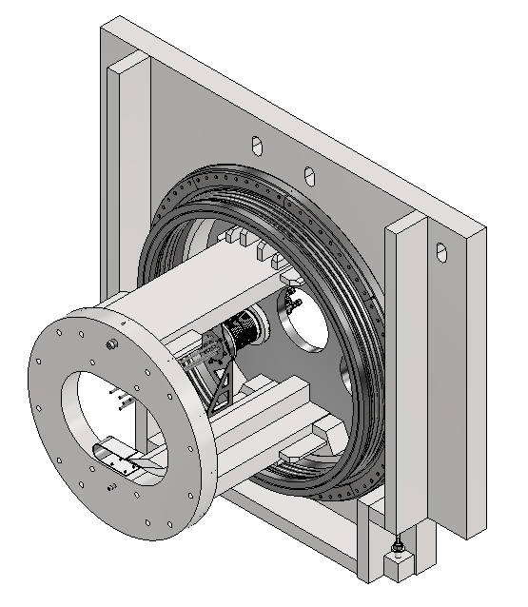
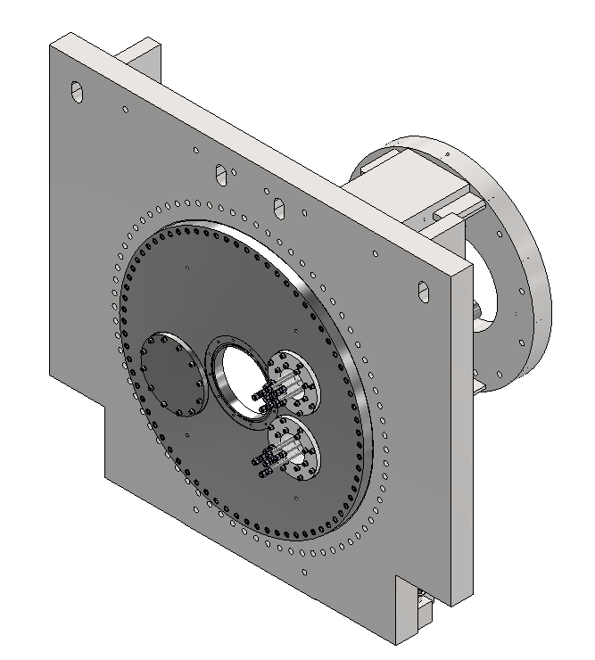
Large-bore
pillow seal
Mechanical flange
Support
beams
Aluminum flange
Beam window
Feedthrough
flanges
Target system
port
Support
flange

