Slide 1
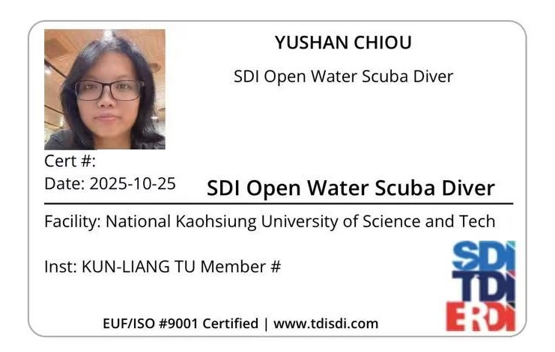

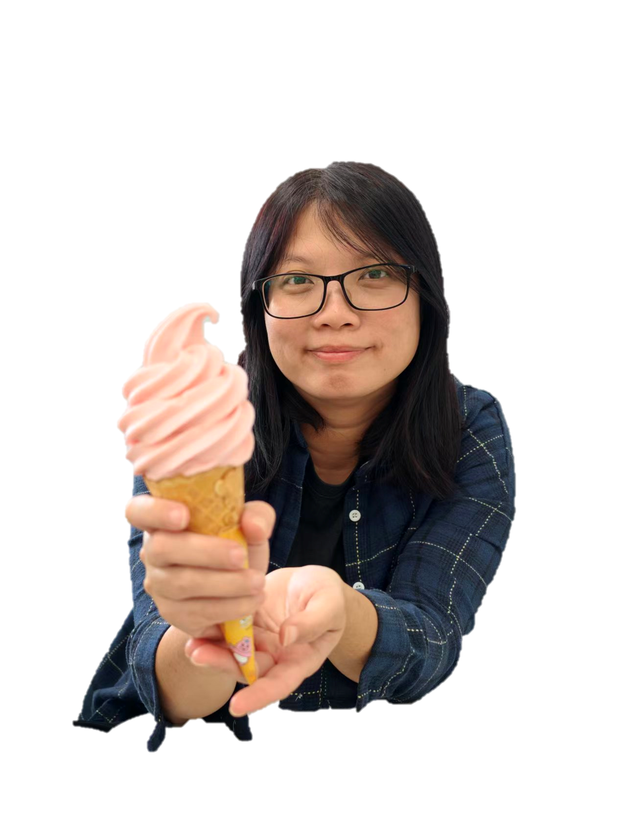


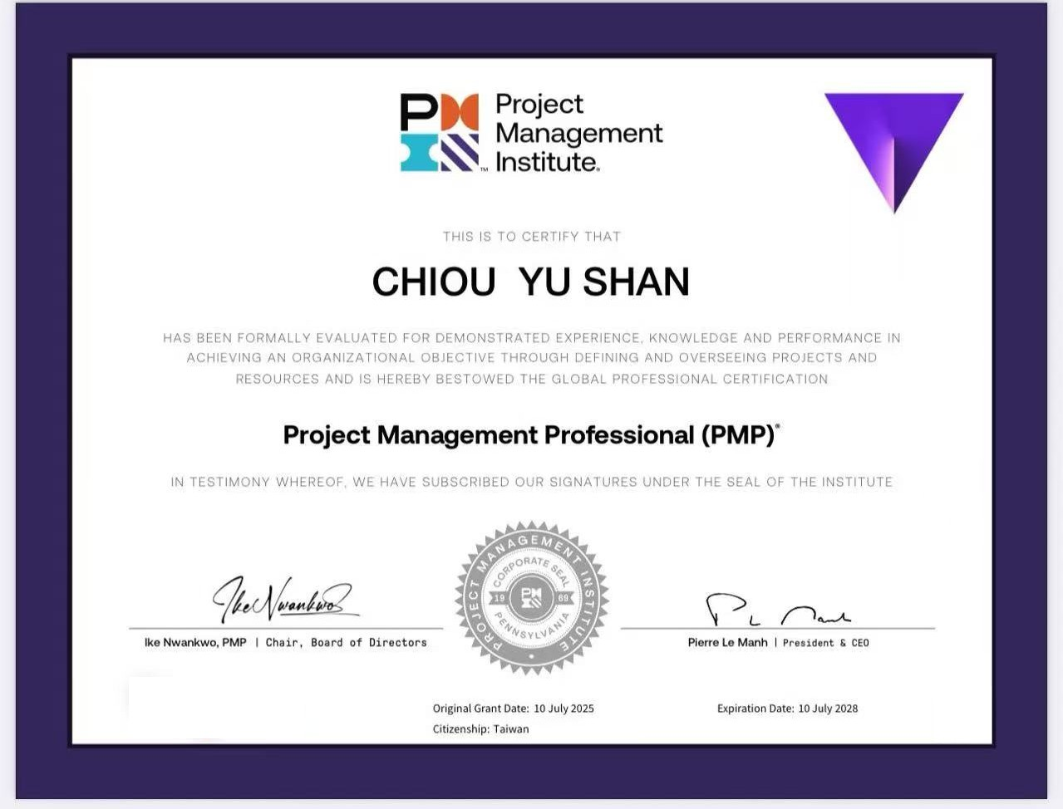

Susan Chiu Smart Factory Project Section Manager | FLEXium
National Kaohsiung Univ. of Applied Sciences
Major: Electronic Engineering
2006–2008
ASE Group
Product Engineer
2008–2013
Army Artillery School
Captain, IT Officer
2013–Present
Project Mgmt
Design
Highlight Award:
2017 1st Place
2018 3rd Place
2020 3rd Place
2021 3rd Place
2022 2nd Place
2022 Outstanding Employee
Highlight Award:
2023 2nd Place
2024 2nd Place
2025 2nd Place

