Slide 1







Slide 2






Slide 3



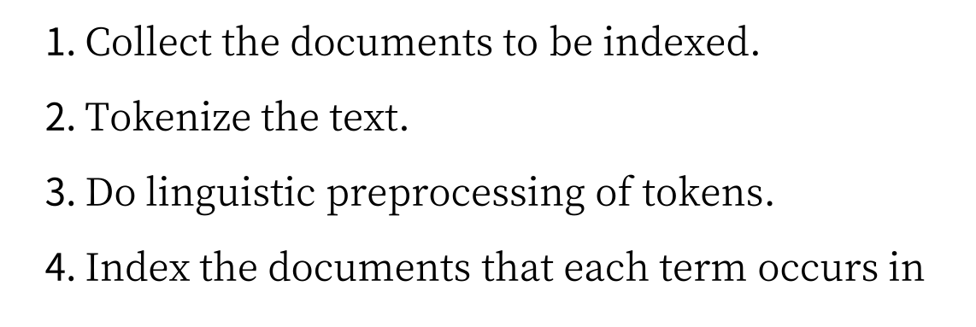

Slide 4







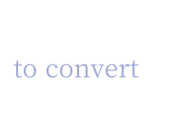


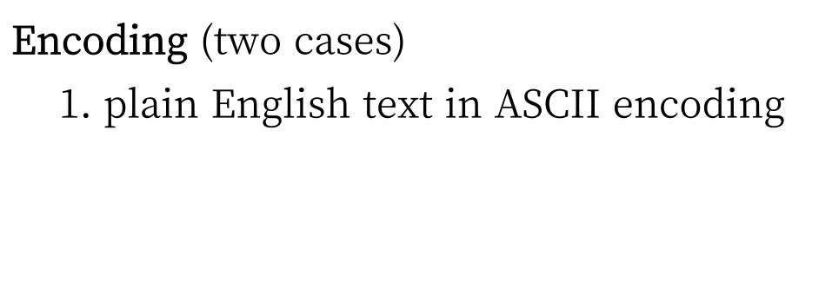




Slide 5





Slide 6










Slide 7







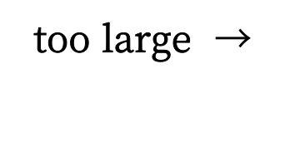

Slide 8









Source: https://nlp.stanford.edu/IR-book/information-retrieval-book.html

Slide 9





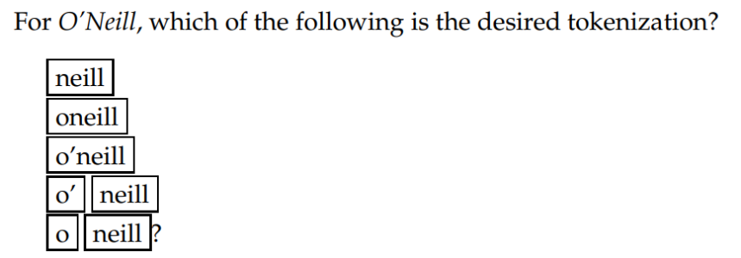
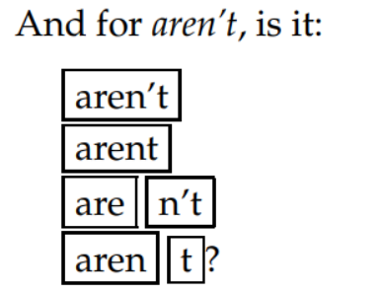
Source: https://nlp.stanford.edu/IR-book/information-retrieval-book.html

Slide 10










Slide 11





Source: https://nlp.stanford.edu/IR-book/information-retrieval-book.html

Slide 12





Source: https://nlp.stanford.edu/IR-book/information-retrieval-book.html

Slide 13









Slide 14




Source: https://nlp.stanford.edu/IR-book/information-retrieval-book.html

Slide 15


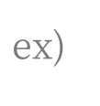






Slide 16






Slide 17









Source: https://nlp.stanford.edu/IR-book/information-retrieval-book.html

Slide 18



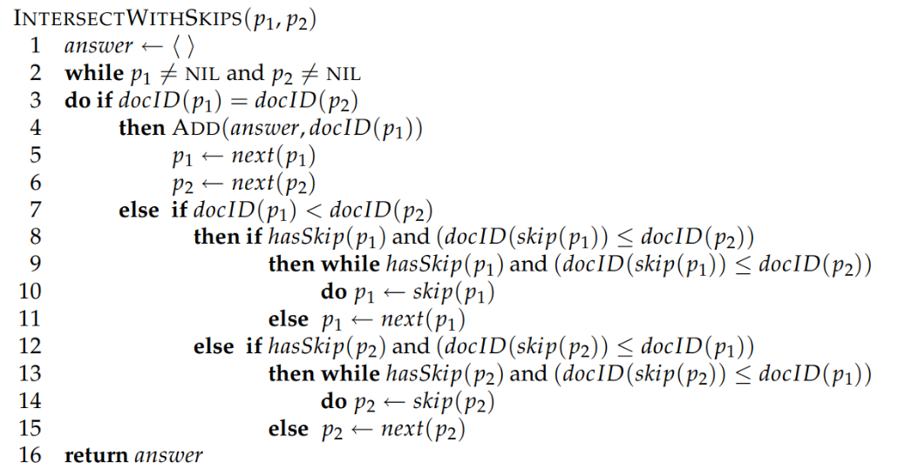
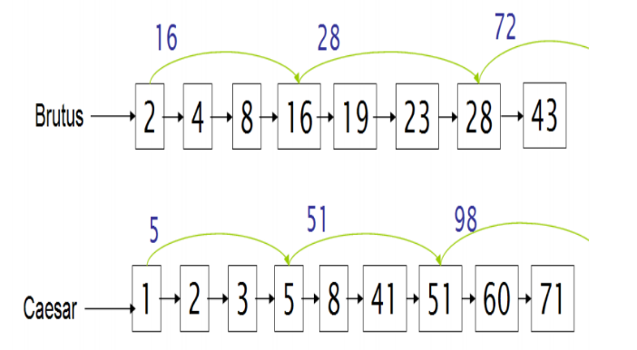
Source: https://nlp.stanford.edu/IR-book/information-retrieval-book.html

Slide 19

Source: https://nlp.stanford.edu/IR-book/information-retrieval-book.html

