Slide 1

Project Title – Seasonal Agriculture Performance Analysis
Student Name – Yashveer Singh Negi
College Name - Indira Gandhi National Open University
AICTE STU ID : STU6a6aececab9041785392364

Slide 2

PROBLEM STATEMENT
(Agricultural activities are influenced by seasonal variations in environmental conditions, farming practices, resource availability and market conditions. As a result, agricultural performance may differ from one season to another. However, raw agricultural data does not clearly explain how agricultural performance changes across seasons or what patterns can be observed in different seasonal conditions. The problem is to analyze the given agricultural dataset and investigate seasonal differences in agricultural performance by identifying meaningful patterns, trends, relationships and variations within the available data.

Slide 3
Project Description
• Analyze the supplied seasonal agriculture dataset using Python and exploratory data analysis.
• Compare agricultural performance across Kharif, Rabi and Zaid seasons.
• Evaluate crop-wise and state-wise performance.
• Study relationships among rainfall, temperature, soil, irrigation, water efficiency and yield.
• Assess revenue, cost, profit and profit margin.
• Convert raw records into clear insights and recommendations for agricultural planning.

Slide 4

WHO ARE THE END USERS?
Farmers – understand seasonal yield, irrigation and risk patterns.
Agricultural planners – compare crops, states and seasons.
Government and agriculture departments – support evidence-based planning and resource allocation.
Agribusiness organizations – evaluate production, revenue and profitability.
Researchers and data analysts – identify trends for deeper modelling.

Slide 5

Technology Used
Technology | Purpose
Python | Analysis and automation
Jupyter Notebook | Interactive analysis
Pandas | Data loading and cleaning
Numpy | Numeric calculation
Matplotlib | Visualization
Seaborn | Statistical visualization

Slide 6
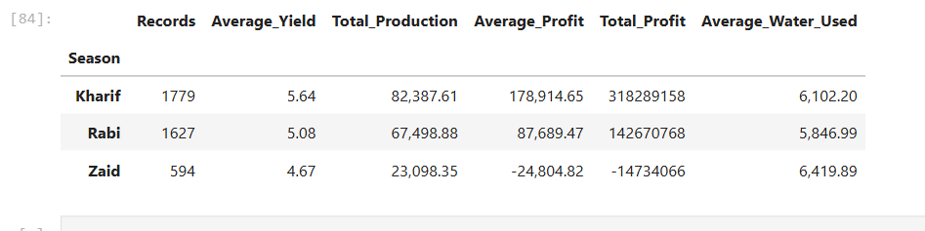
RESULTS

Slide 7
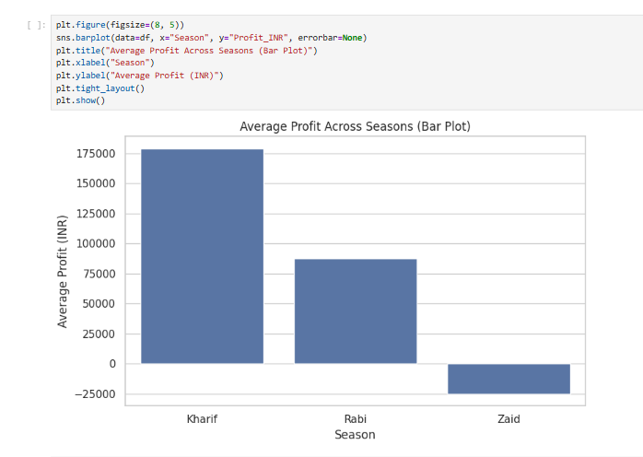
RESULTS
[Add screen shots of your code ]

Slide 8
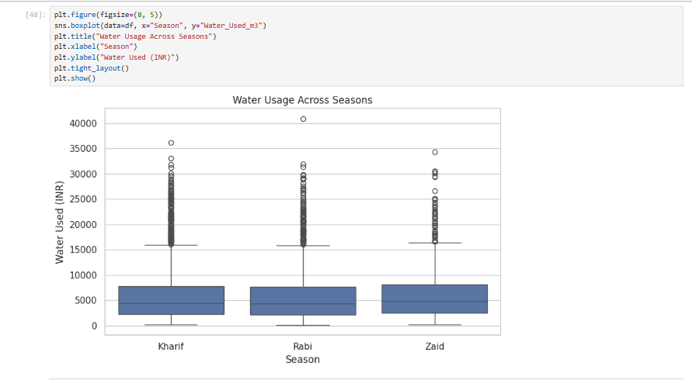
RESULTS
[Add screen shots of your code ]

Slide 9
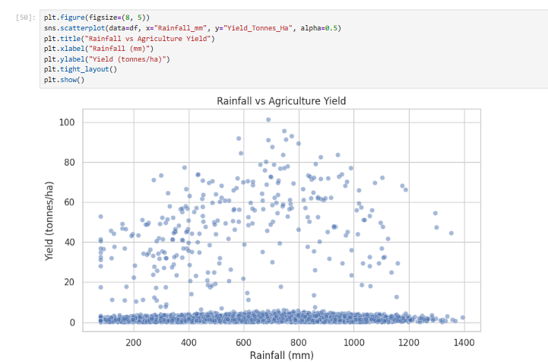
RESULTS
[Add screen shots of your code ]

Slide 10
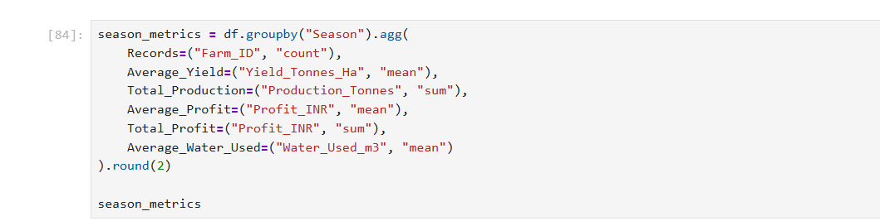
RESULTS
[Add screen shots of your code ]

Slide 11
Future scope
• Machine-learning based yield prediction.
• Seasonal yield forecasting.
• Crop recommendation using environmental and economic conditions.
• Weather-aware irrigation and crop-management decision support.
• Water-use optimization and efficiency benchmarking.
• Disease/pest risk prediction and early-warning systems.
• Interactive Power BI/Tableau dashboard.

Slide 12
GitHub Link
https://github.com/ysnegi78/Seasonal-Agriculture-Performance-Analysis

Slide 13

VOIS Course completion certificate -
Course name- Data Visualization

Slide 14
Thank you
.
.

