Slide 1
I know what you are watching on Netflix
Kookjin Lee, Young Sam Park
(klee@cs.umd.edu, yspark@cs.umd.edu)
Department of Computer Science, University of Maryland

Slide 2
Contents
Introduction
Premise conditions
Pattern Matching Algorithms
KNN
Fast Subsequence
Experimental Results
Conclusion

Slide 3
Introduction
People are judged by their movie preference!
1988 Video Privacy Protection Act
Our target: Reveal the movie title!
Netflix on Android devices
Reveal the movie title through CPU usage statistics of Netflix
Notes:
There are many researches like “You are what you like”, “You are what you say” that reveals private information from people’s preference.

Slide 4
Premise Conditions
Reproducibility
Uniqueness
Feasibility of the Side-channel attack

Slide 5
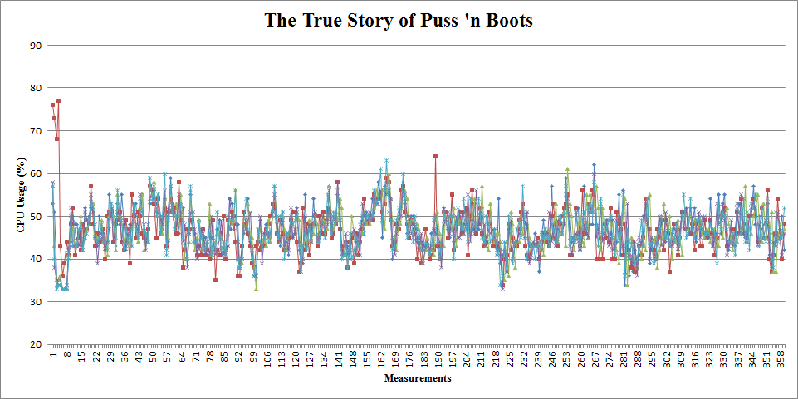
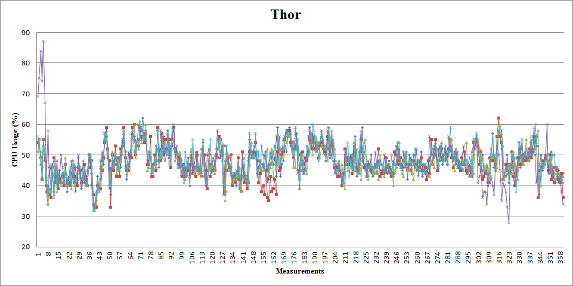
Reproducibility & Uniqueness
Preliminary Experiment
Movies | Euclidean Distance
 | Avg | Min | Max
Movie #1 - #1 | 107.2 | 74.7 | 140.1
Movie #2 - #2 | 91.3 | 70.6 | 120.6
Movie #1 – #2 | 195.2 | 174.8 | 210.4

Slide 6
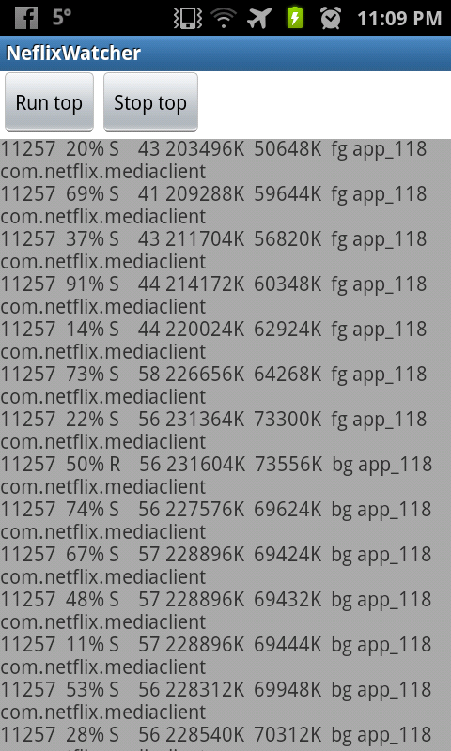
Feasibility of the Side-channel attack
Prototype of Side-channel attack app
Needs no permission
May require access to the Internet
77% of 650 popular Android apps already has the permission

Slide 7
Pattern Matching Algorithms
K-Nearest Neighbors (KNN)
Fast Subsequence Matching

Slide 8
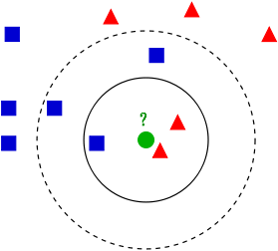
KNN
Classify an object (test data) based on closest training examples (training data)
Metric: Euclidean distance
Each CPU usage statistics is considered a vector

