Slide 1
I Know What You Are Watching on Netflix
Kookjin Lee, Young Sam Park
klee@cs.umd.edu, yspark@cs.umd.edu
Department of Computer Science, University of Maryland

Slide 2
Contents
Introduction
Premise conditions
Pattern Matching Algorithms
KNN
Fast Subsequence
Experimental Results
Conclusion

Slide 3
Introduction
People can be judged by their movie preference!
Our target: Reveal the movie title!
Netflix on Android devices
Reveal the movie title through CPU usage statistics of Netflix
Notes:
There are many researches like “You are what you like”, “You are what you say” that reveals private information from people’s preference.
1988 Video Privacy Protection Act

Slide 4
Premise Conditions
Reproducibility & Uniqueness
Feasibility of the Side-channel attack
Notes:
In order to justify the feasibility of our project, 2 premise conditions should be satisfied.
Reproducibility means repetitive measurement of CPU usage on a single movie should show similar results.
Uniqueness means CPU usage statistics of different movies should be differentiated from each other.
Feasibility of .. means the attack should be implementable without any problem and also should be transparent to victims so that they can’t notice the attack.

Slide 5
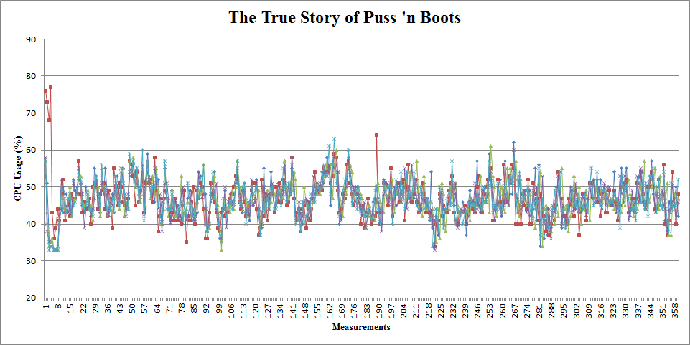
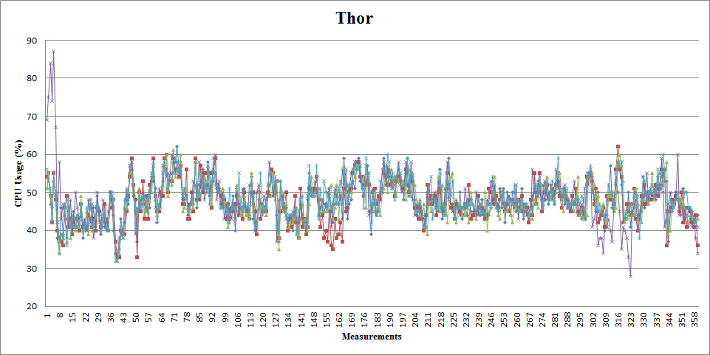
Reproducibility & Uniqueness
Preliminary Experiment
CPU statistics of two selected movies
Movies | Euclidean Distance
 | Avg | Min | Max
Movie #1 - #1 | 107.2 | 74.7 | 140.1
Movie #2 - #2 | 91.3 | 70.6 | 120.6
Movie #1 – #2 | 195.2 | 174.8 | 210.4
Analysis on reproducibility & uniqueness
Notes:
To confirm the reproducibility and uniqueness, we collected CPU statistics from two movies as a preliminary experiment.
As you can see in each graph, measurement of 5 times show almost same patterns.
Also, two movie seem to show different, hopefully unique patterns.
But we need more than this kind of rough guess.
So we calculated the Euclidean distance among the sequences of the same movie and distance between different movies.
This table clearly shows that the Euclidean distance within a single movie is much shorter than the distance between different two movies.
Through this experiment, we confirmed reproducibility and uniqueness.

Slide 6
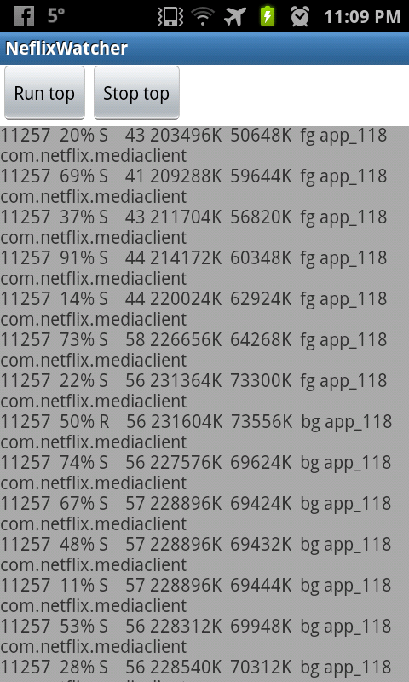
Feasibility of the Side-channel attack
Prototype of Side-channel attack app
Needs no permission
May require access to the Internet
77% of 650 popular Android apps already has the permission
Notes:
To confirm the second premise condition, we implemented a prototype of the side-channel attack application.
As you can see here, this app can collect CPU statistics of Netflix app without any kind of permission.
It would need an access to the Internet but most of apps already requires this permission.
Therefore, we suppose that our side-channel attack can be easily embedded into other applications.

Slide 7
Pattern Matching Algorithms
K-Nearest Neighbors (KNN)
Fast Subsequence Matching

Slide 8
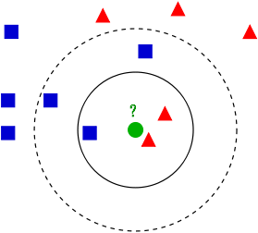
KNN
Classify an object (test data) based on closest training examples (training data)
Metric: Euclidean distance
Each CPU usage statistics is considered a vector
^{KNN Example}
Notes:
We implemented KNN method to classify a given CPU statistics based on pre-collected database of CPU statistics.
In this method, we calculate the Euclidean distance between sequences and then pick K nearest ones.
Then we determine the label of the test sequence by majority rule.

Slide 9
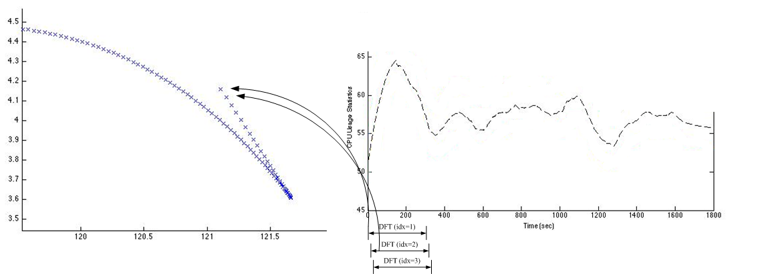
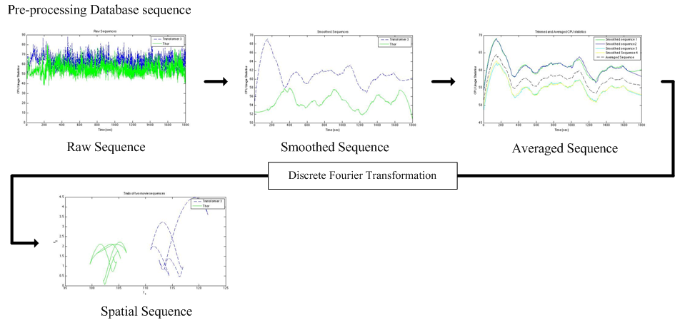
Fast Subsequence Matching Algorithm
Pre-processing (Database sequence)
Smoothing (Savitzky-Gollay Filter), Averaging
Discrete Fourier Transformation

Slide 10
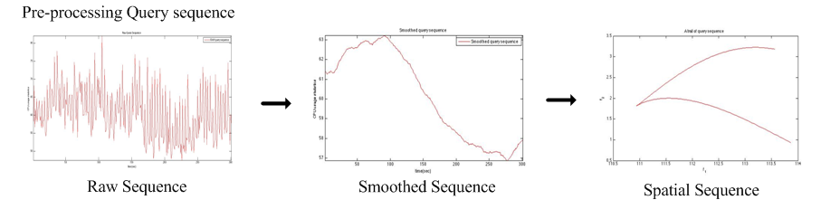
Fast Subsequence Matching Algorithm
Pre-processing (Query Sequence)
Smoothing (Savitzky-Gollay Filter)
Discrete Fourier Transformation

Slide 11
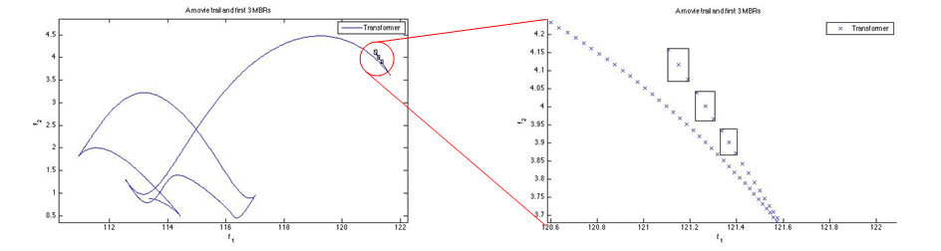
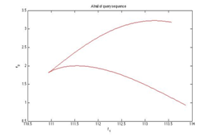
Fast Subsequence Matching Algorithm
Sequence Matching – Nearest Neighbor search
Packaged points - Node
Database sequence – Store to the Data structure (R*tree)
Query sequence – Search nearest neighbor from the Data structure

Slide 12
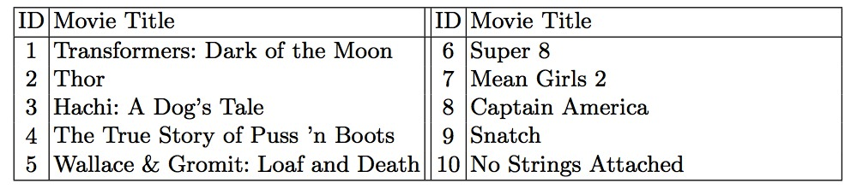
Experimental Results
Experimental Setup
Device setup
Device: Samsung Galaxy S
O/S: Android 2.3 Gingerbread
Application: Netflix
Measurement method
Tool: top (UNIX/Android command)
Target: first 30 minutes of CPU usage statistics of each movie
in 1-minute interval and 5-minute interval
Repeated 5 times for each movie
10 Movies selected from Popular on Netflix

Slide 13
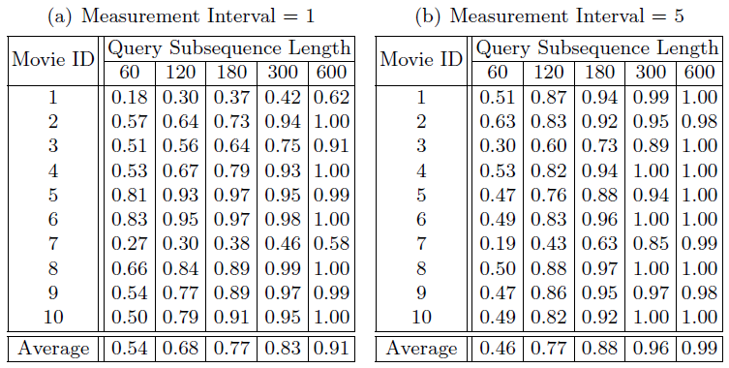
Experimental Results - KNN
Experimental Result of KNN
Success Rate of the prediction

Slide 14
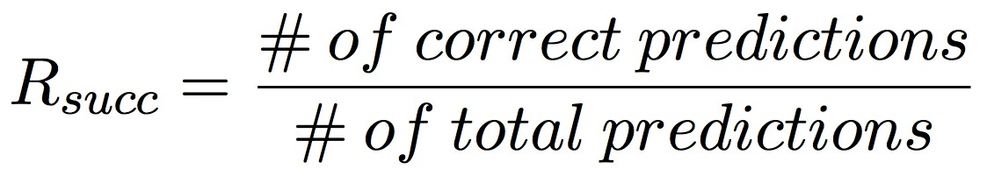
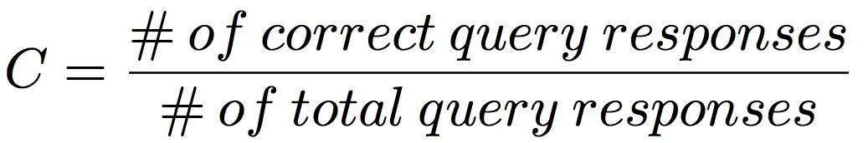
Experimental Results - FSM
Experimental Result of Fast Subsequence Matching Algorithm
Two metrics for the performance measure
Success Rate of the Prediction
Confidence of the prediction

Slide 15
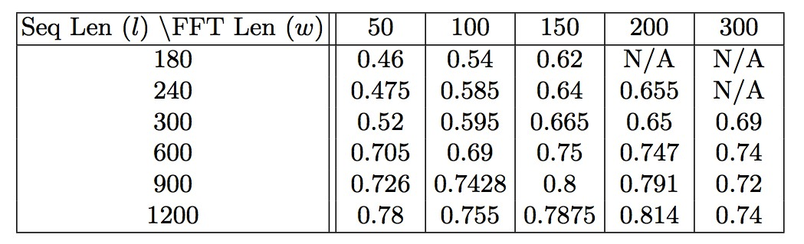
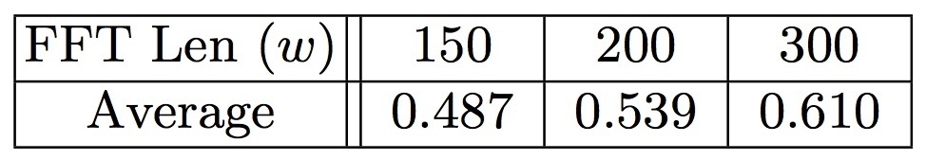
Experimental Results - FSM
Success Rate of the prediction
Confidence of the prediction
Success Rate of the Predictions
^{Confidence of the Predictions}

Slide 16
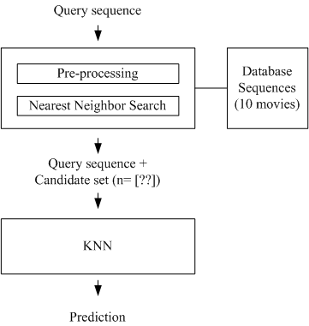

Integrated algorithm
Fast Subsequence Matching + KNN
Parameter Configuration

Slide 17
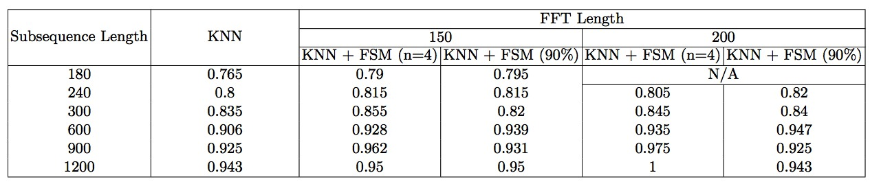
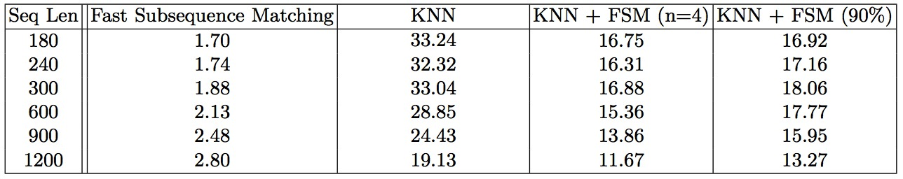
Experimental Results
Success Rate of the prediction
Execution time of the prediction
Success Rate of the Predictions
^{Confidence of the Predictions}

Slide 18
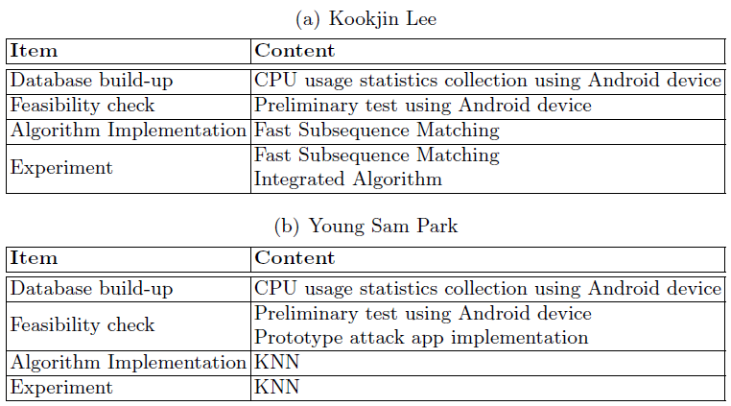
Division of Labor

Slide 19
QnA
Thanks!

