Slide 1
ARDEN
7/15/2013

Slide 2
Goals
Sender anonymity
Strong sender anonymity: even receiver doesn’t know the origin of the message (reply path is given by sender)
Receiver anonymity
Unlinkability
Low latency
Lower than traditional onion routing
Location anonymity is not a goal of ARDEN

Slide 3
Attack model
Passive global eavesdropper
Active attacker can compromise a subset of nodes
Compromising nodes within every group along the routing path will reveal a the source, not the destination

Slide 4
Assumption
Sender knows IDs of a large proportion of nodes in the DTN
From ABE(Attribute-Based Encryption) administrator or from other nodes
Topological knowledge is not assumed.

Slide 5
ARDEN Design
Base: Onion routing
Single path with specific onion proxy nodes
Traditional Onion routing doesn’t fit for disconnected environment
Modification to Onion routing
Single-node proxy is replaced with a group of nodes
Multicast from a group to next group
Better successful delivery rate from sender to destination
Better chance to find a shorter route

Slide 6
Group partitioning/management through ABE
Basics
Attribute: Binary representation of node ID
Access structure: Logical AND of attributes of nodes in a group
Access structures of groups on the path are included in bundles to indicate next group
ABE(Attribute-Based Encryption)
Sender encrypts each layer of a packet using APK (ABE public key) and an access structure of a group of nodes
Each layer of an encrypted packet can only be decrypted by nodes of the designated group

Slide 7
Group partitioning/management through ABE
Partitioning
Sender builds a binary tree where all nodes are leaves of the tree
Position of a node is determined by shuffled node ID.
Sender partitions groups based on the common prefix of shuffled node IDs
(Example on the next slide)
Connectivity between two consequent groups is not considered.
Destination node may not be in the last group on the route.

Slide 8
Group partitioning/management through ABE
Shuffle function: Switch first bit and third bit of node ID
Group size: 3
Node ID | Node ID (Bit string) | Shuffled Node ID (Bit string)
1 | 0001 | 0001
2 | 0010 | 1000
4 | 0100 | 0100
5 | 0101 | 0101
7 | 0111 | 1101
8 | 1000 | 0010
10 | 1010 | 1010
12 | 1100 | 0110
14 | 1110 | 1110
0
1
0
1
0
1
0
1
0
0
1
0
1
1
1
0
1
0
0
0
1
0
0
1
8
4
5
12
2
10
7
14
Group 1: 01XX
Group 2: 1XXX

Slide 9
Routing
Relies on existing routing protocols
Earliest delivery (single path routing)
Epidemic minimum estimated expected delay (replicative routing)
Forwarding Procedure
Intermediate node decrypts a received packet and gets the access structure for the next group
Intermediate node forwards the packet to nodes of the next group, based on the access structure
One or more additional nodes may exist between two consequent groups
The paper doesn’t state when and how a relay node relays bundles to the nodes not in the next group

Slide 10
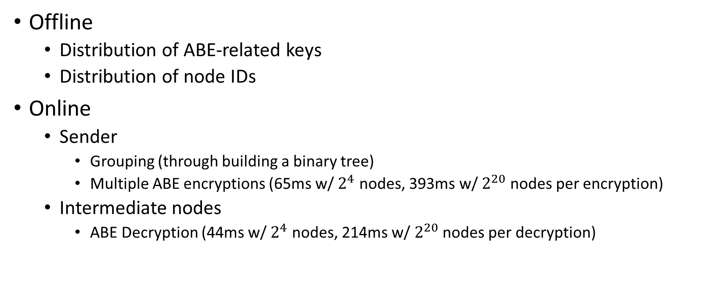
Offline/Online protocol
Offline
Distribution of ABE-related keys
Distribution of node IDs
Online
Sender
Grouping (through building a binary tree)
Multiple ABE encryptions (65ms w/ $2^{4}$ nodes, 393ms w/ $2^{20}$ nodes per encryption)
Intermediate nodes
ABE Decryption (44ms w/ $2^{4}$ nodes, 214ms w/ $2^{20}$ nodes per decryption)

