Slide 1
Small-Proof Big-Data
Benchmark Result
4/30/2013

Slide 2
Benchmark Result
Parameters
  Security Parameter k: 32
  Max size of the stream n: 128
Summary: Prover Update() rate
  Native Linux
    w/ MySQL: 1.6 sec/update
    w/o MySQL: 0.8 ms/update
  VM Linux
    w/ MySQL: 70 ms/update
    w/o MySQL: 1 ms/update

Slide 3
Benchmark Result
Full Implementation (w/ MySQL)
  Native Linux (Mint Linux 13)
  VM Linux (Mint Linux 13)
#Update / #Query |  | 100 / 20 | 100 / 40 | 200 / 40
Prover | Update | 157.846 | 166.264 | 337.752
 | Query | 0.132 | 0.328 | 0.342
Verifier | Update | 0.071 | 0.072 | 0.143
 | Verify | 0.032 | 0.065 | 0.069
#Update / #Query |  | 100 / 20 | 100 / 40 | 200 / 40 | 2000 / 40
Prover | Update | 6.796 | 6.975 | 13.847 | 249.878
 | Query | 0.137 | 0.396 | 0.305 | 2.482
Verifier | Update | 0.102 | 0.095 | 0.19 | 1.525
 | Verify | 0.044 | 0.084 | 0.076 | 0.171

Slide 4
Benchmark Result
Minimal Implementation (w/o MySQL)
  Native Linux (Mint Linux 13)
  VM Linux (Mint Linux 13)
#Update / #Query |  | 100 / 20 | 100 / 40 | 200 / 40 | 2000 / 40
Prover | Update | 0.081 | 0.079 | 0.161 | 1.644
 | Query | 0.009 | 0.018 | 0.019 | 0.019
Verifier | Update | 0.069 | 0.069 | 0.139 | 1.387
 | Verify | 0.031 | 0.062 | 0.062 | 0.062
#Update / #Query |  | 100 / 20 | 100 / 40 | 200 / 40 | 2000 / 40
Prover | Update | 0.113 | 0.104 | 0.203 | 2.049
 | Query | 0.022 | 0.04 | 0.041 | 0.035
Verifier | Update | 0.103 | 0.09 | 0.182 | 1.684
 | Verify | 0.041 | 0.078 | 0.082 | 0.1

Slide 5
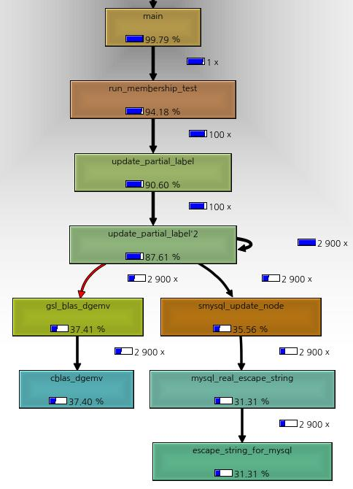
Prover Analysis
Native Linux, w/ MySQL
  Matrix-Vector product for label update (37.41%)
  Vector operation: Binary representation for label-to-digest conversion (4.48%)
  Data conversion for MySQL (31.31%)

Slide 6
Prover Analysis
VM Linux, w/ MySQL
  Matrix-Vector product for label update (38.75%)
  Vector operation: Binary representation for label-to-digest conversion (4.67%)
  Data conversion for MySQL (33.60%)

Slide 7
Prover Analysis
VM Linux, w/o MySQL
  Matrix-Vector product for label update (72.40%)
  Vector operation: Binary representation for label-to-digest conversion (8.67%)
  Vector operation: modulus (6.43%)

