Slide 1
Vehicular Network Simulation in OMNeT++: Vehicular Mobility Management (VMM)
Jaehoon (Paul) Jeong
Department of Computer Science and Engineering
pauljeong@skku.edu

Slide 2
Objective
Describe the Implementation of IPv6 Over IEEE 802.11-OCB and IPv6 Vehicular Neighbor Discovery
Router and Prefix Discovery along with IPv6 Address Autoconfiguration
Address Registration and Multihop Duplicate Address Detection (DAD) Procedure
Multihop DAD and UDP/TCP Transmission via Intermediate Vehicles

Slide 3
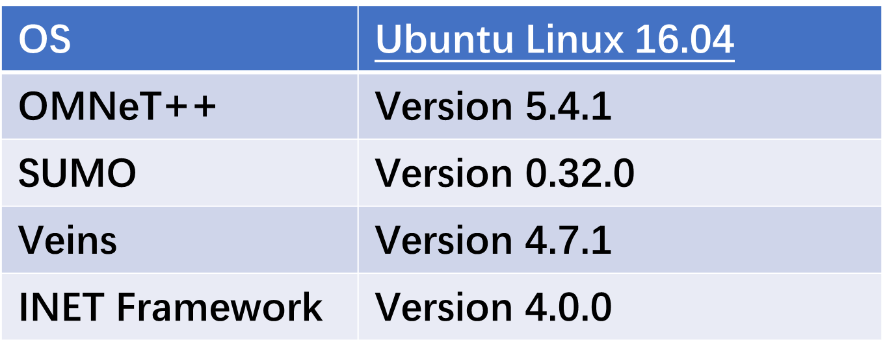
Development Environment

Slide 4
Import VND and VMM Protocols Project

Slide 5
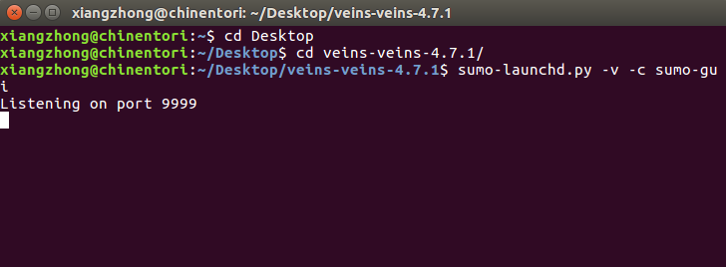
Import VND and VMM Protocols Project (1/6)
1) Run the sumo launched file in veins folder first to ensure the connection to SUMO when you run Veins in OMNeT++.
$ sumo-launchd.py -v -c /home/chris/usr/sumo-0.32.0/bin/sumo-gui

Slide 6
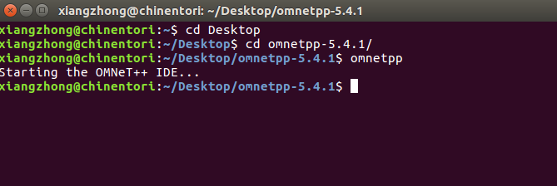
Import VND and VMM Protocols Project (2/6)
2) Open a new terminal, enter the path where omnetpp installed, and run omnetpp.

Slide 7
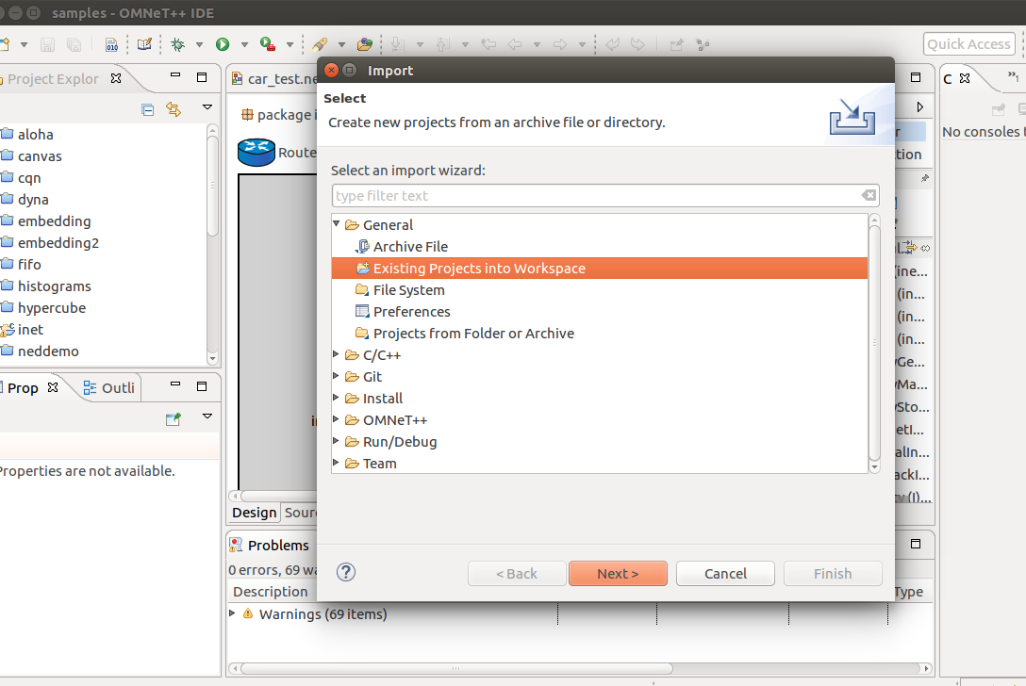
Import VND and VMM Protocols Project (3/6)
3) Import
Click File -> Import -> Existing Projects into Workspace -> Next -> Browse -> Choose the folder of veins -> Finished

Slide 8
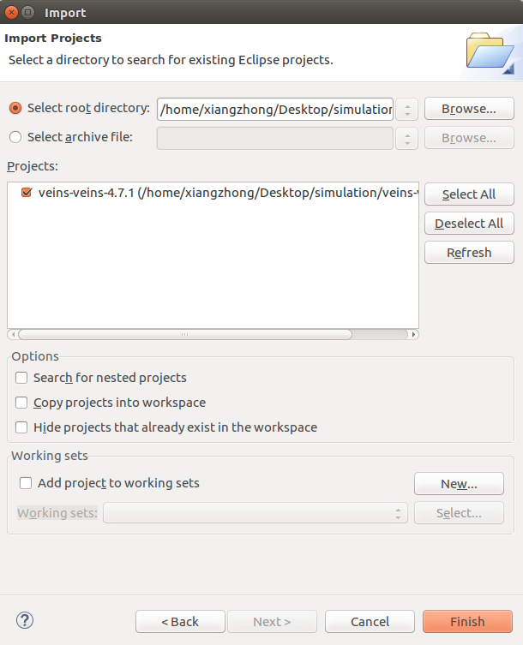
Import VND and VMM Protocols Project (4/6)
4) Select root directory of your Veins project, and then click Finish.
5) In the same way, import in inet-4.0.0 project to the workspace.

Slide 9
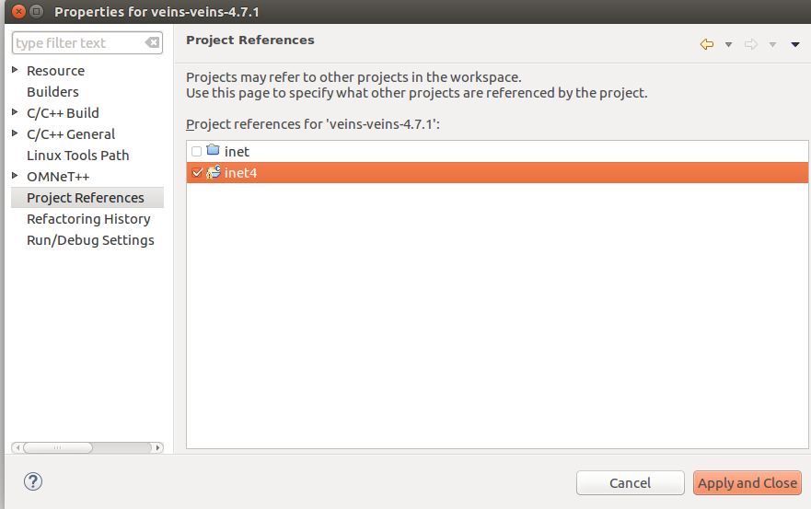
Import VND and VMM Protocols Project (5/6)
6) Now, you may see errors in veins.
That may because the invalid reference folder.
To check the reference of inet to Veins
Mouse-right-button click on Veins project
Then mouse-left-button click Properties
Choose Project References,
Mouse-left-button click inet4 folder on Project References to unselect it and
Mouse-left-button click on inet
Click Apply and close
Notes:
Click -→ Left Click
When is Right Click, it is specified

Slide 10
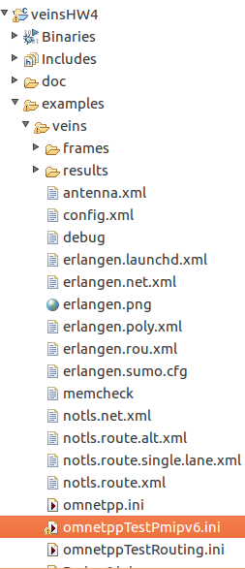
Import VND and VMM Protocols Project (6/6)
7) In Project Explorer, right-click Veins project, and choose Build Project. It may take several minutes.
8) In Project Explorer, find veins -> examples -> veins -> omnetppTestPmipv6.ini, and then right click it.
Choose Run As -> OMNeT++ Simulation. It may take several minutes.

Slide 11
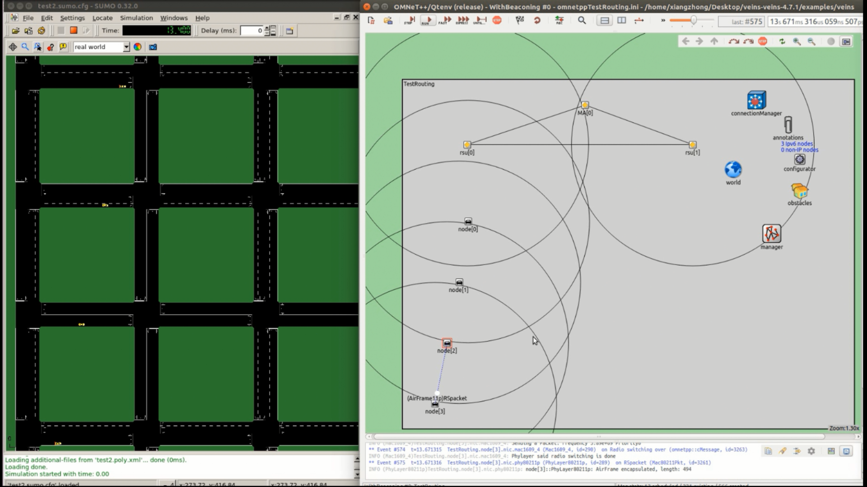
Demonstration Video Clip of IPWAVE Basic Protocols Project
Youtube link:
https://youtu.be/5OnpnYUiLhg

Slide 12
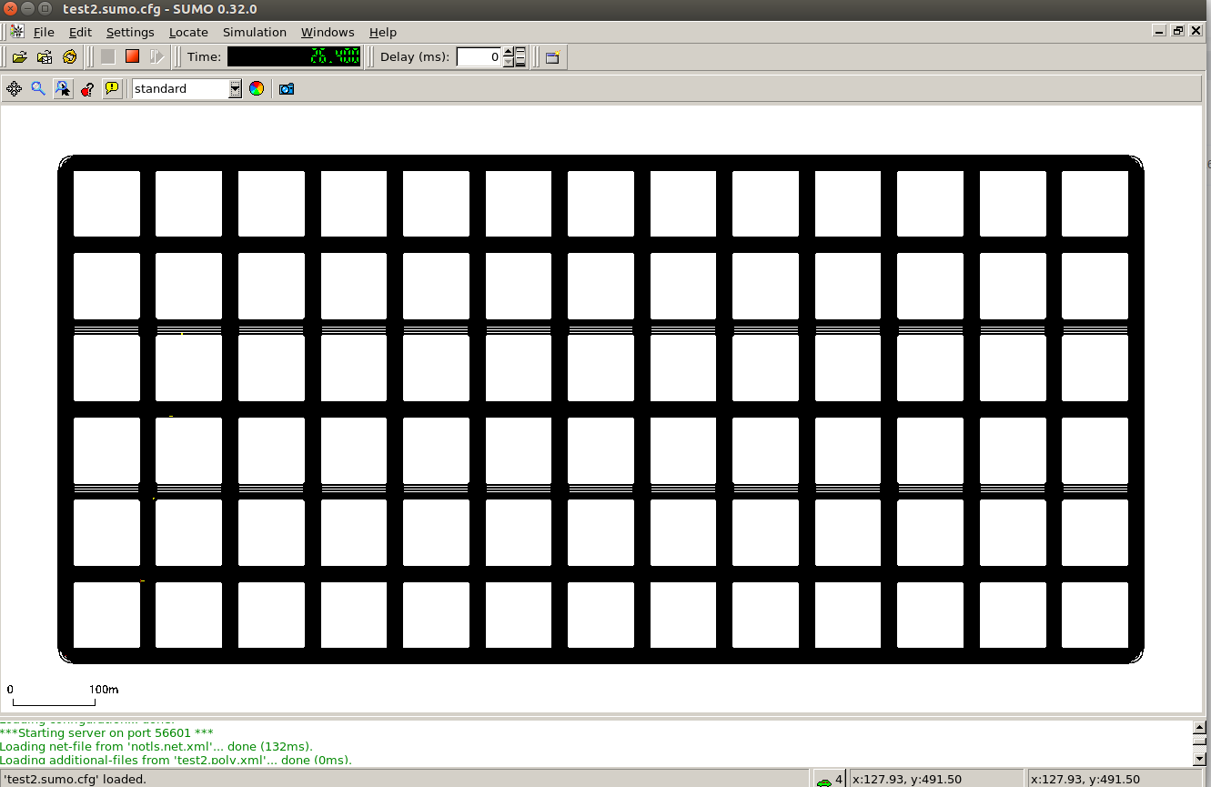
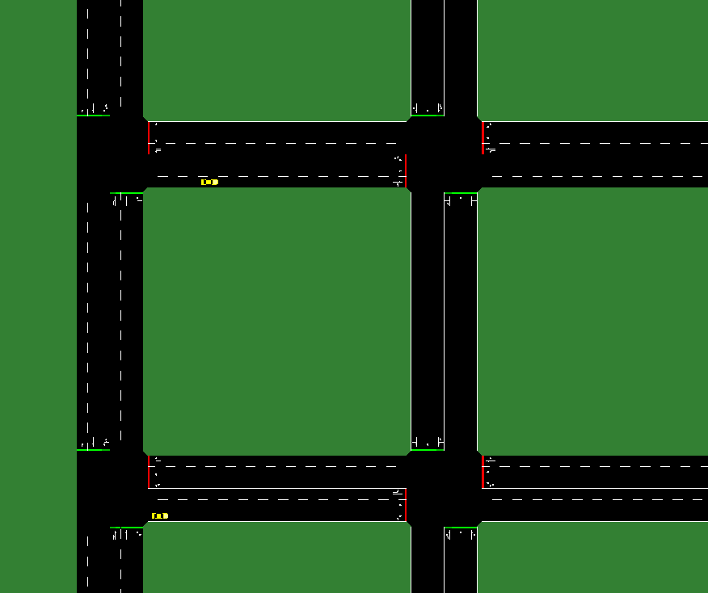
Road Network Architecture (1/2)
14x7 grid map with 3 lanes for a road network

Slide 13
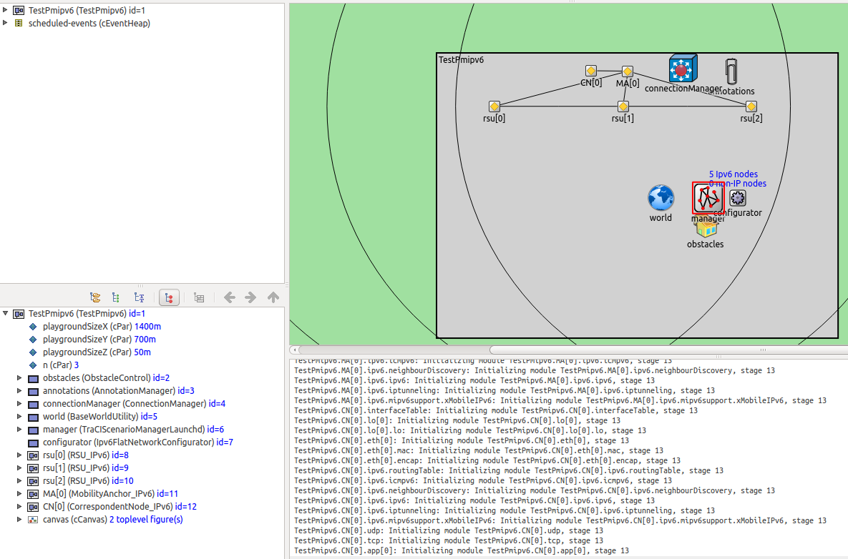
Road Network Architecture (2/2)
Two RSUs
Belong to one subnet.
Connect with each other through Ethernet.
Multiple Vehicles
Some vehicles are outside the coverage of RSUs.
Mobility Anchor
Perform the handover of Vehicles via RSUs.

Slide 14
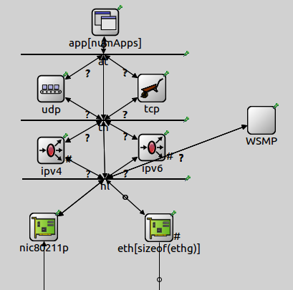
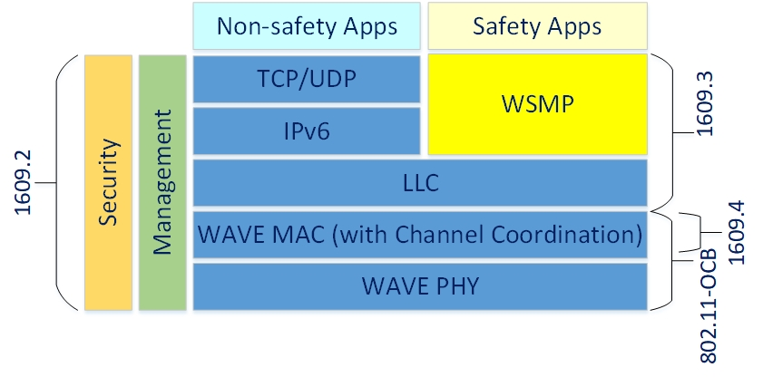
Vehicular Network Architecture
WAVE Stack
Vehicle Structure

Slide 15
ND Information
Design and Implementation of IPWAVE-VND in OMNeT++ and SUMO
Design of IPWAVE-VND Framework in OMNeT++
Implementation of IPv6 over IEEE 802.11-OCB
Proposal of Flexible Mobility Management for IPWAVE-VND
Simplify handover procedure between adjacent RSUs
Alleviate flow pressure at Mobility Anchor

Slide 16
Vehicular Mobility Management (A Simple Scenario)

Slide 17
Mobility Management Requirements
Sharing a Single Prefix Multi-link Subnet (i.e., Prefix Domain)
IP Address Registration through Multihop DAD
Seamless Handoff by Network-Based Mobility Management (MM)
MM Based on Proxy MIPv6 (PMIPv6)
MM based on Distributed Mobility Management (DMM)
Handoff between Multiple prefix Domains
Connectivity Support with the Correspondent Node (CN) via V2I
Ad Hoc Networking Support with Neighboring Vehicles via V2V

Slide 18
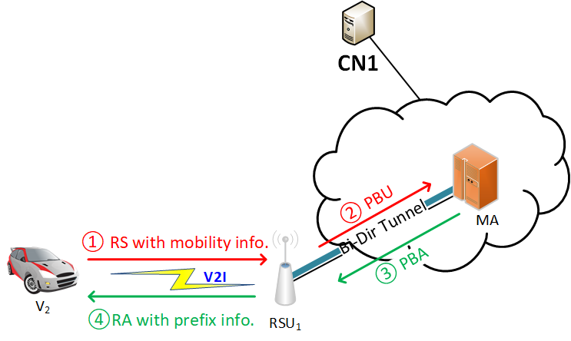
Network Attachment and IP Address Registration

Slide 19
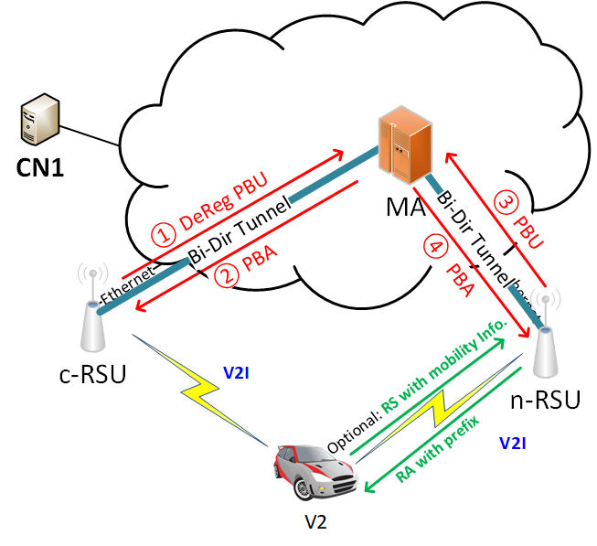
Handoff in Mobility Management (1/4)
Handoff within a Multi-link Subnet through PMIPv6

Slide 20
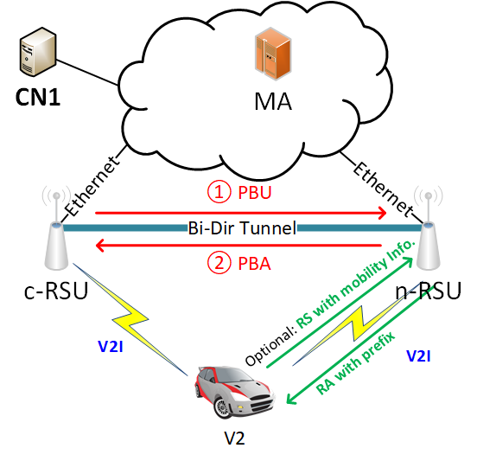
Handoff in Mobility Management (2/4)
Handoff within a multi-link subnet through DMM

Slide 21
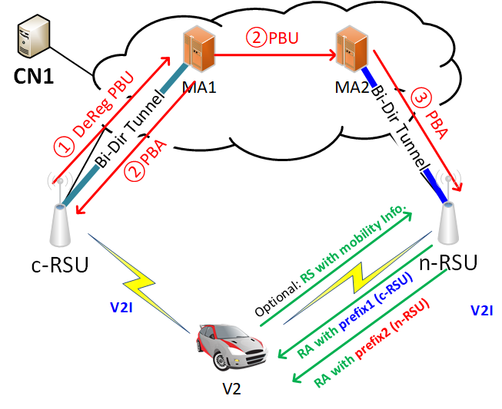
Handoff in Mobility Management (3/4)
Handoff between multi-link subnets through PMIPv6

Slide 22
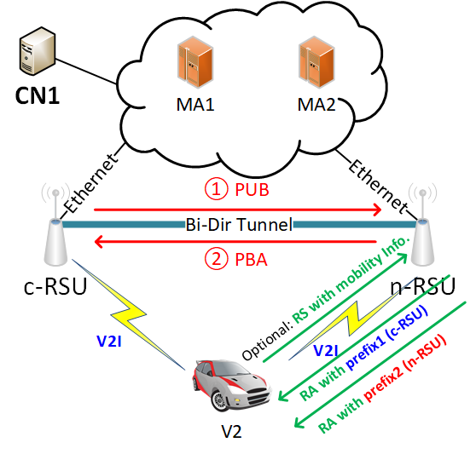
Handoff in Mobility Management (4/4)
Handoff between multi-link subnets through DMM

Slide 23
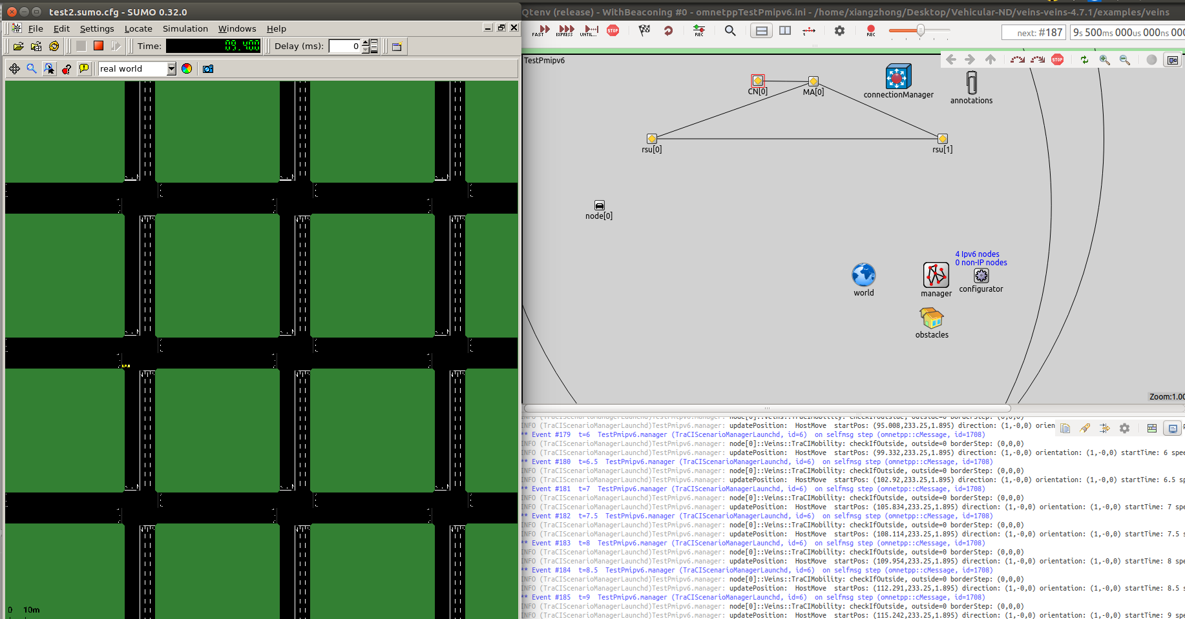
Network Architecture
Notes:
Handoff within a Multi-link Subnet through PMIPv6
MA: Mobility Anchor
CN: Correspondent Node

Slide 24
Main Functions
Transmission of packets from Correspondent Node (CN) to Vehicle
Handoff between different RSUs
Integrated DAD Table: records each vehicle’s address and default RSU
NeighborRoute: records each neighbor/each vehicle’s address and nexthop

Slide 25
Simulation Initiation File
Directory: Veins/examples/veins
TestPmipv6.ned | Scenario of road networks
notls.route.xml | Route definition for vehicles
omnetppTestPmipv6.ini | Initiation file, settings of parameters
Note that for VMM demo, we need to set xMIPv6Support = true in Car_IPv6.ned

Slide 26
Message Flow
Vehicle
RSU1
RSU2
Mobility Anchor
Three NSes for Address Registration (no reply)
Delete default router, restart RD
Router Solicitation
Router Advertisement
NS for Address Registration
NS for updating Vehicle’s default router in neighborRoute
Reply NA (skip DAD)

Slide 27
References
Z. Xiang, Y. C. Shen, and J. P. Jeong, “Ipv6 neighbor discovery with multi-hop communication for ip-based vehicular networks,” in 2019 International Conference on Information and Communication Technology Convergence (ICTC). IEEE, 2019, pp. 813–818.
J. P. Jeong, Y. C. Shen, Z. Xiang, and S. Cespedes, “Vehicular Neighbor Discovery for IP-Based Vehicular Networks,” Internet Engineering Task Forc, Internet-Draft draft-jeong-ipwave-vehicular-neighbor-discovery-08, Nov. 20e19, work in Progress. [Online]. Available: https://datatracker.ietf.org/doc/html/draft-jeong-ipwave-vehicular-neighbor-discovery-08
J. P. Jeong, Y. C. Shen, and Z. Xiang, “Vehicular Mobility Managementfor IP-Based Vehicular Networks,” Internet Engineering Task Force,Internet-Draftdraft-jeong-ipwave-vehicular-mobility-management-02,Nov. 2019, work in Progress. [Online]. Available: https://datatracker.ietf.org/doc/html/draft-jeong-ipwave-vehicular-mobility-management-02

Slide 28
Thanks!

