Slide 1
Introduction to Vehicular Ad Hoc Networks Simulation (Veins) in OMNeT++
Jaehoon (Paul) Jeong
Department of Computer Science and Engineering
pauljeong@skku.edu

Slide 2
Recommended Installation Environment
OS | Ubuntu Linux 16.04
OMNeT++ | Version 5.4.1
SUMO | Version 0.32.0
Veins | Version 4.7.1
INET Framework | Version 4.0.0

Slide 3
SUMO Installation
Version: 0.32.0

Slide 4
Required Tools Installations
$ sudo apt-get install autoconf
$ sudo apt-get install libproj-dev proj-bin proj-data libtool libgdal1-dev libxerces-c3-dev libfox-1.6-0 libfox-1.6-dev python-dev python3-dev

Slide 5
Configure & Make SUMO
Download SUMO source from https://sourceforge.net/projects/sumo/files/sumo/version%200.32.0/sumo-src-0.32.0.tar.gz/download
Go to sumo-0.32.0 folder
$ ./configure --prefix the path of the installation folder
(e.g., /home/iotlab/usr/sumo-0.32.0/bin)
$ make
(in case of multicore (e.g., 4), for speeding compiling, use: make -j 4)
sudo make install
When the make is finished, run ./bin/sumo, it should show version information:

Slide 6
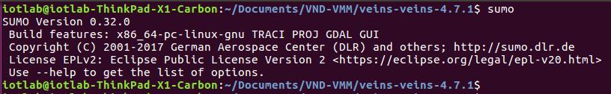
Check Installed SUMO Version

Slide 7
Import Veins Project

Slide 8
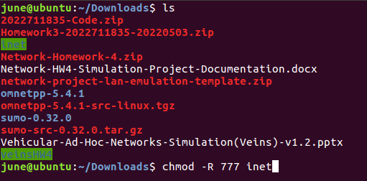
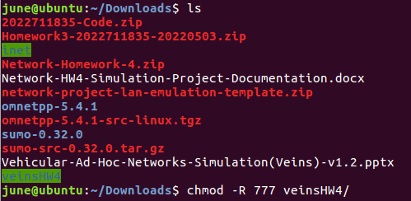
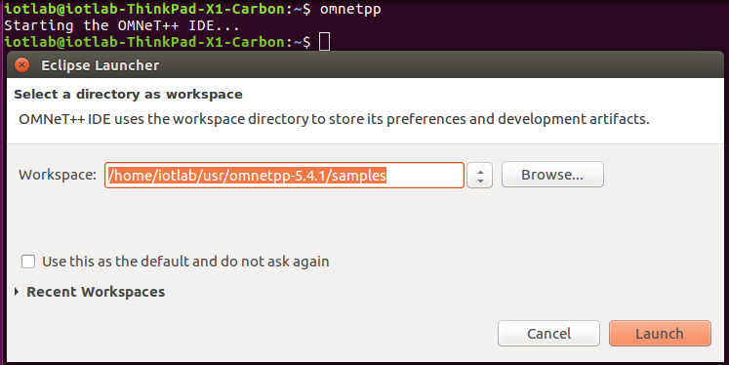
Downloading Veins & Inet
Download Veins and inet HW4 from iCampus
Change the mode by command “chmod –R 777 {veins and inet directory name}”
Ex)
Open a new terminal, type omnetpp to start OMNeT++ IDE

Slide 9
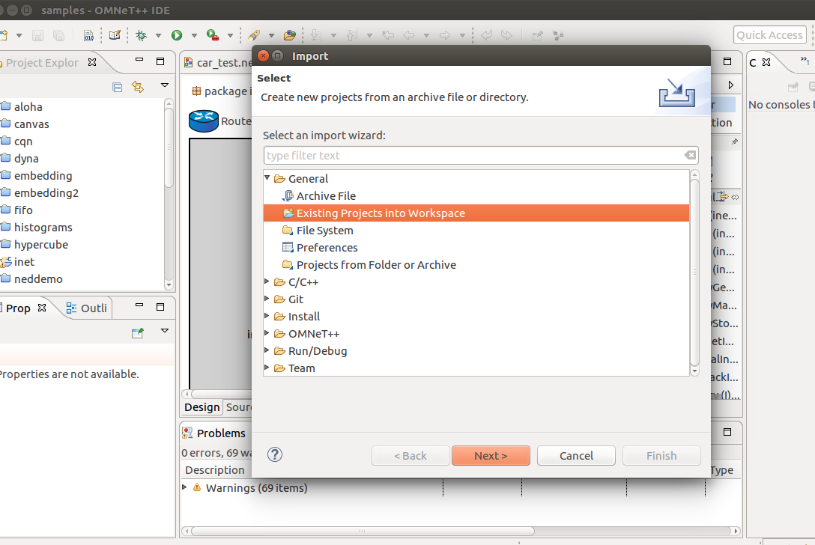
Importing Veins & Inet (1/2)
2) Import Veins
Click File -> Import -> Existing Projects into Workspace ->Next -> Browse -> Choose the folder of veins -> Finished

Slide 10
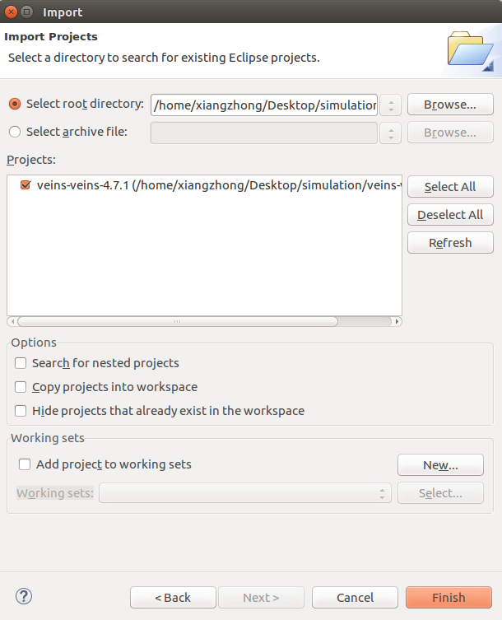
Importing Veins & Inet (2/2)
Select root directory of your Veins project, and then click Finish.
That is the same way, import inet or other OMNeT++ projects to the workspace.

Slide 11
Running SUMO
3) Run the sumo launched file in veins directory
To connect to SUMO when you run Veins in OMNeT++.
$ ./sumo-launchd.py -v -c /home/chris/usr/sumo-0.32.0/bin/sumo-gui

Slide 12
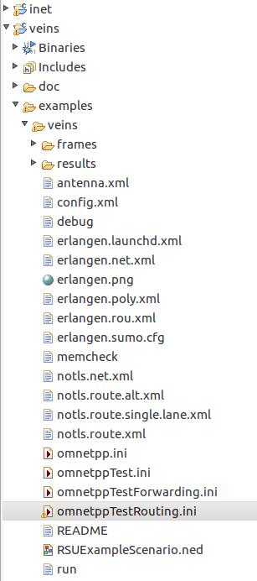
Launch veins
4) Run Veins
In Project Explorer, right-click Veins project, and choose Build Project. It may take several minutes.
In Project Explorer, find veins -> examples -> veins -> omnetppTestRouting.ini, and then right click it -> Choose Run As -> OMNeT++ Simulation. It may take several minutes.

Slide 13
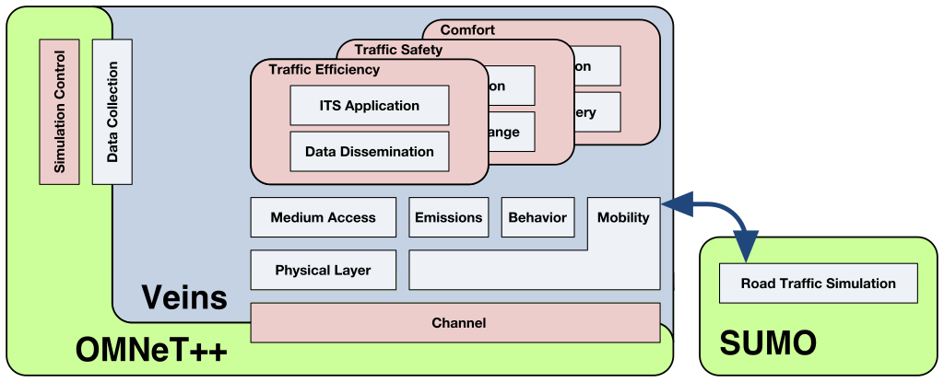
How Veins Works?
OMNeT++: Network Simulation
SUMO: road traffic can be modeled and complex interactions between both domains examined.
TraCI: The protocol for this communication between OMNeT++ and SUMO
Notes:
TraCI: Traffic Control Interface

Slide 14
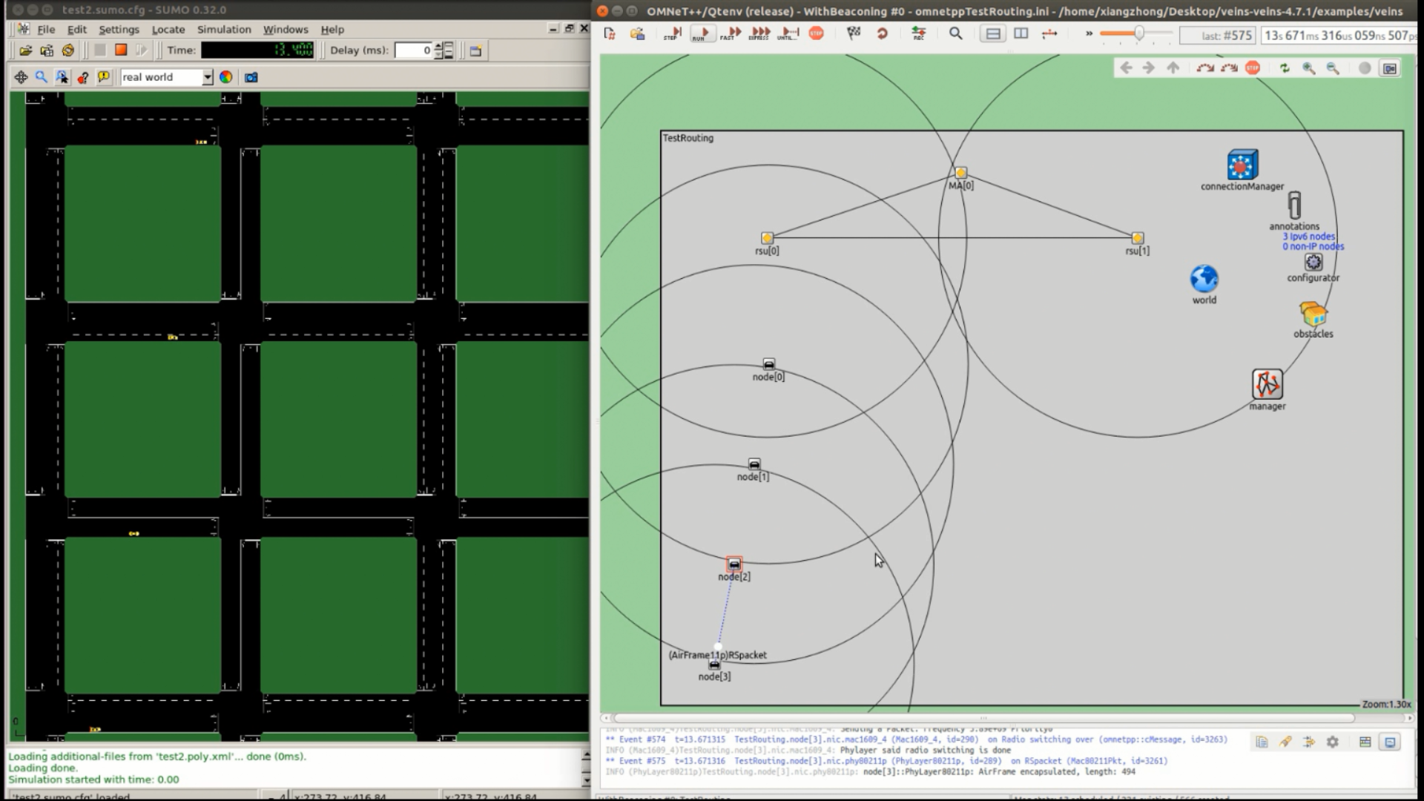
Example of a Running Veins Simulation
Click the Run button to run the program, and then you will see Sumo gui window.
(For test, we reduce the number of cars.)

Slide 15
Basic SUMO useful tools

Slide 16
NETGENERATE
Tool: generate map
https://sumo.dlr.de/docs/NETGENERATE.html
Usage
netgenerate --help
Example
netgenerate -g --grid.x-number 5 --grid.y-number 7 --tls.guess -L 3 -S 20
netgenerate -c <CONFIGURATION> create net from given configuration netgenerate --grid [grid-network options] -o <OUTPUTFILE> create grid net netgenerate --spider [spider-network options] -o <OUTPUTFILE> create spider net netgenerate --rand [random-network options] -o <OUTPUTFILE> create random net
Notes:
NETGENERATE generates abstract road networks that may be used by other SUMO-applications.

Slide 17
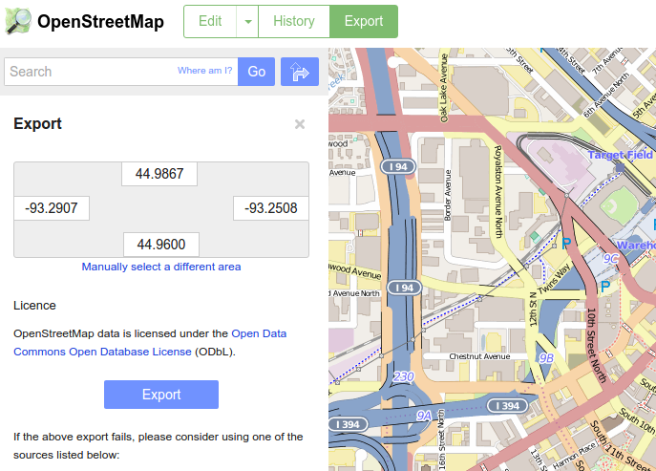
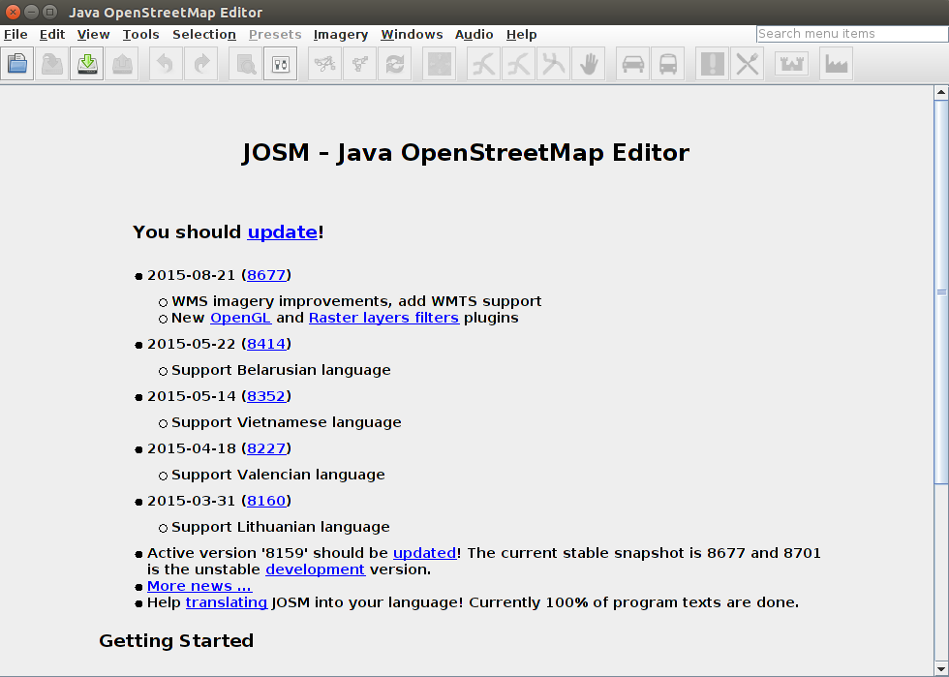
Real Map
OpenStreetMap
https://www.openstreetmap.org/
Usage
netgenerate --help
Example
Java OpenStreetMap Editor(JOSM): https://josm.openstreetmap.de/

Slide 18
NETCONVERT
Tool for road networks import and conversion
https://sumo.dlr.de/docs/NETCONVERT.html
Usage
netconvert --help
Example
netconvert --osm-files ./*.osm --remove-edges.by-vclass hov,taxi,bus,delivery,truck,tram,rail_urban,rail,rail_electric,motorcycle,bicycle,pedestrian -o *.net.xml
netconvert -s *.net.xml --tls.guess
Notes:
NETCONVERT imports digital road networks from different sources and generates road networks that can be used by other tools from the package.

Slide 19
Run Vehicle in the road network
Tool-generated map
Generating random traffic in road network:
in your sumo installation folder: /sumo-0.21.0/tools/
Ref: https://sumo.dlr.de/docs/Tools/Trip.html I
./randomTrips.py
Usage
randomTrips.py --help

Slide 20
Introduction to Veins Implementation Structure

Slide 21
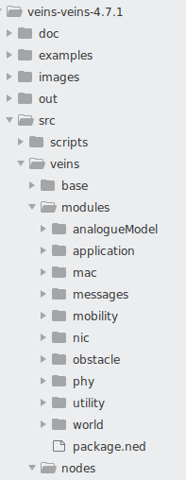
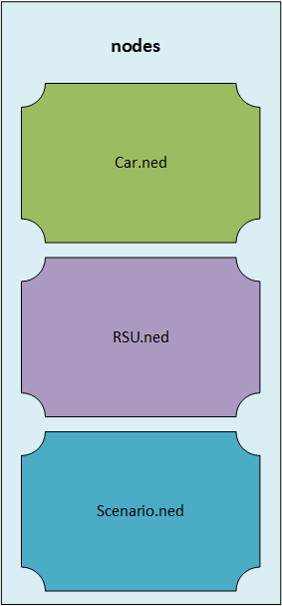
Veins nodes
Vehicles
Used to Simulate cars
Road-Side Unit (RSU)
Deployed in Road Network as infrastructure
Scenario
In modules, we mainly have application, mac, messages, nic, obstacle, mobility and phy subdirectories.

Slide 22
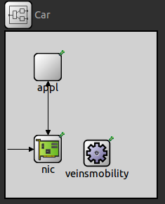

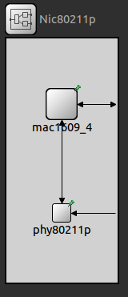
Submodules
Vehicles
Used to Simulate cars
Road-Side Unit (RSU)
Deployed in Road Network as infrastructure
Scenario
In modules, we mainly have application, mac, messages, nic, obstacle, mobility and phy subdirectories.

Slide 23
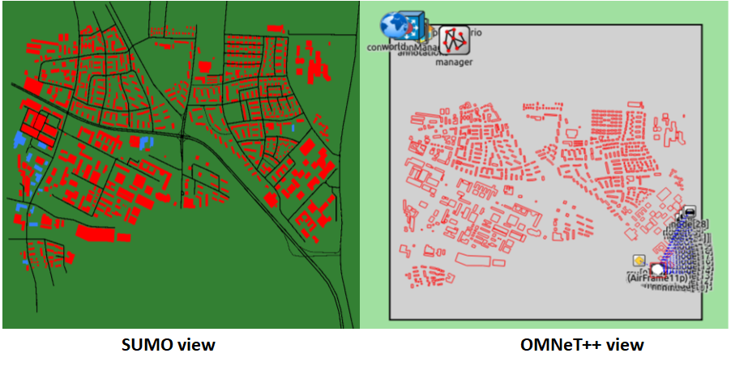
Veins Running View

Slide 24
References
SUMO installation:
https://sumo.dlr.de/docs/Installing/Linux_Build.html
SUMO tools:
https://sumo.dlr.de/docs/SUMO_User_Documentation.html#additional_tools
Veins Documentation
https://veins.car2x.org/

Slide 25
Thanks!

