Slide 1


Plagiarism Detection and Authorial Distinction
In this project, we have developed an intelligent system that takes a single document and classifies different writing styles within the document using stylometric analysis. The system divides the document into chunks of text, computes stylometric features for each chunk, and then uses unsupervised machine learning to cluster the chunks based on their writing style. This allows the system to identify the number of distinct writing styles present in the document, which can be used for applications like plagiarism detection and authorship attribution.

Slide 2
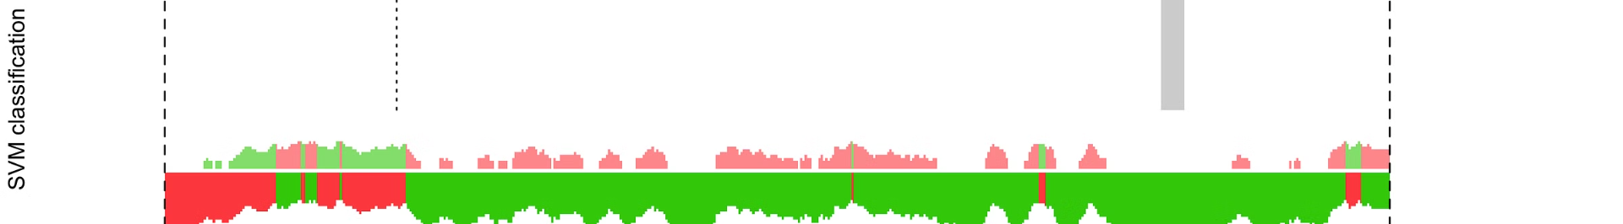
Stylometry and Its Applications
Understanding Literary Style
Stylometry is the study of measurable features of literary style, such as sentence length, readability scores, vocabulary richness, and word frequencies. This field has been around since the mid-19th century and has found numerous practical applications in the modern era of Artificial Intelligence and Machine Learning.
Identifying Authors
One of the key applications of stylometry is authorship attribution - using stylometric analysis to determine the likely author of a document. This can be useful for verifying the authenticity of historical texts or identifying plagiarism.
Classifying Genres
Stylometric features can also be used to distinguish between different genres of writing, such as separating fiction from non-fiction or academic papers from news articles. This can be valuable for text classification and information retrieval tasks.

Slide 3
Methodology: Identifying Writing Styles
Chunk Text
Extract Features
Cluster Chunks
The first step is to divide the input document into smaller chunks of text, typically around 10 sentences each. This allows the system to analyze the writing style at a more granular level.
For each text chunk, the system computes a vector of stylometric features, including lexical features (e.g. word length, sentence length), vocabulary richness features (e.g. Hapax Legomena, Shannon Entropy), and readability scores (e.g. Flesch-Kincaid Grade Level).
The system then uses unsupervised machine learning, specifically the K-Means algorithm, to cluster the text chunks based on their stylometric feature vectors. The number of clusters identified corresponds to the number of distinct writing styles present in the document.

Slide 4

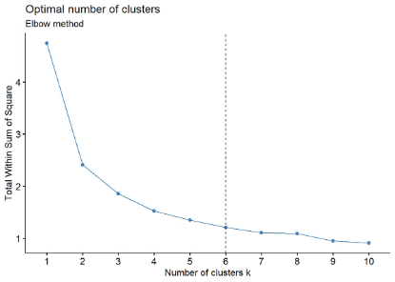
Determining the Number of Writing Styles
1
Elbow Method
2
Parameter Tuning
To determine the optimal number of clusters (K), the system uses the Elbow method. This involves computing the sum of squared errors (SSE) for different values of K, and identifying the "elbow" in the plot where the SSE starts to level off, indicating the appropriate number of clusters.
The system also tunes the parameters of the K-Means algorithm, such as the number of initialization runs (n_init) and the maximum number of iterations (max_iter), to ensure robust and reliable clustering results.
3
Visualization
To visually inspect the clustering results, the system uses Principal Component Analysis (PCA) to project the high-dimensional stylometric feature vectors onto a 2D plane, allowing the user to see how the text chunks are grouped based on their writing styles.

Slide 5
Experiment: Detecting Two Writing Styles
Merged Document
Elbow Method Results
For the proof of concept, the system was tested on a document that combined a story and a research paper, with the expectation that it would identify two distinct writing styles.
The Elbow method correctly identified the optimal number of clusters as 2, indicating that the document contained two different writing styles.
Visualization
Successful Detection
The PCA-based visualization clearly showed the two distinct clusters of text chunks, corresponding to the story and research paper sections of the document.
The experiment demonstrated the system's ability to accurately identify the number of writing styles present in a document and visually distinguish the different styles.
Quantitative Analysis
Comparison with Ground Truth
In addition to the qualitative analysis, the system also provided a quantitative analysis of the writing styles. It calculated various stylometric features, such as sentence length, vocabulary richness, and syntactic complexity, to further characterize the different writing styles.
To validate the accuracy of the system's detection, the results were compared with the ground truth labels of the document. The system achieved a high level of agreement, confirming its effectiveness in identifying writing styles.

Slide 6
Limitations and Considerations
Information Loss in PCA
The use of Principal Component Analysis (PCA) to visualize the high-dimensional stylometric feature vectors can result in some loss of information. This means that the 2D plot generated by PCA may not fully capture the distinct separation of clusters. It's important to keep this limitation in mind when interpreting the visual representation of the writing styles.
Single Author Nuances
Even when a document is written by a single author, the system may still identify multiple writing style clusters. This can occur due to subtle differences in lexical features across paragraphs or sections, which can result in variations in writing style within the same document. It's crucial to be aware of these nuances when analyzing the identified writing style clusters.
Ambiguity in Clustering
The process of labeling and interpreting unsupervised learning methods, such as clustering, involves a certain level of subjectivity. As a result, there can be ambiguity in the interpretation of the clustering results. It's important to consider this subjectivity when analyzing the identified writing style clusters and to exercise caution in drawing definitive conclusions.

Slide 7
Conclusion
Document Input
The system takes a document as input and divides it into smaller text chunks.
Feature Extraction
It then computes a vector of stylometric features for each text chunk, including lexical, vocabulary richness, and readability measures.
Clustering
The system uses K-Means clustering to group the text chunks based on their stylometric feature vectors, with the number of clusters indicating the distinct writing styles present in the document. To determine the optimal number of clusters, we employ the Elbow Method.
The Elbow Method involves plotting the within-cluster sum of squares (WCSS) against the number of clusters. The WCSS measures the compactness of the clusters, and a lower value indicates better clustering. The plot forms an elbow shape, and the optimal number of clusters is typically located at the "elbow" where the improvement in WCSS starts to diminish.
We iterate the K-Means clustering process for different values of clusters, calculate the WCSS for each iteration, and plot the results. By visually inspecting the plot, we can determine the appropriate number of clusters to use for identifying the writing styles in the document.
Visualization
The clustering results are visualized using PCA to allow the user to inspect the different writing styles identified by the system.
Validation
To validate the effectiveness of the system, we compare the identified writing styles with known writing samples from different authors or genres. This helps us assess the accuracy and reliability of the system's classification.
We start by collecting a set of writing samples that are representative of the different writing styles we expect the system to identify. These samples can come from various sources, such as literature, journalism, or academic writing.
We then pass these samples through the system and compare the identified writing styles with the known styles of the samples. We use metrics such as precision, recall, and F1-score to evaluate the system's performance, with higher values indicating better classification.
If the system shows poor performance, we may need to revisit our feature selection or clustering algorithm and make adjustments accordingly. Once we are satisfied with the system's accuracy and reliability, we can confidently apply it to new documents and use it for various applications.

Slide 8
Applications and Future Work
Plagiarism Detection
The system's ability to identify distinct writing styles within a document can be used to detect potential plagiarism, where sections of the text may have been copied from other sources.
Authorship Attribution
Stylometric analysis can also be used to determine the likely author of a document, which is useful for verifying the authenticity of historical texts or literary works.
Genre Separation
The system can be used to distinguish between different genres of writing, such as fiction, non-fiction, academic papers, and news articles, which can be valuable for text classification and information retrieval tasks.
Future Improvements
Potential areas for future work include exploring more advanced machine learning techniques, incorporating additional stylometric features, and improving the visualization of clustering results.

Slide 9
Acknowledgements
YASH TAMAR
(500109727)
MILIND VISHWAKARMA
(500105627)
BATCH 3 AIML (H)

Slide 10
References
1
Stylometry Wikipedia
2
Distinguishing Human and Machine Text
https://en.wikipedia.org/wiki/Stylometry
http://homepage.divms.uiowa.edu/~mshafiq/files/shehroze-text-spinner-icdm2017.pdf
3
Intrinsic Plagiarism Detection
4
Stylometry and Machine Learning
https://www.uni-weimar.de/medien/webis/publications/papers/stein_2011a.pdf
http://citeseerx.ist.psu.edu/viewdoc/download?doi=10.1.1.440.1634&rep=rep1&type=pdf

