Slide 1
Recommendation System
- Yash patel (Data Scientist)

Slide 2
Recommendation System
A recommendation engine separates through data using various algorithms and suggests the most relevant items to users. It first analyses a customer's past behavior and then recommends products that the user is likely to purchase.
Importance of Recommendation system
Netflix: According to a recent study, Netflix uses personalized recommendations, and it is responsible for 80 percent of the content streamed. This has allowed Netflix to earn 1 billion dollars in a single year. Netflix doesn’t spend much on marketing but on recommendations to improve customer retention.
Amazon: Similarly, 35% of the Amazon website’s sales come from personalized recommendations. So, even Amazon does not spend much on marketing. However, it is still able to retain customers using personalized recommendations.

Slide 3
Recommendation System
Why the Recommendation system?
Benefits users in finding items of their interest.
Help item providers in delivering their items to the right user.
Identity products that are most relevant to users.
Personalized content.
Help websites to improve user engagement.

Slide 4
Recommendation System
Types of Recommendation system
Collaborative filtering based recommendation system
Content based recommendation system
Hybrid recommendation system

Slide 5
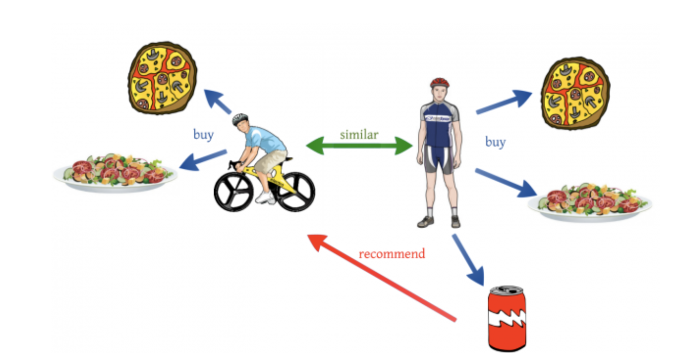
Collaborative filtering based recommendation system
Collaborative filtering is used by most recommendation systems to find similar patterns or information of the users, this technique can filter out items that users like on the basis of the ratings or reactions by similar users.
By User Similarity: This strategy involves creating user groups by comparing users’ activities and providing recommendations that are popular among other members of the group. It is useful on sites with a strong but versatile audience to quickly provide recommendations for a user on which little information is available.
By Association: This is known as “Users who looked at X also looked at Y.” Implementing this type of recommendation system is a matter of looking at purchasing sequences or purchasing groups, and showing similar content. This strategy is useful for capturing recommendations related to naturally complementary content as well as at a certain point in the life of the user.

Slide 6
Collaborative filtering based recommendation system
Collaborative filtering recommend items to users based on the similarity computation of these users to similar users in the system or based on the items similar to the items liked by the user in past. So collaborative filtering can be further divided into two categories -
user-based collaborative filtering – The recommender system tries to find out similar users to the target user by calculating certain similarity measures and then suggest items to the target user based on similar user preferences. Similarity calculation is an important task here.
item-based collaborative filtering – The recommender system tries to find out items based on previous user preferences of the user and then recommend similar items to the user. These items might be of interest to the user.

Slide 7
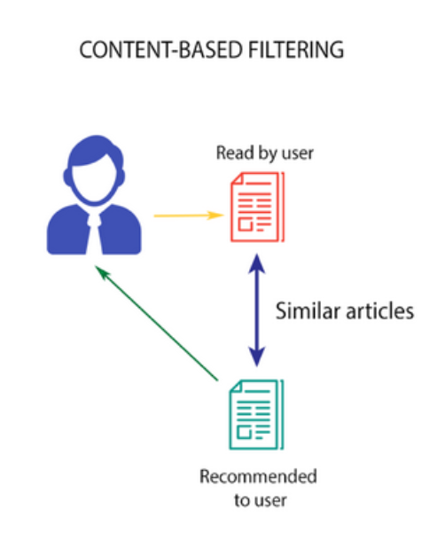
Content-based filtering based recommendation system
This algorithm recommends products which are similar to the ones that a user has liked in the past.
For example, if a person has liked the movie “Inception”, then this algorithm will recommend movies that fall under the same genre.

Slide 8
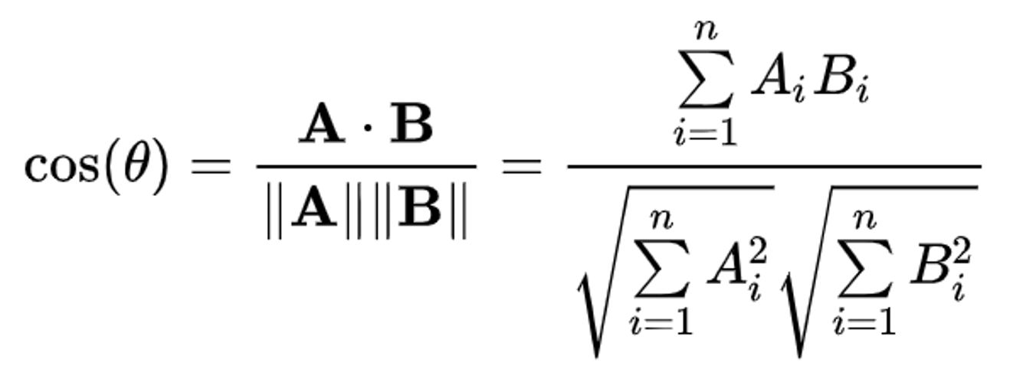
Content-based filtering based recommendation system
For example,
Netflix save all the information related to each user in a vector form. This vector contains the past behavior of the user,
The movies liked/disliked by the user and the ratings given by them. This vector is known as the profile vector.
All the information related to movies is stored in another vector called the item vector. Item vector contains the details of each movie, like genre, cast, director, etc.
The content-based filtering algorithm finds the cosine of the angle between the profile vector and item vector,
i.e. cosine similarity. Suppose A is the profile vector and B is the item vector, then the similarity between them can be calculated as:

Slide 9
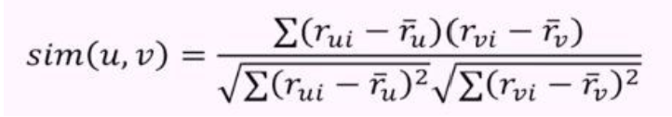
Content-based filtering based recommendation system
Based on the cosine value, which ranges between -1 to 1, the movies are arranged in descending order and one of the two below approaches is used for recommendations:
Top-n approach: where the top n movies are recommended (Here n can be decided by the business)
Rating scale approach: Where a threshold is set and all the movies above that threshold are recommended
Other methods that can be used to calculate the similarity are:
Euclidean Distance: Similar items will lie in close proximity to each other if plotted in n-dimensional space. So, we can calculate the distance between items and based on that distance, recommend items to the user. The formula for the Euclidean distance is given by:
Pearson’s Correlation: It tells us how much two items are correlated. Higher the correlation, more will be the similarity. Pearson’s correlation can be calculated using the following formula:

Slide 10
Issues in Recommender Systems:
Cold Start Problem : Whenever a new user enters a recommender system, the question arises of what to recommend him/her and on what basis as previous data is not available and similarity calculation could not be performed. One solution to this problem is to make the new users enter a small introduction form containing basic information about a person’s interests, hobbies, occupation, and creating a basic user profile and then recommending items to the new user. This would solve the cold start problem to a great extent.
Data Sparsity Problem: The major issue in a recommender system is the unavailability of appropriate data which is the main requirement for the recommendation process. Many users don’t bother to review items they bought. As a result, the user-item rating matrix has many sparse entries which degrade the performance of the similarity calculation algorithm.
Changing Dataset: With the increase in the amount of data every day, there is an increase in the inclusion of data in the previous dataset of the recommender system which may alter the overall structure and composition of the dataset. Both new users and new items needed to get included in the dataset. So this change needed to be accommodated in the dataset.
Scalability Problem: In a practical scenario, it is not always possible to find similar users and similar items every time and prevent the system from failure. So building a scalable recommender system is a major concern.
Shilling attack: Shilling attack is defined as the process of inclusion of fake profiles and biased reviews and ratings to bias the entire recommendation process. A malicious attacker may inject these profiles so as to increase/decrease recommending frequency of target items.

Slide 11
Benefits of a recommender system:
Increasing profit by increasing the number of items sold: One of the major objectives of building commercial recommender systems is to enhance business and increase profit. This could be done by suggesting users new items which may attract the users and they may buy more items as compared to those without Recommender Systems.
Enhanced user satisfaction: The main motive of any business application should be user satisfaction as it enhances overall business growth and the healthy survival of the company. A well-designed recommender system enhances the user’s overall experience in using that application. They may find recommendations useful and relevant to user needs. So the major purpose of RS is to satisfy the users and make them happy.
Extraction of useful patterns: The recommender system provides a way of extracting useful patterns of users’ needs and preferences that could serve as strategic information for the business. For example, if a business company could get insights about which product is being extensively liked b its customers and which product is not being liked then they could change their product list.
Provide more diverse items to users: Sometimes it is impossible to find the items personally that a recommender system may provide. This increases the variety of items that users get from recommendations.

