Slide 1
Ajoutez de la reconnaissance d'écriture à votre webapp grâce à Polymer
Yohann STREIBEL
Pierre-Alban DEWITTE
`

Slide 2


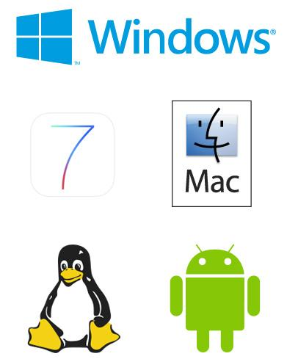




Notes:
Searching how to recognize hand-writing for 17 years. More than 100 peoples working in Nantes (France), Dayton (US) but also China, Korea and Japan.
Various technlogy like Text, Math, Shape and Music. We currently recognize more than 100 languages in 13 scripts.
Building multi-platforme handwriting recognition softwares. From Iphone (with MyScript Calculator) to QNX with automotive softwares with also a cloud division.
I am Pierre-Alban DEWITTE and i am in charge of the team. I love software development from database to front-end.
I am Yohann STREIBEL ...

Slide 3
http://webdemo.myscript.com
Notes:
Text demo

Slide 4

How it works
Pre-processing
Segmentation
Dynamic Programming
Language processing
Character classification
Sing a song of peace
Notes:
Different stages are required to recognize a "Digital ink"
Pre-processing
Segmentation
Character classification
Language processing
Dynamic Programming

Slide 5
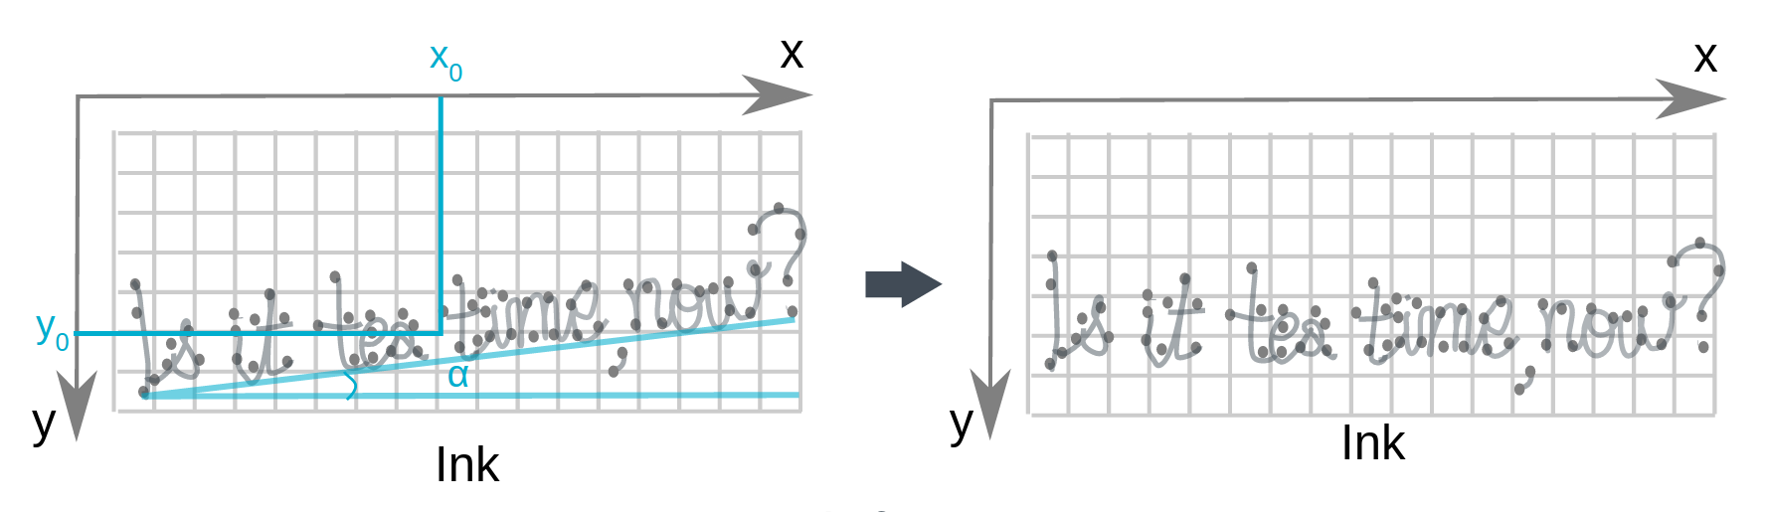
Baseline correction
Notes:
Goal of pre-processing is to normalize the input signal and ease the next steps.
One of the first step is to detect the baseline. Various algothms are used depending of the script.

Slide 6
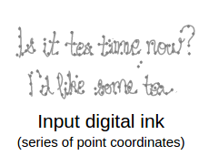
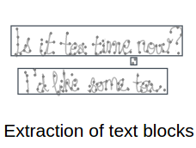
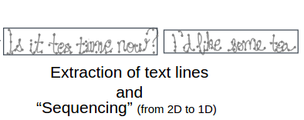
Line extraction
Notes:
One the base line is detected we try to identify the text block in order to reprocess the text to have a single line. It is a 2D to 1D treatment.

Slide 7
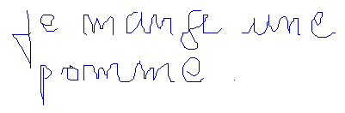
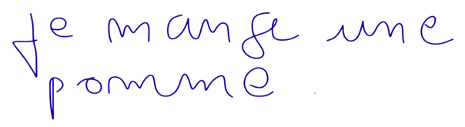
Smoothing
Notes:
The quality of ink vary a lot across devices. In order to processs the recognition in a reasonable time we have to resample the ink and smooth it.

Slide 8
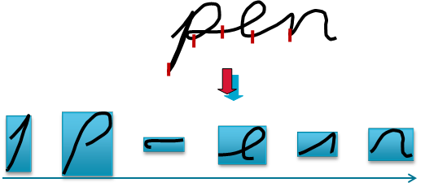
Segmentation
Notes:
After pre processing the first step of recognition occurs.
In cursive connected script, characters are linked through pieces of contours called ligatures. It is necessary, though, to provide the recognizer with the separated fragments of cursive script potentially matching symbols by cutting portions of ink at relevant points. This is addressed by the ink segmentation stage. This stage involves two main issues to solve. First, one should find the set of all potential segmentation points. Second, one should combine cuts to form characters.

Slide 9
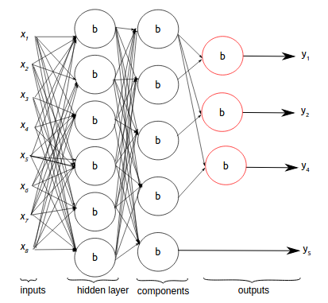
Character classification
Notes:
Recognizing a character implies complex processes that machine learning techniques are meant to address by sorting and classifying a digital ink sample based on its characteristics, also called features. We refer to a character classifier as the system in charge for carrying out the character classification.
A character classifier involves different neural networks that process different sets of features, leading to specialized neural networks answering particular sub-problems.
There can be different arrangements of neural networks according to the type of recognition to run. For instance, recognition of isolated Armenian characters while Korean will require,others.

Slide 10
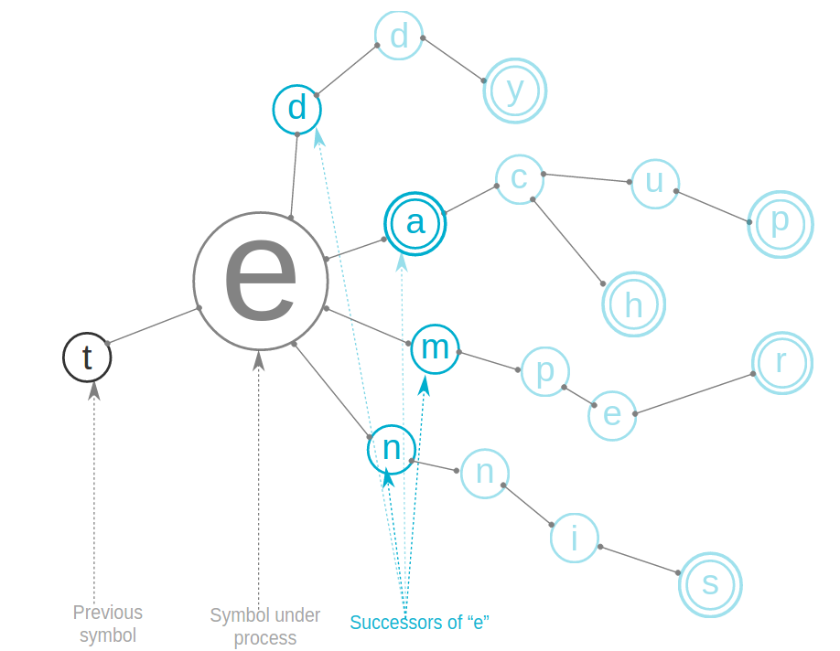
Language processing
Notes:
Accuracy of word and text recognition, as well as text input prediction, can be enhanced by using a priori linguistic knowledge. Indeed, the word/text-candidate lattice is reduced when the recognition is aided by linguistic information. Computational methods, also referred to asNatural Language Processing, implement knowledge-engineered and statistical techniques within so-called language models (LMs). This section discusses the linguistic knwoledge, the language models and the language processing.

Slide 11
How it works
Pre-processing
Segmentation
Dynamic Programming
Language processing
Character classification
Sing a song of peace
Notes:
As the segmentation graph is traveled across, cost values related to the three different types of observations (linguistics-based, segmentation-based, character classification related) are propagated from one hypothesis to another. The dynamic programming (DP) method solves the problem by finding the path that amounts to the minimum cost, as well as the subsequent recognized text sequence. Result is provided through different resolutions: character level, word level and text level

Slide 12


Web Components
Notes:
Web Components are a set of standards for the creation of reusable widgets or components in web documents and web applications. The components model allows for encapsulation and interoperability of individual HTML elements.
Build with polymer from the version 0.5 until now.
Possible to integrate in any webpage without being constrained by any framework.
Ease the complexity of cross device management.
Offer a contract layer to our javascript libraries.

Slide 13
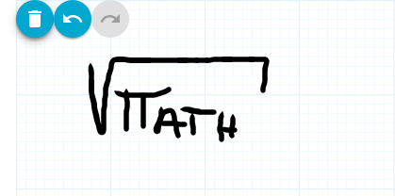
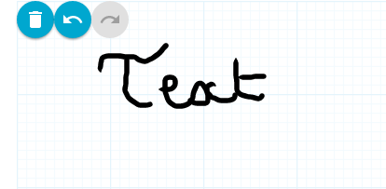
Hand-writing in a web page
Notes:
Challenge is to have a nice user experience
Fast recognition with a good accuracy
Ease of capture
Nice rendering
Our components capture the ink, render it and use the websocket endpoints of cloud to recognize what is write by user.
A set of properties help customize the ui and access to recognition events and labels

Slide 14
Live coding
Notes:
Let’s see in action how you can integrate handwrting in you webapp

Slide 15
http://demo.webservices.myscript.com

Slide 16

Questions
All slide content is copyright by MyScript
Demo http://demo.webservices.myscript.com
Give a try to our technology http://dev.myscript.com

