Slide 1
Discover MyScript Web Components and MyScriptJS
Yohann Streibel, Web Components Lead Developer
Fabien Ric, Product Manager
MyScript Webinar – June 11, 2015
Notes:
Hello everybody, welcome to this MyScript webinar.
Are we ready to start ? Thank you for being here, we’re really excited to see so many people connected today.
My name is Fabien and I’m the product manager for Math & Shape products at MyScript.
I’m with Yohann Streibel today who works in our web services team and will show how to use our web components.
Just before we begin, I’d like to know how many of you already use MyScript technology in your apps?
Before jumping into the demonstration, I’d like to give you more details on MyScript and its product offering.
<next>

Slide 2
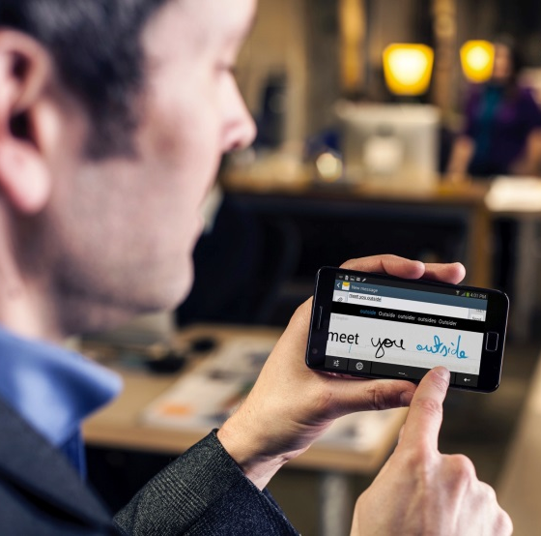

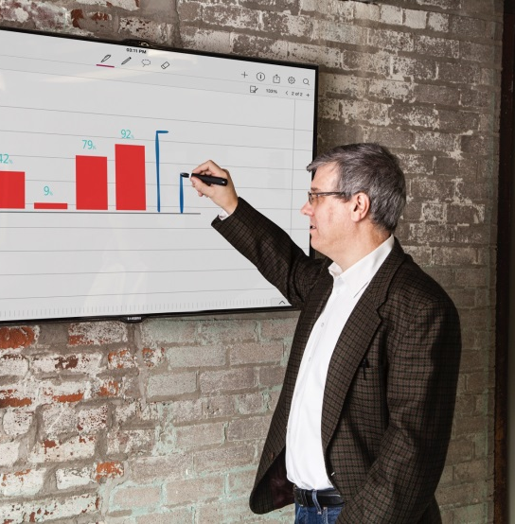
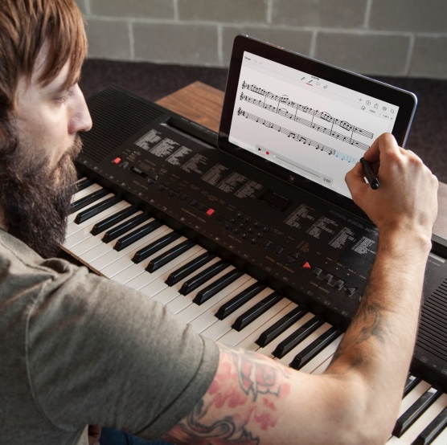
MyScript at a glance
#1 handwriting recognition for Text, Math, Shape and Music
All major platforms, nearly 100 languages, +200 M users
Notes:
At MyScript, we’re creating an handwriting recognition technology that provides optimal, consistent results with any digital writing device.
<next>
MyScript can recognize text, complex mathematical equations, geometric shapes, and music notation.
<next>
It works on all popular operating systems, with great accuracy on almost 100 languages.
More than 200 M people use MyScript-enabled hardware or software.

Slide 3

MyScript Product Offering
APPs
WHITE LABEL
Rebranding
Customization
For web apps or hybrid mobile apps, based on SDK APIs
Fast development path for mobile apps
CDK
ATK
ONLINE RECOGNITION:
SaaS or SERVER offer with simpler APIs
JavaScript library
INTERACTIVITY:
User interface,
Real-time recognition,
Gestures.
SDK
LOW LEVEL APIs
High level of integration and customizability.
Runs on servers, desktops, mobile and embedded devices
Windows, Mac OS, Linux, Android, iOS
Notes:
We offer several entry points:
The SDK which offers low level-apis, allowing full control of the recognition process, cross platform
The ATK stands for Application Toolkit, which handles interactivity, gestures and recognition for you, allowing a simpler integration
The CDK which enables to use our SDK in the Cloud
And Applications that are ready to rebrand and bundle.
<next>
Today’s webinar will focus on the CDK and especially on the new set of tools we’ve added to help you get your projects started even faster.

Slide 4



MyScript Cloud Development Kit
The full stack for online handwriting recognition.
MyScript Cloud recognition
Online handwriting recognition
for text, shapes, music notation and mathematical expressions
MyScriptJS
The JavaScript library for the
MyScript Cloud recognition service
MyScript Web Components
Polymer Components for
handwriting recognition in your Polymer app
Notes:
We’ve just released a major update of our Cloud Development Kit, that makes it the first full stack for online handwriting recognition.
In addition to our cloud recognition service for text, math, shapes and music ; we released 2 news set of tools to speed up the development of your web app.
MyScriptJS 1.0
A javascript library that handles common tasks involved in web handwriting interfaces
MyScript Web Components 1.0
First set of MyScript Polymer components, ready for Polymer 1.0
Includes a rich Math component

Slide 5
What’s new in CDK 3.0
Easier integration
MyScriptJS and Web Components
Increased reactivity
WebSocket support for Math and Text
Enhanced security
Introducing HMAC signature
Notes:
In addition to an easier integration, this CDK update brings 2 new features:
Websocket support that enables bi-directional communication between your app and the recognition server, for a reduced latency enabling enhanced interactive applications
Increased security through HMAC signature support
Before we go more in details with MyScriptJS and MyScript Web Components, it’s important to understand the main steps involved in performing handwriting recognition in a web application.

Slide 6
Main concepts
Application
XYT coordinates
Handwriting
interface
Renderer
Ink manager
Result
Strokes
Other input components
Recognizer*
Full request
Full response
MyScript
Cloud
* requires a MyScript Cloud account
Notes:
Handwriting interfaces usually requires to implement the following concepts:
First we need to capture strokes (for example a simple equation as shown). In other words the trajectory represented as a sequence of X & Y coordinates between the pen down and pen up event.
It is highly recommended to provide visual feedback to the user performing these strokes thanks to a renderer.
The management and storage of the strokes is performed by the Ink manager, enabling editing operations such as undo/redo
Finally the communication between the Ink manager and MyScript Cloud is performed by the Recognizer for both the sending of ink and receiving of recognition results.
Recognition requires a Cloud account.
---------------------
They are few concept that you need to know before to use ours tools.
What is a stroke?
A stroke is defined as the trajectory of the pen or the finger from the moment it touches the surface until it is lifted.
A stroke is represented as a sequence of 2D points (X, Y coordinates) ordered by time (T).
Ink manager
The ink manager is used to built and store strokes .
Recognizer
The recognizer sends the strokes from the ink manager to MyScript Cloud.
You need a cloud account to use recongition sevices.
When the recognition is done, recognizer send the response to the application.
Renderer
The renderer allows you to draw strokes on the fly on an HTML canvas. It gives you utilities methods.

Slide 7
MyScriptJS
The JavaScript library for the MyScript® Cloud recognition service
Handles the common tasks involved in handwriting interface
Follow evolutions of the SDK
Free and open-source
Notes:
MyScriptJS contains all the methods necessary to manage the handwriting recognition tasks described previously.
All this hard and specific work is done for you: you don’t need to implement that, you have just to use ours javascript objects and methods bring by MyScriptJS.
This saves you time so you can focus on what makes your app unique.
You also get peace of mind regarding code evolution in the future, as we at MyScript will ensure compatibility with future releases of our Cloud Server.
Last but not least, MyScritpJS is free and open-source and available on GitHub. This way you can benefit from the community and help us to track issues.

Slide 8

MyScript Web Components
Polymer components for handwriting recognition
Library of custom and customizable web components.
Ready to use in your web app
Free and open-source
Notes:
To make it even quicker to integrate handwriting recognition, we created a library of customized and customizable Polymer Web Components.
It offers real flexibility as you can reuse our components or create your owns.
We based them on Polymer to ensure a consistent behavior across web components compatible browsers.
Recognition is based on MyScript Cloud using the underlying library of MyScriptJS.
MyScript Web Components is also available for free on GitHub together with extensive API reference documentation and samples.

Slide 9
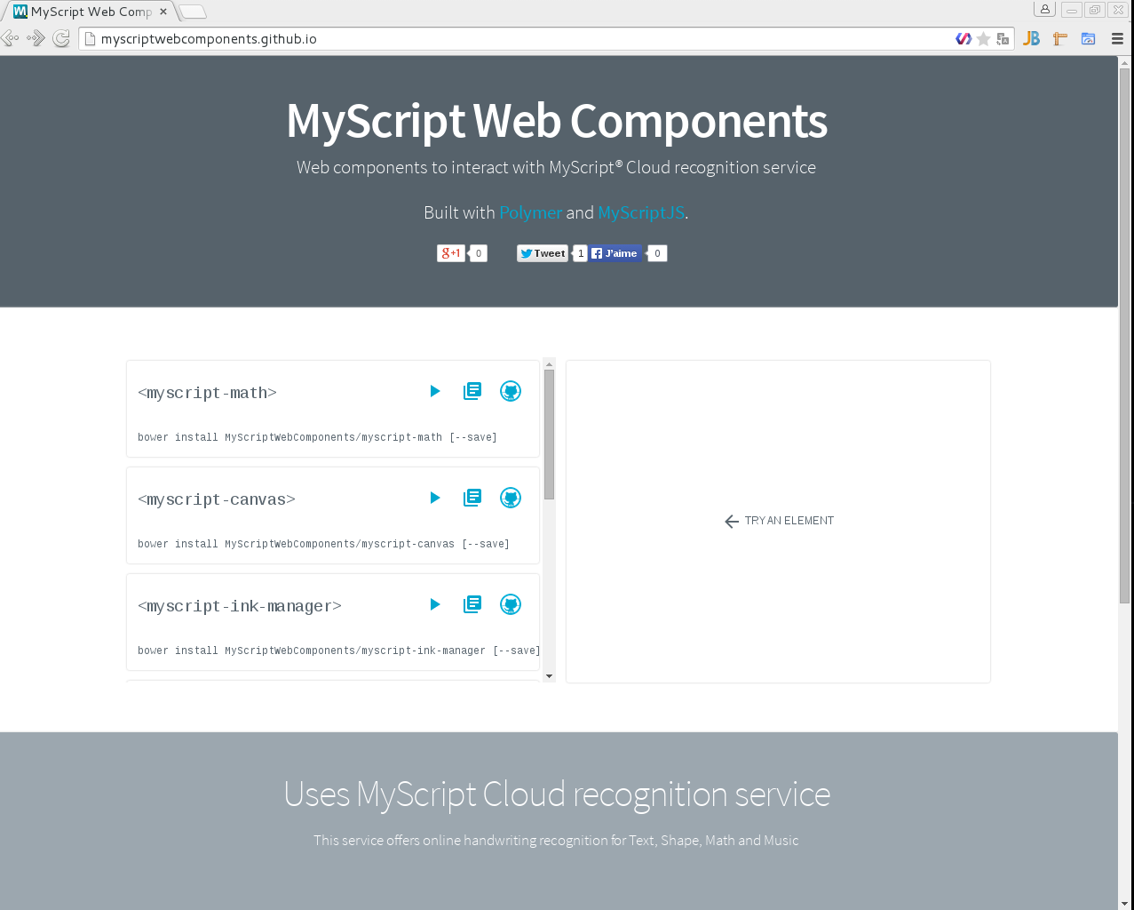
myscriptwebcomponents.github.io
Notes:
Let’s visit the MyScript GitHub page and see how to access the Web Components.
myscriptwebcomponents.github.io
In the left column we see the list of components. Each component can be separately run in the right column. Documentation and source code is also available here.
For each documentation of web components, you can see all attributes to declare on html file.
Now Yohann can you please tell us more about those components?

Slide 10
MyScript Web Components Overview
myscript-elements
…
Math recognition ready to use
Rich web components
myscript-math
Simple web components
myscript-canvas
myscript-renderer
myscript-toolbar
myscript-ink-manager
Create your own rich components based on MyScript
myscript-result
myscript-recognizer
Polymer
Notes:
Hi everyone,
This is an overview of MyScript Web Components architecture.
MyScript Web Components are based on Polymer.
They are composed with two differents groups of components.
One called « Rich web component » where you can find myscript-math and an other called « Simple web components » that allow you to create your own rich components.
Myscript-math is composed with the Simple Web Components.

Slide 11
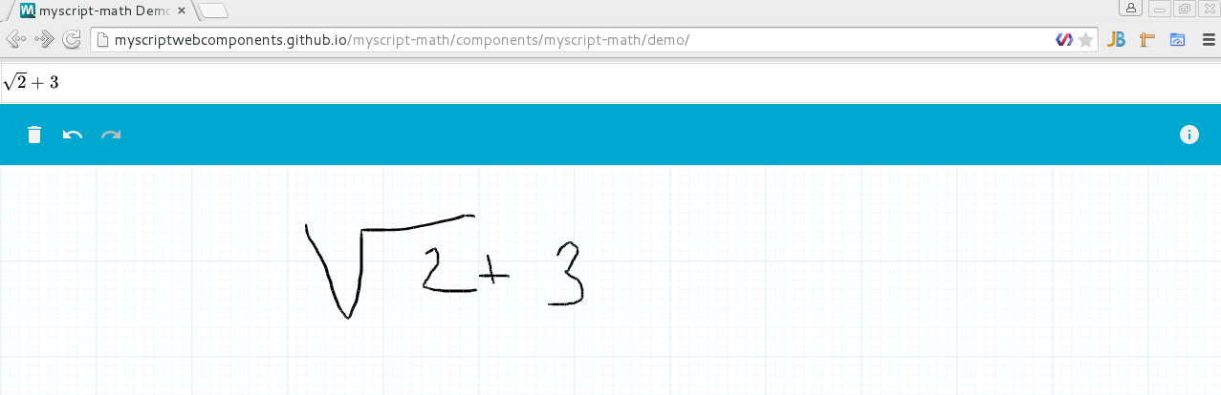
MyScript-math Web Component
myscript-result
myscript-toolbar
myscript-renderer
myscript-ink-manager
myscript-canvas
myscript-recognizer
Notes:
<next>
myscript-canvas is a writing area which is listening gestures events like touch and click.
<next>
myscript-renderer allow you to render strokes on canvas.
<next>
The strokes are built and stored in a non visible component, myscript-ink-manager.
<next>
When you finish to write on the canvas, myscript-recognizer sends strokes from the myscript-ink-manager to MyScript Cloud. It’s also a non visible component.
<next>
When the recognition is done, myscript-recognizer sends the response to myscript-result.
Recognition result's return is latex string that is rendered using the katex library.
<next>
myscript-toolbar interacts with all components to manage the undo,redo and clear features.

Slide 12
Live demo
How to add myscript-math, the rich MyScript math web component, on a simple HTML page ?
Notes:
Now it’s time to make a live demo for you to understand all we said on previous slide:
Firstevall, I will try to create a simple HTML application.
This application should be use the rich myscript-math web components to make math recognition.
1) I create a new directory name webinar-demo for the web application
2) I move on webinar-demo
3) I use Bower to initialise our project dependencies with this command : “Bower Init”
Bower is a tool that manages all your frameworks, libraries, assets and utilities.
It works by fetching and installing packages from all over, taking care of hunting, finding, downloading, and saving the stuff you’re looking for.
This tool allow you to get all myscript web components.
4) I add all myscript-elements by typing :
Bower install myscript-elements –-save
myscript-element aggregate all myscript web components
5) I’m checking the bower.json to show you how bower add the dependencies
We observe a new line on dependencies properties.
6) Now, I open up my integrated development Environment “Webstorm” and I open the project.
7) You could see the bower_component directory that contains all dependencies. We have myscript-math here.
8) I’m creating a new file, index.html
9) In this file I add a Title and the import link to myscript-math.
Myscipt-math is in bower_components like we saw.
10) I add the myscript-math component by typing :
<myscript-math></myscript-math>
11) I’m launching a simple http server with python but it works with all http server.
Python –m SimpleHTTPServer
12) I’m going on the url localhost:8000, to see what we’ve got.
13) I’m trying to recognize something
14) Like I would like to show you, it doesn’t work cause it miss some attributes to my myscript-math component declaration to do handwriting recognition.
I need to add applicationkey and hmackey, it’s necessary to use handwriting recognition with the cloud.
15) To get an applicationkey and hmackey, I’m going to the developer portal dev.myscript.com.
Create your own account if you don’t have one. I already have my own, so for the demo I’m using it.
I’m clicking on login button.
I’m adding my username and password
I’m clicking on user menu, then dashboard
In the dashboard page you have a MyScript CDK button, I’m clicking on it.
I ‘m going on the cloud login page.
I need to login with my account email and password.
I need to create an application by clicking on the “create application” button.
I’m taking the form. MyScript Webinar for the name and “this is an application for the webinar demonstration” for the description
My application is create. I open it.
Click on “generate application key”.
Your applicationkey and hmackey are created and I check the box “enable hmackey”
16) Now we have just to copy/paste the value on each myscript-math attributes.
17) I’m going to chrome and refresh the page.
I write strokes… the recognition is done.

Slide 13
Getting started with CDK
Go to our Developer Portal : dev.myscript.com
Create an account for a free 90-days trial period
Go on GitHub and start coding!
http://myscriptwebcomponents.github.io/
http://myscript.github.io/MyScriptJS/
Need help to get started? Get in touch on GitHub or our Forum!
https://dev.myscript.com/forums/forum/cdk/
Notes:
Get started with the CDK is as simple as 1, 2, 3.
Just go to our dev portal to create an account, after a mail confirmation you’ll be able to create your application key and start your project with a free 90-days trial period.
If you need help get in touch with us on GitHub or the forum.
Thanks for your attention, it’s time to ask your questions!

Slide 14
Q&A session

