Slide 1

Workshops
UOB AM AI Workshop

Slide 2
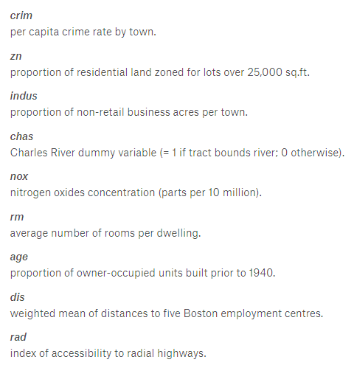
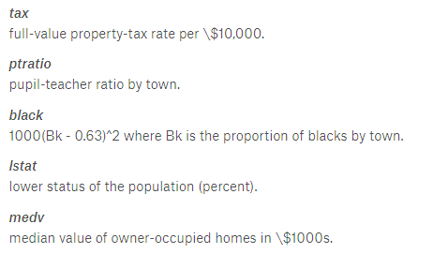
Workshop 1: Predicting Boston Housing Values
Predict the Median Value (MEDV) of Homes in terms of thousands
The Boston data frame has 506 rows and 14 columns.
https://www.kaggle.com/c/boston-housing/overview/description

Slide 3
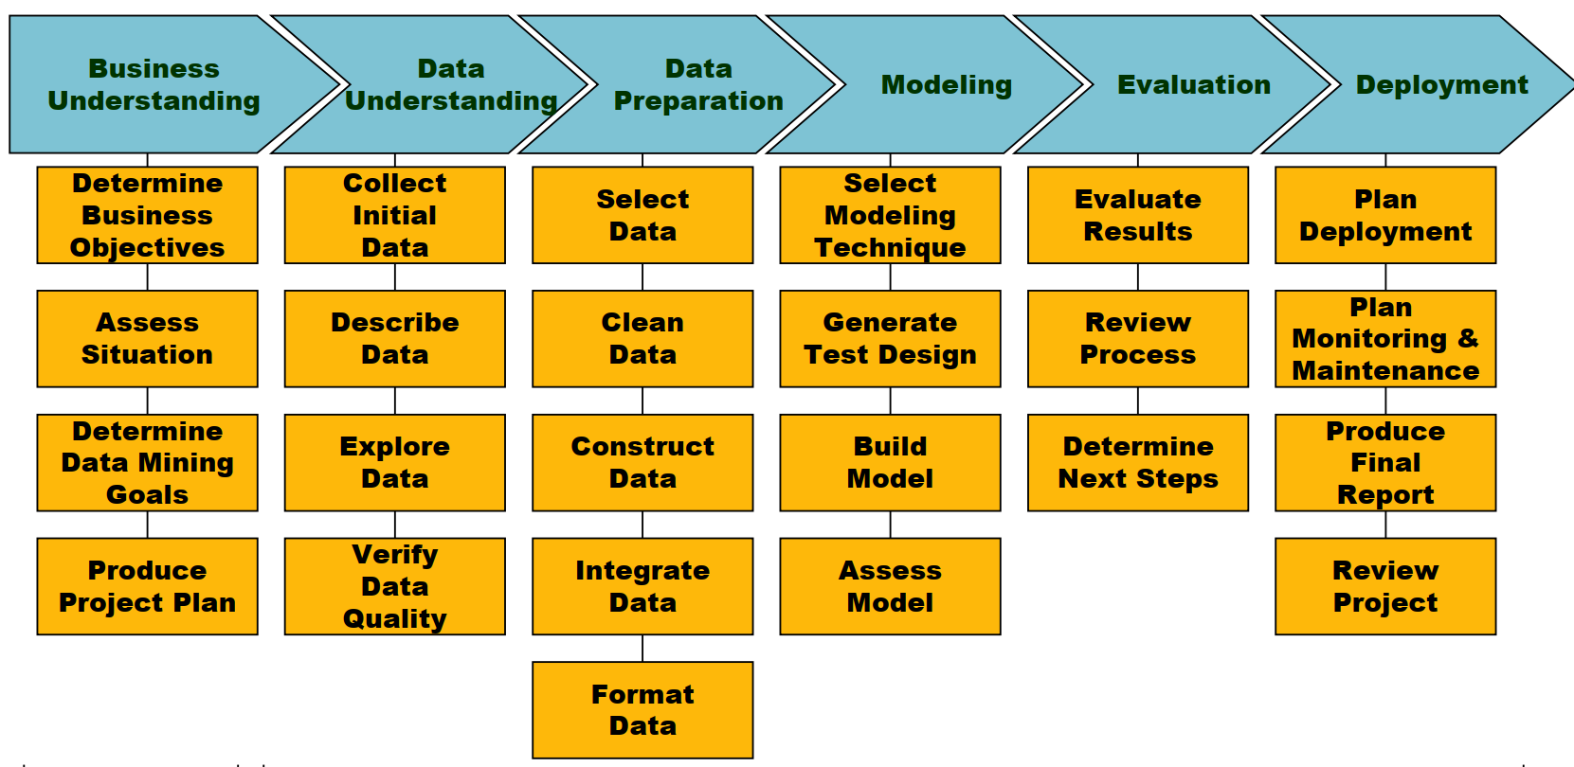
Workshop 1: Predicting Boston Housing Values

Slide 4
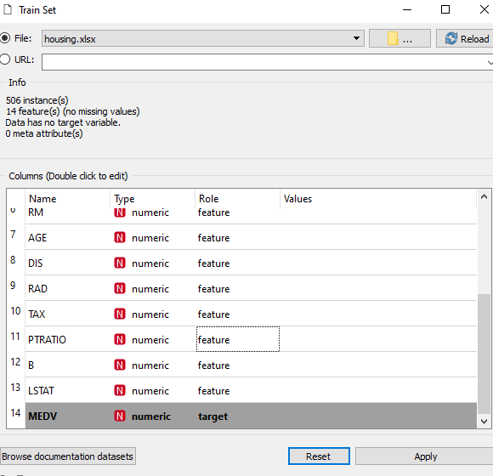
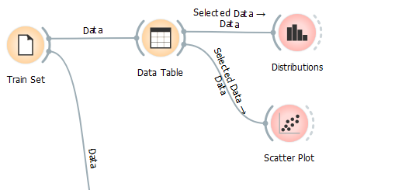

Slide 5
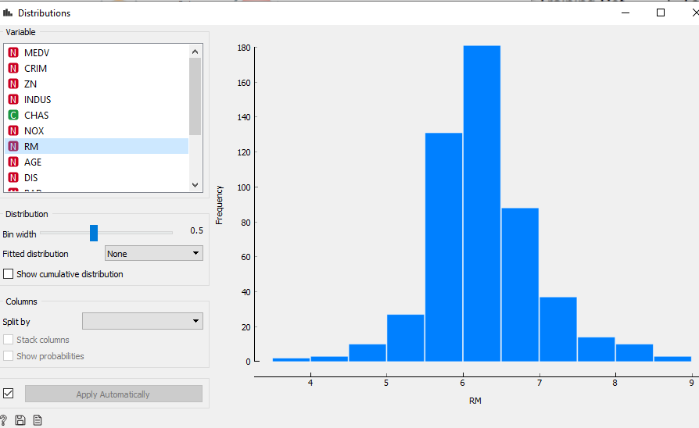
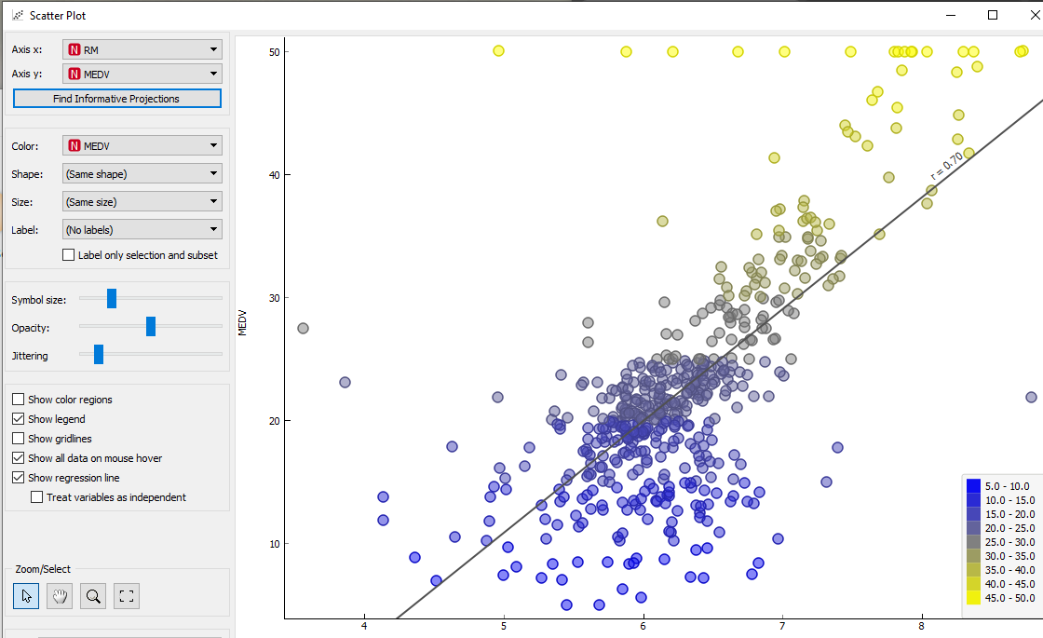
Workshop1: Explore the Data

Slide 6
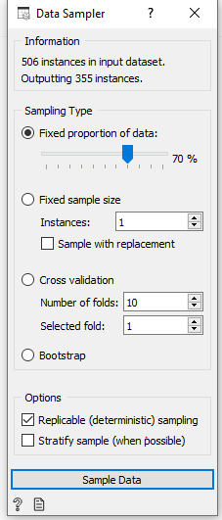
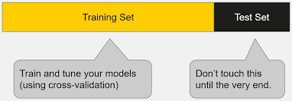
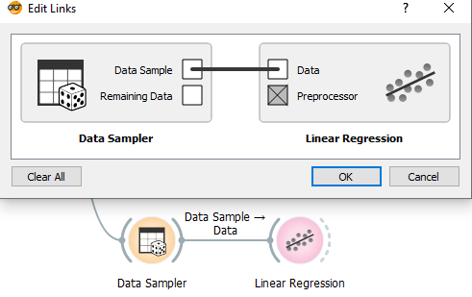
Workshop 1: Training the Model (With 70% of the data)

Slide 7
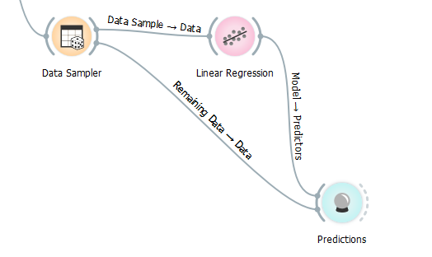
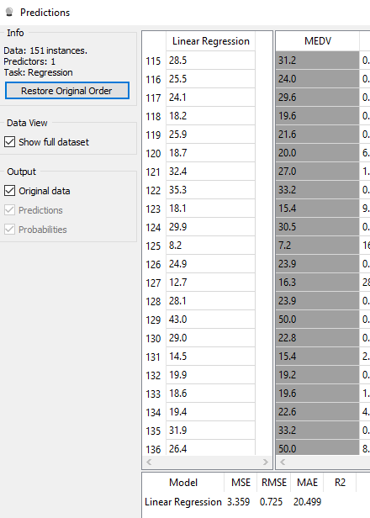
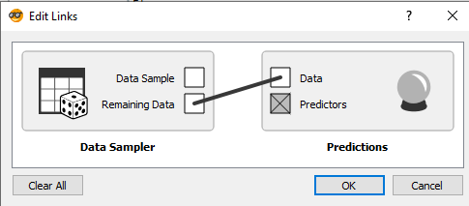
Workshop 1: Predicting the MedV target value on 30% of the test data
Note: Bugged RMSE values!

Slide 8
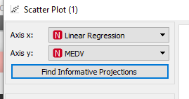
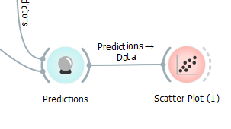
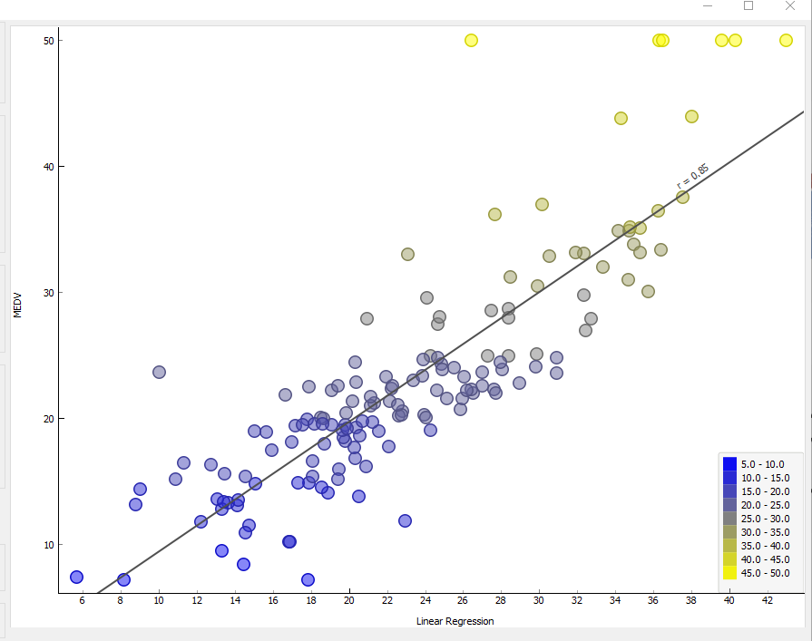
Visualising your Linear Regression Line

Slide 9
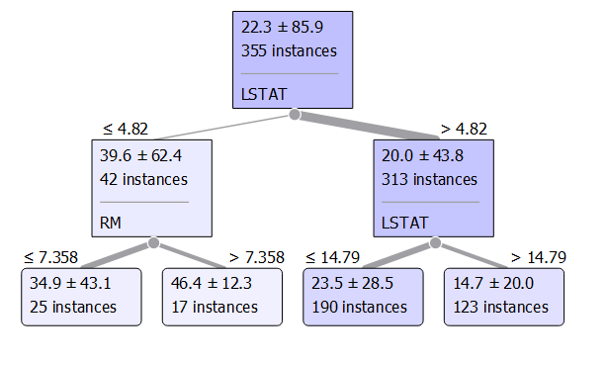
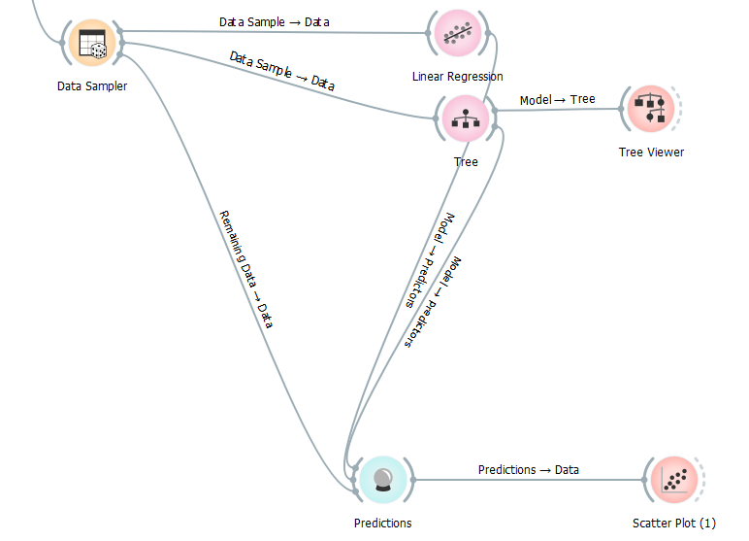
Workshop 2: Predicting Boston Housing Values – Using Decision Trees

Slide 10
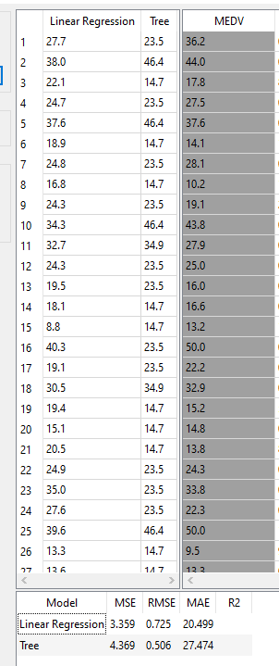
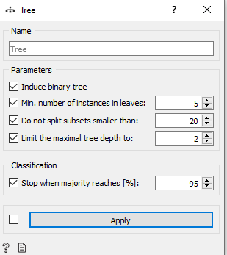
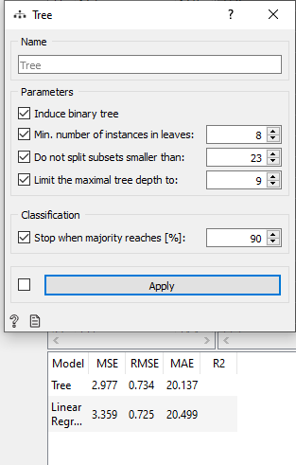
Workshop 2: Predicting Boston Housing Values – Using Decision Trees

Slide 11
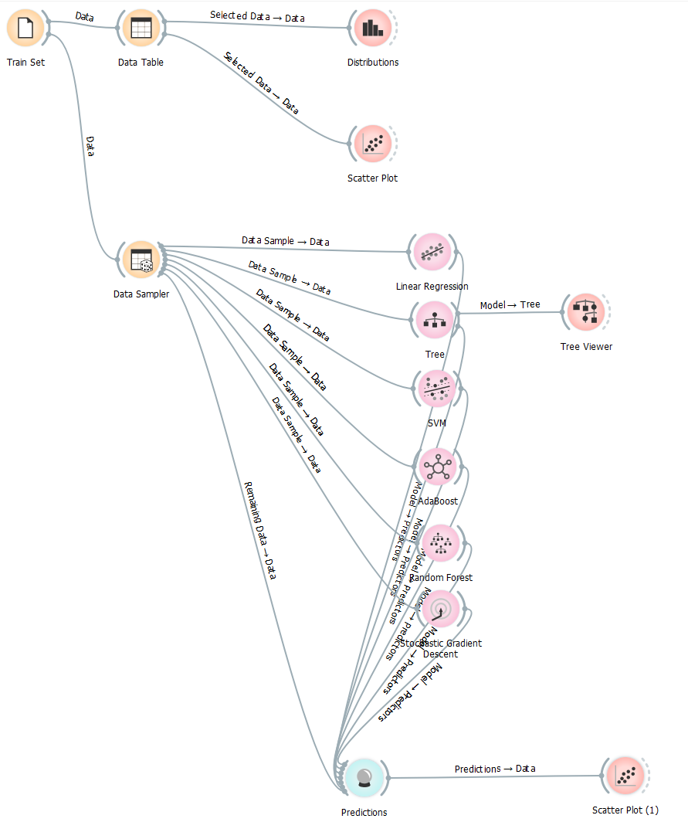
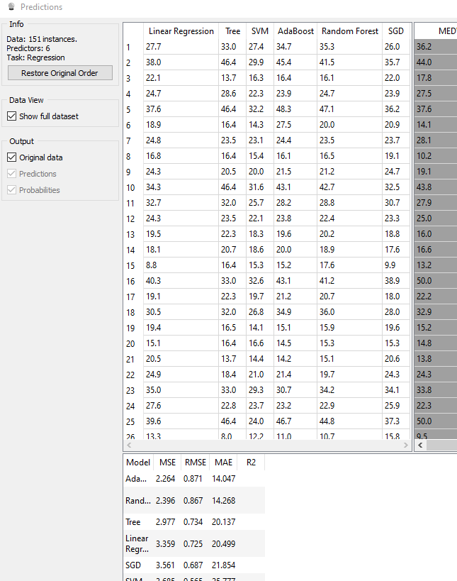
Workshop 3: Predicting Boston Housing Values – Evaluating Multiple Models

Slide 12
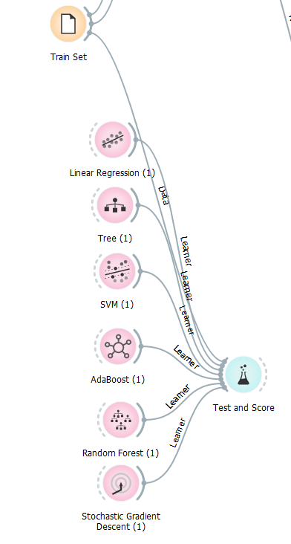
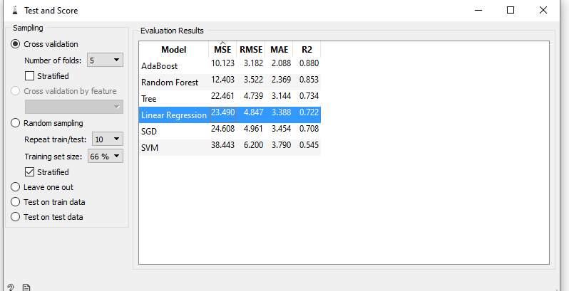
Workshop 4: K-Fold validation

Slide 13

Workshop 5: Predict Stock Prices using Regression ML
Problem Statement: Given the Past 10 Days of Dow Jones Data, can you predict the next day closing price?
Dow Jones data range variation is huge – We need to Scale/Standardize it, or Index It to a lower number
Pre-processing Step – Using
*In statistics, standardized variables are variables that have been standardized to have a mean of 0 and a standard deviation of 1. The variables are rescaled using the z-score formula. Standardizing makes it easier to compare scores, even if those scores were measured on different scales
https://towardsdatascience.com/aifortrading-2edd6fac689d
https://www.youtube.com/watch?v=ftMq5ps503w

Slide 14
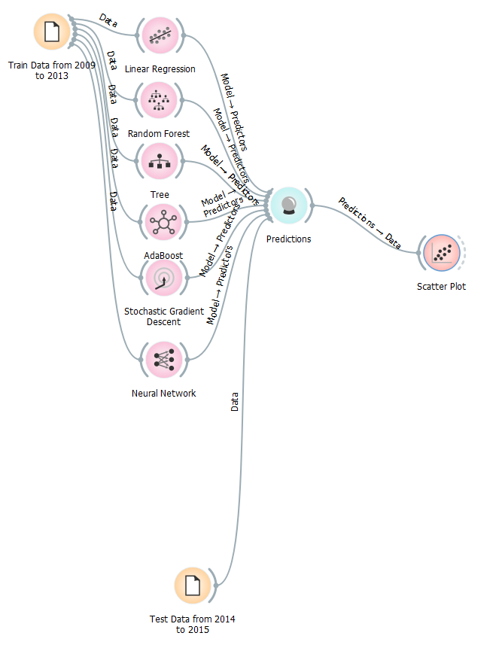
Workshop 5: Predict Stock Prices using Regression ML
Data Split: We train with data from 2009 to 2013; Test data runs from 2014 to 2015
https://towardsdatascience.com/aifortrading-2edd6fac689d
https://www.youtube.com/watch?v=ftMq5ps503w

Slide 15
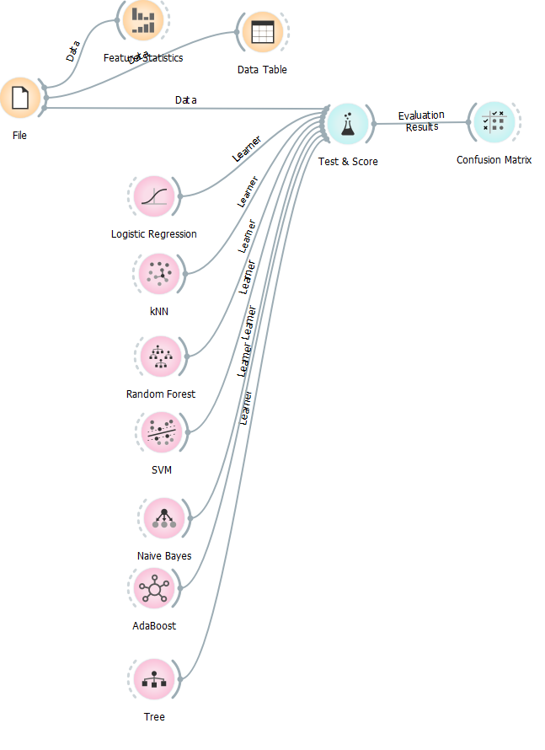
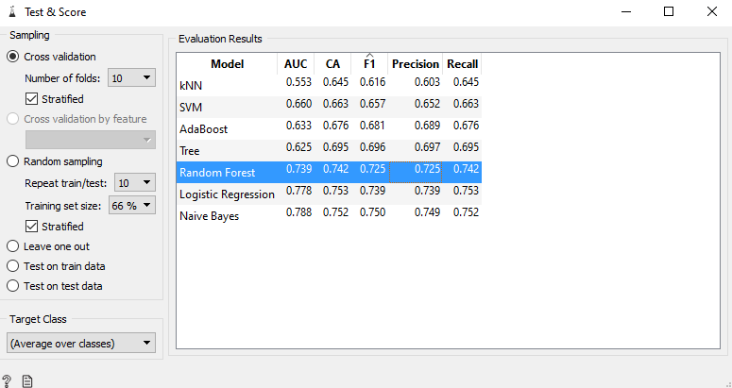
Workshop 6 – Predicting if a person has Creditability (Qualified for loan)
Problem Statement – Is it possible to build a good classifier to predict if a person has creditability?

Slide 16
Workshop 7 – Predicting Dow Jones Direction based on past 10 days data
Problem Statement – Is it possible to build a good classifier to predict dow jones direction based on just past 10 days data?

Slide 17
Workshop 8 & 9 Clustering – K Means & Hierarchical

