Slide 1

NetRS: Cutting Response Latency in Distributed Key-Value Stores with In-Network Replica Selection
Yi Su, Dan Feng, Yu Hua, Zhan Shi, Tingwei Zhu
Huazhong University of Science and Technology
ICDCS 2018 - Vienna, Austria

Slide 2
Outline
Background
Replica Selection Challenges
The Design of NetRS
Evaluation
Conclusion

Slide 3
What is NetRS?
NetRS is a hardware/software co-design framework that exploits
for
in distributed key-value stores.
NetRS could cut response latency by reducing the impact of
of servers.
Programmable Switches
Network Accelerators
Replica Selection
Performance Fluctuations

Slide 4





Distributed Key-Value Store
A critical building block for Web applications
Cassandra
Riak KV
Voldemort
Memcached
Couchbase
……
Target scenario
Distributed Key-Value Store
Response Latency Sensitive
Multiple Replicas for Reliability
Small Data Object
Read Intensive Workload

Slide 5
Distributed Key-Value Store
Response Latency Sensitive
Multiple Replicas for Reliability
Small Data Object
Read Intensive Workload
7ms
End-user Request
User-perceived Latency
Application Server
-------------------------
Storage Client
Interactive Web-based Applications
Storage Request
1ms
1ms
1ms
7ms
1ms
1ms
1ms
1ms
Storage Latency
Even Tail Latency Matters!!

Slide 6
Distributed Key-Value Store
Response Latency Sensitive
Multiple Replicas for Reliability
Small Data Object
Read Intensive Workload
Application Server
-------------------------
Storage Client
Interactive Web-based Applications
Storage Request
1ms
1ms
1ms
1ms
1ms
1ms
1ms
Storage Latency
Replica Server
4ms
1ms
7ms
Response Latency of Server

Slide 7
Outline
Background
Replica Selection Challenges
The Design of NetRS
Evaluation
Conclusion

Slide 8
Replica Selection Challenges
Inaccurate estimation of server status
Piggybacking server status in response packet
Avoid overheads of status synchronization
“Herd behavior” of clients
Distributed replica selection
Avoid latency penalties of cross-hosts coordination.

Slide 9
Inaccurate Estimation of Server Status
……
……
Storage Client
……
Replica Server
……
Response Latency
of Server
……

Slide 10
Replica Selection Challenges
Inaccurate estimation of server status
Piggybacking status in response packet
Avoid overheads of status synchronization
“Herd behavior” of clients
Distributed replica selection
Avoid latency penalties of cross-hosts coordination.

Slide 11
“Herd Behavior” of Clients
Herd Behavior
Load Oscillations
Storage Client
……
Replica Server
……
2ms
1ms
Response Latency
of Server
7ms
4ms
7ms

Slide 12
Replica Selection Node (RSNode)
Storage Client
……
RSNode
Replica Server
……
Who runs as RSNode?

Slide 13
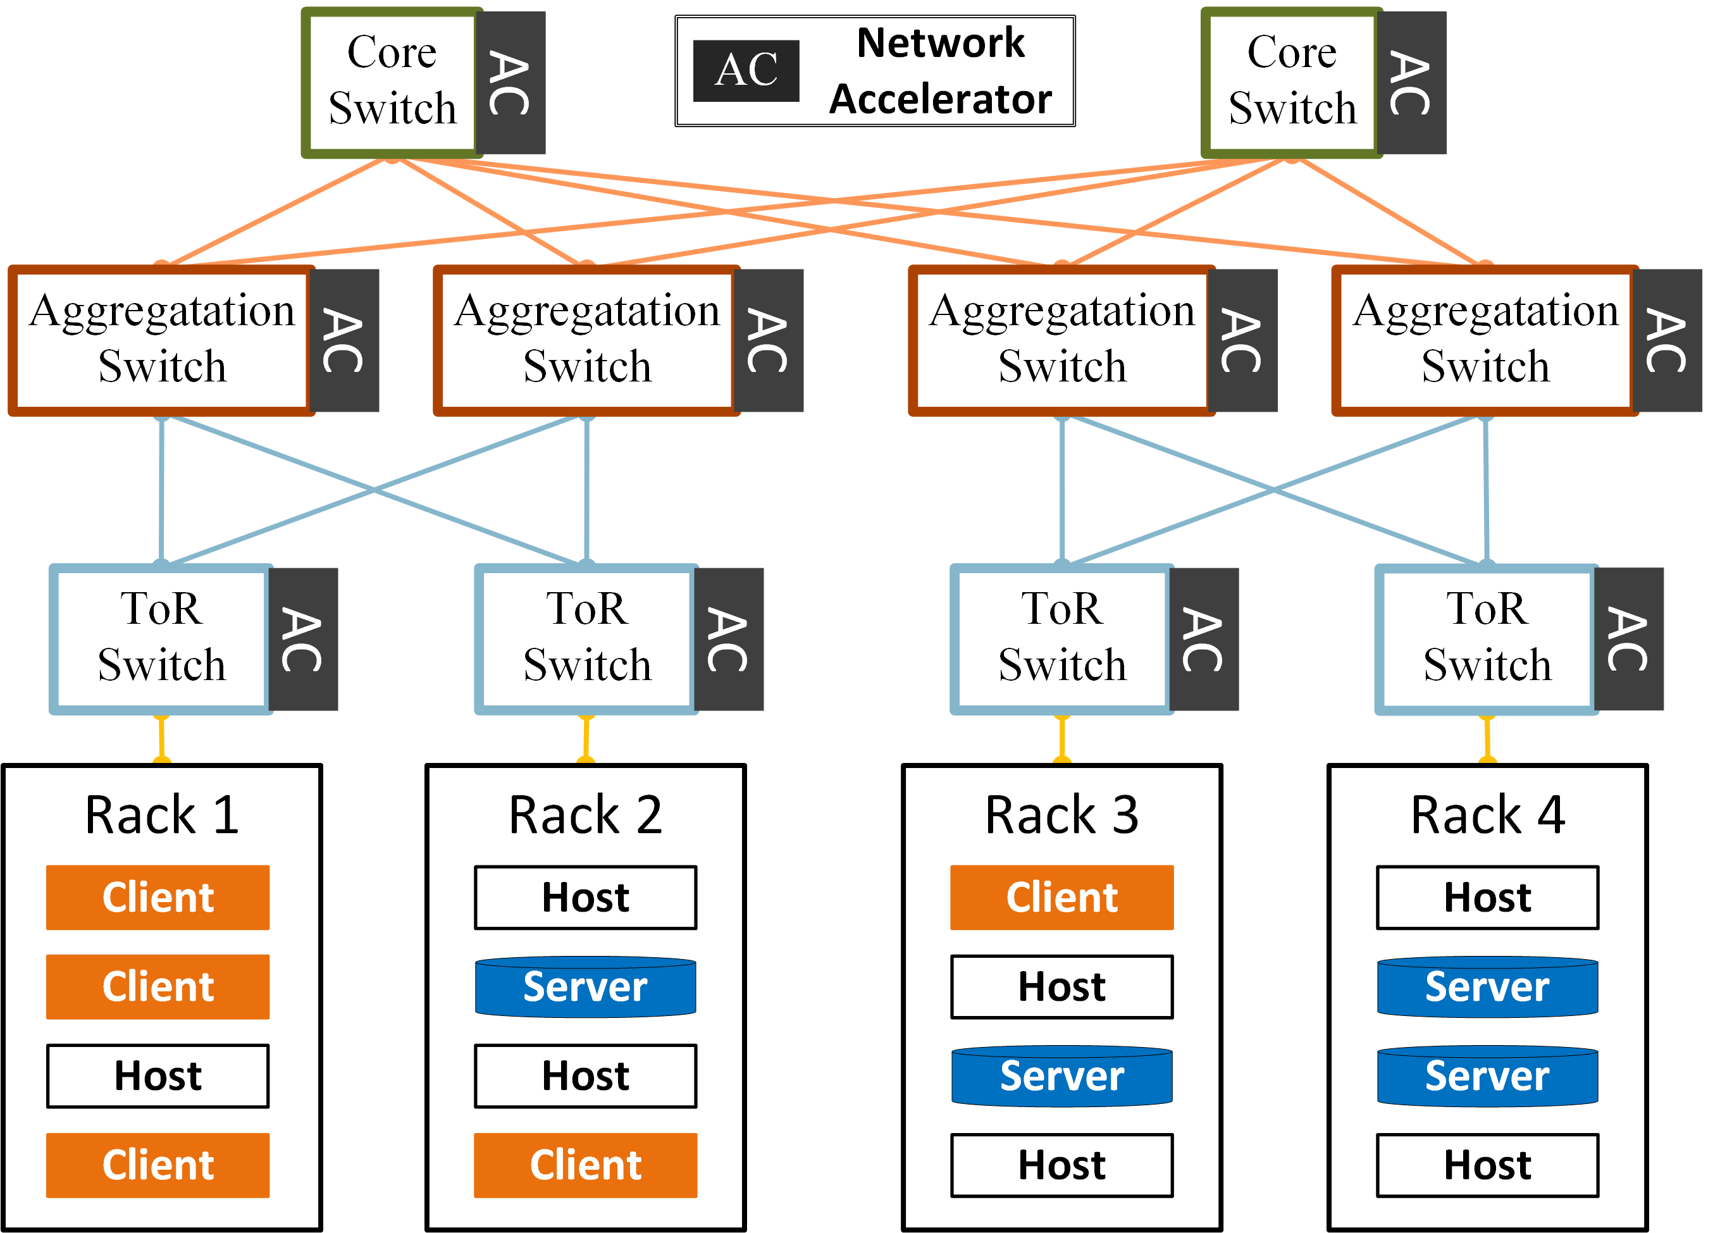
Host-based RSNode

Slide 14
Network-based RSNode

Slide 15
Distributed Key-Value Store
Response Latency Sensitive
Multiple Replicas for Reliability
Small Data Object
Read Intensive Workload
 | Host-based RSNode | Network-based RSNode
Target Scenario | Throughput critical | Latency critical
Typical System | HDFS, etc. | Cassandra, etc.
Data Object Size | Several MBs or GBs | About 1KB
Latency Requirement | Tens of milliseconds, Seconds | Milliseconds, Sub-millisecond
Available Solution | Proxy servers, Mayflower^{[1]}, etc | NetRS
[1] S. Rizvi, et al., “Mayflower: Improving Distributed Filesystem Performance Through SDN/Filesystem Co-Design,” in IEEE ICDCS, 2016.

Slide 16
Outline
Background
Replica Selection Challenges
The Design of NetRS
Evaluation
Conclusion

Slide 17
3.1 RSNodes Placement
NetRS Challenges
HOW TO place RSNodes in a complex topology of datacenter network?
HOW TO set forwarding rules for NetRS packets?
HOW TO accommodate diverse algorithms of replica selection?

Slide 18
RSNodes Placement Optimization
?
?
?
?
?
?
?
?
?
?

Slide 19
RSNodes Placement Optimization
Optimization goals
Maximizing the recency of local status for an RSNode.
Minimizing the occurrence of “herd behavior”.
Optimization constraints
There should be only one RSNode for each request.
The utilization of a network device should be limited.
The total amount of extra hops to RSNodes that requests take should be limited.
Optimization method
We use Integer Linear Programming (ILP) to formalize the optimization problem.

Slide 20
RSNodes Placement Optimization
Traffic group
The granularity of RSNode allocation.
NetRS controller
A centralized controller.
Periodically updates the placement of RSNodes.
NetRS monitor
Match-action rules (counters).
Only on ToR switches.
Collect traffic statistics.

Slide 21
3.2 NetRS Forwarding Rules
NetRS Challenges
HOW TO place RSNodes in a complex topology of datacenter network?
HOW TO set forwarding rules for NetRS packets?
HOW TO accommodate diverse algorithms of replica selection?

Slide 22
Forwarding Rules
Keep things in network
RSNodes placement should be agnostic to end-hosts.
Support dynamically enabling/disabling NetRS
Clients can select replicas for requests when exceptions (e.g. failure of network device) occur.
Handle multiple paths problem
A request and its response should flow through the same RSNode.

Slide 23
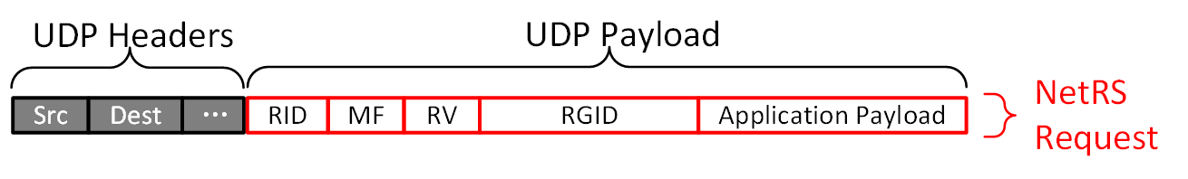
Keep Things in Network
RSNode ID
Magic Field
Replica Group ID
Magic Field
A label shows the type of a packet.
RSNode ID
An ID indicates where the RSNode is located in the network topology.
Replica Group ID
An ID indicate the set of replica servers that can serve this request.
Clients ONLY need to set MF & RGID.

Slide 24
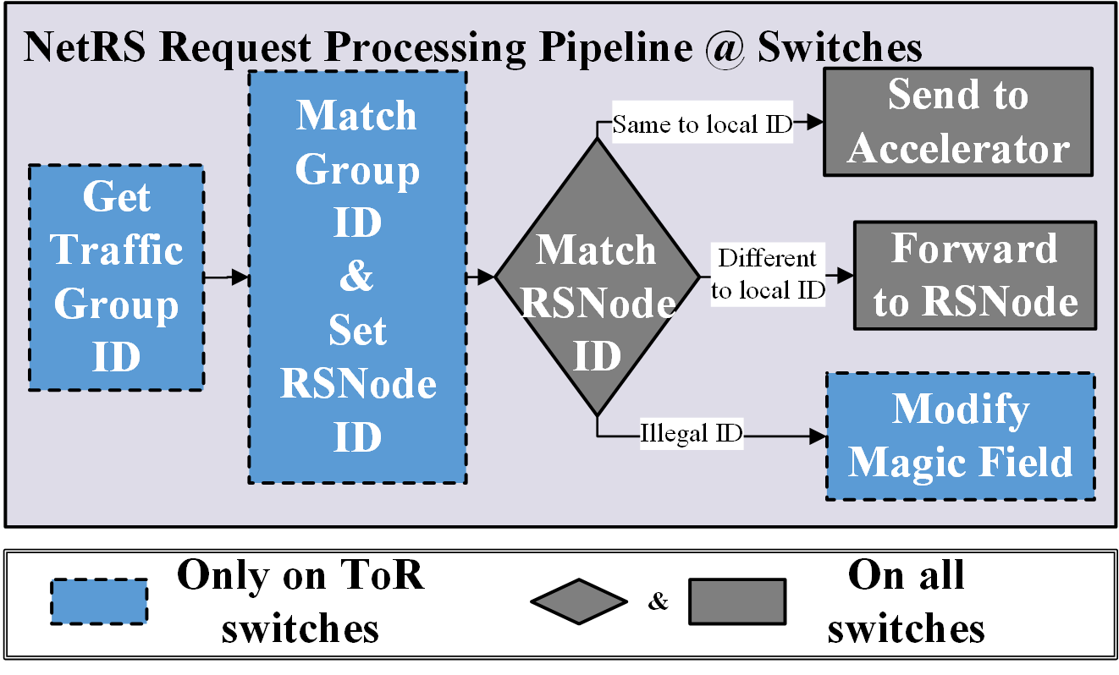
Keep Things in Network

Slide 25
Enable/Disable NetRS
Set an Illegal RSNode ID

Slide 26
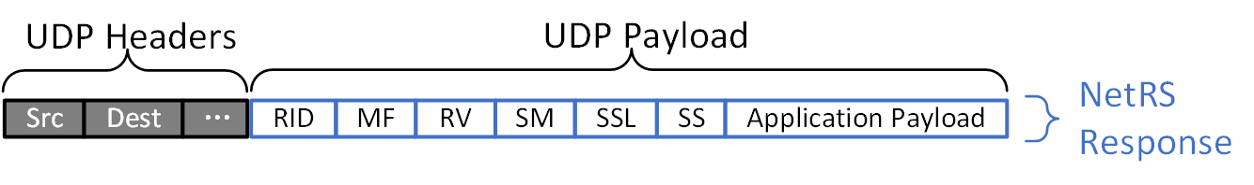
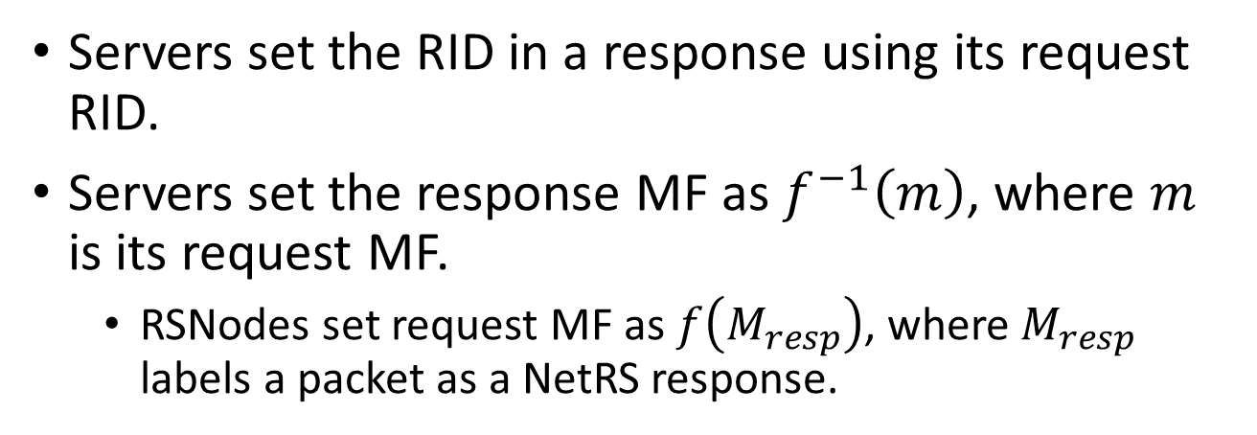
Handle Multiple Paths Problem
RSNode ID
Magic Field
Servers set the RID in a response using its request RID.
Servers set the response MF as $f^{−1}\left(m\right)$, where $m$ is its request MF.
RSNodes set request MF as $f\left(M_{resp}\right)$, where $M_{resp}$ labels a packet as a NetRS response.

Slide 27
3.3 Replica Selection Operator
NetRS Challenges
HOW TO place RSNodes in a complex topology of datacenter network?
HOW TO set forwarding rules for NetRS packets?
HOW TO accommodate diverse algorithms of replica selection?

Slide 28
Replica Selection Algorithm
Requirements of performing algorithms
RSNode should perform mathematical calculation for replica ranking.
RSNode should store the state data of a algorithm.
Collecting inputs of algorithm
NetRS protocol should provide flexible interfaces for RSNodes collecting necessary input data.

Slide 29
Perform Algorithms
 | Programmable Switch | Network Accelerator
Memory Space | Several MBs | Several GBs
Computing Resource | ASIC | Multicore, Manycore
Port Number | Dozens, Several hundreds | Less than 10
Routing Performance | High | Relatively low
Usage | Adaptively route packets | Perform replica selection

Slide 30
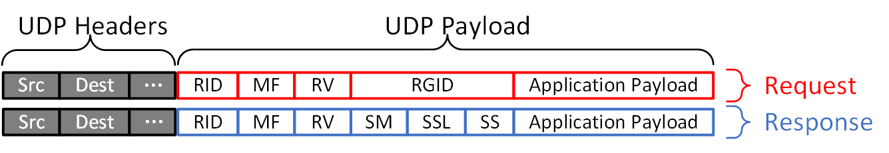
Collect Algorithm Inputs
Retaining Value
Retaining Value
A value set by the RSNode for a request.
The response and its request get the same retaining value.
Potential usage (collect request-level data)
Timestamp of request sending as RV.
Request ID as RV.

Slide 31
Outline
Background
Replica Selection Challenges
The Design of NetRS
Evaluation
Conclusion

Slide 32
Evaluation
Simulation-based experiments
Use the simulator from C3^{[2]} with our extension on network devices.
Simulation setup (default)
Network topology : 16-ary fat tree
Client/Server number : 500/100
Service time distribution : bimodal distribution
Server Concurrency : 4
Replication factor : 3
[2] L. Suresh, et al., “C3:Cutting Tail Latency in Cloud Data Stores via Adaptive Replica Selection,” in USENIX NSDI, 2015.

Slide 33
Evaluation
Workload
Open-loop, Poisson arrival, Zipfian distribution (0.99).
6 million requests, 100 million keys, 200 workload generators.
Varied factors
Number of clients
Demand skewness of clients
Utilization of system
Service time of servers

Slide 34
Comparing Schemes
CliRS (ClientRS)
Clients work as RSNodes
CliRS-R95 (ClientRS with Redundancy)
Clients work as RSNodes + Redundant requests
NetRS-ToR
Network-based RSNodes + ToR-based placement
NetRS-ILP
Network-based RSNodes + ILP-based placement

Slide 35
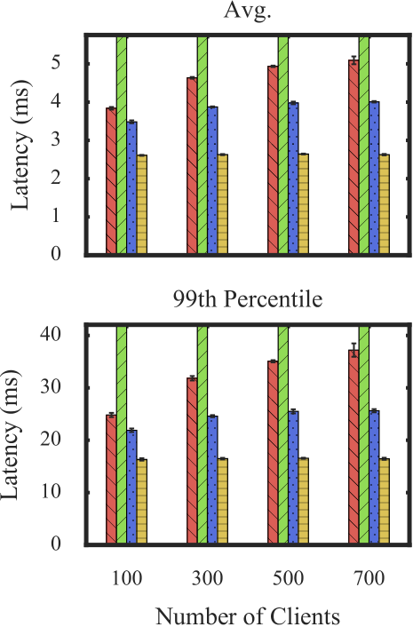
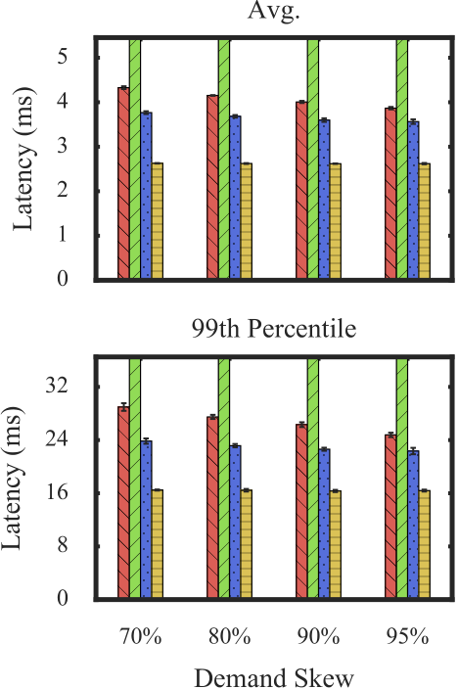
Mean & Tail Response Latency
Lower
is
Better

Slide 36
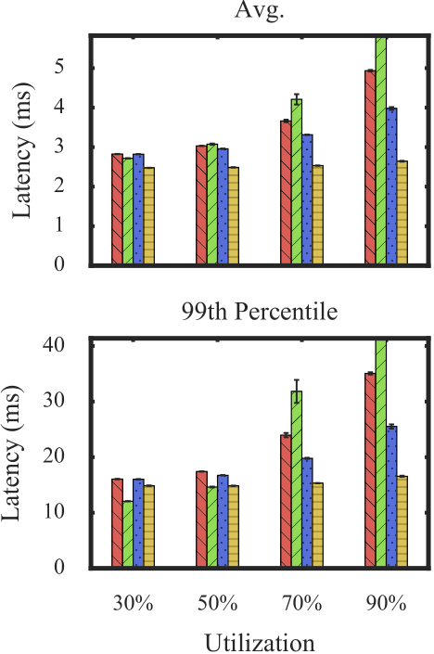
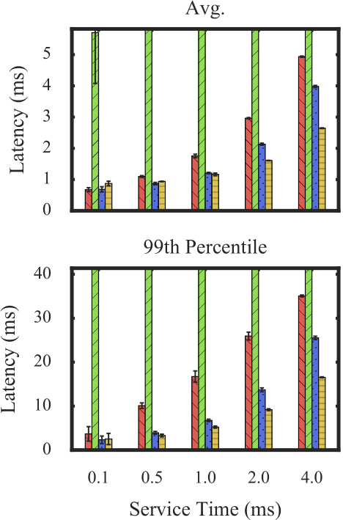
Mean & Tail Response Latency
Lower
is
Better

Slide 37
Conclusion
NetRS enables in-network replica selection using programmable network devices.
NetRS improves the replica selection in distributed key-value stores.
Makes RSNodes more accurately estimate server status.
Reduces the occurrence of “Herd Behavior”.
NetRS effectively cuts mean and tail response latency.

Slide 38
Thank You!

