Slide 1

Predicting Response Latency Percentiles for Cloud Object Storage Systems
Yi Su, Dan Feng, Yu Hua, Zhan Shi
Huazhong University of Science and Technology
ICPP 2017 – Bristol, UK
Notes:
Good morning everyone, today I will introduce you a queueing-theory based performance model for cloud object storage systems. Different from models that predict average performance metrics, our model concentrates on predicting the percentile of requests meeting a response latency requirement.

Slide 2





The Cloud Object Storage System
A fundamental service for modern web-based applications
  Serves millions of users
    Response latency sensitive
  Stores millions or billions of data objects
    TCO (Total Cost of Ownership) sensitive
Famous cloud object storage systems
  AWS S3, Azure Blob Storage, OpenStack Swift, etc.
  Facebook Haystack, LinkedIn Ambry, etc.
Notes:
The Cloud object storage system plays an important role in modern web-based applications. In addition to public cloud providers, like Amazon and Microsoft, industrials also build and maintain their own cloud object storage systems. As one of the fundamental cloud services, the cloud object storage system generally stores and retrieves millions or even billions of diverse data objects, including photos, audios, videos, documents, and so on. Moreover, the cloud object storage system may directly serve millions of Internet users. Considered the large volume of data and latency sensitive users, the main concerns of the cloud object storage system are to reduce the total cost of ownership and to cut the response latency.

Slide 3
Motivation
Use scenarios of a performance model:
  Capacity Planning
  Overload Control
  Elastic Storage
Latency percentiles vs. Average performance metrics
Analytic-based model vs. Simulation-based model
Notes:
Due to the lack of suitable understanding on the latency distribution, current practice is to use overprovision resources to meet Service Level Agreement (SLA) on response latency. Hence we build a performance model for the cloud object storage system to predict the percentile of requests meeting a SLA. There are plenty of use scenarios of such a performance model, for example, capacity planning, overload control, and elastic storage.
With the ability to predict latency percentiles, our model is able to handle the SLAs, like, 99 percent of requests should be responded in at most 100 milliseconds. Such SLAs are common because, in the context of cloud object storage systems, even one percent of traffic corresponds to a significant volume of user requests.
Compared with simulation-based models, our model is more robust to the changes of workloads and system configurations.

Slide 4
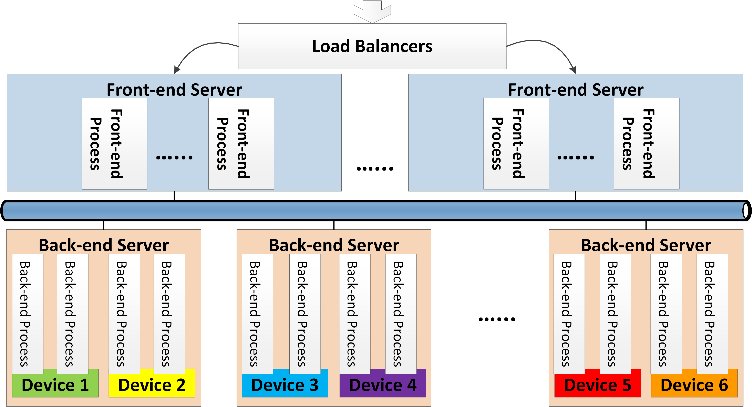
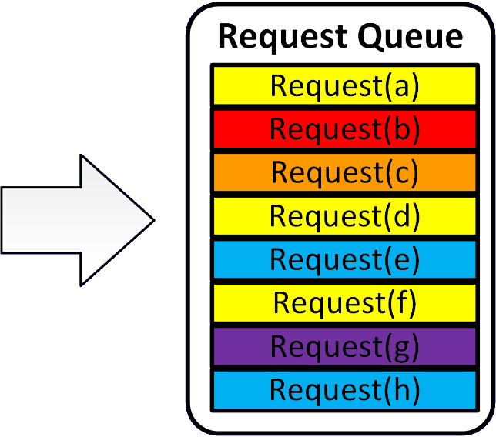
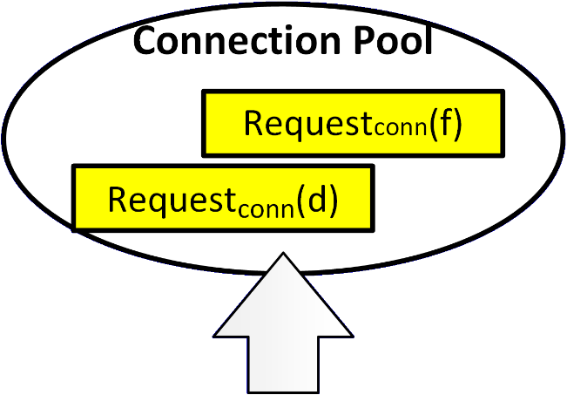
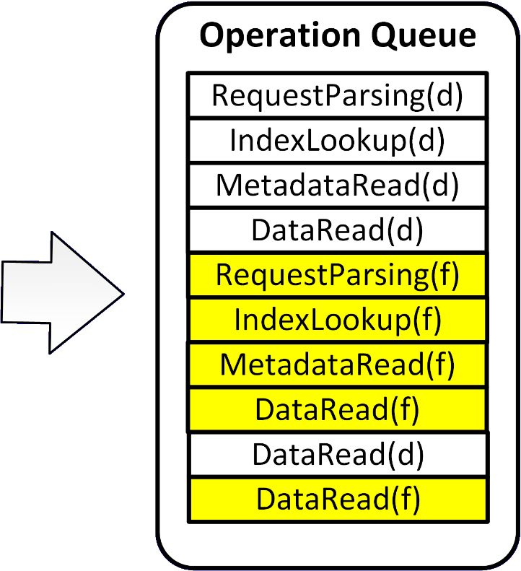
Background
Request(f)
Response(f)
Requestconn(f)
RequestHTTP(f)
Responseconn(f)
ResponseHTTP(f)
Notes:
Now, I will briefly describe the procedure of request processing in the cloud object storage system.
Here we consider a request(f), which requests a data object on device 2. When request(f) arrives, the load balancer assigns it to one of the front-end processes, then the request(f) enters the request queue of the front-end process. When processing request(f), the front-end process first sends a connecting request to the back-end server, where the device 2 is located. However, before one of the back-end process of device 2 accept()-s the connecting request, the connecting request has to wait in the connection pool of the back-end server.
After the front-end process receives the response of the connecting request, it sends a HTTP request to the back-end process, which has accept()-ed the connecting request. When the HTTP request arrives at the back-end process, it turns into multiple operations, and these operations will enter the corresponding operation queue. There are four kinds of operations, including RequestParsing, IndexLookup, MetadataRead, and multiple DataReads. The RequestParsing operation determines the data for serving the request, the IndexLookup operation locates the data on the storage device, the MetadataRead operation gets the attributes of the data object, and the DataRead operation returns a data chunk.
The back-end process performs the operations of different requests in an interleaving manner. As you can see, an operation of request(d) is performed in the middle of performing the operations of request(f). At last, the back-end process sends the response to the front-end process and the front-end process then response to the user.
Since our model assumes read-heavy workloads, we do not consider WRITE and DELETE requests. This assumption of read-heavy workloads is true for many production environments, for example, more than 95 percent of requests are READ requests in cloud object storage systems of Facebook, Linkedin, and Wikipedia.

Slide 5
Background
TCO sensitive cloud providers
  Prefer cheap storage device of large capacity (e.g. HDD)
  Prefer not providing “enough” memory for caching
Concurrency model
  Event-driven programming model
  Thread-per-connection
Notes:
In order to reduce the cost, cloud providers prefer to use cheap storage device of large capacity due to the large volume of data. As a result, cloud object storage systems use HDD instead of SSD as the storage device. Furthermore, they even prefer not providing ``enough'' memory for caching. When I say ``enough'' memory, I mean the memory that is able to cache all the index and the metadata. There could be a large volume of the index and the metadata due to the large number of data objects.
The event-driven programming model and thread-per-connection model are the two main concurrency model for the cloud object storage system, and we focus on systems using the event-driven programming model. The event-driven programming model is widely adopted in production systems and is superior to the thread-per-connection model in both throughput and tail latency.

Slide 6
Challenges
Diverse disk operations
  Including IndexLookup, MetadataRead and DataRead
  Different performance characteristics
  Different cache miss ratios
Data chunking with event-driven programming model
  Processing different requests in an interleaving manner
Waiting time for being accept()-ed (WTA)
Notes:
So there are three challenges for modeling the cloud object storage system. First of all, serving a request at back-end servers involves performing multiple diverse operations, including IndexLookup, MetadataRead, and DataRead. The different kind operations have different performance characteristics and different cache miss ratios. Secondly, the back-end process processing the requests in an interleaving manner due to data chunking, which makes it difficult to build the queueing-theory model. Thirdly, we have to know how long connecting requests wait in the connection pool of back-end servers. To the best of our knowledge, there is no quantitative analysis on the waiting time for being accept()-ed.

Slide 7
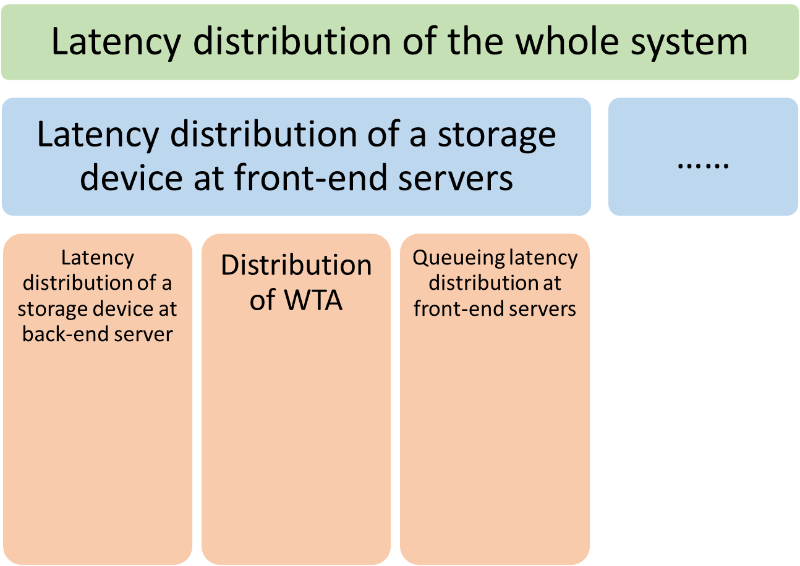
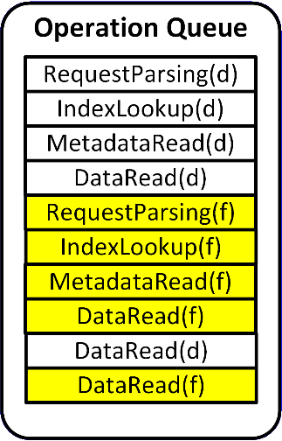
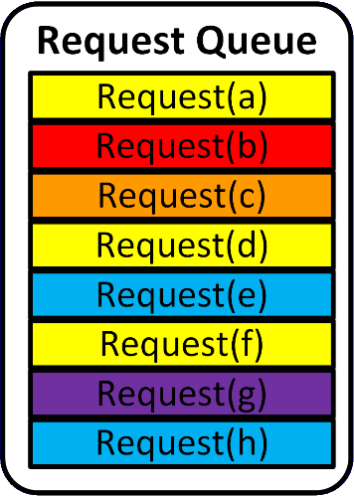
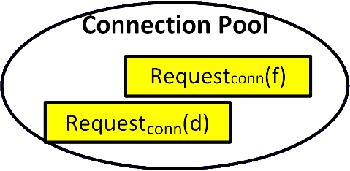
Our Model – overview
Notes:
Here is the structure of our model. We calculate the latency distribution of each storage device separately. For each storage device, its latency at front-end servers has three components: the response latency of the storage device at the back-end server, the waiting time for being accept()-ed, and the queueing latency at front-end servers. We can get the latency distribution of the whole system by combining latency distributions of each storage device.

Slide 8
Our Model – backend
Notes:
Firstly, the latency distribution of a storage device at the back-end server.

Slide 9
The Union Operation
A queueing-theory friendly operation
Abstracting the following aspects:
  queue discipline of event-driven architecture
  caching,
  data chunking,
  diverse operations
Notes:
The core idea is to pack the diverse operations into a queueing-theory friendly operation, and we call it the union operation.

Slide 10
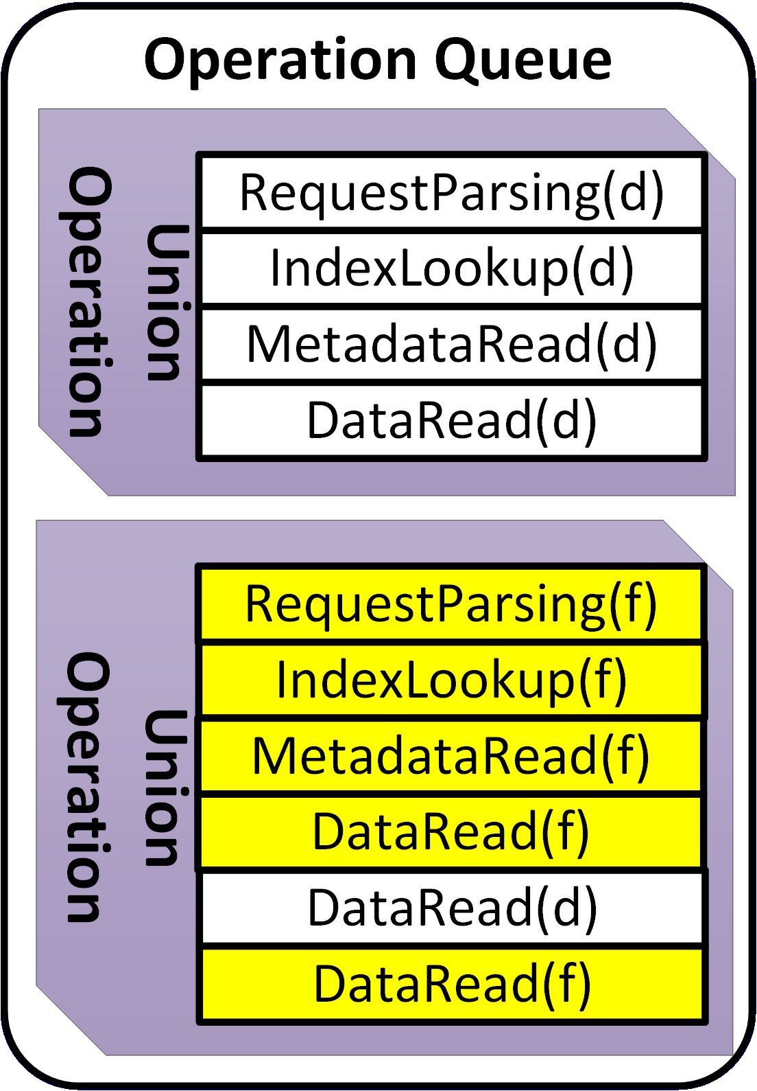
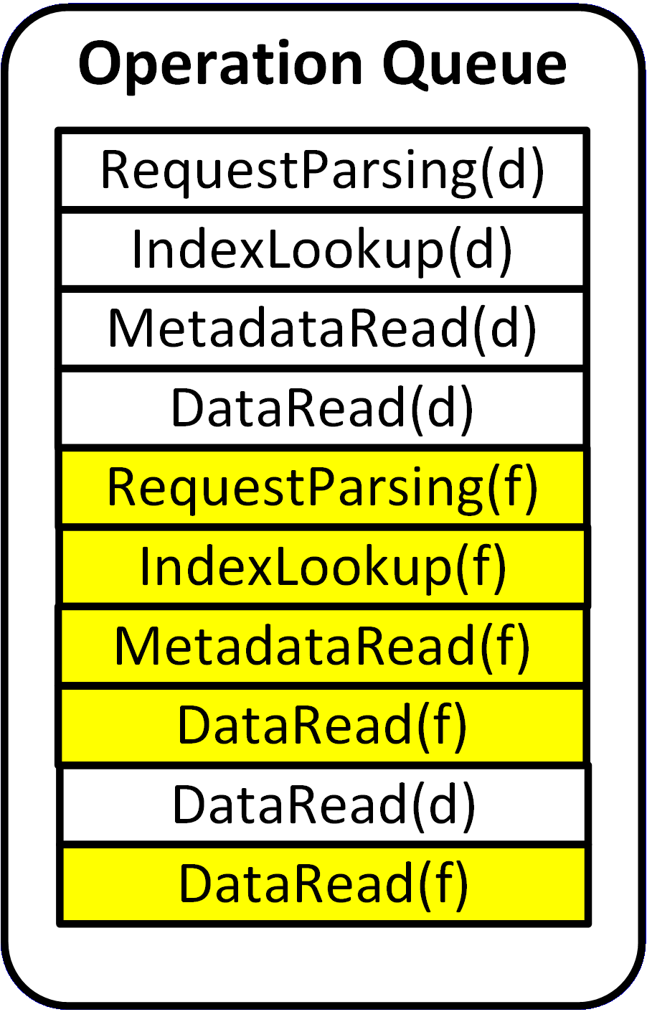
The Union Operation
Pack operations into a union operation
  A RequestParsing operation and its following non-RequestParsing operations
Modeling the union operation queue as an M/G/1 queue
Notes:
This is an example of packing operations into union operations. A union operation starts with a RequestParsing operation and includes its following non-RequestParsing operations.
In this operation queue, the white blocks are the operations from request(d) and the yellow blocks are the operations from request(f). And these operations are packed into two union operations, like this. So we transform the original operation queue into a union operation queue, and we can use the M/G/1 queue to model the union operation queue. You can read the paper to know how to get the service time distribution of a union operation.

Slide 11
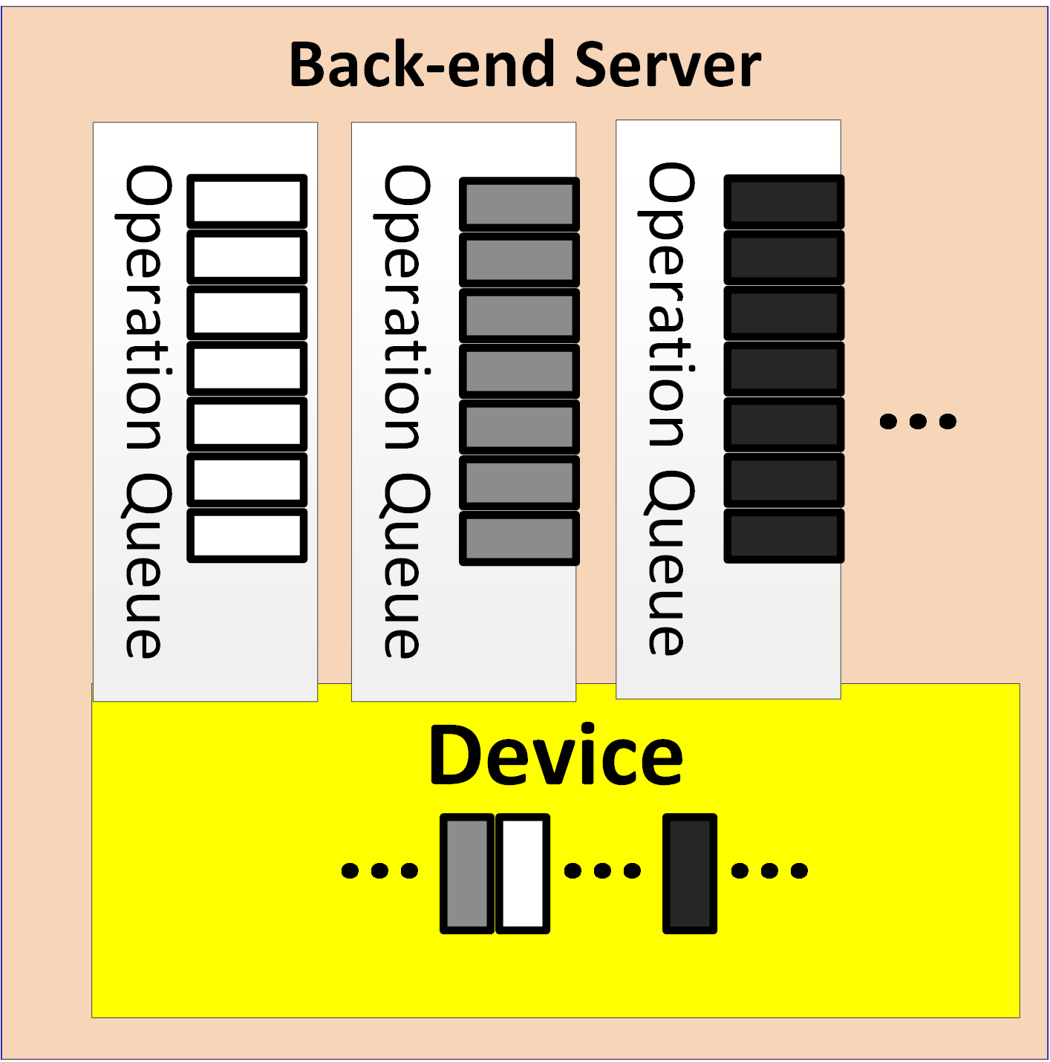
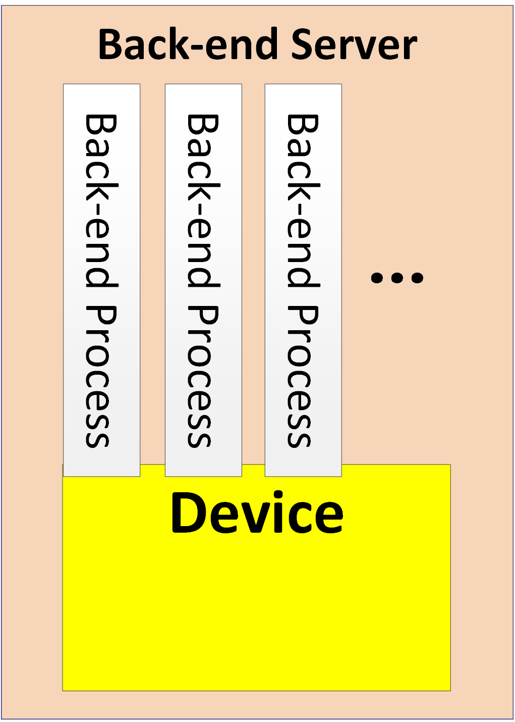
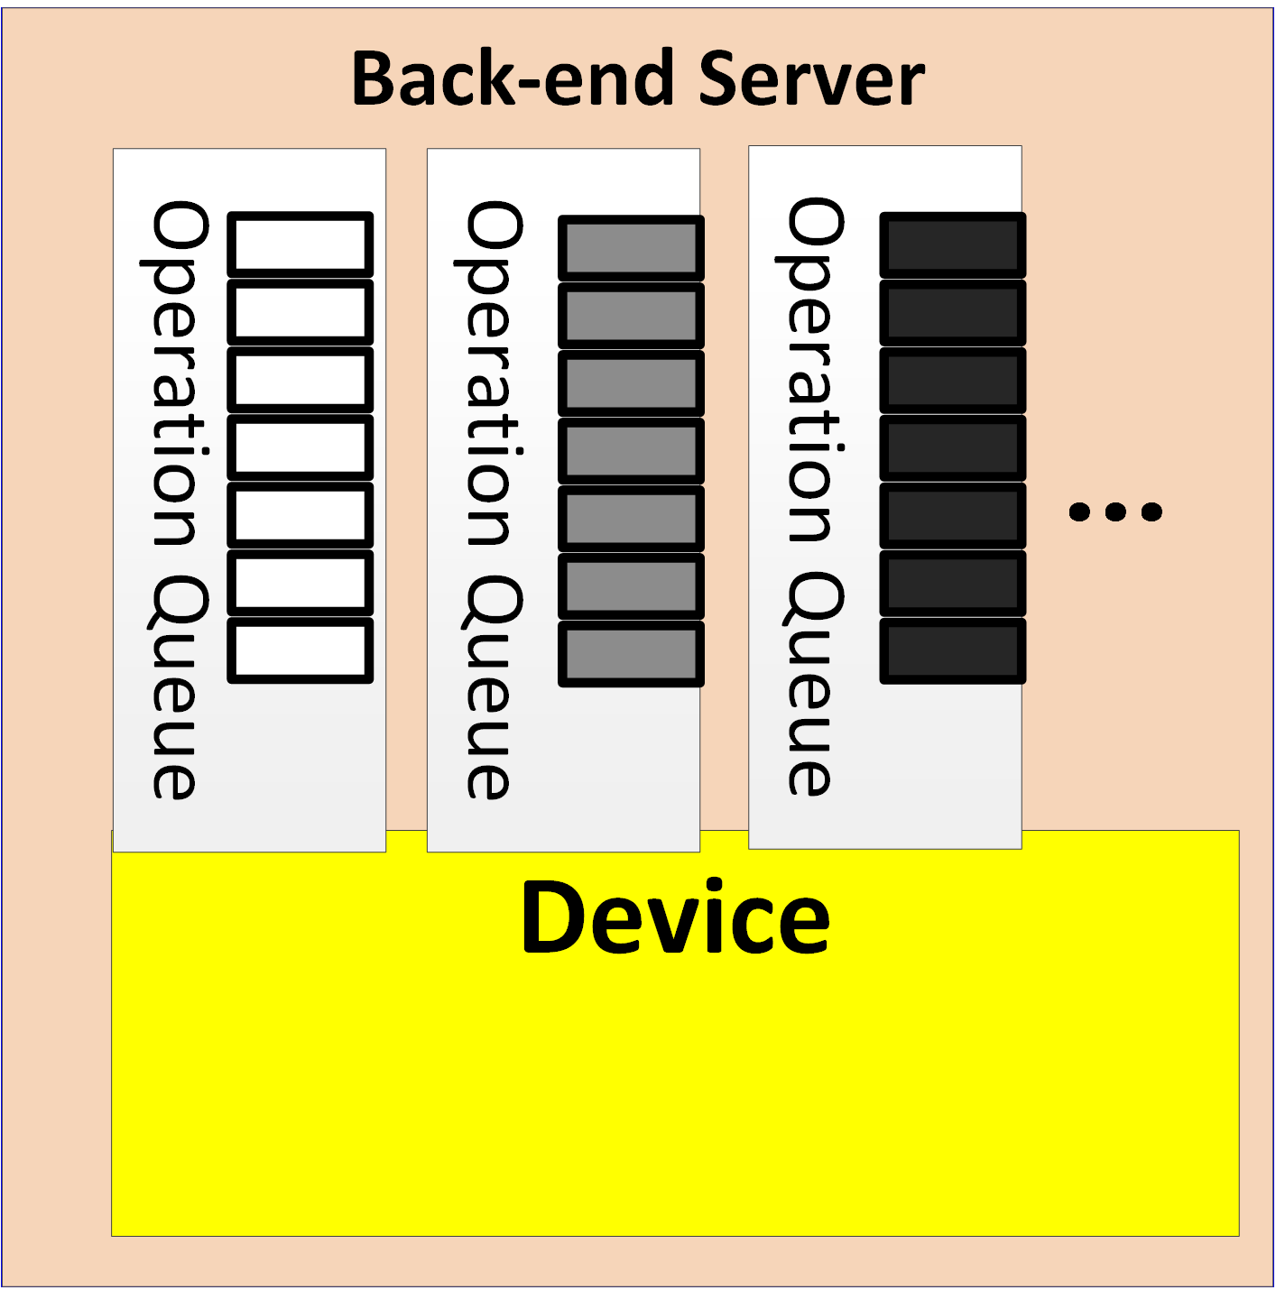
The Union Operation
Multiple identical back-end processes per storage device
  multiple operation queues of mutual influence
Use one queue to approximate multiple queues
  Response latency as “service time” for the device
Notes:
However, things are tricky when there are multiple back-end processes per storage device. The multiple processes mean that there are multiple queues, and the multiple queues may influence each other due to accessing the same device. To solve this problem, we use one queue to approximate the multiple queues and treat the response latency of the device as the ``service time'' of the device. The response latency of the device actually reflects the influence from other back-end processes.

Slide 12
Our Model – backend
Response latency of a storage device at back-end server has two components
  Waiting time in the operation queue of a back-end process
    Be equal to the waiting time of the corresponding union operation
  Request processing time of a back-end process
    The sum of operation service times, including RequestParsing, IndexLookup, MetadataRead and DataRead
Use convolution to combine all latency components
Notes:
As we already have the queueing-theory model of the union operation queue, we can get the waiting time distribution of union operations, which is equal to the waiting time distribution of requests. Then, the response latency distribution of a storage device at the back-end server is the combination of the waiting time distribution of requests and the processing time distribution of requests.

Slide 13
Our Model – WTA
Notes:
Secondly, the waiting time distribution for being accept()-ed.

Slide 14
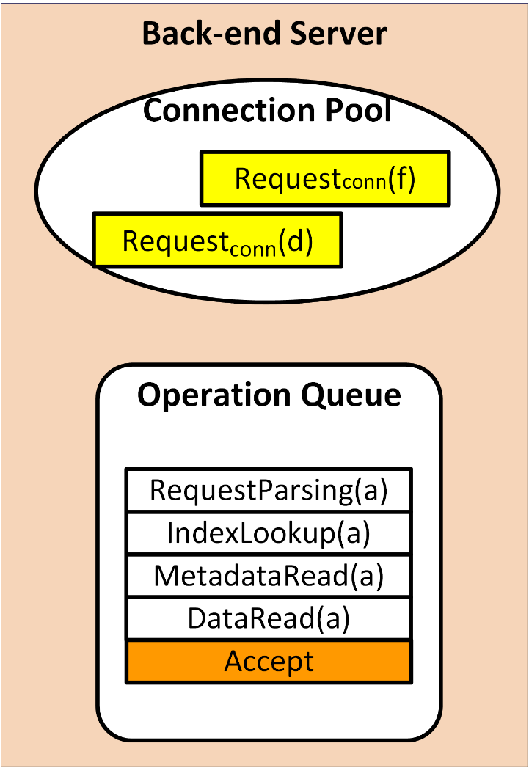
Our Model – WTA
The WTA of a connection request equals to the waiting time of the Accept operation in operation queue.
Use the request waiting time in the operation queue to approximate the WTA.
Notes:
The time of a connecting request waiting in the connection pool depends on the time point that the back-end process performs the accept() operation. With the event-driven programming model, the back-end process schedules the accept() operation as identical as ordinary operations. So we use the wait time distribution of requests, which we have already known, to approximate the waiting time distribution for being accept()-ed.

Slide 15
Our Model – frontend queueing
Notes:
Thirdly, the queueing latency distribution at front-end servers.

Slide 16
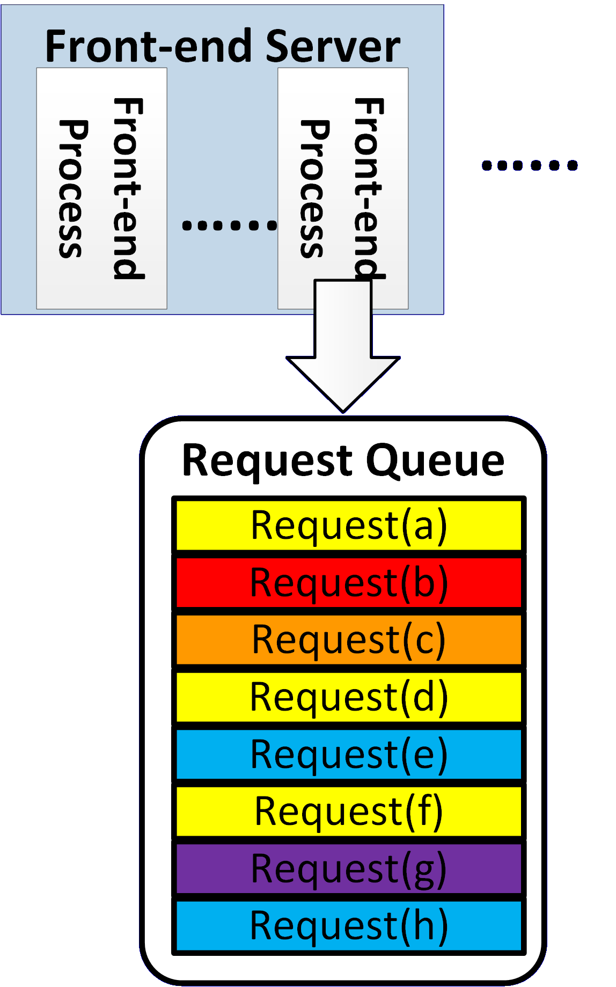
Our Model – frontend queueing
Identical front-end processes
  The overall queueing latency equals to the queueing latency of any single process
Modeling the request queue of a front-end process as an M/G/1 queue
Notes:
We only consider one front-end process because front-end processes are stateless and identical to each other. For the request queue of a front-end process, we can use the M/G/1 queue to model it.

Slide 17
Our Model – frontend
Notes:
Based on the above results, we can get the latency distribution of a storage device at front-end servers by combining the three latency distributions.

Slide 18
Our Model – frontend
Response latency of a storage device at front-end servers has three components:
  Response latency of the storage device at back-end server
  WTA
  Queueing latency at front-end servers
Use convolution to combine all latency components
Notes:
Specifically, the response latency distribution of the storage device at the back-end server, the waiting time distribution for being accept()-ed, and the queueing latency distribution at front-end servers.

Slide 19
Our Model – whole system
Notes:
Finally, we can get the latency distribution of the whole system.

Slide 20
Our Model – whole system
The latency distribution of the whole system is a mixture distribution
  Mixture components
    Latency distribution of each storage device at front-end servers
  Mixture weights
    Workload proportion of each storage device
Notes:
The latency distribution of the whole system is actually a mixture distribution. The mixture components are the latency distributions of each storage device at front-end servers, and for each storage device, the mixture weight is its workloads proportion. So that's all of our model.

Slide 21
Evaluation
Testbed
  A cluster of OpenStack Swift (7 nodes)
Dataset & Trace
  Media files and accesses of Wikipedia (WikiBench)
Response latency requirement (SLA)
  10ms, 50ms, 100ms
Baseline models
  ODOPR
    assuming no more than One Disk Operation Per Request
  noWTA
    assuming no Waiting Time for being Accept()-ed
Notes:
In order to evaluate the accuracy of our model, we run experiments on a 7 nodes cluster of OpenStack Swift. In the experiments, we use the real-world data set from Wikipedia. We compare our model with two baseline models in the context of different SLAs. The ODOPR model is one of the baseline models, which assumes that no more than on disk operation per request. The ODOPR model stands for the models that do not consider the data chunking, IndexLoopup, and MetadataRead. Another baseline model is the noWTA model, which assumes that connecting requests do not need to wait in the connection pool at back-end servers.

Slide 22
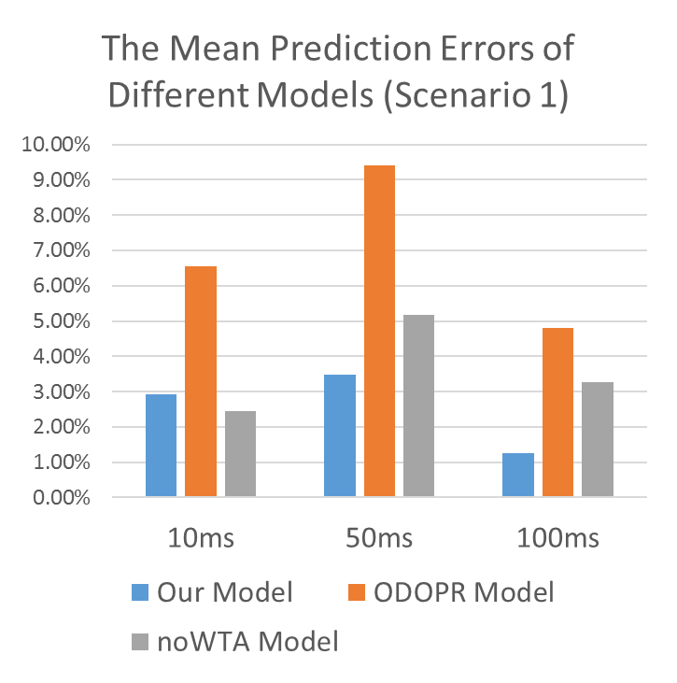
Evaluation
Scenario 1
  1 back-end process per storage device
Workload
  From 10 requests per second to 350 requests per second with the increase of 5
Notes:
Firstly, we evaluate the models when there is 1 back-end process per storage device. This figure shows the average prediction errors of various workloads for different latency requirements. The prediction error is the absolute difference between the predicted and observed percentile of requests meeting the latency requirement. We can see that, our model can reduce the prediction errors in general.

Slide 23
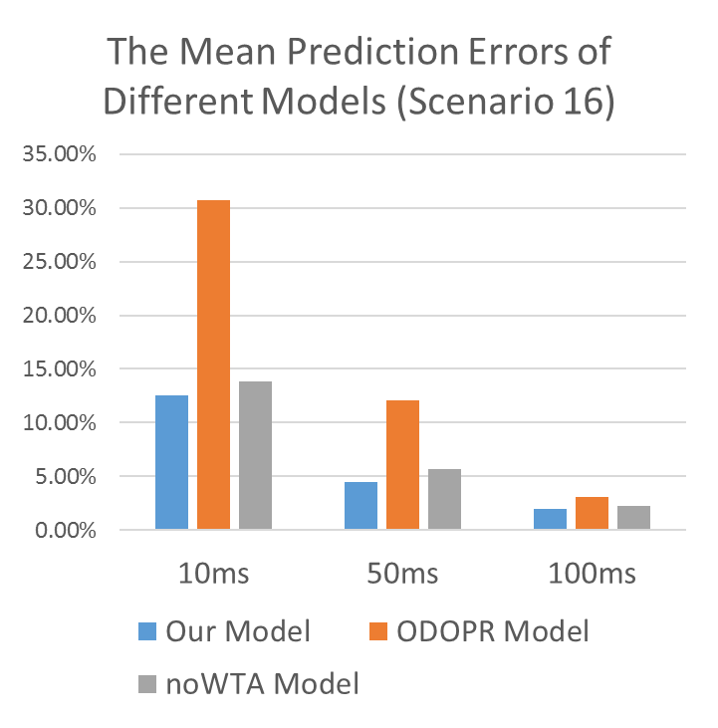
Evaluation
Scenario 16
  16 back-end processes per storage device
Workload
  From 10 requests per second to 600 requests per second with the increase of 5
Notes:
We also evaluate the models when there are 16 back-end processes per storage device. Similarly, we can also see that our model can reduce the prediction errors in this scenario.

Slide 24
Evaluation
Prediction Errors of our model
  Average error: 4.44%
  Worst case error: 16.61%
Compared with ODOPR model
  Reduce average prediction errors by 36% ~ 73% (relative percentage)
Compared with noWTA model
  Reduce average prediction errors by -0.46% ~ 61% (relative percentage)
Notes:
In summary, the prediction error of our model is about 4 percent on average and 16 percent for the worst case.
Compared with the ODOPR model, our model reduces the average prediction errors by up to 73 percent.
Compared with the noWTA model, our model reduces the average prediction errors by up to 61 percent.

Slide 25
Conclusion
Build an analytic-based model that predicts the percentile of requests meeting a latency requirement for the cloud object storage system.
Key contributions
  The abstraction of union operation
  Modeling waiting time for being accept()-ed at back-end servers
Notes:
In conclusion, we build an analytic-based model that predicts the percentile of requests meeting a response latency requirement for cloud object storage systems. And there are two contributions of our model, firstly, we propose the abstraction of union operation, which makes it much easier to build the queueing-theory model for back-end processes. Secondly, we provide a method to predict the waiting time distribution for being accept()-ed, which haven't been considered in existing analytic-based models.

Slide 26
Thank you!
Notes:
That's all, Thank you for listening.

