Slide 1



Exploiting Relevance Feedback in Knowledge Graph Search
Xifeng Yan
University of California at Santa Barbara
with Yu Su, Shengqi Yang, Huan Sun, Mudhakar Srivatsa, Sue Kase, Michelle Vanni
Notes:
Thanks much for the introduction…Good morning, everyone …
Facility:
Impacts (healthcare, intelligent policing, patent, bing search), technical merits (challenges: knowledge base, deep learning) +
Benefit: 1. project 2.
Apple siri: problem failed: one laughable question
1.

Slide 2


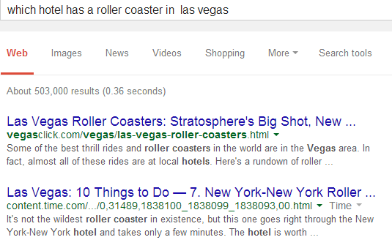


Transformation in Information Search
Desktop search
Mobile search
Hi,
what can I
help you
with?
“Which hotel has a roller coaster in Las Vegas?”
Read Lengthy Documents? Direct Answers Desired!
Answer:
New York-New York hotel
Notes:
The way people search information is currently undergoing a transformation from traditional desktop search, where people type keywords in search engines, to mobile search, where people can directly speak to the smart phones and get the information they want. Such mobile search brings much more convenience to our life. Think about this scenario: In this coming holiday season, suppose you are traveling with your little kids to Las Vegas, little kids suddenly came up with the idea to ride a roller coaster when you are driving. But you need the information about which hotel has a roller coaster and how to go there. In this case, you can turn to your smart phone for help. Instead of typing keywords and reading webpages on the small screen, you can directly speak to the personal assistants such as Siri or google now on the phone, and get the exact answer.

Slide 3


















Strings to Things
Notes:
Since text is the main carrier of knowledge, it is natural to extract knowledge from text. For instance, we can construct an structured knowledge graph from the large volume of text data, where nodes are entities and edges encode relationships among entities. Such formal and structural representation of knowledge has the advantage of being easy to manage and reason with, which can greatly facilitate many AI applications. Despite the big attraction, automatically extracting knowledge from text is quite challenging. For computer system, texts are just strings, or combinations of letters. It has no idea what they really mean. In order to distill knowledge from text, we have to move from strings to things.

Slide 4
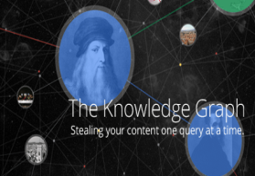







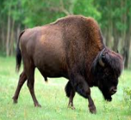







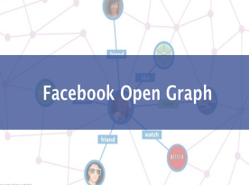
Knowledge Graphs
Yellowstone NP
Univeristy
follow
Business
join
Mammal
watch
Video
follow
music
class
listen
Photo: bison
tagged
Football Team
City
Photo
Country

Slide 5

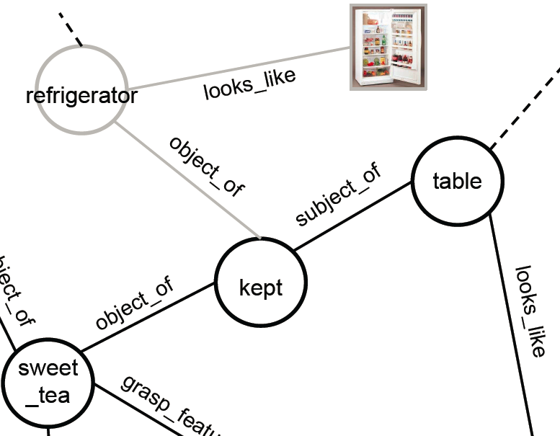


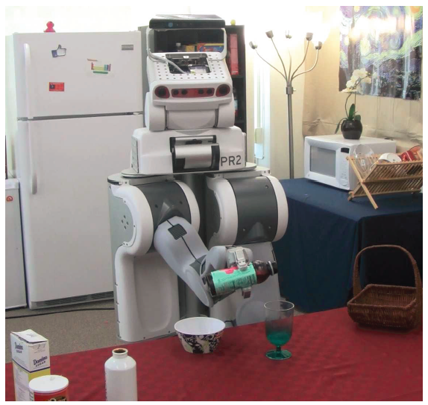

Broad Applications
Customer Service
Healthcare
RoboBrain
[Saxena et al., Cornell & Stanford]
Business Intelligence
Enterprise search
Intelligent Policing
Robotics
Notes:
Query resolution, or more broadly, knowledge dicovery, has a variety of application scenarios and a great prospect. For example, in customer service, specialized agents need to be found to efficiently resolve queries from customers. Similarly important in healthcare and BI domains. By mining massive EHR, scientific reports, etc., a doctor-assistant system can help doctors to find individualized treatment options; in other businesses, decision-support systems can help humans make critical decisions by analyzing massive enterprise data. IBM cognitive systems Watson is one of the pioneering systems in these areas. (IBM Watson for Oncology is doing this with a famous cancer center Memorial Sloan Kettering center…) ; (other decision making such as product positioning, pricing …)
Big companies : IBM watson (health care, travel and insurance services), Gartner, HG data, ca
Query resolution and knowledge discovery assist humans to acquire knowledge and make decisions. In fact, Not only humans need such systems, but also
More interestingly, not only humans could query, but also robots.
Robots need them. Currently researchers in Cornell and Stanford are building a query engine for robots called Robobrain. Given a task, a robot can query robobrain to get the knowledge that
In this way, robots can execute commands in a more active and autonomous manner in the future, by querying the information they need.
So, in this exciting area, what have I been doing ?
effectively mine (cause and treatment) clues for a certain disease and predict the potential outcome of a certain treatment from massive scientific reports / records. Business intelligence, some real example. Last, not only humans have queries to resolve, but also for robots, researchers from Cornell and Stanford.

Slide 6

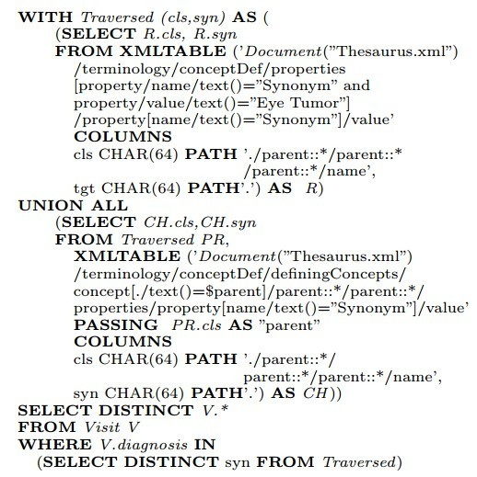

Certainly, You Do Not Want to Write This!
“find all patients diagnosed with eye tumor”
“Semantic queries by example”,
Lipyeow Lim et al., EDBT 2014
Notes:
Another option is to use graph query languages, such as SPARQL queries.
They can specify a result in a very exact way, with strictly defined syntax and grammar.
But they become so complex that it is very difficult for people to learn how to use them.
What I’m showing here is a SPARQL query to search
NCIthesaurus, a network of medicine terminologies. To accurately find patients with eye tumor,
a doctor has to write such a query specifying that eye tumor is actually related to
A set of disease via a relationship named ‘synonym.
Can you see the problem here? How can we assumes that a user already know what a data graph looks like or
what the answer exactly looks like when he tries to look for it? Unfortunately this dilemma seems to be ignored by most graph query languages!

Slide 7
Search Knowledge Graphs
Structured search: Exact schema item + structure
Precise and expressive
Information overload: too complex schema
Keyword search: Free keywords, no structure
User-friendly
Low expressiveness

Slide 8


Graph Query
Geoffrey Hinton
(1947-)
Prof., 70 yrs.
Find professors at age of 70, who works at Toronto and joined Google recently.
Toronto
Google
Univ. of Toronto
DNNResearch
Google
Natural language query
Graph query
A result (match)

Slide 9
Schema-less Graph Querying (SLQ, VLDB 2014)
Users freely post queries, without any knowledge on data graphs.
SLQ finds results through a set of transformations.
Query
A Match
Prof., ~70 yrs
Geoffrey Hinton (Professor, 1947)
University of Toronto
DNNresearch
UT
Google
Google
Acronym transformation: ‘UT’ ←→ ‘University of Toronto’
Abbreviation transformation: ‘Prof.’ ←→‘Professor’
Numeric transformation: ‘~70’ ←→ ‘1947’
Structural transformation: an edge ←→ a path
9
Notes:
Our recent work on schema-less graph querying (SLQ for short) aims at alleviating such challenges. Under our proposed querying framework, The application scenario is that users can freely post queries, without possessing any knowledge of the underlying data. The methodology for our querying framework is to find the matches of a user query based on a set of transformations. Given a query, by the following transformations, we can find a match in the knowledge graph to this query.

Slide 10
Evaluate a Candidate Match: Ranking Function
Query:
Candidate Match:
Geoffrey Hinton (Professor, 1947)
Prof., ~70 yrs
?
University of Toronto
DNNresearch
UT
Google
Google
Features
Node matching features:
Edge matching features:
Matching Score
10
Notes:
Under the set of transformations, there could be many matches for a given query. Which transformations are more important or can induce more relevant matches? We do not know at the very beginning. We learn the weights or importance of different transformations by designing a ranking function and rank relevant matches as high as possible. In our work, we resort to a well-studied conditional random fields (CRFs) model to model graph querying. Conditional random fields model is not the only choice here. We select it because it fits our problem setting and is well studied in terms of parameter learning and inference. In our formulation, finding a good match to a user’s query, is treated as finding the most likely configuration of latent variables in CRFs, given the observed variables. Given a graph query Q and one possible match phi(Q) from the knowledge graph, we evaluate the relevance of phi(Q) , based on the conditional probability formulated under the CRFs framework. Based on the training set where we have the relevant and irrelevant matches, we can learn the parameters in the model.

Slide 11
Query-specific Ranking via Relevance Feedback
Generic ranking: sub-optimal for specific queries
By “Washington”, user A means Washington D.C., while user B might mean University of Washington
Query-specific ranking: tailored for each query
But need additional query-specific information for further disambiguation
Where to get? From users!
Relevance Feedback:
Users indicate the (ir)relevance of a handful of answers

Slide 12
Problem Definition
Graph Relevance Feedback (GRF):
Generate a query-specific ranking function for based on and

Slide 13
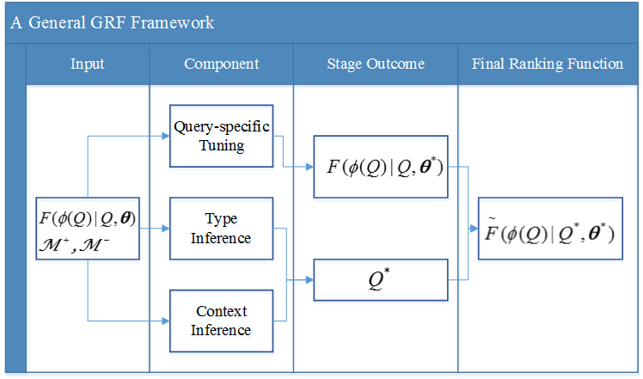

Slide 14
Query-specific Tuning
The represents (query-independent) feature weights. However, each query carries its own view of feature importance
Find query-specific that better aligned with the query using user feedback
User Feedback
Regularization

Slide 15
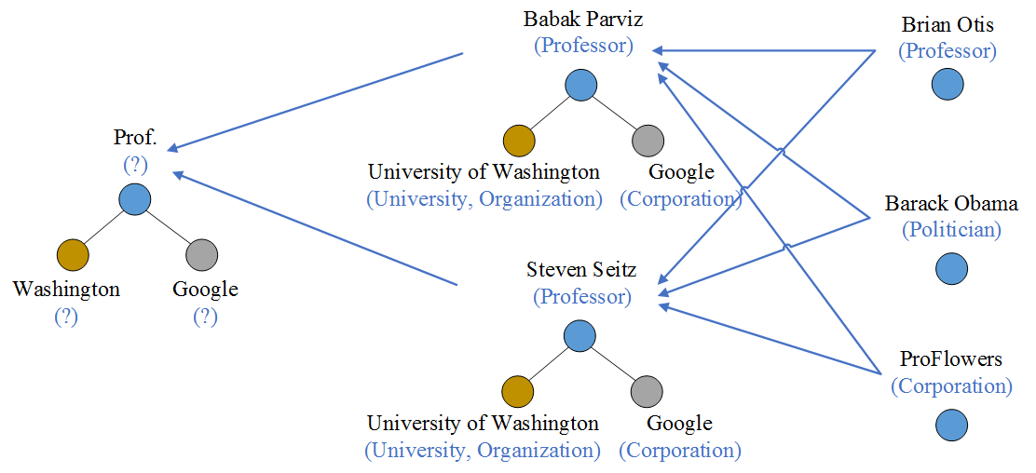
Type Inference
Infer the implicit type of each query node
The types of the positive entities constitute a composite type for each query node
Query
Positive Feedback
Candidate
Nodes

Slide 16
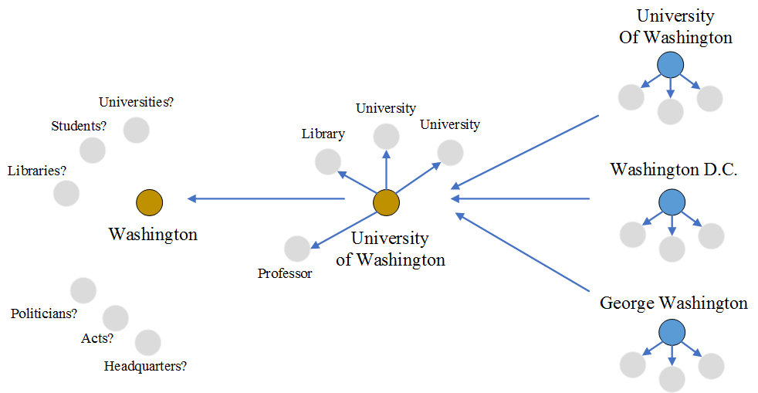
Context Inference
Entity context: neighborhood of the entity
The contexts of the positive entities constitute a composite context for each query node
Query
Positive Entities
Candidates

Slide 17
The Next Action with the New Ranking Function
 | Re-searching | Re-ranking
How | Search the data graph again | Re-rank the initial answer list
Pros | Find new relevant answers, probably higher accuracy | Save time
Cons | Time-consuming | May lose some good answers
It’s a query-dependent decision
Many underlying factors may affect this decision
Lead to a trade-off between answer quality and runtime

Slide 18
A Predictive Solution
Build a binary classifier to predict the optimal action for each query
Key: Training set construction
Feature extraction
Query, match and feedback features
Convert each query into a 18-dimensional feature vector
Label assignment
Assign a label to each query in the training set
specifies the preference between answer quality and runtime.

Slide 19
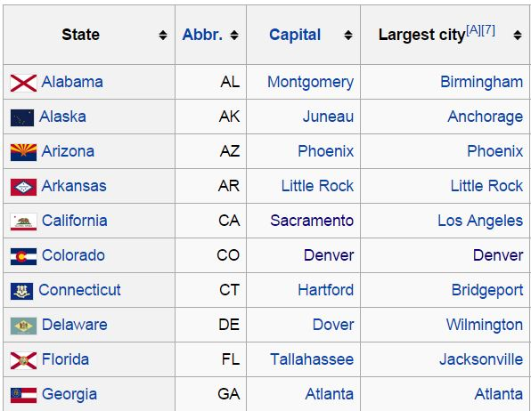



Experiment Setup
Base graph query engine: SLQ (Yang et at., 2014)
Knowledge graph: DBpedia (4.6M nodes, 100M edges)
Graph query sets: WIKI (50) and YAGO (100)
WIKI
Wikipedia List Page
Graph Query
Structured
Information need
Links between
Wikipedia and DBpedia
Ground Truth
… …

Slide 20
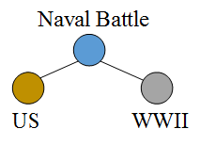
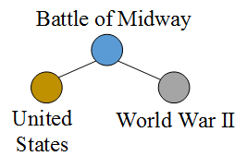
Experiment Setup
Base graph query engine: SLQ (Yang et at., 2014)
Knowledge graph: DBpedia (4.6M nodes, 100M edges)
Graph query sets: WIKI (50) and YAGO (100)
YAGO
YAGO Class
Graph Query
Naval Battles of World War II Involving the United States
Structured
Information need
Links between
YAGO and DBpedia
Instances
Ground Truth
Battle of Midway
Battle of the Caribbean
… …
… …

Slide 21
Overall Performance
(a) WIKI
(b) YAGO
Exp 1. Overall performance of different GRF variants

Slide 22
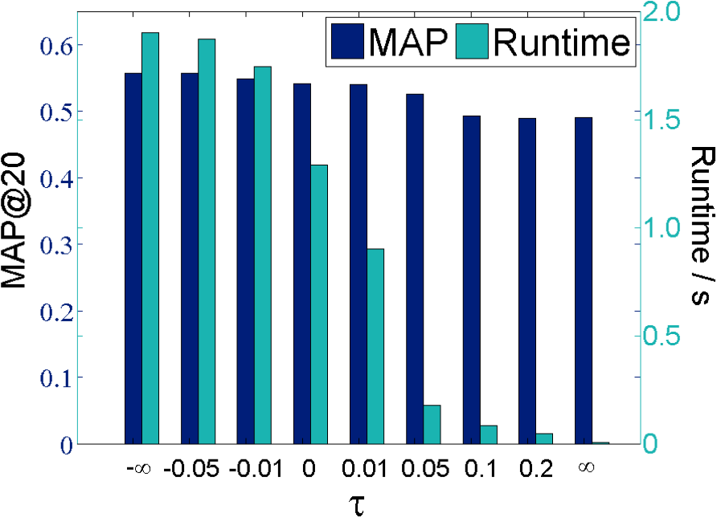
Answer Quality vs. Runtime
Exp 3. Tradeoff between answer quality and runtime

Slide 23


