Slide 1


A Fast Kernel for Attributed Graphs
Yu Su
University of California at Santa Barbara
with Fangqiu Han, Richard E. Harang, and Xifeng Yan
Notes:
Good morning everyone. I’m Yu Su from UCSB. Today I’m going to introduce our work, a fast kernel for attributed graphs. It’s a joint work with Fangqiu Han, Richard Harang, and my advisor Xifeng Yan.

Slide 2
Introduction

Slide 3
Graph Kernel
A graph kernel defines a similarity measure over graphs
— a core problem in graph mining
Inner product in some (latent) feature space
Decouple data representation from learning machine
Once a graph kernel is supplied, a whole toolbox of kernel machines become readily applicable
SVM, Kernel PCA, Support Vector Regression, Clustering, etc.
A good graph kernel is thus the key
Notes:
first, what is graph kernel. A graph kernel is basically a similarity measure over graphs In order to be a valid kernel, it needs to correspond to an inner product in some feature space.
A unique advantage of graph kernels is that they can decouple data representation from learning machine. In other words, once we apply a graph kernel on our graphs, a whole bunch of kernel machines will become applicable, even though they are not originally designed for graph data. So we are free to use SVM for classification, kernel PCA for feature selction, etc. Therefore, the key is to design a good graph kernel

Slide 4
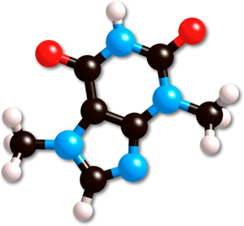
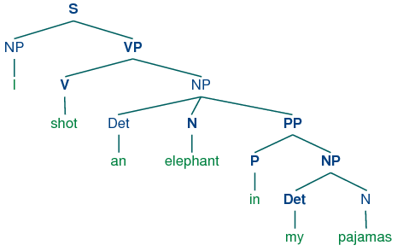
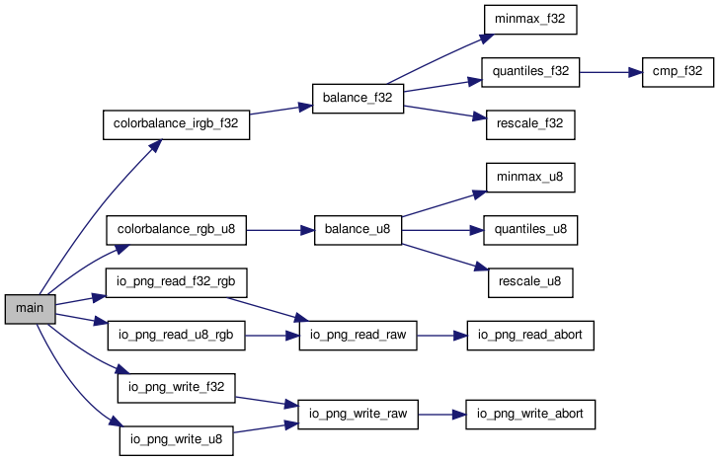
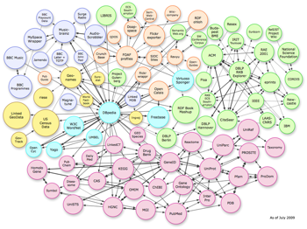
Broad Applications
Chemo- & Bioinformatics
Natural Language Processing
Software Engineering
Semantic web
Notes:
Graph kernels have been widely used in many domains. For example, in chemo and bioinformatics, people represent chemical compounds and proteins as graphs, and use graph kernel to predict the function of them. In natural language processing, it is a common practice to represent the syntactic and semantic structure of a sentence as trees. and graph kernels have been applied to a lot of NLP tasks, like machine translation, paraphrase detection, sentiment analysis, etc. In software engineering, graph kernels can be used on the function call graphs of softwares to predict whether a software is a malware. And finally, in semantic web, graph kernels have been used on tasks like link prediction.

Slide 5
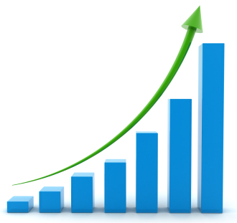
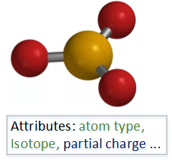
Trends and Challenges in the Big Data Era
Increasing graph size
More efficient methods
More versatile methods
Richer graph attributes
This work: A linear-time kernel that can handle both categorical and numerical attributes.
Notes:
We are living in the big data era, so we are facing new challenges. On the one hand, the size of graphs is increasing, so we need more efficient methods. On the other hand, richer attributes on graphs are becoming available. For example, on chemical compounds, we have categorical attributes like atom type, and also numerical attributes like the partial charge of atoms. So we need more versatile methods to handle graphs with such rich attributes. In this work, we propose a linear-time kernel that can handle both categorical and numerical attributes. Here linear-time means the computation time of the kernel is linear with respect to graph size, which is the number of nodes and edges in the graph.

Slide 6
Graph Kernel as a Measure of Graph Similarity
Decompose each graph into a (multi-)set of features
Subgraphs (Gartner et al. 2003, NP-hard!)
Random walks (Gartner et al. 2003, Kashima et al. 2003)
Subtrees (Shervashidze and Borgwardt 2009)
Vectors (Neumann et al. 2016)
Notes:
Let’s start with how a graph kernel works as a measure of graph similarity. A graph kernel usually has two steps. In the first step, it decomposes a graph into a set of features. Different kernels use different features, and the cost of finding those features are different. We could use all possible subgraphs as features. So we enumerate all of the subgraphs of each graph. But unfortunately this is very expensive. It’s an NP-hard problem. So people have tried to use other features that are easier to compute. For example, randome walks, subtrees, and vectors.

Slide 7
Graph Kernel as a Measure of Graph Similarity
Decompose each graph into a (multi-)set of features
Subgraphs (Gartner et al. 2003, NP-hard!)
Random walks (Gartner et al. 2003, Kashima et al. 2003)
Subtrees (Shervashidze and Borgwardt 2009)
Vectors (Neumann et al. 2016)
Notes:
In this work, we will use vectors. As we will show later, vector features can be computed in linear-time, and can easily handle both categorical and numerical attributes.

Slide 8
Graph Kernel as a Measure of Graph Similarity
Decompose each graph into a (multi-)set of features
Subgraphs (Gartner et al. 2003, NP-hard!)
Random walks (Gartner et al. 2003, Kashima et al. 2003)
Subtrees (Shervashidze and Borgwardt 2009)
Vectors (Neumann et al. 2016)
Compare feature sets
Pair-wise comparison (quadratic)
Notes:
In the second step, we need to compare the feature sets to get a similarity value. One straightforward way is to do pair-wise comparison, so we compare every possible pair from these two sets. It’s computation time is apparently quadratic.

Slide 9
Graph Kernel as a Measure of Graph Similarity
Decompose each graph into a (multi-)set of features
Subgraphs (Gartner et al. 2003, NP-hard!)
Random walks (Gartner et al. 2003, Kashima et al. 2003)
Subtrees (Shervashidze and Borgwardt 2009)
Vectors (Neumann et al. 2016)
Compare feature sets
Pair-wise comparison (quadratic)
Inner product (linear; only when features are discrete)
Notes:
We can also use inner product. So we represent each feature set as a vector, can then compute their inner product. But we can only do this when the features are discrete, so that we can determine the dimensions of the feature vector.

Slide 10
Graph Kernel as a Measure of Graph Similarity
Decompose each graph into a (multi-)set of features
Subgraphs (Gartner et al. 2003, NP-hard!)
Random walks (Gartner et al. 2003, Kashima et al. 2003)
Subtrees (Shervashidze and Borgwardt 2009)
Vectors (Neumann et al. 2016)
Compare feature sets
Pair-wise comparison (quadratic)
Inner product (linear; only when features are discrete)
Discretization (linear; can handle numerical attributes)
Notes:
Finally, we can also use discretization techniques. As we will show soon, discretization can be done in linear-time, and make it possible to handle numerical attributes.

Slide 11
Graph Kernel as a Measure of Graph Similarity
Decompose each graph into a (multi-)set of features
Subgraphs (Gartner et al. 2003, NP-hard!)
Random walks (Gartner et al. 2003, Kashima et al. 2003)
Subtrees (Shervashidze and Borgwardt 2009)
Vectors (Neumann et al. 2016)
Compare feature sets
Pair-wise comparison (quadratic)
Inner product (linear; only when features are discrete)
Discretization (linear; can handle numerical attributes)
vector features + discretization
Notes:
So in this work, we will present a very simple method, which uses the combination of vector features and discretization. Although the idea is very simple, we will show that it can achieve surprisingly good performance, in both efficency and accuracy.

Slide 12
Method

Slide 13
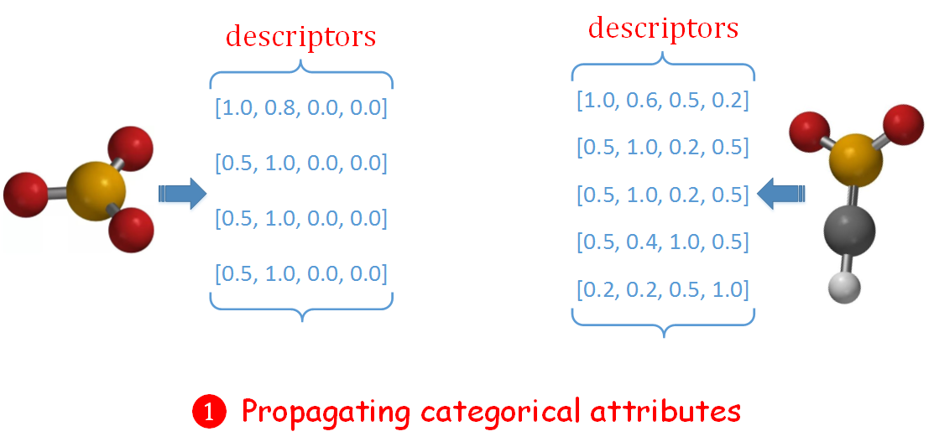
Descriptor Matching (DM) Kernel: An Overview
Notes:
Here is an overview of our method, which we call as the descriptor matching kernel. Supppose we have two chemical compounds. We first generate a vector on each node, which we call as descriptor. So this is the descriptor of this central node.The dimansionality of the descriptors is equal to the number of categorical attributes. For example, here we have four different types of atoms, one, two three, four, so the dimensionality will be four. Each dimension corresponds to a categorical attribute, and the value indicates the strength of association between a node and an attribute. If there are more nodes carrying this attribute in the neighborhood of a node, the association will be stronger. For example, here the first dimension corresponds to the attribute on this node, so it will be 1. The second dimension corresponds to the attribute of these three nodes. Although this central node doesn’t have this attribute, many neighbors of it have, so still the value is large. We will obtain these descriptors by propagating categorical attributes. So these neighboring nodes will exchange their attribute information with the central node. The descriptors can be generated in linear time.

Slide 14
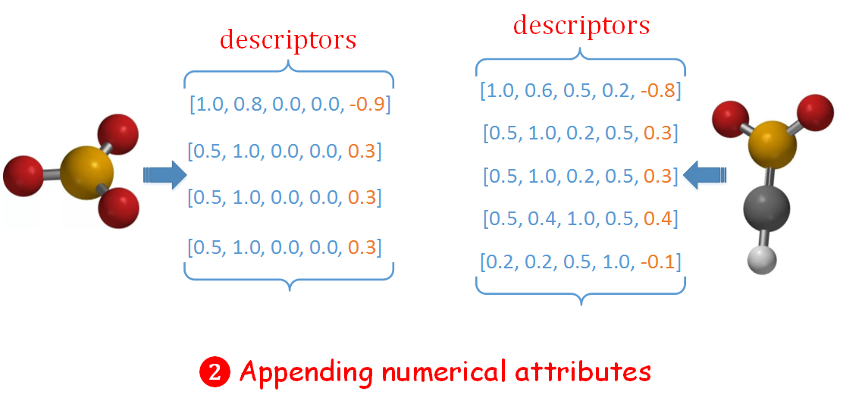
Descriptor Matching (DM) Kernel: An Overview
Notes:
Next, if there are numerical attributes on nodes, we will directly append them to the corresponding descriptors. This is only possible because we choose vectors as features. As you can imagine, if the features are some discrete structures like subtrees, it’s impossible to do this.

Slide 15
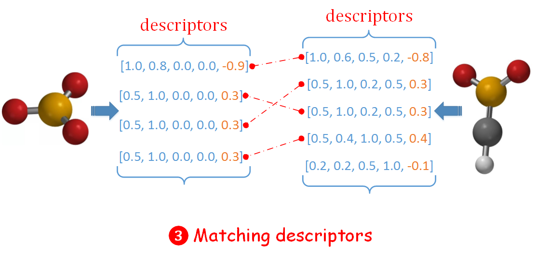
Descriptor Matching (DM) Kernel: An Overview
Notes:
Finally, we match the descriptors to get the similarity of these two graphs. The matching can also be done in linear time.

Slide 16
Desired Descriptor Property: Preserve Similarity
Similar nodes should have similar descriptors
So it becomes meaningful to compare graph similarity by matching their descriptors
Nodes are more similar if their attributes and neighbors are more similar
Recursive definition of similarity makes it natural to generate descriptors in a recursive manner
Notes:
Next we will introduce how we generate descriptors. Before that, let’s discuss what properties these descriptors should have. So the most important property is that similar nodes should have similar descriptors. So there are two nodes in two different graphs, we can compute their similarity by comparing their descriptors. Next, we follow a recursive definition of node similarity. Two nodes are more similar if their attributes and neighbors are more similar. So it’s natural to generate descriptors in a recursive manner, where nodes exchange attribute information with their neighbors.

Slide 17
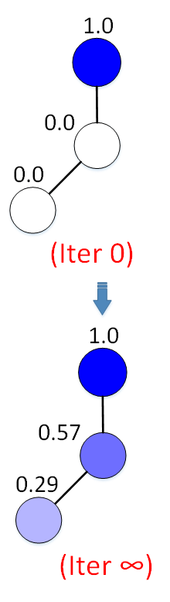
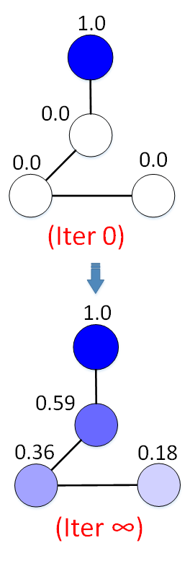
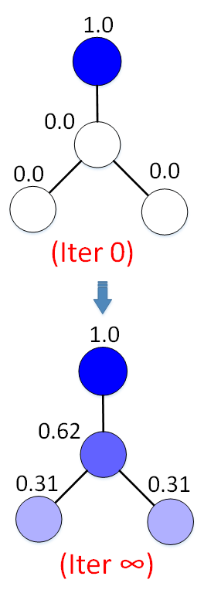
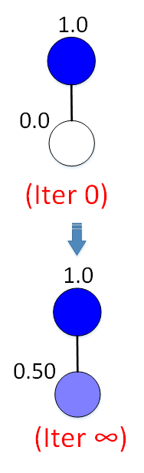
Desired Descriptor Property: Highly Discriminative
Notes:
As we said, we want descriptors to capture neighborhood information, so they need to be sensitive to neighborhood structure. If the neighborhood structure of a node is different, the descriptor should be different. For example, here we have two nodes and one attribute, at first only this node has this attribute, so it’s one here and 0 here. Then this information is propagated to this node, and in the end this node will have 0.5. If we change the structure a little bit, we add one node here. So the neighborhood structure of this node changed. Then we hope the descriptors will capture such change. Since there are more nodes in the neighborhood now, the value on this node should increase a little bit. Similarly, if we add one more node here, the value on this node should further increase.

Slide 18
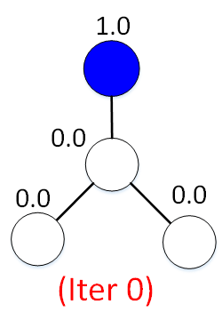
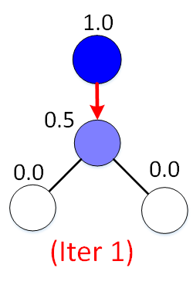
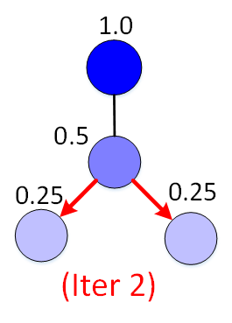

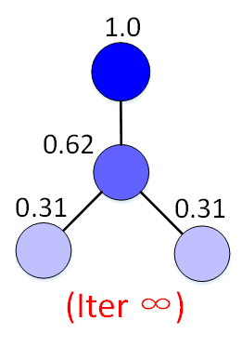
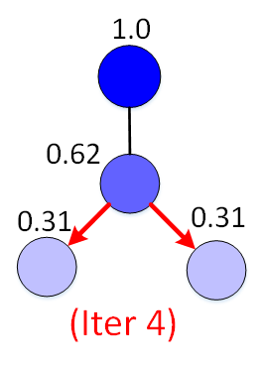
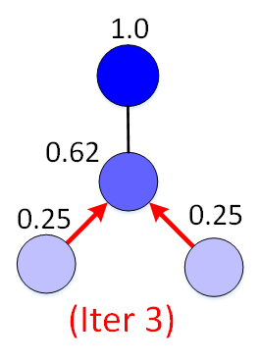

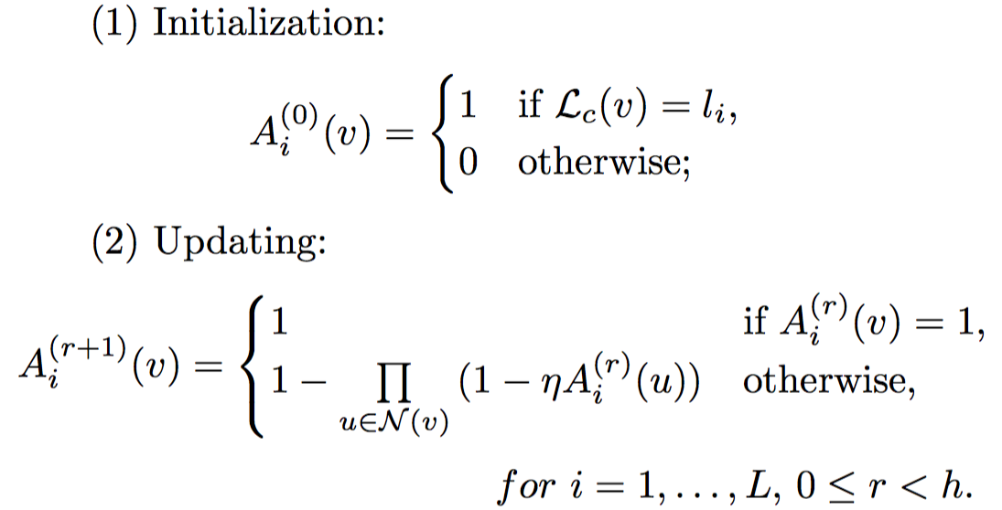
Descriptor Generation via Propagation
Notes:
Here is our propagation algorithm. Suppose at first only one node has this attribute. Then it propagates this attribute to this central node, with a decay of 0.5. Next this central node propagates to its neighbors, again with a decay of 0.5. In the next iteration, since there are more neighboring nodes carrying this attribute now, the value on the central node will further increase. So as you can see, these nodes will exchange information and sort of reinforce each other, and finally reach a stable state.

Slide 19
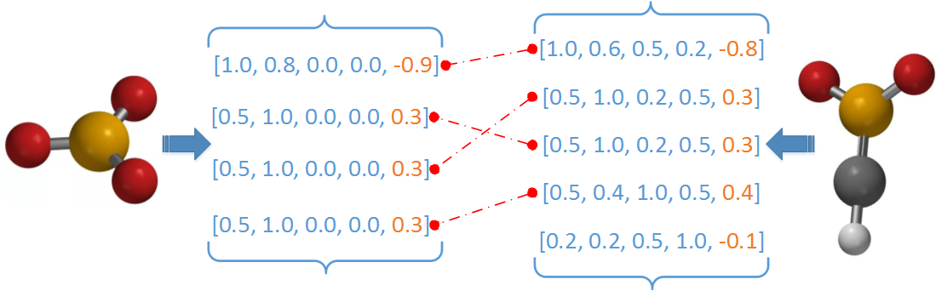
Descriptor Matching
Optimal matching: Maximum weighted bipartite matching
Cubic time. Not a valid kernel (Vert 2008)
Notes:
After we generated the descriptors, basically we convert each graph into a set of descriptors. Then we need to match the descriptors. One attractive option is to do optimal matching, for example, treat this as a Maximum weighted bipartite matching. But the problem is that its expensive to compute, and the result is not a valid kernel.

Slide 20
Descriptor Matching
Optimal matching: Maximum weighted bipartite matching
Cubic time. Not a valid kernel (Vert 2008)
Discretization: Uniform binning
Linear time. Valid kernel. Unweighted, independent bins.
Notes:
We will do discretization. Basically the descriptors are all in the same vector space, and we try to put some bins in this space. The straightforward way is to find some uniform bins, and put the descriptors in the bins. If two descriptors fall into the same bin, they are matched. We can easily do this in linear time, and get a valid kernel. But the downside is that the bins are unweighted, so the matches found in different bins will be counted as the same. Another problem is the bins are independent, so even if two descriptors fall into two neighboring bins, they can never be matched.

Slide 21
Descriptor Matching
Optimal matching: Maximum weighted bipartite matching
Cubic time. Not a valid kernel (Vert 2008)
Discretization: Uniform binning
Linear time. Valid kernel. Unweighted, independent bins.
Discretization: Data-dependent hierarchical binning
Linear time. Valid kernel. Weighted, multi-resolution bins.
Vocabulary-Guided pyramid matching (VG) kernel (Grauman and Darrell 2006)
Notes:
So it’s better to do data-dependent hierarchical binning. We will hierarchically partition the descriptor space based on the distribution of descriptors. We will emply the VG pyramid matching kernel, which was proposed in 2006 for computer vision.

Slide 22
Descriptor Matching
Optimal matching: Maximum weighted bipartite matching
Cubic time. Not a valid kernel (Vert 2008)
Discretization: Uniform binning
Linear time. Valid kernel. Unweighted, independent bins.
Discretization: Data-dependent hierarchical binning
Linear time. Valid kernel. Weighted, multi-resolution bins.
Vocabulary-Guided pyramid matching (VG) kernel (Grauman and Darrell 2006)

Slide 23
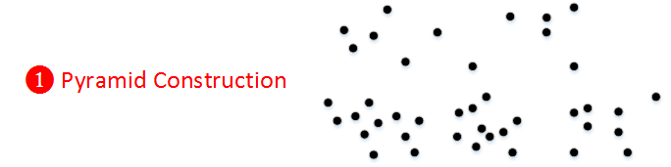
Descriptor Matching via Pyramid Matching Kernel
Notes:
So first we put the descriptors of all of the graphs together in this vector space. Then we do hierarchical clustering to partition this space.

Slide 24
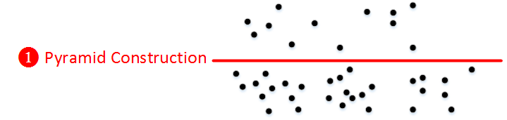
Descriptor Matching via Pyramid Matching Kernel
Notes:
First the data is partitioned into two level-1 bins

Slide 25
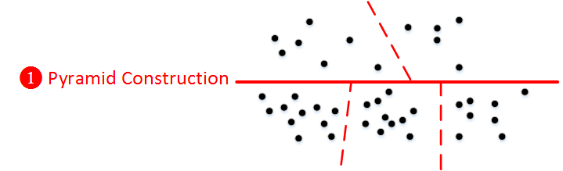
Descriptor Matching via Pyramid Matching Kernel
Notes:
Then we further partition each level-1 bin into several level-2 bins. Denser areas will be partitioned into more, and smaller bins, so here we have three bins while here we only have two bins. This is called a pyramid.

Slide 26
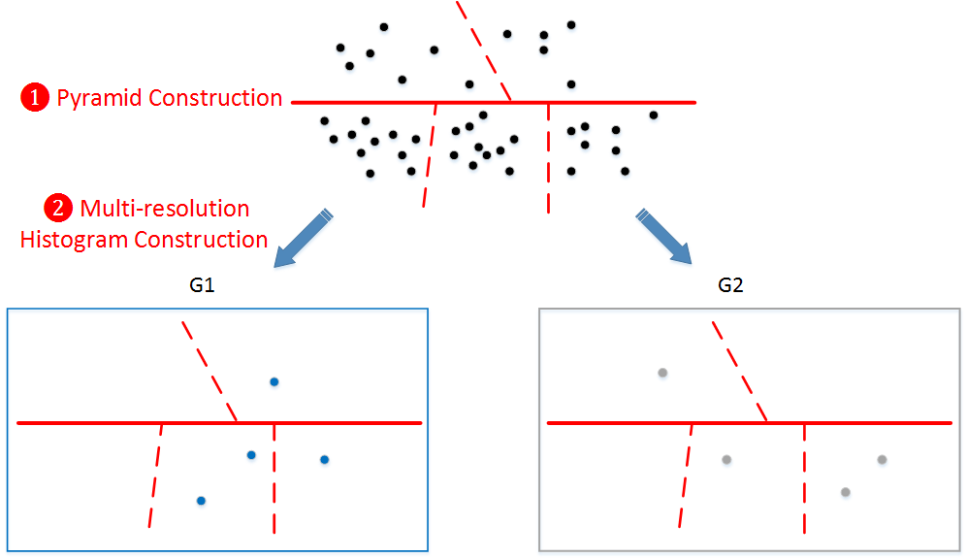
Descriptor Matching via Pyramid Matching Kernel
Notes:
Then we put the descriptors of each graph into this pyramid. So for G1, two descriptors are in this bin, one here, and one here. For G2, there is only one in this bin, but two in this bin.

Slide 27
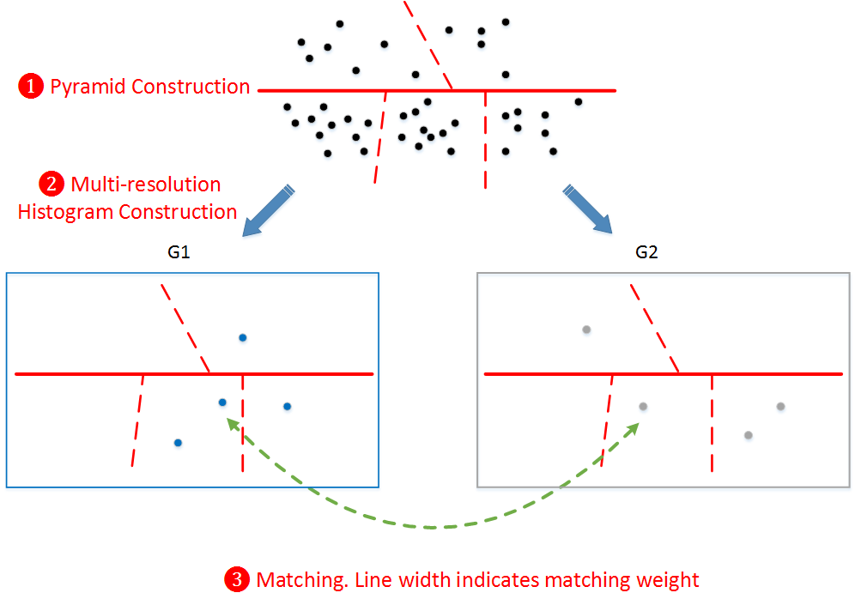
Descriptor Matching via Pyramid Matching Kernel
Notes:
Finally we match the descritpors in a bottom-up manner. A match found in a smaller bin will be given a larger weight. So we first find this match,

Slide 28
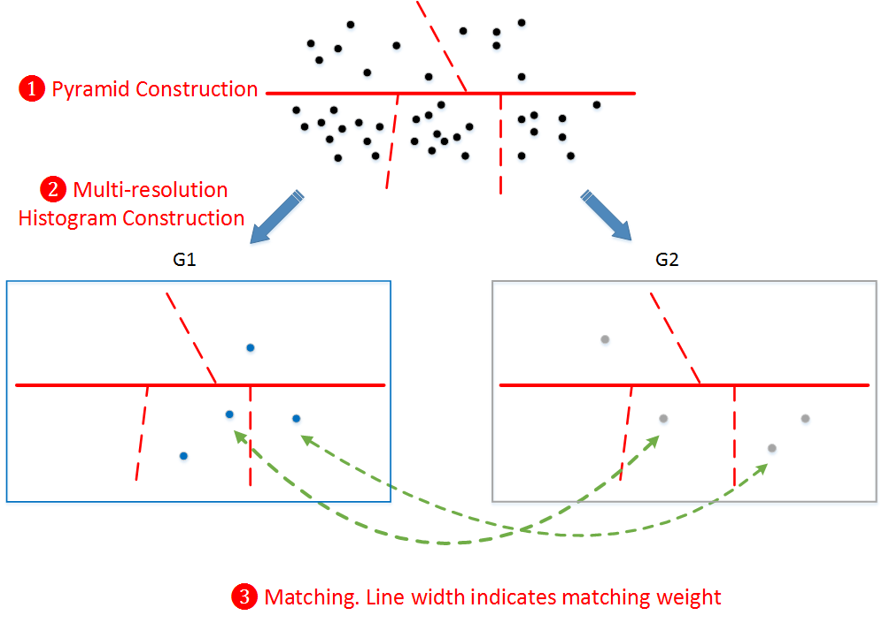
Descriptor Matching via Pyramid Matching Kernel
Notes:
Then this match. They are in the same bin.

Slide 29

Descriptor Matching via Pyramid Matching Kernel
Notes:
For these two descriptors, we cannot match them in a level-2 bin, so we match them in a level-1 bin. Since now the bin is much larger, the weight is much smaller.

Slide 30

Descriptor Matching via Pyramid Matching Kernel
Notes:
Finally, we also match these two descriptors in the other level-1 bin. Similarly, the weight of this match is small.

Slide 31
Evaluation

Slide 32
Efficiency on Synthetic Graphs
DM: this work
PK: ML’16
GH: NIPS’13
WLSP: JMLR’11
SP: ICDM’05
CSM: ICML’12
Number of nodes
Notes:
Here are some experiment results. In the first experiment, we focus on efficiency. We will use synthetic graphs, and change the graph size. We compare with several state-of-the-art graph kernels which can handle both categorical and numerical attributes. The propagation kernel was published in the Machine Learning Journal, 2016. The GraphHopper kernel was published in NIPS 2013, the Weisfeiler-leiman Shortest-path kernel was published in JMLR 2011, the shortest path kernel was published in ICDM 05, and the connected subgraph matching kernel was published in ICML 2012. As we can see, fro graphs with 1000 nodes, many kernels already take hours or days. Our kernel shows a very stable linear increase, and is only slower than PK.

Slide 33
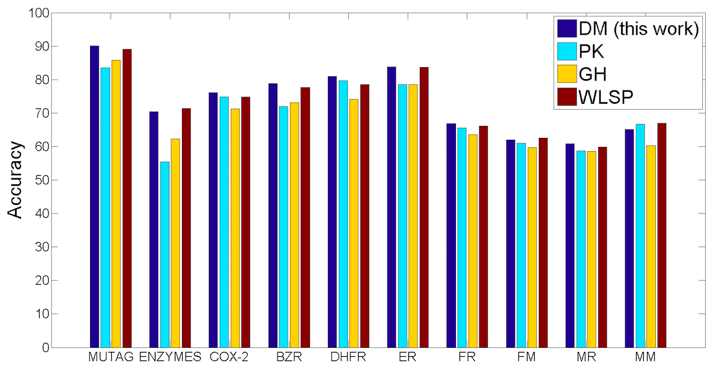
Accuracy on Real-world Graphs
DM is among the best in 9 out of the 10 datasets, and is significantly better than PK on 8 dataset (Student’s t test at p=0.05).
Notes:
Next, we focus on accuracy on classification accuracy. We test on 10 real-world classification datasets from chemo- and bioinformatics. For example, MUTAG is a set of chemical compounds. The task is to predict whether they have a mutagenic effect on a bacterium. ENZYMES is a set of enzymes, and the task is to classify them into 6 enzyme classes. We found that the performance of our DM kernel is quite competitive. Under student t test at p=0.05, we found that DM is among the best in 9 out of 10 datasets. Specifically, we compare DM with the PK kernel, and found that DM is significantly better than PK on 8 datasets.

Slide 34
Summaries
A graph kernel
Can be computed in linear time w.r.t. graph size
Can handle both categorical and numerical attributes
Key ideas
Descriptor generation via categorical attribute propagation
Descriptor matching via hierarchical data-dependent discretization
Competitive performance
Efficient: scale to graphs with 100,000 nodes
Accurate: best on 9 out of 10 datasets

Slide 35

Thank You!
Notes:
This brings to the end of my talk. Thank you for your attention, and I will be pleased to take any questions.

