Slide 1

E-Resource ID
Streaming Audio
Motto: 'Listen and learn'
You are creative and a natural performer. You keep people entertained and informed on the go. Your voice matters, and you use it well.
Where to find:
Quicksearch - Select “Online” and “Audio” in the for-mat facet in the Catalog
Try these streaming audio databases:
DRAM
Music Online. Contemporary World Music
Naxos Music Library

Slide 2

E-Resource ID
Database
Motto: 'The more, the merrier'
You are detail-oriented and
love to make connections. You are always growing and changing. You have it all!
Where to find:
Quicksearch - Databases AZ List
Try these databases:
Business Source Complete
JSTOR
PubMed

Slide 3

E-Resource ID
E-book
Motto: 'Knowledge at your fingertips'
You are a good travel companion and always available and accessible to
anyone who needs you. You are a loyal friend.
Where to find:
Quicksearch - Select “Online” and “Books” in the for-mat facet in the Catalog
Try these e-book platforms:
O'Reilly Safari
OverDrive
Underground and independent comics

Slide 4

E-Resource ID
E-Journal
Motto: 'Stay up to date'
You have a tendency to
change frequently, but are forward-thinking and a
trendsetter. You thrive under peer pressure!
Where to find:
E-Journal Search, Articles+, and Quicksearch
Try these e-journals:
Journal of Cereal Science
Nature
New England Journal of Medicine

Slide 5

E-Resource ID
Streaming Video
Motto: 'A picture is worth a thousand words'
You are constantly in motion but good at helping friends to relax and unwind. You are
always in high demand!
Where to find:
Quicksearch - Select “Online” and “Video & Film” in the format facet in the Catalog
Try these streaming video platforms:
Alexander Street
Kanopy
Met Opera on Demand

Slide 6
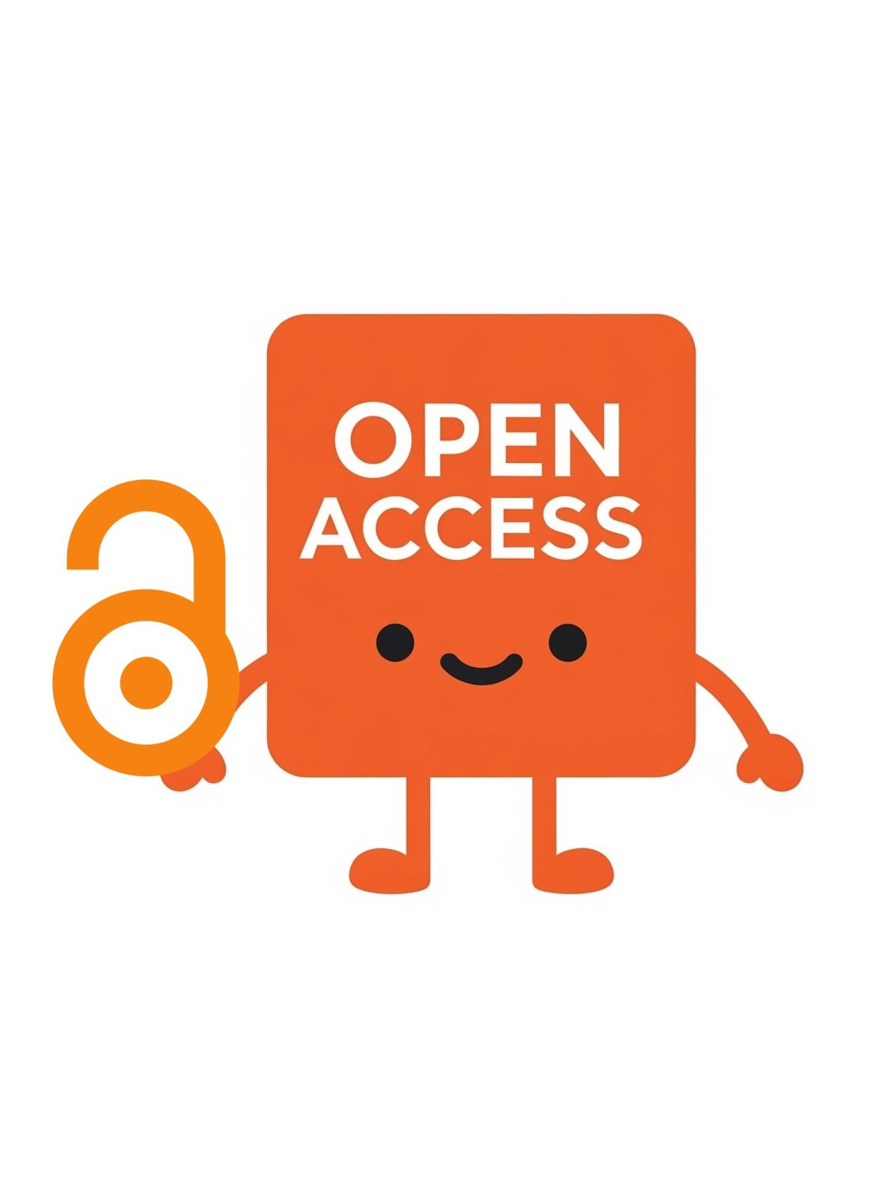
E-Resource ID
Open Access Resource
Motto: 'Believe in sharing'
You are open and accessible to everyone. You maintain high standards and work with your community to solve
problems.
Where to find:
Internet, E-Journal Search, Articles+, and Quicksearch
Try these open access resources:
DOAB Directory of Open Access Books
Independent Voices
World Bank Open Knowledge Repository

