Slide 1
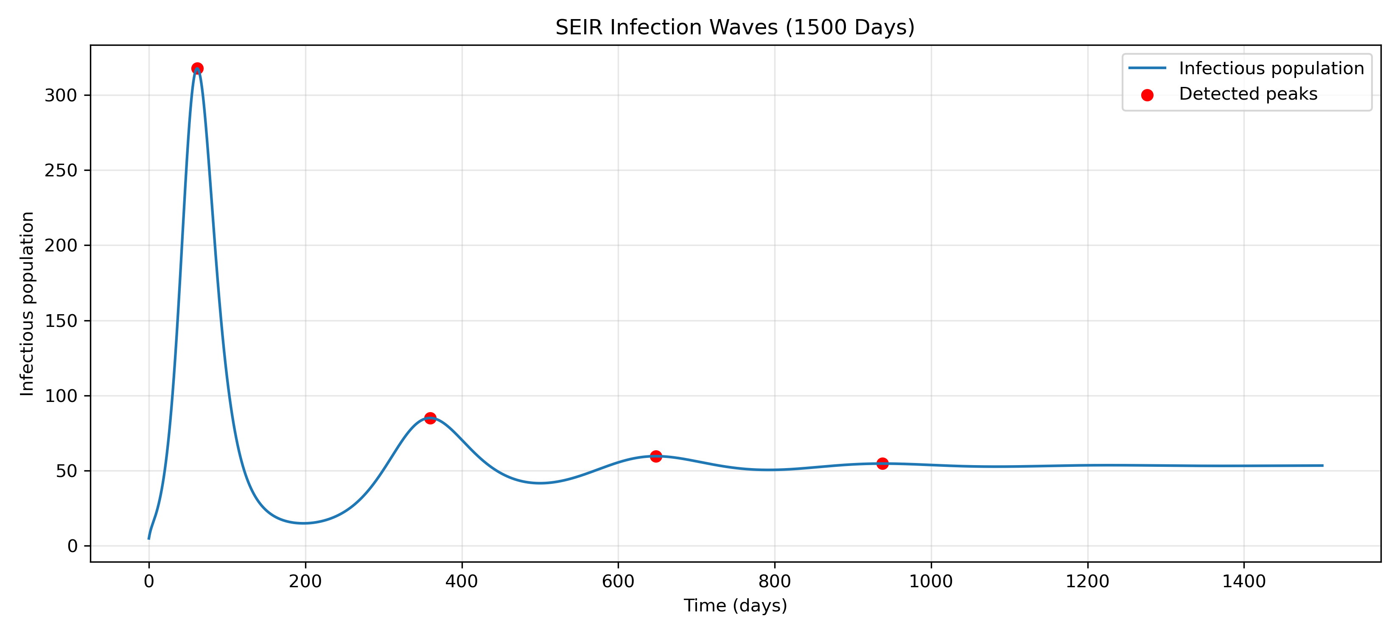
Multiple Infection Waves in the SEIR Model
Hypothesis: I expected several infection waves because the exposed stage slows down the spread.
Verdict: Partially Supported
Key Numbers
  First peak: Day 61.7
  Peak infected: 317.6 people
  4 peaks detected
Lesson Learned
  Birth continuously added new susceptible people, developed multiple waves together with exposed stage.

