Slide 1
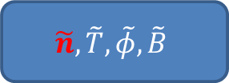
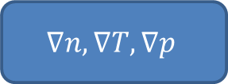
$$∇n, ∇T, ∇p$$
Complex, highly nonlinear,
self-regulating system
Transport
(>> neoclassical)
Micro-instabilities (TEM, ITG, ETG,…)
$$\tilde{n}, \tilde{T}, \tilde{φ}, \tilde{B}$$
Turbulence

Slide 2

Frequency spectrum ${(N}_{FFT}\sim 1,000)$
Decomposition: models
Parameter reduction: parametrization ($N_{p}∼10$)
Database: Ohmic, ICRH, LH
General trend / global pattern

