Slide 1
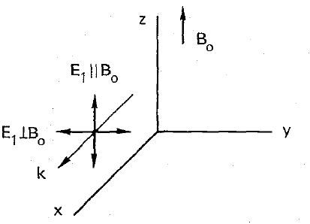

Slide 2





$${2ω}_{ce}$$
$$ω_{U}$$
$$ω_{ce}$$
$$ω_{O}$$
$$ω_{L}$$

