Slide 1
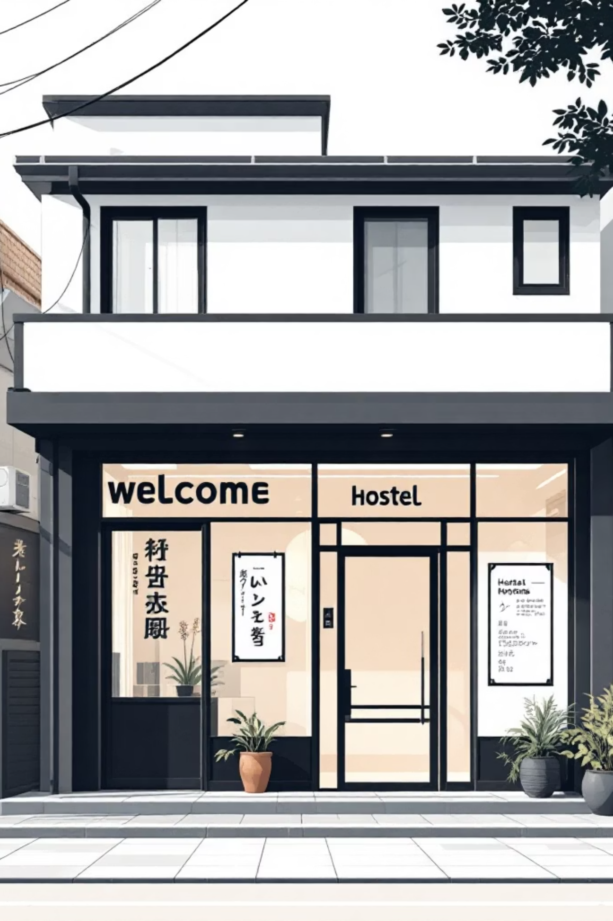
Hostel Utility Consumption Analytics & Monitoring System
Ki Project Presented by
Y. Suriyavelan
D. Franto Vasanth

Slide 2
The Problem: Unseen Wastage & Soaring Costs
Hostels face significant challenges with utility management, leading to unnecessary expenses and environmental impact.
High Wastage
Energy Drain
Water Loss
Prevalent electricity and water waste due to negligence.
Fans and lights often left running in unoccupied rooms.
Frequent water leakage and tank overflow issues.
Budget Impact
Blind Spots
Escalating monthly electricity bills directly affecting budgets.
Absence of proper monitoring and alert mechanisms.

Slide 3

Limitations of Existing Systems
Current utility management practices in hostels are often inefficient and reactive.
Absent Analytics
No analytical tools or comprehensive consumption reports.
No Alerts
Absence of an automated alert system for wastage detection.
No Prediction
Inability to forecast future consumption or potential costs.

Slide 4









Our Proposed Solution: Smart Utility Monitoring
Input Data
Web-based System
Analytics & Alerts
Predicted Consumption
We introduce a comprehensive web-based system designed to revolutionize hostel utility management.
Web-Based Platform
Integrated Tracking
Accessible and intuitive interface for all users.
Monitors both electricity and water consumption.
Wastage Detection
Predictive Analytics
Automated identification of anomalies and inefficiencies.
Forecasts future usage and potential billing.

Slide 5

Platform & Technologies Utilized
Our system leverages modern web technologies and AI for robust performance.
Platform: Web Application for broad accessibility.
Tool Used: AntiGravity Web App Builder for efficient
development.
Frontend: Dynamic and user-friendly Dashboard UI.
Backend: Secure Database and complex business logic.
AI Logic: Advanced Trend-based Prediction models.

Slide 6










System Architecture Overview
A modular design ensures scalability and efficient management of various functions.
User Roles
Monitoring Module
Analytics & Reports
Alert & Notification
Admin, Warden, Student, Maintenance personnel with distinct access levels.
Real-time tracking of electricity and water consumption across the hostel.
Generates detailed usage reports and analytical insights.
Automated alerts for anomalies and critical events.
AI Prediction Module
Leverages AI to forecast future utility consumption patterns.

Slide 7
Key Features & Functionality
Our system delivers a robust suite of features for comprehensive utility oversight.
Granular Monitoring: Room-wise and block-wise consumption tracking.
Usage Visuals: Daily, weekly, and monthly usage charts for clear insights.
Anomaly Detection: Identifies power spikes and unusual consumption.
Leakage Alerts: Proactive detection of water leakage issues.
Smart Alerts: Automated generation of alerts for critical events.
Data Import: Convenient CSV data upload functionality.
AI Forecasting: Predictive analysis for future consumption and billing.

Slide 8





Solving the Problem: Real-World Impact
The system addresses core challenges by providing actionable intelligence and automation.
Pinpoint Wastage
Reduce Energy Use
Prevent Water Loss
Timely Intervention
Identifies the exact source of inefficiency and excessive usage.
Empowers users to minimize unnecessary power consumption.
Mitigates water wastage due to leaks and overflows.
Enables administrators to take swift corrective actions.
Lower Bills
Significantly reduces overall electricity and water expenditures.

Slide 9

Advantages & Versatile Applications
Our solution offers numerous benefits and broad applicability beyond hostels.
Cost-Effective: A financially viable solution for various institutions.
User-Friendly: Designed for ease of use and operational simplicity.
Scalable: Easily adaptable to different sizes and types of facilities.
Resource Management: Enhances efficiency in utility allocation and use.
Wide Applicability: Ideal for hostels, educational institutions, and more.
Hardware Independent: No reliance on specific physical devices, simplifying deployment.

Slide 10
Future Enhancements & Conclusion
Our system is designed for continuous improvement and paves the way for smarter utility management.
Future Enhancements
Conclusion
IoT Integration: Seamless connectivity with smart meters for real-time data.
Mobile App: Dedicated application with instant alerts and controls.
Expanded Notifications: SMS and email alerts for critical updates.
Advanced AI: Deeper analysis for predictive maintenance and optimization.
This system offers a smart, sustainable, and cost-saving solution for modern utility management in hostels.
It promotes efficiency, reduces environmental impact, and provides valuable insights for informed decision-making.

