Slide 1
Dynamic Inventory Control Analysis for Local Pharmacies with Vaccination Appointment System
IOE545 Team 1, 4/26

Slide 2
Overview
Problem Background
Model Formulation
Data Source
Policy Design and Implementation
Numerical Analysis
Summary

Slide 3
Project Background
Referring to the data as of today, out of nearly 10-million of Michigan residents, 66.8% of the population have already initiated a vaccination procedure
Over 50% of the total vaccines distributed goes to local pharmacies
Pharmacists and pharmacy staff need support through technical and operational assistance to store, reconstitute, and administer COVID-19 vaccines
How to manage the inventory of COVID vaccines wisely with the appointment system?
How different administration policies are going to affect the operational cost?
Is the notification system actually beneficiary?

Slide 4
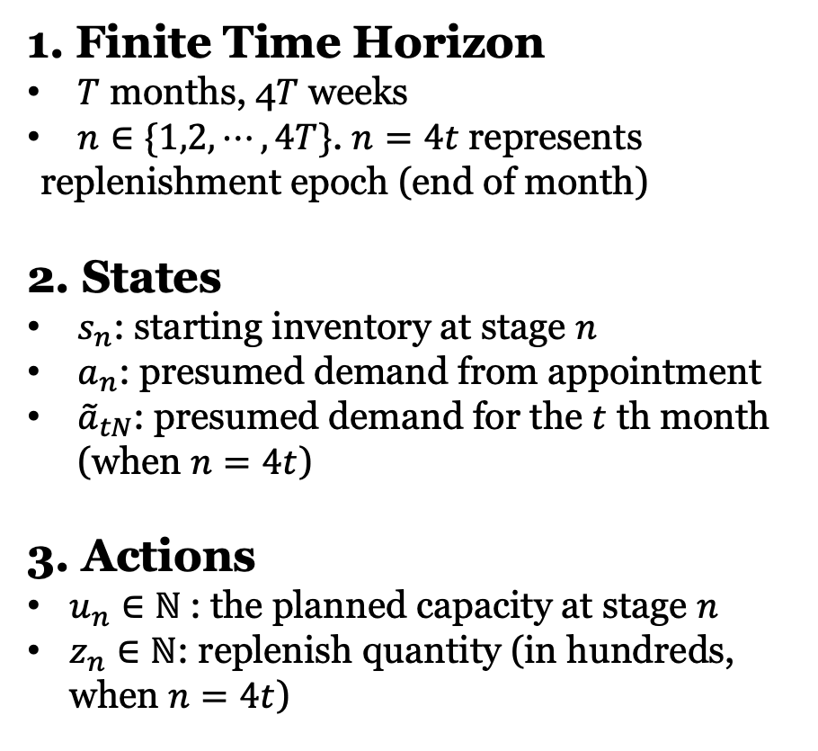
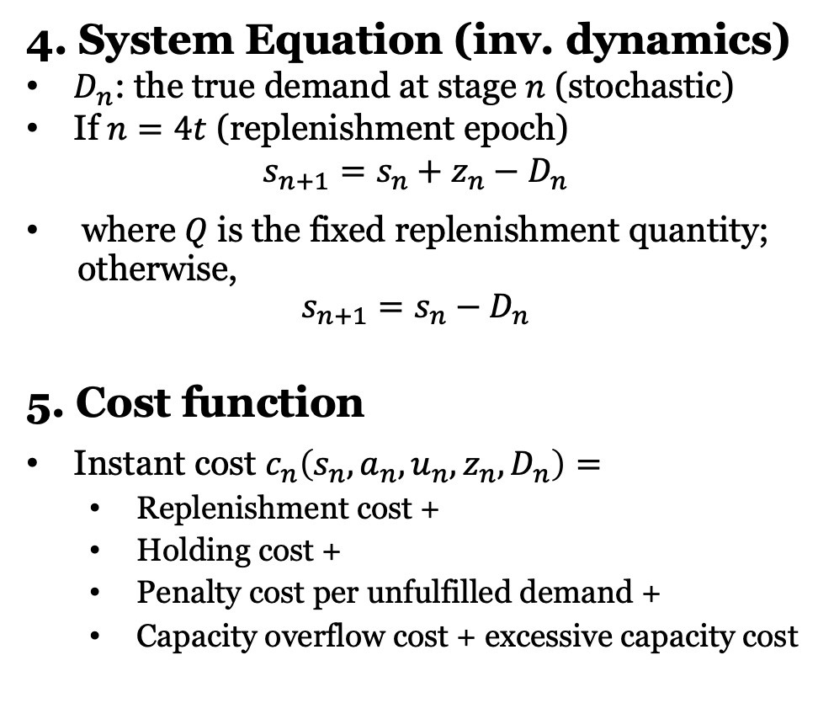
Model Formulation – MDP framework

Slide 5
Data Source – Cost function
Replenishment cost (per order):(R)
Fixed operating cost + (Distance / Consumption rate)* Fuel price + Wage * Duration
$100 + (120 miles/ 6.9 miles/liter) * $4.9/liter + $15/hr * 2hrs = $220
Holding cost (per item per week):(H)
(Average facility cost/Life expectancy + Electric cost)/ Capacity
($10,000/576 weeks + $12/week) / 600= $0.05
Penalty cost for unfulfilled demand (per customer):(P)
Covid infection rate * Death rate * Expected remaining life * GDP per capita
20.83% * 1.6% * 3.21 yrs * $56,554 = $604

Slide 6
Data Source – Cost function
Turn Back Ratio (Tr)
Accounts for the proportion of rejected recipients that will come back (0.9)
Capacity overflow cost (per item) (C)
Average wage of nurse * Mean operation time
$42.56 * ⅙ hrs = $7.09
Excessive capacity cost(per item) (E)
proportional to the capacity overflow cost
Objective function:

Slide 7
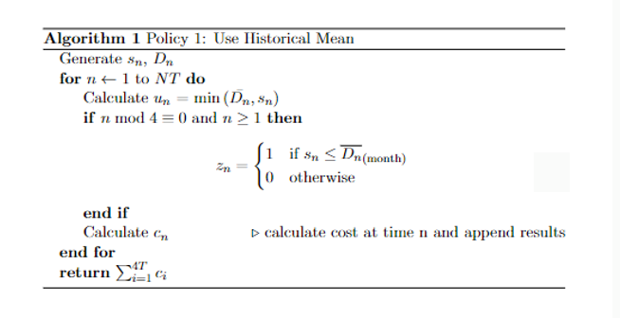
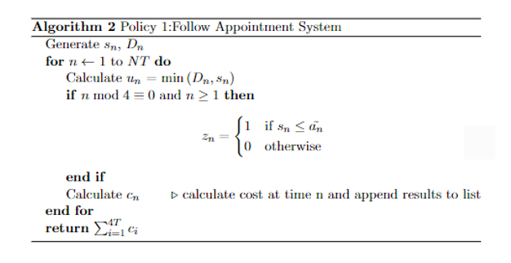
Policy Design
Policy 1: Ignore Appointment
Policy 2: Trust Appointment

Slide 8
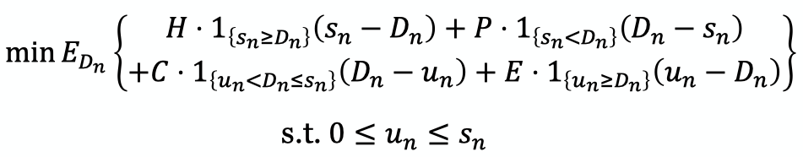
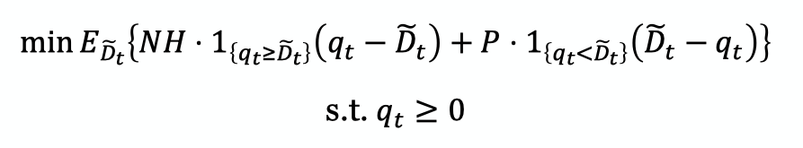
Policy Design
Policy 3: Local stochastic programming (modified newsvendor)
For capacity planning decision, stage n
For replenishment quantity decision
The random demand is implemented to follow a normal distribution centered at appt. demand.
Round the optimal solution to integer (or in hundred) as an approximation.
Notes:
find somewhere in between, use the appointment information wisely -> MDP value aggregation, policy restriction, huge complexity, approximation may not be insightful
technical detail not too deep, but really easy to understand and follow.
with our well-adjusted parameters from real data, let’s see what insights they’ll give us on the front-line operations
by the way, demand is from michigan gov, washtenaw covid vaccination weekly data

Slide 9
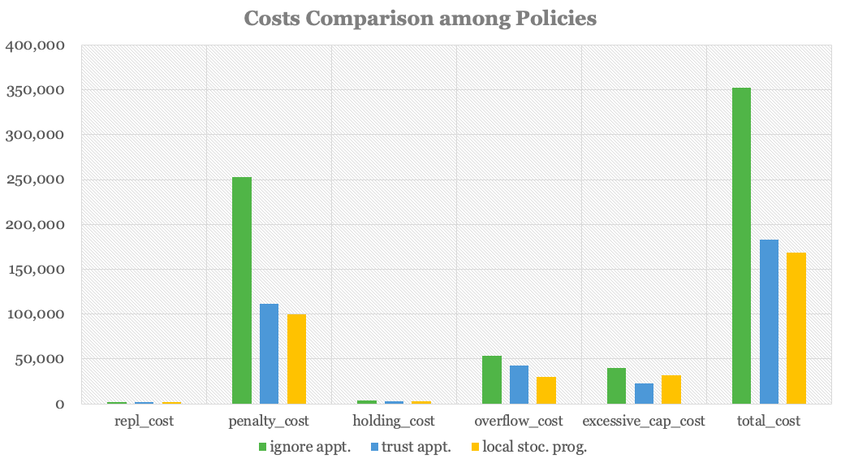
Numerical Analysis - Compare Policies
Report the average performance on 30 replicas for each configuration.
Three policies gets
0.87 : 0.92 : 1 in repl. costs
2.5 : 1.1 : 1 in penalty costs
1.07 : 1.02 : 1 in holding costs
1.8 : 1.4 : 1 in overflow costs
1.2 : 0.7 : 1 in ex. capacity costs
2.1 : 1.1 : 1 in total costs
With an appointment system, - 48% costs
with an extra heuristic policy,
- 8% costs additionally
Notes:
and we controlled each replica to have the exact same data for all configurations

Slide 10
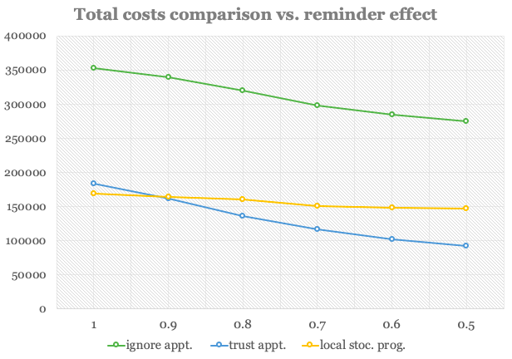
Numerical Analysis - Notification System?
Notification system reduces demand uncertainty with a factor {0.9, 0.8, 0.7, 0.6, 0.5}
With a notification system, no need of the math at all, just trust the appointment!
Under our parameters, the taking-over point is around 0.9.
Notes:
If we propose a notification system, which could reduce the uncertainty in terms of standard deviation

Slide 11
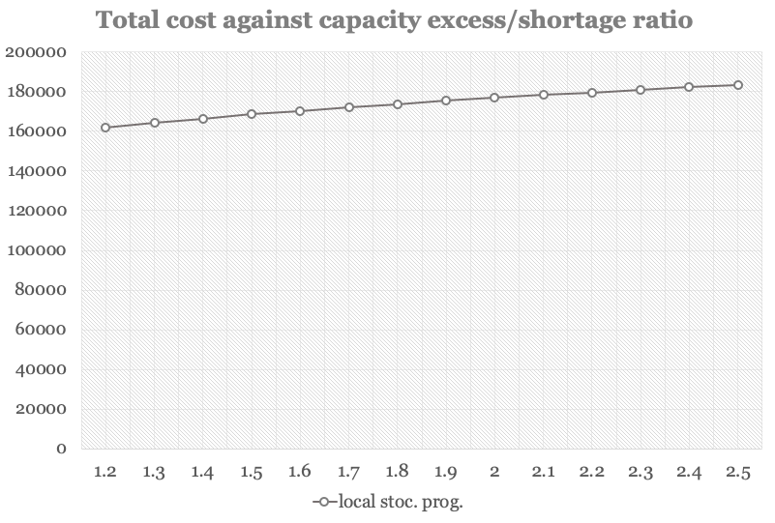
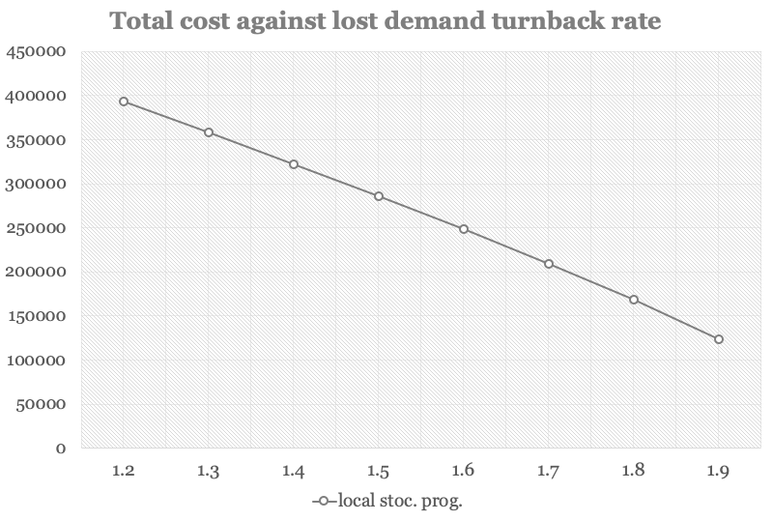
Numerical Analysis - Sensitivity Analysis
Okay!
Needs real data to fix this.

Slide 12
Summary
We take the perspective of one local pharmacy in the Washtenaw County;
Three easy-to-follow inventory control policies tested on data as real as possible;
Appointment system works, notification system helps!

Slide 13
Reference
Literature
[1] Bertsimas, Dimitris et al. (2021). Where to locate COVID-19 mass vaccination facilities? Naval Research Logistics (NRL).
[2] Liu, Kanglin et al. (2021). Testing facility location and dynamic capacity planning for pandemics with demand uncertainty. European Journal of Operational Research.
[3] Basciftci, B., Yu, X., & Shen, S. (2021). Resource Distribution Under Spatiotemporal Uncertainty of Disease Spread: Stochastic versus Robust Approaches. Available at SSRN 3799367.
[4] Yin, X., & Büyüktahtakın, İ. E. (2021). A multi-stage stochastic programming approach to epidemic resource allocation with equity considerations. Health Care Management Science, 24(3), 597-622.
[5] Azadi, Z., Gangammanavar, H., & Eksioglu, S. (2016). Stochastic Optimization of Vaccine Vial Replenishment.
[6] Li, L., Li, X., Qi, W., Zhang, Y., & Yang, W. (2020). Targeted reminders of electronic coupons: using predictive analytics to facilitate coupon marketing. Electronic Commerce Research, 1-30.
Main Data Source
Michigan Government Coronavirus Statistics: https://www.michigan.gov/coronavirus/stats
Washtenaw County Health Department: https://www.washtenaw.org/3158/Testing
Indeed Job Salary in Michigan: https://www.indeed.com/career/registered-nurse/salaries/MI
US Department of Numbers (Michigan GDP and demographics): https://www.deptofnumbers.com/gdp/michigan/
Longview News Journal (Michigan Expected Life Expectancy): https://www.news-journal.com/here-s-how-life-expectancy-in-michigan-compares-to-the-nation/article_5a02437b-fdbb-5fe4-a4f3-c3b79d2b12ac.html
Notes:
If we propose a notification system, which could reduce the standard deviation

