Slide 1

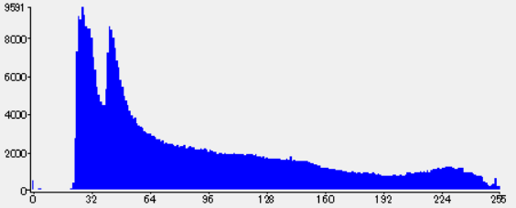
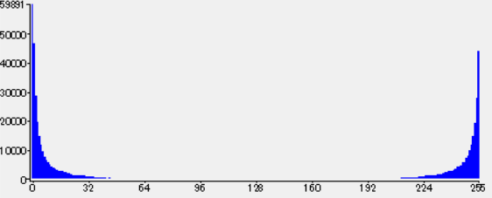
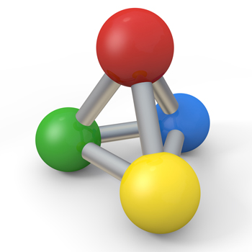
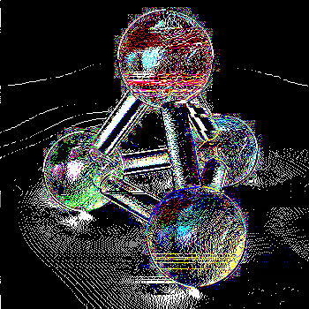
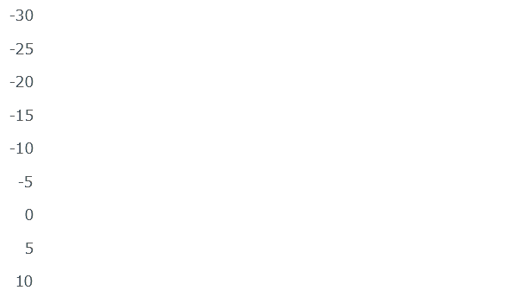
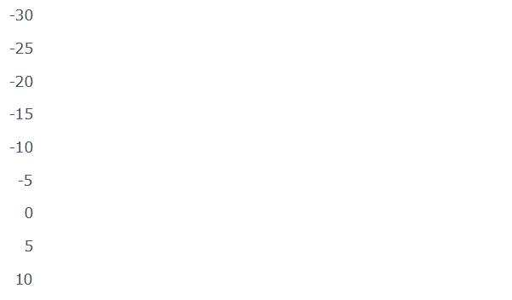

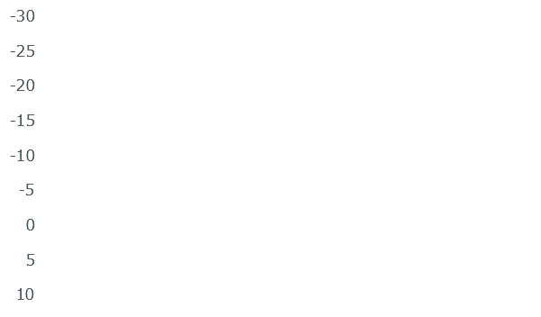
Filtering Methods to Improve the Compression Ratio of PNG
Introduction
66
161
171
62
164
165
4
253
6
Filtering
c
b
p
p̂
x
a
p
row by row
4
253
6
62
164
165
66
161
171
Unfiltering
x
p̂
p
Filters
p
x
>
67
181
179
56
164
168
↓select one filter
for each row
(3)
62
164
165
Filtering
Deflate
69
164
182
p̂
Objecticve
Conclution
Suggest filtering methods to improve compression ratio
All methods are effective, especially method c
Methods
Result
Change filter section formula to entropy
Adding filters from lossless JPEG
Adding diff of G channel to R and B channels
Sorted the percentage increase in file size compared to existing method
(natural images : red screen shots : blue)
Existing
(choose max)
Entropy
(choose min)
Compress 200 images (natural images : 100, screen shots : 100) by combining a, b, c methods
Future Direction
Researching about filter across colors based on method c

