Slide 1

Chapter 2. Analytic Functions
Weiqi Luo (骆伟祺)
School of Data & Computer Science
Sun Yat-Sen University
Email：luoweiqi@mail.sysu.edu.cn

Slide 2
Chapter 2: Analytic Functions
Functions of a Complex Variable; Mappings
Mappings by the Exponential Function
Limits; Theorems on Limits
Limits Involving the Point at Infinity
Continuity; Derivatives; Differentiation Formulas
Cauchy-Riemann Equations; Sufficient Conditions for Differentiability; Polar Coordinates;
Analytic Functions; Harmonic Functions; Uniquely Determined Analytic Functions; Reflection Principle

Slide 3
12. Functions of a Complex Variable
Function of a complex variable
Let s be a set complex numbers. A function f defined on S is a rule that assigns to each z in S a complex number w.
Complex
numbers
Complex
numbers
f
z
w
S
S’
The domain of definition of f
The range of f

Slide 4
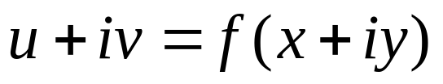
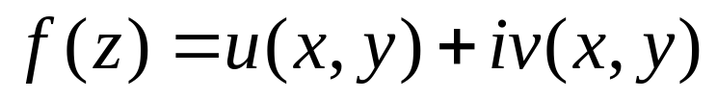
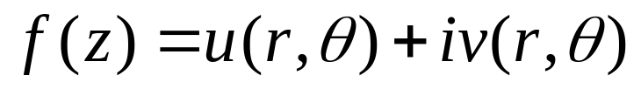
12. Functions of a Complex Variable
Suppose that w=u+iv is the value of a function f at z=x+iy, so that
Thus each of real number u and v depends on the real variables x and y, meaning that
Similarly if the polar coordinates r and θ, instead of x and y, are used, we get

Slide 5

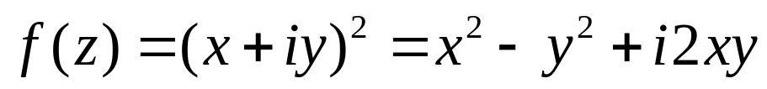
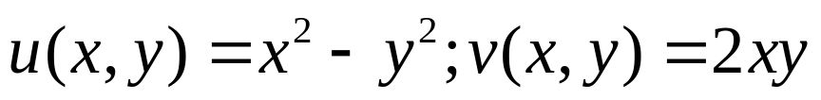

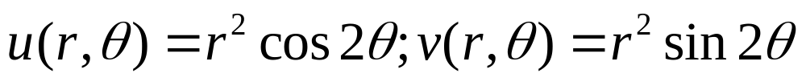
12. Functions of a Complex Variable
Example 2
If f(z)=z², then
case #1:
case #2:
When v=0, f is a real-valued function.

Slide 6
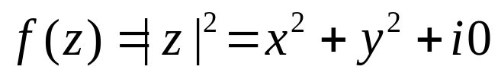
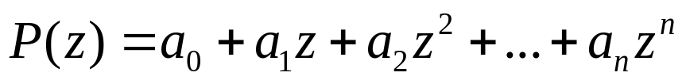
12. Functions of a Complex Variable
Example 3
A real-valued function is used to illustrate some important concepts later in this chapter is
Polynomial function
where n is zero or a positive integer and a₀, a₁, …a_{n} are complex constants, a_{n} is not 0;
Rational function
the quotients P(z)/Q(z) of polynomials
The domain of definition is the entire z plane
The domain of definition is Q(z)≠0

Slide 7
12. Functions of a Complex Variable
Multiple-valued function
A generalization of the concept of function is a rule that assigns more than one value to a point z in the domain of definition.
Complex
numbers
Complex
numbers
f
w₂
z
w₁
w_{n}
S
S’

Slide 8
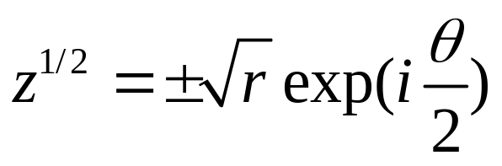
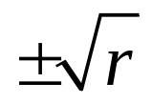
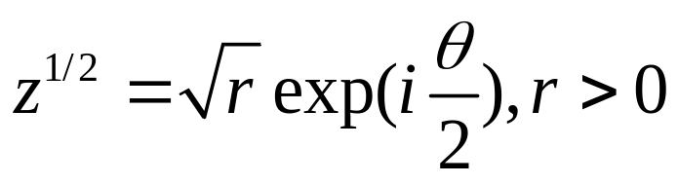
12. Functions of a Complex Variable
Example 4
Let z denote any nonzero complex number, then z^{1/2} has the two values
If we just choose only the positive value of
Multiple-valued function
Single-valued function

Slide 9
12. Homework
pp. 37-38
Ex. 1, Ex. 2, Ex. 4

Slide 10
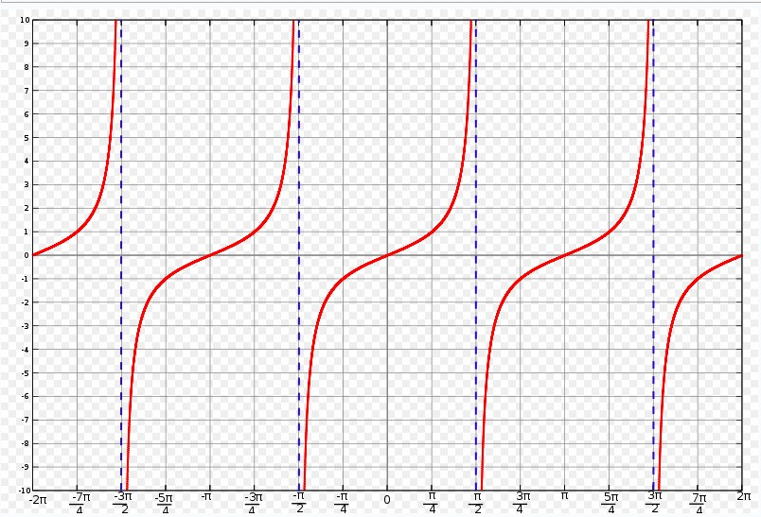
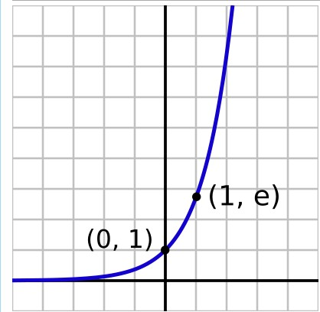
13. Mappings
Graphs of Real-value functions
f=tan(x)
f=e^{x}
Note that both x and f(x) are real values.

Slide 11
13. Mappings
Complex-value functions
mapping
v
y
z(x,y)
w(u(x,y),v(x,y))
u
x
Note that here x, y, u(x,y) and v(x,y) are all real values.

Slide 12

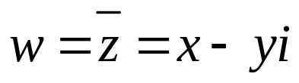
13. Mappings
Examples
y
v
z(x,y)
w(x+1,y)
Translation Mapping
x
u
y
v
z(x,y)
Reflection Mapping
u
w(x,-y)

Slide 13
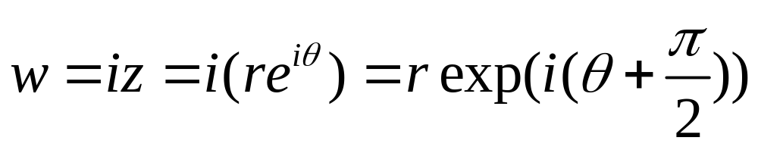

13. Mappings
Example
Rotation Mapping
y
v
z
w
r
r
θ
θ
u

Slide 14
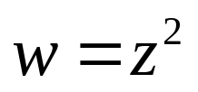
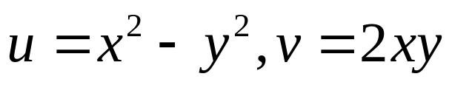
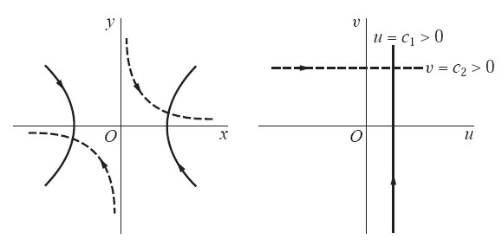
13. Mappings
Example 1
Let u=c₁>0 in the w plane, then x²-y²=c₁ in the z plane
Let v=c₂>0 in the w plane, then 2xy=c₂ in the z plane

Slide 15
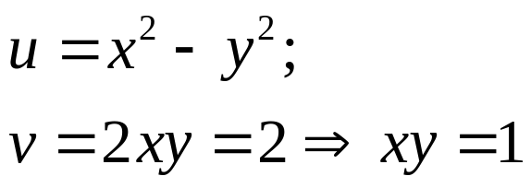
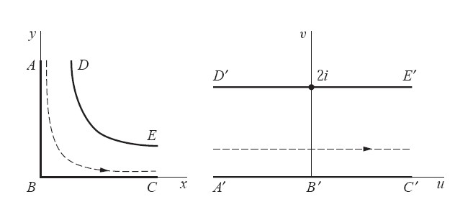
13. Mappings
Example 2
The domain x>0, y>0, xy<1 consists of all points lying on the upper branches of hyperbolas
x=0,y>0
x>0,y=0

Slide 16
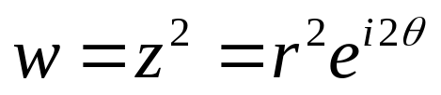
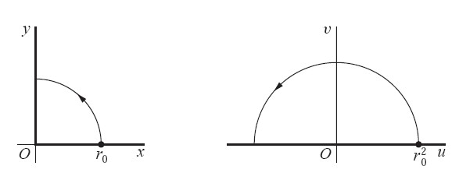
13. Mappings
Example 3
In polar coordinates

Slide 17
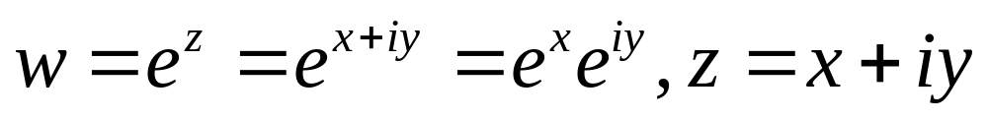
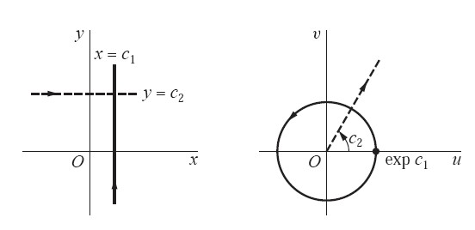
14. Mappings by the Exponential Function
The exponential function
ρe^{iθ}
ρ=e^{x}, θ=y

Slide 18
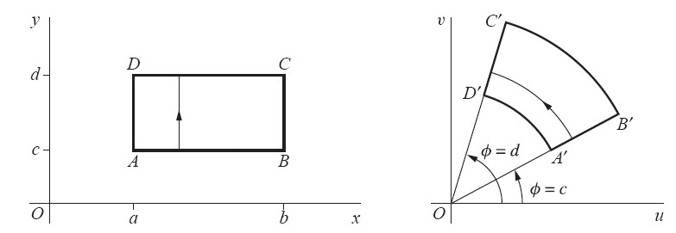
14. Mappings by the Exponential Function
Example 2
w=exp(z)

Slide 19
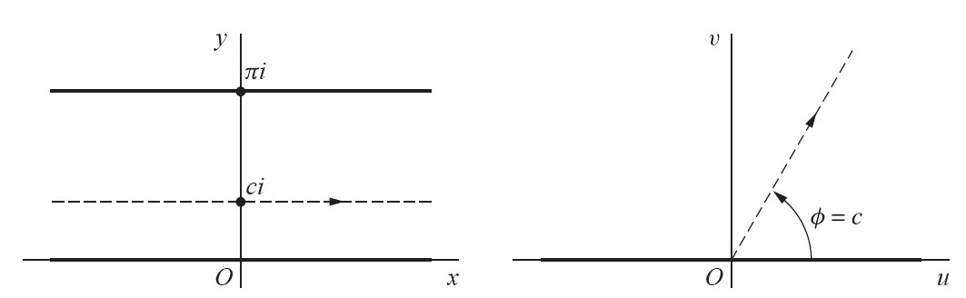
14. Mappings by the Exponential Function
Example 3
w=exp(z)=e^{x+yi}

Slide 20
14. Homework
pp. 44-45
Ex. 2, Ex. 3, Ex. 7, Ex. 8

Slide 21
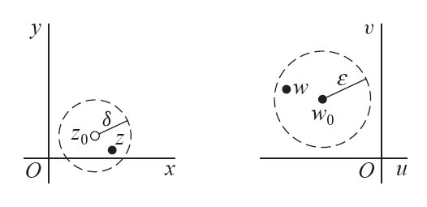
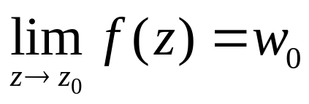
15. Limits
For a given positive value ε, there exists a positive value δ (depends on ε) such that
when 0 < |z-z₀| < δ, we have |f(z)-w₀|< ε
meaning the point w=f(z) can be made arbitrarily chose to w₀ if we choose the point z close enough to z₀ but distinct from it.

Slide 22
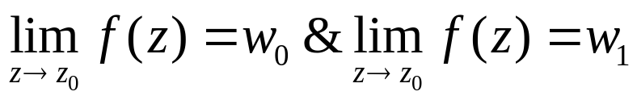






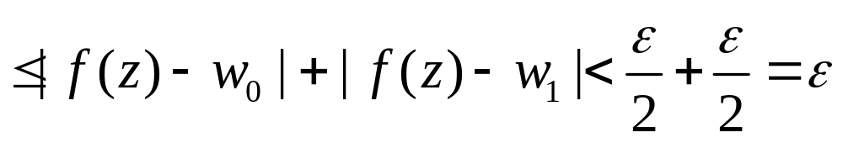
15. Limits
The uniqueness of limit
If a limit of a function f(z) exists at a point z₀, it is unique.
Proof: suppose that
then
when
Let , when 0<|z-z₀|<δ, we have

Slide 23

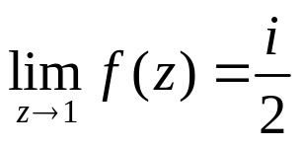
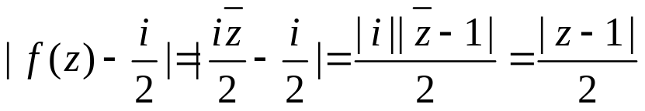

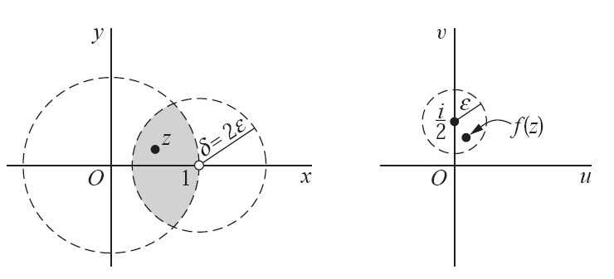

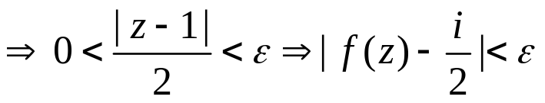
15. Limits
Example 1
Show that in the open disk |z|<1, then
Proof:
when

Slide 24
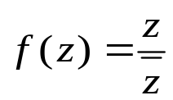
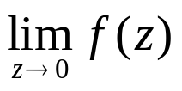
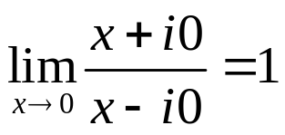

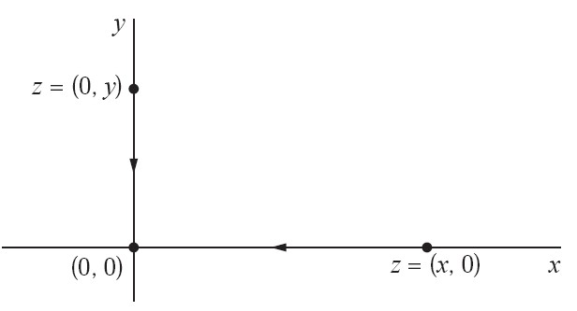
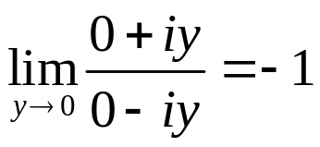

15. Limits
Example 2
If then the limit does not exist.
≠

Slide 25




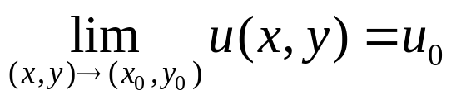
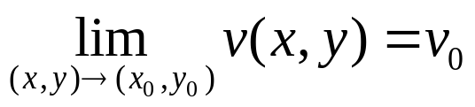
16. Theorems on Limits
Theorem 1
Let
and
then
if and only if
(a)
and
(b)

Slide 26

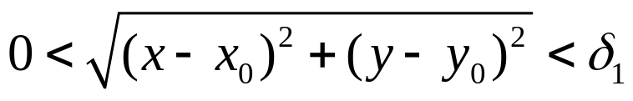
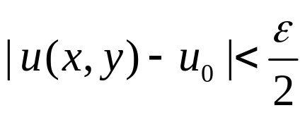
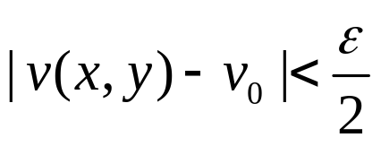
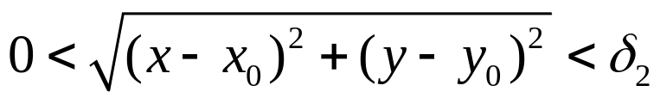

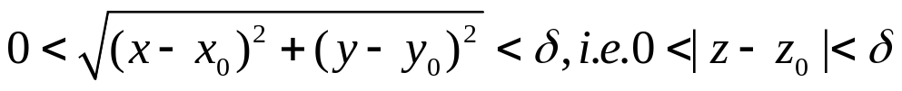

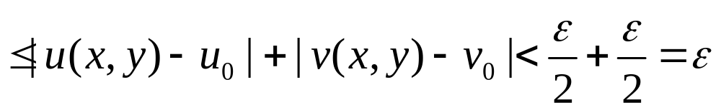
16. Theorems on Limits
Proof: (b)➔(a)
&
When
Let
When

Slide 27





16. Theorems on Limits
Proof: (a)➔(b)
&
When
Thus
When (x,y)→(x₀,y₀)

Slide 28
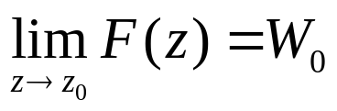
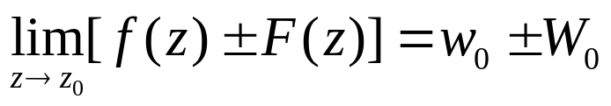
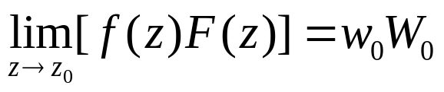

16. Theorems on Limits
Theorem 2
Let and
then

Slide 29


16. Theorems on Limits
&
Let
When (x,y)→(x₀,y₀);
u(x,y)→u₀; v(x,y)→v₀; & U(x,y)→U₀; V(x,y)→V₀;
Re(f(z)F(z)):
w₀W₀
Im(f(z)F(z)):

Slide 30





16. Theorems on Limits
It is easy to verify the limits
For the polynomial
We have that

Slide 31

17. Limits Involving the Point at Infinity
Riemannsphere & Stereographic Projection
N: the north pole

Slide 32
17. Limits Involving the Point at Infinity
The ε Neighborhood of Infinity
y
When the radius R is large enough
R₁
i.e. for each small positive number ε
O
R₂
x
R=1/ε
The region of |z|>R=1/ε is called the
ε Neighborhood of Infinity(∞)

Slide 33






17. Limits Involving the Point at Infinity
Theorem
If z₀ and w₀ are points in the z and w planes, respectively, then
iff
iff
iff

Slide 34



17. Limits Involving the Point at Infinity
Examples

Slide 35




18. Continuity
Continuity
A function is continuous at a point z₀ if
meaning that
the function f has a limit at point z₀ and
the limit is equal to the value of f(z₀)
For a given positive number ε, there exists a positive number δ, s.t.
When

Slide 36

18. Continuity
Theorem 1
A composition of continuous functions is itself continuous.
Suppose w=f(z) is a continuous at the point z₀;
g=g(f(z)) is continuous at the point f(z₀)
Then the composition g(f(z)) is continuous at the point z₀

Slide 37






18. Continuity
Theorem 2
If a function f (z) is continuous and nonzero at a point z₀, then f (z) ≠ 0 throughout some neighborhood of that point.
Proof
Why?
f(z)
f(z₀)
When
r
If f(z)=0, then
Contradiction!

Slide 38


18. Continuity
Theorem 3
If a function f is continuous throughout a region R that is both closed and bounded, there exists a nonnegative real number M such that
where equality holds for at least one such z.
for all points z in R
Note:
where u(x,y) and v(x,y) are continuous real functions

Slide 39
18. Homework
pp. 55-56
Ex. 2, Ex. 3, Ex. 6, Ex. 9, Ex. 11, Ex. 12

Slide 40

19. Derivatives
Derivative
Let f be a function whose domain of definition contains a neighborhood |z-z₀|<ε of a point z₀. The derivative of f at z₀ is the limit
And the function f is said to be differentiable at z₀ when f’(z₀) exists.

Slide 41





19. Derivatives
Illustration of Derivative
Any position
f(z₀+Δz)
v
Δw
f(z₀)
O
u

Slide 42

19. Derivatives
Example 1
Suppose that f(z)=z². At any point z
since 2z + Δz is a polynomial in Δz. Hence dw/dz=2z or f’(z)=2z.

Slide 43




19. Derivatives
Example 2
If f(z)=z, then
In any direction
Δy
Case #2
Case #1: Δx→0, Δy=0
Case #1
O
Δx
Case #2: Δx=0, Δy→0
Since the limit is unique, this function does not exist anywhere

Slide 44




19. Derivatives
Example 3
Consider the real-valued function f(z)=|z|². Here
Case #1: Δx→0, Δy=0
Case #2: Δx=0, Δy→0
dw/dz can not exist when z is not 0

Slide 45

19. Derivatives
Continuity & Derivative
Continuity Derivative
Derivative Continuity
For instance,
f(z)=|z|² is continuous at each point, however, dw/dz does not exists when z is not 0
Note: The existence of the derivative of a function at a point implies the continuity
of the function at that point.

Slide 46








20. Differentiation Formulas
Differentiation Formulas
Refer to pp.7 (13)

Slide 47

20. Differentiation Formulas
Example
To find the derivative of (2z²+i)⁵, write w=2z²+i and W=w⁵. Then

Slide 48
20. Homework
pp. 62-63
Ex. 1, Ex. 4, Ex. 8, Ex. 9

Slide 49



21. Cauchy-Riemann Equations
Theorem
Suppose that
and that f’(z) exists at a point z₀=x₀+iy₀. Then the first-order partial derivatives of u and v must exist at (x₀,y₀), and they must satisfy the Cauchy-Riemann equations
then we have

Slide 50



21. Cauchy-Riemann Equations
Proof:
Let
Note that (Δx, Δy) can be tend to (0,0) in any manner .
Consider the horizontally and vertically directions

Slide 51





21. Cauchy-Riemann Equations
Horizontally direction (Δy=0)
Vertically direction (Δx=0)
Cauchy-Riemann equations

Slide 52






21. Cauchy-Riemann Equations
Example 1
is differentiable everywhere and that f’(z)=2z. To verify that the Cauchy-Riemann equations are satisfied everywhere, write

Slide 53





21. Cauchy-Riemann Equations
Example 2
If the C-R equations are to hold at a point (x,y), then
Therefore, f’(z) does not exist at any nonzero point.

Slide 54

22. Sufficient Conditions for Differentiability
Theorem
be defined throughout some ε neighborhood of a point z₀ = x₀ + iy₀, and suppose that
the first-order partial derivatives of the functions u and v with respect to x and y exist everywhere in the neighborhood;
those partial derivatives are continuous at (x₀, y₀) and satisfy the Cauchy–Riemann equations
Then f ’(z₀) exists, its value being f ’ (z₀) = u_{x} + iv_{x} where the right-hand side is to be evaluated at (x₀, y₀).
at (x₀,y₀)

Slide 55




22. Sufficient Conditions for Differentiability
Proof
Let
Note : (a) and (b) assume that the first-order partial derivatives of u and v are continuous at the point (x₀,y₀) and exist everywhere in the neighborhood
Where ε₁, ε₂, ε₃ and ε₄ tend to 0 as (Δx, Δy) approaches (0,0) in the Δz plane.

Slide 56


22. Sufficient Conditions for Differentiability
-v_{x}(x₀,y₀)
u_{x}(x₀,y₀)
Note : The assumption (b) that those partial derivatives are continuous at (x₀, y₀) and satisfy the Cauchy–Riemann equations
i²v_{x}(x₀,y₀)

Slide 57





22. Sufficient Conditions for Differentiability

Slide 58



22. Sufficient Conditions for Differentiability
Example 1
Both Assumptions (a) and (b) in the theorem are satisfied.

Slide 59





22. Sufficient Conditions for Differentiability
Example 2
Therefore, f has a derivative at z=0, and cannot have a derivative at any nonzero points.

Slide 60









23. Polar Coordinates
Assuming that z₀≠0
Similarly
If the partial derivatives of u and v with respect to x and y satisfy the Cauchy-Riemann equations

Slide 61

23. Polar Coordinates
Theorem
Let the function f(z)=u(r,θ)+iv(r,θ) be defined throughout some ε neighborhood of a nonzero point z₀=r₀exp(iθ₀) and suppose that
the first-order partial derivatives of the functions u and v with respect to r and θ exist everywhere in the neighborhood;
those partial derivatives are continuous at (r₀, θ₀) and satisfy the polar form ru_{r} = v_{θ}, u_{θ} = −rv_{r} of the Cauchy-Riemann equations at (r₀, θ₀)
Then f’(z₀) exists, its value being

Slide 62




23. Polar Coordinates
Example 1
Consider the function
Then

Slide 63
23. Homework
pp. 71-72
Ex. 1, Ex. 2, Ex. 6, Ex. 7, Ex. 8

Slide 64
24. Analytic Function
Analytic at a point z₀
A function f of the complex variable z is analytic at a point z₀ if it has a derivative at each point in some neighborhood of z₀.
Analytic function
A function f is analytic in an open set if it has a derivative everywhere in that set.
Note that if f is analytic at a point z₀, it must be analytic at each point in some neighborhood of z₀
Note that if f is analytic in a set S which is not open, it is to be understood that f is analytic in an open set containing S.

Slide 65
24. Analytic Function
Analytic vs. Derivative
For a point
Analytic ➔ Derivative
Derivative ➔Analytic
For all points in an open set
Analytic ➔ Derivative
Derivative ➔Analytic
f is analytic in an open set D iff f is derivative in D

Slide 66
24. Analytic Function
Singular point (singularity)
If function f fails to be analytic at a point z₀ but is analytic at some point in every neighborhood of z₀, then z₀ is called a singular point.
For instance, the function f(z)=1/z is analytic at every point in the finite plane except for the point of (0,0). Thus (0,0) is the singular point of function 1/z.
Entire Function
An entire function is a function that is analytic at each point in the entire finite plane.
For instance, the polynomial is entire function.

Slide 67

24. Analytic Function
Property 1
If two functions are analytic in a domain D, then
their sum and product are both analytic in D
their quotient is analytic in D provided the function in the denominator does not vanish at any point in D
Property 2
From the chain rule for the derivative of a composite function, a composition of two analytic functions is analytic.

Slide 68





24. Analytic Function
Theorem
If f ’(z) = 0 everywhere in a domain D, then f (z) must be constant throughout D.
U is the unit vector along L

Slide 69


25. Examples
Example 1
The quotient
is analytic throughout the z plane except for the singular points

Slide 70






25. Examples
Example 3
Suppose that a function and its conjugate are both analytic in a given domain D. Show that f(z) must be constant throughout D.
Proof:
is analytic, then
is analytic, then
Based on the Theorem in pp. 74, we have that f is constant throughout D

Slide 71


25. Examples
Example 4
Suppose that f is analytic throughout a given region D, and the modulus |f(z)| is constant throughout D, then the function f(z) must be constant there too.
Proof:
|f(z)| = c, for all z in D
where c is real constant.
If c=0, then f(z)=0 everywhere in D.
If c ≠ 0, we have
Both f and it conjugate are analytic, thus f must be constant in D. (Refer to Ex. 3)

Slide 72
25. Homework
pp. 77~78
Ex. 2, Ex. 3, Ex. 4, Ex. 6, Ex. 7

Slide 73

26. Harmonic Functions
A Harmonic Function
A real-valued function H of two real variables x and y is said to be harmonic in a given domain of the xy plane if, throughout that domain, it has continuous partial derivatives of the first and second order and satisfies the partial differential equation
Known as Laplace’s equation.

Slide 74






26. Harmonic Functions
Theorem 1
If a function f (z) = u(x, y) + iv(x, y) is analytic in a domain D, then its component functions u and v are harmonic in D.
Proof:
is analytic in D
Differentiating both sizes of these equations with respect to x and y respectively, we have
continuity
Theorem in Sec.52:
a function is analytic at a point, then its real and imaginary components
have continuous partial derivatives of all order at that point.

Slide 75



26. Harmonic Functions
Example 3
The function f(z)=i/z² is analytic whenever z≠0 and since
The two functions
are harmonic throughout any domain in the xy plane that does not contain the origin.

Slide 76

26. Harmonic Functions
Harmonic conjugate
If two given function u and v are harmonic in a domain D and their first-order partial derivatives satisfy the Cauchy-Riemann equation throughout D, then v is said to be a harmonic conjugate of u.
Is the definition symmetry for u and v?
Cauchy-Riemann equation
If u is a harmonic conjugate of v, then

Slide 77



26. Harmonic Functions
Theorem 2
A function f (z) = u(x, y) + iv(x, y) is analytic in a domain D if and only if v is a harmonic conjugate of u.
Example 4
The function is entire function, and its real and imaginary components are
Based on the Theorem 2, v is a harmonic conjugate of u throughout the plane. However, u is not the harmonic conjugate of v, since is not an analytic function.

Slide 78







26. Harmonic Functions
Example 5
Obtain a harmonic conjugate of a given function.
Suppose that v is the harmonic conjugate of the given function
Then

Slide 79
26. Homework
pp. 81-82
Ex. 1, Ex. 2, Ex. 3, Ex. 5

Slide 80
27. Uniquely Determined Analytic Function
Lemma
Suppose that
A function f is analytic throughout a domain D;
f(z)=0 at each point z of a domain or line segment contained in D.
Then f (z) ≡ 0 in D; that is, f (z) is identically equal to zero throughout D.
Refer to Chap. 6 for the proof.

Slide 81

27. Uniquely Determined Analytic Function
Theorem
A function that is analytic in a domain D is uniquely determined over D by its values in a domain, or along a line segment, contained in D.
D
D
f(z)
g(z)

Slide 82

28. Reflection Principle
Theorem
Suppose that a function f is analytic in some domain D which contains a segment of the x axis and whose lower half is the reflection of the upper half with respect to that axis. Then
for each point z in the domain if and only if f (x) is real for each point x on the segment.
y
D
x

