Slide 1
Chapter 5. Series
Weiqi Luo (骆伟祺)
School of Data & Computer Science
Sun Yat-Sen University
Email：luoweiqi@mail.sysu.edu.cn

Slide 2
Chapter 5: Series
Convergence of Sequences; Convergence of Series
Taylor Series; Proof of Taylor's Theorem; Examples;
Laurent Series; Proof of Laurent's Theorem; Examples
Absolute and Uniform Covergence of Power Series
Continuity of Sums of Power Series
Integration and Differentiation of Power Series
Uniqueness of Series Representations
Multiplication and Division of Power Series

Slide 3
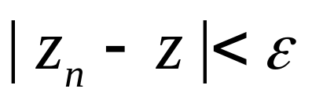
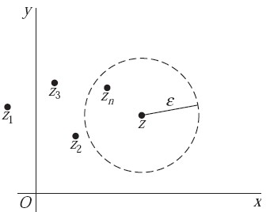
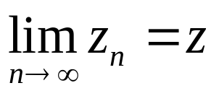
55. Convergence of Sequences
The limit of Sequences
An infinite sequence
z₁, z₂, …, z_{n}, …
of complex number has a limit z if, for each positive number ε, there exists a positive integer n₀ such that when n>n₀
Denoted as
Note that the limit must be unique if it exists;
Otherwise it diverges

Slide 4
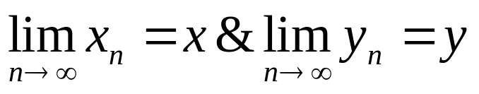
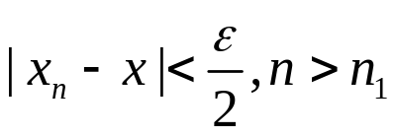
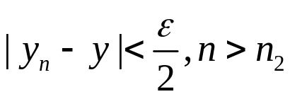
55. Convergence of Sequences
Theorem
Suppose that z_{n} = x_{n} + iy_{n} (n = 1, 2, . . .) and z = x + iy. Then
If and only if
Proof:
If
then, for each positive number ε, there exists n₁ and n₂, such that

Slide 5
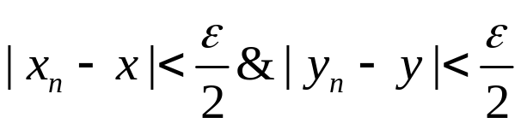
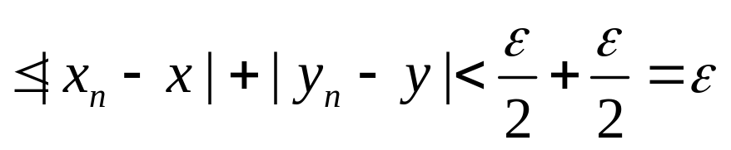


55. Convergence of Sequences
Let n₀=max(n₁,n₂), then when n>n₀
Conversely, if we have that for each positive ε, there
exists a positive integer n₀ such that, when n>n₀

Slide 6
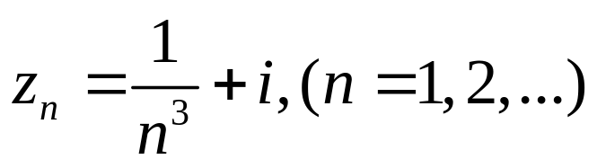
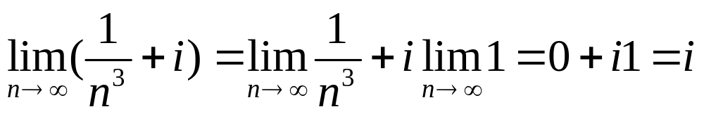
55. Convergence of Sequences
Example 1
The sequence
converges to i since

Slide 7
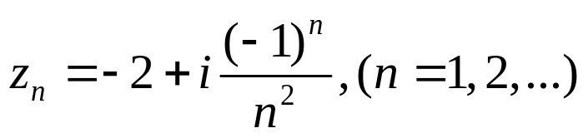
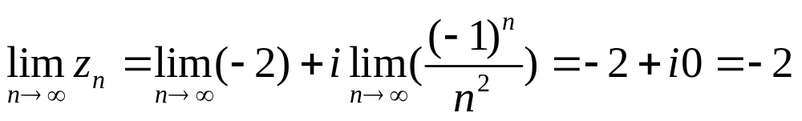

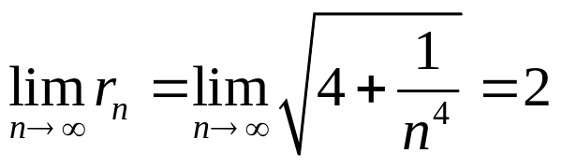

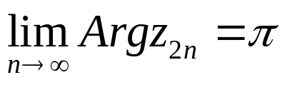
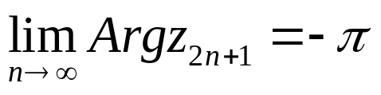
55. Convergence of Sequences
Example 2
When
The theorem tells us that
If using polar coordinates, we write
Evidently, the limit of Θ_{n} does not exist as n
tends to infinity.
Why?

Slide 8
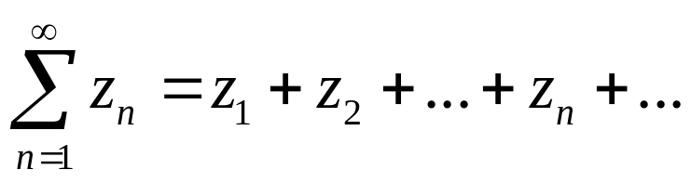
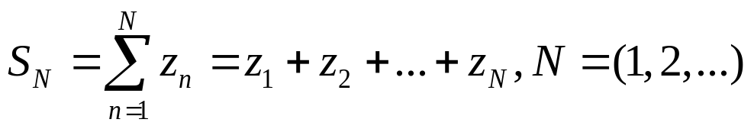
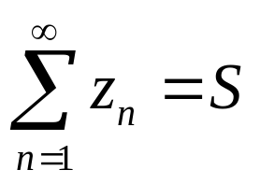
56. Convergence of Series
Convergence of Series
An infinite series
of complex number converges to the sum S if the sequence
of partial sums converges to S; we then write
Series
Sequence
The series has at most one limit,
otherwise it diverges

Slide 9
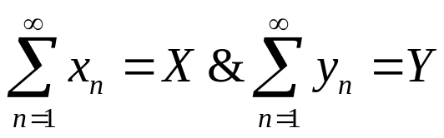
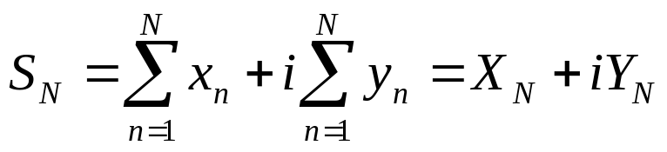
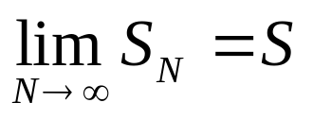
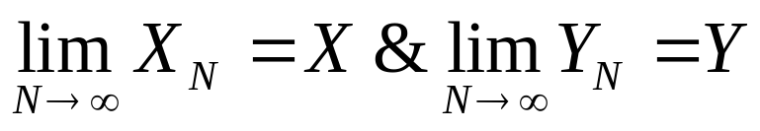
56. Convergence of Series
Theorem
Suppose that z_{n} = x_{n} + iy_{n} (n = 1, 2, . . .) and S = X + iY. Then
If and only if

Slide 10
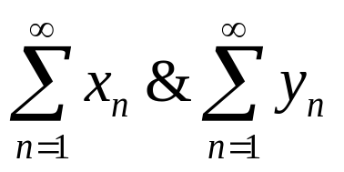
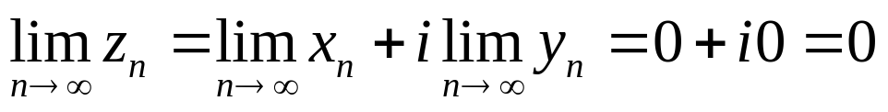
56. Convergence of Series
Corollary 1
If a series of complex numbers converges, the nth term converges to zero as n tends to infinity.
Assuming that converges, based on the theorem, both the two following real series converse.
Then we get that x_{n} and y_{n} converge to zero as n tends to infinity (why?), and thus

Slide 11
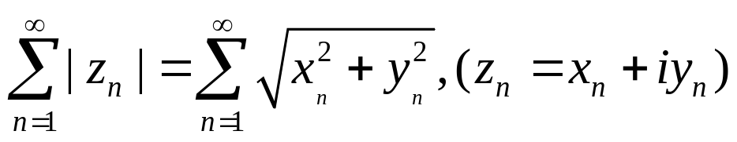
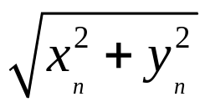
56. Convergence of Series
Absolutely convergent
If the series
of real number converges,
then the series is said to be absolutely convergent.

Slide 12
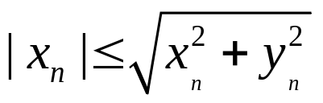
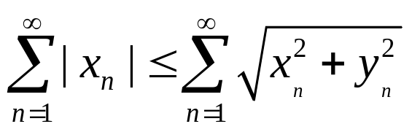
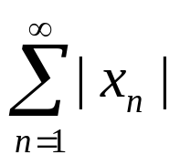
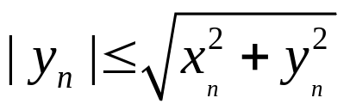
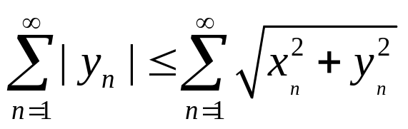
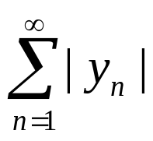
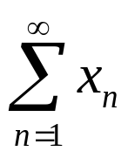
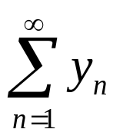
56. Convergence of Series
Corollary 2
The absolute convergence of a series of complex numbers implies the convergence of that series.
Converge
Converge
Converge

Slide 13
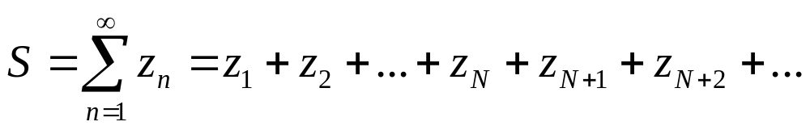
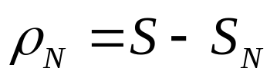
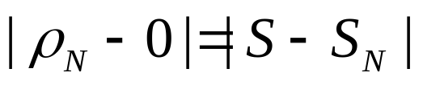
56. Convergence of Series
The remainder ρ_{N} after N terms
S_{N}
ρ_{N}
Therefore, a series converges to a number S if and only if the sequence of
remainders tends to zero.

Slide 14
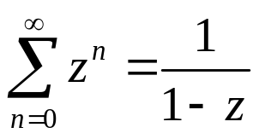
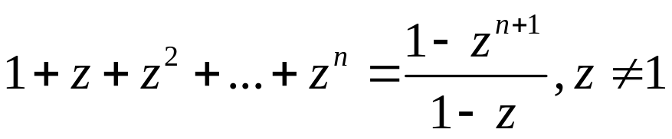
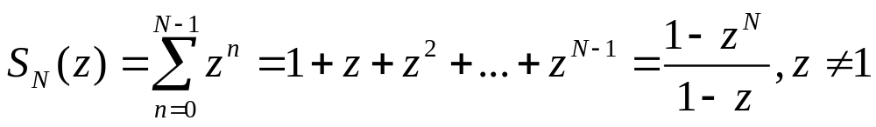
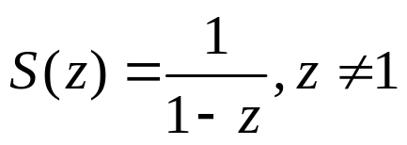
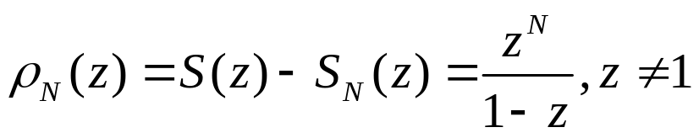
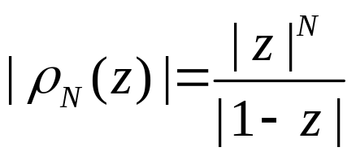
56. Convergence of Series
Example
With the aid of remainders, it is easy to verify that when |z| <1,
Note that
The partial sums
If then
When |z|<1 ρ_{N} tends to zero, but not when |z|>1

Slide 15
56. Homework
pp.188-189
Ex. 2, Ex. 3, Ex. 5, Ex. 9

Slide 16
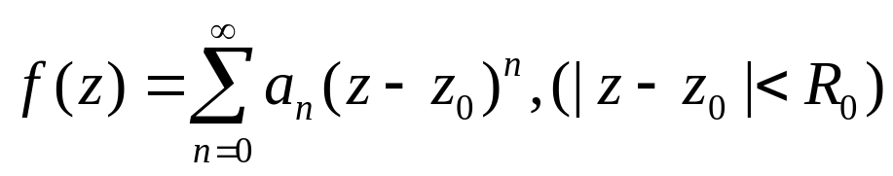
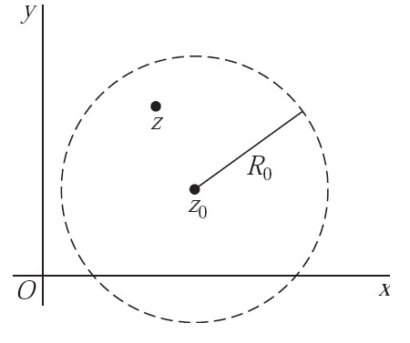
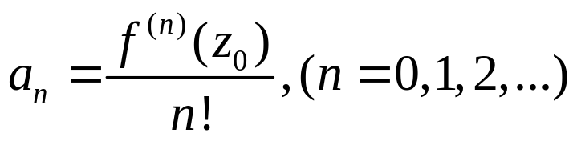
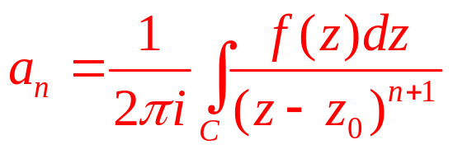
57. Taylor Series
Theorem
Suppose that a function f is analytic throughout a disk |z − z₀| < R₀, centered at z₀ and with radius R₀. Then f (z) has the power series representation
That is, series converges to f (z) when z lies in the stated open disk.
Refer to pp.167

Slide 17
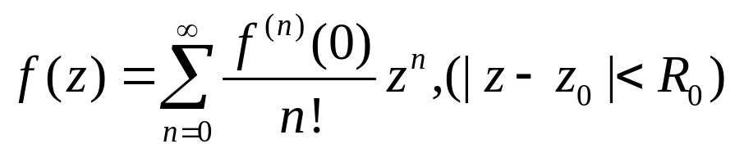
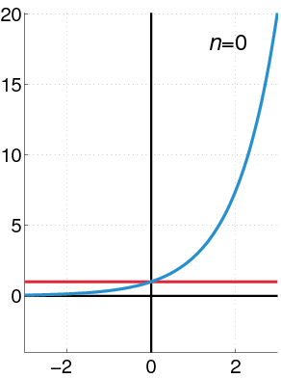
57. Taylor Series
Maclaurin Series
When z₀=0 in the Taylor Series become the Maclauin Series
In the following Section, we first prove
the Maclaurin Series, in which case f is
assumed to be assumed to be analytic
throughout a disk |z|<R₀
y=e^{x}

Slide 18
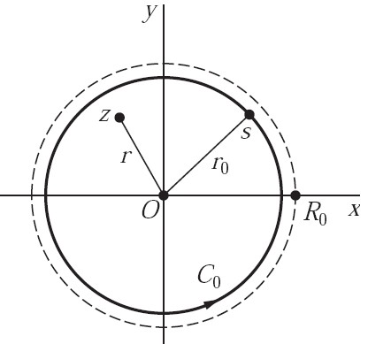


58. Proof the Taylor’s Theorem
Proof:
Let C₀ denote and positively oriented circle |z|=r₀, where r<r₀<R₀
Since f is analytic inside and on the circle C₀ and since the
point z is interior to C₀, the Cauchy integral formula holds
Refer to pp.187

Slide 19





58. Proof the Taylor’s Theorem
Refer to pp.167
ρ_{N}

Slide 20






58. Proof the Taylor’s Theorem
When
Where M denotes the maximum value of |f(s)| on C₀

Slide 21


59. Examples
Example 1
Since the function f (z) = e^{z} is entire, it has a Maclaurin series representation which is valid for all z. Here f^{(n)}(z) = e^{z} (n = 0, 1, 2, . . .) ; and because f^{(n)}(0) = 1 (n = 0, 1, 2, . . .) , it follows that
Note that if z=x+i0, the above expansion becomes

Slide 22


59. Examples
Example 1 (Cont’)
The entire function z²e^{3z} also has a Maclaurin series expansion,
If replace n by n-2, we have
Replace z by 3z

Slide 23


59. Example2
Example 2
Trigonometric Functions

Slide 24



59. Examples
Example 4
Another Maclaurin series representation is
since the derivative of the function f(z)=1/(1-z), which fails to be analytic at z=1, are
In particular,

Slide 25


59. Examples
Example 4 (Cont’)
substitute –z for z
replace z by 1-z

Slide 26



59. Examples
Example 5
expand f(z) into a series involving powers of z.
We can not find a Maclaurin series for f(z) since it is not analytic at z=0. But we do know that expansion
Hence, when 0<|z|<1
Negative powers

Slide 27
59. Homework
pp. 195-197
Ex. 2, Ex. 3, Ex. 7, Ex. 11

Slide 28




60. Laurent Series
Theorem
Suppose that a function f is analytic throughout an annular domain R₁< |z − z₀| < R₂, centered at z₀ , and let C denote any positively oriented simple closed contour around z₀ and lying in that domain. Then, at each point in the domain, f (z) has the series representation

Slide 29




60. Laurent Series
Theorem (Cont’)

Slide 30




60. Laurent Series
Laurent’s Theorem
If f is analytic throughout the disk |z-z₀|<R₂,
reduces to Taylor
Series about z₀
Analytic in the region |z-z₀|<R₂

Slide 31





62. Examples
Example 1
Replacing z by 1/z in the Maclaurin series expansion
We have the Laurent series representation
There is no positive powers of z, and all coefficients of the positive powers are zeros.
where c is any positively oriented simple closed
contours around the origin

Slide 32



62. Examples
Example 2
The function f(z)=1/(z-i)² is already in the form of a Laurent series, where z₀=i,. That is
where c₋₂=1 and all of the other coefficients are zero.
where c is any positively oriented simple contour
around the point z₀=i

Slide 33





62. Examples
Consider the following function
which has the two singular points z=1 and z=2, is analytic in the domains

Slide 34


62. Examples
Example 3
The representation in D₁ is Maclaurin series.
Refer to pp. 194 Example 4
where |z|<1 and |z/2|<1

Slide 35


62. Examples
Example 4
Because 1<|z|<2 when z is a point in D₂, we know
Refer to pp. 194 Example 4
where |1/z|<1 and |z/2|<1

Slide 36


62. Examples
Example 5
Because 2<|z|<∞ when z is a point in D₃, we know
Refer to pp. 194 Example 4
where |1/z|<1 and |2/z|<1

Slide 37
62. Homework
pp. 205-208
Ex. 3, Ex. 4, Ex. 6, Ex. 7

Slide 38


63~66 Some Useful Theorems
Theorem 1 (pp.208)
If a power series
converges when z = z₁ (z₁ ≠ z₀), then it is absolutely convergent at each point z in the open disk |z − z₀| < R₁ where R₁ = |z₁ − z₀|

Slide 39

63~66 Some Useful Theorems
Theorem 2 (pp.210)
If z₁ is a point inside the circle of convergence |z − z₀| = R of a power series
then that series must be uniformly convergent in the closed disk |z − z₀| ≤ R₁, where R₁ = |z₁ − z₀|

Slide 40
63~66 Some Useful Theorems
Theorem (pp.211)
A power series
represents a continuous function S(z) at each point inside its circle of convergence |z − z₀| = R.

Slide 41


63~66 Some Useful Theorems
Theorem 1 (pp.214)
Let C denote any contour interior to the circle of convergence of the power series S(z), and let g(z) be any function that is continuous on C. The series formed by multiplying each term of the power series by g(z) can be integrated term by term over C; that is,
Corollary: The sum S(z) of power series is analytic at each point z interior to the circle of convergence of that series.

Slide 42

63~66 Some Useful Theorems
Theorem 2 (pp.216)
The power series S(z) can be differentiated term by term. That is, at each point z interior to the circle of convergence of that series,

Slide 43

63~66 Some Useful Theorems
The uniqueness of Taylor/Laurent series representations
Theorem 1 (pp.217)
If a series
converges to f (z) at all points interior to some circle |z − z₀| = R, then it is the Taylor series expansion for f in powers of z − z₀.
Theorem 2 (pp.218)
If a series
converges to f (z) at all points in some annular domain about z₀, then it is the Laurent series expansion for f in powers of z − z₀ for that domain.

