Slide 1

Chapter 1. Complex Numbers
Weiqi Luo (骆伟祺)
School of Data & Computer Science
Sun Yat-Sen University
Email：luoweiqi@mail.sysu.edu.cn

Slide 2
Textbook:
  James Ward Brown, Ruel V. Churchill, Complex Variables and Applications (the 8th ed.), China Machine Press, 2008
Reference:
  王忠仁 张静 《工程数学 - 复变函数与积分变换》高等教育出版社，2006

Slide 3
Numbers System
Natural Numbers
Zero & Negative Numbers
Integers
Fraction
Rational numbers
Irrational numbers
Real numbers
Imaginary numbers
Complex numbers
… More advanced number systems
Refer to: http://en.wikipedia.org/wiki/Number_system

Slide 4
Chapter 1: Complex Numbers
Sums and Products; Basic Algebraic Properties
Further Properties; Vectors and Moduli
Complex Conjugates; Exponential Form
Products and Powers in Exponential Form
Arguments of Products and Quotients
Roots of Complex Numbers
Regions in the Complex Plane

Slide 5
1. Sums and Products
Definition
Complex numbers can be defined as ordered pairs (x, y) of real numbers that are to be interpreted as points in the complex plane
y
(x, y)
Note: The set of complex numbers
Includes the real numbers as a subset
(0, y)
imaginary axis
Real axis
O
(x, 0)
x
Complex plane

Slide 6
1. Sums and Products
Notation
It is customary to denote a complex number (x,y) by z,
x = Rez (Real part);
y = Imz (Imaginary part)
y
z=(x, y)
(0, y)
z₁=z₂
iff
Rez₁= Rez₂
Imz₁ = Imz₂
O
(x, 0)
x
Q: z₁<z₂?

Slide 7
1. Sums and Products
Two Basic Operations
Sum
(x₁, y₁) + (x₂, y₂) = (x₁+x₂, y₁+y₂)
Product
(x₁, y₁) (x₂, y₂) = (x₁x₂ - y₁y₂, y₁x₂+x₁y₂)
when y₁=0, y₂=0, the above operations reduce to the usual operations of
addition and multiplication for real numbers.
2. Any complex number z= (x,y) can be written z = (x,0) + (0,y)
3. Let i be the pure imaginary number (0,1), then
z = x (1, 0) + y (0,1) = x + i y, x & y are real numbers
i² =(0,1) (0,1) =(-1, 0) ➔ i²=-1

Slide 8
1. Sums and Products
Two Basic Operations (i² → -1)
Sum
(x₁, y₁) + (x₂, y₂) = (x₁+x₂, y₁+y₂)
➔ (x₁ + iy₁) + (x₂+ iy₂) = (x₁+x₂)+i(y₁+y₂)
Product
(x₁, y₁) (x₂, y₂) = (x₁x₂ - y₁y₂, y₁x₂+x₁y₂)
➔ (x₁ + iy₁) (x₂+ iy₂) = (x₁x₂+ x₁ iy₂) + (iy₁x₂ + i² y₁y₂)
= (x₁x₂+ x₁ iy₂) + (iy₁x₂ - y₁y₂)
= (x₁x₂ - y₁y₂) +i(y₁x₂+x₁y₂)

Slide 9
2. Basic Algebraic Properties
Various properties of addition and multiplication of complex numbers are the same as for real numbers
Commutative Laws
z₁+ z₂= z₂ +z₁, z₁z₂=z₂z₁
Associative Laws
(z₁+ z₂ )+ z₃ = z₁+ (z₂+z₃)
(z₁z₂) z₃ =z₁ (z₂z₃)
e.g. Prove that z₁z₂=z₂z₁
(x₁, y₁) (x₂, y₂) = (x₁x₂ - y₁y₂, y₁x₂+x₁y₂) = (x₂x₁ - y₂y₁, y₂x₁ +x₂y₁) = (x₂, y₂) (x₁, y₁)

Slide 10
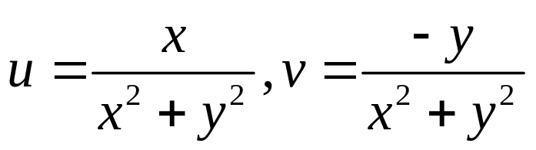
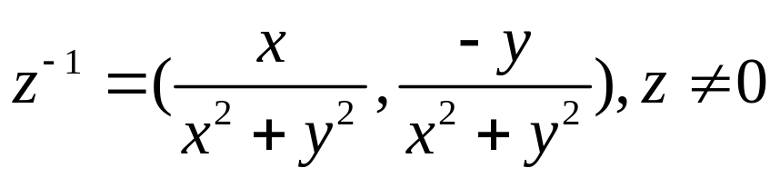
2. Basic Algebraic Properties
For any complex number z(x,y)
z + 0 = z; z ∙ 0 = 0; z ∙ 1 = z
Additive Inverse
-z = 0 – z = (-x, -y) ➔ (-x, -y) + (x, y) =(0,0)=0
Multiplicative Inverse
when z ≠ 0 , there is a number z⁻¹ (u,v) such that
z z⁻¹ =1 , then
(x,y) (u,v) =(1,0) ➔ xu-yv=1, yu+xv=0

Slide 11
Homework
pp. 5
Ex. 1, Ex.4, Ex. 8, Ex. 9

Slide 12
3. Further Properties
If z₁z₂=0, then so is at least one of the factors z₁ and z₂
Proof: Suppose that z₁ ≠ 0, then z₁⁻¹ exists
z₁⁻¹ (z₁z₂)=z₁⁻¹ 0 =0
z₁⁻¹ (z₁z₂)=( z₁⁻¹ z₁) z₂ =1 z₂ = z₂
Associative Laws
Therefore we have z₂=0

Slide 13
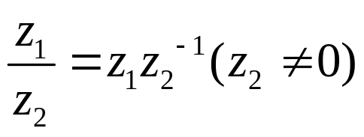
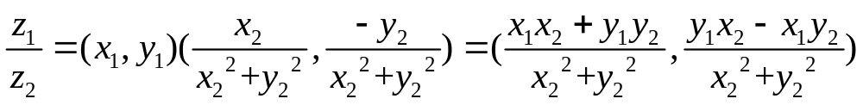
3. Further Properties
Other two operations: Subtraction and Division
Subtraction: z₁-z₂=z₁+(-z₂)
(x₁, y₁) - (x₂, y₂) = (x₁, y₁)+(-x₂, -y₂) = (x₁ -x₂, y₁-y₂)
Division:

Slide 14
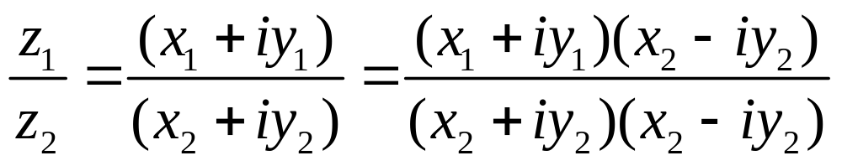
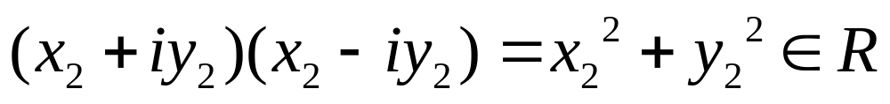
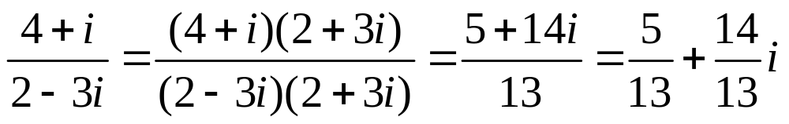
3. Further Properties
An easy way to remember to computer z₁/z₂
commonly used
Note that
For instance

Slide 15
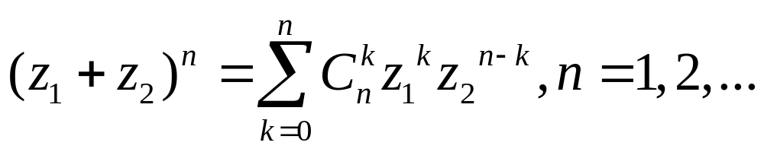
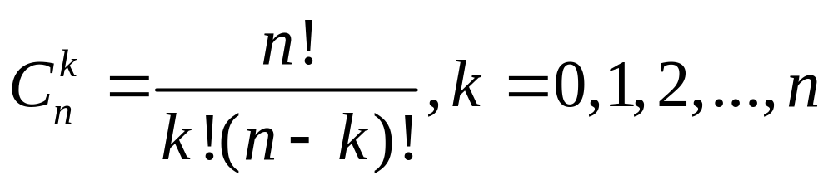
3. Further Properties
Binomial Formula
Where

Slide 16
3. Further Properties
pp.8
Ex. 1. Ex. 2, Ex. 3, Ex. 6

Slide 17




4. Vectors and Moduli
Any complex number is associated a vector from the origin to the point (x, y)
y
y
z₁=(x₁, y₁)
z₁+z₂
z₂=(x₂, y₂)
z₁
z₂
O
x
O
x
The moduli or absolute value of z
is a nonnegative real number
Sum of two vectors
Product: refer to pp.21

Slide 18

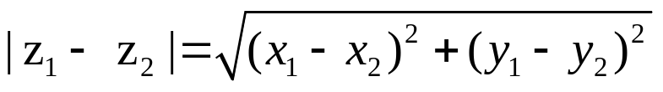
4. Vectors and Moduli
Example 1
The distance between two point z₁(x₁, y₁) and z₂(x₂, y₂)
is |z₁-z₂|.
Note: |z₁ - z₂ | is the length of the vector
representing the number z₁-z₂ = z₁ + (-z₂)
y
|z₁ - z₂ |
Therefore
-z₂
z₂
z₁
z₁ - z₂
O
x

Slide 19
4. Vectors and Moduli
Example 2
The equation |z-1+3i|=2 represents the circle whose
center is z₀ = (1, -3) and whose radius is R=2
y
Note: | z-1+3i |
= | z-(1-3i) |
= 2
x
O
z₀(1, -3)

Slide 20



4. Vectors and Moduli
Some important inequations
Since we have
Triangle inequality
y
z₁=(x, y)
O
x
y
z₁+z₂
z₁
z₂
O
x

Slide 21









4. Vectors and Moduli
Proof: when |z₁| ≥ |z₂|, we write
Triangle inequality
Similarly when |z₂| ≥ |z₁|, we write

Slide 22




4. Vectors and Moduli

Slide 23



4. Vectors and Moduli
Example 3
If a point z lies on the unit circle |z|=1 about the origin, then we have
y
z
O
1
2
x

Slide 24
4. Homework
pp. 12
Ex. 2, Ex. 4, Ex. 5

Slide 25
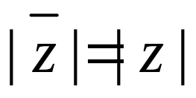
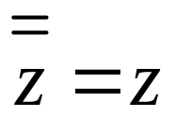
5. Complex Conjugates
Complex Conjugate (conjugate)
The complex conjugate or simply the conjugate, of a complex number z=x+iy is defined as the complex number x-iy and is denoted by z
y
Properties:
z(x,y)
O
x
z (x,-y)

Slide 26


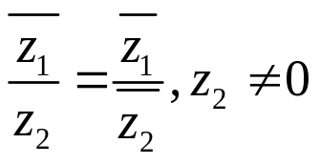
5. Complex Conjugates
If z₁=x₁+iy₁ and z₂=x₂+iy₂ , then
Similarly, we have

Slide 27

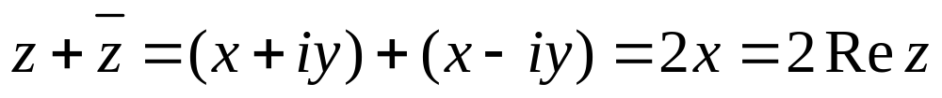
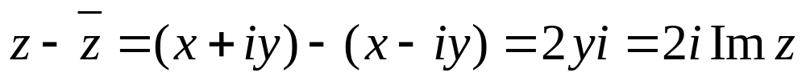
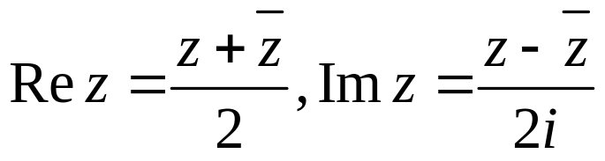
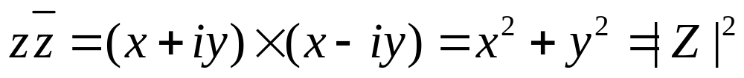
5. Complex Conjugates
If , then

Slide 28
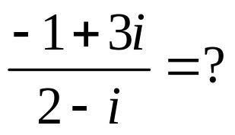
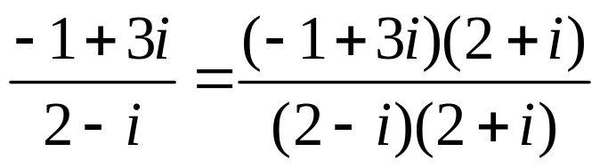
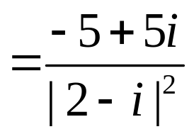
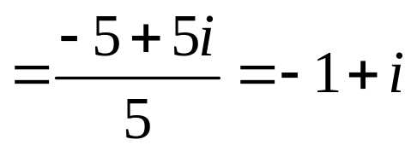
5. Complex Conjugates
Example 1

Slide 29
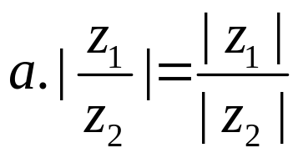
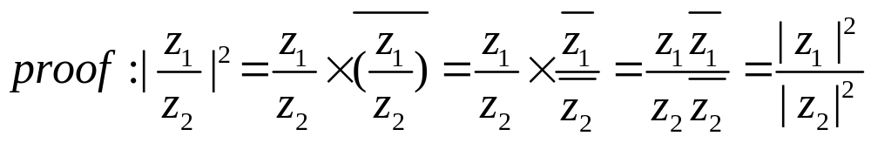
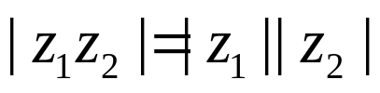
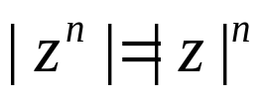





5. Complex Conjugates
Example 2
Refer to pp. 14

Slide 30
5. Homework
pp. 14 – 16
Ex. 1, Ex. 2, Ex. 7, Ex. 14

Slide 31

6. Exponential Form
Polar Form
Let r and θ be polar coordinates of the point (x,y) that corresponds to a nonzero complex number z=x+iy, since x=rcosθ and y=rsinθ, the number z can be written in polar form as z=r(cosθ + isinθ), where r>0
θ
Θ
y
y
z(x,y)
z(x,y)
argz: the argument of z
Argz: the principal value of argz
r
r
θ
θ
O
O
1
x
x

Slide 32
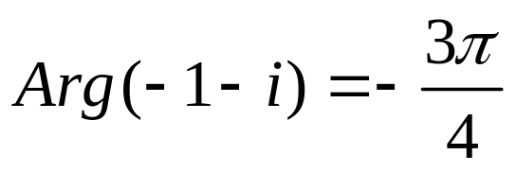
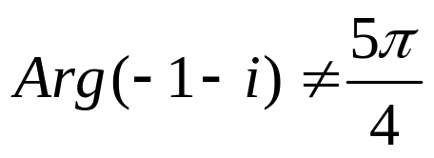
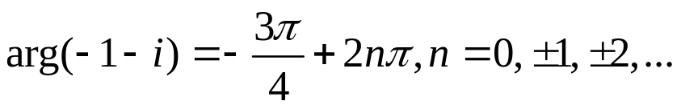
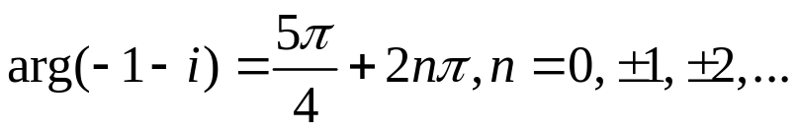
6. Exponential Form
Example 1
The complex number -1-i, which lies in the third quadrant has principal argument -3π/4. That is
It must be emphasized that the principal argument must be in the region of (-π, +π ]. Therefore,
However,
argz = α + 2nπ
Here: α can be any one
of arguments of z

Slide 33

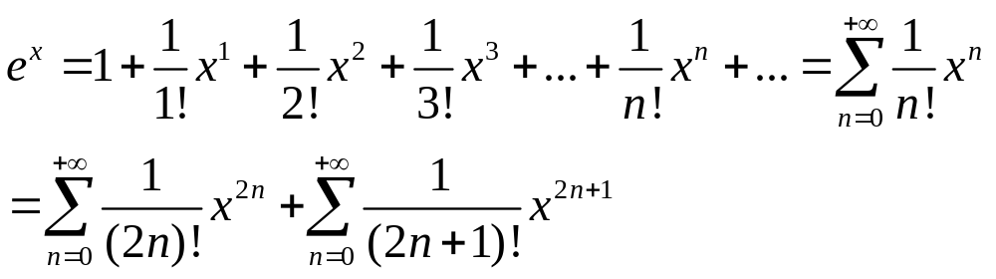
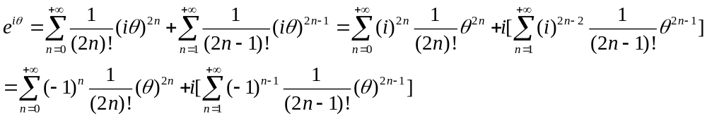
6. Exponential Form
The symbol e^{iθ} , or exp(iθ)
Why? Refer to Sec. 29
Let x=iθ, then we have
cosθ
sinθ

Slide 34
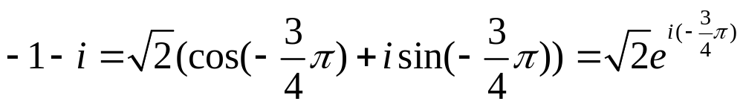
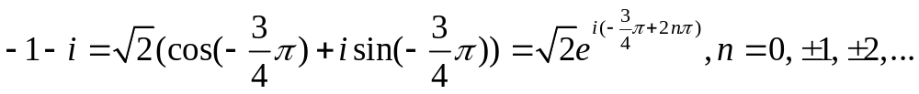
6. Exponential Form
Example 2
The number -1-i in Example 1 has exponential form

Slide 35
6. Exponential Form
z=Re^{iθ} where 0≤ θ ≤2 π
y
y
Re^{iθ}
θ
Re^{iθ}
z
z₀
θ
R
O
O
x
x
z=z₀ +Re^{iθ}

Slide 36
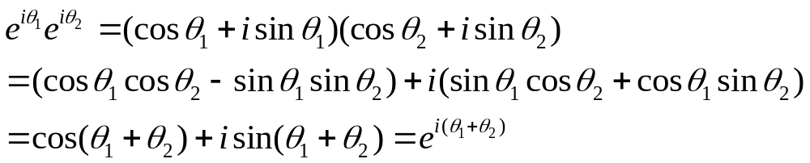

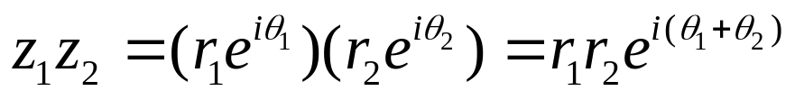
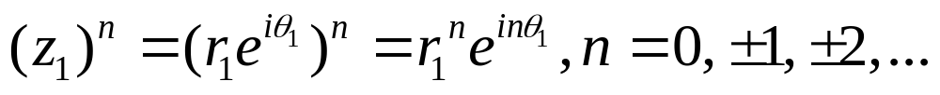
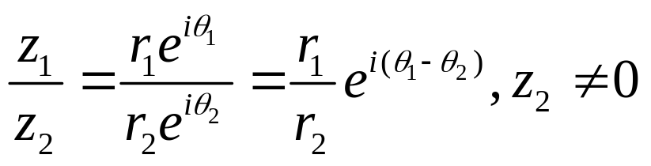
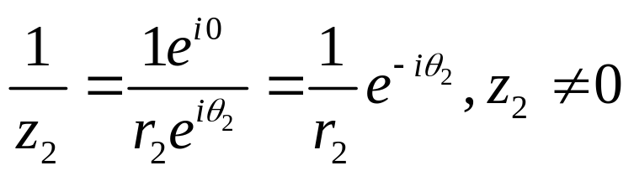
7. Products and Powers in Exponential Form
Product in exponential form

Slide 37

7. Products and Powers in Exponential Form
Example 1
In order to put in rectangular form, one need only write

Slide 38
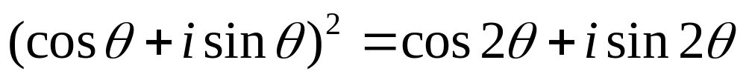
7. Products and Powers in Exponential Form
Example 2
de Moivre’s formula
pp. 23, Exercise 10, 11

Slide 39
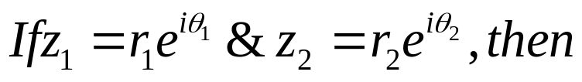
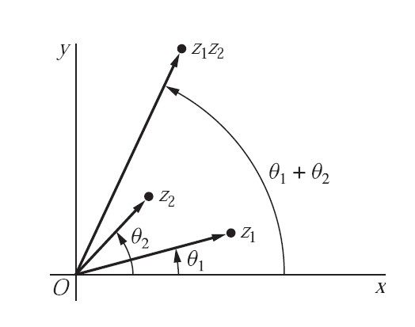
8. Arguments of products and quotients
θ₁ is one of arguments of z₁ and
θ₂ is one of arguments of z₂ then
θ₁ +θ₂ is one of arguments of z₁z₂
arg(z₁z₂)= θ₁ +θ₂ +2nπ, n=0, ±1, ±2 …
argz₁z₂= θ₁ +θ₂ +2(n₁+n₂)π
= (θ₁ +2n₁π)+ (θ₂ +2n₂π)
= argz₁+argz₂
Q: Argz₁z₂ = Argz₁+Argz₂?
Here: n₁ and n₂ are two integers with n₁+n₂=n

Slide 40
8. Arguments of products and quotients
Example 1
When z₁=-1 and z₂=i, then
Arg(z₁z₂)=Arg(-i) = -π/2
but
Arg(z₁)+Arg(z₂)=π+π/2=3π/2
≠
Note: Argz₁z₂=Argz₁+Argz₂ is not always true.

Slide 41
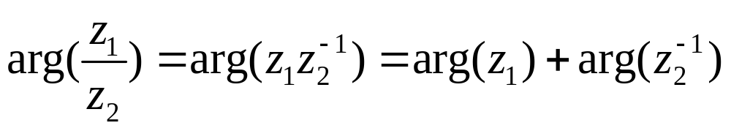
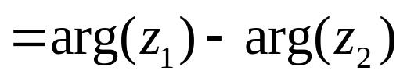
8. Arguments of products and quotients
Arguments of Quotients

Slide 42
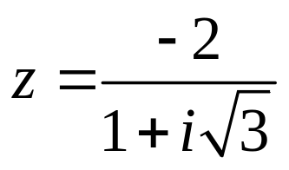
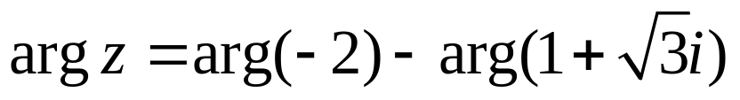
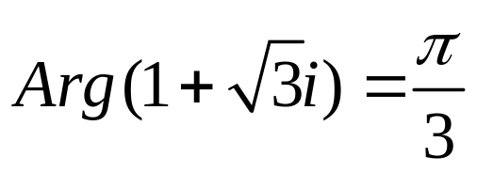

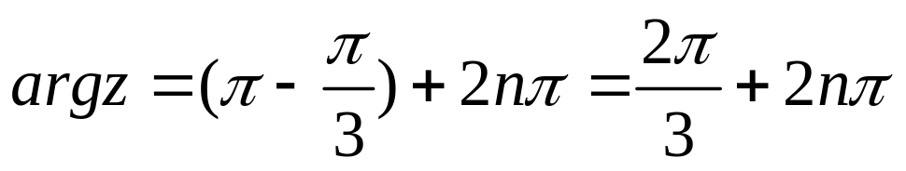
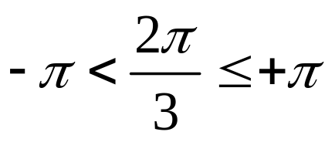
8. Arguments of products and quotients
Example 2
In order to find the principal argument Arg z when
observe that
since
Argz

Slide 43
8. Homework
pp. 22-24
Ex. 1, Ex. 6, Ex. 8, Ex. 10

Slide 44
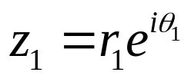
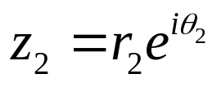



9. Roots of Complex Numbers
Two equal complex numbers
At the same point
If and only if
for some integer k

Slide 45






9. Roots of Complex Numbers
Roots of Complex Number
Given a complex number , we try to find all the number z, s.t.
Let then
thus we get
The unique positive nth root of r₀

Slide 46



9. Roots of Complex Numbers
The nth roots of z₀ are
Note:
All roots lie on the circle |z|;
There are exactly n distinct roots!
|z|

Slide 47





9. Roots of Complex Numbers
Let then
Therefore
where
Note: the number c₀ can be replaced by any particular nth root of z₀

Slide 48





10. Examples
Example 1
Let us find all values of (-8i)^{1/3}, or the three roots of the number -8i. One need only write
To see that the desired roots are
2i

Slide 49




10. Examples
Example 2
To determine the nth roots of unity, we start with
And find that
n=3
n=4
n=6

Slide 50







10. Examples
Example 3
the two values c_{k} (k=0,1) of , which are the square roots of , are found by writing

Slide 51
10. Homework
pp. 29-31
Ex. 2, Ex. 4, Ex. 5, Ex. 7, Ex. 9

Slide 52



11. Regions in the Complex Plane
ε- neighborhood
The ε- neighborhood
of a given point z₀ in the complex plane as shown below
y
y
ε
ε
z
z
z₀
z₀
O
O
x
x
Neighborhood
Deleted neighborhood

Slide 53
11. Regions in the Complex Plane
Interior Point
A point z₀ is said to be an interior point of a set S whenever there is some neighborhood of z₀ that contains only points of S
Exterior Point
A point z₀ is said to be an exterior point of a set S when there exists a neighborhood of it containing no points of S;
Boundary Point
A boundary point is a point all of whose neighborhoods contain at least one point in S and at least one point not in S.
The totality of all boundary points is called the boundary of S.

Slide 54
11. Regions in the Complex Plane
Consider the set S={z| |z|≤1}
All points z, where |z|>1
are Exterior points of S;
y
z₀
z₀
O
x
z₀
All points z, where |z|<1
are Interior points of S;
All points z, where |z|=11
are Boundary points of S;

Slide 55
11. Regions in the Complex Plane
Open Set
A set is open if it and only if each of its points is an interior point.
Closed Set
A set is closed if it contains all of its boundary points.
Closure of a set
The closure of a set S is the closed set consisting of all points in S together with the boundary of S.

Slide 56
11. Regions in the Complex Plane
Examples
S={z| |z|<1} ?
Open Set
S={z| |z|≤1} ?
Closed Set
S={z| |z|≤1} – {(0,0)} ?
Neither open nor closed
S= all points in complex plane ?
Both open and closed
Key: identify those boundary points of a given set

Slide 57

11. Regions in the Complex Plane
Connected
An open set S is connected if each pair of points z₁ and z₂ in it can be joined by a polygonal line, consisting of a finite number of line segments joined end to end, that lies entirely in S.
y
O
x
The open set
1<|z|<2 is connected.
The set S={z| |z|<1 U |z-(2+i)|<1} is open
However, it is not connected.

Slide 58
11. Regions in the Complex Plane
Domain
A set S is called as a domain iff
S is open;
S is connected.
e.g. any neighborhood is a domain.
Region
A domain together with some, none, or all of it boundary points is referred to as a region.

Slide 59
11. Regions in the Complex Plane
Bounded
A set S is bounded if every point of S lies inside some circle |z|=R; Otherwise, it is unbounded.
y
e.g. S={z| |z|≤1} is bounded
S
R
S={z| Rez≥0} is unbounded
O
x

Slide 60
11. Regions in the Complex Plane
Accumulation point
A point z₀ is said to be an accumulation point of a set S if each deleted neighborhood of z₀ contains at least one point of S.
If a set S is closed, then it contains each of its accumulation points. Why?
A set is closed iff it contains all of its accumulation points
e.g. the origin is the only accumulation point of the set Z_{n}=i/n, n=1,2,…
The relationships among the Interior, Exterior, Boundary and Accumulation Points!
An Interior point must be an accumulation point.
An Exterior point must not be an accumulation point.
A Boundary point must be an accumulation point?

Slide 61
11. Homework
pp. 33
Ex. 1, Ex. 2, Ex. 5, Ex. 6, Ex.10

