Slide 1
Chapter 3. Elementary Functions
Weiqi Luo (骆伟祺)
School of Data & Computer Science
Sun Yat-Sen University
Email：luoweiqi@mail.sysu.edu.cn

Slide 2
Chapter 3: Elementary Functions
The Exponential Functions
The Logarithmic Function
Branches and Derivatives of Logarithms
Some Identities Involving Logarithms
Complex Exponents
Trigonometric Function
Hyperbolic Functions
Inverse Trigonometric and Hyperbolic Functions

Slide 3
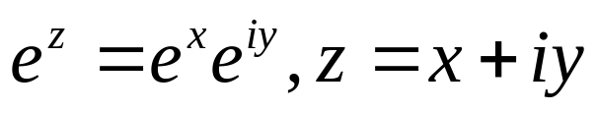
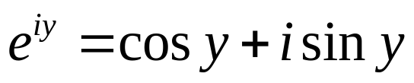
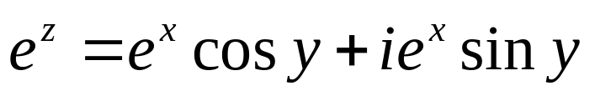
29. The Exponential Function
The Exponential Function
Single-Valued
According to the Euler’ Formula
u(x,y)
v(x,y)
Note that here when x=1/n (n=2,3…) & y=0, e^{1/n} denotes the positive nth root of e.

Slide 4
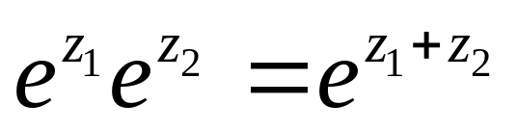
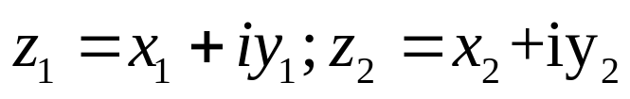

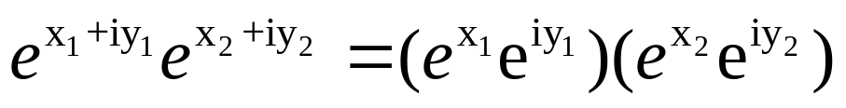
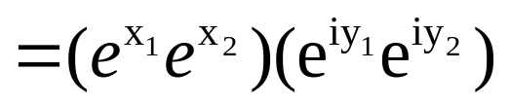

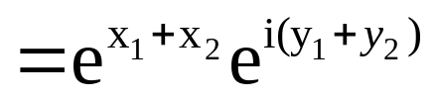
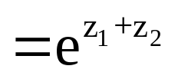

29. The Exponential Function
Properties
Let
Real value:
Refer to pp. 18

Slide 5
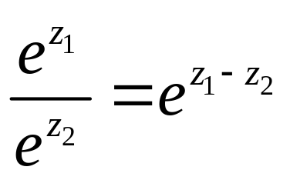
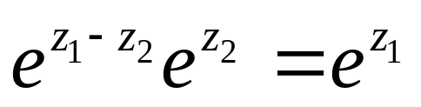
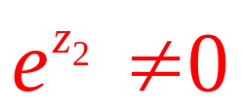
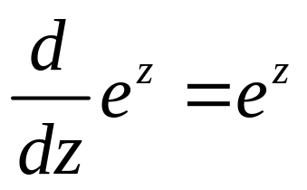
29. The Exponential Function
Properties
Refer to Example 1 in Sec 22, (pp.68), we have that
everywhere in the z plane
which means that the function e^{z} is entire.

Slide 6
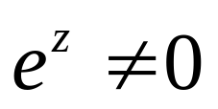
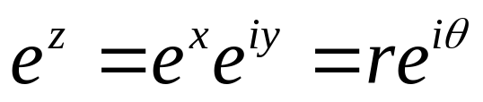
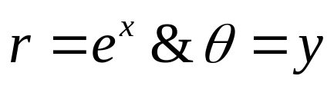
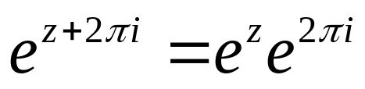

29. The Exponential Function
Properties
For any complex number z
which means that the function e^{z} is periodic, with a pure imaginary period of 2πi

Slide 7
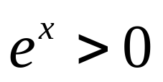
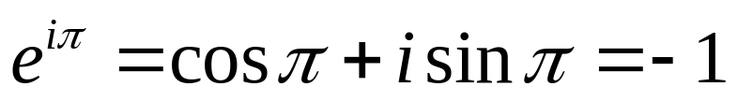
29. The Exponential Function
Properties
For any real value x
while e^{z} can be a negative value, for instance

Slide 8
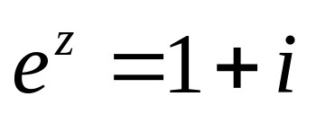
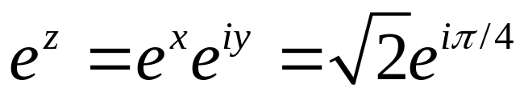
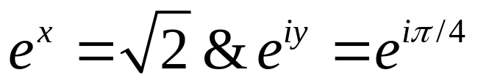
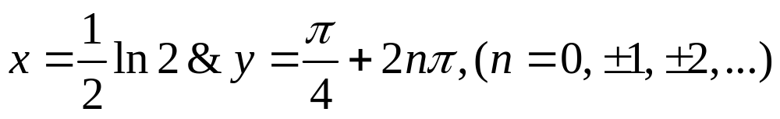
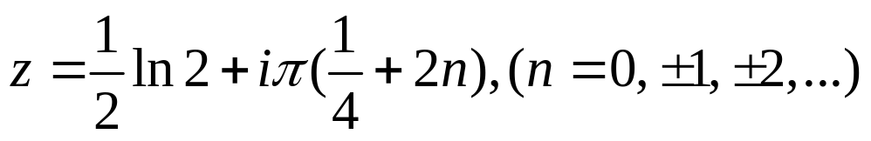
29. The Exponential Function
Example
In order to find numbers z=x+iy such that

Slide 9
29. Homework
pp. 92-93
Ex. 1, Ex. 6, Ex. 8

Slide 10


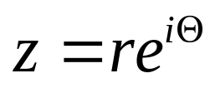


30. The Logarithmic Function
The Logarithmic Function
Please note that the Logarithmic Function is the multiple-valued function.
One to infinite values
…
It is easy to verify that

Slide 11


30. The Logarithmic Function
The Logarithmic Function
Suppose that 𝝝 is the principal value of argz, i.e. -π <𝝝 ≤π
is single valued.
And

Slide 12
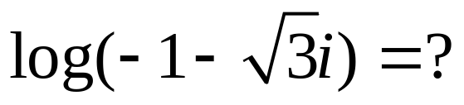
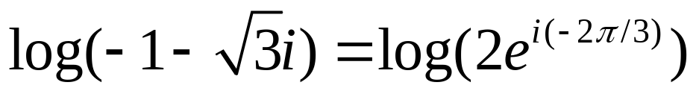
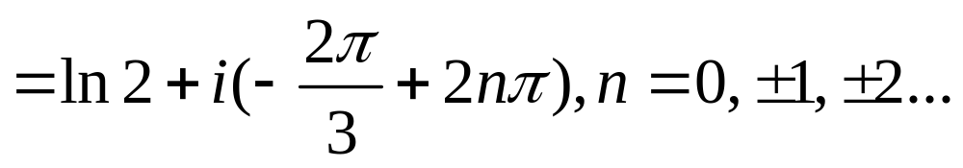
30. The Logarithmic Function
Example 1

Slide 13


30. The Logarithmic Function
Example 2 & 3

Slide 14


31. Branches and Derivatives of Logarithms
The Logarithm Function
where𝝝=Argz, is multiple-valued.
If we let θ is any one of the value in arg(z), and let α denote any real number and restrict the value of θ so that
The above function becomes single-valued.
With components

Slide 15

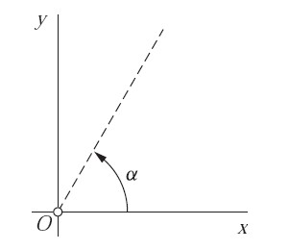

31. Branches and Derivatives of Logarithms
The Logarithm Function
is not only continuous but also analytic throughout the domain
A connected open set

Slide 16
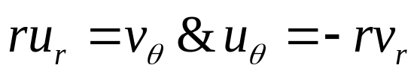
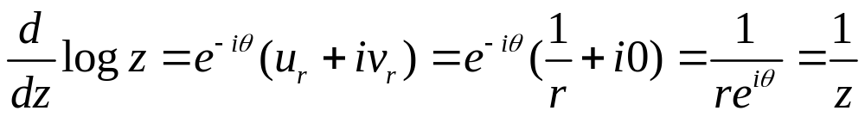
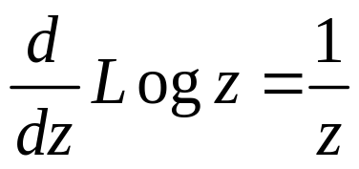
31. Branches and Derivatives of Logarithms
The derivative of Logarithms

Slide 17
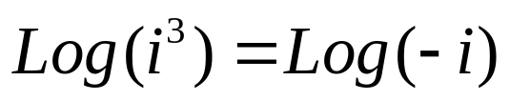
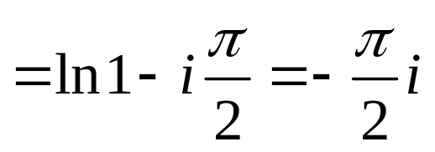
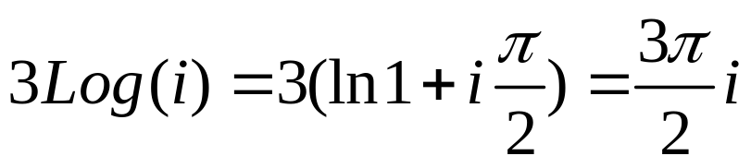
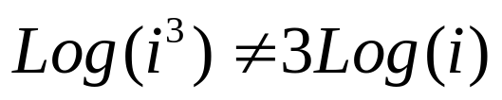
31. Branches and Derivatives of Logarithms
Examples
When the principal branch is considered, then
And

Slide 18
31. Homework
pp. 97-98
Ex. 1, Ex. 3, Ex. 4, Ex. 9, Ex. 10

Slide 19
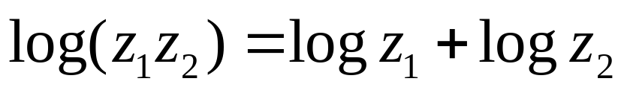
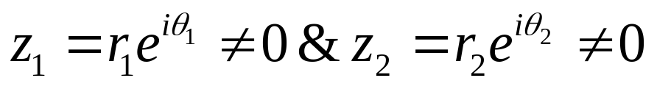
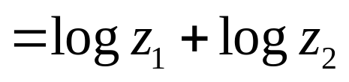
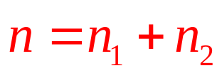
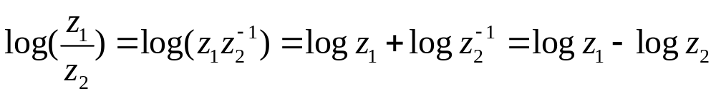
32. Some Identities Involving Logarithms
where

Slide 20
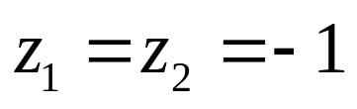
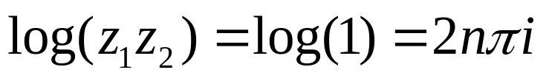
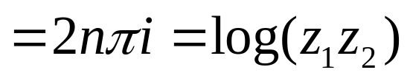
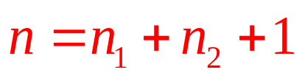
32. Some Identities Involving Logarithms
Example

Slide 21
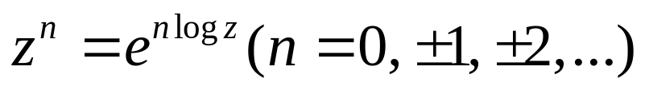
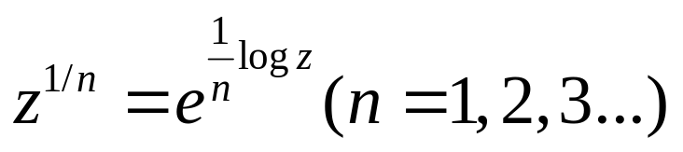
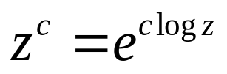
32. Some Identities Involving Logarithms
When z≠0, then
Where c is any complex number

Slide 22
32. Homework
pp. 100
Ex. 1, Ex. 2, Ex. 3

Slide 23
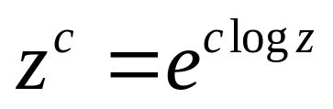
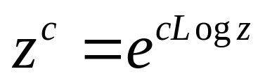
33. Complex Exponents
Complex Exponents
When z≠0 and the exponent c is any complex number, the function z^{c} is defined by means of the equation
where logz denotes the multiple-valued logarithmic function. Thus, z^{c} is also multiple-valued.
The principal value of z^{c} is defined by

Slide 24





33. Complex Exponents
If and α is any real number, the branch
Of the logarithmic function is single-valued and analytic in the indicated domain.
When the branch is used, it follows that the function
is single-valued and analytic in the same domain.

Slide 25


33. Complex Exponents
Example 1
Note that i^{-2i} are all real numbers

Slide 26


33. Complex Exponents
Example 2
The principal value of (-i)^{i} is
P.V.

Slide 27


33. Complex Exponents
Example 3
The principal branch of z^{2/3} can be written
Thus
P.V.
This function is analytic in the domain r>0, -π<𝝝<π

Slide 28








33. Complex Exponents
Example 4
Consider the nonzero complex numbers
When principal values are considered

Slide 29


33. Complex Exponents
The exponential function with base c
Based on the definition, the function c^{z} is multiple-valued.
And the usual interpretation of e^{z} (single-valued) occurs when the principal value of the logarithm is taken. The principal value of loge is unity.
When logc is specified, c^{z} is an entire function of z.

Slide 30
33. Homework
pp. 104
Ex. 2, Ex. 4, Ex. 8

Slide 31


34. Trigonometric Functions
Trigonometric Functions
Based on the Euler’s Formula
Here x and y are real numbers
Here z is a complex number

Slide 32

34. Trigonometric Functions
Trigonometric Functions
Both sinz and cosz are entire since they are linear combinations
of the entire Function e^{iz} and e^{-iz}

Slide 33
34. Homework
pp.108-109
Ex. 2, Ex. 3

Slide 34


35. Hyperbolic Functions
Hyperbolic Function
Both sinhz and coshz are entire since they are linear combinations
of the entire Function e^{iz} and e^{-iz}

Slide 35
35. Hyperbolic Functions
Hyperbolic v.s. Trgonometric

Slide 36
35. Homework
pp. 111-112
Ex. 3

Slide 37








36. Inverse Trigonometric and Hyperbolic Functions
In order to define the inverse sin function sin⁻¹z, we write
When
Similar, we get
Multiple-valued functions.
One to infinite many values
Note that when specific branches of the square root and logarithmic functions are used,
all three Inverse functions become single-valued and analytic.

Slide 38



36. Inverse Trigonometric and Hyperbolic Functions
Inverse Hyperbolic Functions

Slide 39
36. Homework
pp. 114-115
Ex. 1

