Slide 1
Chapter 4. Integrals
Weiqi Luo (骆伟祺)
School of Data & Computer Science
Sun Yat-Sen University
Email：luoweiqi@mail.sysu.edu.cn

Slide 2
Chapter 4: Integrals
Derivatives of Functions w(t)
Definite Integrals of Functions w(t)
Contours; Contour Integrals;
Some Examples; Example with Branch Cuts
Upper Bounds for Moduli of Contour Integrals
Anti derivatives; Proof of the Theorem
Cauchy-Goursat Theorem; Proof of the Theorem
Simply Connected Domains; Multiple Connected Domains;
Cauchy Integral Formula; An Extension of the Cauchy Integral Formula; Some Consequences of the Extension
Liouville’s Theorem and the Fundamental Theorem
Maximum Modulus Principle

Slide 3
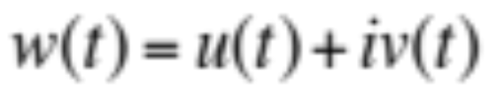
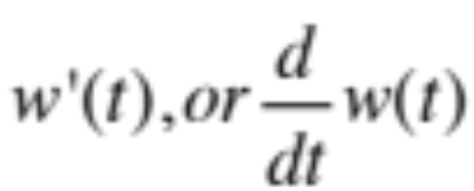
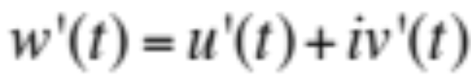
37. Derivatives of Functions w(t)
Consider derivatives of complex-valued functions w of real variable t
where the function u and v are real-valued functions of t. The derivative
of the function w(t) at a point t is defined as

Slide 4
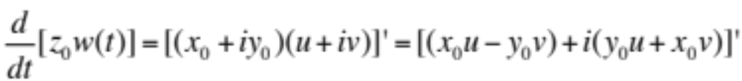
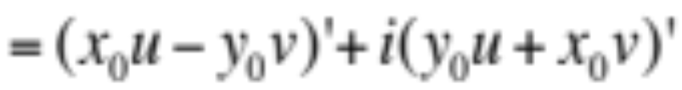
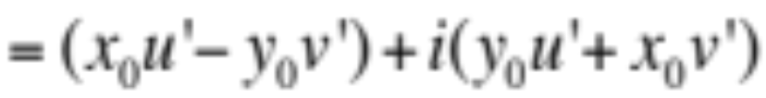
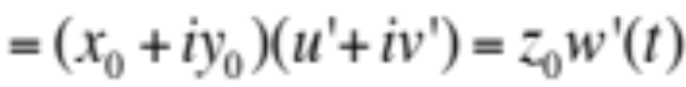
37. Derivatives of Functions w(t)
Properties
For any complex constant z₀=x₀+iy₀,
u(t)
v(t)

Slide 5
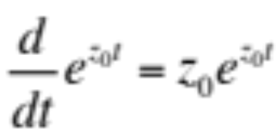
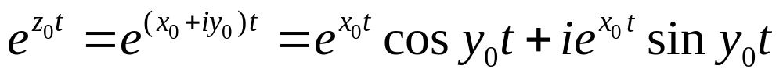
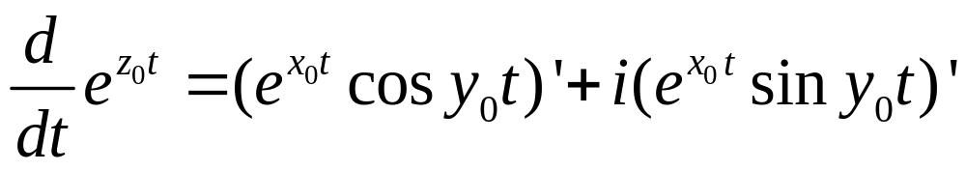
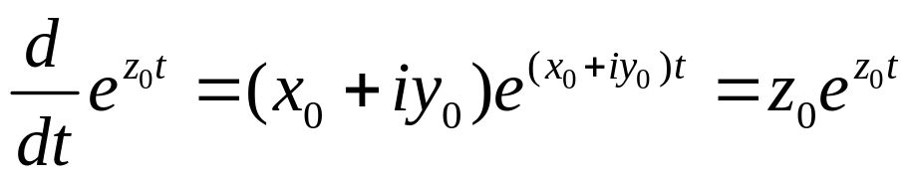
37. Derivatives of Functions w(t)
Properties
where z₀=x₀+iy₀. We write
u(t)
v(t)
Similar rules from calculus and some simple algebra then lead us to the expression

Slide 6
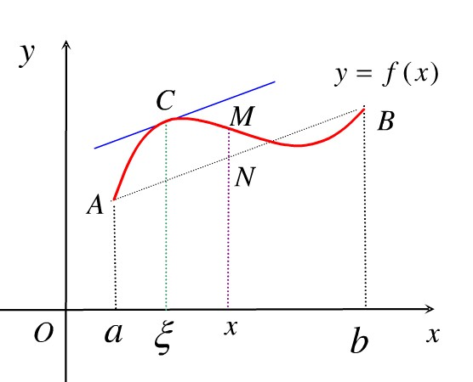
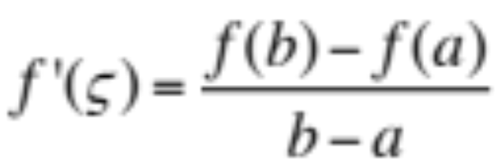
37. Derivatives of Functions w(t)
Example
Suppose that the real function f(t) is continuous on an interval a≤ t ≤b, if f’(t) exists when a<t<b, the mean value theorem for derivatives tells us that there is a number ζ in the interval a<ζ<b such that

Slide 7
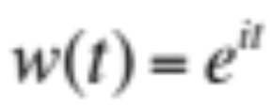

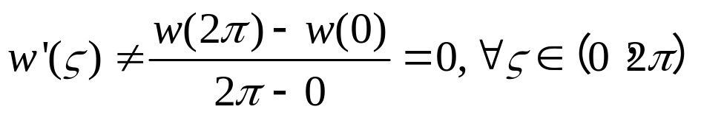

37. Derivatives of Functions w(t)
Example (Cont’)
The mean value theorem no longer applies for some complex functions. For instance, the function
on the interval 0 ≤ t ≤ 2π .
Please note that
And this means that the derivative w’(t) is never zero, while

Slide 8
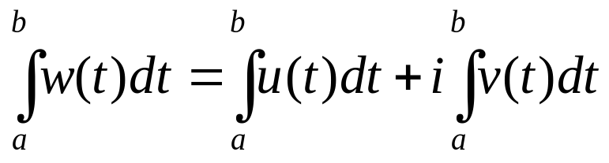
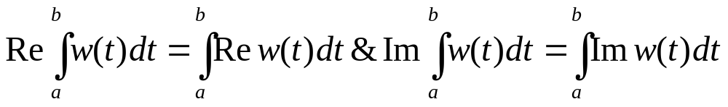
38. Definite Integrals of Functions w(t)
When w(t) is a complex-valued function of a real variable t and is written
where u and v are real-valued, the definite integral of w(t) over an interval a ≤ t ≤ b is defined as
Provided the individual integrals on the right exist.

Slide 9
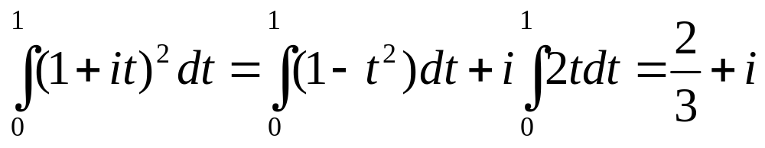
38. Definite Integrals of Functions w(t)
Example 1

Slide 10
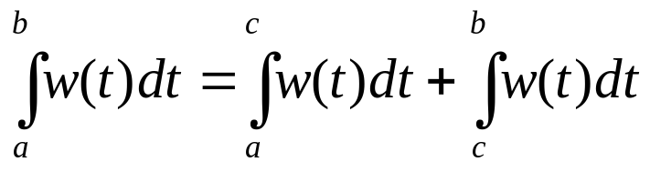
38. Definite Integrals of Functions w(t)
Properties
The existence of the integrals of u and v is ensured if those functions are piecewise continuous on the interval a ≤ t ≤ b. For instance,

Slide 11

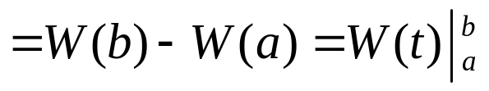
38. Definite Integrals of Functions w(t)
Integral vs. Anti-derivative
Suppose that
are continuous on the interval a ≤ t ≤ b.
If W’(t)=w(t) when a ≤ t ≤ b, then U’(t)=u(t) and V’(t)=v(t). Hence, in view of definition of the integrals of function

Slide 12
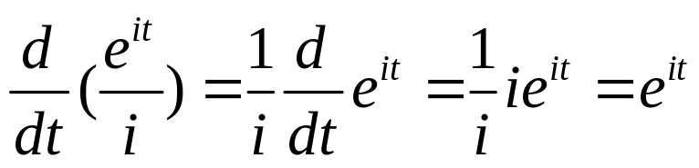
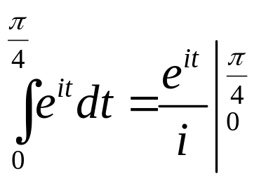
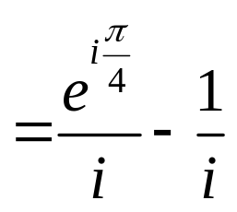
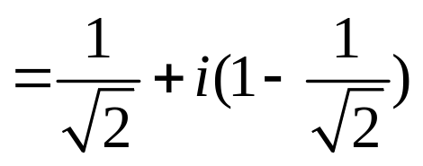
38. Definite Integrals of Functions w(t)
Example 2
Since
one can see that

Slide 13
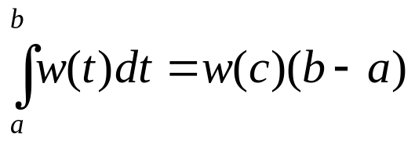
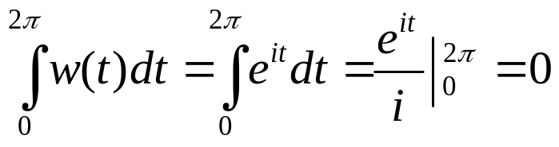

38. Definite Integrals of Functions w(t)
Example 3
Let w(t) be a continuous complex-valued function of t defined on an interval a ≤ t ≤ b. In order to show that it is not necessarily true that there is a number c in the interval a <t< b such that
We write a=0, b=2π and use the same function w(t)=e^{it} (0 ≤ t ≤ 2π) as the Example in the previous Section (pp.118). We then have that
However, for any number c such that 0 < c < 2π
And this means that w(c)(b-a) is not zero.

Slide 14
38. Homework
pp. 121
Ex. 1, Ex. 2, Ex. 4

Slide 15
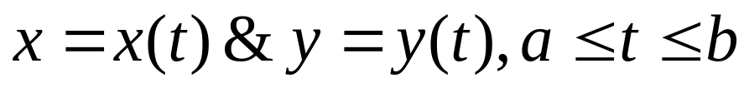
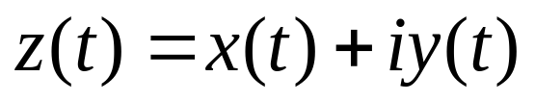
39. Contours
Arc
A set of points z=(x, y) in the complex plane is said to be an arc if
where x(t) and y(t) are continuous functions of the real parameter t. This definition establishes a continuous mapping of the interval a ≤ t ≤ b in to the xy, or z, plane.
And the image points are ordered according to increasing values of t. It is convenient to describe the points of C by means of the equation

Slide 16
39. Contours
Simple arc (Jordan arc)
The arc C: z(t)=x(t)+iy(t) is a simple arc, if it does not cross itself; that is, C is simple if z(t₁)≠z(t₂) when t₁≠t₂
Simple closed curve (Jordan curve)
When the arc C is simple except for the fact that z(b)=z(a), we say that C is simple closed curve.
Define that such a curve is positively oriented when it is in the counterclockwise direction.

Slide 17
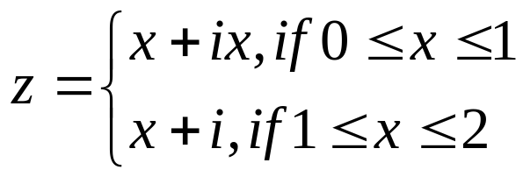
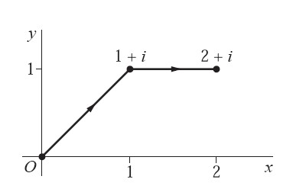
39. Contours
Example 1
The polygonal line defined by means of the equations
and consisting of a line segment from 0 to 1+i followed by one from 1+i to 2+i is a simple arc

Slide 18
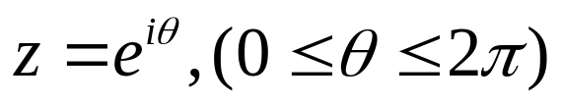
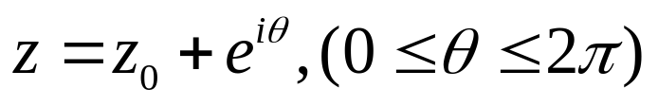
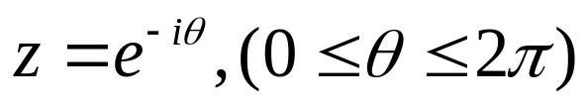
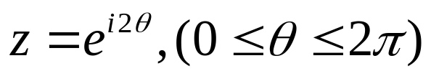
39. Contours
Example 2~4
The unit circle
about the origin is a simple closed curve, oriented in the counterclockwise direction.
So is the circle
centered at the point z₀ and with radius R.
The set of points
This unit circle is traveled in the clockwise direction.
The set of point
This unit circle is traversed twice in the counterclockwise direction.
Note: the same set of points can make up different arcs.

Slide 19

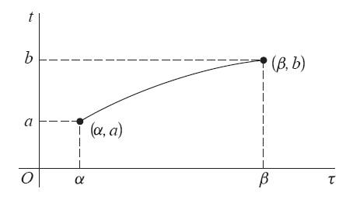


39. Contours
The parametric representation used for any given arc C is not unique
To be specific, suppose that
where Φ is a real-valued function mapping an interval α ≤ τ ≤ β onto a ≤ t ≤ b.
The same arc C
Here we assume Φ is a continuous functions with a continuous derivative, and Φ’(τ)>0 for each τ (why?)

Slide 20
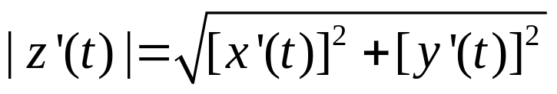
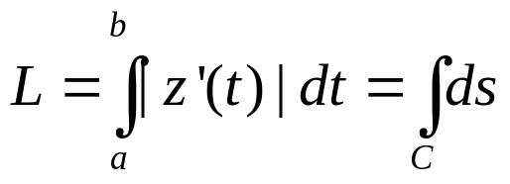
39. Contours
Differentiable arc
Suppose the arc function is z(t)=x(t)+iy(t), and the components x’(t) and y’(t) of the derivative z(t) are continuous on the entire interval a ≤ t ≤ b.
Then the arc is called a differentiable arc, and the real-valued function
is integrable over the interval a ≤ t ≤ b.
In fact, according to the definition of a length in calculus, the length of C is the number
Note: The value L is invariant under certain changes in the representation for C.

Slide 21
39. Contours
Smooth arc
A smooth arc z=z(t) (a ≤ t ≤ b), then it means that the derivative z’(t) is continuous on the closed interval a ≤ t ≤ b and nonzero throughout the open interval a < t < b.
A Piecewise smooth arc (Contour)
Contour is an arc consisting of a finite number of smooth arcs joined end to end. (e.g. Fig. 36)
Simple closed contour
When only the initial and final values of z(t) are the same, a contour C is called a simple closed contour. (e.g. the unit circle in Ex. 5 and 6)

Slide 22
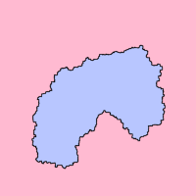
39. Contours
Jordan Curve Theorem
Interior of C (bounded)
Jordan Curve Theorem asserts that
every Jordan curve divides the plane into an "interior" region bounded by the curve and an "exterior" region containing all of the nearby and far away exterior points.
Jordan curve
Exterior of C (unbounded)
Refer to: http://en.wikipedia.org/wiki/Jordan_curve_theorem

Slide 23
39. Homework
pp. 125-126
Ex. 1, Ex. 3, Ex.4

Slide 24
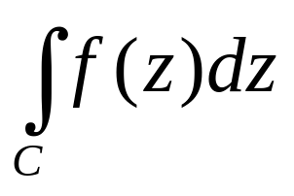
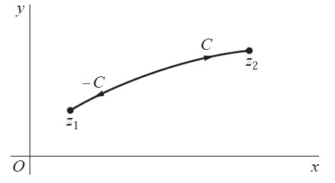
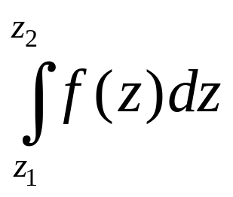
40. Contour Integrals
Consider the integrals of complex-valued function f of the complex variable z on a given contour C, extending from a point z=z₁ to a point z=z₂ in the complex plane.
or
When the value of the integral is independent of the choice
of the contour taken between two fixed end points.

Slide 25
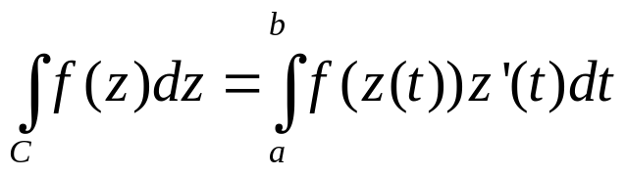
40. Contour Integrals
Contour Integrals
Suppose that the equation z=z(t) (a ≤ t ≤b) represents a contour C, extending from a point z₁=z(a) to a point z₂=z(b). We assume that f(z(t)) is piecewise continuous on the interval a ≤ t ≤b, then define the contour integral of f along C in terms of the parameter t as follows
Contour integral
On the integral [a b] as defined previously
Note the value of a contour integral is invariant under a change
in the representation of its contour C.

Slide 26
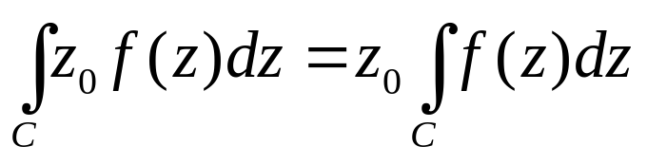
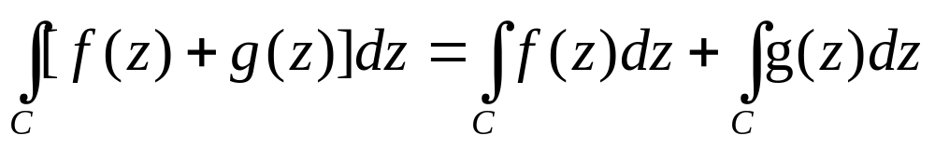
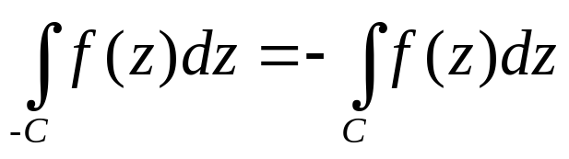
40. Contour Integrals
Properties
Note that the value of the contour integrals
depends on the directions of the contour

Slide 27
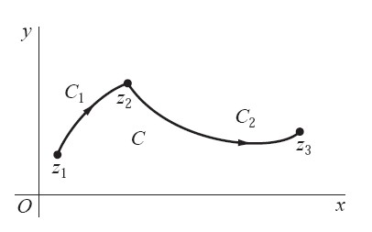
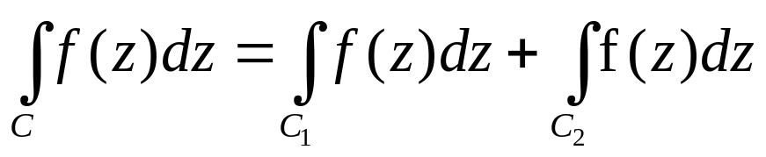
40. Contour Integrals
Properties
The contour C is called the sum of its legs C₁ and C₂ and is denoted by C₁+C₂

Slide 28
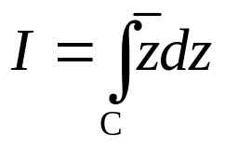
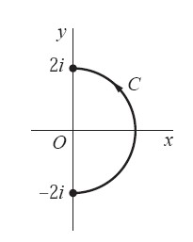
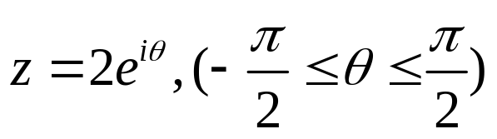






41. Some Examples
Example 1
Let us find the value of the integral
when C is the right-hand half

Slide 29





41. Some Examples
Example 2
C₁ denotes the polygnal line OAB, calculate the integral
Where
The leg OA may be represented parametrically as z=0+iy, 0≤y ≤1
In this case, f(z)=y, then we have

Slide 30


41. Some Examples
Example 2 (Cont’)
Similarly, the leg AB may be represented parametrically as z=x+i, 0≤x ≤1
In this case, f(z)=1-x-i3x², then we have
Therefore, we get

Slide 31


41. Some Examples
Example 2 (Cont’)
C₂ denotes the polygonal line OB of the line y=x, with parametric representation z=x+ix (0≤ x ≤1)
A nonzero value

Slide 32




41. Some Examples
Example 3
We begin here by letting C denote an arbitrary smooth arc
from a fixed point z₁ to a fixed point z₂. In order to calculate the integral
Please note that

Slide 33


41. Some Examples
Example 3 (Cont’)
The value of the integral is only dependent on the two end points z₁ and z₂

Slide 34



41. Some Examples
Example 3 (Cont’)
When C is a contour that is not necessarily smooth since a contour consists of a finite number of smooth arcs C_{k} (k=1,2,…n) jointed end to end. More precisely, suppose that each C_{k} extend from w_{k} to w_{k+1}, then

Slide 35




42. Examples with Branch Cuts
Example 1
Let C denote the semicircular path
from the point z=3 to the point z = -3.
Although the branch
of the multiple-valued function z^{1/2} is not defined at the initial point z=3 of the contour C, the integral
nevertheless exists.
Why?

Slide 36







42. Examples with Branch Cuts
Example 1 (Cont’)
Note that
At θ=0, the real and imaginary component are 0 and
Thus f[z(θ)]z’(θ) is continuous on the closed interval 0≤ θ ≤ π when its value at θ=0
is defined as

Slide 37





42. Examples with Branch Cuts
Example 2
Suppose that C is the positively oriented circle
Let a denote any nonzero real number. Using the principal branch
of the power function z^{a-1}, let us evaluate the integral
-R

Slide 38


42. Examples with Branch Cuts
Example 2 (Cont’)
when z(θ)=Re^{iθ}, it is easy to see that
where the positive value of Rª is to be taken.
Thus, this function is piecewise continuous on -π ≤ θ ≤ π, the integral exists.
If a is a nonzero integer n, the integral becomes 0
If a is zero, the integral becomes 2πi.

Slide 39
42. Homework
pp. 135-136
Ex. 2, Ex. 5, Ex. 7, Ex. 8, Ex. 10

Slide 40




43. Upper Bounds for Moduli of Contour Integrals
Lemma
If w(t) is a piecewise continuous complex-valued function defined on an interval a ≤ t ≤b
Proof:
Case #1:
holds
Case #2:

Slide 41


43. Upper Bounds for Moduli of Contour Integrals
Lemma (Cont’)
Note that the values in both sizes of this equation are real numbers.
Why?

Slide 42


43. Upper Bounds for Moduli of Contour Integrals
Theorem
Let C denote a contour of length L, and suppose that a function f(z) is piecewise continuous on C. If M is a nonnegative constant such that
For all point z on C at which f(z) is defined, then

Slide 43



43. Upper Bounds for Moduli of Contour Integrals
Theorem (Cont’)
Proof: We let z=z(t) (a ≤ t ≤ b) be a parametric representation of C. According to the lemma, we have

Slide 44





43. Upper Bounds for Moduli of Contour Integrals
Example 1
Let C be the arc of the circle |z|=2 from z=2 to z=2i that lies in the first quadrant. Show that
Based on the triangle inequality,
Then, we have
And since the length of C is L=π, based on the theorem

Slide 45




43. Upper Bounds for Moduli of Contour Integrals
Example 2
Here C_{R} is the semicircular path
and z^{1/2} denotes the branch (r>0, -π/2<θ<3π/2)
Without calculating the integral, show that

Slide 46





43. Upper Bounds for Moduli of Contour Integrals
Example 2 (Cont’)
Note that when |z|=R>1
Based on the theorem

Slide 47
43. Homework
pp. 140-141
Ex. 3, Ex. 4, Ex. 5

Slide 48

44. Antiderivatives
Theorem
Suppose that a function f (z) is continuous on a domain D. If any one of the following statements is true, then so are the others
f (z) has an antiderivative F(z) throughout D;
the integrals of f (z) along contours lying entirely in D and extending from any fixed point z₁ to any fixed point z₂ all have the same value, namely
where F(z) is the antiderivative in statement (a);
the integrals of f (z) around closed contours lying entirely in D all have value zero.

Slide 49

44. Antiderivatives
Example 1
The continuous function f (z) = z² has an antiderivative F(z) = z³/3 throughout the plane. Hence
For every contour from z=0 to z=1+i

Slide 50


44. Antiderivatives
Example 2
The function f (z) = 1/z², which is continuous everywhere except at the origin, has an antiderivative F(z) = −1/z in the domain |z| > 0, consisting of the entire plane with the origin deleted. Consequently,
Where C is the positively oriented circle

Slide 51



44. Antiderivatives
Example 3
Let C denote the circle as previously, calculate the integral
It is known that
For any given branch
?

Slide 52



44. Antiderivatives
Example 3 (Cont’)
Let C₁ denote
The principal branch

Slide 53



44. Antiderivatives
Example 3 (Cont’)
Let C₂ denote
Consider the function
Why not Logz?

Slide 54


44. Antiderivatives
Example 3 (Cont’)
The value of the integral of 1/z around the entire circle C=C₁+C₂ is thus obtained:

Slide 55



44. Antiderivatives
Example 4
Let us use an antiderivative to evaluate the integral
where the integrand is the branch
Let C₁ is any contour from z=-3 to 3 that, except for
its end points, lies above the X axis.
Let C₂ is any contour from z=-3 to 3 that, except for
its end points, lies below the X axis.

Slide 56



44. Antiderivatives
Example 4 (Cont’)
f₁ is defined and continuous everywhere on C₁

Slide 57

44. Antiderivatives
Example 4 (Cont’)
f₂ is defined and continuous everywhere on C₂

Slide 58


45. Proof of the Theorem
Basic Idea: (a) ➔ (b) ➔ (c) ➔ (a)
(a) ➔ (b)
Suppose that (a) is true, i.e. f(z) has an antiderivative F(z) on the domain D being considered.
If a contour C from z₁ to z₂ is a smooth are lying in D, with parametric representation z=z(t) (a≤ t≤b), since
Note: C is not necessarily a smooth one, e.g. it may contain finite number of smooth arcs.

Slide 59




45. Proof of the Theorem
(b)➔ (c)
Suppose the integration is independent of paths, we try to show that the value of any integral around a closed contour C in D is zero.
C=C1-C2 denote any integral around a closed contour C in D

Slide 60

45. Proof of the Theorem
(c) ➔ (a)
Suppose that the integrals of f (z) around closed contours lying entirely in D all have value zero. Then, we can get the integration is independent of path in D (why?)
We create the following function
and try to show that F’(z)=f(z) in D
i.e. (a) holds

Slide 61





45. Proof of the Theorem
Since the integration is independent of path in D, we consider the path of integration in a line segment in the following. Since

Slide 62




45. Proof of the Theorem
Please note that f is continuous at the point z, thus, for each positive number ε,
a positive number δ exists such that
When
Consequently, if the point z+Δz is close to z so that | Δ z| <δ, then

Slide 63
45. Homework
pp. 149
Ex. 2, Ex. 3, Ex. 4

Slide 64
46. Cauchy-Goursat Theorem
Cauchy-Goursat Theorem
Give other conditions on a function f which ensure that the value of the integral of f(z) around a simple closed contour is zero.
The theorem is central to the theory of functions of a complex variable, some modification of it, involving certain special types of domains, will be given in Sections 48 and 49.

Slide 65


46. Cauchy-Goursat Theorem
Let C be a simple closed contour z=z(t) (a≤t ≤b) in the positive sense,
and f is analytic at each point. Based on the definition of the
contour integrals
And if f(z)=u(x,y)+iv(x,y) and z(t)=x(t) + iy(t)

Slide 66






46. Cauchy-Goursat Theorem
Based on Green’s Theorem, if the two real-valued functions P(x,y) and Q(x,y), together
with their first-order partial derivatives, are continuous throughout the closed region R
consisting of all points interior to and on the simple closed contour C, then
If f(z) is analytic in R and C, then the Cauchy-Riemann equations shows that
Both become zeros

Slide 67

46. Cauchy-Goursat Theorem
Example
If C is any simple closed contour, in either direction, then
This is because the composite function f(z)=exp(z³) is analytic everywhere and its derivate f’(z)=3z²exp(z³) is continuous everywhere.

Slide 68
46. Cauchy-Goursat Theorem
Two Requirements described previously
The function f is analytic at all points interior to and on a simple closed contour C, then
The derivative f’ is continuous there
Goursat was the first to prove that the condition of continuity on f’ can be omitted.

Slide 69

46. Cauchy-Goursat Theorem
Cauchy-Goursat Theorem
If a function f is analytic at all points interior to and on a simple closed contour C, then
Interior of C (bounded)

Slide 70
48. Simply Connected Domains
Simple Connected domain
A simple connected domain D is a domain such that every simple closed contour within it encloses only points of D. For instance,
A simple
connected domain
The set of points interior to
a simple closed contour
Not a simple connected domain

Slide 71



48. Simply Connected Domains
Theorem 1
If a function f is analytic throughout a simply connected domain D, then
for every closed contour C lying in D.
Basic idea: Divide it into finite simple
closed contours. For this example,

Slide 72


48. Simply Connected Domains
Example
If C denotes any closed contour lying in the open disk |z|<2, then
This is because the disk is a simply connected domain and the two singularities z = ±3i of the integrand are exterior to the disk.

Slide 73
48. Simply Connected Domains
Corollary
A function f that is analytic throughout a simply connected domain D must have an antiderivative everywhere in D.
Refer to the theorem in Section 44 (pp.142), (c)➔(a)

Slide 74
49. Multiply Connected Domains
Multiply Connected Domain
A domain that is not simple connected is said to be multiply connected. For instance,
The following theorem is an adaptation of the Cauchy-Goursat theorem to multiply connected domains.
Multiply connected domain
Multiply connected domain

Slide 75


49. Multiply Connected Domains
Theorem
Suppose that
C is a simple closed contour, described in the counterclockwise direction;
C_{k} (k = 1, 2, . . . , n) are simple closed contours interior to C, all described in the clockwise direction, that are disjoint and whose interiors have no points in common.
If a function f is analytic on all of these contours and throughout the multiply connected domain consisting of the points inside C and exterior to each C_{k}, then
Main Idea:
Multiple → Finite Simple connected domains

Slide 76


49. Multiply Connected Domains
Corollary
Let C₁ and C₂ denote positively oriented simple closed contours, where C₁ is interior to C₂. If a function f is analytic in the closed region consisting of those contours and all points between them, then

Slide 77




49. Multiply Connected Domains
Example
When C is any positively oriented simple closed contour surrounding the origin, the corollary can be used to show that
For a positively oriented circle C₀ with center at the original
pp. 136 Ex. 10

Slide 78
49. Homework
pp. 160-163
Ex. 1, Ex. 2, Ex. 3, Ex. 7

Slide 79

50. Cauchy Integral Formula
Theorem
Let f be analytic everywhere inside and on a simple closed contour C, taken in the positive sense. If z₀ is any point interior to C, then
which tells us that if a function f is to be analytic within and on a simple closed contour C, then the values of f interior to C are completely determined by the values of f on C.
Cauchy Integral Formula

Slide 80





50. Cauchy Integral Formula
Proof:
Let C_{ρ} denote a positively oriented circle |z-z₀|=ρ, where ρ is small enough that C_{ρ}
is interior to C , since the quotient f(z)/(z-z₀) is analytic between and on the contours
C_{ρ} and C, it follows from the principle of deformation of paths
This enables us to write
pp. 136 Ex. 10
2πi

Slide 81




50. Cauchy Integral Formula
Now the fact that f is analytic, and therefore continuous, at z₀ ensures
that corresponding to each positive number ε, however small, there is a
positive number δ such that when |z-z₀|< δ
The theorem is proved.

Slide 82


50. Cauchy Integral Formula
This formula can be used to evaluate certain integrals along simple closed contours.
Example
Let C be the positively oriented circle |z|=2, since the function
is analytic within and on C and since the point z₀=-i is interior to C,
the above formula tells us that

Slide 83


51. An Extension of the Cauchy Integral Formula
The Cauchy Integral formula can be extended so as to provide an integral representation for derivatives of f at z₀

Slide 84


51. An Extension of the Cauchy Integral Formula
Example 1
If C is the positively oriented unit circle |z|=1 and
then

Slide 85


51. An Extension of the Cauchy Integral Formula
Example 2
Let z₀ be any point interior to a positively oriented simple closed contour C. When f(z)=1, then
And

Slide 86

52. Some Consequences of the Extension
Theorem 1
If a function f is analytic at a given point, then its derivatives of all orders are analytic there too.
Corollary
If a function f (z) = u(x, y) + iv(x, y) is analytic at a point z = (x, y), then the component functions u and v have continuous partial derivatives of all orders at that point.

Slide 87

52. Some Consequences of the Extension
Theorem 2
Let f be continuous on a domain D. If
For every closed contour C in D. then f is analytic throughout D

Slide 88


52. Some Consequences of the Extension
Theorem 3
Suppose that a function f is analytic inside and on a positively oriented circle C_{R}, centered at z₀ and with radius R. If M_{R} denotes the maximum value of |f (z)| on C_{R}, then
The Cauchy’s Inequality

Slide 89
52. Homework
pp.170-172
Ex. 2, Ex. 4, Ex. 5, Ex. 7

