Slide 1
Algorithm Design and Applications
Shortest Paths

Slide 2
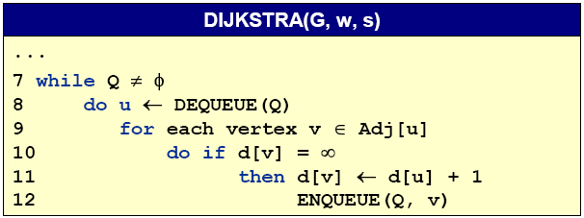
Unweighted graphs
Suppose that w(u,v)=1 for all (u,v) ∈E.
-- Use a simple FIFO queue instead of a priority queue.
Breadth-first search
Analysis: Time=O(V+E)

Slide 3
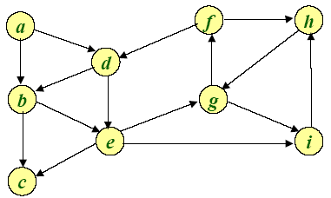
Example of Breadth-first search
Q:

Slide 4
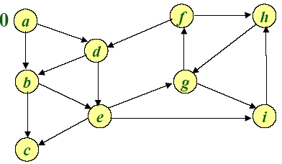
Example of Breadth-first search
0
Q: a

Slide 5
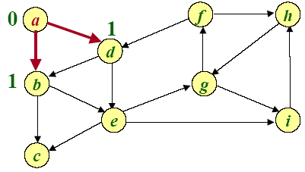
Example of Breadth-first search
1 1
Q: a b d

Slide 6
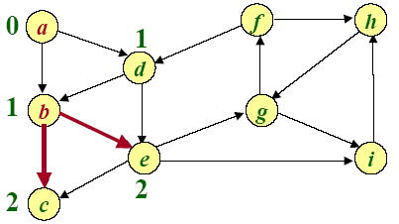
Example of Breadth-first search
1 2 2
Q: a b d c e

Slide 7
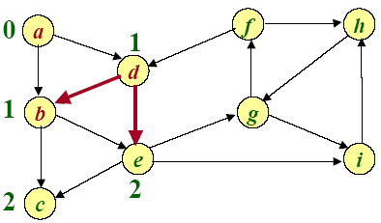
Example of Breadth-first search
2 2
Q: a b d c e

Slide 8
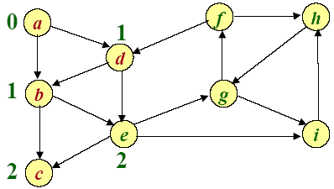
Example of Breadth-first search
2
Q: a b d c e

Slide 9
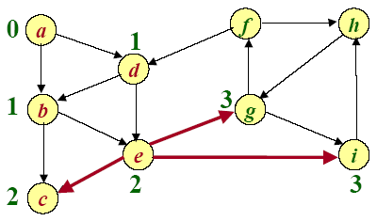
Example of Breadth-first search
3 3
Q: a b d c e g i

Slide 10
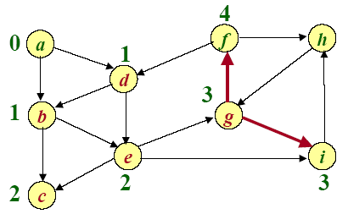
Example of Breadth-first search
3 4
Q: a b d c e g i f

Slide 11
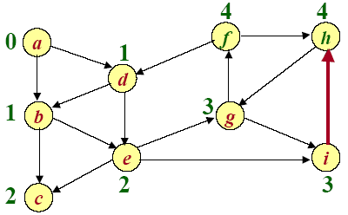
Example of Breadth-first search
4 4
Q: a b d c e g i f h

Slide 12
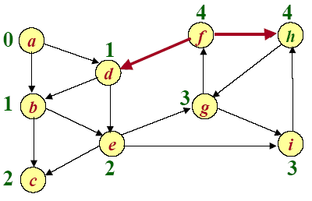
Example of Breadth-first search
4
Q: a b d c e g i f h

Slide 13
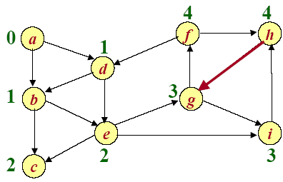
Example of Breadth-first search
Q: a b d c e g i f h

Slide 14

Paths in graphs
Consider a digraph (directed graph) G=(V,E), with edge-weight function w : E→R. The weight of path p=v₁→v₂--…→v_{k} is defined to be
w(p)=∑_{i=1..k-1}w(v_{i} ,v_{i+1})
Example:

Slide 15
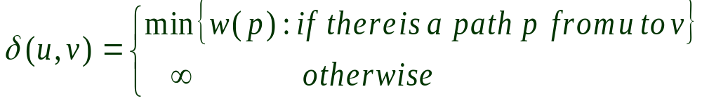
Shortest paths
A shortest path from u to v is a path of minimum weight from u to v. The shortest-path weight form u to v is defined as

Slide 16

Optimal structure
Theorem. A subgraph of shortest path is a shortest path.
Proof. Cut and paste:

Slide 17
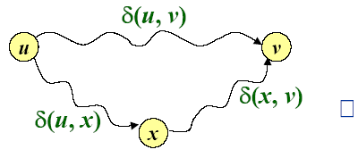
Triangle inequality
Theorem. For all u, v, x∈V, we have
δ(u,v) ≤δ(u,x)+δ(x,v)
Proof.

Slide 18
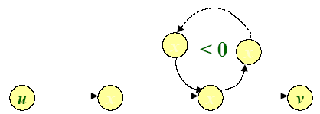
Well-definedness of shortest paths
If a graph G contains a negative-weight cycle, then some shortest paths may not exist.

Slide 19
Single-source shortest paths
Problem. From a given source vertex s∈V, find the shortest-path weightδ(s,v) for all v∈V.
If all edge weight w(u,v) are nonnegative, all shortest-path weights must exist.
IDEA: Greedy
1. Maintain a set S of vertices whose shortest-path distances from s are known.
2. At each step add to S the vertex v∈V-S whose distance estimate from s is minimal.
3. Update the distance estimates of vertices adjacent to v.

Slide 20
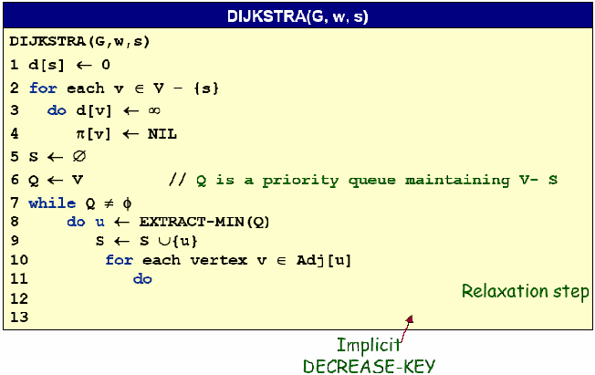

Dijkstra’s algorithm

Slide 21
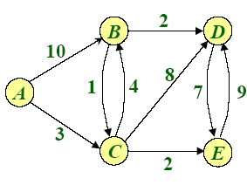
Example of Dijkstra’s algorithm
Graph with nonnegative edge weights:

Slide 22
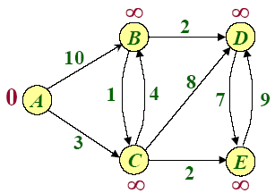
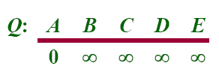

Example of Dijkstra’s algorithm
Initialize:

Slide 23

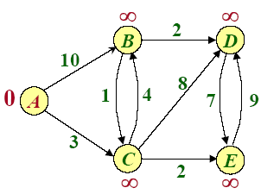


Example of Dijkstra’s algorithm

Slide 24
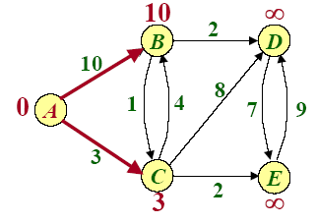
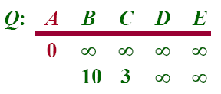
Example of Dijkstra’s algorithm
Relax all edges leaving A :

Slide 25

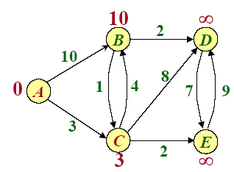
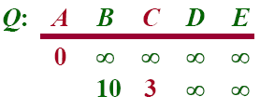

Example of Dijkstra’s algorithm

Slide 26
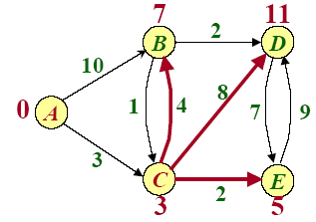
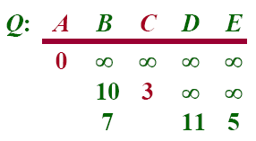
Example of Dijkstra’s algorithm
Relax all edges leaving C :

Slide 27

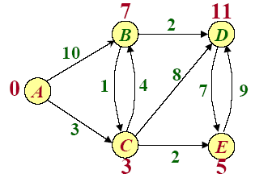
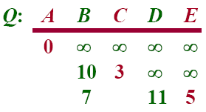

Example of Dijkstra’s algorithm

Slide 28
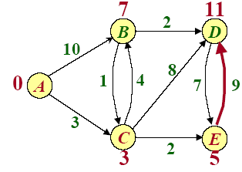
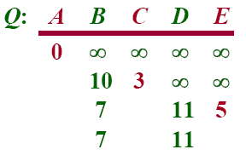
Example of Dijkstra’s algorithm
Relax all edges leaving E :

Slide 29

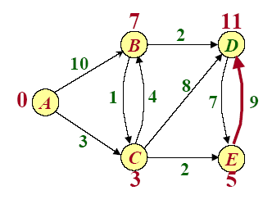
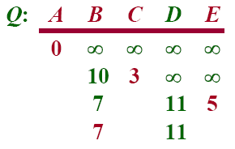

Example of Dijkstra’s algorithm

Slide 30
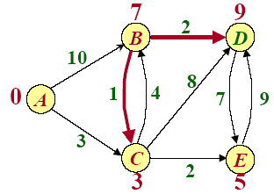
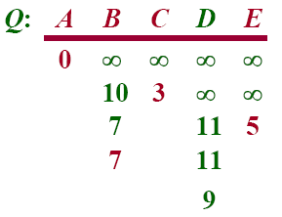
Example of Dijkstra’s algorithm
Relax all edges leaving B :

Slide 31

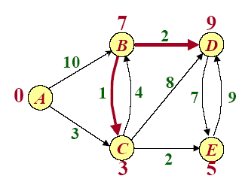
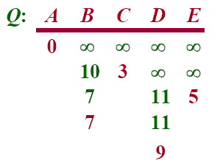

Example of Dijkstra’s algorithm

Slide 32
Example of Dijkstra’s algorithm

Slide 33
Dijkstra’s algorithm

Slide 34
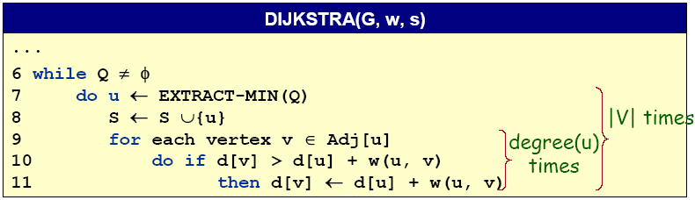
Analysis of Dijkstra’s algorithm
Hanshaking Lemma→Θ(E) implicit DECREASE-KEY’s
Time=Θ(V.T_{EXTRACT-MIN}+E.T_{DECREASE-KEY})

Slide 35
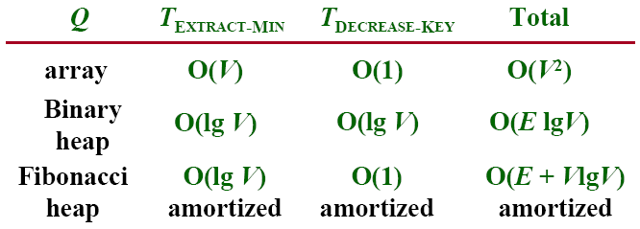
Analysis of Dijkstra’s algorithm
Time=Θ(V.T_{EXTRACT-MIN}+E.T_{DECREASE-KEY})

Slide 36
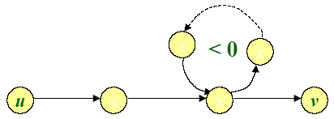
Negative-weight cycles
Recall: If a graph G=(V,E) contains a negative-weight cycle, then some shortest paths may not exist.
Example:
Bellman-Ford algorithm: Finds all shortest-path lengths from a source s∈V to v∈V or determines that negative-weight cycle exists.

Slide 37
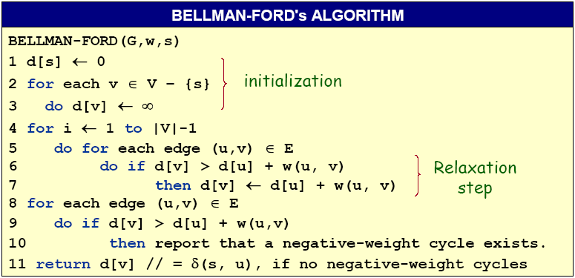
Bellman-Ford algorithm
Time=O(|V||E|)

Slide 38
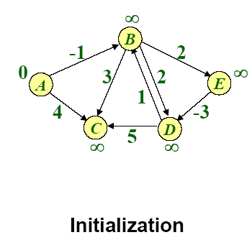
Example of Bellman-Ford

Slide 39
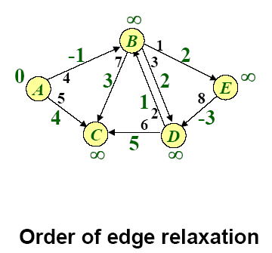
Example of Bellman-Ford

Slide 40
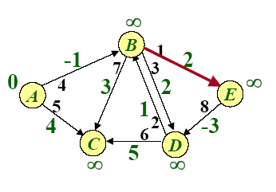
Example of Bellman-Ford

Slide 41
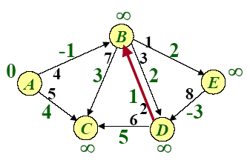
Example of Bellman-Ford

Slide 42
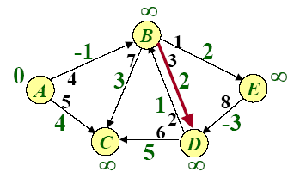
Example of Bellman-Ford

Slide 43
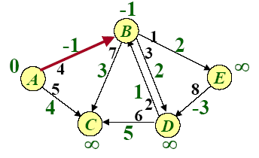
Example of Bellman-Ford

Slide 44
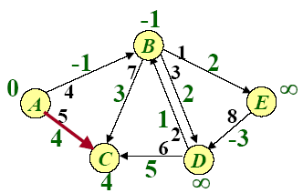
Example of Bellman-Ford

Slide 45
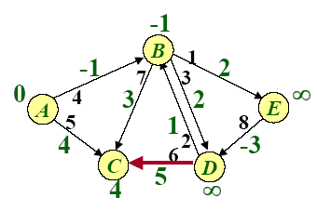
Example of Bellman-Ford

Slide 46
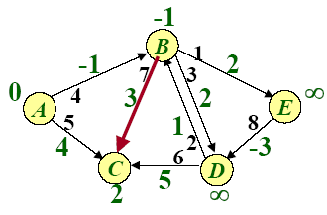
Example of Bellman-Ford

Slide 47
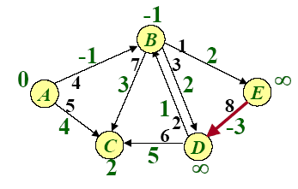
Example of Bellman-Ford

Slide 48

Example of Bellman-Ford

Slide 49

Example of Bellman-Ford

Slide 50

Example of Bellman-Ford

Slide 51

Example of Bellman-Ford

Slide 52

Example of Bellman-Ford

Slide 53

Example of Bellman-Ford

Slide 54

Example of Bellman-Ford

Slide 55

Example of Bellman-Ford

Slide 56

Example of Bellman-Ford

Slide 57

Example of Bellman-Ford

Slide 58

Correctness
Theorem. If G=(V, E) contains no negative-weight cycles, then after the Bellman-Ford algorithm executes, d[v]=δ(s,v) for all v∈V
Proof. Let v ∈V be any vertex, and consider a shortest path p from s to v with the minimum number of edges.
Since p is a shortest path, we have
δ(s,v_{i})=δ(s,v_{i-1})+w(v_{i-1},v_{i})

Slide 59
Correctness (continued)
Initially, d[v₀]=0=δ(s,v₀) and d[v₀] is unchanged by subsequent relaxations (because of the lemma from previous Lecture that d[v] ≥δ(s,v))
-- After 1 path through E, we have d[v₁]= δ(s,v₁)
-- After 2 path through E, we have d[v₂]= δ(s,v₂)
--…
-- After k path through E, we have d[v_{k}]= δ(s,v_{k})
Since G contains no negative-weight cycles, p is simple.
Longest simple path has ≤ |V|-1 edges.□

Slide 60
Detection of negative-weight cycles
Corollary. If a value d[v] fails to converge after |V|-1 passes, there exists a negative-weight cycle in G reachable from s.□

Slide 61
Bellman-Ford algorithm
Time=O(|V||E|)

