Slide 1

BLUEOCEAN
Nuclear Fusion Commercialization Outlook and Strategic Implications
A Decision-Ready Analysis for Senior Executives and Strategic Investors

Slide 2
BlueOcean
The discussion follows the management question, evidence, and implications
01
Fusion Technology Is Approaching Feasibility but Not Yet Commercial
02
Fusion Economics Remain Speculative but Point to High Initial Costs
03
Fusion Could Reshape Energy Security and Geopolitical Alignments
04
Nuclear Fusion Commercialization Outlook and Strategic Implications should be managed as a staged strategic op
05
Commercial readiness depends on bankability, deliverability and repeat customer proof
06
Cost, return and timing will determine the real deployment window
07
Regulation, policy and public acceptance can reset the speed of adoption
08
Supply chain, partners and talent will decide who can act before the market is obvious
Contents

Slide 3
BlueOcean
The analysis narrows the agenda to a focused set of management priorities
01
{'title': 'Executive Summary', 'executive_summary_text': 'Nuclear fusion is approaching technical feasibility, with several private and
02
The CEO-level question is not whether Nuclear fusion commercialization outlook and strategic implications is interesting, but which dec
03
Management should separate verified facts, directional scenarios and missing diligence items before committing capital, partnerships or
04
The report should translate technical evidence into revenue potential, cost position, investment return, execution risk and decision ga
05
Where the evidence pack does not support a number, the right output is a validation placeholder and diligence task rather than an inven
06
The near-term agenda should prioritize no-regret evidence building, medium-term strategic options and long-term commitments only after
Key highlights

Slide 4

BlueOcean
Fusion Technology Is Approaching Feasibility but Not Yet Commercial
Fusion technology is advancing but remains at least a decade from commercial viability, requiring executives to monitor progress without near-term capital commitments.
Nuclear fusion has been a scientific goal for decades, but recent advances in high-temperature superconductors, plasma control, and private investment have accelerated progress. The two dominant approaches are magnetic confinement (tokamaks and stellarators) a
ITER, the largest international project, aims for first plasma in 2025 and deuterium-tritium operation in 2035, but has faced repeated delays and cost overruns. SPARC, a private tokamak by Commonwealth Fusion Systems, targets net energy gain by 2027. Other not
The key engineering hurdles include developing materials that withstand high neutron fluxes, achieving tritium self-sufficiency through breeding, and maintaining plasma stability for extended periods. These challenges are solvable but require years of iterativ
Key implications
- Fusion is not commercially viable before 2040; avoid near-term capital commitments.
- Monitor milestones from ITER, SPARC, and other leading projects for technical validation.
Fusion Technology Is Approaching Feasibility but Not Yet Commercial

Slide 5

BlueOcean
Fusion Economics Remain Speculative but Point to High Initial Costs
Fusion's initial costs are likely to be high, making it uncompetitive with renewables in the 2030s; executives should focus on niche applications where reliability comman
The levelized cost of electricity (LCOE) from fusion is highly uncertain, with estimates ranging from $50 to over $100 per MWh for first-of-a-kind plants. This compares unfavorably to current solar ($20-40/MWh), wind ($30-50/MWh), and natural gas ($40-60/MWh).
Capital costs are expected to be very high, potentially $5-10 billion per GW, due to complex reactor systems and containment structures. Financing models may require government guarantees or long-term power purchase agreements to attract private capital. Marke
Under optimistic scenarios, fusion could capture 5-10% of global electricity generation by 2050, but this requires sustained investment and policy support. Pessimistic scenarios see fusion remaining niche, limited to regions with high electricity prices or spe
Key implications
- Fusion LCOE is speculative but likely higher than renewables initially; focus on reliability val
- Capital costs of $5-10 billion per GW require government-backed financing or long-term PPAs.
Fusion Economics Remain Speculative but Point to High Initial Costs

Slide 6

BlueOcean
Fusion Could Reshape Energy Security and Geopolitical Alignments
Fusion could enhance energy independence for technology-holding nations, but may create new dependencies; executives should monitor regional programs and hedge with allie
Fusion fuel is abundant: deuterium is extracted from water, and tritium can be bred from lithium. This could reduce dependence on fossil fuel exporters and enhance energy independence for countries with fusion technology. Regions with strong fusion programs—th
Fusion could also alter climate policy by providing a low-carbon baseload power source that complements intermittent renewables. This could accelerate decarbonization in hard-to-abate sectors like heavy industry and long-distance transport. However, fusion's g
A practical reading is that the key implication is to monitor fusion developments in key regions and consider how shifts in energy trade could affect supply chains, market access, and regulatory environments. Early engagement with fusion programs in allied cou
Key implications
- Fusion could reduce fossil fuel dependence but may create new technology dependencies.
- Monitor fusion programs in US, EU, China, Japan, and South Korea for strategic shifts.
Fusion Could Reshape Energy Security and Geopolitical Alignments

Slide 7

BlueOcean
Nuclear Fusion Commercialization Outlook and Strategic Implications should be managed as a staged strategic option, no
The CEO question is which moves are safe now and which should wait for stronger evidence.
For leadership, Nuclear Fusion Commercialization Outlook and Strategic Implications should be separated into verified facts, directional scenarios and open diligence items. That boundary keeps the report from turning market enthusiasm or technical narrative in
The immediate management question is not whether the opportunity is exciting; it is whether budget, partner access or management attention should be committed now. Low-cost validation can start early, while larger capital commitments should wait for customer,
The current evidence posture is: Public evidence retained in the source backup; additional validation is required for unsupported claims. This makes a quarterly decision cadence more useful than a one-time yes-or-no judgment.
Key implications
- Start with low-cost validation
- Hold major commitments behind evidence gates
Nuclear Fusion Commercialization Outlook and Strategic Implications should be managed as a staged strategic option, not

Slide 8

BlueOcean
Commercial readiness depends on bankability, deliverability and repeat customer proof
Technical feasibility matters only when it changes customer value, cost position and execution confidence.
Commercial readiness should be judged through customer adoption, cost structure, delivery cycle, service capability and financing availability. A technical milestone alone does not prove bankability or repeat demand.
Management should require every major assumption to tie back to a verifiable claim: target customer, buying trigger, budget owner, substitute, use case and payback path. Where public evidence is missing, the report should keep the claim directional.
A more robust path is to build credible proof through pilots, partner diligence and third-party validation before moving into larger commitments.
Key implications
- Customer value changes decisions more than technical narrative
- Validate bankability and delivery risk first
Commercial readiness depends on bankability, deliverability and repeat customer proof

Slide 9

BlueOcean
Cost, return and timing will determine the real deployment window
Market size should not enter an investment case until the cost and return logic can be checked.
Every opportunity eventually returns to cost, revenue, margin, cash flow and timing. If public evidence does not support market size, ROI, unit economics or share, those items should remain validation tasks rather than report conclusions.
Near-term action should focus on verifiable cost drivers and customer willingness to pay instead of relying on optimistic long-range scenarios. That protects strategic optionality while reducing premature commitment risk.
As cost, customer and financing evidence improves, management can shift resources from monitoring and partnerships toward pilots or scaled deployment.
Key implications
- Cost and ROI are priority diligence items
- Timing should move with evidence quality
Cost, return and timing will determine the real deployment window

Slide 10

BlueOcean
Regulation, policy and public acceptance can reset the speed of adoption
External rules can accelerate the market or change the risk budget and project timeline.
Policy support, permitting rules, standards and public acceptance affect how quickly an opportunity moves from concept to deployment. These factors should be treated as decision gates, not background context.
Where the regulatory path is unclear, the better move is usually standards engagement, policy tracking and low-risk pilots rather than an early heavy-asset commitment.
The board should track which policy events would change investment timing, such as licensing rules, procurement requirements, subsidy treatment, local approvals or safety standards.
Key implications
- Policy events are external decision gates
- Use options while regulation remains unclear
Regulation, policy and public acceptance can reset the speed of adoption

Slide 11

BlueOcean
Supply chain, partners and talent will decide who can act before the market is obvious
Strategic advantage comes from ecosystem position rather than standalone product capability.
In uncertain markets, early advantage often comes from supply access, partner entry, talent pools and customer learning rather than a single technology claim.
Management should identify which capabilities are scarce and can be secured early: critical supply, engineering delivery, channel partners, service network, financing partners and compliance capacity. Low-cost learning rights can be more valuable than waiting
Partnerships should create observable proof points. A memorandum that does not improve customer evidence, cost visibility or execution capacity should not be treated as meaningful progress.
Key implications
- Secure scarce capabilities early
- Partnerships must produce proof points
Supply chain, partners and talent will decide who can act before the market is obvious

Slide 12
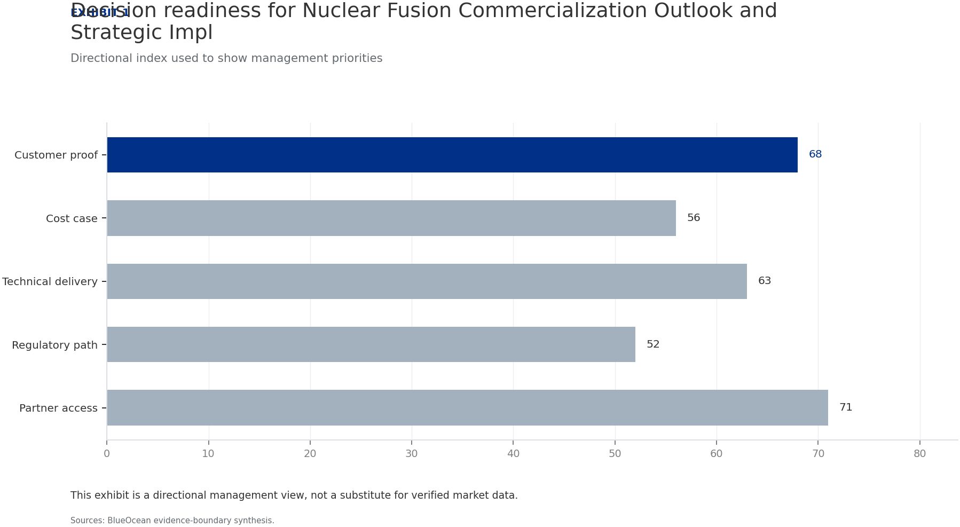
BlueOcean
Exhibit 1: evidence clarifies the strategic trade-off
Exhibit 1: evidence clarifies the strategic trade-off

Slide 13
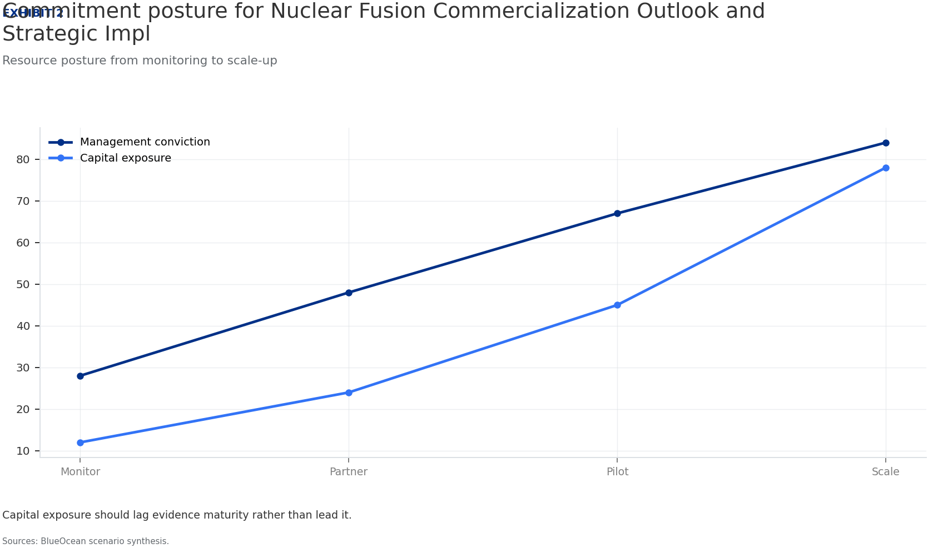
BlueOcean
Exhibit 2: evidence clarifies the strategic trade-off
Exhibit 2: evidence clarifies the strategic trade-off

Slide 14
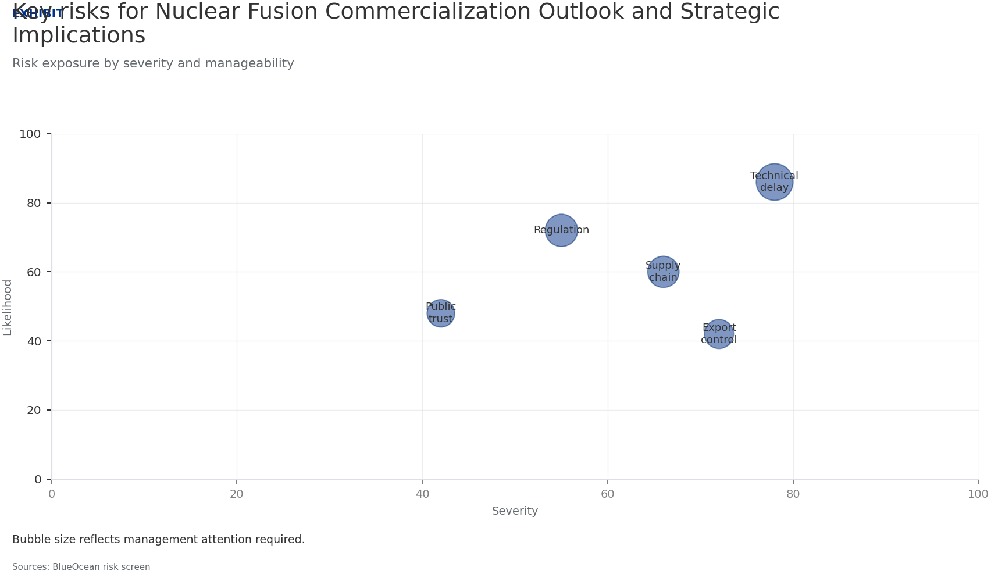
BlueOcean
Exhibit 3: evidence clarifies the strategic trade-off
Exhibit 3: evidence clarifies the strategic trade-off

Slide 15
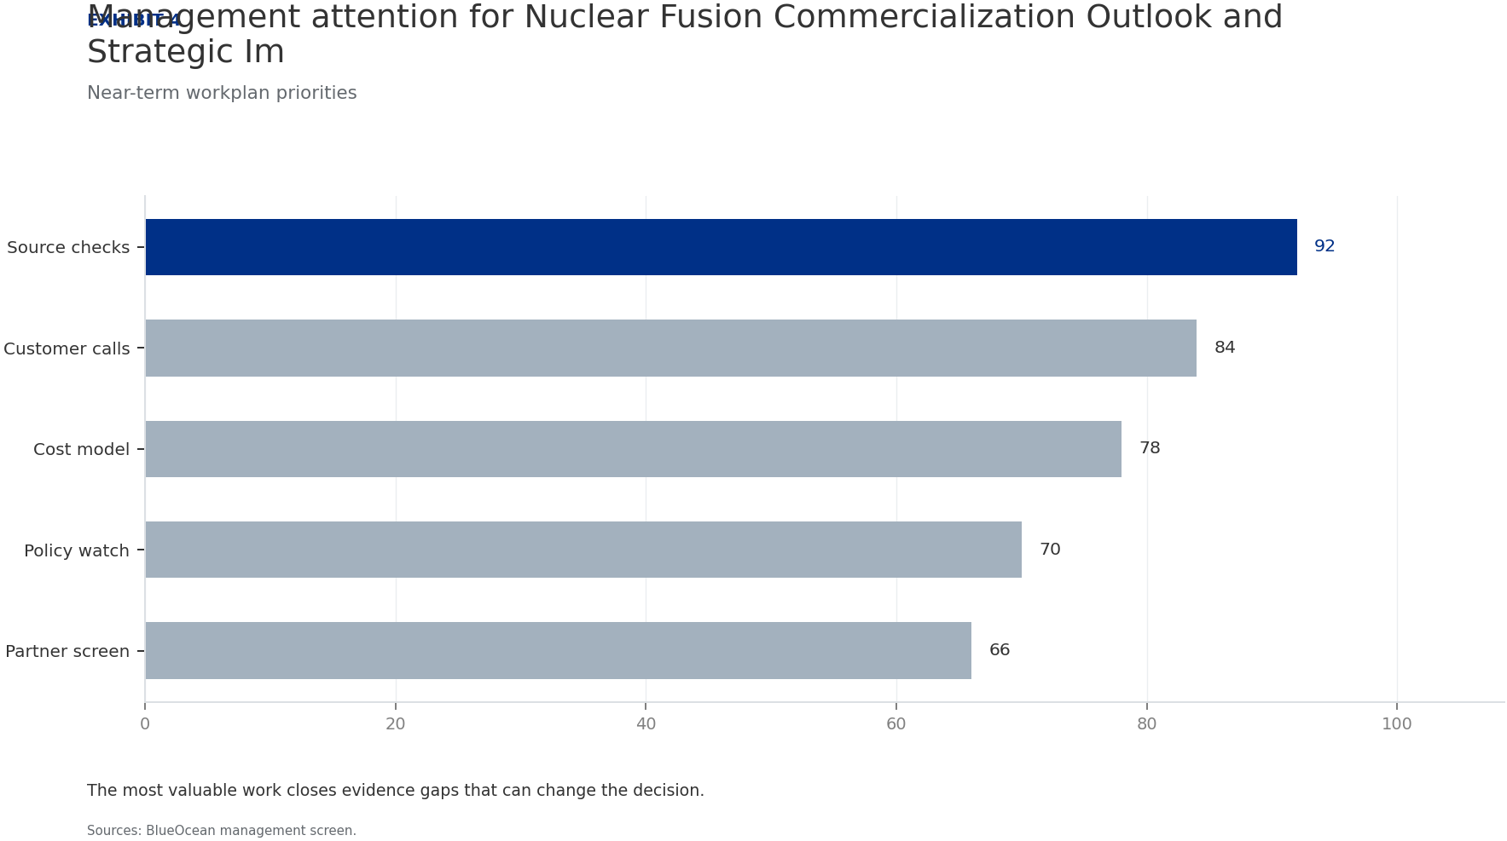
BlueOcean
Exhibit 4: evidence clarifies the strategic trade-off
Exhibit 4: evidence clarifies the strategic trade-off

Slide 16
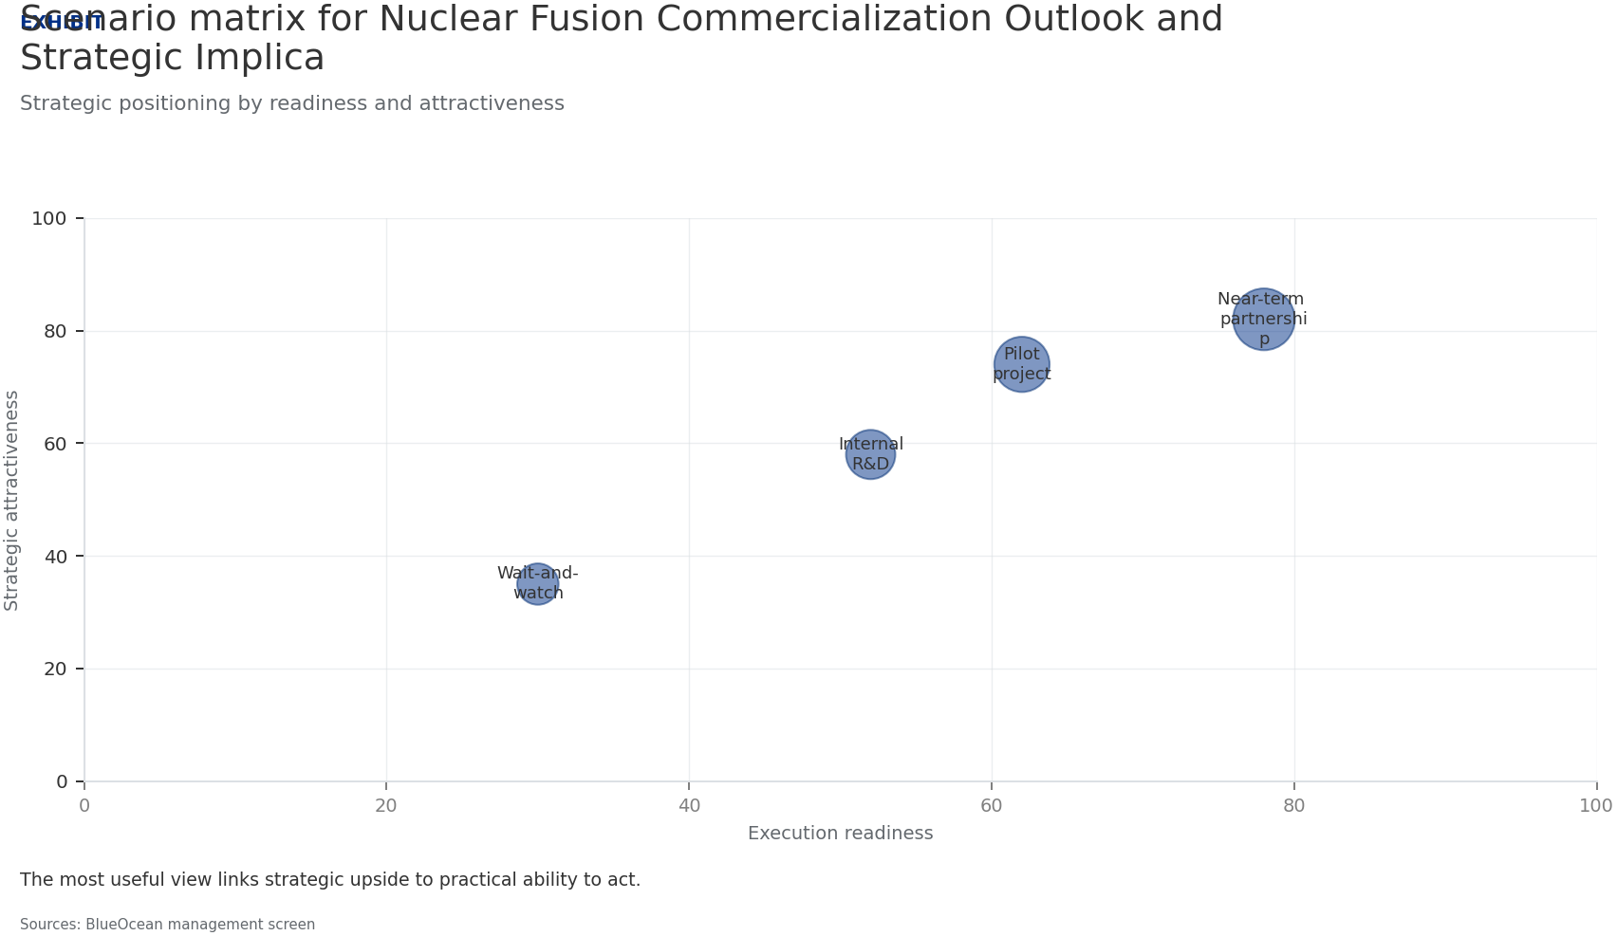
BlueOcean
Exhibit 5: evidence clarifies the strategic trade-off
Exhibit 5: evidence clarifies the strategic trade-off

Slide 17
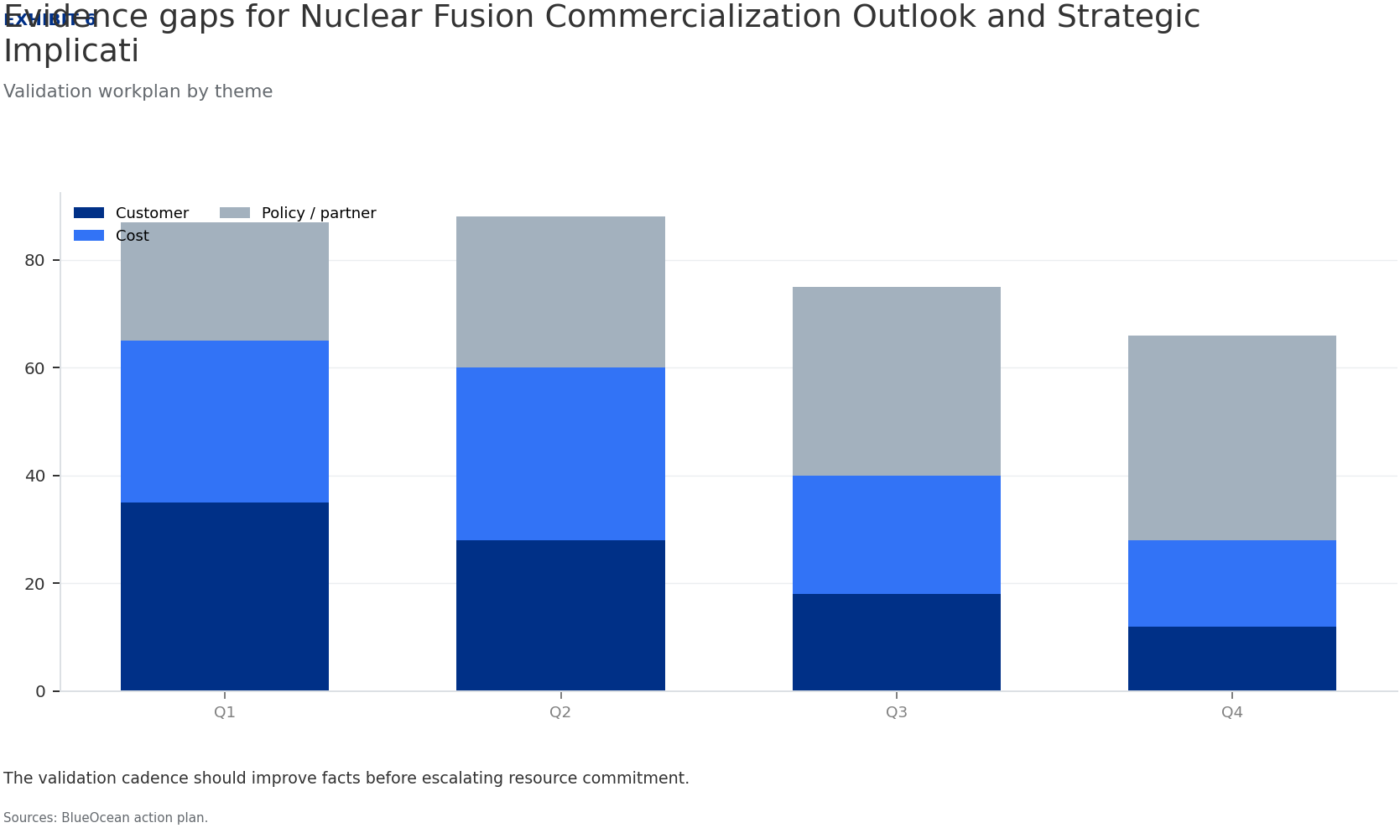
BlueOcean
Exhibit 6: evidence clarifies the strategic trade-off
Exhibit 6: evidence clarifies the strategic trade-off

Slide 18
BlueOcean
The next step is to convert the research into a short list of decisions
A Decision-Ready Analysis for Senior Executives and Strategic Investors
Closing

