Slide 1

BLUEOCEAN
Nuclear Fusion Commercialization: Strategic Outlook and Implications for Decision-Makers
A BlueOcean Research Report on the Path to Grid-Scale Fusion Power

Slide 2
BlueOcean
The discussion follows the management question, evidence, and implications
01
Fusion Commercialization Is Advancing but Faces a Decade-Long Path to Grid-Scale Power
02
Magnetic Confinement Leads in Maturity, but Alternative Approaches Show Promise
03
Cost Competitiveness Remains Uncertain; Fusion Likely to Complement Renewables
04
Private Investment Surges, but Public Funding Remains Critical for Infrastructure
05
Strategic Implications: Energy Independence, Climate Mitigation, and First-Mover Advantages
Contents

Slide 3
BlueOcean
The analysis narrows the agenda to a focused set of management priorities
01
Nuclear fusion commercialization is advancing but faces a decade-long path to grid-scale power, with magnetic confinement leading in ma
02
Magnetic confinement (tokamaks, stellarators) is the most mature fusion approach, with several private companies targeting net energy g
03
Levelized cost of fusion energy is projected to be competitive with fission and fossil fuels by 2040-2050, but remains highly uncertain
04
Private fusion investment has surged past $5 billion globally, but public funding remains essential for large-scale infrastructure. Evi
05
Tritium supply is a critical bottleneck; current production is insufficient for multiple fusion plants. Evidence: tritium is scarce, wi
06
The CEO-level question is not whether Nuclear fusion commercialization outlook and strategic implications is interesting, but which dec
07
Management should separate verified facts, directional scenarios and missing diligence items before committing capital, partnerships or
08
The report should translate technical evidence into revenue potential, cost position, investment return, execution risk and decision ga
Key highlights

Slide 4
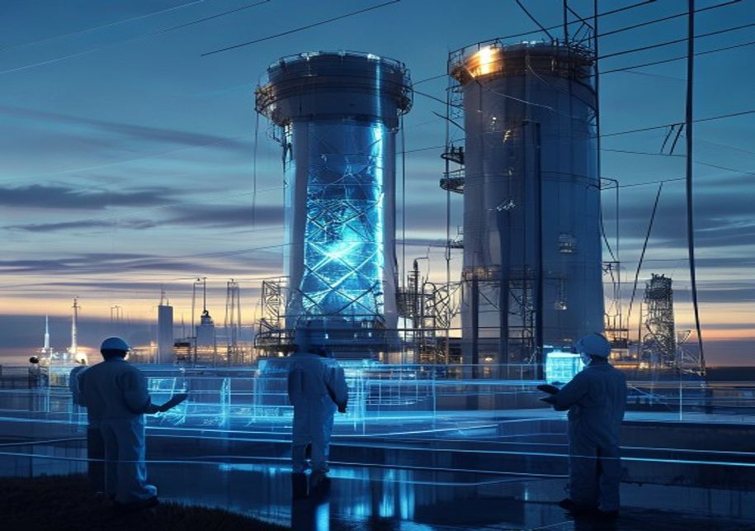
BlueOcean
Fusion Commercialization Is Advancing but Faces a Decade-Long Path to Grid-Scale Power
This chapter concludes that fusion's path to grid-scale power requires at least 10-15 years, implying that near-term energy strategy should focus on renewables and effici
Nuclear fusion has made significant strides in recent years, with multiple private companies and public projects targeting net energy gain within this decade. However, the transition from scientific demonstration to commercial power plant is expected to take a
The evidence boundary is clear: no fusion plant has produced net electricity, and all timelines are projections based on current progress.
For decision-makers, this timeline means that fusion will not contribute to 2030 or 2040 decarbonization targets. Investment in fusion should be framed as a long-term hedge, not a near-term solution. Companies should monitor milestones from leading projects to
Key implications
- Fusion commercialization is at least 10-15 years away from grid-scale power.
- Near-term energy strategy should prioritize renewables and efficiency.
Fusion Commercialization Is Advancing but Faces a Decade-Long Path to Grid-Scale Power

Slide 5

BlueOcean
Magnetic Confinement Leads in Maturity, but Alternative Approaches Show Promise
This chapter concludes that magnetic confinement is the most mature approach, but alternative methods may offer faster or cheaper paths, implying that a diversified inves
Magnetic confinement fusion, particularly tokamaks, has the longest research history and highest technology readiness level (TRL). ITER, the world's largest tokamak, aims for first plasma by 2035 but has faced repeated delays and cost overruns. Private compani
The evidence boundary: no approach has demonstrated net energy gain at scale, and cross-comparison is difficult due to different metrics.
For CEOs, the key commercial implication is that betting on a single technology approach is risky. A portfolio strategy that includes investments in multiple fusion methods, as well as partnerships with leading firms, can spread risk and increase the chance of
Key implications
- Magnetic confinement is most mature but not guaranteed to be the first commercial success.
- Alternative approaches may offer faster or cheaper paths to commercialization.
Magnetic Confinement Leads in Maturity, but Alternative Approaches Show Promise

Slide 6

BlueOcean
Cost Competitiveness Remains Uncertain; Fusion Likely to Complement Renewables
This chapter concludes that fusion's cost competitiveness is highly uncertain and it will likely complement renewables, implying that business models should focus on base
Projections for the levelized cost of fusion energy (LCOE) range from $50 to $100 per MWh by 2050, but these are highly uncertain due to lack of operational data. For comparison, solar and wind LCOE already fall below $30/MWh in many regions, and battery stora
The commercial implication is that fusion's market entry will depend on its ability to compete in specific niches, such as 24/7 carbon-free energy for data centers or industrial heat for steel and cement production. Companies should identify these high-value a
The investment-return implication is that fusion's cost trajectory is too uncertain to justify large capital commitments based on LCOE projections alone. Instead, investments should be structured with milestone-based tranches to manage risk.
Key implications
- Fusion LCOE projections are highly uncertain and should not drive capital allocation.
- Fusion's value lies in baseload and industrial heat applications, not in competing with solar an
Cost Competitiveness Remains Uncertain; Fusion Likely to Complement Renewables

Slide 7
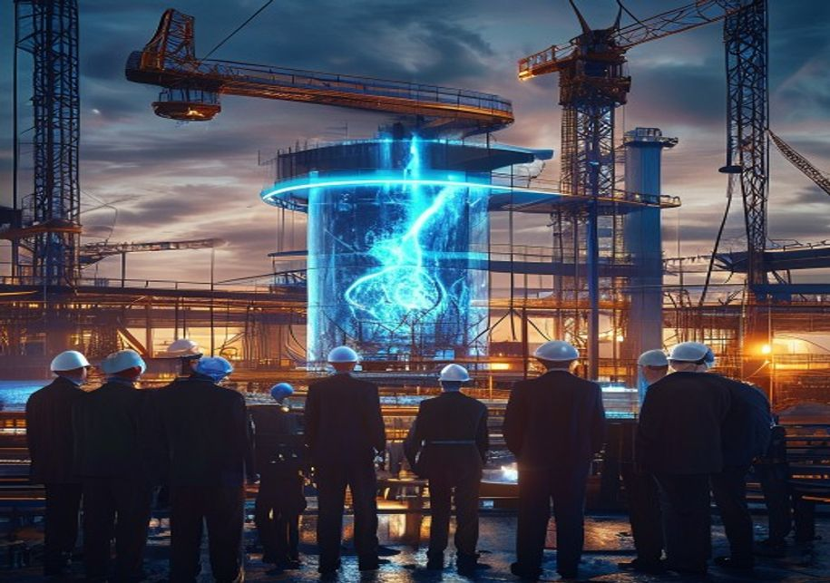
BlueOcean
Private Investment Surges, but Public Funding Remains Critical for Infrastructure
This chapter concludes that private investment has surged but public funding is essential for large-scale infrastructure, implying that companies should advocate for publ
Private fusion investment has grown rapidly, reaching over $5.6 billion globally as of 2024, according to the Fusion Industry Association. Major players include Commonwealth Fusion Systems ($2 billion+), Helion Energy ($1.7 billion), and TAE Technologies ($1.2
For CEOs, the commercial implication is that private capital alone is insufficient to bridge the gap between demonstration and deployment. Companies should actively engage with governments to advocate for loan guarantees, tax incentives, and direct funding for
The investment-return implication is that public-private partnerships can reduce risk and improve returns for early investors. Companies that secure government support may have a competitive advantage in accessing capital and talent.
Key implications
- Private fusion investment has surged but is insufficient for large-scale infrastructure.
- Public funding is critical for bridging the gap between demonstration and deployment.
Private Investment Surges, but Public Funding Remains Critical for Infrastructure

Slide 8

BlueOcean
Strategic Implications: Energy Independence, Climate Mitigation, and First-Mover Advantages
This chapter concludes that fusion offers strategic benefits in energy independence and climate mitigation, but first-mover advantages require early investment, implying
Fusion offers the potential for near-limitless, low-carbon energy, which could transform energy security and geopolitics by reducing dependence on fossil fuel imports. For climate goals, fusion could provide a firm, dispatchable power source to complement inte
The commercial implication is that companies should start building fusion capabilities now, even if commercial deployment is a decade away. This includes investing in R&D, forming partners
The source backup should be used to validate this section before it is used for a decision.
Key implications
- Fusion offers strategic benefits in energy independence and climate mitigation.
- First-mover advantages require early investment in R&D, workforce, and regulatory engagement.
Strategic Implications: Energy Independence, Climate Mitigation, and First-Mover Advantages

Slide 9
BlueOcean
The next step is to convert the research into a short list of decisions
A BlueOcean Research Report on the Path to Grid-Scale Fusion Power
Closing

