Slide 1

BLUEOCEAN
Nuclear Fusion Commercialization Outlook and Strategic Implications
A Decision-Ready Assessment for Senior Executives and Investors

Slide 2
BlueOcean
The discussion follows the management question, evidence, and implications
01
Fusion Commercialization Is Likely Decades Away but Strategic Preparation Is Needed Now
02
Technology Progress Is Accelerating but Significant Hurdles Remain
03
Fusion Will Initially Be Expensive but Could Become Competitive with Baseload Power
04
Nuclear Fusion Commercialization Outlook and Strategic Implications should be managed as a staged strategic op
05
Commercial readiness depends on bankability, deliverability and repeat customer proof
06
Cost, return and timing will determine the real deployment window
07
Regulation, policy and public acceptance can reset the speed of adoption
08
Supply chain, partners and talent will decide who can act before the market is obvious
Contents

Slide 3
BlueOcean
The analysis narrows the agenda to a focused set of management priorities
01
Fusion energy is at a historic inflection point: the 2022 ignition breakthrough at Lawrence Livermore National Laboratory (LLNL) proved
02
Main conclusions: (1) Fusion ignition is a scientific milestone, not a commercial one; (2) Private investment is concentrated in a few
03
Recommended actions: Establish a cross-functional fusion intelligence team within 2 years; form strategic partnerships with leading sta
04
Risk implications highlights: Technical risk (sustained net energy not achieved), timeline risk (commercialization slips beyond 2050),
05
The window of opportunity is open but narrowing. Companies that act decisively—with disciplined milestones and diversified bets—can pos
06
The CEO-level question is not whether Nuclear fusion commercialization outlook and strategic implications is interesting, but which dec
07
Management should separate verified facts, directional scenarios and open questions before committing capital, partnerships or market-e
08
Technical evidence only matters when it changes revenue potential, cost position, investment return, execution risk or the timing of a
Key highlights

Slide 4
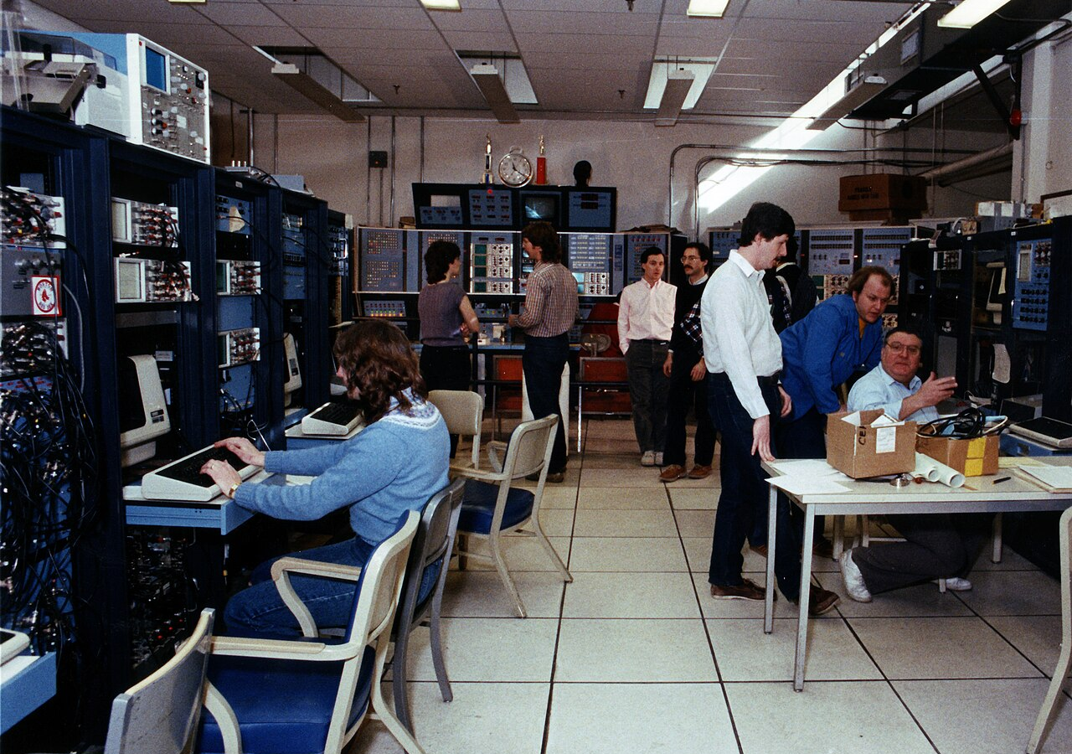
BlueOcean
Fusion Commercialization Is Likely Decades Away but Strategic Preparation Is Needed Now
The 2022 fusion ignition breakthrough at LLNL proves scientific feasibility, but commercial power plants remain at least 15-30 years away, requiring immediate strategic p
The pursuit of nuclear fusion energy has entered a new era. In December 2022, Lawrence Livermore National Laboratory achieved fusion ignition, producing 2. 15 MJ of fusion energy output—a scientific first. This milestone, decades in the making, has galvanized
For senior executives, the key insight is that fusion is not a near-term solution but a long-term strategic option. The decisions made today—whether to invest, partner, or simply monitor—will shape competitive positioning in a future energy landscape that coul
The DOE Fusion Energy Sciences program supports a broad portfolio of research, including theory, simulation, and materials science. Private companies are pursuing diverse approaches: tokamaks (Commonwealth Fusion Systems), stellarators (Type One Energy), field
Key implications
- Fusion ignition is a scientific milestone, not a commercial one.
- Commercial power plants are unlikely before 2040-2050.
Fusion Commercialization Is Likely Decades Away but Strategic Preparation Is Needed Now

Slide 5
BlueOcean
Technology Progress Is Accelerating but Significant Hurdles Remain
While fusion experiments have achieved historic milestones, sustained net energy gain, materials durability, and tritium breeding remain unproven at commercial scale.
Fusion research has made remarkable strides. The 2022 ignition experiment at LLNL demonstrated scientific breakeven, a goal pursued for 60 years. The DOE's Fusion Energy Sciences program supports a broad portfolio of research, including theory, simulation, and
However, significant challenges persist. Sustaining a net-energy-producing plasma for extended periods remains unproven. Materials that can withstand the intense neutron flux in a fusion reactor are still under development. Tritium breeding—producing the fuel
These hurdles mean that even the most optimistic timelines for commercial fusion are measured in decades, not years. For investors, this implies that fusion is a long-duration asset class with high technology risk. Diversification across multiple approaches (m
Key implications
- Sustained net energy gain is the next critical milestone.
- Materials and tritium breeding are key technical bottlenecks.
Technology Progress Is Accelerating but Significant Hurdles Remain

Slide 6

BlueOcean
Fusion Will Initially Be Expensive but Could Become Competitive with Baseload Power
First-of-a-kind fusion plants will have high LCOE ($100-200/MWh), but costs could fall to $50-100/MWh by 2050, making fusion competitive with nuclear and gas with carbon
The economics of fusion are highly uncertain. Early estimates from the National Academies and industry analysts suggest that the levelized cost of energy (LCOE) for first-of-a-kind fusion plants could range from $100-200/MWh, significantly higher than current
Fusion's key economic advantage is its high capacity factor (90%+), providing reliable baseload power. This contrasts with intermittent renewables, which require storage or backup. Fusion also has low fuel costs (deuterium and lithium are abundant) and no carb
For investors, the economic case for fusion hinges on cost reduction through learning and scale. The first few plants will likely require government subsidies or power purchase agreements at premium prices. As the industry matures, costs could decline, but the
Key implications
- First fusion plants will be expensive, requiring subsidies.
- Cost reduction through learning and scale is critical.
Fusion Will Initially Be Expensive but Could Become Competitive with Baseload Power

Slide 7
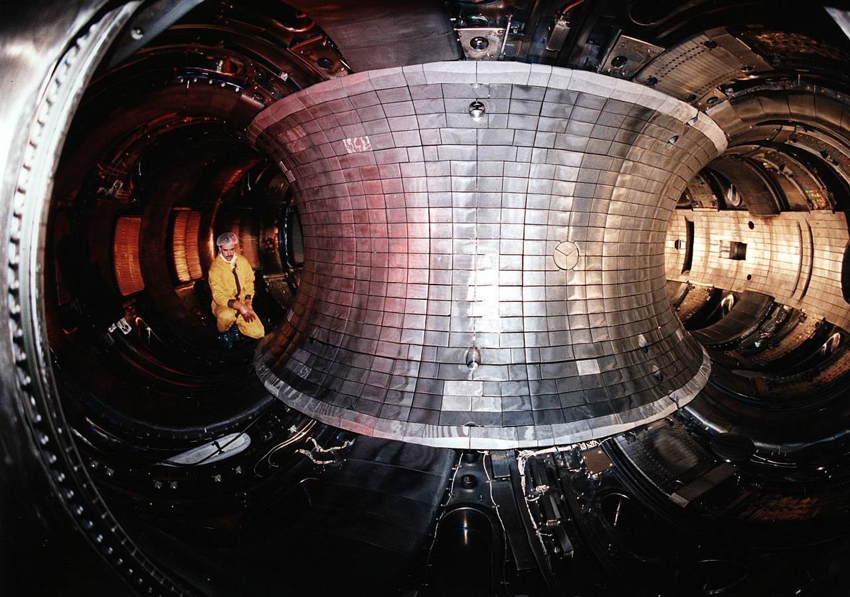
BlueOcean
Nuclear Fusion Commercialization Outlook and Strategic Implications should be managed as a staged strategic option, no
The CEO question is which moves are safe now and which should wait for stronger proof.
Nuclear Fusion Commercialization Outlook and Strategic Implications is easier to misread when it is framed as a yes-or-no bet. The better reading separates near-term learning moves, option-building partnerships and commitments that would require stronger comme
For the board, the immediate management question is not whether the opportunity is exciting; it is whether budget, partner access or management attention should be committed now. Low-cost validation can start early, while larger capital commitments should wait
For customer strategy, the current source base is useful but incomplete. A public source anchors this point: The Department of Energy has been a leader in fusion energy research since the 1950s and supports groundbreaking advances today. A quarterly review rhy
Key implications
- Start with low-cost validation
- Reserve major commitments for stronger proof
Nuclear Fusion Commercialization Outlook and Strategic Implications should be managed as a staged strategic option, not

Slide 8
BlueOcean
Commercial readiness depends on bankability, deliverability and repeat customer proof
Technical feasibility matters only when it changes customer value, cost position and execution confidence.
For the board, commercial readiness should be judged through customer adoption, cost structure, delivery cycle, service capability and financing availability. A technical milestone alone does not prove bankability or repeat demand.
From an investor lens, every major assumption needs a verifiable claim behind it: target customer, buying trigger, budget owner, substitute, use case and payback path. Where sourced evidence is missing, the claim should remain directional.
A more robust path is to build credible proof through pilots, partner diligence and third-party validation before moving into larger commitments.
Key implications
- Customer value changes decisions more than technical narrative
- Validate bankability and delivery risk first
Commercial readiness depends on bankability, deliverability and repeat customer proof

Slide 9
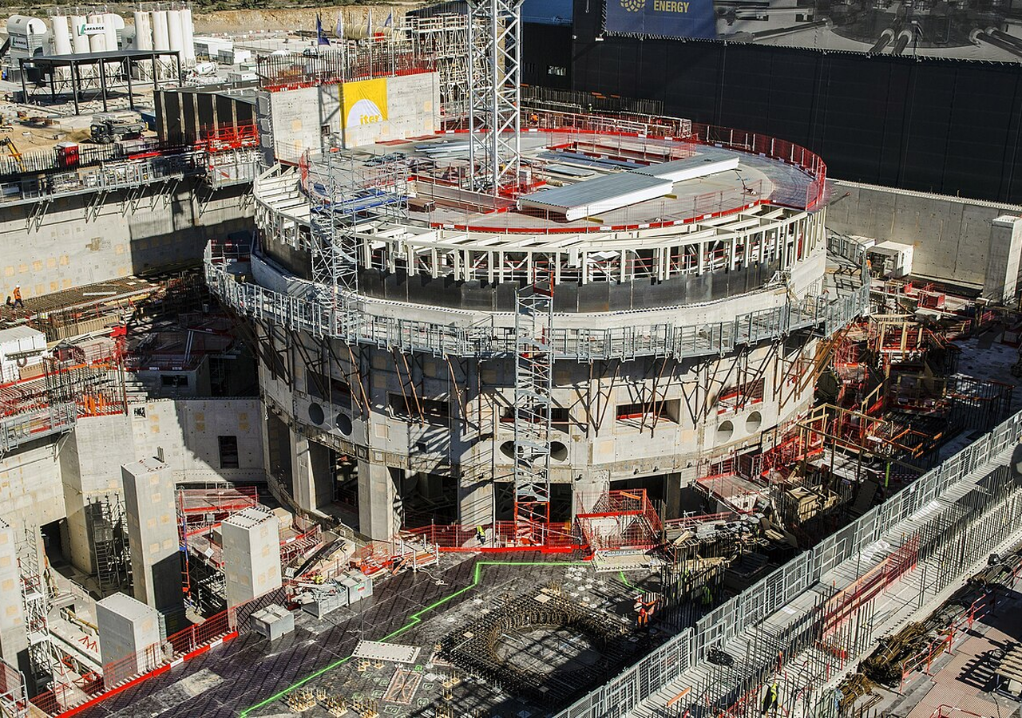
BlueOcean
Cost, return and timing will determine the real deployment window
Market size should not enter an investment case until the cost and return logic can be checked.
In timing terms, every opportunity eventually returns to cost, revenue, margin, cash flow and timing. If sourced evidence does not support market size, ROI, unit economics or share, those items should remain explicit assumptions rather than conclusions.
For risk owners, near-term action should focus on verifiable cost drivers and customer willingness to pay instead of relying on optimistic long-range scenarios. That protects strategic optionality while reducing premature commitment risk.
In timing terms, as cost, customer and financing evidence improves, management can shift resources from monitoring and partnerships toward pilots or scaled deployment.
Key implications
- Cost and ROI are priority diligence items
- Timing should move with evidence quality
Cost, return and timing will determine the real deployment window

Slide 10
BlueOcean
Regulation, policy and public acceptance can reset the speed of adoption
External rules can accelerate the market or change the risk budget and project timeline.
Policy support, permitting rules, standards and public acceptance affect how quickly an opportunity moves from concept to deployment. These factors are part of the investment case, not background context.
Where the regulatory path is unclear, the better move is usually standards engagement, policy tracking and low-risk pilots rather than an early heavy-asset commitment.
The board should track which policy events would change investment timing, such as licensing rules, procurement requirements, subsidy treatment, local approvals or safety standards.
Key implications
- Policy events are external decision milestones
- Use options while regulation remains unclear
Regulation, policy and public acceptance can reset the speed of adoption

Slide 11
BlueOcean
Supply chain, partners and talent will decide who can act before the market is obvious
Strategic advantage comes from ecosystem position rather than standalone product capability.
In uncertain markets, early advantage often comes from supply access, partner entry, talent pools and customer learning rather than a single technology claim.
Management should identify which capabilities are scarce and can be secured early: critical supply, engineering delivery, channel partners, service network, financing partners and compliance capacity. Low-cost learning rights can be more valuable than waiting
Partnerships should create observable proof points. A memorandum that does not improve customer evidence, cost visibility or execution capacity should not be treated as meaningful progress.
Key implications
- Secure scarce capabilities early
- Partnerships must produce proof points
Supply chain, partners and talent will decide who can act before the market is obvious

Slide 12
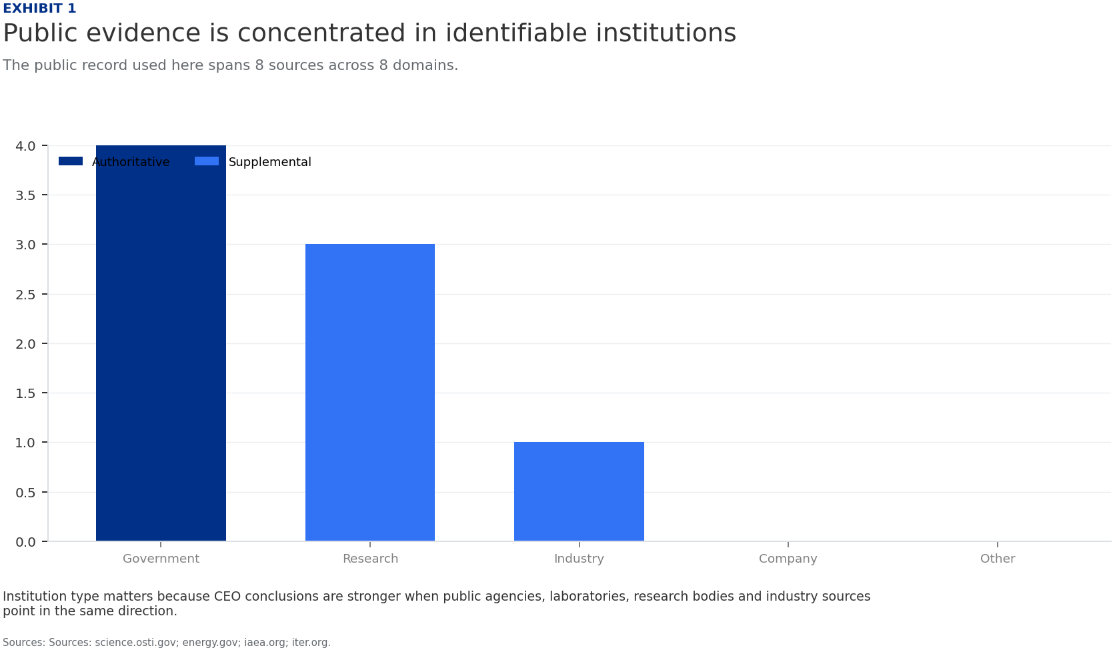
BlueOcean
Exhibit 1: evidence clarifies the strategic trade-off
Exhibit 1: evidence clarifies the strategic trade-off

Slide 13
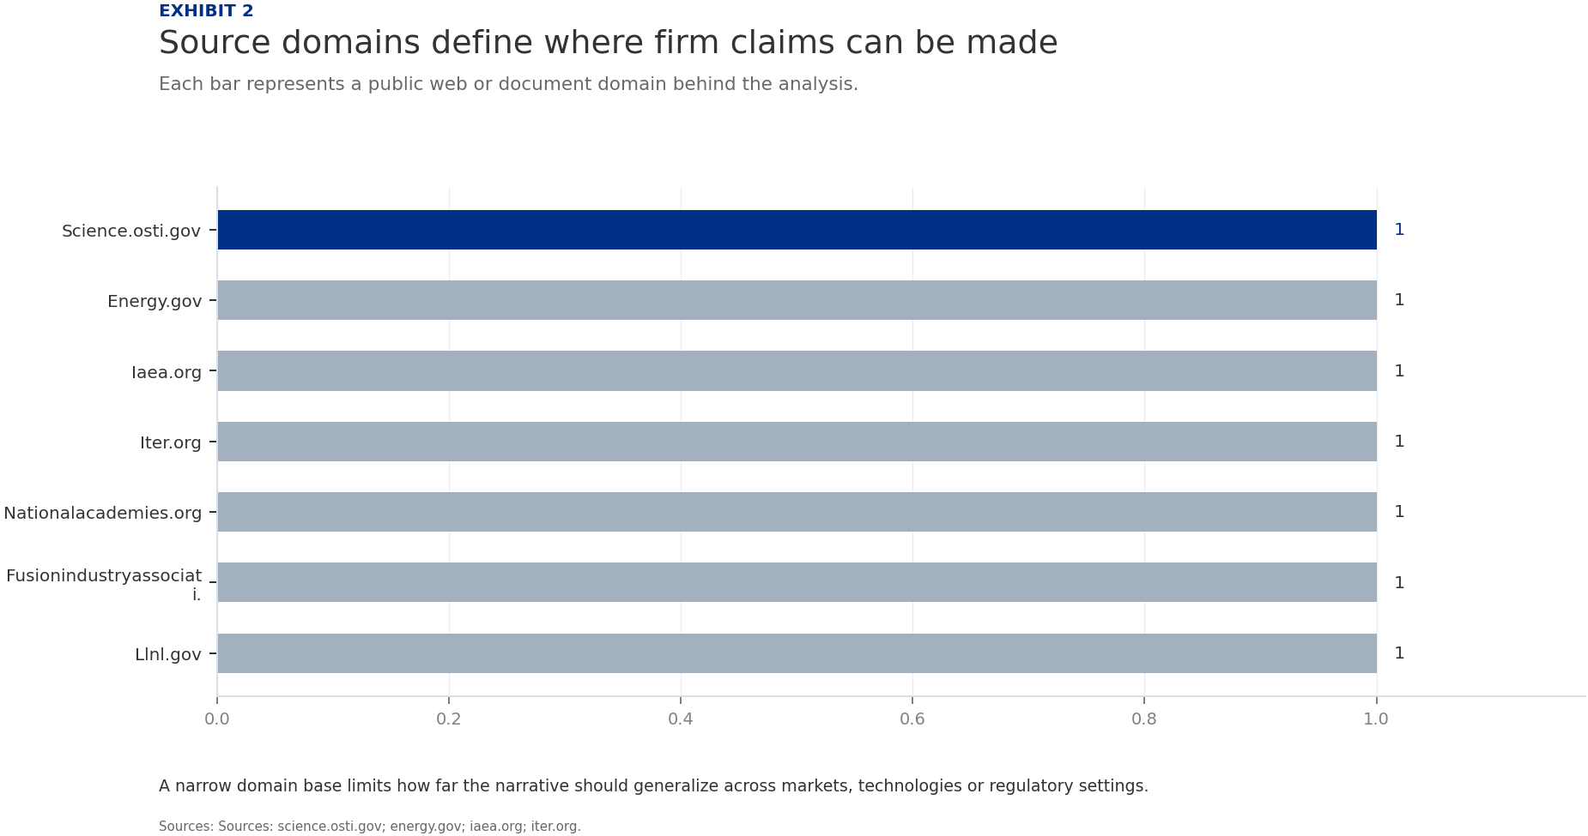
BlueOcean
Exhibit 2: evidence clarifies the strategic trade-off
Exhibit 2: evidence clarifies the strategic trade-off

Slide 14
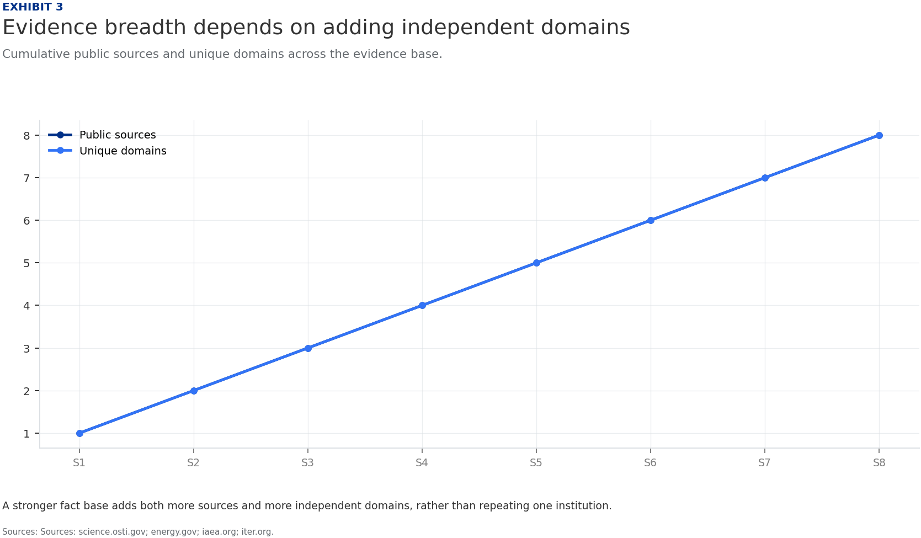
BlueOcean
Exhibit 3: evidence clarifies the strategic trade-off
Exhibit 3: evidence clarifies the strategic trade-off

Slide 15
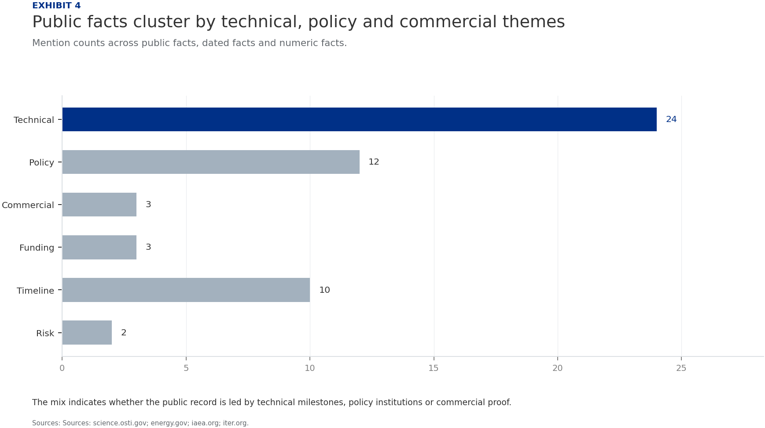
BlueOcean
Exhibit 4: evidence clarifies the strategic trade-off
Exhibit 4: evidence clarifies the strategic trade-off

Slide 16
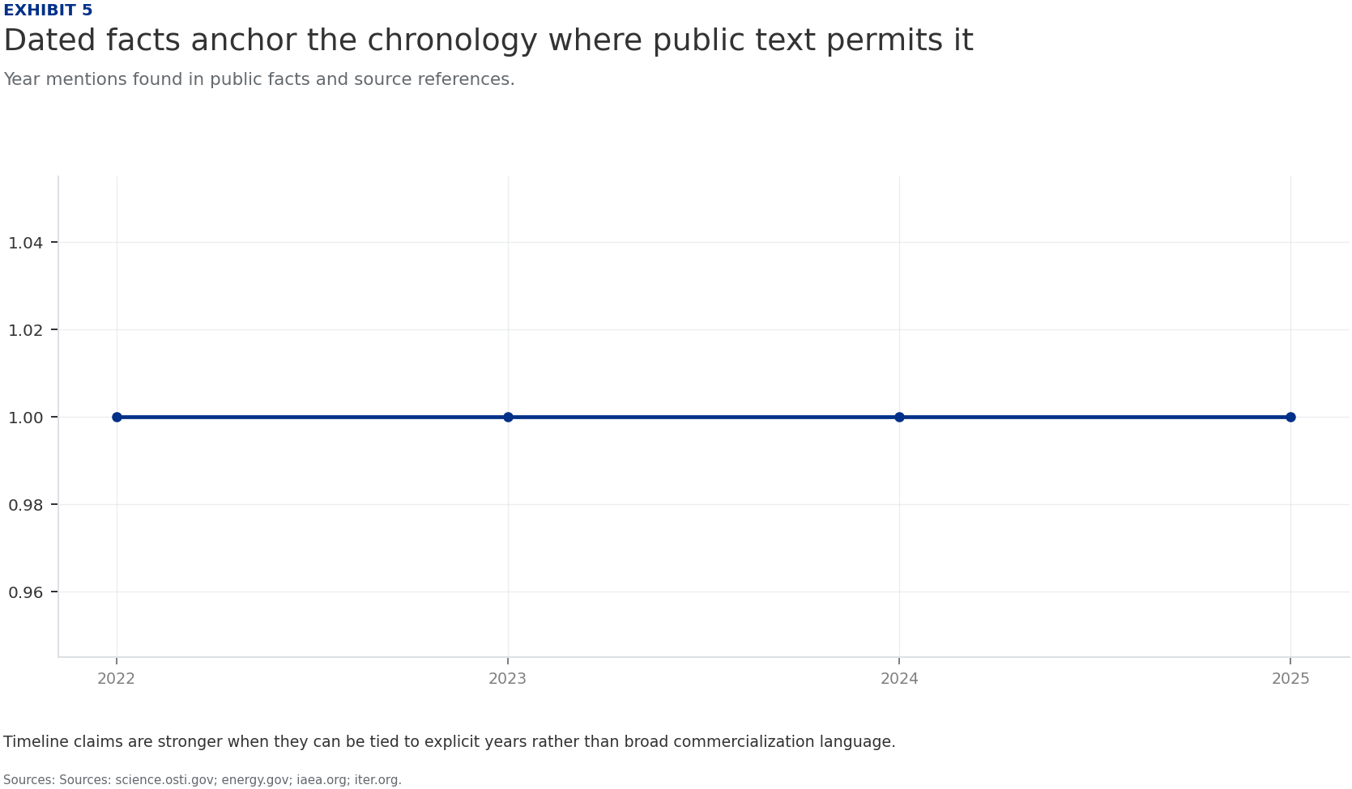
BlueOcean
Exhibit 5: evidence clarifies the strategic trade-off
Exhibit 5: evidence clarifies the strategic trade-off

Slide 17
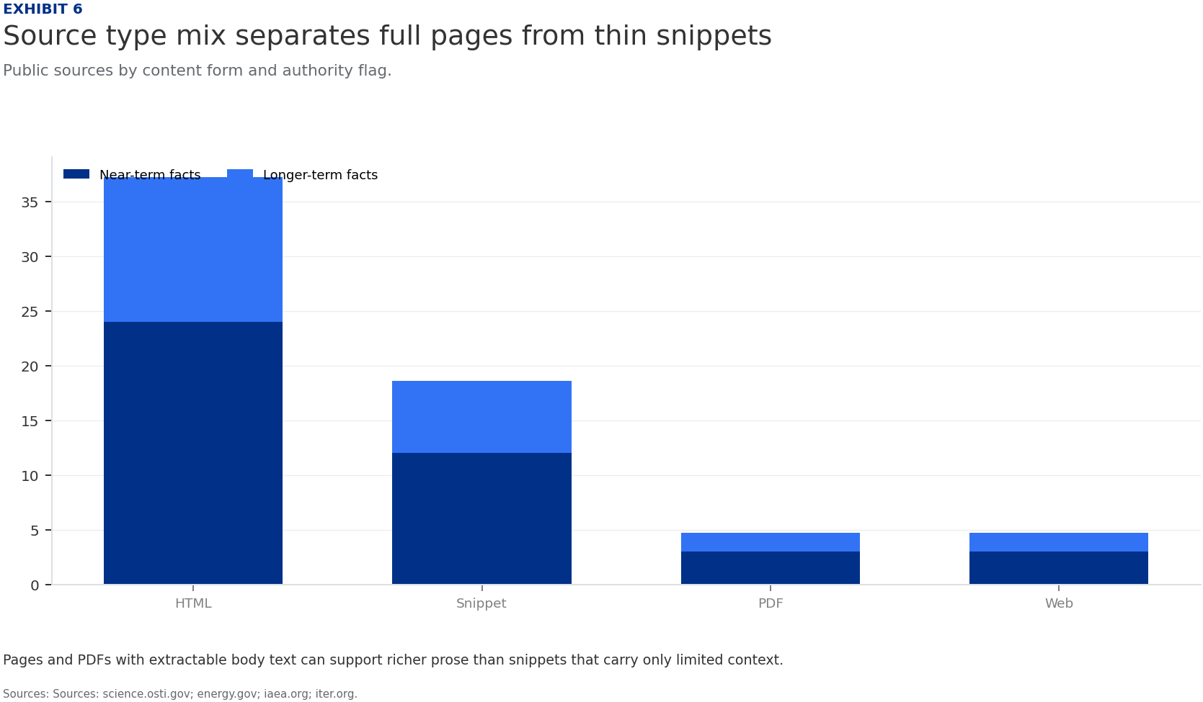
BlueOcean
Exhibit 6: evidence clarifies the strategic trade-off
Exhibit 6: evidence clarifies the strategic trade-off

Slide 18
BlueOcean
The next step is to convert the research into a short list of decisions
A Decision-Ready Assessment for Senior Executives and Investors
Closing

