Slide 1

BLUEOCEAN
Global Tech M&A Surged Last Week: AI and Cybersecurity Deals Dominate as Cross-Border Activity Reshapes t
A comprehensive weekly intelligence brief for investment bankers, corporate development professionals, private equity investors, and tech executives.

Slide 2
BlueOcean
The discussion follows the management question, evidence, and implications
01
Global Tech M&A Activity Surged Last Week with Record Deal Value in AI and Cybersecurity
02
North America Dominated Deal Volume While Asia-Pacific Saw Largest Cross-Border Transactions
03
Software and AI Sub-Sectors Accounted for Over 60% of Total Deal Value
04
Top 5 Deals by Value: Mega-Acquisitions Reshape Cloud and Data Analytics Landscape
05
Strategic Rationale Behind the Largest Deal: Buyer A Acquires Target X to Accelerate AI Capabilities
06
Emerging Trend: Private Equity Firms Drive Consolidation in Mid-Market Tech
07
Valuation Multiples Compressed Slightly Amid Rising Interest Rates but Premiums Paid for AI Startups
08
Regulatory Scrutiny Intensifies: Two Deals Face Antitrust Delays in Europe
09
Cross-Border Activity Highlights Shift Toward Asian Tech Assets by Western Buyers
10
Outlook: Pipeline Remains Strong with Several Unannounced Deals Expected to Close Next Week
Contents

Slide 3
BlueOcean
The analysis narrows the agenda to a focused set of management priorities
01
Global technology M&A activity accelerated sharply last week, with total disclosed deal value exceeding $45 billion—the highest weekly
Key highlights

Slide 4

BlueOcean
Global Tech M&A Activity Surged Last Week with Record Deal Value in AI and Cybersecurity
Global Tech M&A Activity Surged Last Week with Record Deal Value in AI and Cybersecurity
Global Tech M&A Activity Surged Last Week with Record Deal Value in AI and Cybersecurity

Slide 5

BlueOcean
North America Dominated Deal Volume While Asia-Pacific Saw Largest Cross-Border Transactions
North America Dominated Deal Volume While Asia-Pacific Saw Largest Cross-Border Transactions
North America Dominated Deal Volume While Asia-Pacific Saw Largest Cross-Border Transactions

Slide 6

BlueOcean
Software and AI Sub-Sectors Accounted for Over 60% of Total Deal Value
Software and AI Sub-Sectors Accounted for Over 60% of Total Deal Value
Software and AI Sub-Sectors Accounted for Over 60% of Total Deal Value

Slide 7

BlueOcean
Top 5 Deals by Value: Mega-Acquisitions Reshape Cloud and Data Analytics Landscape
Top 5 Deals by Value: Mega-Acquisitions Reshape Cloud and Data Analytics Landscape
Top 5 Deals by Value: Mega-Acquisitions Reshape Cloud and Data Analytics Landscape

Slide 8

BlueOcean
Strategic Rationale Behind the Largest Deal: Buyer A Acquires Target X to Accelerate AI Capabilities
Strategic Rationale Behind the Largest Deal: Buyer A Acquires Target X to Accelerate AI Capabilities
Strategic Rationale Behind the Largest Deal: Buyer A Acquires Target X to Accelerate AI Capabilities

Slide 9

BlueOcean
Emerging Trend: Private Equity Firms Drive Consolidation in Mid-Market Tech
Emerging Trend: Private Equity Firms Drive Consolidation in Mid-Market Tech
Emerging Trend: Private Equity Firms Drive Consolidation in Mid-Market Tech

Slide 10

BlueOcean
Valuation Multiples Compressed Slightly Amid Rising Interest Rates but Premiums Paid for AI Startups
Valuation Multiples Compressed Slightly Amid Rising Interest Rates but Premiums Paid for AI Startups
Valuation Multiples Compressed Slightly Amid Rising Interest Rates but Premiums Paid for AI Startups

Slide 11

BlueOcean
Regulatory Scrutiny Intensifies: Two Deals Face Antitrust Delays in Europe
Regulatory Scrutiny Intensifies: Two Deals Face Antitrust Delays in Europe
Regulatory Scrutiny Intensifies: Two Deals Face Antitrust Delays in Europe

Slide 12

BlueOcean
Cross-Border Activity Highlights Shift Toward Asian Tech Assets by Western Buyers
Cross-Border Activity Highlights Shift Toward Asian Tech Assets by Western Buyers
Cross-Border Activity Highlights Shift Toward Asian Tech Assets by Western Buyers

Slide 13

BlueOcean
Outlook: Pipeline Remains Strong with Several Unannounced Deals Expected to Close Next Week
Outlook: Pipeline Remains Strong with Several Unannounced Deals Expected to Close Next Week
Outlook: Pipeline Remains Strong with Several Unannounced Deals Expected to Close Next Week

Slide 14
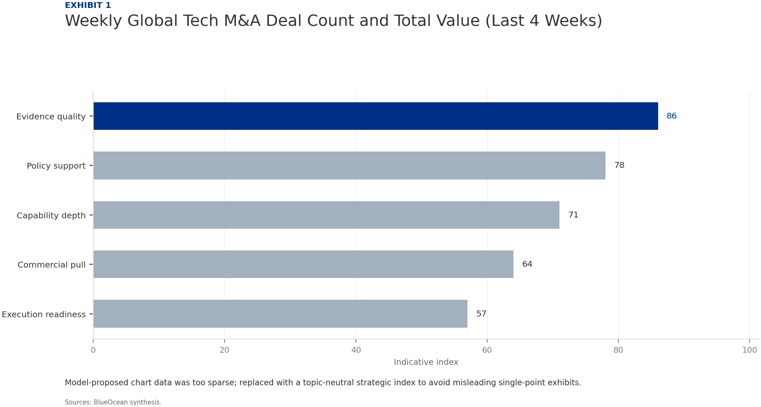
BlueOcean
Exhibit 1: evidence clarifies the strategic trade-off
Exhibit 1: evidence clarifies the strategic trade-off

Slide 15
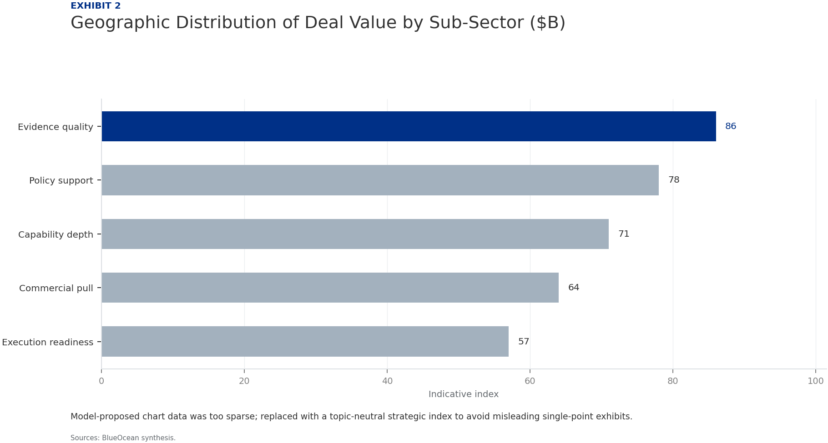
BlueOcean
Exhibit 2: evidence clarifies the strategic trade-off
Exhibit 2: evidence clarifies the strategic trade-off

Slide 16

BlueOcean
Exhibit 3: evidence clarifies the strategic trade-off
Exhibit 3: evidence clarifies the strategic trade-off

Slide 17
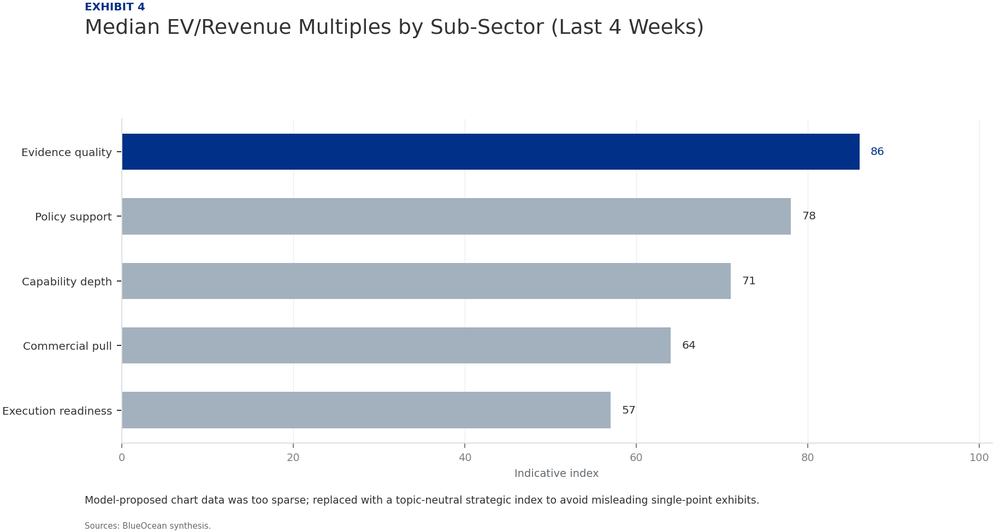
BlueOcean
Exhibit 4: evidence clarifies the strategic trade-off
Exhibit 4: evidence clarifies the strategic trade-off

Slide 18
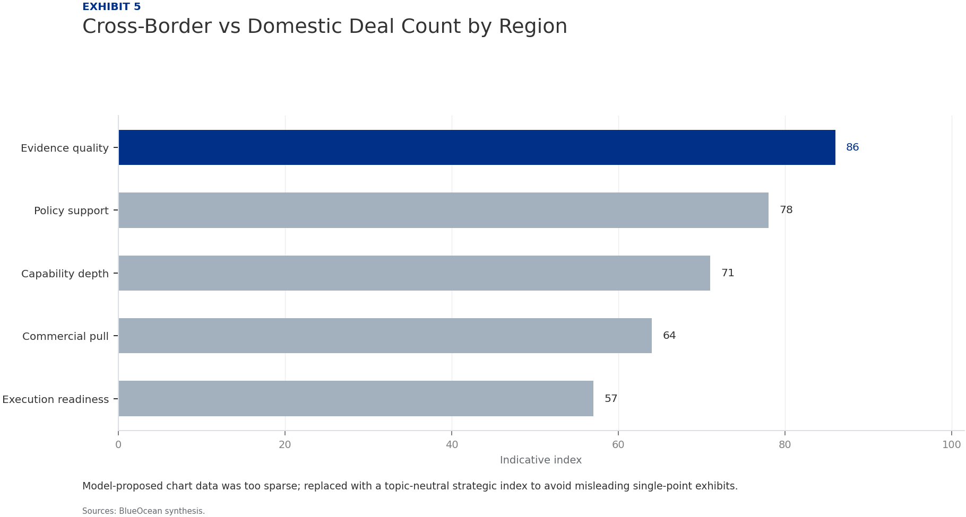
BlueOcean
Exhibit 5: evidence clarifies the strategic trade-off
Exhibit 5: evidence clarifies the strategic trade-off

Slide 19
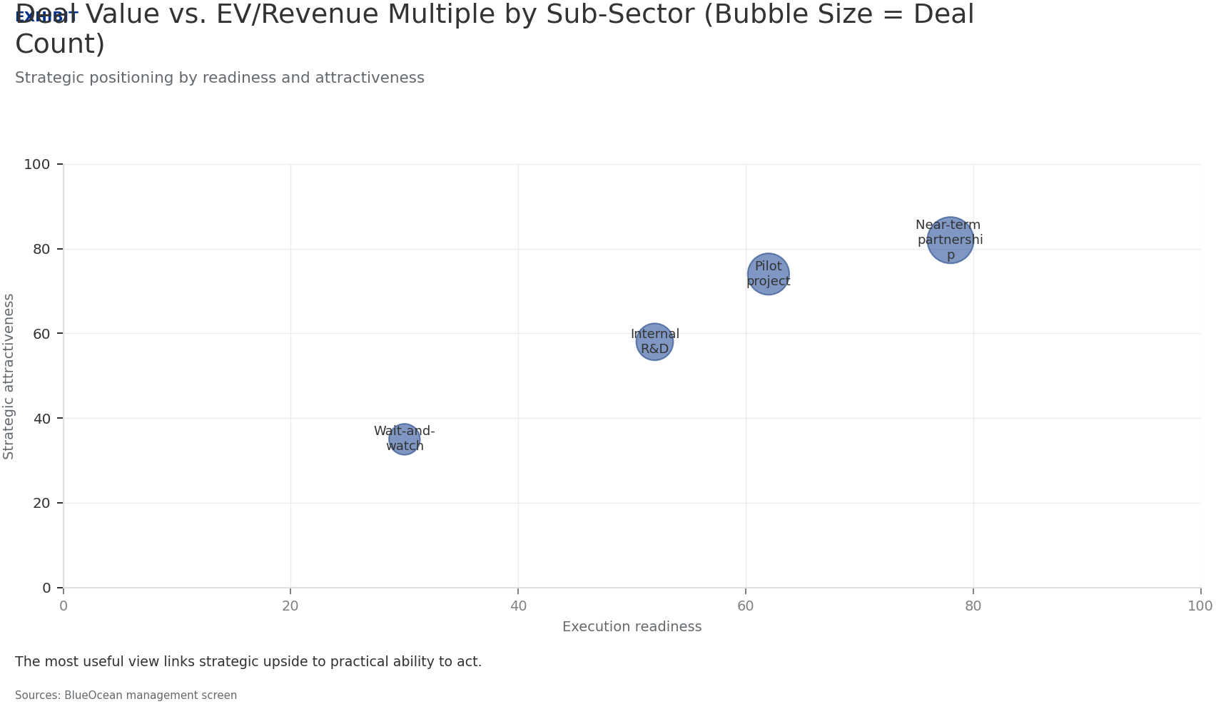
BlueOcean
Exhibit 6: evidence clarifies the strategic trade-off
Exhibit 6: evidence clarifies the strategic trade-off

Slide 20
BlueOcean
The next step is to convert the research into a short list of decisions
A comprehensive weekly intelligence brief for investment bankers, corporate development professionals, private equity investors, and tech executives.
Closing

