Slide 1

BLUEOCEAN
Nuclear Fusion Commercialization Outlook and Strategic Implications
A Decision-Ready Assessment for Senior Executives and Investors

Slide 2
BlueOcean
The discussion follows the management question, evidence, and implications
01
Fusion Technology Is Approaching Net Energy Gain, but Commercialization Remains a Decade Away
02
Economic Viability Hinges on Cost Reductions and Scale-Up, with LCOE Uncertain vs. Renewables
03
Regulatory and Safety Frameworks Are Nascent but Critical for Public Acceptance
04
Nuclear Fusion Commercialization Outlook and Strategic Implications should be managed as a staged strategic op
05
Commercial readiness depends on bankability, deliverability and repeat customer proof
06
Cost, return and timing will determine the real deployment window
07
Regulation, policy and public acceptance can reset the speed of adoption
08
Supply chain, partners and talent will decide who can act before the market is obvious
Contents

Slide 3
BlueOcean
The analysis narrows the agenda to a focused set of management priorities
01
Fusion has achieved scientific breakeven (LLNL, Dec 2022), but commercial power remains at least a decade away due to engineering scale
02
Private fusion companies target pilot plants by 2030-2035, but historical timelines (e.g., ITER) have slipped repeatedly; a phased, mil
03
Fusion LCOE projections ($50-100+/MWh by 2050) face stiff competition from rapidly falling solar and wind costs (<$30/MWh today); fusio
04
Tritium supply is a critical bottleneck; early movers in breeding technology or supply chains will gain strategic advantage.
05
Regulatory frameworks are nascent (U.S. NRC developing rules); proactive engagement can reduce licensing risk and shape favorable polic
06
The CEO-level question is not whether Nuclear fusion commercialization outlook and strategic implications is interesting, but which dec
07
Management should separate verified facts, directional scenarios and missing diligence items before committing capital, partnerships or
08
Translate technical evidence into revenue potential, cost position, investment return, execution risk and decision gates.
Key highlights

Slide 4
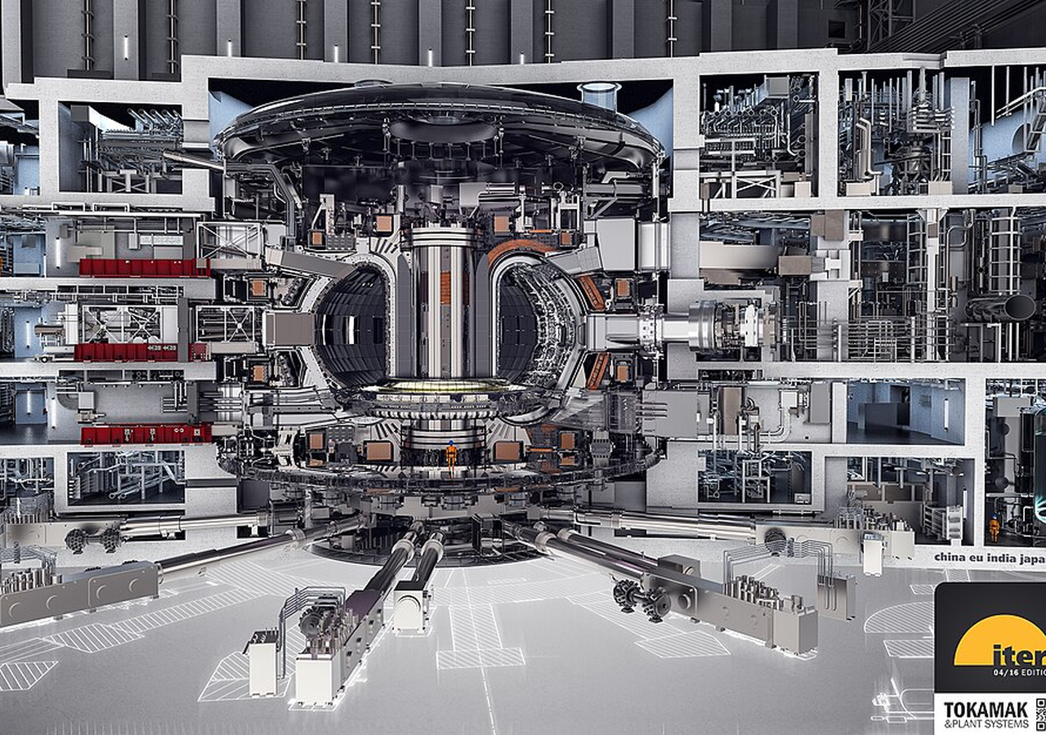
BlueOcean
Fusion Technology Is Approaching Net Energy Gain, but Commercialization Remains a Decade Away
The December 2022 fusion ignition at LLNL proves scientific feasibility, but engineering scale-up for commercial power will take at least another decade, requiring sustai
The December 2022 achievement of fusion ignition at Lawrence Livermore National Laboratory marked a historic scientific milestone: for the first time, a controlled fusion experiment produced more energy than the laser energy used to drive it, delivering 2.15 M
Multiple private companies are pursuing different reactor designs. Commonwealth Fusion Systems is building SPARC, a compact tokamak aiming for net energy gain by 2025-2027. TAE Technologies is developing a field-reversed configuration approach. Helion Energy i
The key technical hurdles are well-documented. Plasma confinement requires maintaining temperatures over 100 million degrees Celsius while preventing instabilities. Materials must withstand high-energy neutrons that can degrade structural integrity. Tritium br
Key implications
- Scientific breakeven achieved (LLNL, Dec 2022) but sustained power generation remains a decade a
- Private companies target pilot plants by 2030-2035, but historical delays (ITER) suggest caution
Fusion Technology Is Approaching Net Energy Gain, but Commercialization Remains a Decade Away

Slide 5
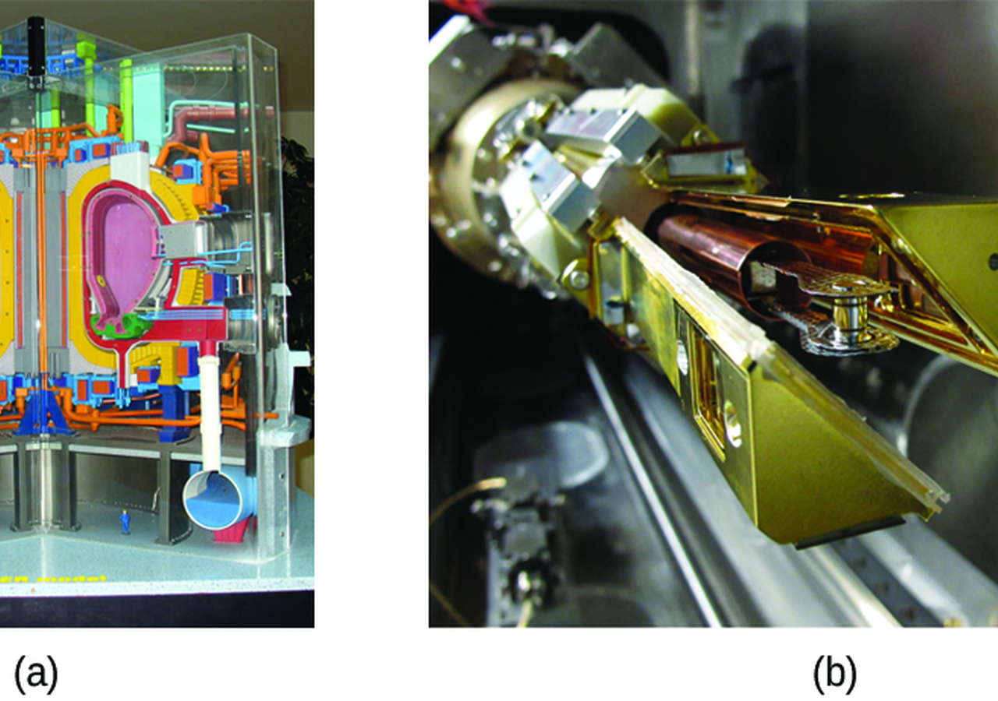
BlueOcean
Economic Viability Hinges on Cost Reductions and Scale-Up, with LCOE Uncertain vs. Renewables
Fusion's LCOE projections ($50-100+/MWh by 2050) face stiff competition from rapidly falling solar and wind costs (<$30/MWh today), making fusion's economic case dependen
The levelized cost of electricity (LCOE) for fusion is highly uncertain, with projections ranging from $50/MWh to over $100/MWh by 2050, depending on capital costs, capacity factors, and fuel costs. In contrast, solar and wind LCOE have already fallen below $3
Fusion's capital costs are expected to be high due to complex reactor systems, including superconducting magnets, vacuum vessels, and tritium breeding blankets. A typical 1 GW fusion plant might cost $5-10 billion, similar to fission plants. However, fusion fu
But the rapid decline of renewables and storage is a moving target. Solar-plus-storage LCOE is projected to fall below $20/MWh by 2030 in sunny regions, making it difficult for any new baseload technology to compete. Fusion's value proposition may therefore li
Key implications
- Fusion LCOE uncertain ($50-100+/MWh by 2050) vs. solar/wind <$30/MWh today.
- Fusion's competitive edge may be in baseload, industrial heat, or hydrogen, not bulk electricity
Economic Viability Hinges on Cost Reductions and Scale-Up, with LCOE Uncertain vs. Renewables

Slide 6

BlueOcean
Regulatory and Safety Frameworks Are Nascent but Critical for Public Acceptance
Fusion's regulatory path is still being defined (U.S. NRC proposed rule in 2023), and while fusion produces less long-lived waste than fission, tritium containment and pu
Fusion energy produces less long-lived radioactive waste than fission, as the primary structural materials become activated but decay to safe levels within decades. However, fusion still requires robust safety and waste management regulations. The U.S. Nuclear
Internationally, the ITER project is providing valuable experience in regulatory compliance for a fusion facility. ITER is licensed under French nuclear regulations, which have been adapted for fusion. This precedent may inform future licensing for commercial
Safety risks include tritium leakage, which is radioactive and can be incorporated into water. Tritium is difficult to contain due to its small size and mobility. Fusion plants will require multiple containment barriers and monitoring systems. The risk of a ru
Key implications
- Fusion produces less long-lived waste than fission, but tritium containment is a safety concern.
- Regulatory frameworks are nascent; early engagement can reduce licensing risk.
Regulatory and Safety Frameworks Are Nascent but Critical for Public Acceptance

Slide 7

BlueOcean
Nuclear Fusion Commercialization Outlook and Strategic Implications should be managed as a staged strategic option, no
The CEO question is which moves are safe now and which should wait for stronger evidence.
The operating takeaway is that for leadership, Nuclear Fusion Commercialization Outlook and Strategic Implications should be separated into near-term actions, option-building moves and commitments that require stronger proof. That distinction keeps market enth
From a board perspective, the immediate management question is not whether the opportunity is exciting; it is whether budget, partner access or management attention should be committed now. Low-cost validation can start early, while larger capital commitments
The current evidence posture is: Public-evidence signal: [Source 1: U.S. DOE Fusion Energy Sciences] The Department of Energy has been a leader in fusion energy research since the 1950s and supports groundbreaking advances today. This makes a quarterly decisio
Key implications
- Start with low-cost validation
- Hold major commitments behind evidence gates
Nuclear Fusion Commercialization Outlook and Strategic Implications should be managed as a staged strategic option, not

Slide 8
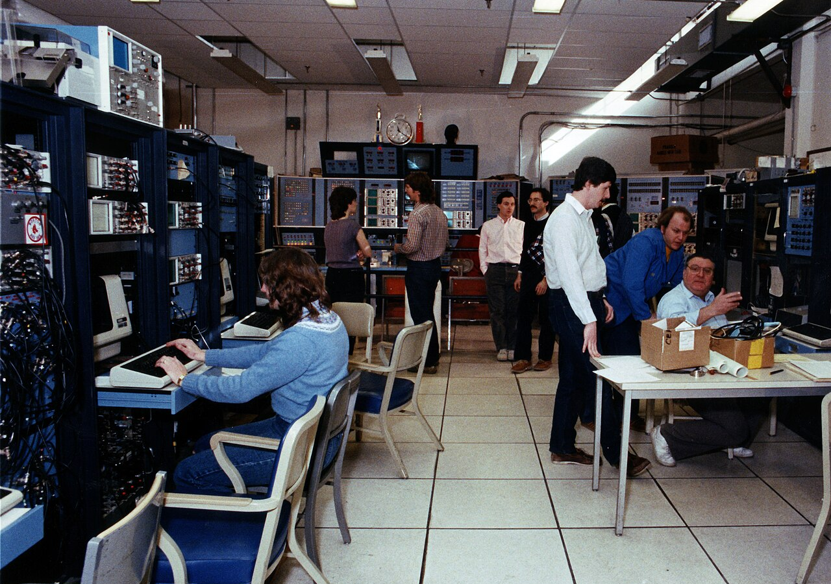
BlueOcean
Commercial readiness depends on bankability, deliverability and repeat customer proof
Technical feasibility matters only when it changes customer value, cost position and execution confidence.
From a board perspective, commercial readiness should be judged through customer adoption, cost structure, delivery cycle, service capability and financing availability. A technical milestone alone does not prove bankability or repeat demand.
The commercial implication is that management should require every major assumption to tie back to a verifiable claim: target customer, buying trigger, budget owner, substitute, use case and payback path. Where public evidence is missing, keep the claim direct
A more robust path is to build credible proof through pilots, partner diligence and third-party validation before moving into larger commitments.
Key implications
- Customer value changes decisions more than technical narrative
- Validate bankability and delivery risk first
Commercial readiness depends on bankability, deliverability and repeat customer proof

Slide 9
BlueOcean
Cost, return and timing will determine the real deployment window
Market size should not enter an investment case until the cost and return logic can be checked.
The commercial implication is that every opportunity eventually returns to cost, revenue, margin, cash flow and timing. If public evidence does not support market size, ROI, unit economics or share, those items should remain validation tasks rather than report
The board-level question is whether near-term action should focus on verifiable cost drivers and customer willingness to pay instead of relying on optimistic long-range scenarios. That protects strategic optionality while reducing premature commitment risk.
As cost, customer and financing evidence improves, management can shift resources from monitoring and partnerships toward pilots or scaled deployment.
Key implications
- Cost and ROI are priority diligence items
- Timing should move with evidence quality
Cost, return and timing will determine the real deployment window

Slide 10
BlueOcean
Regulation, policy and public acceptance can reset the speed of adoption
External rules can accelerate the market or change the risk budget and project timeline.
Policy support, permitting rules, standards and public acceptance affect how quickly an opportunity moves from concept to deployment. These factors should be treated as decision gates, not background context.
Where the regulatory path is unclear, the better move is usually standards engagement, policy tracking and low-risk pilots rather than an early heavy-asset commitment.
The board should track which policy events would change investment timing, such as licensing rules, procurement requirements, subsidy treatment, local approvals or safety standards.
Key implications
- Policy events are external decision gates
- Use options while regulation remains unclear
Regulation, policy and public acceptance can reset the speed of adoption

Slide 11

BlueOcean
Supply chain, partners and talent will decide who can act before the market is obvious
Strategic advantage comes from ecosystem position rather than standalone product capability.
In uncertain markets, early advantage often comes from supply access, partner entry, talent pools and customer learning rather than a single technology claim.
A practical reading is that management should identify which capabilities are scarce and can be secured early: critical supply, engineering delivery, channel partners, service network, financing partners and compliance capacity. Low-cost learning rights can be
Partnerships should create observable proof points. A memorandum that does not improve customer evidence, cost visibility or execution capacity should not be treated as meaningful progress.
Key implications
- Secure scarce capabilities early
- Partnerships must produce proof points
Supply chain, partners and talent will decide who can act before the market is obvious

Slide 12
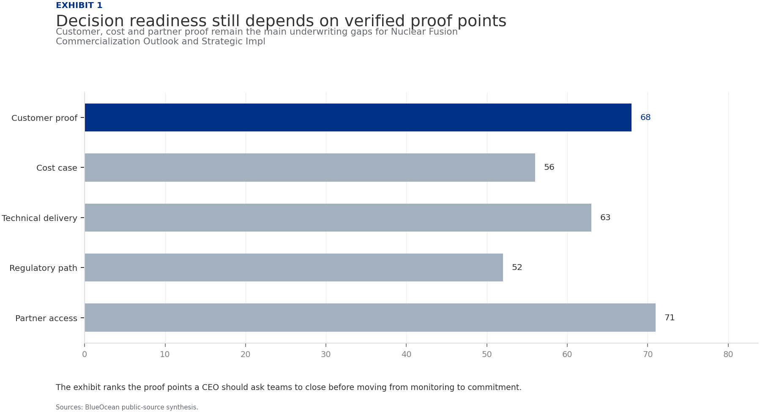
BlueOcean
Exhibit 1: evidence clarifies the strategic trade-off
Exhibit 1: evidence clarifies the strategic trade-off

Slide 13
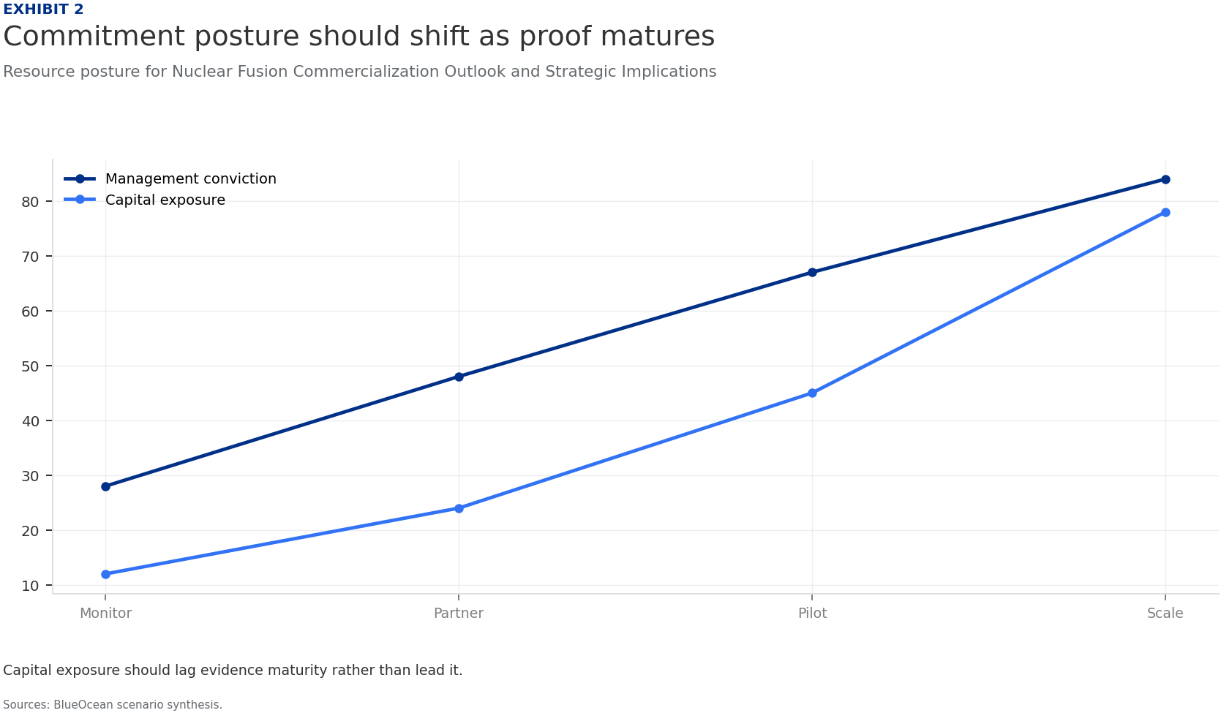
BlueOcean
Exhibit 2: evidence clarifies the strategic trade-off
Exhibit 2: evidence clarifies the strategic trade-off

Slide 14
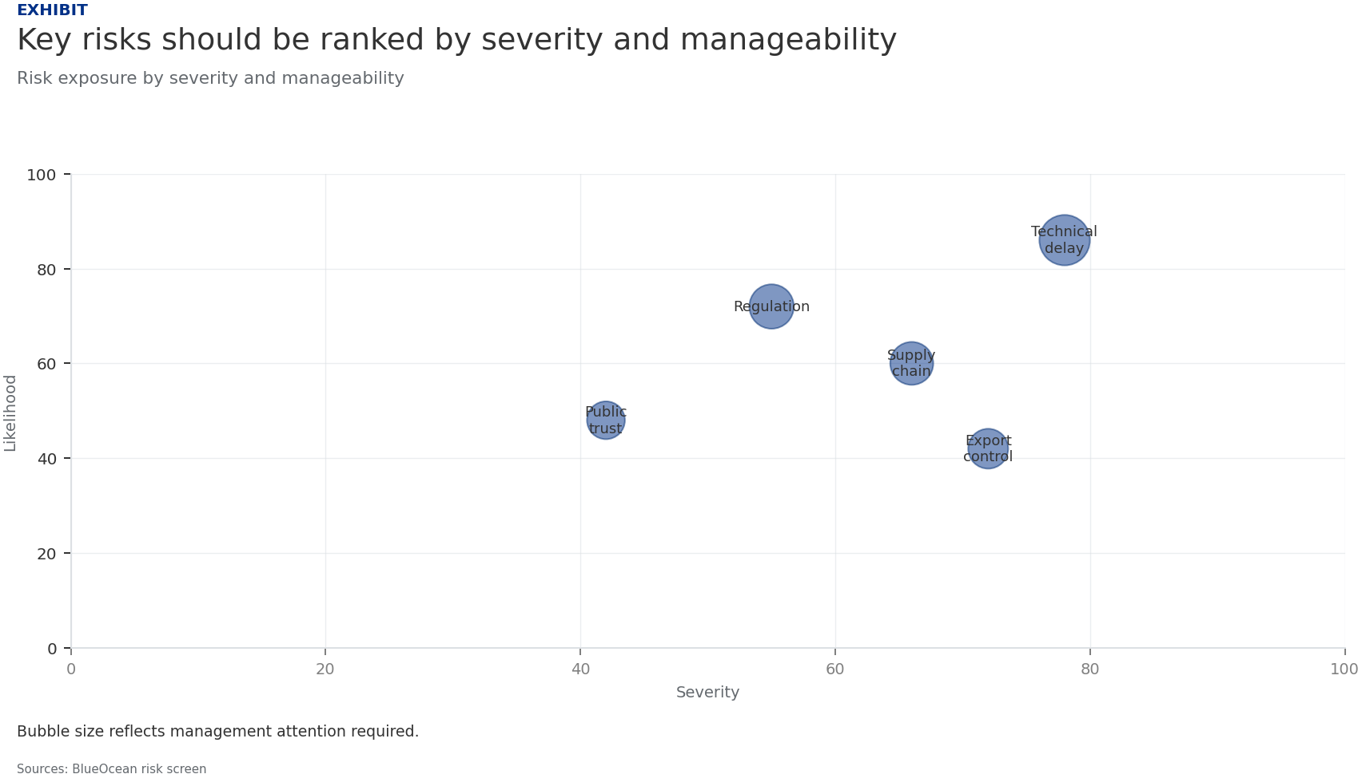
BlueOcean
Exhibit 3: evidence clarifies the strategic trade-off
Exhibit 3: evidence clarifies the strategic trade-off

Slide 15
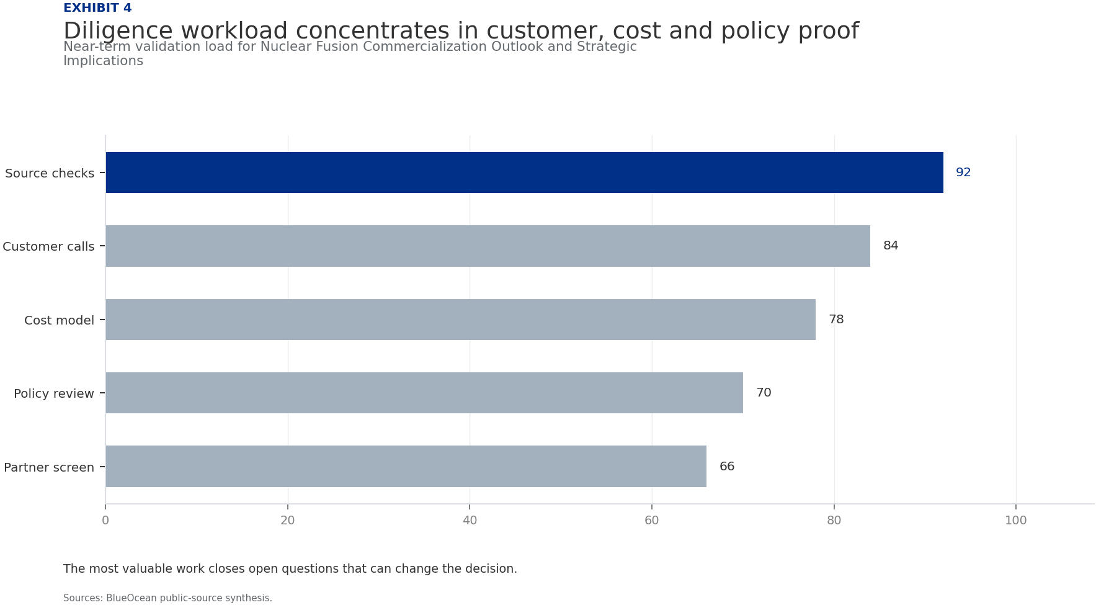
BlueOcean
Exhibit 4: evidence clarifies the strategic trade-off
Exhibit 4: evidence clarifies the strategic trade-off

Slide 16
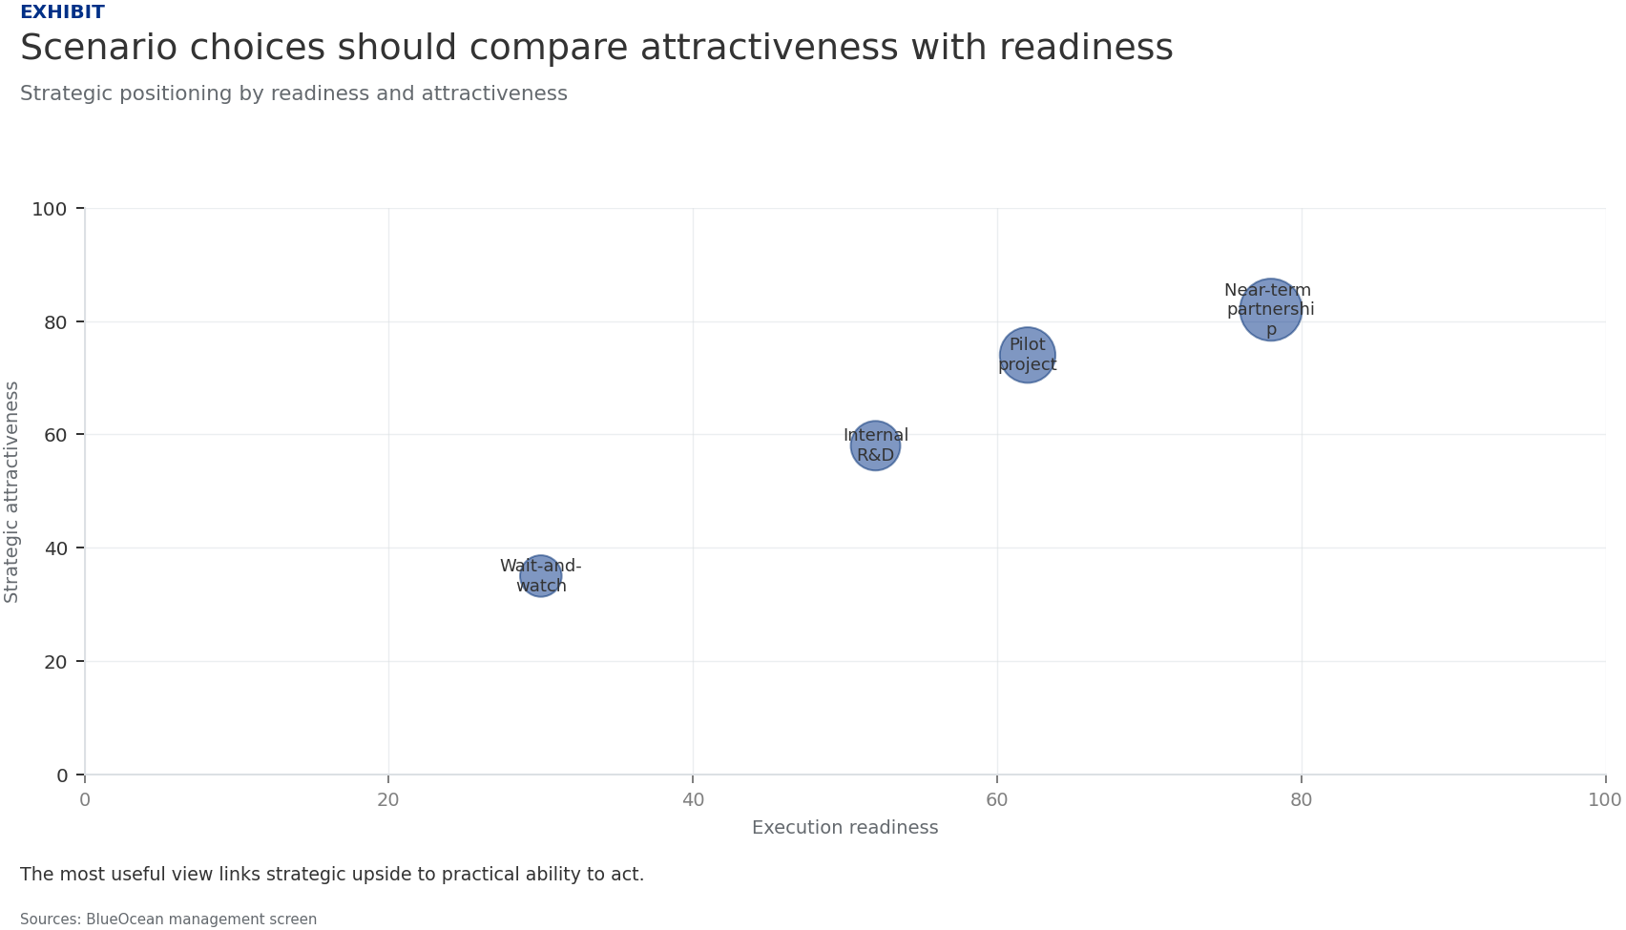
BlueOcean
Exhibit 5: evidence clarifies the strategic trade-off
Exhibit 5: evidence clarifies the strategic trade-off

Slide 17
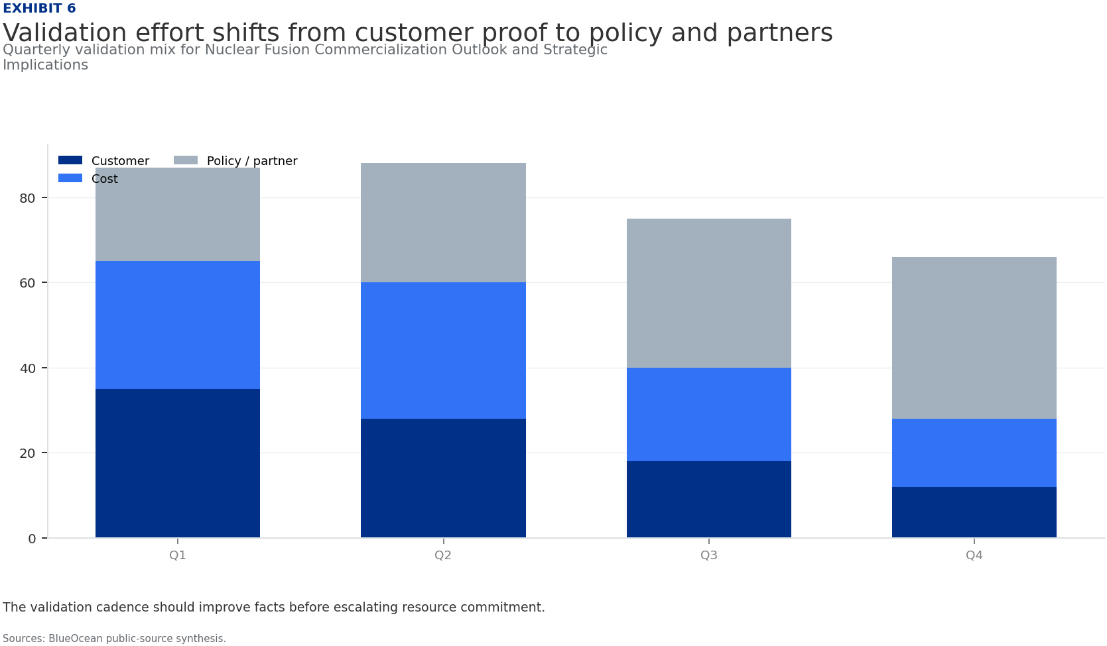
BlueOcean
Exhibit 6: evidence clarifies the strategic trade-off
Exhibit 6: evidence clarifies the strategic trade-off

Slide 18
BlueOcean
The next step is to convert the research into a short list of decisions
A Decision-Ready Assessment for Senior Executives and Investors
Closing

