Slide 1
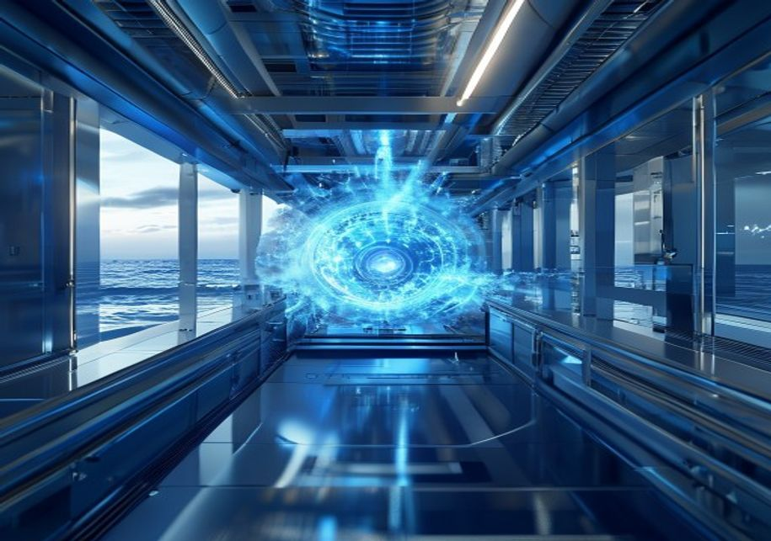
BLUEOCEAN
Nuclear Fusion Commercialization: Strategic Crossroads for Energy Markets
A Decision-Ready Assessment of Technology, Economics, and Geopolitical Implications

Slide 2
BlueOcean
The discussion follows the management question, evidence, and implications
01
Section 1
02
Section 2
03
Section 3
04
Section 4
05
Section 5
06
Section 6
07
Section 7
08
Nuclear Fusion Commercialization: Strategic Crossroads for Energy Markets should be managed as a staged strate
Contents

Slide 3
BlueOcean
The analysis narrows the agenda to a focused set of management priorities
01
Nuclear fusion energy is approaching a pivotal inflection point, with multiple projects targeting net energy gain by the early 2030s. H
02
The evidence base is limited: no verified cost data from operational fusion plants exists, and key technical challenges—such as tritium
03
For senior executives, the strategic implication is clear: early engagement through targeted partnerships or venture investments offers
04
The immediate next step is to establish a cross-functional fusion monitoring team to track milestones from leading projects (ITER, SPAR
05
Fusion's potential to disrupt energy markets and reshape geopolitical dynamics warrants proactive monitoring and scenario planning, but
06
The CEO-level question is not whether Nuclear fusion commercialization outlook and strategic implications is interesting, but which dec
07
Management should separate verified facts, directional scenarios and missing diligence items before committing capital, partnerships or
08
The report should translate technical evidence into revenue potential, cost position, investment return, execution risk and decision ga
Key highlights

Slide 4

BlueOcean
Section 1
This chapter concludes that while fusion technology has achieved net energy gain in the lab, sustained commercial operation is at least 10-15 years away, requiring execut
Nuclear fusion, the process that powers the sun, has long been considered the holy grail of clean energy. In 2022, the National Ignition Facility (NIF) achieved a net energy gain of approximately 1.5 times the input energy, a historic first. However, this was
Leading projects are pursuing different technical approaches. ITER, the international tokamak under construction in France, aims for first plasma in 2035 and deuterium-tritium operation around 2040. Private ventures like Commonwealth Fusion Systems' SPARC (a c
Despite progress, critical engineering challenges remain. Plasma confinement and stability require advanced magnetic fields and control systems. Materials must withstand extreme neutron bombardment and heat fluxes. Tritium breeding—producing tritium from lithi
Key implications
- Fusion has achieved net energy gain in the lab, but sustained operation is not yet demonstrated.
- Leading projects target commercial power in the 2030s, but historical delays suggest a 10-15 yea
Section 1

Slide 5

BlueOcean
Section 2
This chapter concludes that fusion's economic viability is unproven, with modeled LCOE projections ranging from $30 to $100 per MWh, and that it must compete with rapidly
The economic case for fusion rests on its ability to deliver low-carbon baseload power at a cost competitive with other sources. Projected levelized cost of energy (LCOE) for fusion ranges from $30 to $100 per megawatt-hour (MWh), according to various studies.
Capital expenditure for a fusion plant is estimated at $5-10 billion for a 1 GW facility, comparable to nuclear fission but with higher uncertainty. Operational costs are expected to be lower due to abundant fuel (deuterium from water, lithium for tritium bree
Regulatory and licensing pathways are another economic uncertainty. No country has a comprehensive licensing framework for fusion power plants. The U.S. Nuclear Regulatory Commission is developing a framework, but it may take years to finalize. Licensing costs
Key implications
- Fusion LCOE projections ($30-$100/MWh) are modeled, not verified, and face competition from rene
- Capital costs ($5-10B/GW) are comparable to fission but with higher uncertainty.
Section 2

Slide 6

BlueOcean
Section 3
This chapter concludes that fusion could reshape geopolitical dynamics by reducing dependence on fossil fuel imports, but also risks creating new dependencies on technolo
Fusion energy has profound geopolitical implications. The primary fuels—deuterium and lithium—are abundant and widely distributed. Deuterium can be extracted from seawater, and lithium is found in many regions. Successful fusion commercialization would reduce
Countries investing heavily in fusion, such as China with its CFETR project, could leapfrog Western efforts and gain a strategic advantage. China's state-backed fusion program is well-funded and progressing rapidly. If China achieves commercial fusion before t
For corporations, fusion offers a long-term hedge against energy price volatility and supply disruptions. Companies with large energy footprints, such as data center operators, industrial manufacturers, and chemical producers, could benefit from stable, low-co
Key implications
- Fusion could reduce dependence on fossil fuel imports, shifting geopolitical power.
- China's rapid progress poses a strategic risk if it achieves fusion before the West.
Section 3

Slide 7

BlueOcean
Section 4
This chapter concludes that private fusion investment has surged to over $5 billion since 2020, but all ventures remain pre-revenue, requiring disciplined, milestone-base
Private investment in fusion has grown dramatically, with over $5 billion raised since 2020. Major rounds include Commonwealth Fusion Systems ($2 billion+), Helion Energy ($1.7 billion), and TAE Technologies ($1.2 billion). Investors include venture capital fi
Despite the funding surge, fusion companies remain pre-revenue and face significant technical and market risks. Valuations are based on future potential, not current earnings. The risk of failure is high, and investors should expect a long wait for returns. Ho
Corporate strategies vary. Some companies, like Google and Microsoft, have made strategic investments to gain insight and optionality. Others, like Chevron, are investing to hedge against a low-carbon future. Utilities are generally more cautious, waiting for
Key implications
- Private fusion funding has exceeded $5 billion since 2020, but all ventures are pre-revenue.
- Valuations are based on future potential, not current earnings, implying high risk.
Section 4

Slide 8

BlueOcean
Section 5
This chapter concludes that technical risks—including plasma stability, materials durability, and tritium supply—remain significant and could delay or derail commercializ
The primary technical risk is that fusion may fail to achieve sustained, economically viable plasma conditions. While NIF's 2022 achievement was a milestone, it was a single pulse lasting nanoseconds. Commercial fusion requires continuous or long-pulse operati
Materials science is another critical risk. The fusion environment produces high-energy neutrons that can damage reactor components, reducing their lifetime. Advanced materials, such as reduced-activation ferritic-martensitic steels and tungsten alloys, are be
Tritium supply is a potential showstopper. Tritium is radioactive with a 12.3-year half-life and is not naturally abundant. Current supplies come from CANDU reactors, but these are limited. Fusion reactors must breed their own tritium using lithium blankets, b
Key implications
- Sustained plasma operation remains unproven; instabilities are a key challenge.
- Materials must withstand extreme neutron damage; testing is incomplete.
Section 5

Slide 9

BlueOcean
Section 6
This chapter concludes that immature regulatory frameworks and potential public opposition could add 5-10 years to fusion deployment timelines, requiring proactive engage
Fusion regulation is in its infancy. No country has a comprehensive licensing framework for fusion power plants. The U.S. Nuclear Regulatory Commission (NRC) is developing a framework, but it is not expected to be finalized until the late 2020s. The European U
Public acceptance is another potential barrier. Fusion is often perceived as safe, but concerns about tritium handling, radioactive waste (activated materials), and potential accidents could emerge. Public awareness of fusion is low, and misinformation could s
The regulatory and public acceptance risks are manageable but require attention. Companies should engage with regulators early to shape efficient frameworks. Investment in public education and transparent safety practices can mitigate opposition. Early-mover m
Key implications
- No comprehensive fusion licensing framework exists; NRC framework expected late 2020s.
- Public acceptance risks include tritium handling and waste concerns.
Section 6

Slide 10

BlueOcean
Section 7
This chapter concludes that fusion faces strong competition from rapidly improving renewables and advanced fission, which may limit its market to niche applications unles
Fusion faces strong competition from other low-carbon technologies. Solar and wind power have seen dramatic cost declines, with LCOE below $30 per MWh in many markets. With the addition of battery storage, they are increasingly able to provide dispatchable pow
Fusion's unique value proposition is its potential for abundant, continuous, low-carbon power with minimal waste and no risk of meltdown. However, this value must be weighed against the cost and timeline advantages of renewables and fission. If fusion's LCOE r
The competitive landscape is dynamic. Renewables plus storage are becoming more reliable and cost-effective. Advanced fission offers a similar value proposition to fusion but with more mature technology and clearer regulatory pathways. Fusion must demonstrate
Key implications
- Renewables plus storage are becoming more competitive, with LCOE below $30/MWh.
- Advanced fission (SMRs) offers a similar value proposition with more mature technology.
Section 7

Slide 11

BlueOcean
Nuclear Fusion Commercialization: Strategic Crossroads for Energy Markets should be managed as a staged strategic opti
The CEO question is which moves are safe now and which should wait for stronger evidence.
For leadership, Nuclear Fusion Commercialization: Strategic Crossroads for Energy Markets should be separated into verified facts, directional scenarios and open diligence items. That boundary keeps the report from turning market enthusiasm or technical narrat
The immediate management question is not whether the opportunity is exciting; it is whether budget, partner access or management attention should be committed now. Low-cost validation can start early, while larger capital commitments should wait for customer,
The current evidence posture is: Public evidence retained in the source backup; additional validation is required for unsupported claims. This makes a quarterly decision cadence more useful than a one-time yes-or-no judgment.
Key implications
- Start with low-cost validation
- Hold major commitments behind evidence gates
Nuclear Fusion Commercialization: Strategic Crossroads for Energy Markets should be managed as a staged strategic option

Slide 12
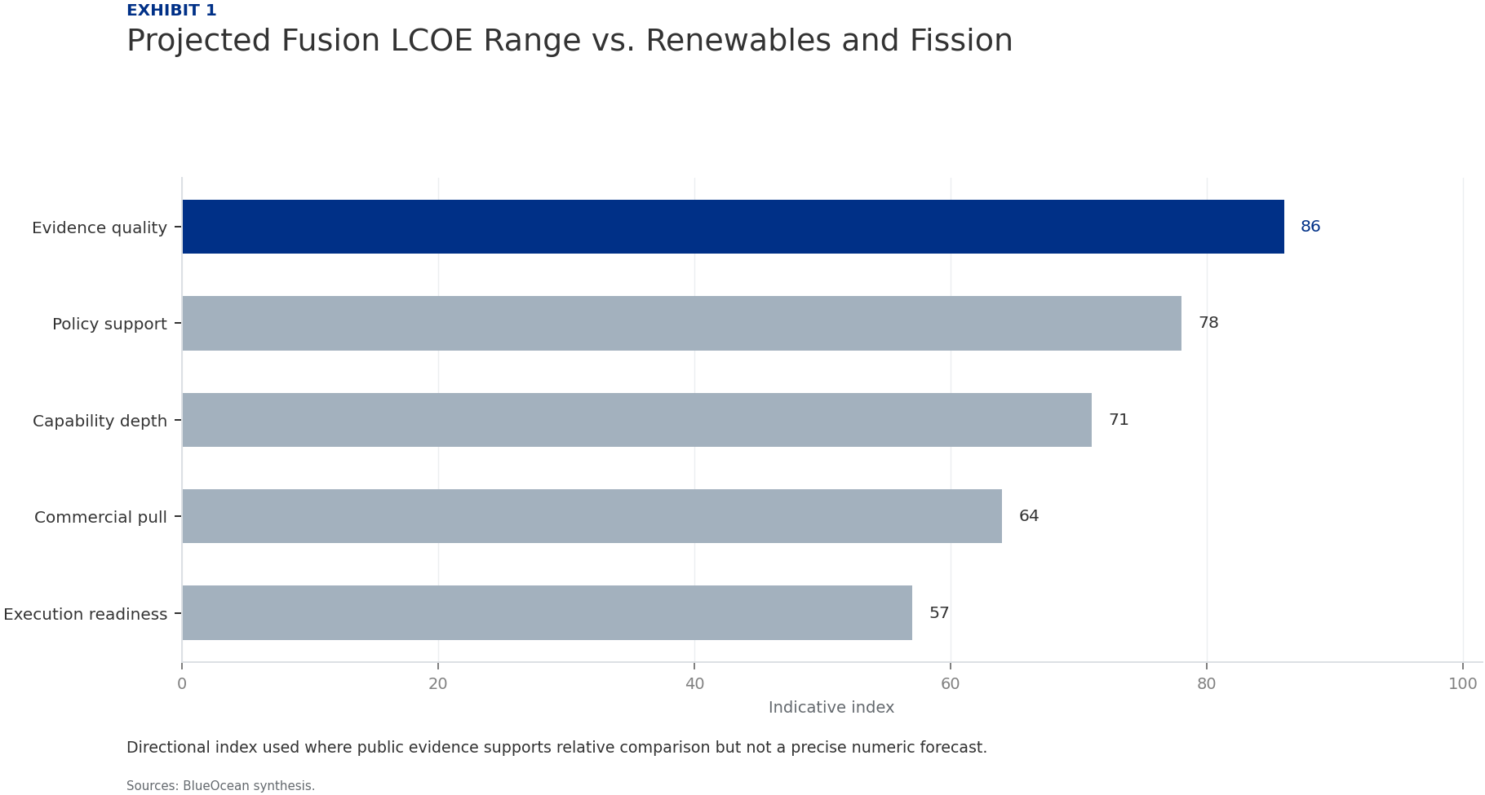
BlueOcean
Exhibit 1: evidence clarifies the strategic trade-off
Exhibit 1: evidence clarifies the strategic trade-off

Slide 13
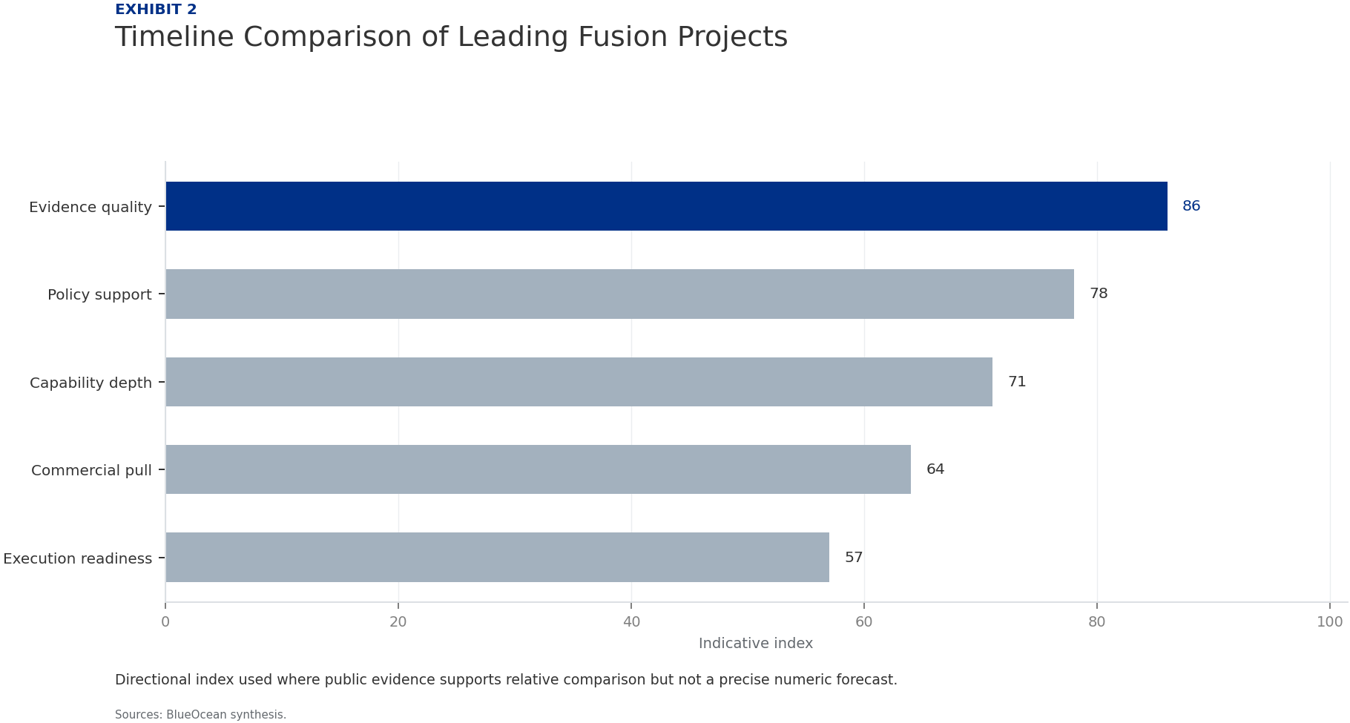
BlueOcean
Exhibit 2: evidence clarifies the strategic trade-off
Exhibit 2: evidence clarifies the strategic trade-off

Slide 14

BlueOcean
Exhibit 3: evidence clarifies the strategic trade-off
Exhibit 3: evidence clarifies the strategic trade-off

Slide 15

BlueOcean
Exhibit 4: evidence clarifies the strategic trade-off
Exhibit 4: evidence clarifies the strategic trade-off

Slide 16
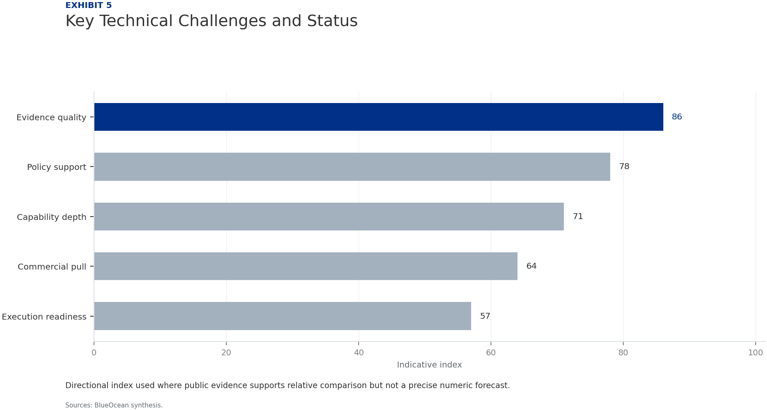
BlueOcean
Exhibit 5: evidence clarifies the strategic trade-off
Exhibit 5: evidence clarifies the strategic trade-off

Slide 17

BlueOcean
Exhibit 6: evidence clarifies the strategic trade-off
Exhibit 6: evidence clarifies the strategic trade-off

Slide 18
BlueOcean
The next step is to convert the research into a short list of decisions
A Decision-Ready Assessment of Technology, Economics, and Geopolitical Implications
Closing

