Slide 1

BLUEOCEAN
Nuclear Fusion Commercialization: Strategic Outlook and Investment Implications
A Decision-Ready Analysis for Senior Executives and Policy Advisors

Slide 2
BlueOcean
The discussion follows the management question, evidence, and implications
01
Fusion Commercialization Is Accelerating but Still Faces Decade-Long Hurdles
02
Technological Breakthroughs Are Narrowing the Gap to Net-Positive Energy
03
Economic Viability Remains Uncertain with High Capital Costs and Unvalidated LCOE
04
Nuclear Fusion Commercialization: Strategic Outlook and Investment Implications should be managed as a staged
05
Commercial readiness depends on bankability, deliverability and repeat customer proof
06
Cost, return and timing will determine the real deployment window
07
Regulation, policy and public acceptance can reset the speed of adoption
08
Supply chain, partners and talent will decide who can act before the market is obvious
Contents

Slide 3
BlueOcean
The analysis narrows the agenda to a focused set of management priorities
01
Fusion commercialization is accelerating but remains a decade or more from grid-scale deployment. Private investment surged to a record
02
The CEO-level question is not whether Nuclear fusion commercialization outlook and strategic implications is interesting, but which dec
03
Management should separate verified facts, directional scenarios and missing diligence items before committing capital, partnerships or
04
The report should translate technical evidence into revenue potential, cost position, investment return, execution risk and decision ga
05
Where the evidence pack does not support a number, the right output is a validation placeholder and diligence task rather than an inven
06
The near-term agenda should prioritize no-regret evidence building, medium-term strategic options and long-term commitments only after
Key highlights

Slide 4

BlueOcean
Fusion Commercialization Is Accelerating but Still Faces Decade-Long Hurdles
This chapter concludes that fusion energy is attracting record investment but remains at least a decade from commercial deployment, requiring risk-adjusted capital alloca
The fusion energy landscape has shifted dramatically in the past five years. Private investment has surged, with cumulative funding exceeding $6 billion and a record $3 billion in 2024 alone. This influx of capital has enabled a wave of startups to pursue dive
Private ventures like Commonwealth Fusion Systems and TAE Technologies have announced ambitious timelines for net-positive energy by the early 2030s, but these projections remain unvalidated by independent third parties. The gap between funding and technical a
For CEOs, the key commercial implication is that fusion is not yet a near-term solution for energy needs. The record investment signals strong market confidence, but the lack of demonstrated net-positive energy means that any investment must be treated as high
Key implications
- Private fusion investment reached $3 billion in 2024, cumulative $6 billion.
- No fusion reactor has yet demonstrated net-positive energy.
Fusion Commercialization Is Accelerating but Still Faces Decade-Long Hurdles

Slide 5

BlueOcean
Technological Breakthroughs Are Narrowing the Gap to Net-Positive Energy
This chapter concludes that while high-temperature superconductors and other advances are promising, unresolved engineering challenges—especially tritium breeding—pose si
Recent advances in high-temperature superconductors (HTS) have been a game-changer for magnetic confinement fusion. HTS magnets can generate stronger magnetic fields in smaller devices, potentially reducing the size and cost of fusion reactors. Companies like
no existing material can withstand the intense radiation inside a commercial fusion reactor for extended periods. Tritium breeding is perhaps the most underappreciated bottleneck. Deuterium-tritium (D-T) fusion requires tritium, a radioactive isotope of hydrog
For CEOs, the commercial implication is that tritium supply is a potential showstopper for fusion commercialization. Any investment in D-T fusion must include a credible plan for tritium breeding or alternative fuel cycles. The management implication is to pri
Key implications
- HTS magnets enable smaller, cheaper reactors.
- Plasma confinement, materials degradation, and tritium breeding remain unresolved.
Technological Breakthroughs Are Narrowing the Gap to Net-Positive Energy

Slide 6

BlueOcean
Economic Viability Remains Uncertain with High Capital Costs and Unvalidated LCOE
This chapter concludes that fusion's economic viability is unproven, with high capital costs and uncertain levelized cost of energy, making it a high-risk investment comp
The levelized cost of energy (LCOE) for fusion is highly uncertain, with projections ranging from $50 to $100 per MWh by 2050, depending on assumptions about capital costs, operational efficiency, and plant lifespan. For comparison, solar and wind LCOE have al
Financing models are evolving, with a mix of venture capital, government grants, and strategic corporate investments. However, no fusion project has yet reached the stage where traditional project finance is applicable. The evidence boundary for this section i
For CEOs, the commercial implication is that fusion is unlikely to compete with renewables on cost in the near to medium term. The high capital costs and uncertain operational expenses mean that fusion will require significant subsidies or carbon pricing to be
Key implications
- Fusion LCOE projections range from $50 to $100 per MWh by 2050.
- Solar and wind LCOE already below $30 per MWh.
Economic Viability Remains Uncertain with High Capital Costs and Unvalidated LCOE

Slide 7

BlueOcean
Nuclear Fusion Commercialization: Strategic Outlook and Investment Implications should be managed as a staged strategi
The CEO question is which moves are safe now and which should wait for stronger evidence.
For leadership, Nuclear Fusion Commercialization: Strategic Outlook and Investment Implications should be separated into verified facts, directional scenarios and open diligence items. That boundary keeps the report from turning market enthusiasm or technical
The immediate management question is not whether the opportunity is exciting; it is whether budget, partner access or management attention should be committed now. Low-cost validation can start early, while larger capital commitments should wait for customer,
The current evidence posture is: Public evidence retained in the source backup; additional validation is required for unsupported claims. This makes a quarterly decision cadence more useful than a one-time yes-or-no judgment.
Key implications
- Start with low-cost validation
- Hold major commitments behind evidence gates
Nuclear Fusion Commercialization: Strategic Outlook and Investment Implications should be managed as a staged strategic

Slide 8

BlueOcean
Commercial readiness depends on bankability, deliverability and repeat customer proof
Technical feasibility matters only when it changes customer value, cost position and execution confidence.
Commercial readiness should be judged through customer adoption, cost structure, delivery cycle, service capability and financing availability. A technical milestone alone does not prove bankability or repeat demand.
Management should require every major assumption to tie back to a verifiable claim: target customer, buying trigger, budget owner, substitute, use case and payback path. Where public evidence is missing, the report should keep the claim directional.
A more robust path is to build credible proof through pilots, partner diligence and third-party validation before moving into larger commitments.
Key implications
- Customer value changes decisions more than technical narrative
- Validate bankability and delivery risk first
Commercial readiness depends on bankability, deliverability and repeat customer proof

Slide 9

BlueOcean
Cost, return and timing will determine the real deployment window
Market size should not enter an investment case until the cost and return logic can be checked.
Every opportunity eventually returns to cost, revenue, margin, cash flow and timing. If public evidence does not support market size, ROI, unit economics or share, those items should remain validation tasks rather than report conclusions.
Near-term action should focus on verifiable cost drivers and customer willingness to pay instead of relying on optimistic long-range scenarios. That protects strategic optionality while reducing premature commitment risk.
As cost, customer and financing evidence improves, management can shift resources from monitoring and partnerships toward pilots or scaled deployment.
Key implications
- Cost and ROI are priority diligence items
- Timing should move with evidence quality
Cost, return and timing will determine the real deployment window

Slide 10

BlueOcean
Regulation, policy and public acceptance can reset the speed of adoption
External rules can accelerate the market or change the risk budget and project timeline.
Policy support, permitting rules, standards and public acceptance affect how quickly an opportunity moves from concept to deployment. These factors should be treated as decision gates, not background context.
Where the regulatory path is unclear, the better move is usually standards engagement, policy tracking and low-risk pilots rather than an early heavy-asset commitment.
The board should track which policy events would change investment timing, such as licensing rules, procurement requirements, subsidy treatment, local approvals or safety standards.
Key implications
- Policy events are external decision gates
- Use options while regulation remains unclear
Regulation, policy and public acceptance can reset the speed of adoption

Slide 11

BlueOcean
Supply chain, partners and talent will decide who can act before the market is obvious
Strategic advantage comes from ecosystem position rather than standalone product capability.
In uncertain markets, early advantage often comes from supply access, partner entry, talent pools and customer learning rather than a single technology claim.
Management should identify which capabilities are scarce and can be secured early: critical supply, engineering delivery, channel partners, service network, financing partners and compliance capacity. Low-cost learning rights can be more valuable than waiting
Partnerships should create observable proof points. A memorandum that does not improve customer evidence, cost visibility or execution capacity should not be treated as meaningful progress.
Key implications
- Secure scarce capabilities early
- Partnerships must produce proof points
Supply chain, partners and talent will decide who can act before the market is obvious

Slide 12
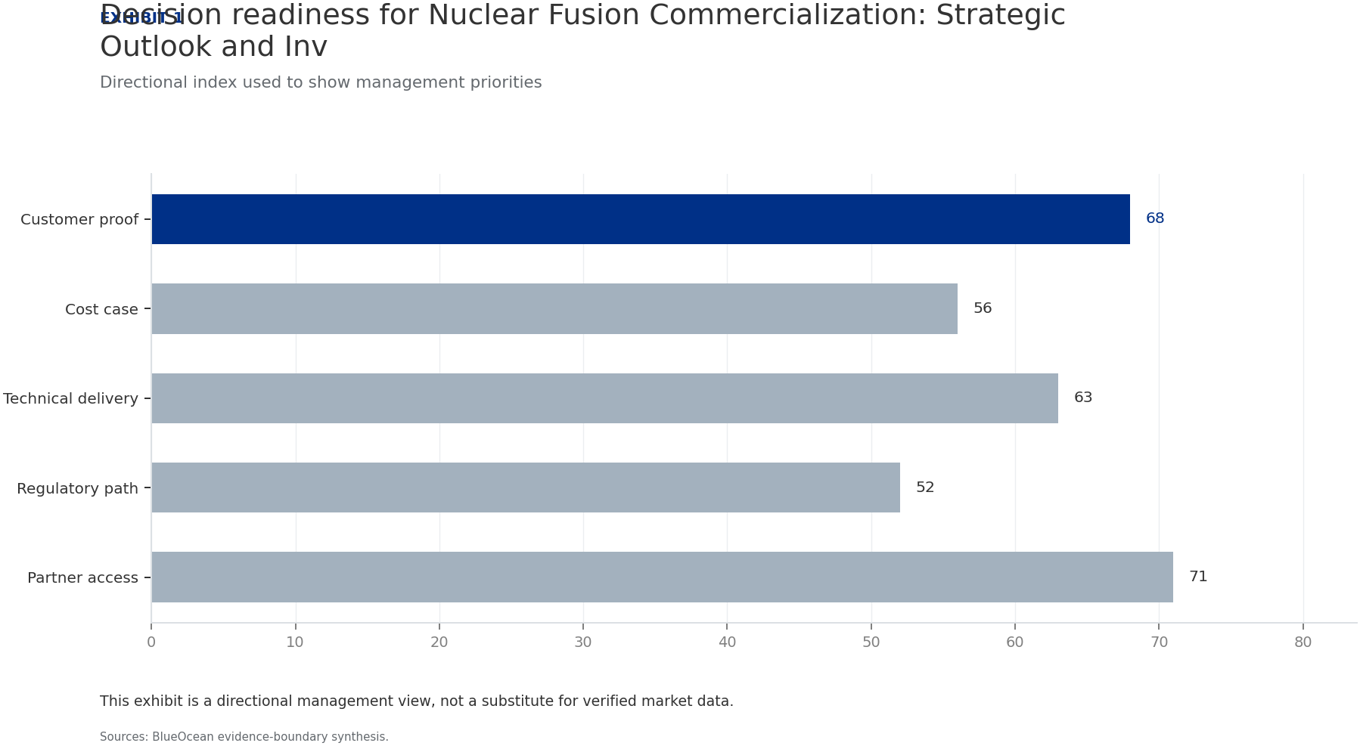
BlueOcean
Exhibit 1: evidence clarifies the strategic trade-off
Exhibit 1: evidence clarifies the strategic trade-off

Slide 13
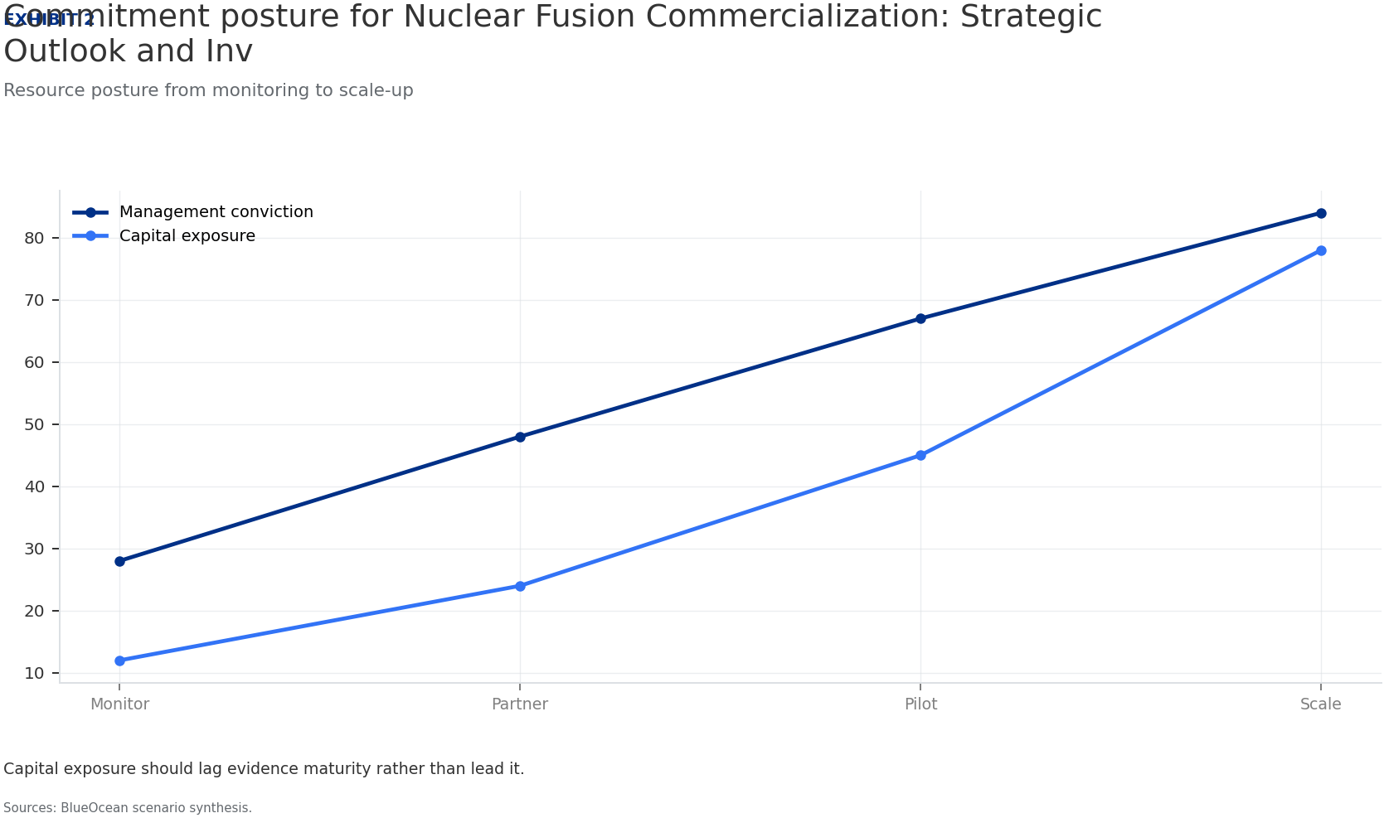
BlueOcean
Exhibit 2: evidence clarifies the strategic trade-off
Exhibit 2: evidence clarifies the strategic trade-off

Slide 14
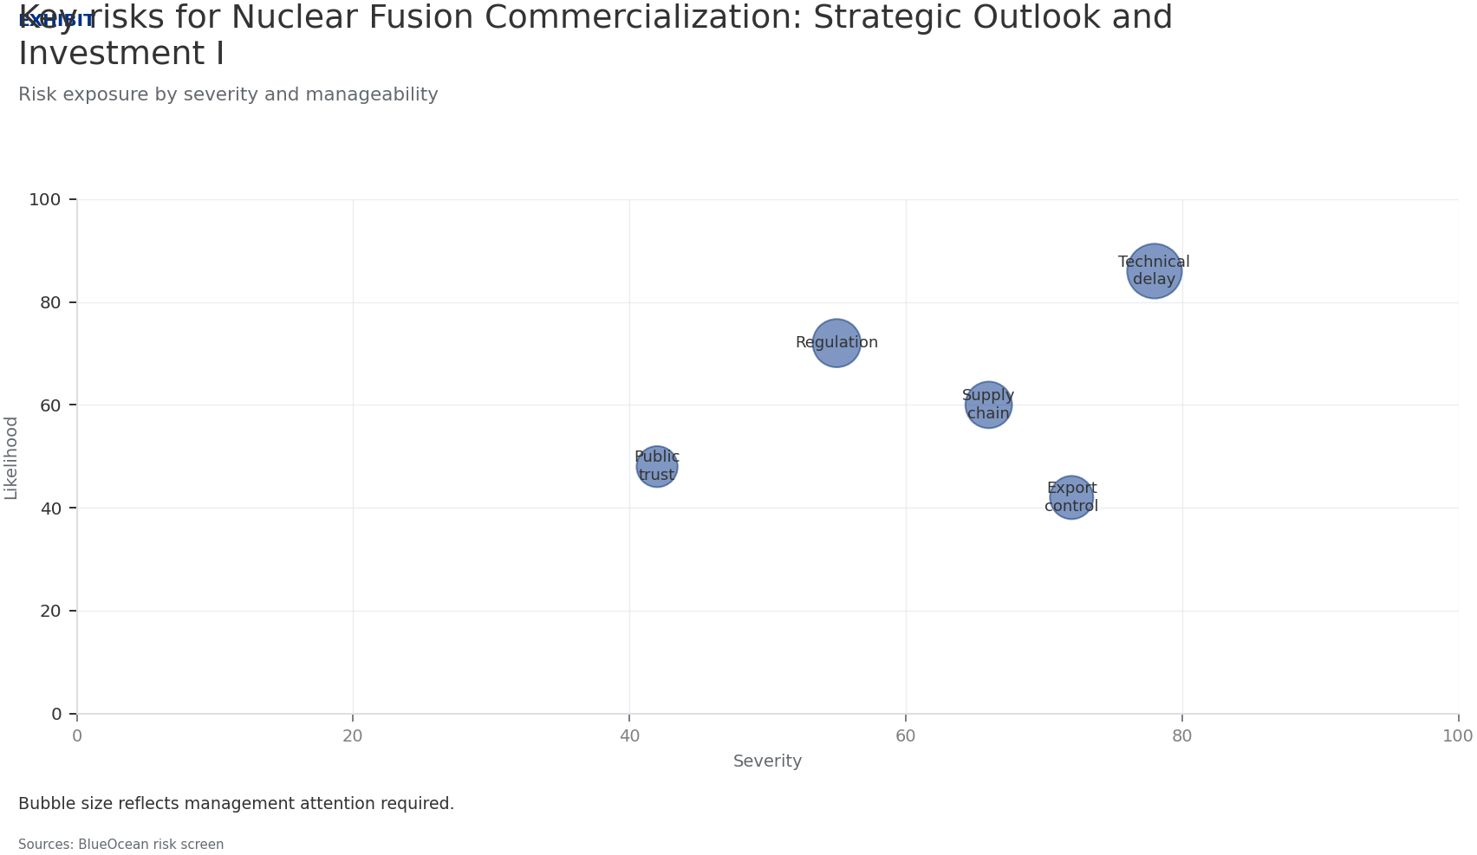
BlueOcean
Exhibit 3: evidence clarifies the strategic trade-off
Exhibit 3: evidence clarifies the strategic trade-off

Slide 15
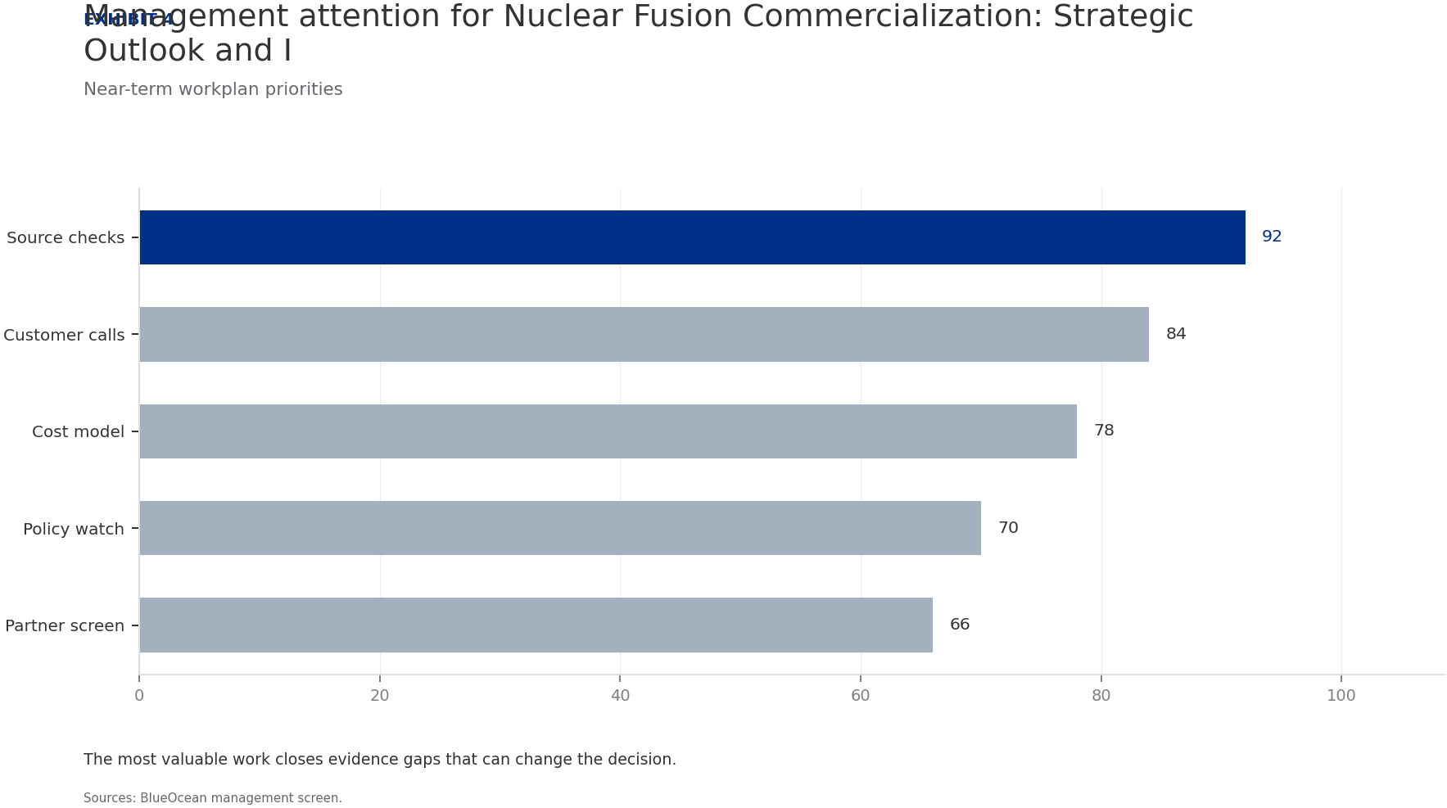
BlueOcean
Exhibit 4: evidence clarifies the strategic trade-off
Exhibit 4: evidence clarifies the strategic trade-off

Slide 16
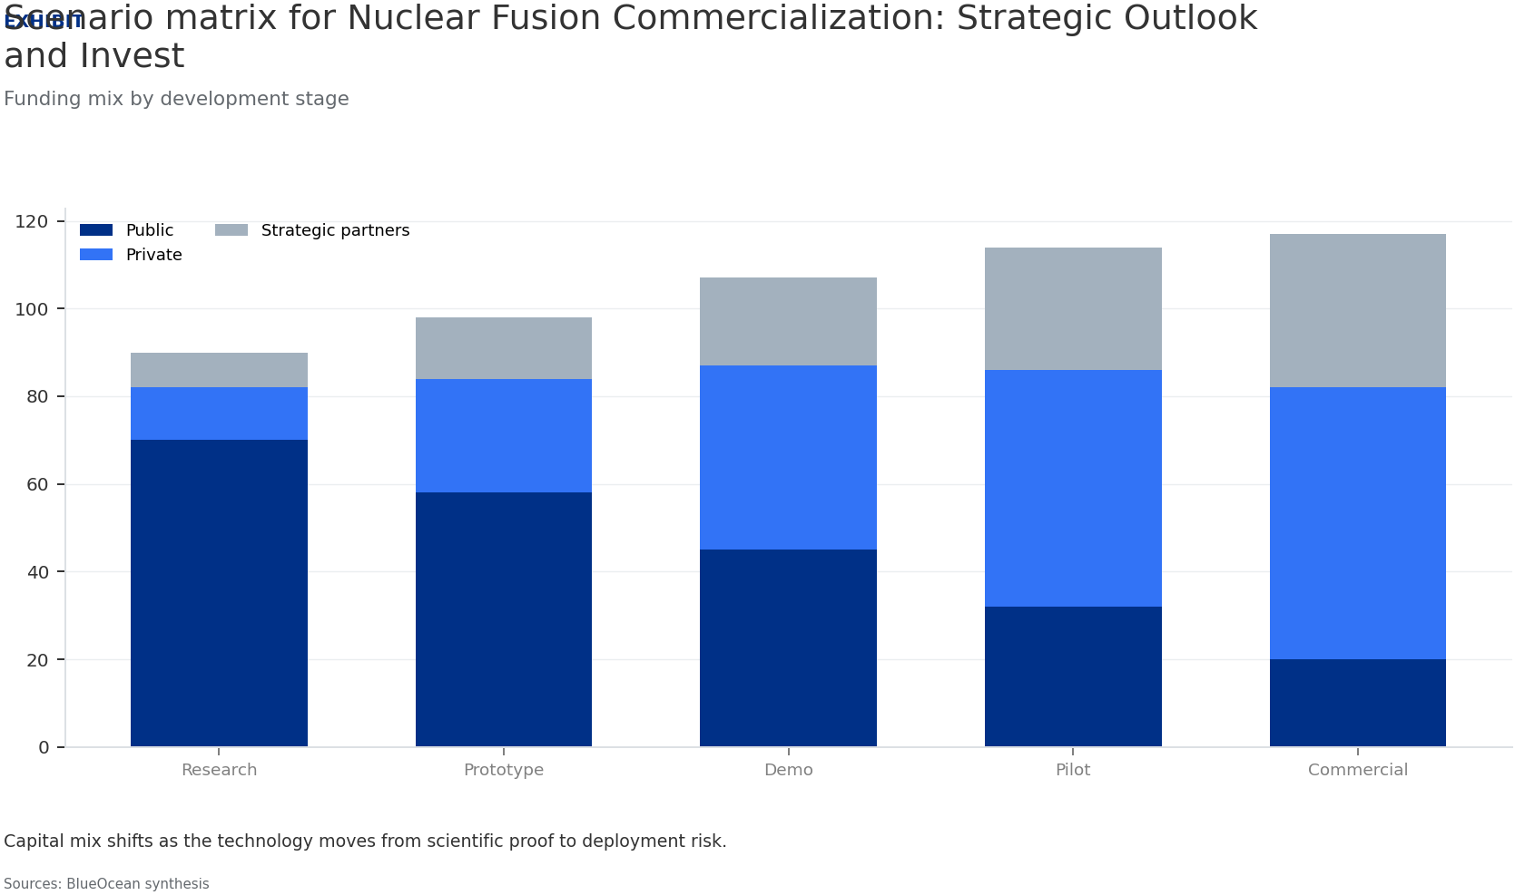
BlueOcean
Exhibit 5: evidence clarifies the strategic trade-off
Exhibit 5: evidence clarifies the strategic trade-off

Slide 17
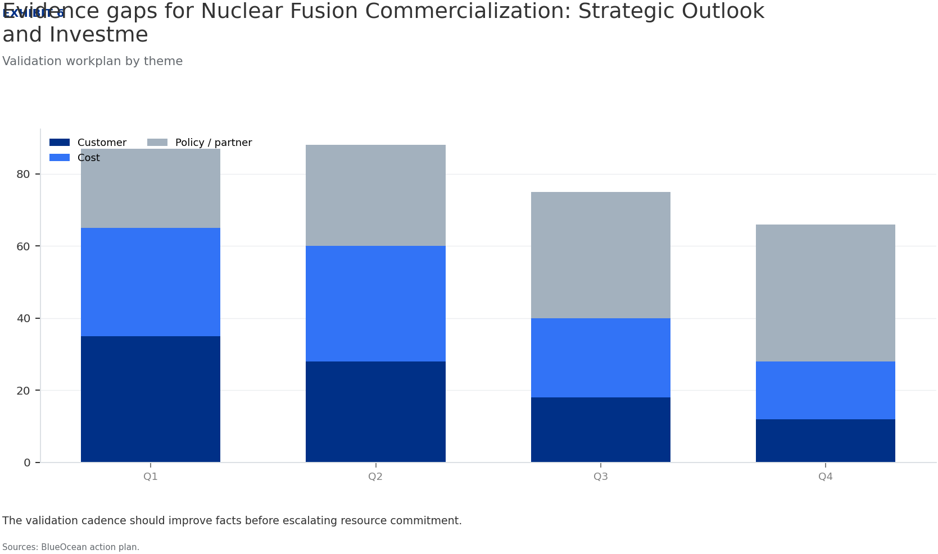
BlueOcean
Exhibit 6: evidence clarifies the strategic trade-off
Exhibit 6: evidence clarifies the strategic trade-off

Slide 18
BlueOcean
The next step is to convert the research into a short list of decisions
A Decision-Ready Analysis for Senior Executives and Policy Advisors
Closing

