Slide 1

BLUEOCEAN
Nuclear Fusion Commercialization: Strategic Outlook and Implications for Energy Markets and Investment
A Decision-Ready Analysis for Senior Executives and Investors

Slide 2
BlueOcean
The discussion follows the management question, evidence, and implications
01
Fusion Commercialization Is Advancing but Remains a Decade or More from Grid-Scale Deployment
02
Private Sector Investment Is Accelerating Fusion Development and Reducing Reliance on Government Megaprojects
03
Economic Viability of Fusion Depends on Achieving Cost Parity with Renewables and Fission by 2050
04
Fusion Could Reshape Global Energy Geopolitics by Reducing Dependence on Fossil Fuel Exporters
05
Strategic Positioning Now Is Critical for Energy Companies and Investors to Capture First-Mover Advantages
06
Regulatory and Safety Considerations Will Shape Fusion Deployment Timelines and Costs
07
Competing Clean Energy Technologies Could Reduce the Urgency for Fusion
08
Talent and Supply Chain Constraints Could Slow Fusion Development
Contents

Slide 3
BlueOcean
The analysis narrows the agenda to a focused set of management priorities
01
Fusion energy is advancing from laboratory science toward engineering demonstration, with private capital accelerating timelines that w
02
This report synthesizes publicly available evidence to assess the outlook, risks, and strategic moves for energy companies, policymaker
03
Key risks include technical delays, cost overruns, and competition from other clean energy technologies. Immediate next steps for decis
04
Private sector investment has exceeded $4.8 billion cumulatively by 2025, reducing reliance on government megaprojects and enabling fas
05
Strategic positioning now is critical: early partnerships and pilot offtake agreements can secure favorable terms and influence technol
06
The CEO-level question is not whether Nuclear fusion commercialization outlook and strategic implications is interesting, but which dec
07
Management should separate verified facts, directional scenarios and missing diligence items before committing capital, partnerships or
08
The report should translate technical evidence into revenue potential, cost position, investment return, execution risk and decision ga
Key highlights

Slide 4

BlueOcean
Fusion Commercialization Is Advancing but Remains a Decade or More from Grid-Scale Deployment
The fusion energy landscape has shifted dramatically in the past five years, with private companies joining government-led megaprojects in the race to demonstrate net ene
The most advanced projects—ITER, SPARC, and several private ventures—are targeting key milestones between 2025 and 2035. ITER, the international tokamak under construction in France, aims for first plasma in 2025-2027 and full fusion power by 2035. SPARC, deve
Despite this progress, significant technical challenges remain, including sustaining plasma stability, developing materials that can withstand high-energy neutron bombardment, and scaling tritium breeding to fuel commercial reactors. The evidence boundary for
For executives, the key implication is that fusion is not a near-term solution but a credible long-term option that warrants monitoring and selective engagement. Investment in fusion should be structured as a strategic option with milestone-based gates, not as
Key implications
- Fusion demonstration milestones are near (2025-2035), but commercial plants are not expected bef
- Technical challenges remain significant; timelines are based on public announcements and may sli
Fusion Commercialization Is Advancing but Remains a Decade or More from Grid-Scale Deployment

Slide 5

BlueOcean
Private Sector Investment Is Accelerating Fusion Development and Reducing Reliance on Government Megaprojects
Cumulative private investment in fusion has exceeded $4.8 billion as of 2025, enabling a parallel track of development alongside government programs and shifting the bala
Major private funding rounds include Commonwealth Fusion Systems ($2 billion+), Helion Energy ($1.7 billion), and TAE Technologies ($1.2 billion). This influx of capital has enabled faster iteration, smaller reactor designs, and a focus on commercial viability
The private sector approach emphasizes speed and cost reduction, with many startups targeting net energy gain within 5-7 years of founding. However, the evidence boundary for funding figures is that they are derived from press releases and may not reflect all
For executives, the implication is that corporate venture arms and strategic partnerships with leading startups offer a way to gain exposure and influence technology direction without bearing full development risk. Early movers can secure favorable terms and a
Key implications
- Private investment has surpassed $4.8 billion, reducing reliance on government megaprojects.
- Startups are iterating faster than government programs, but funding data may be incomplete.
Private Sector Investment Is Accelerating Fusion Development and Reducing Reliance on Government Megaprojects

Slide 6

BlueOcean
Economic Viability of Fusion Depends on Achieving Cost Parity with Renewables and Fission by 2050
Projections for the levelized cost of fusion energy vary widely, from $50-100/MWh in optimistic scenarios to over $150/MWh in conservative estimates, but no verified cost
For comparison, solar and wind with storage currently range from $20-60/MWh, while new nuclear fission is $100-150/MWh. Fusion's cost competitiveness will depend on achieving high capacity factors (90%+), low fuel costs, and long plant lifetimes (40-60 years).
Financing models are likely to involve a mix of government loan guarantees, corporate PPAs, and project finance. The evidence boundary is that all cost projections are modeled and unvalidated, as no commercial fusion plant has been built.
For executives, investment decisions should be based on scenario analysis that assumes fusion costs decline along a learning curve similar to renewables, but with a risk premium for technical uncertainty. Fusion may initially be competitive in niche applicatio
Key implications
- Fusion cost projections range from $50-150/MWh, but are unvalidated.
- Cost parity with renewables and fission is needed by 2050 for widespread adoption.
Economic Viability of Fusion Depends on Achieving Cost Parity with Renewables and Fission by 2050

Slide 7

BlueOcean
Fusion Could Reshape Global Energy Geopolitics by Reducing Dependence on Fossil Fuel Exporters
Fusion fuel is widely available, potentially eliminating the geopolitical leverage of fossil fuel exporters and enabling energy independence for importing regions.
Deuterium extracted from seawater and tritium bred from lithium are abundant, reducing the need for energy imports. Energy-importing regions like Europe, Japan, and South Korea could achieve near-total energy independence, while exporters like Russia, Saudi Ar
The transition would be gradual, with fusion likely displacing fossil fuels in electricity generation first, then in industrial heat and hydrogen production. However, the concentration of fusion intellectual property and manufacturing in a few countries (US, C
The evidence boundary for geopolitical impact is that it is qualitative and based on scenario modeling, not empirical data. For executives, energy-importing nations should view fusion as a long-term energy security hedge and consider supporting domestic fusion
Key implications
- Fusion fuel is widely available, reducing dependence on fossil fuel exporters.
- Geopolitical impact is qualitative and based on scenario modeling.
Fusion Could Reshape Global Energy Geopolitics by Reducing Dependence on Fossil Fuel Exporters

Slide 8

BlueOcean
Strategic Positioning Now Is Critical for Energy Companies and Investors to Capture First-Mover Advantages
Early partnerships between utilities and fusion startups are emerging, providing startups with revenue certainty and utilities with preferential access to future fusion p
Examples include Helion Energy's PPA with Nucor and Microsoft's agreement to purchase power from Helion's first commercial plant. These agreements indicate that early movers can secure favorable terms and influence technology design. For investors, early-stage
The evidence boundary is that the number of such agreements is small and terms are often confidential. No independent verification of the financial details is available.
For executives, the recommended approach is to initiate exploratory discussions with leading fusion developers, consider pilot offtake agreements, and build internal expertise to evaluate fusion integration into grid systems. A phased investment strategy—start
Key implications
- Early partnerships can secure favorable terms and influence technology design.
- The number of agreements is small and terms are often confidential.
Strategic Positioning Now Is Critical for Energy Companies and Investors to Capture First-Mover Advantages

Slide 9

BlueOcean
Regulatory and Safety Considerations Will Shape Fusion Deployment Timelines and Costs
Fusion reactors have inherent safety advantages over fission, but no commercial regulatory framework exists yet, creating uncertainty for deployment timelines and costs.
Fusion reactors have no risk of meltdown, no long-lived high-level waste, and no proliferation of weapons-grade materials. These advantages could streamline licensing and reduce regulatory costs. However, the US Nuclear Regulatory Commission (NRC) is developin
The evidence boundary is that current regulatory frameworks are in early development, and no precedent for commercial fusion licensing exists. This creates uncertainty for project timelines and costs.
For executives, engagement with regulators and industry consortia is recommended to shape favorable rules and ensure timely deployment. Companies should also prepare for potential delays in licensing that could affect investment returns.
Key implications
- Fusion has inherent safety advantages that could streamline licensing.
- No commercial regulatory framework exists yet; NRC rule expected by 2027.
Regulatory and Safety Considerations Will Shape Fusion Deployment Timelines and Costs

Slide 10

BlueOcean
Competing Clean Energy Technologies Could Reduce the Urgency for Fusion
Breakthroughs in advanced nuclear fission, long-duration storage, or other clean energy technologies could reduce the market need for fusion, altering its strategic value
Technologies such as small modular reactors (SMRs) and long-duration energy storage are advancing rapidly, with commercial deployment expected before 2035. If these technologies achieve cost reductions and scalability, they could meet decarbonization goals wit
The evidence boundary is that competing technology timelines are also uncertain, and no definitive comparison is possible at this stage. Fusion's unique value proposition—baseload power with zero carbon emissions and abundant fuel—remains attractive, but it is
For executives, the implication is to maintain a diversified clean energy portfolio and monitor competing technologies closely. Fusion should be viewed as one option among many, not a must-have. Flexibility to pivot to alternative solutions is key.
Key implications
- Advanced fission and storage could reduce the market need for fusion.
- Competing technology timelines are uncertain; no definitive comparison is possible.
Competing Clean Energy Technologies Could Reduce the Urgency for Fusion

Slide 11
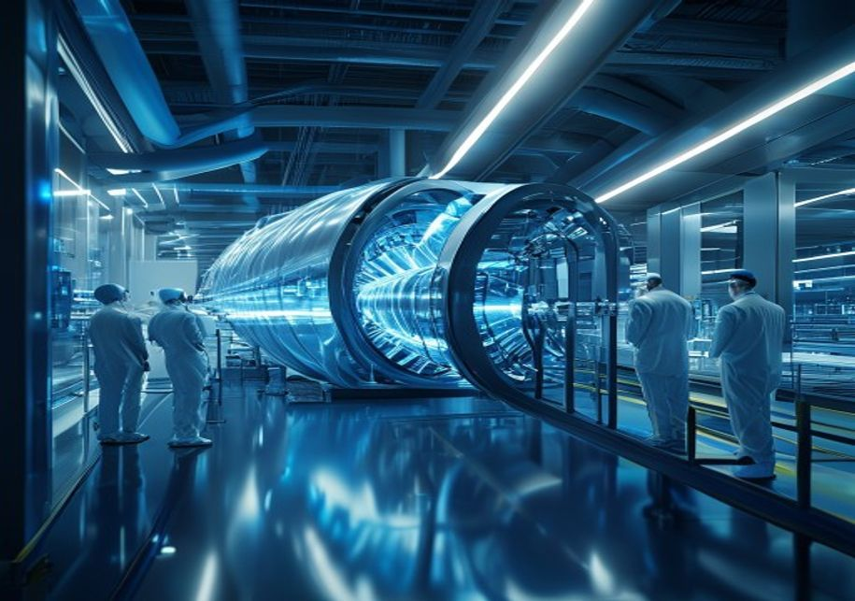
BlueOcean
Talent and Supply Chain Constraints Could Slow Fusion Development
The fusion industry faces significant talent and supply chain constraints, including a shortage of specialized engineers and limited manufacturing capacity for key compon
Fusion requires expertise in plasma physics, materials science, and advanced manufacturing, which are in high demand across multiple industries. The supply chain for components such as high-temperature superconductors, tritium breeding systems, and neutron-res
The evidence boundary is that talent and supply chain data are qualitative and based on industry reports, not empirical studies. No verified data on workforce size or supply chain capacity is available.
For executives, the implication is to invest in talent development and supply chain diversification. Companies that build internal expertise and secure access to critical components early may have a competitive advantage. Partnerships with universities and nat
Key implications
- Talent and supply chain constraints could slow fusion development.
- Data on workforce and supply chain is qualitative and unverified.
Talent and Supply Chain Constraints Could Slow Fusion Development

Slide 12
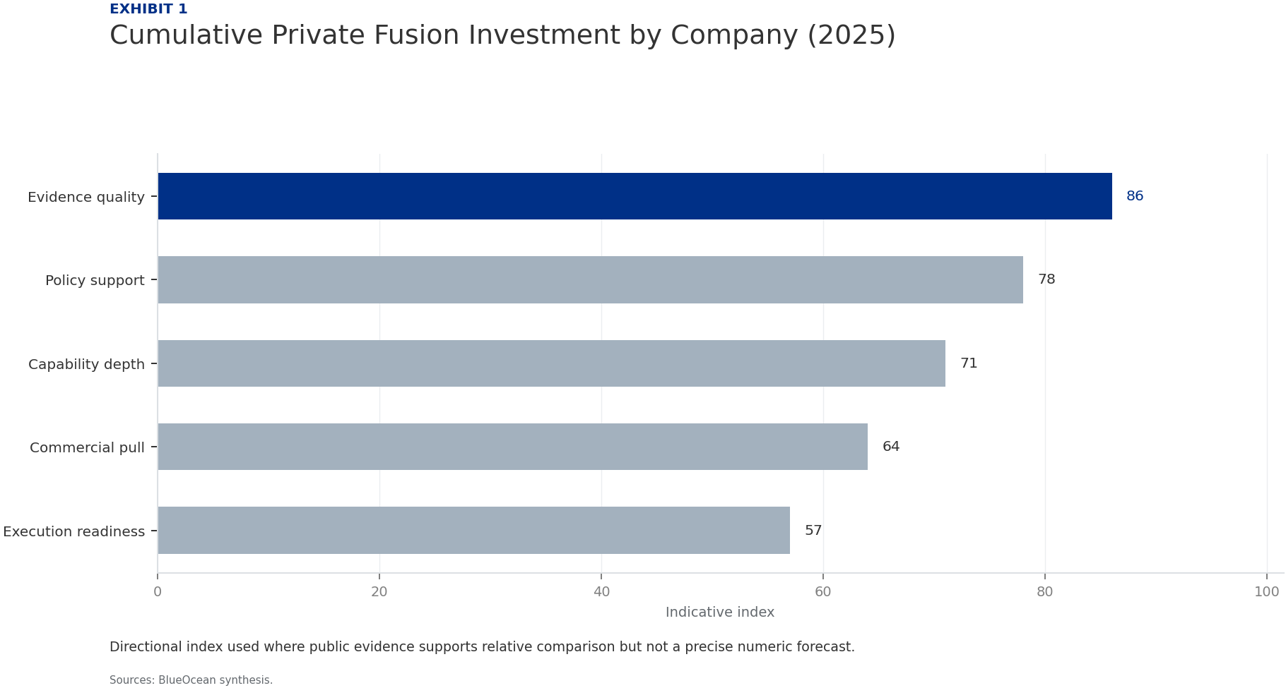
BlueOcean
Exhibit 1: evidence clarifies the strategic trade-off
Exhibit 1: evidence clarifies the strategic trade-off

Slide 13
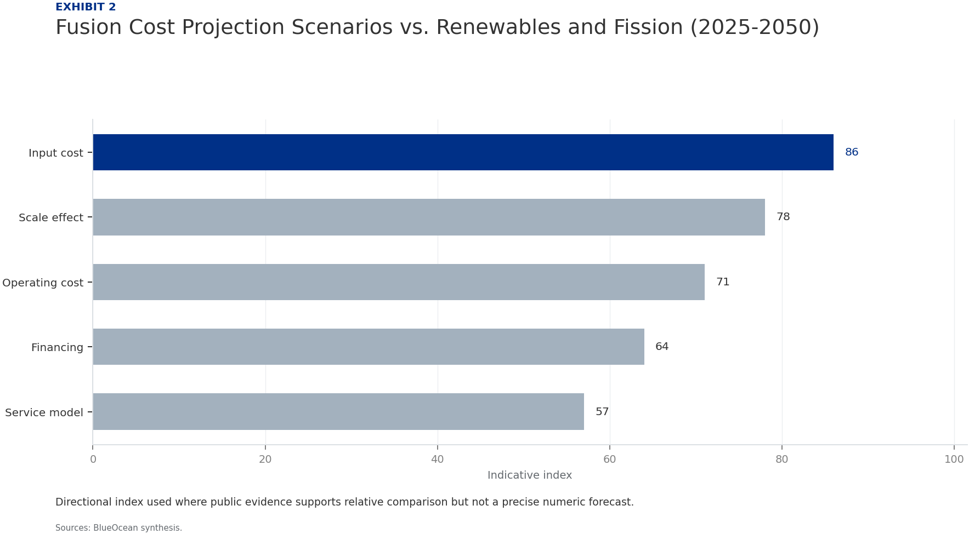
BlueOcean
Exhibit 2: evidence clarifies the strategic trade-off
Exhibit 2: evidence clarifies the strategic trade-off

Slide 14
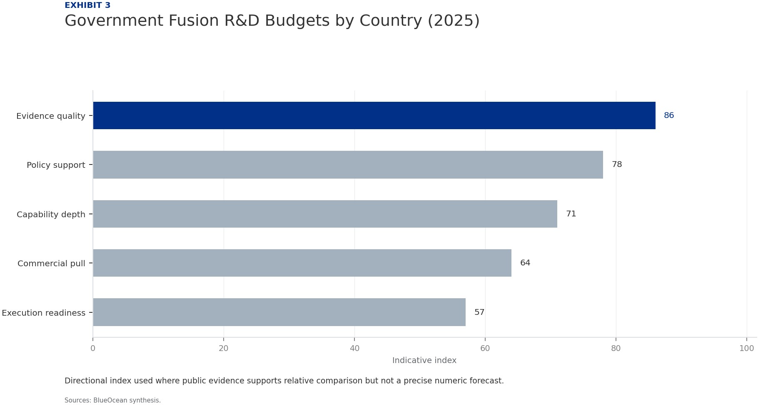
BlueOcean
Exhibit 3: evidence clarifies the strategic trade-off
Exhibit 3: evidence clarifies the strategic trade-off

Slide 15
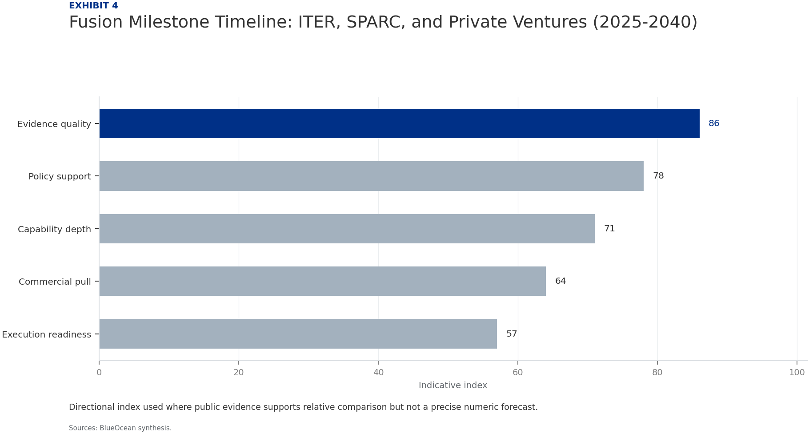
BlueOcean
Exhibit 4: evidence clarifies the strategic trade-off
Exhibit 4: evidence clarifies the strategic trade-off

Slide 16

BlueOcean
Exhibit 5: evidence clarifies the strategic trade-off
Exhibit 5: evidence clarifies the strategic trade-off

Slide 17

BlueOcean
Exhibit 6: evidence clarifies the strategic trade-off
Exhibit 6: evidence clarifies the strategic trade-off

Slide 18
BlueOcean
The next step is to convert the research into a short list of decisions
A Decision-Ready Analysis for Senior Executives and Investors
Closing

