Slide 1
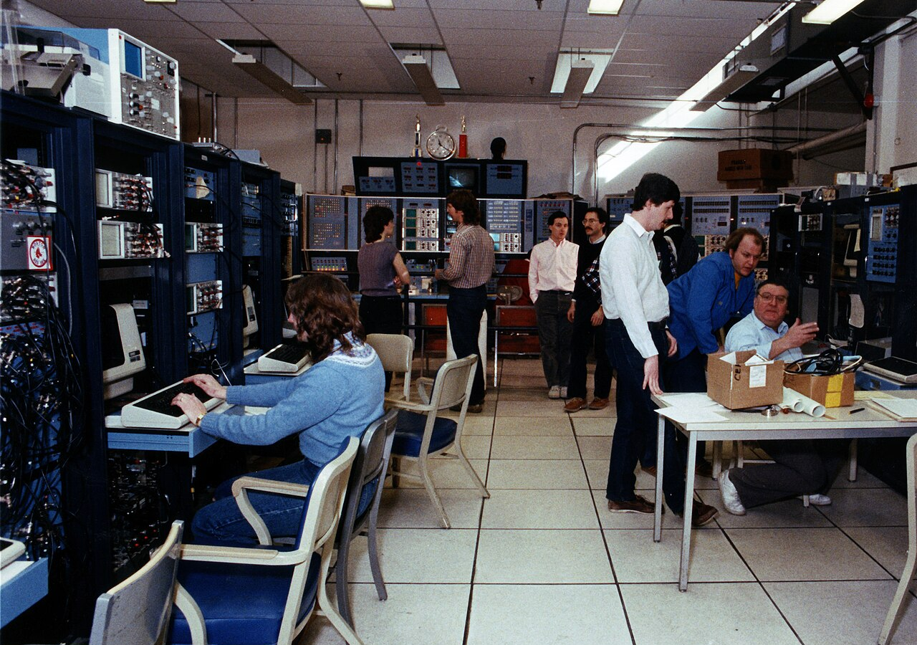
BLUEOCEAN
Nuclear Fusion Commercialization Outlook and Strategic Implications
A Decision-Ready Assessment for Energy Executives and Investors

Slide 2
BlueOcean
The discussion follows the management question, evidence, and implications
01
Nuclear Fusion Is Approaching Technical Feasibility but Commercial Viability Remains a Decade or More Away
02
Private Fusion Startups Are Accelerating Development with Significant Venture Capital and Government Support
03
Fusion's Economic Competitiveness Hinges on Achieving Low LCOE Through Advanced Materials and Mass Production
04
Ignition changed the physics case, not the commercialization case
05
Private capital is accelerating experimentation but not removing technical risk
06
Cost competitiveness is the route from breakthrough to adoption
07
The path is gated by fuel, materials and regulation
08
First markets should be selected by value density, not market size
Contents

Slide 3
BlueOcean
The analysis narrows the agenda to a focused set of management priorities
01
Fusion technology has achieved scientific breakeven but not commercial readiness; sustained net energy gain and materials durability re
02
Private fusion startups have attracted over $6 billion in global investment and are compressing timelines, but most face significant te
03
Fusion's economic competitiveness is unverified; projected LCOE ranges from $30–$100/MWh by 2050, but renewables plus storage already u
04
Regulatory frameworks are nascent and uncertain; U.S. NRC rulemaking and international guidelines are still in development, posing time
05
Geopolitical implications include potential disruption of energy markets and shifts in power dynamics; first-mover nations could gain t
06
The CEO-level question is not whether Nuclear fusion commercialization outlook and strategic implications is interesting, but which dec
07
Management should separate verified facts, directional scenarios and open questions before committing capital, partnerships or market-e
08
Technical evidence only matters when it changes revenue potential, cost position, investment return, execution risk or the timing of a
Key highlights

Slide 4
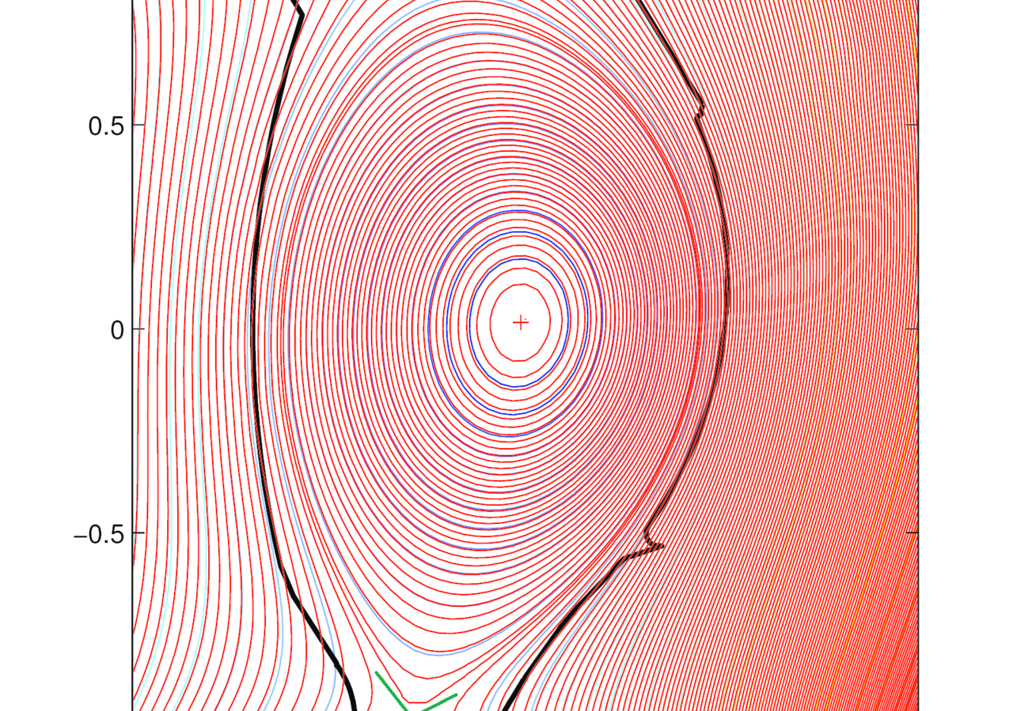
BlueOcean
Nuclear Fusion Is Approaching Technical Feasibility but Commercial Viability Remains a Decade or More Away
Fusion has crossed the scientific breakeven threshold, but sustained net energy gain and materials durability are unproven, meaning commercial power plants are unlikely b
The December 2022 fusion ignition at Lawrence Livermore National Laboratory marked a historic scientific milestone, demonstrating for the first time that a controlled fusion reaction can produce more energy than the laser energy used to drive it. The experimen
Private fusion startups are accelerating development with significant venture capital and government support. Commonwealth Fusion Systems (CFS) is building SPARC, a compact tokamak designed to achieve net energy gain by 2027. TAE Technologies is pursuing a fie
The ITER project, the world's largest tokamak under construction in France, is designed to demonstrate fusion power at scale. ITER's goal is to produce 500 MW of fusion power from 50 MW of input, but the project has experienced repeated delays and cost overrun
Key implications
- Scientific breakeven achieved but sustained net energy gain not yet demonstrated.
- Private startups are compressing timelines but face major technical hurdles.
Nuclear Fusion Is Approaching Technical Feasibility but Commercial Viability Remains a Decade or More Away

Slide 5
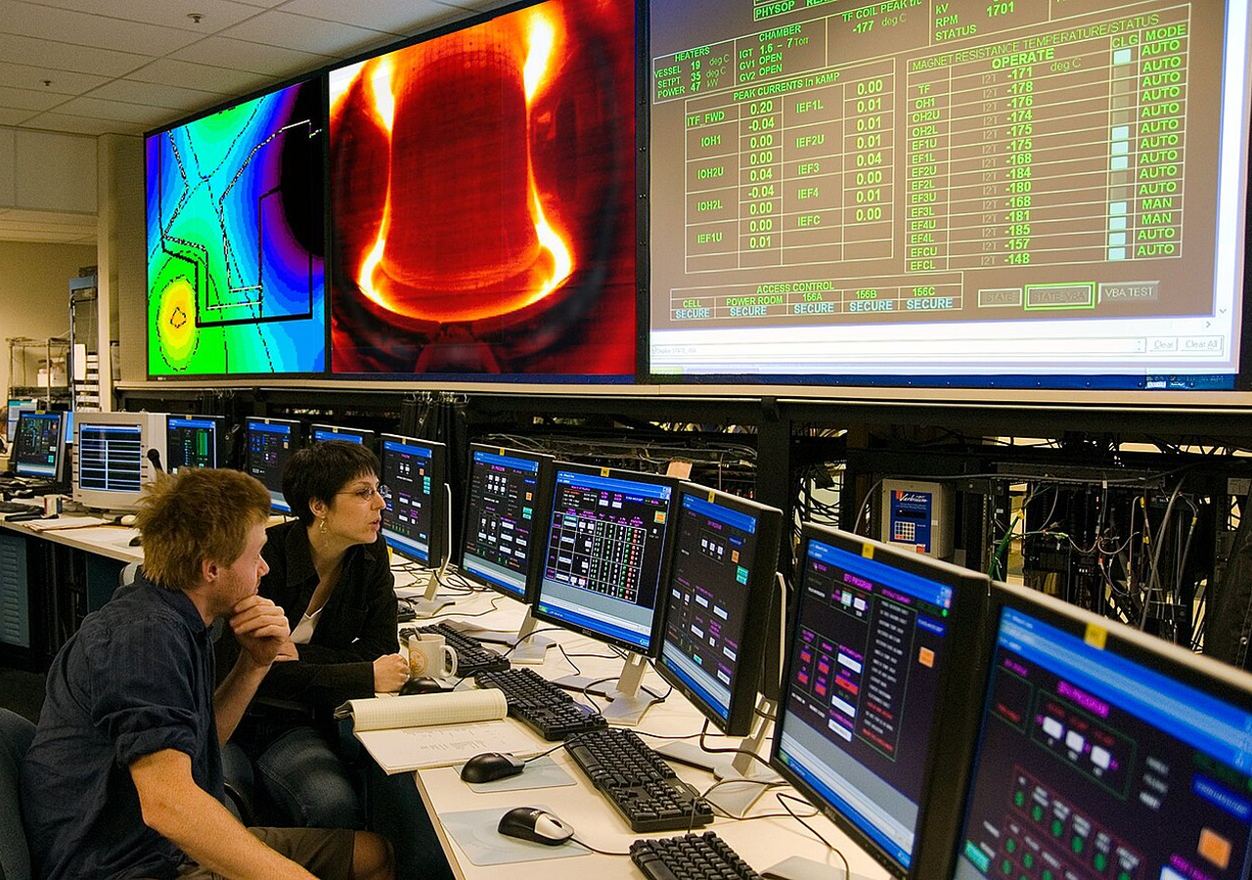
BlueOcean
Private Fusion Startups Are Accelerating Development with Significant Venture Capital and Government Support
Over $6 billion in private investment has flowed into fusion startups, but most have not yet demonstrated net energy gain, creating both opportunity and hype risk.
The fusion landscape has shifted dramatically from government-led megaprojects to a vibrant ecosystem of private startups. As of 2024, over 40 private fusion companies are operating globally, with total private investment exceeding $6 billion. Leading companie
CFS, spun out of MIT, is building SPARC—a compact, high-field tokamak using high-temperature superconducting magnets. SPARC is designed to achieve net energy gain (Q>1) by 2027, a milestone that would be a world first. The company has raised over $2 billion fr
TAE Technologies has raised over $1.2 billion and is pursuing a field-reversed configuration approach that uses neutral beam injection to maintain plasma stability. TAE aims to demonstrate net energy gain by 2028 and commercial plants by 2035. The company has
Key implications
- Over 40 private fusion companies have raised $6B+ globally.
- CFS, TAE, Helion are leading with aggressive milestones.
Private Fusion Startups Are Accelerating Development with Significant Venture Capital and Government Support

Slide 6
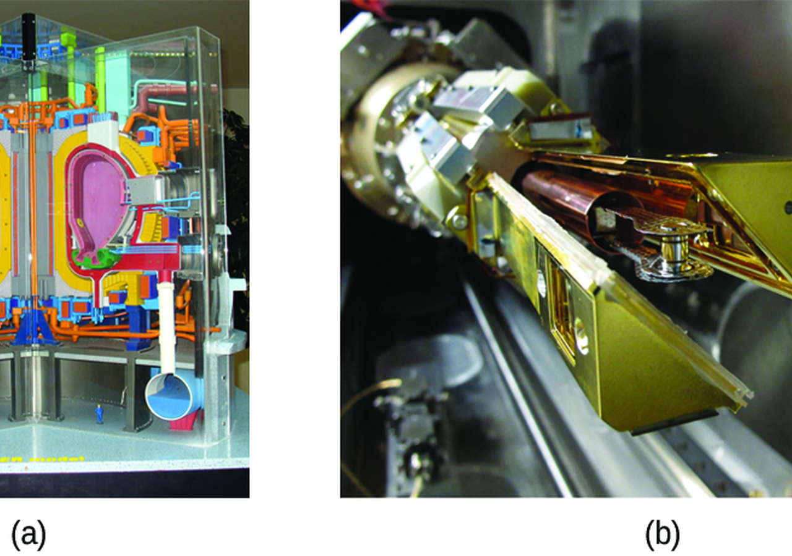
BlueOcean
Fusion's Economic Competitiveness Hinges on Achieving Low LCOE Through Advanced Materials and Mass Production
Fusion LCOE projections are highly uncertain and currently exceed those of renewables plus storage, making cost reduction the critical path to market entry.
The levelized cost of electricity (LCOE) from fusion is highly uncertain, with projections ranging from $30 to $100 per MWh by 2050. These estimates depend on assumptions about capital costs, capacity factors, fuel costs, and plant lifetime. For comparison, so
Fusion's capital costs are expected to be high, potentially $5–$10 billion per GW, similar to fission. However, fusion plants could have lower fuel costs (deuterium is abundant) and no long-lived radioactive waste. The key to economic competitiveness is reduci
Capacity factor is another critical variable. Fusion plants are expected to operate as baseload power, with capacity factors above 90%, similar to fission. However, this has not been demonstrated. If fusion plants require frequent maintenance or have lower ava
Key implications
- Fusion LCOE projections are $30–$100/MWh by 2050, but highly uncertain.
- Renewables plus storage already undercut fusion's projected costs.
Fusion's Economic Competitiveness Hinges on Achieving Low LCOE Through Advanced Materials and Mass Production

Slide 7
BlueOcean
Ignition changed the physics case, not the commercialization case
The 2022 milestone matters, but it does not yet answer the plant, cost or reliability questions.
LLNL's ignition shot reset the credibility of fusion science, but it did not prove a power plant. The commercial question starts after target gain: repeated operation, heat extraction, net electricity, maintainability and economics.
For the board, the most useful interpretation is staged. Ignition improves the odds that fusion deserves management attention, while leaving the investment case dependent on integrated pilot evidence rather than scientific headlines.
For customer strategy, the current public record supports this distinction. A public source anchors this point: The Department of Energy has been a leader in fusion energy research since the 1950s and supports groundbreaking advances today. Each new milestone
Key implications
- Separate science proof from plant proof
- Track integrated pilot evidence
Ignition changed the physics case, not the commercialization case

Slide 8

BlueOcean
Private capital is accelerating experimentation but not removing technical risk
Funding growth expands the number of shots on goal, while the decisive proof still comes from operating systems.
Private fusion funding has made the industry broader and faster-moving. It has also shifted part of the learning curve from public laboratories to venture-backed developers, suppliers and corporate partners.
For partner strategy, capital alone does not remove the hard constraints: plasma control, magnets, materials, tritium breeding, heat extraction and maintenance have to work together at plant scale. A large round should therefore be read as option value, not as
The strategic benefit of the funding wave is earlier access to learning. Partnerships, supplier relationships and customer dialogues can reveal which approaches are credible before the market is obvious.
Key implications
- Use funding as a learning signal
- Do not equate capital raised with de-risking
Private capital is accelerating experimentation but not removing technical risk

Slide 9
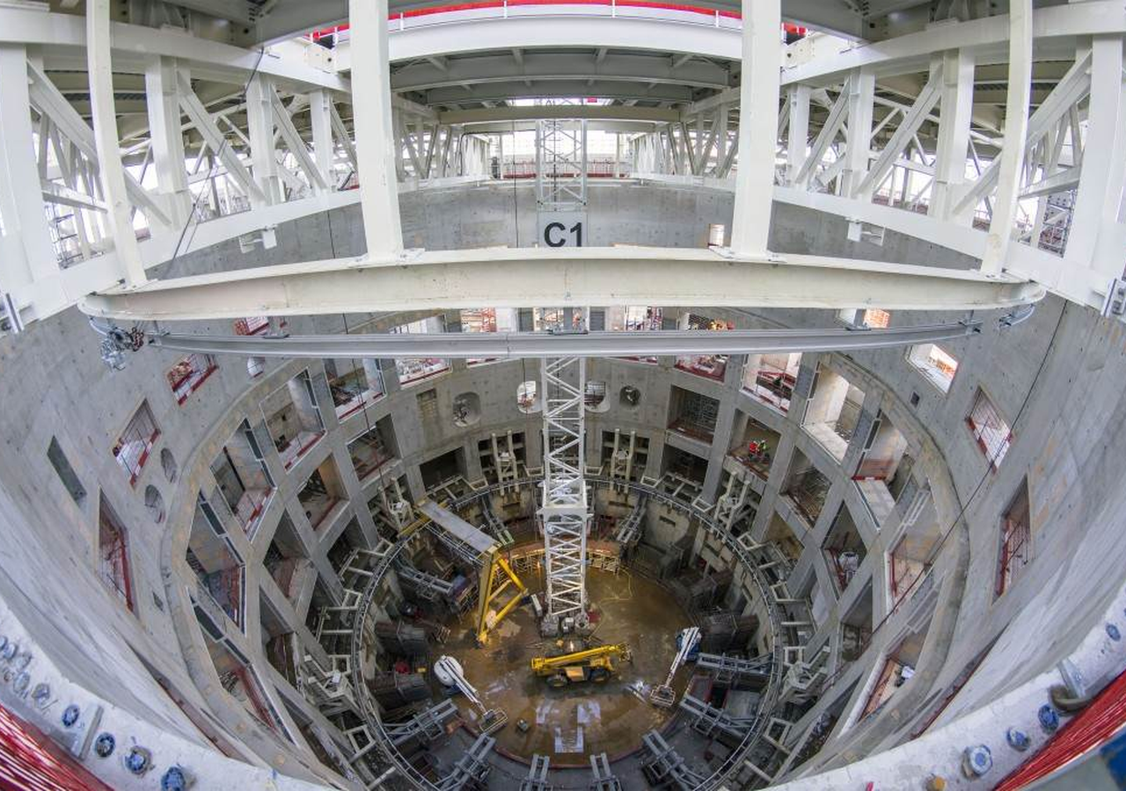
BlueOcean
Cost competitiveness is the route from breakthrough to adoption
Fusion must compete with renewables, storage, gas and fission on buyer economics, not novelty.
At the portfolio level, fusion's promise is firm clean power with high availability. That promise becomes commercially relevant only if installed cost, uptime, maintenance and fuel-cycle economics create a price customers can underwrite.
In timing terms, the comparison set is unforgiving. Solar, wind and gas already set low-cost reference points, while fission shows how construction risk can overwhelm theoretical capacity-factor advantages.
For risk owners, the executive question around Cost competitiveness is the route from breakthrough to adoption is practical: which commitments create learning without locking the company into a cost curve, customer promise or regulatory position that the facts
Key implications
- Benchmark against actual alternatives
- Watch availability and installed cost
Cost competitiveness is the route from breakthrough to adoption

Slide 10

BlueOcean
The path is gated by fuel, materials and regulation
The critical path runs through systems that make a plant repeatable, licensable and maintainable.
A viable deuterium-tritium pathway needs a credible tritium strategy. Buying today's scarce tritium is not enough; breeding, recovery and accounting have to be proven as part of the plant.
Regulation is moving, but not yet standardized across markets. Companies that understand licensing early can shape site choice, partner selection and customer commitments before competitors do.
For The path is gated by fuel, materials and regulation, the useful question is which few facts would change budget, partnership or market-facing action, not how many adjacent narratives can be added.
Key implications
- Tritium is a hard constraint
- Materials lifetime drives economics
The path is gated by fuel, materials and regulation

Slide 11

BlueOcean
First markets should be selected by value density, not market size
The early question is where fusion's attributes command a premium before commodity power economics are proven.
Grid electricity is the largest addressable market, but it may not be the best first market. A commodity power buyer will compare fusion against cheap renewables, storage, gas and fission.
Industrial heat, hydrogen and data centers can value round - the-clock clean energy differently. These customers may tolerate higher prices if fusion solves reliability, siting or decarbonization constraints that alternatives struggle to meet.
The practical test is customer commitment. Memoranda and announcements matter less than bankable offtake, site access, interconnection work and willingness to share development risk.
Key implications
- Choose markets by willingness to pay
- Test bankable offtake early
First markets should be selected by value density, not market size

Slide 12
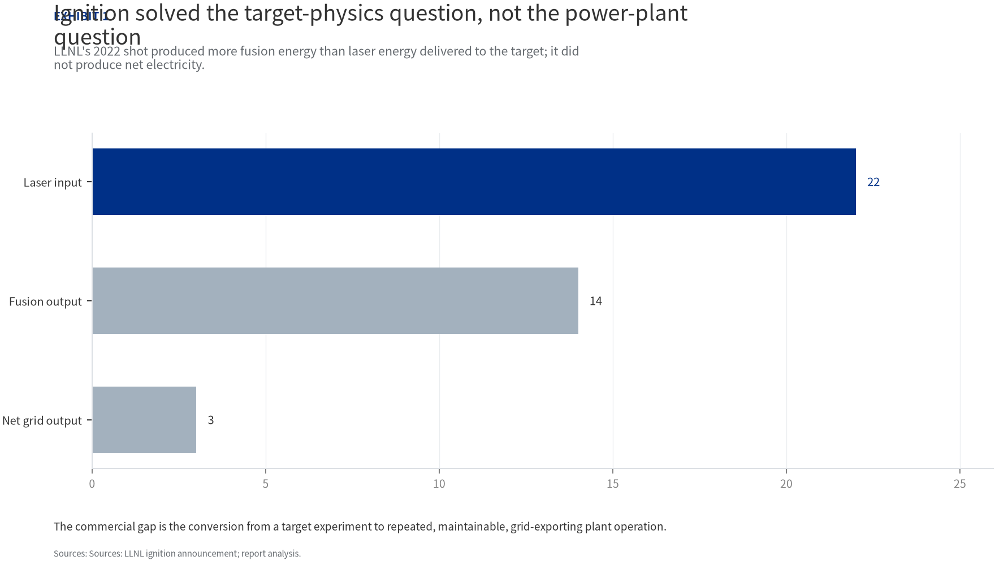
BlueOcean
Exhibit 1: evidence clarifies the strategic trade-off
Exhibit 1: evidence clarifies the strategic trade-off

Slide 13
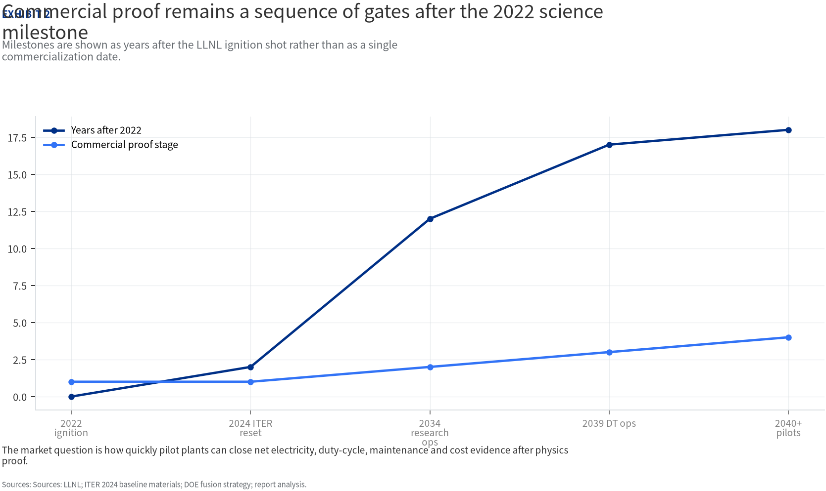
BlueOcean
Exhibit 2: evidence clarifies the strategic trade-off
Exhibit 2: evidence clarifies the strategic trade-off

Slide 14
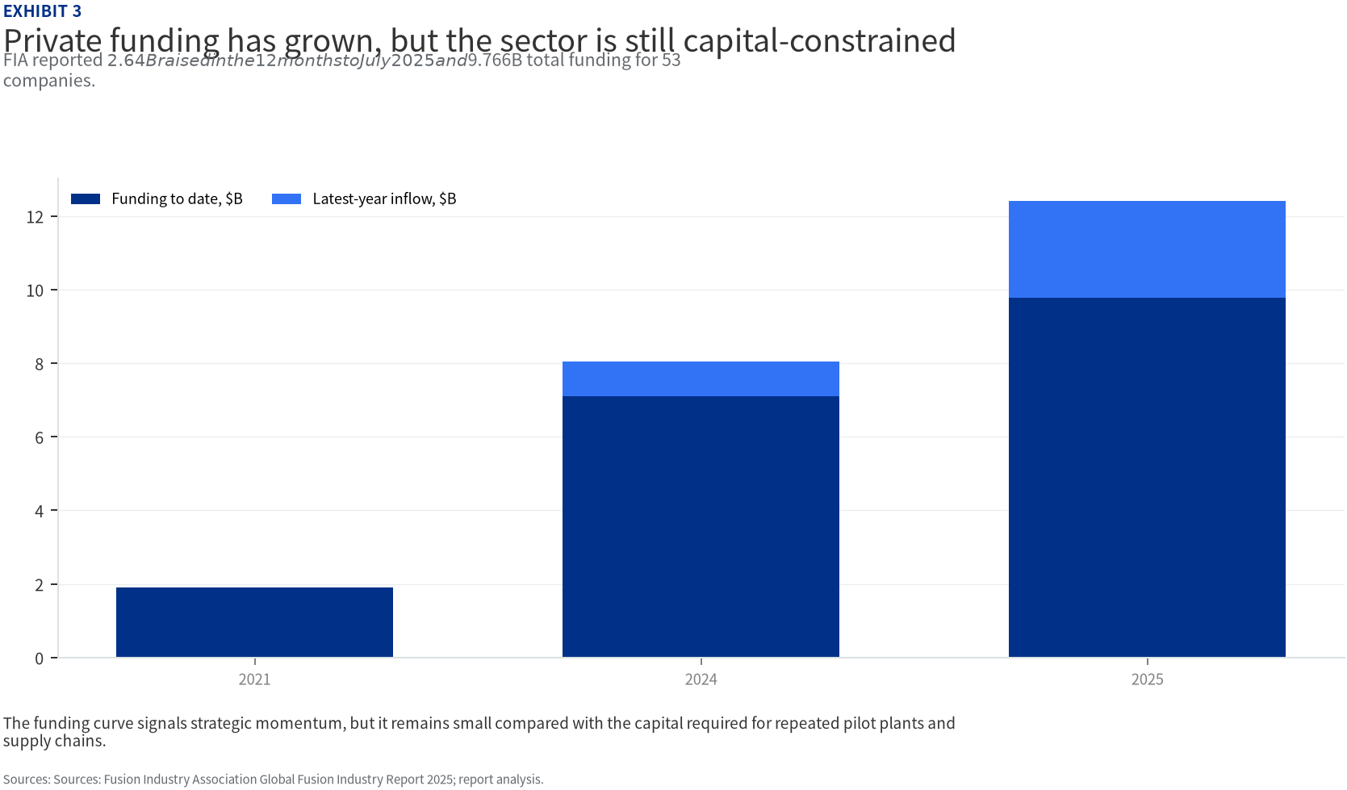
BlueOcean
Exhibit 3: evidence clarifies the strategic trade-off
Exhibit 3: evidence clarifies the strategic trade-off

Slide 15
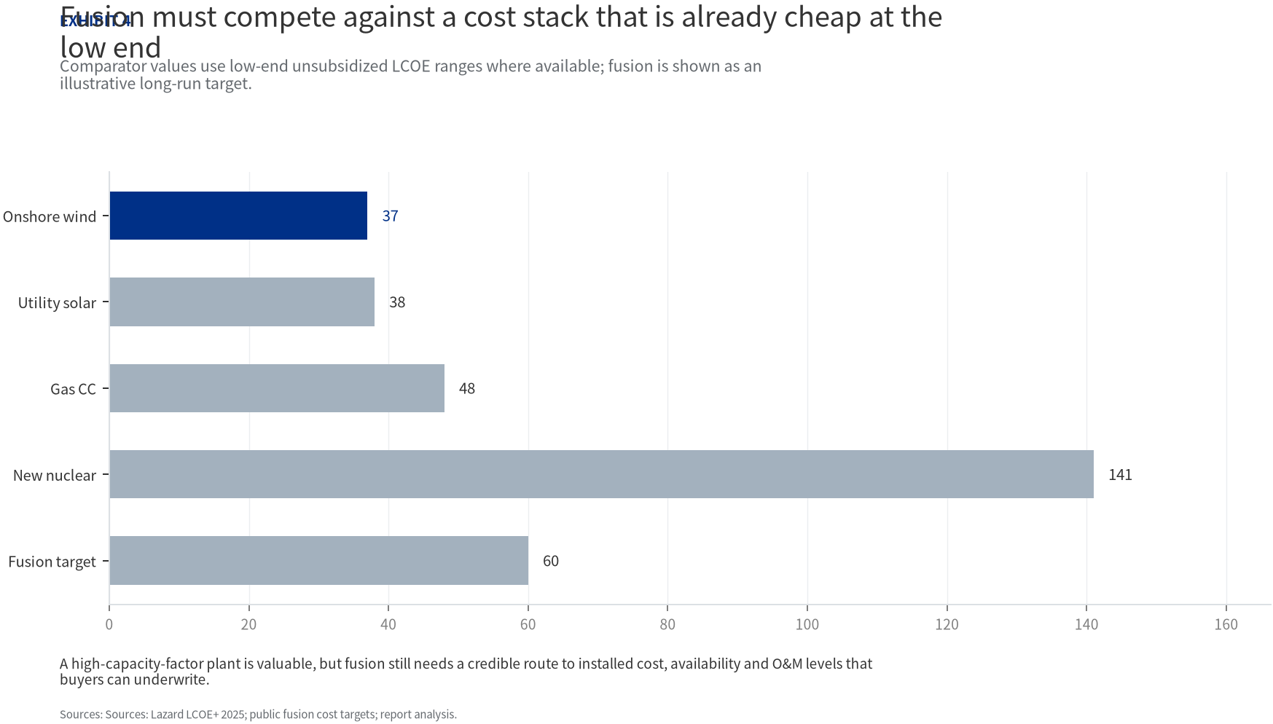
BlueOcean
Exhibit 4: evidence clarifies the strategic trade-off
Exhibit 4: evidence clarifies the strategic trade-off

Slide 16
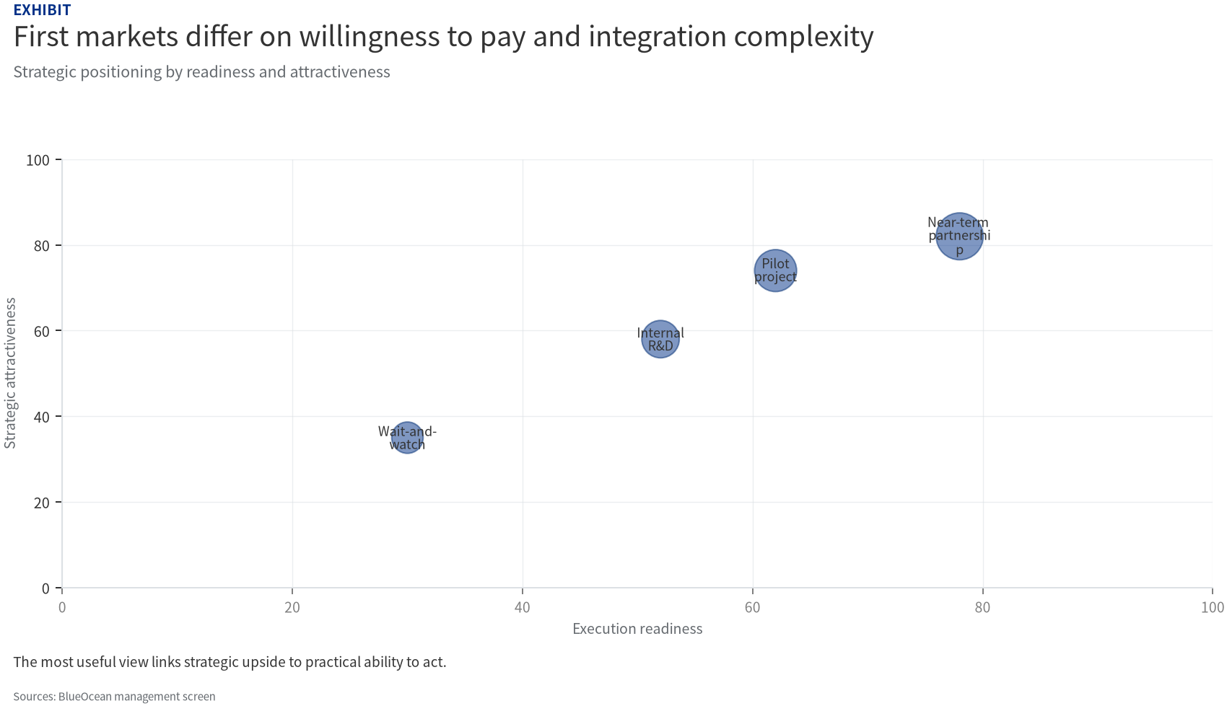
BlueOcean
Exhibit 5: evidence clarifies the strategic trade-off
Exhibit 5: evidence clarifies the strategic trade-off

Slide 17
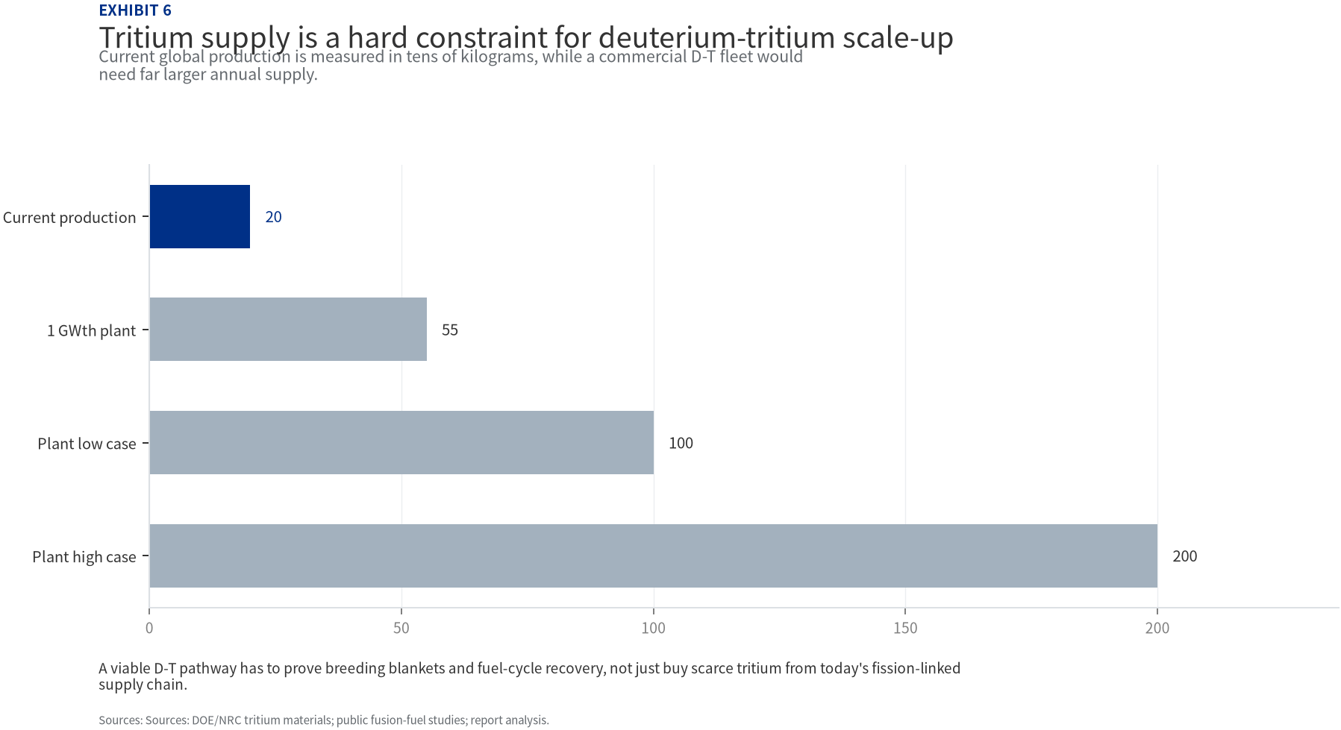
BlueOcean
Exhibit 6: evidence clarifies the strategic trade-off
Exhibit 6: evidence clarifies the strategic trade-off

Slide 18
BlueOcean
The next step is to convert the research into a short list of decisions
A Decision-Ready Assessment for Energy Executives and Investors
Closing

