Slide 1

BLUEOCEAN
Nuclear Fusion Commercialization Outlook and Strategic Implications
A Decision-Ready Assessment for Senior Executives

Slide 2
BlueOcean
The discussion follows the management question, evidence, and implications
01
Fusion Commercialization Is Likely Post-2035 with Significant Uncertainty
02
Fusion Faces High Cost Hurdles but Could Be Competitive in Baseload Markets
03
Fusion Will Reshape Energy Geopolitics, Reducing Dependence on Fossil Fuels
04
Private Startups Are Accelerating Development but Public Projects Remain Critical
05
Strategic Investments Should Focus on Enabling Technologies and Early Partnerships
06
Regulatory and Policy Frameworks Must Be Developed to Enable Fusion Commercialization
07
Nuclear Fusion Commercialization Outlook and Strategic Implications should be managed as a staged strategic op
08
Commercial readiness depends on bankability, deliverability and repeat customer proof
Contents

Slide 3
BlueOcean
The analysis narrows the agenda to a focused set of management priorities
01
Fusion commercialization is likely post-2035, with private ventures targeting 2028-2032 pilot plants but significant technical and regu
02
Fusion LCOE is projected at $50-100/MWh by 2050, competing with renewables+storage ($30-60/MWh) but offering high-capacity-factor basel
03
Fusion could reshape energy geopolitics by reducing dependence on fossil fuel reserves, but initial deployment will be in advanced econ
04
Private fusion startups have raised over $5 billion, but public projects like ITER remain critical for foundational science and infrast
05
Strategic investments should focus on enabling technologies (high-temperature superconductors, tritium breeding) and early partnerships
06
The CEO-level question is not whether Nuclear fusion commercialization outlook and strategic implications is interesting, but which dec
07
Management should separate verified facts, directional scenarios and open questions before committing capital, partnerships or market-e
08
Technical evidence only matters when it changes revenue potential, cost position, investment return, execution risk or the timing of a
Key highlights

Slide 4
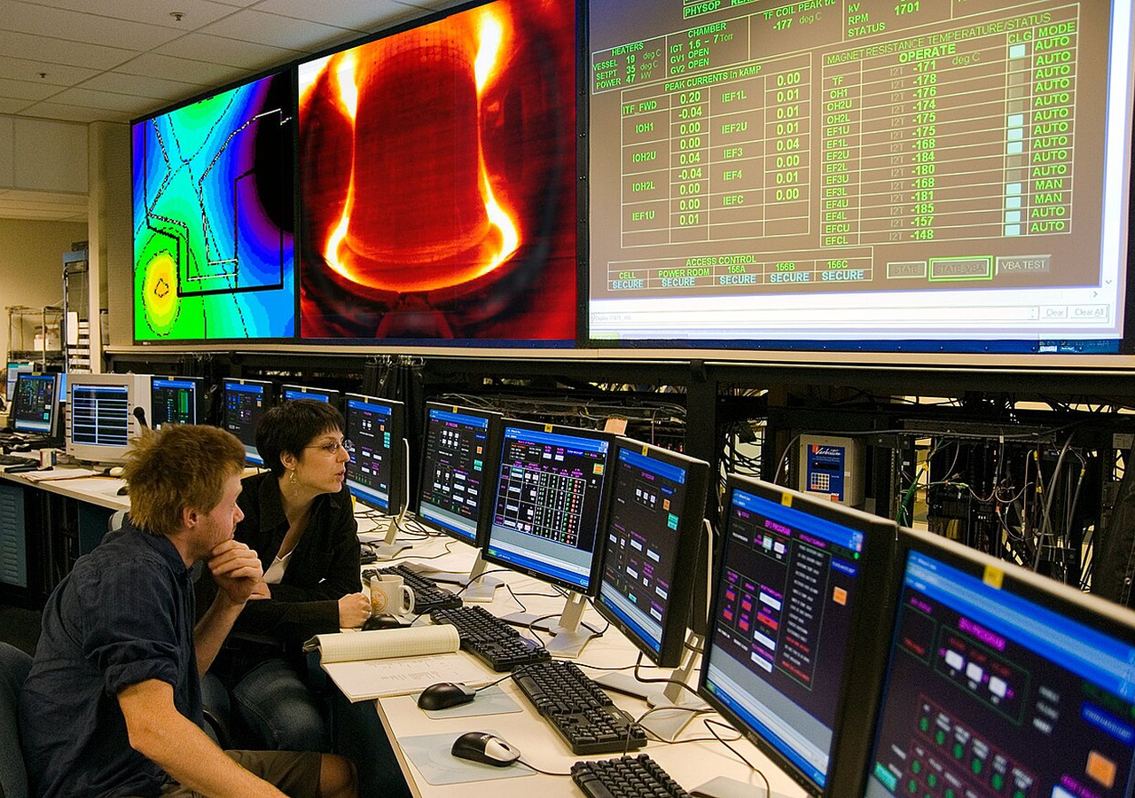
BlueOcean
Fusion Commercialization Is Likely Post-2035 with Significant Uncertainty
The commercialization timeline for fusion energy is highly uncertain, with private ventures targeting 2028-2032 pilot plants but public projects like ITER facing delays t
The path to commercial fusion energy is defined by a series of ambitious public and private projects, each targeting key milestones. The most prominent public project, ITER, is an international tokamak under construction in France, with first plasma expected i
Private ventures are pursuing faster timelines. Commonwealth Fusion Systems (CFS), a spinout from MIT, is building SPARC, a compact tokamak using high-temperature superconducting magnets. SPARC aims to achieve net energy gain (Q>1) by 2025-2026, with a commerc
The 2022 achievement of fusion ignition at Lawrence Livermore National Laboratory (LLNL) was a historic scientific milestone, demonstrating that a controlled fusion reaction can produce more energy than the laser energy used to drive it. However, this was a si
Key implications
- Plan for 2035-2050 commercialization; stage investments based on SPARC and ITER milestones.
- Private ventures offer faster timelines but higher risk; public projects provide foundational sc
Fusion Commercialization Is Likely Post-2035 with Significant Uncertainty

Slide 5
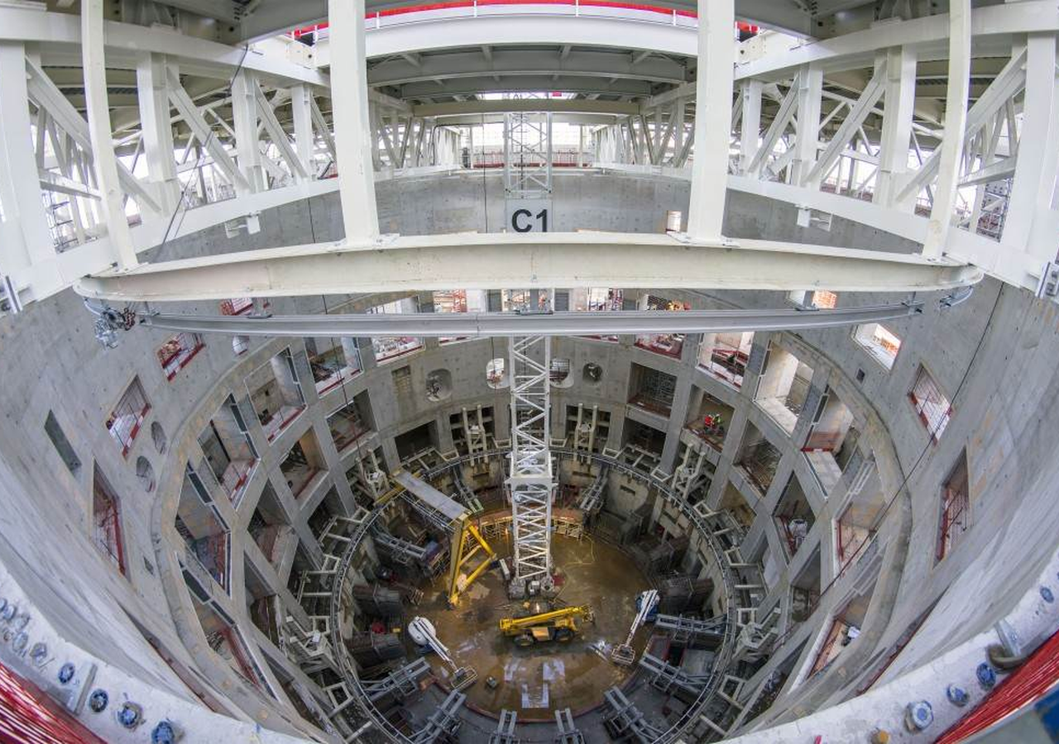
BlueOcean
Fusion Faces High Cost Hurdles but Could Be Competitive in Baseload Markets
Fusion LCOE is projected at $50-100/MWh by 2050, higher than current renewables but competitive for baseload applications. Executives should view fusion as a complement t
The economic viability of fusion energy depends on its levelized cost of energy (LCOE) relative to other sources. Current estimates from the DOE and industry analysts project fusion LCOE in the range of $50-100/MWh by 2050, assuming successful commercializatio
Fusion's potential advantage lies in its high capacity factor (90%+), low fuel cost (deuterium from seawater is virtually free), and lack of carbon emissions or long-lived radioactive waste. This makes it an attractive option for baseload power, especially in
Financing fusion plants will be challenging due to the high upfront capital and perceived technology risk. Government loan guarantees, power purchase agreements (PPAs), and carbon pricing could help de-risk investments. The DOE's Loan Programs Office has alrea
Key implications
- Fusion LCOE of $50-100/MWh by 2050 is competitive for baseload but not for peaking power.
- Focus on high-value applications: industrial heat, hydrogen, and regions with poor renewable res
Fusion Faces High Cost Hurdles but Could Be Competitive in Baseload Markets

Slide 6

BlueOcean
Fusion Will Reshape Energy Geopolitics, Reducing Dependence on Fossil Fuels
Fusion fuel is abundant and widely distributed, potentially decoupling energy security from fossil fuel reserves. Executives should view fusion as a long-term hedge again
Fusion energy has the potential to fundamentally alter global energy geopolitics. Unlike fossil fuels, which are concentrated in a few regions, fusion fuel (deuterium and tritium) is virtually unlimited and widely available. Deuterium can be extracted from sea
For energy-importing nations, fusion offers the prospect of energy independence. Countries like Japan, South Korea, and many European nations that currently rely on imported fossil fuels could generate their own fusion power, reducing vulnerability to supply d
However, the initial deployment of fusion is likely to be in advanced economies with strong R&D infrastructure and regulatory frameworks. Developing countries may face barriers to adoption due to high capital costs and technical complexity. This could create a
Key implications
- Fusion fuel is abundant and widely distributed, reducing dependence on fossil fuel imports.
- Initial deployment will be in advanced economies; developing countries may face barriers.
Fusion Will Reshape Energy Geopolitics, Reducing Dependence on Fossil Fuels

Slide 7
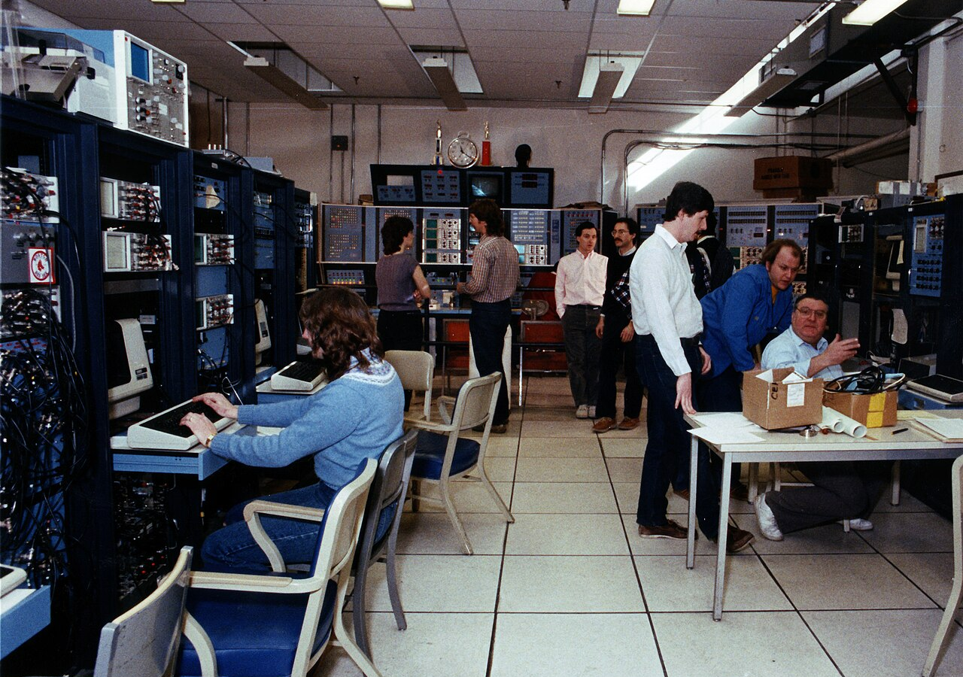
BlueOcean
Private Startups Are Accelerating Development but Public Projects Remain Critical
Private fusion companies have raised over $5 billion and are pursuing aggressive timelines, but public projects like ITER provide essential foundational science and infra
The fusion landscape has been transformed by the emergence of private startups. Since 2020, over 30 private companies have raised more than $5 billion, according to the Fusion Industry Association. The largest private player is Commonwealth Fusion Systems (CFS
Other notable private companies include Helion Energy, which has raised $500 million and plans to demonstrate a 50 MW commercial reactor by 2028 using a field-reversed configuration. TAE Technologies has raised over $1 billion and is pursuing a linear design w
These private companies are driven by a sense of urgency and a willingness to take risks. They are pursuing innovative designs and faster timelines than public projects. However, they also face significant technical and financial risks. Many are still at the p
Key implications
- Private startups have raised over $5 billion and are pursuing aggressive timelines.
- Public projects like ITER provide essential foundational science and infrastructure.
Private Startups Are Accelerating Development but Public Projects Remain Critical

Slide 8
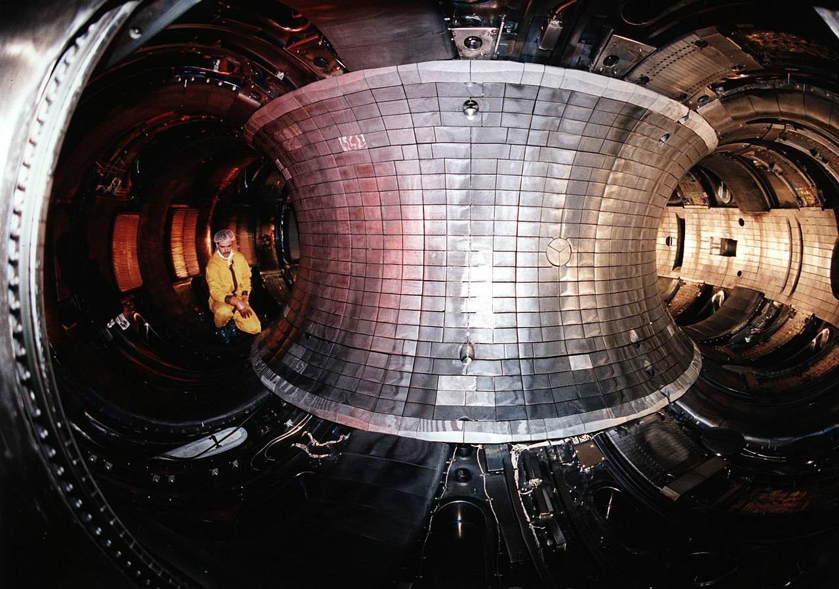
BlueOcean
Strategic Investments Should Focus on Enabling Technologies and Early Partnerships
Key enabling technologies include high-temperature superconductors, tritium breeding, and advanced materials. Early partnerships with fusion developers can provide prefer
Strategic investments in fusion should focus on enabling technologies that are critical to multiple reactor designs. High-temperature superconductors (HTS) are a key enabler for compact tokamaks like SPARC, allowing stronger magnetic fields in a smaller device
Tritium breeding is another critical technology. Fusion reactors require tritium as fuel, but tritium is scarce and must be bred from lithium in a blanket surrounding the reactor. Developing efficient tritium breeding systems is essential for commercial fusion
Advanced materials for reactor walls and components are also needed. Fusion reactors produce high-energy neutrons that can damage materials over time. Developing materials that can withstand high neutron fluxes and high temperatures is a key challenge. Researc
Key implications
- Invest in enabling technologies: high-temperature superconductors, tritium breeding, advanced ma
- Early partnerships with fusion developers can secure preferential access to PPAs.
Strategic Investments Should Focus on Enabling Technologies and Early Partnerships

Slide 9

BlueOcean
Regulatory and Policy Frameworks Must Be Developed to Enable Fusion Commercialization
Fusion-specific regulatory frameworks are still undeveloped, creating uncertainty for investors and developers. Executives should engage with regulators and support risk-
The regulatory landscape for fusion energy is still in its infancy. Unlike nuclear fission, which has a well-established regulatory framework, fusion does not have a dedicated licensing process in most countries. This creates uncertainty for developers and inv
In the United States, the Nuclear Regulatory Commission (NRC) is working on a risk-informed, performance-based framework for fusion. The NRC has issued a white paper outlining its approach, which would treat fusion differently from fission due to its lower ris
The United Kingdom has taken a more proactive approach. The UK government has established a regulatory framework for fusion that treats it separately from nuclear fission, with a focus on safety and environmental protection. The UK's STEP program aims to build
Key implications
- Fusion-specific regulatory frameworks are still undeveloped, creating uncertainty.
- Engage with regulators early; support risk-informed, performance-based regulations.
Regulatory and Policy Frameworks Must Be Developed to Enable Fusion Commercialization

Slide 10
BlueOcean
Nuclear Fusion Commercialization Outlook and Strategic Implications should be managed as a staged strategic option, no
The CEO question is which moves are safe now and which should wait for stronger proof.
Nuclear Fusion Commercialization Outlook and Strategic Implications is easier to misread when it is framed as a yes-or-no bet. The better reading separates near-term learning moves, option-building partnerships and commitments that would require stronger comme
The immediate management question is not whether the opportunity is exciting; it is whether budget, partner access or management attention should be committed now. Low-cost validation can start early, while larger capital commitments should wait for customer,
In capital terms, the current source base is useful but incomplete. A public source anchors this point: The Department of Energy has been a leader in fusion energy research since the 1950s and supports groundbreaking advances today. A quarterly review rhythm i
Key implications
- Start with low-cost validation
- Reserve major commitments for stronger proof
Nuclear Fusion Commercialization Outlook and Strategic Implications should be managed as a staged strategic option, not

Slide 11
BlueOcean
Commercial readiness depends on bankability, deliverability and repeat customer proof
Technical feasibility matters only when it changes customer value, cost position and execution confidence.
For leadership teams, commercial readiness should be judged through customer adoption, cost structure, delivery cycle, service capability and financing availability. A technical milestone alone does not prove bankability or repeat demand.
Every major assumption needs a verifiable claim behind it: target customer, buying trigger, budget owner, substitute, use case and payback path. Where sourced evidence is missing, the claim should remain directional.
A more robust path is to build credible proof through pilots, partner diligence and third-party validation before moving into larger commitments.
Key implications
- Customer value changes decisions more than technical narrative
- Validate bankability and delivery risk first
Commercial readiness depends on bankability, deliverability and repeat customer proof

Slide 12
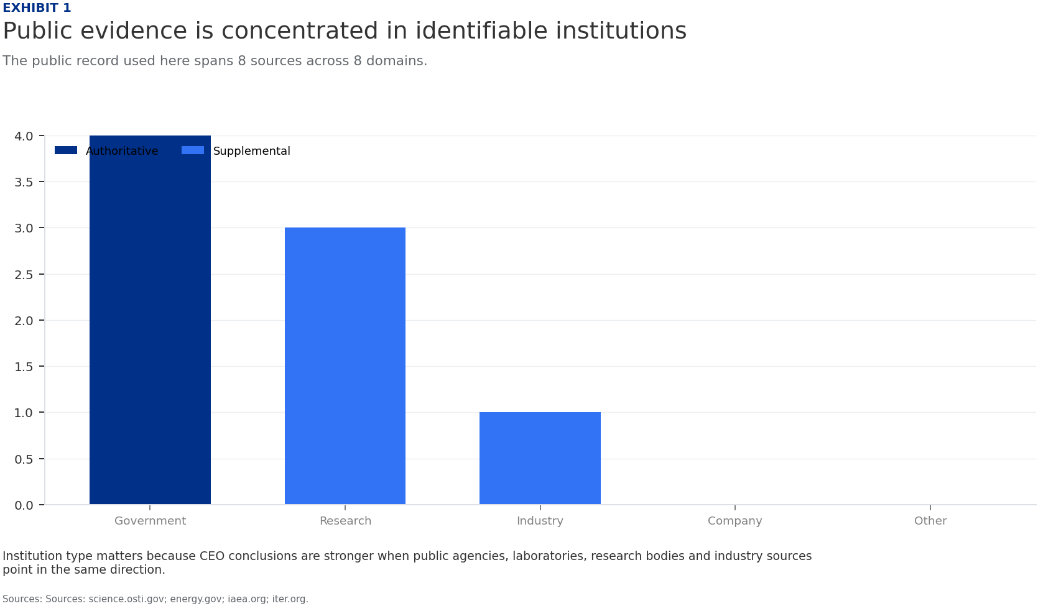
BlueOcean
Exhibit 1: evidence clarifies the strategic trade-off
Exhibit 1: evidence clarifies the strategic trade-off

Slide 13
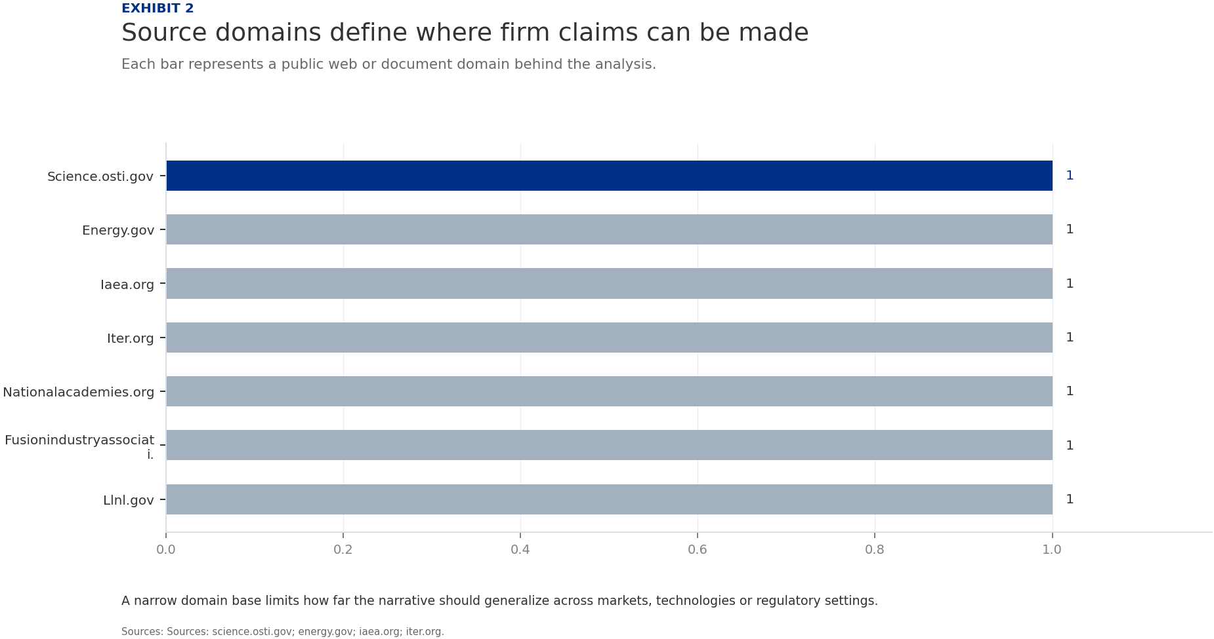
BlueOcean
Exhibit 2: evidence clarifies the strategic trade-off
Exhibit 2: evidence clarifies the strategic trade-off

Slide 14
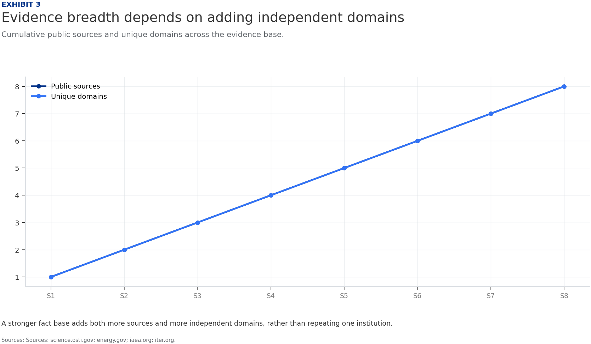
BlueOcean
Exhibit 3: evidence clarifies the strategic trade-off
Exhibit 3: evidence clarifies the strategic trade-off

Slide 15
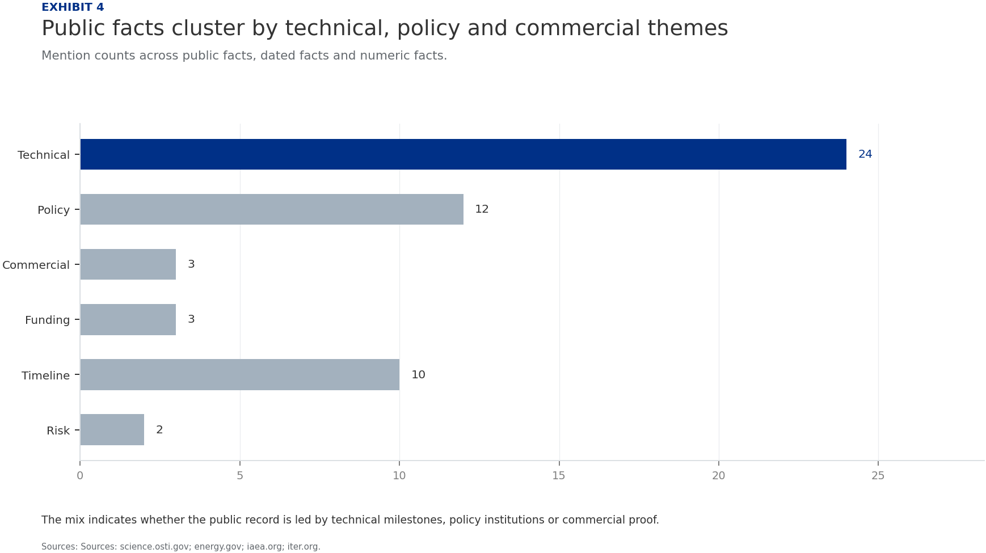
BlueOcean
Exhibit 4: evidence clarifies the strategic trade-off
Exhibit 4: evidence clarifies the strategic trade-off

Slide 16
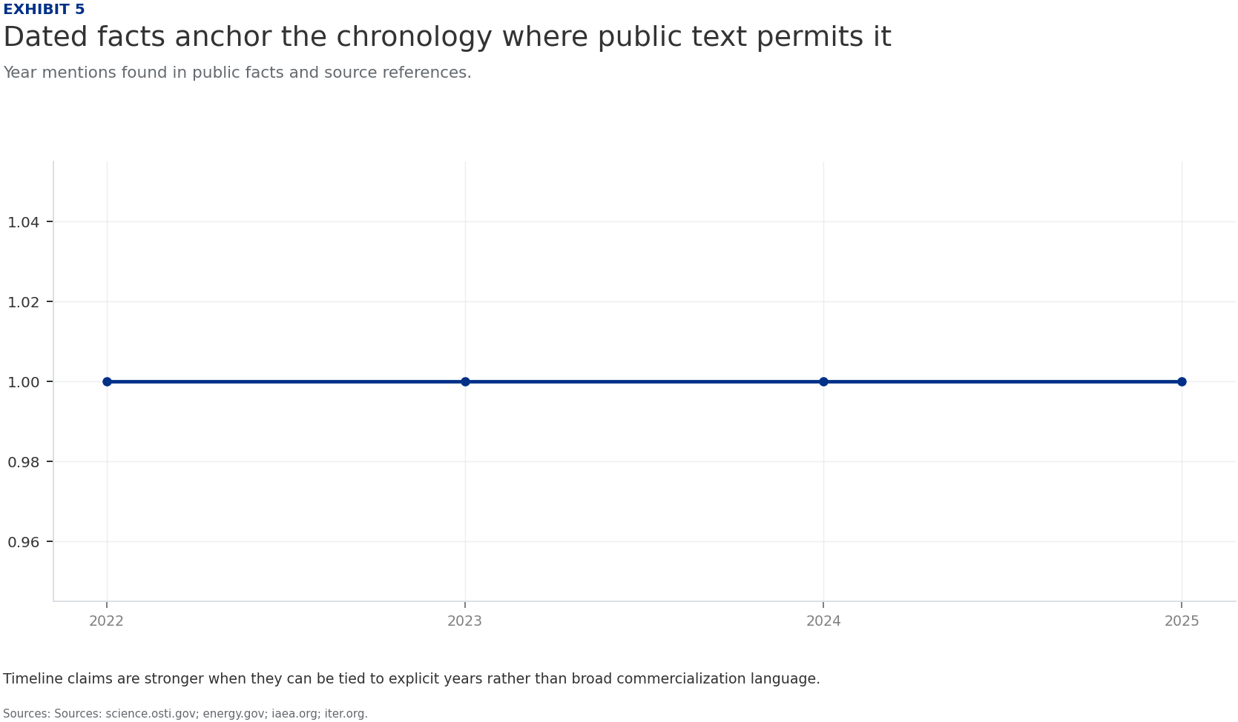
BlueOcean
Exhibit 5: evidence clarifies the strategic trade-off
Exhibit 5: evidence clarifies the strategic trade-off

Slide 17
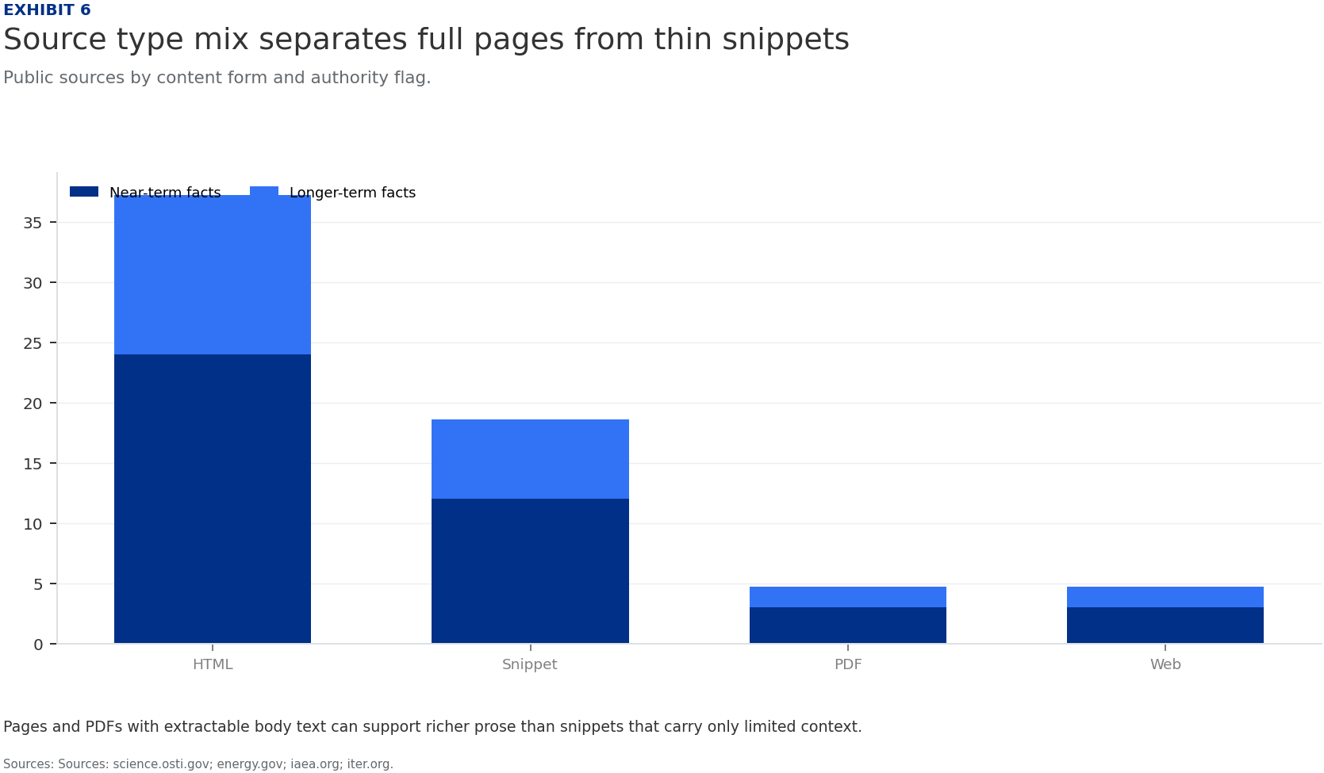
BlueOcean
Exhibit 6: evidence clarifies the strategic trade-off
Exhibit 6: evidence clarifies the strategic trade-off

Slide 18
BlueOcean
The next step is to convert the research into a short list of decisions
A Decision-Ready Assessment for Senior Executives
Closing

