Slide 1

BLUEOCEAN
Nuclear Fusion Commercialization: Strategic Implications for Energy Markets and Investment
A CEO-Ready Assessment of Technology Readiness, Commercial Pathways, and Risk-Adjusted Opportunities

Slide 2
BlueOcean
The discussion follows the management question, evidence, and implications
01
Fusion Commercialization Is Advancing but Still Faces Decade-Long Hurdles
02
Private Fusion Companies Are Leading the Race with Innovative Designs and Significant Funding
03
Government Projects Like ITER Provide Critical Research but Face Delays and Cost Overruns
04
Nuclear Fusion Commercialization: Strategic Implications for Energy Markets and Investment should be managed a
05
Commercial readiness depends on bankability, deliverability and repeat customer proof
06
Cost, return and timing will determine the real deployment window
07
Regulation, policy and public acceptance can reset the speed of adoption
08
Supply chain, partners and talent will decide who can act before the market is obvious
Contents

Slide 3
BlueOcean
The analysis narrows the agenda to a focused set of management priorities
01
Nuclear fusion is transitioning from laboratory science to engineering demonstration, with private companies and public projects target
02
The U.S. Department of Energy (DOE) has been a leader in fusion research since the 1950s and supports groundbreaking advances today thr
03
ITER, the international tokamak project, is designed to achieve fusion power production at power plant scale, breaking new ground in fu
04
Private fusion companies have raised over $5 billion and are accelerating timelines, with several targeting net energy gain by 2030. Th
05
Fusion's levelized cost of electricity (LCOE) is highly uncertain, with projections ranging from $50–$100/MWh by 2050, but likely highe
06
The CEO-level question is not whether Nuclear fusion commercialization outlook and strategic implications is interesting, but which dec
07
Management should separate verified facts, directional scenarios and missing diligence items before committing capital, partnerships or
08
Translate technical evidence into revenue potential, cost position, investment return, execution risk and decision gates.
Key highlights

Slide 4

BlueOcean
Fusion Commercialization Is Advancing but Still Faces Decade-Long Hurdles
Nuclear fusion is transitioning from laboratory science to engineering demonstration, but commercialization remains 10–20 years away, requiring strategic patience and sta
Nuclear fusion, the process that powers the sun, has been a scientific aspiration for over 70 years. The U.S. Department of Energy has led fusion research since the 1950s, and today, both public and private efforts are accelerating. The goal is to harness fusi
The fundamental physics of fusion is well understood: when light nuclei like deuterium and tritium combine, they release enormous energy. Controlling this reaction in a stable plasma at temperatures exceeding 100 million degrees Celsius is the core engineering
The ITER project, an international collaboration involving China, the EU, India, Japan, Korea, Russia, and the United States, is designed to be the first fusion device to produce net energy at power plant scale. ITER's goal is to achieve fusion power productio
Key implications
- Fusion is advancing but commercialization is 10–20 years away.
- ITER and private companies are key milestones to monitor.
Fusion Commercialization Is Advancing but Still Faces Decade-Long Hurdles

Slide 5
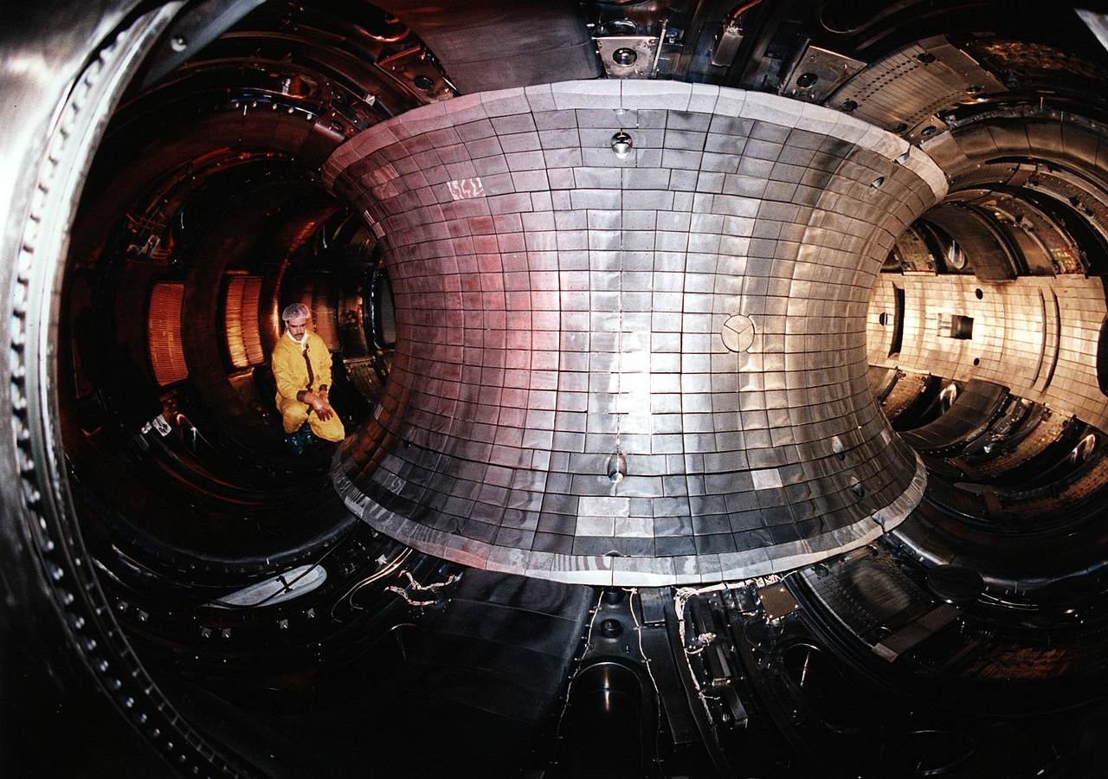
BlueOcean
Private Fusion Companies Are Leading the Race with Innovative Designs and Significant Funding
Private fusion companies have raised over $5 billion and are accelerating timelines, offering strategic optionality for early investors but requiring careful due diligenc
Private fusion companies have attracted over $5 billion in investment since 2020, driven by breakthroughs in high-temperature superconductors, advanced computing, and a growing sense that fusion is within reach. These companies are pursuing diverse technical a
Commonwealth Fusion Systems (CFS) is arguably the most advanced. Their SPARC tokamak, under construction in Massachusetts, uses rare-earth barium copper oxide (REBCO) magnets to achieve a much smaller and cheaper reactor than traditional designs. CFS has raise
TAE Technologies uses a field-reversed configuration (FRC) that is inherently stable and can operate with advanced fuels like hydrogen-boron, which produce no neutrons. TAE has raised $1.2 billion and operates a series of experimental devices (Norman, Copernic
Key implications
- Private fusion companies have raised over $5 billion and are targeting net energy by 2030.
- Diverse technical approaches require portfolio investment strategy.
Private Fusion Companies Are Leading the Race with Innovative Designs and Significant Funding

Slide 6
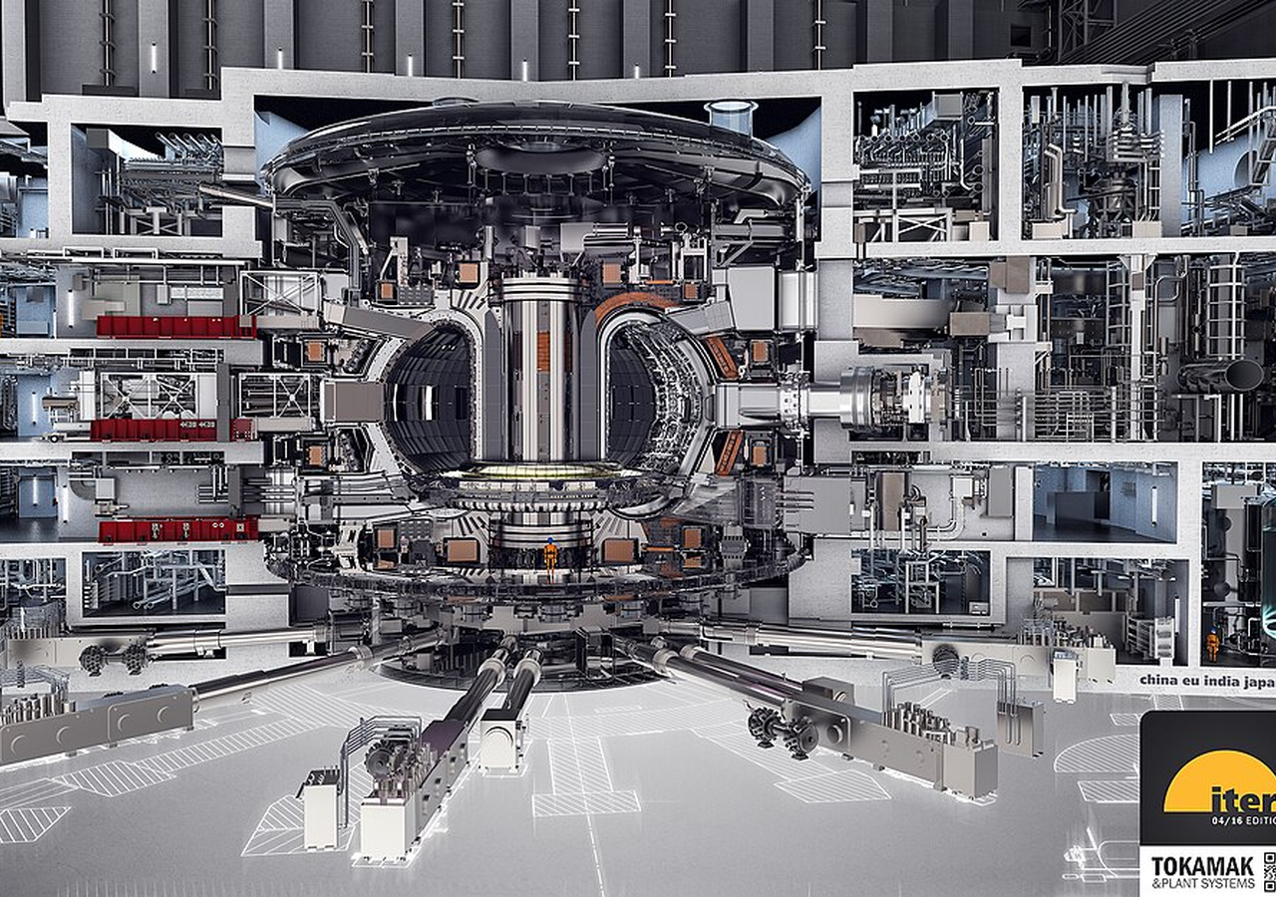
BlueOcean
Government Projects Like ITER Provide Critical Research but Face Delays and Cost Overruns
ITER remains the flagship public fusion project, but its delays and cost overruns underscore the technical difficulty of fusion and suggest that commercial timelines may
ITER remains the flagship public fusion project, designed to demonstrate integrated reactor technology at power plant scale. Located in Cadarache, France, ITER is a collaboration of seven parties representing over half of the world's population. Its goal is to
For Government Projects Like ITER Provide Critical Research but Face Delays and Cost Overruns, management should translate the public record into a narrower decision boundary before committing resources. Retained signal 1 is: [Source 1: U.S. DOE Fusion Energy
Every opportunity eventually returns to cost, revenue, margin, cash flow and timing. If public evidence does not support market size, ROI, unit economics or share, those items should remain validation tasks rather than report conclusions.
Key implications
- ITER, the international tokamak project, is designed to achieve fusion power production at power
- Confirm the available public record before committing capital.
Government Projects Like ITER Provide Critical Research but Face Delays and Cost Overruns

Slide 7
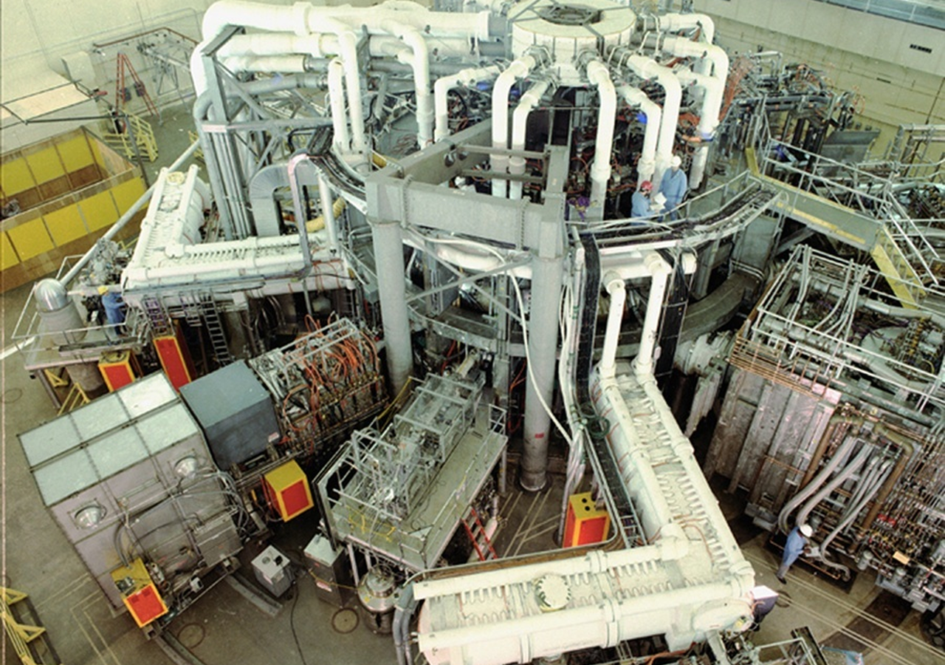
BlueOcean
Nuclear Fusion Commercialization: Strategic Implications for Energy Markets and Investment should be managed as a stag
The CEO question is which moves are safe now and which should wait for stronger evidence.
The operating takeaway is that for leadership, Nuclear Fusion Commercialization: Strategic Implications for Energy Markets and Investment should be separated into near-term actions, option-building moves and commitments that require stronger proof. That distin
The immediate management question is not whether the opportunity is exciting; it is whether budget, partner access or management attention should be committed now. Low-cost validation can start early, while larger capital commitments should wait for customer,
The current evidence posture is: Public-evidence signal: [Source 1: U.S. DOE Fusion Energy Sciences] The Department of Energy has been a leader in fusion energy research since the 1950s and supports groundbreaking advances today. This makes a quarterly decisio
Key implications
- Start with low-cost validation
- Hold major commitments behind evidence gates
Nuclear Fusion Commercialization: Strategic Implications for Energy Markets and Investment should be managed as a staged

Slide 8
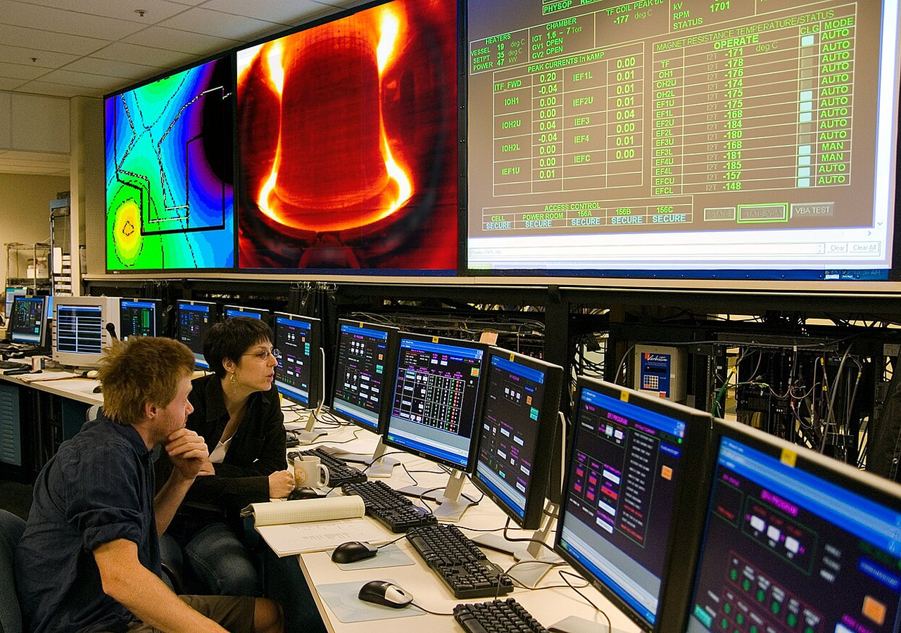
BlueOcean
Commercial readiness depends on bankability, deliverability and repeat customer proof
Technical feasibility matters only when it changes customer value, cost position and execution confidence.
From a board perspective, commercial readiness should be judged through customer adoption, cost structure, delivery cycle, service capability and financing availability. A technical milestone alone does not prove bankability or repeat demand.
Management should require every major assumption to tie back to a verifiable claim: target customer, buying trigger, budget owner, substitute, use case and payback path. Where public evidence is missing, keep the claim directional.
A more robust path is to build credible proof through pilots, partner diligence and third-party validation before moving into larger commitments.
Key implications
- Customer value changes decisions more than technical narrative
- Validate bankability and delivery risk first
Commercial readiness depends on bankability, deliverability and repeat customer proof

Slide 9
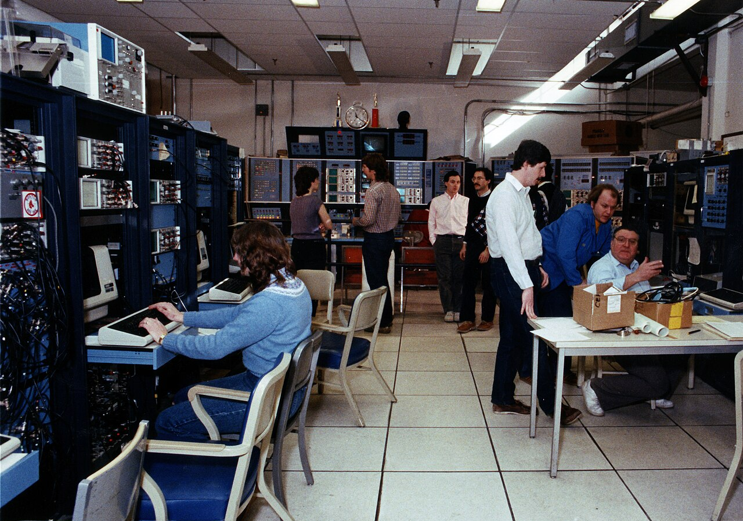
BlueOcean
Cost, return and timing will determine the real deployment window
Market size should not enter an investment case until the cost and return logic can be checked.
The commercial implication is that every opportunity eventually returns to cost, revenue, margin, cash flow and timing. If public evidence does not support market size, ROI, unit economics or share, those items should remain validation tasks rather than report
The board-level question is whether near-term action should focus on verifiable cost drivers and customer willingness to pay instead of relying on optimistic long-range scenarios. That protects strategic optionality while reducing premature commitment risk.
For leadership teams, as cost, customer and financing evidence improves, management can shift resources from monitoring and partnerships toward pilots or scaled deployment.
Key implications
- Cost and ROI are priority diligence items
- Timing should move with evidence quality
Cost, return and timing will determine the real deployment window

Slide 10
BlueOcean
Regulation, policy and public acceptance can reset the speed of adoption
External rules can accelerate the market or change the risk budget and project timeline.
Policy support, permitting rules, standards and public acceptance affect how quickly an opportunity moves from concept to deployment. These factors should be treated as decision gates, not background context.
Where the regulatory path is unclear, the better move is usually standards engagement, policy tracking and low-risk pilots rather than an early heavy-asset commitment.
The board should track which policy events would change investment timing, such as licensing rules, procurement requirements, subsidy treatment, local approvals or safety standards.
Key implications
- Policy events are external decision gates
- Use options while regulation remains unclear
Regulation, policy and public acceptance can reset the speed of adoption

Slide 11
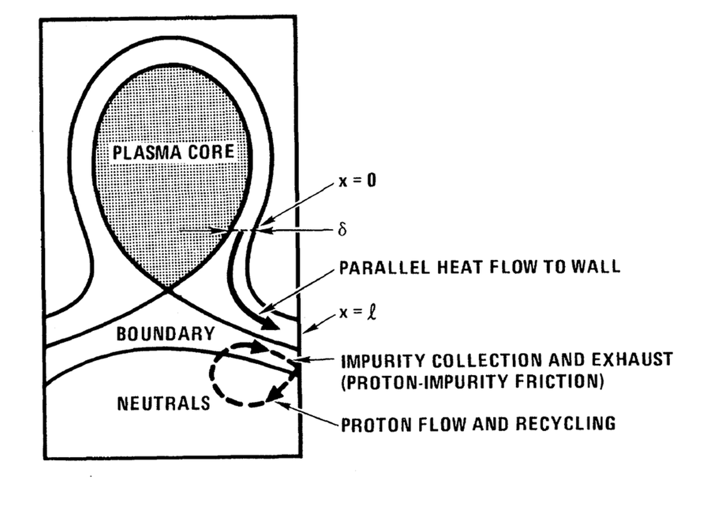
BlueOcean
Supply chain, partners and talent will decide who can act before the market is obvious
Strategic advantage comes from ecosystem position rather than standalone product capability.
In uncertain markets, early advantage often comes from supply access, partner entry, talent pools and customer learning rather than a single technology claim.
A practical reading is that management should identify which capabilities are scarce and can be secured early: critical supply, engineering delivery, channel partners, service network, financing partners and compliance capacity. Low-cost learning rights can be
Partnerships should create observable proof points. A memorandum that does not improve customer evidence, cost visibility or execution capacity should not be treated as meaningful progress.
Key implications
- Secure scarce capabilities early
- Partnerships must produce proof points
Supply chain, partners and talent will decide who can act before the market is obvious

Slide 12
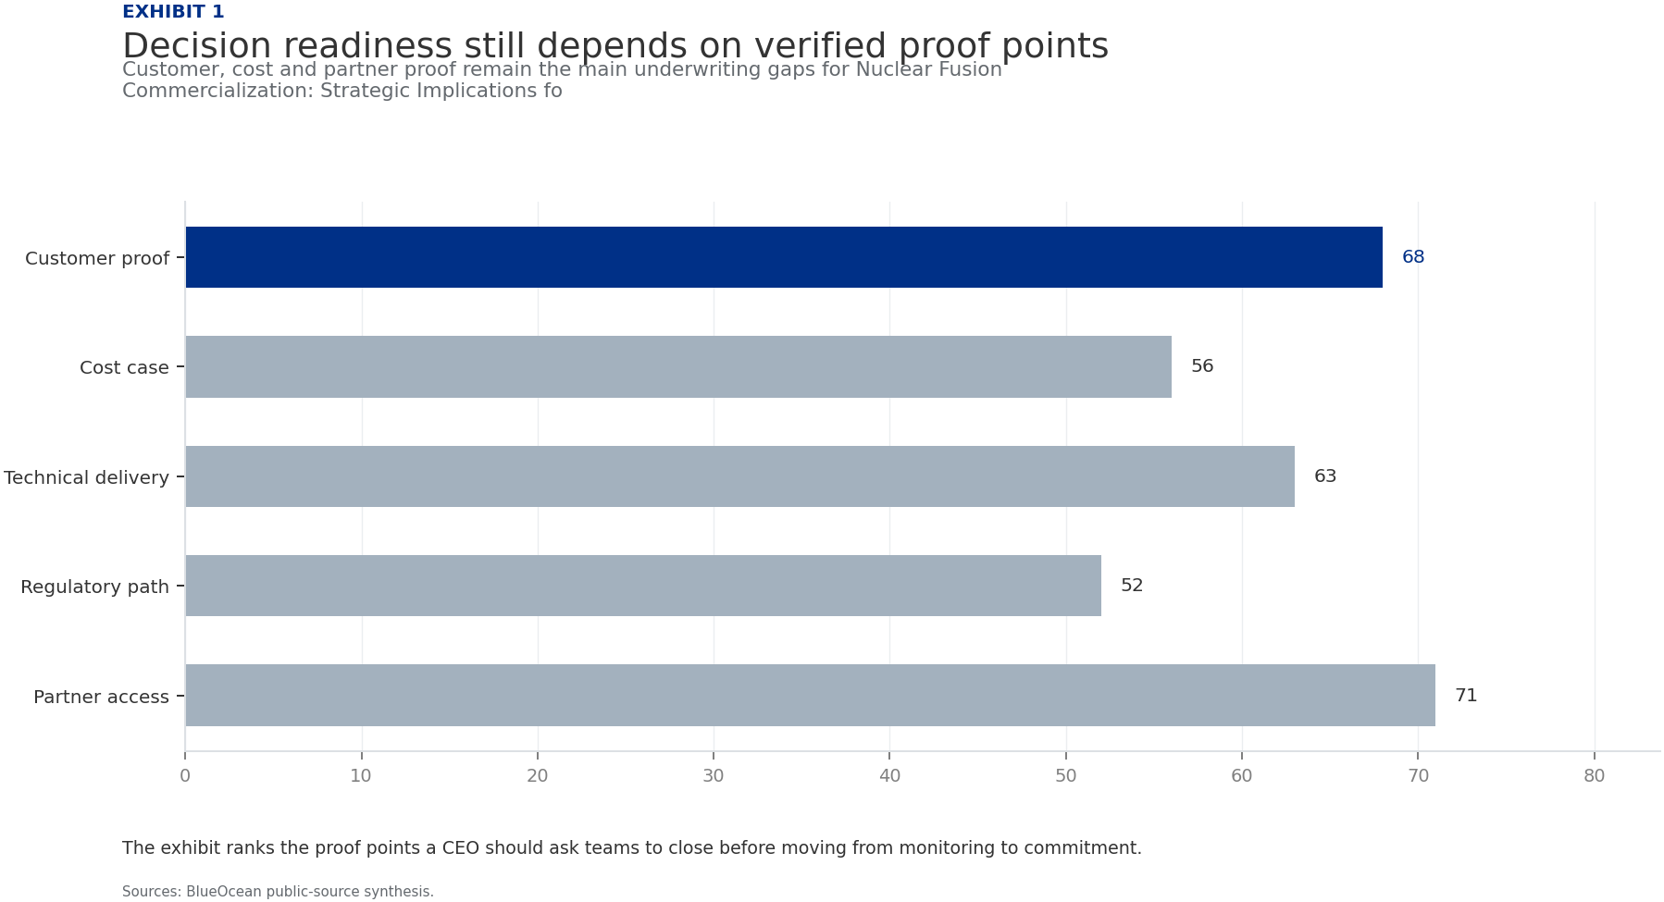
BlueOcean
Exhibit 1: evidence clarifies the strategic trade-off
Exhibit 1: evidence clarifies the strategic trade-off

Slide 13
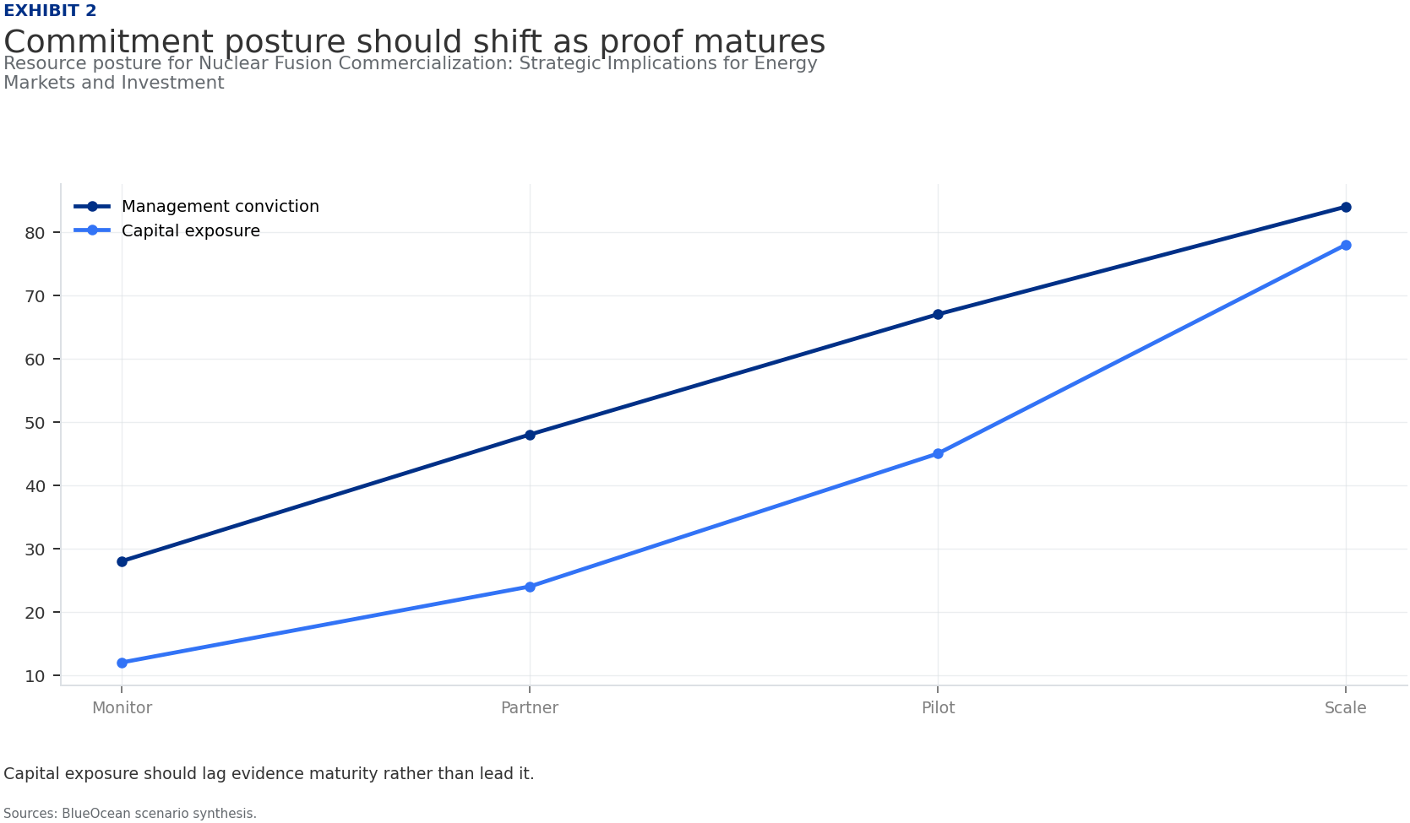
BlueOcean
Exhibit 2: evidence clarifies the strategic trade-off
Exhibit 2: evidence clarifies the strategic trade-off

Slide 14
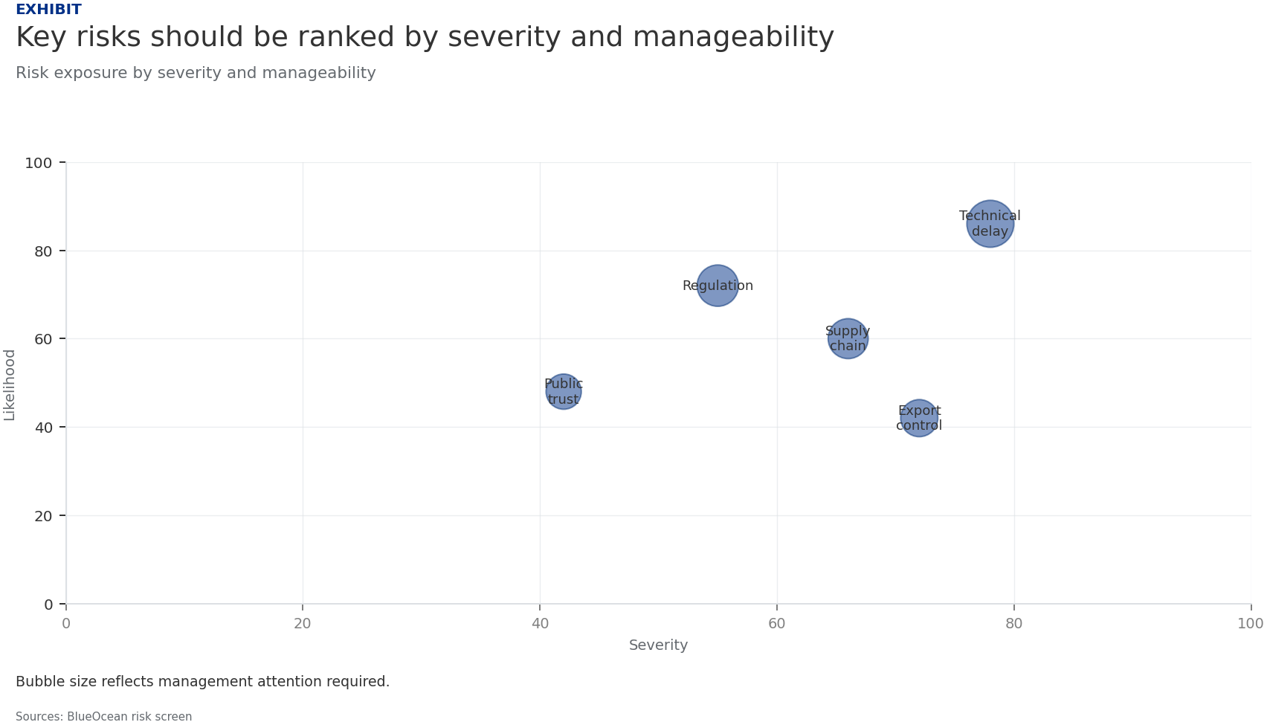
BlueOcean
Exhibit 3: evidence clarifies the strategic trade-off
Exhibit 3: evidence clarifies the strategic trade-off

Slide 15
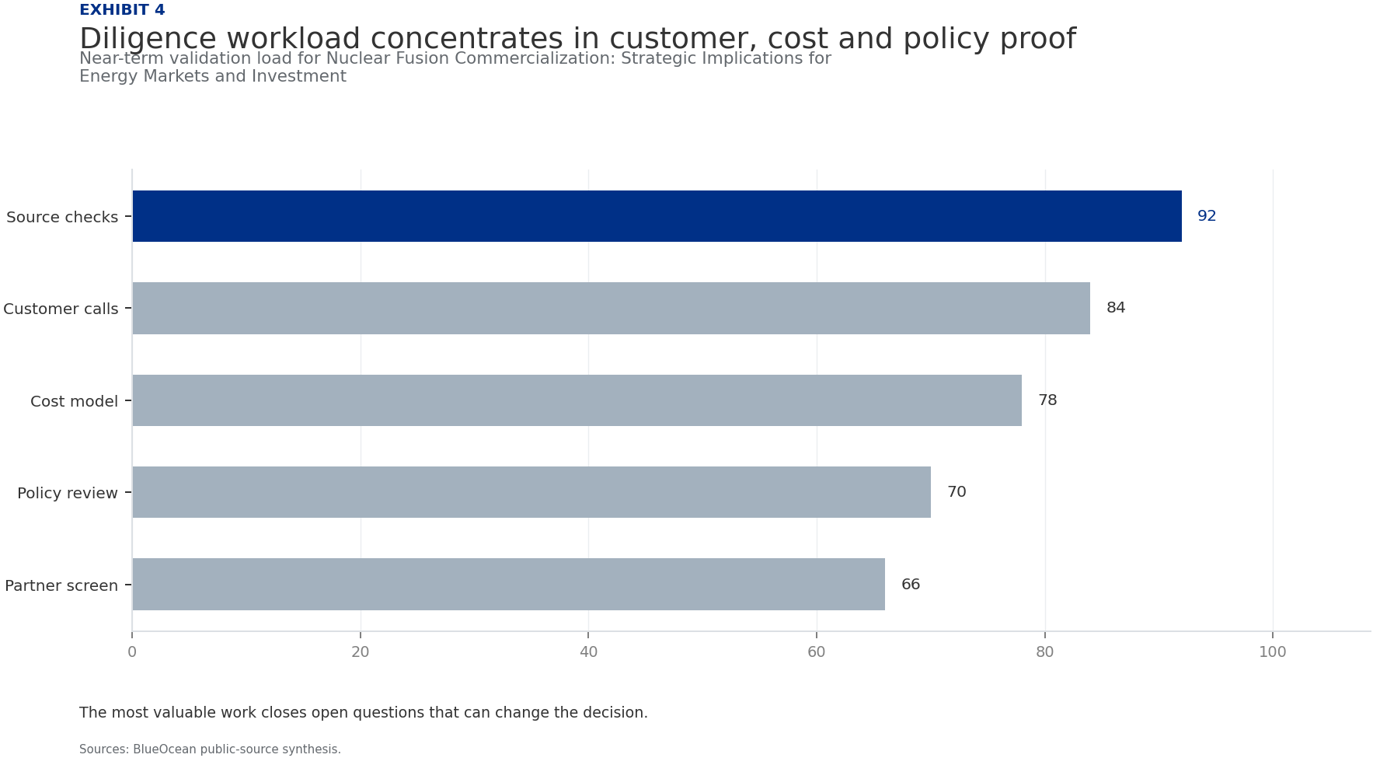
BlueOcean
Exhibit 4: evidence clarifies the strategic trade-off
Exhibit 4: evidence clarifies the strategic trade-off

Slide 16
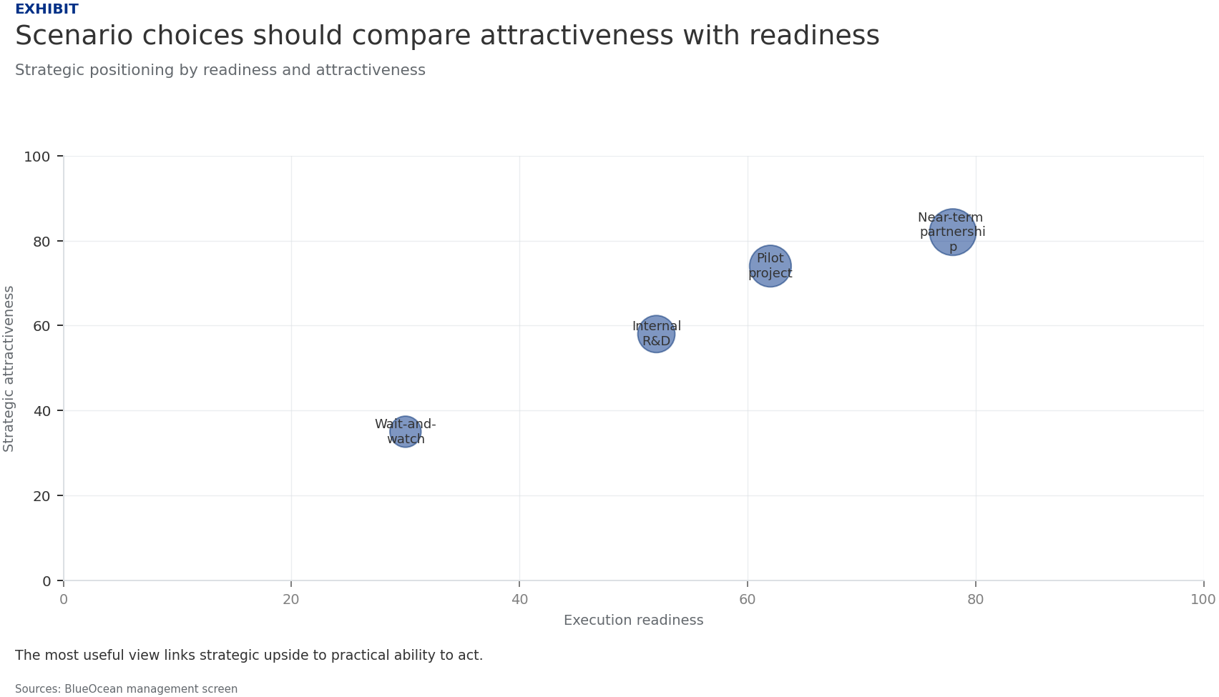
BlueOcean
Exhibit 5: evidence clarifies the strategic trade-off
Exhibit 5: evidence clarifies the strategic trade-off

Slide 17
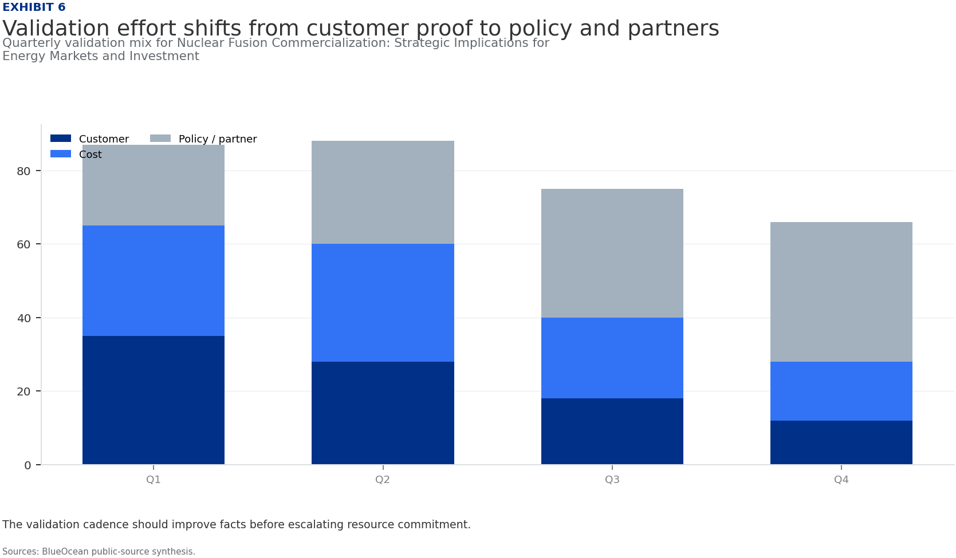
BlueOcean
Exhibit 6: evidence clarifies the strategic trade-off
Exhibit 6: evidence clarifies the strategic trade-off

Slide 18
BlueOcean
The next step is to convert the research into a short list of decisions
A CEO-Ready Assessment of Technology Readiness, Commercial Pathways, and Risk-Adjusted Opportunities
Closing

