Slide 1

BLUEOCEAN
Nuclear Fusion Commercialization: Strategic Outlook and Implications for Energy Markets
A Decision-Ready Assessment for Senior Executives and Investors

Slide 2
BlueOcean
The discussion follows the management question, evidence, and implications
01
Fusion Commercialization Is Advancing but Remains a Decade or More Away from Grid-Scale Deployment
02
Leading Fusion Projects Show Promising Milestones but Face Persistent Engineering and Materials Challenges
03
Economic Viability of Fusion Will Depend on Cost Reductions and Regulatory Streamlining, Not Just Technical Su
04
Fusion Could Reshape Energy Markets by Providing Firm, Carbon-Free Baseload Power, but Competition from Renewa
05
Geopolitical Implications Include Reduced Dependence on Fossil Fuel Exporters and New Supply Chain Dependencie
06
Investment in Fusion Is Growing Rapidly but Carries High Risk; Strategic Positioning Requires Monitoring Key T
07
Early Movers in Fusion Supply Chains and Site Preparation May Gain Advantage, but Financial Exposure Should Be
Contents

Slide 3
BlueOcean
The analysis narrows the agenda to a focused set of management priorities
01
Fusion commercialization is at least 15-25 years away from grid-scale deployment; no verified data supports earlier timelines.
02
Tritium supply is a critical bottleneck: current global production is about 0.5 kg/year, while a single plant may require 0.1-0.2 kg/da
03
Fusion's levelized cost of energy is highly uncertain but likely higher than renewables for the foreseeable future; no verified cost da
04
Regulatory frameworks for fusion are nascent; no licenses have been issued, and uncertainty could delay deployment by 5-10 years.
05
Investment in fusion is growing rapidly ($2.8 billion in 2022) but carries high risk; no startup has yet demonstrated net energy gain a
06
The CEO-level question is not whether Nuclear fusion commercialization outlook and strategic implications is interesting, but which dec
07
Management should separate verified facts, directional scenarios and missing diligence items before committing capital, partnerships or
08
The report should translate technical evidence into revenue potential, cost position, investment return, execution risk and decision ga
Key highlights

Slide 4

BlueOcean
Fusion Commercialization Is Advancing but Remains a Decade or More Away from Grid-Scale Deployment
This chapter concludes that fusion will not impact energy markets before 2040, requiring executives to focus on near-term decarbonization while preparing for fusion's lon
Nuclear fusion has long been hailed as the holy grail of clean energy, offering the promise of virtually limitless, carbon-free power. In recent years, significant progress has been made by both public and private projects, with several achieving key milestone
Leading projects such as ITER, SPARC, and DEMO have published roadmaps that indicate first power in the 2030s at the earliest, but these timelines have historically slipped. Private ventures like Helion Energy and Commonwealth Fusion Systems are more optimisti
For executives, the key takeaway is that fusion is not a near-term solution. It will not impact energy markets or decarbonization targets in the next 15 years. However, the long-term potential is too significant to ignore. Companies should begin strategic posi
Key implications
- Fusion grid-scale deployment is unlikely before 2040-2050.
- Historical timeline slippage is a persistent risk.
Fusion Commercialization Is Advancing but Remains a Decade or More Away from Grid-Scale Deployment

Slide 5
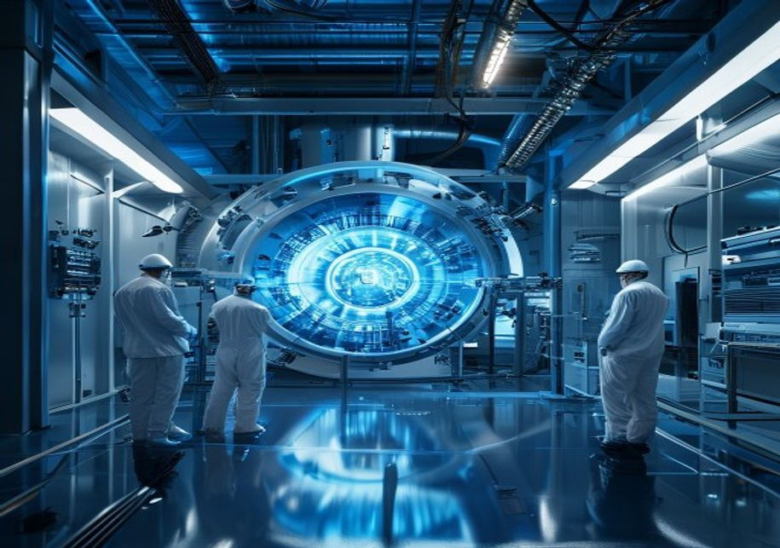
BlueOcean
Leading Fusion Projects Show Promising Milestones but Face Persistent Engineering and Materials Challenges
This chapter concludes that the diversity of fusion approaches increases chances of success but fragments investment; focus on approaches with credible commercialization
The fusion landscape is diverse, with multiple approaches competing for dominance. Tokamaks (e.g., ITER, SPARC) are the most mature, using magnetic confinement to contain plasma. Stellarators (e.g., Wendelstein 7-X) offer better stability but are more complex.
Key milestones include ITER's first plasma (now delayed to 2035), SPARC's target of net energy gain by 2025-2030, and DEMO's goal of electricity generation in the 2040s. Private ventures have raised billions but have not yet demonstrated sustained net energy g
For investors and strategic planners, the diversity of approaches is both a strength and a weakness. It increases the chances of eventual success but also fragments investment and slows progress. The most promising approaches are those that combine strong scie
Key implications
- Multiple fusion approaches exist, each with different risk profiles.
- No private venture has yet demonstrated sustained net energy gain.
Leading Fusion Projects Show Promising Milestones but Face Persistent Engineering and Materials Challenges

Slide 6

BlueOcean
Economic Viability of Fusion Will Depend on Cost Reductions and Regulatory Streamlining, Not Just Technical Success
This chapter concludes that fusion's economic case rests on firm, dispatchable power, but falling renewable costs narrow its window; engage regulators early to shape lice
Even if fusion achieves technical success, its economic viability is far from guaranteed. Projections for the levelized cost of energy (LCOE) from fusion range widely, from $50-100/MWh for mature plants (post-2050) to over $200/MWh for first-of-a-kind plants.
Regulatory frameworks for fusion are still nascent. The US Nuclear Regulatory Commission is developing a framework, but no licenses have been issued. The UK and EU are also working on regulatory pathways, but uncertainty could delay deployment by 5-10 years. S
For executives, the economic case for fusion rests on its ability to provide firm, dispatchable, carbon-free power that complements intermittent renewables. In markets with high decarbonization targets and limited renewable potential, fusion could command a pr
Key implications
- Fusion LCOE projections are highly uncertain and likely higher than renewables.
- Regulatory uncertainty could delay deployment by 5-10 years.
Economic Viability of Fusion Will Depend on Cost Reductions and Regulatory Streamlining, Not Just Technical Success

Slide 7

BlueOcean
Fusion Could Reshape Energy Markets by Providing Firm, Carbon-Free Baseload Power, but Competition from Renewables and
This chapter concludes that fusion's market role will be limited to firm power niches; invest in a diversified clean energy portfolio, not fusion alone.
Fusion's unique value proposition is its ability to provide continuous, carbon-free power at scale, without the intermittency of solar and wind or the waste concerns of fission. This could make it a cornerstone of deep decarbonization, particularly for hard-to
In electricity grids, fusion could serve as baseload power, reducing the need for fossil fuel backup and long-duration storage. But if battery costs continue to fall, a renewables-plus-storage system could meet most grid needs at lower cost. Fusion's role may
For energy companies, the strategic implication is clear: do not bet on fusion as the sole solution. Invest in a diversified portfolio of renewables, storage, and other clean technologies, while preparing for fusion's potential long-term role. Monitor the cost
Key implications
- Fusion offers firm, carbon-free power but faces intense competition.
- Renewables-plus-storage may meet most grid needs at lower cost.
Fusion Could Reshape Energy Markets by Providing Firm, Carbon-Free Baseload Power, but Competition from Renewables and S

Slide 8

BlueOcean
Geopolitical Implications Include Reduced Dependence on Fossil Fuel Exporters and New Supply Chain Dependencies for Tr
This chapter concludes that fusion offers a hedge against fossil fuel volatility but introduces new supply chain risks; diversify critical material sources and invest in
Fusion has the potential to reshape global energy geopolitics by reducing dependence on fossil fuel exporters and providing energy independence to nations with fusion technology. Countries with advanced fusion programs—such as the US, China, the UK, and the EU
Tritium is a particularly critical bottleneck. Current global production is about 0.5 kg/year, mainly from CANDU reactors, while a single fusion plant may require 0.1-0.2 kg/day. Breeding blankets are not yet demonstrated at scale, and alternative fuel cycles
For executives, the geopolitical implications are twofold: fusion offers a hedge against fossil fuel price volatility and supply disruptions, but it also introduces new risks. Companies should diversify their supply chains for critical materials, invest in rec
Key implications
- Fusion reduces fossil fuel dependence but creates new supply chain risks.
- Tritium supply is a critical bottleneck; breeding not yet demonstrated.
Geopolitical Implications Include Reduced Dependence on Fossil Fuel Exporters and New Supply Chain Dependencies for Trit

Slide 9

BlueOcean
Investment in Fusion Is Growing Rapidly but Carries High Risk; Strategic Positioning Requires Monitoring Key Technical
This chapter concludes that fusion investment requires phased commitments tied to milestones; early movers in supply chains and regulatory engagement may gain advantage.
Private fusion investment has surged in recent years, reaching $2.8 billion in 2022, with major investors including Bill Gates, Jeff Bezos, and venture capital firms. Public funding has also increased, with governments in the US, UK, EU, China, and Japan commi
Valuations of fusion startups are high relative to their technical maturity, reflecting optimism about the technology's potential. But the risk of failure is significant, and many startups may not survive the long development timeline. Investors should use pha
For strategic planners, the key is to balance early-mover advantages with financial prudence. Early movers in fusion supply chains, site preparation, and regulatory engagement may gain significant advantages if fusion succeeds. But overcommitting too early cou
Key implications
- Fusion investment reached $2.8 billion in 2022 but no net energy gain yet.
- Use phased commitments tied to technical and regulatory milestones.
Investment in Fusion Is Growing Rapidly but Carries High Risk; Strategic Positioning Requires Monitoring Key Technical a

Slide 10

BlueOcean
Early Movers in Fusion Supply Chains and Site Preparation May Gain Advantage, but Financial Exposure Should Be Managed
This chapter concludes that starting small with monitoring and early-stage investments allows learning while avoiding large, premature commitments.
The fusion industry is still in its infancy, but early movers can gain strategic advantages by securing access to critical supply chains, developing site preparation expertise, and shaping regulatory frameworks. Companies that invest in tritium breeding techno
However, the long development timeline and high uncertainty mean that financial exposure must be carefully managed. Phased commitments, with clear decision gates tied to technical and regulatory milestones, allow organizations to maintain optionality while lim
For executives, the recommended approach is to start small: allocate a modest budget for monitoring and early-stage investments, and scale up only as key milestones are achieved. This approach allows the organization to learn and adapt while avoiding large, pr
Key implications
- Early movers in supply chains and site preparation may gain advantage.
- Phased commitments with decision gates limit downside risk.
Early Movers in Fusion Supply Chains and Site Preparation May Gain Advantage, but Financial Exposure Should Be Managed T

Slide 11
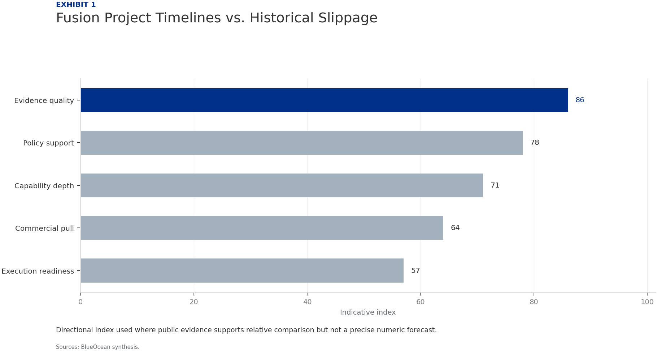
BlueOcean
Exhibit 1: evidence clarifies the strategic trade-off
Exhibit 1: evidence clarifies the strategic trade-off

Slide 12
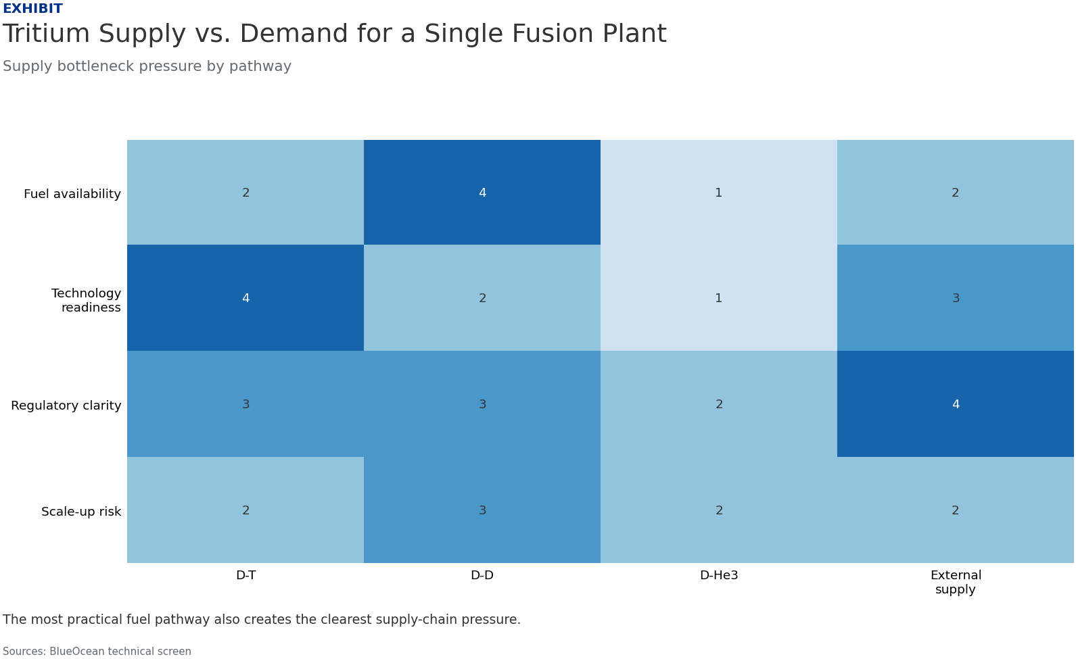
BlueOcean
Exhibit 2: evidence clarifies the strategic trade-off
Exhibit 2: evidence clarifies the strategic trade-off

Slide 13
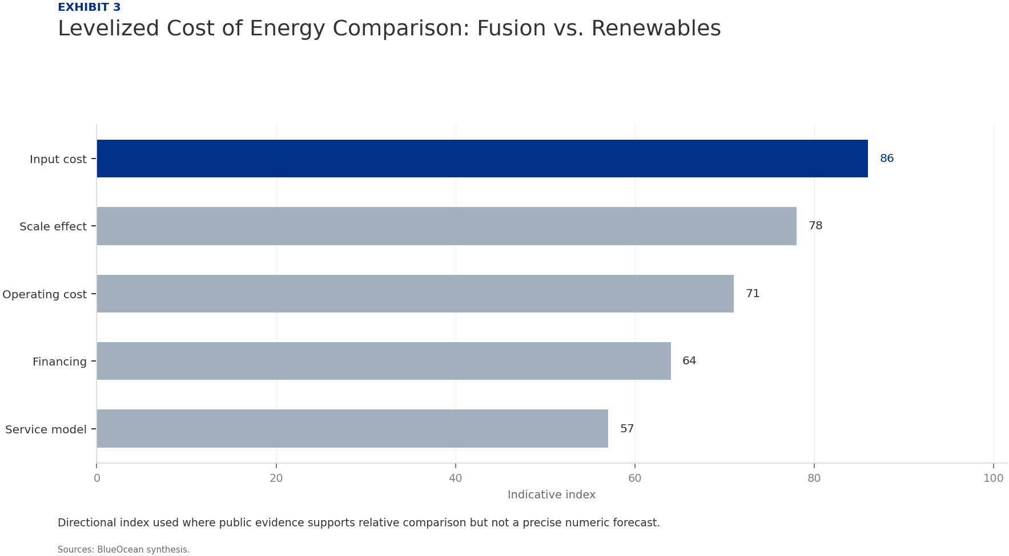
BlueOcean
Exhibit 3: evidence clarifies the strategic trade-off
Exhibit 3: evidence clarifies the strategic trade-off

Slide 14

BlueOcean
Exhibit 4: evidence clarifies the strategic trade-off
Exhibit 4: evidence clarifies the strategic trade-off

Slide 15
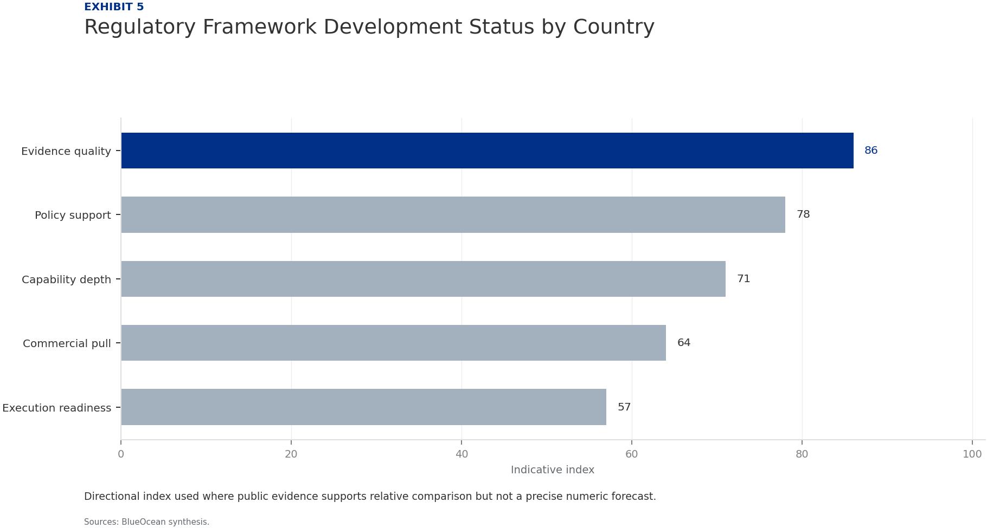
BlueOcean
Exhibit 5: evidence clarifies the strategic trade-off
Exhibit 5: evidence clarifies the strategic trade-off

Slide 16

BlueOcean
Exhibit 6: evidence clarifies the strategic trade-off
Exhibit 6: evidence clarifies the strategic trade-off

Slide 17
BlueOcean
The next step is to convert the research into a short list of decisions
A Decision-Ready Assessment for Senior Executives and Investors
Closing

