Slide 1
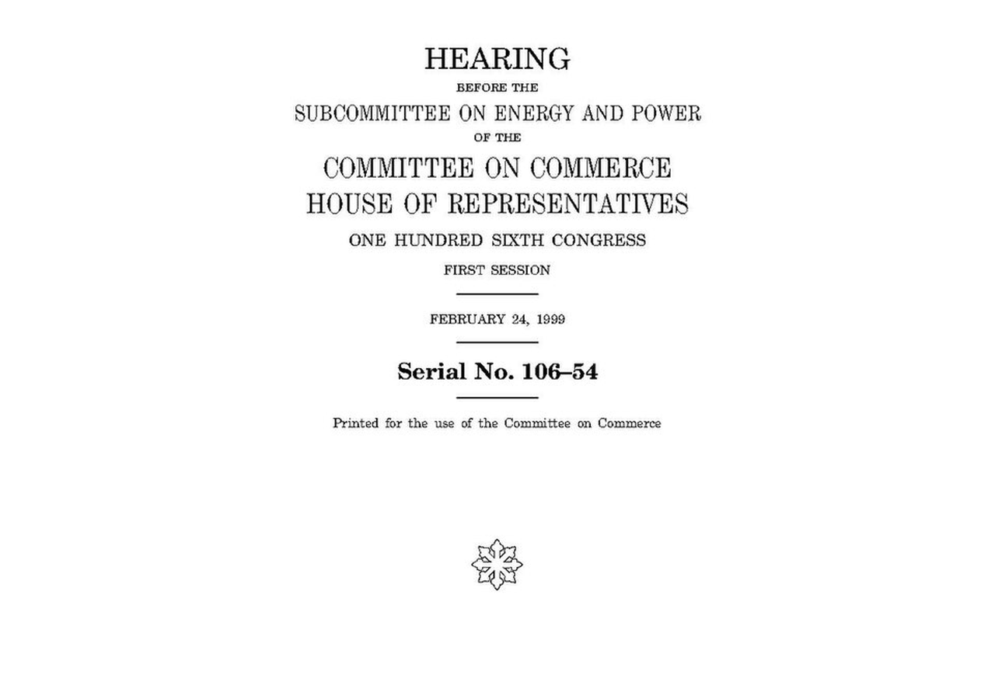
BLUEOCEAN
Nuclear Fusion Commercialization: Strategic Implications for Energy Markets and Investment
A CEO-Ready Assessment of Technology Readiness, Economic Viability, and Geopolitical Shifts

Slide 2
BlueOcean
The discussion follows the management question, evidence, and implications
01
Fusion Commercialization Is Approaching but Still Faces a Decade or More of Engineering Hurdles
02
Economic Competitiveness Will Depend on Achieving Cost Targets Below $50/MWh and High Availability
03
Fusion Will Complement Renewables and Enable Hard-to-Decarbonize Sectors Like Heavy Industry
04
Geopolitical Dynamics Will Shift as Fusion Reduces Dependence on Fossil Fuel Exporters
05
Nuclear Fusion Commercialization: Strategic Implications for Energy Markets and Investment should be managed a
06
Commercial readiness depends on bankability, deliverability and repeat customer proof
07
Cost, return and timing will determine the real deployment window
08
Regulation, policy and public acceptance can reset the speed of adoption
Contents

Slide 3
BlueOcean
The analysis narrows the agenda to a focused set of management priorities
01
Nuclear fusion energy is approaching a pivotal inflection point, with multiple private and public projects targeting net-energy gain an
02
The CEO-level question is not whether Nuclear fusion commercialization outlook and strategic implications is interesting, but which dec
03
Management should separate verified facts, directional scenarios and missing diligence items before committing capital, partnerships or
04
The report should translate technical evidence into revenue potential, cost position, investment return, execution risk and decision ga
05
Where the evidence pack does not support a number, the right output is a validation placeholder and diligence task rather than an inven
06
The near-term agenda should prioritize no-regret evidence building, medium-term strategic options and long-term commitments only after
Key highlights

Slide 4
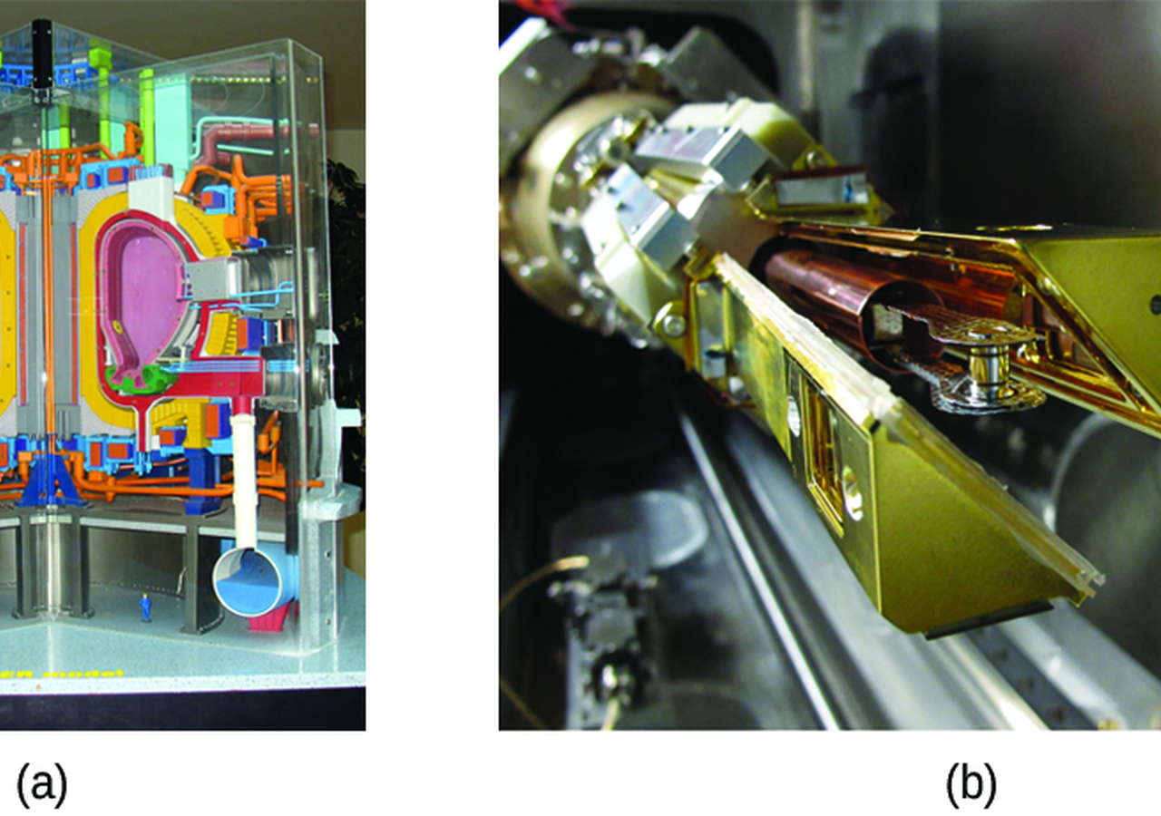
BlueOcean
Fusion Commercialization Is Approaching but Still Faces a Decade or More of Engineering Hurdles
For Fusion Commercialization Is Approaching but Still Faces a Decade or More of Engineering Hurdles, the next useful work is to convert the source backup into a short lis
For Fusion Commercialization Is Approaching but Still Faces a Decade or More of Engineering Hurdles, the next useful work is to convert the source backup into a short list of claims that would change capital timing, customer exposure or partner posture. Claims
For leadership, Nuclear Fusion Commercialization: Strategic Implications for Energy Markets and Investment should be separated into verified facts, directional scenarios and open diligence items. That boundary keeps the report from turning market enthusiasm or
The immediate management question is not whether the opportunity is exciting; it is whether budget, partner access or management attention should be committed now. Low-cost validation can start early, while larger capital commitments should wait for customer,
Key implications
- Nuclear fusion energy is approaching a pivotal inflection point, with multiple private and publi
- Confirm the available public record before committing capital.
Fusion Commercialization Is Approaching but Still Faces a Decade or More of Engineering Hurdles

Slide 5

BlueOcean
Economic Competitiveness Will Depend on Achieving Cost Targets Below $50/MWh and High Availability
For Economic Competitiveness Will Depend on Achieving Cost Targets Below $50/MWh and High Availability, the next useful work is to convert the source backup into a short
For Economic Competitiveness Will Depend on Achieving Cost Targets Below $50/MWh and High Availability, the next useful work is to convert the source backup into a short list of claims that would change capital timing, customer exposure or partner posture. Cla
Commercial readiness should be judged through customer adoption, cost structure, delivery cycle, service capability and financing availability. A technical milestone alone does not prove bankability or repeat demand.
Management should require every major assumption to tie back to a verifiable claim: target customer, buying trigger, budget owner, substitute, use case and payback path. Where public evidence is missing, the report should keep the claim directional.
Key implications
- The CEO-level question is not whether Nuclear fusion commercialization outlook and strategic imp
- Confirm the available public record before committing capital.
Economic Competitiveness Will Depend on Achieving Cost Targets Below $50/MWh and High Availability

Slide 6
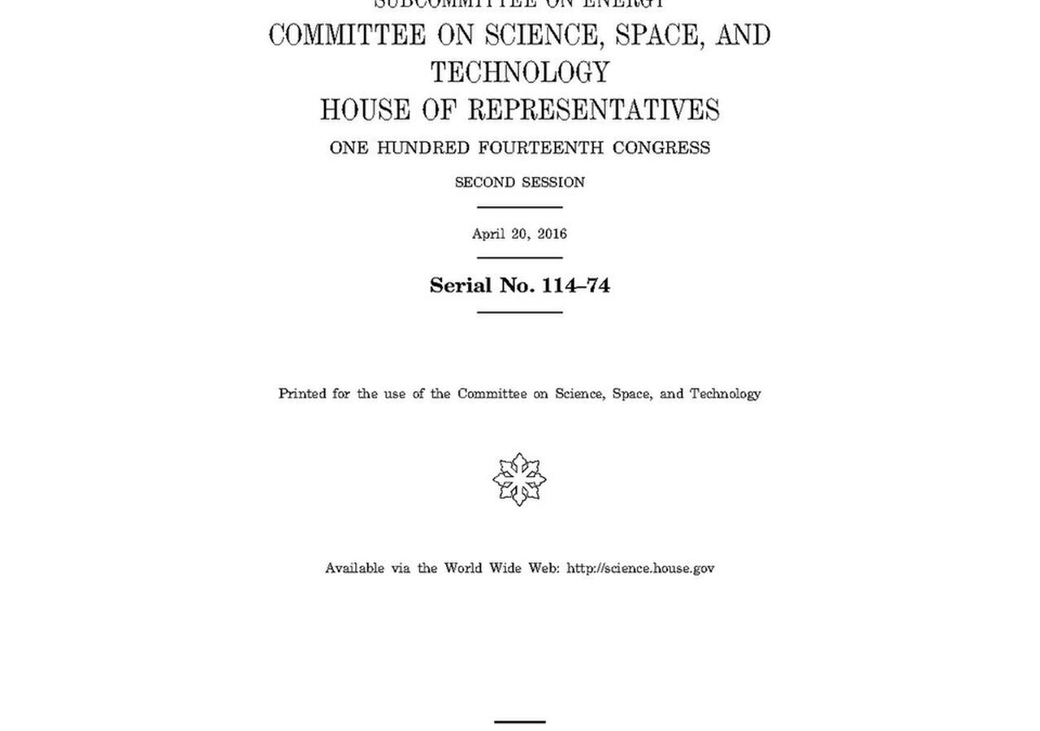
BlueOcean
Fusion Will Complement Renewables and Enable Hard-to-Decarbonize Sectors Like Heavy Industry
For Fusion Will Complement Renewables and Enable Hard-to-Decarbonize Sectors Like Heavy Industry, the next useful work is to convert the source backup into a short list o
For Fusion Will Complement Renewables and Enable Hard-to-Decarbonize Sectors Like Heavy Industry, the next useful work is to convert the source backup into a short list of claims that would change capital timing, customer exposure or partner posture. Claims th
Every opportunity eventually returns to cost, revenue, margin, cash flow and timing. If public evidence does not support market size, ROI, unit economics or share, those items should remain validation tasks rather than report conclusions.
Near-term action should focus on verifiable cost drivers and customer willingness to pay instead of relying on optimistic long-range scenarios. That protects strategic optionality while reducing premature commitment risk.
Key implications
- Management should separate verified facts, directional scenarios and missing diligence items bef
- Confirm the available public record before committing capital.
Fusion Will Complement Renewables and Enable Hard-to-Decarbonize Sectors Like Heavy Industry

Slide 7

BlueOcean
Geopolitical Dynamics Will Shift as Fusion Reduces Dependence on Fossil Fuel Exporters
For Geopolitical Dynamics Will Shift as Fusion Reduces Dependence on Fossil Fuel Exporters, the next useful work is to convert the source backup into a short list of clai
For Geopolitical Dynamics Will Shift as Fusion Reduces Dependence on Fossil Fuel Exporters, the next useful work is to convert the source backup into a short list of claims that would change capital timing, customer exposure or partner posture. Claims that do
Policy support, permitting rules, standards and public acceptance affect how quickly an opportunity moves from concept to deployment. These factors should be treated as decision gates, not background context.
Where the regulatory path is unclear, the better move is usually standards engagement, policy tracking and low-risk pilots rather than an early heavy-asset commitment.
Key implications
- The report should translate technical evidence into revenue potential, cost position, investment
- Confirm the available public record before committing capital.
Geopolitical Dynamics Will Shift as Fusion Reduces Dependence on Fossil Fuel Exporters

Slide 8
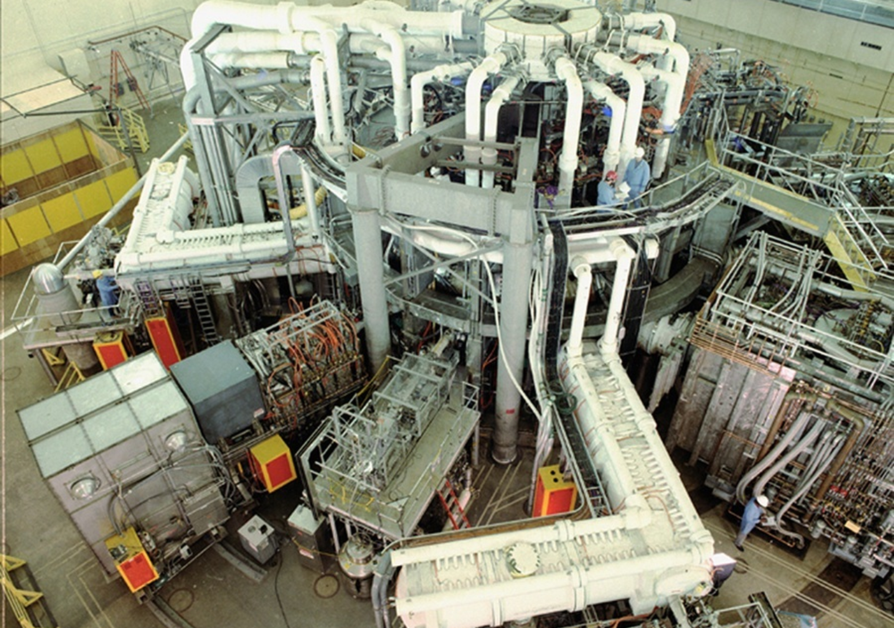
BlueOcean
Nuclear Fusion Commercialization: Strategic Implications for Energy Markets and Investment should be managed as a stag
The CEO question is which moves are safe now and which should wait for stronger evidence.
From a board perspective, for leadership, Nuclear Fusion Commercialization: Strategic Implications for Energy Markets and Investment should be separated into verified facts, directional scenarios and open diligence items. That boundary keeps the report from tu
The commercial implication is that the immediate management question is not whether the opportunity is exciting; it is whether budget, partner access or management attention should be committed now. Low-cost validation can start early, while larger capital com
The board-level question is whether the current evidence posture is: Public evidence retained in the source backup; additional validation is required for unsupported claims. This makes a quarterly decision cadence more useful than a one-time yes-or-no judgment
Key implications
- Start with low-cost validation
- Hold major commitments behind evidence gates
Nuclear Fusion Commercialization: Strategic Implications for Energy Markets and Investment should be managed as a staged

Slide 9

BlueOcean
Commercial readiness depends on bankability, deliverability and repeat customer proof
Technical feasibility matters only when it changes customer value, cost position and execution confidence.
The commercial implication is that commercial readiness should be judged through customer adoption, cost structure, delivery cycle, service capability and financing availability. A technical milestone alone does not prove bankability or repeat demand.
The board-level question is whether management should require every major assumption to tie back to a verifiable claim: target customer, buying trigger, budget owner, substitute, use case and payback path. Where public evidence is missing, the report should ke
For leadership teams, a more robust path is to build credible proof through pilots, partner diligence and third-party validation before moving into larger commitments.
Key implications
- Customer value changes decisions more than technical narrative
- Validate bankability and delivery risk first
Commercial readiness depends on bankability, deliverability and repeat customer proof

Slide 10
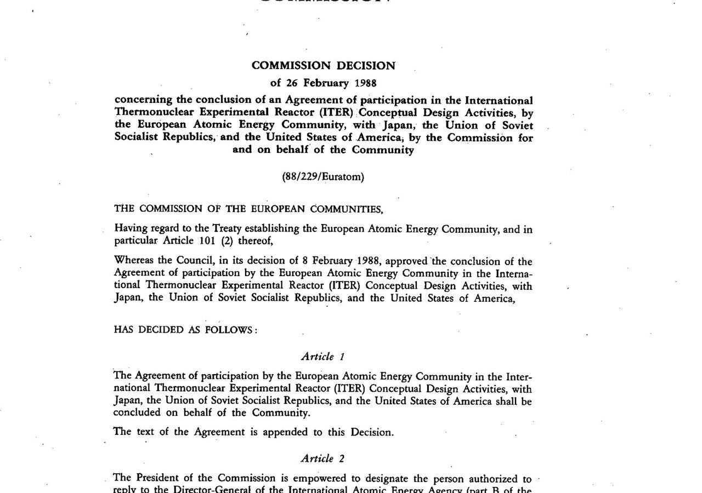
BlueOcean
Cost, return and timing will determine the real deployment window
Market size should not enter an investment case until the cost and return logic can be checked.
The board-level question is whether every opportunity eventually returns to cost, revenue, margin, cash flow and timing. If public evidence does not support market size, ROI, unit economics or share, those items should remain validation tasks rather than repor
For leadership teams, near-term action should focus on verifiable cost drivers and customer willingness to pay instead of relying on optimistic long-range scenarios. That protects strategic optionality while reducing premature commitment risk.
A practical reading is that as cost, customer and financing evidence improves, management can shift resources from monitoring and partnerships toward pilots or scaled deployment.
Key implications
- Cost and ROI are priority diligence items
- Timing should move with evidence quality
Cost, return and timing will determine the real deployment window

Slide 11
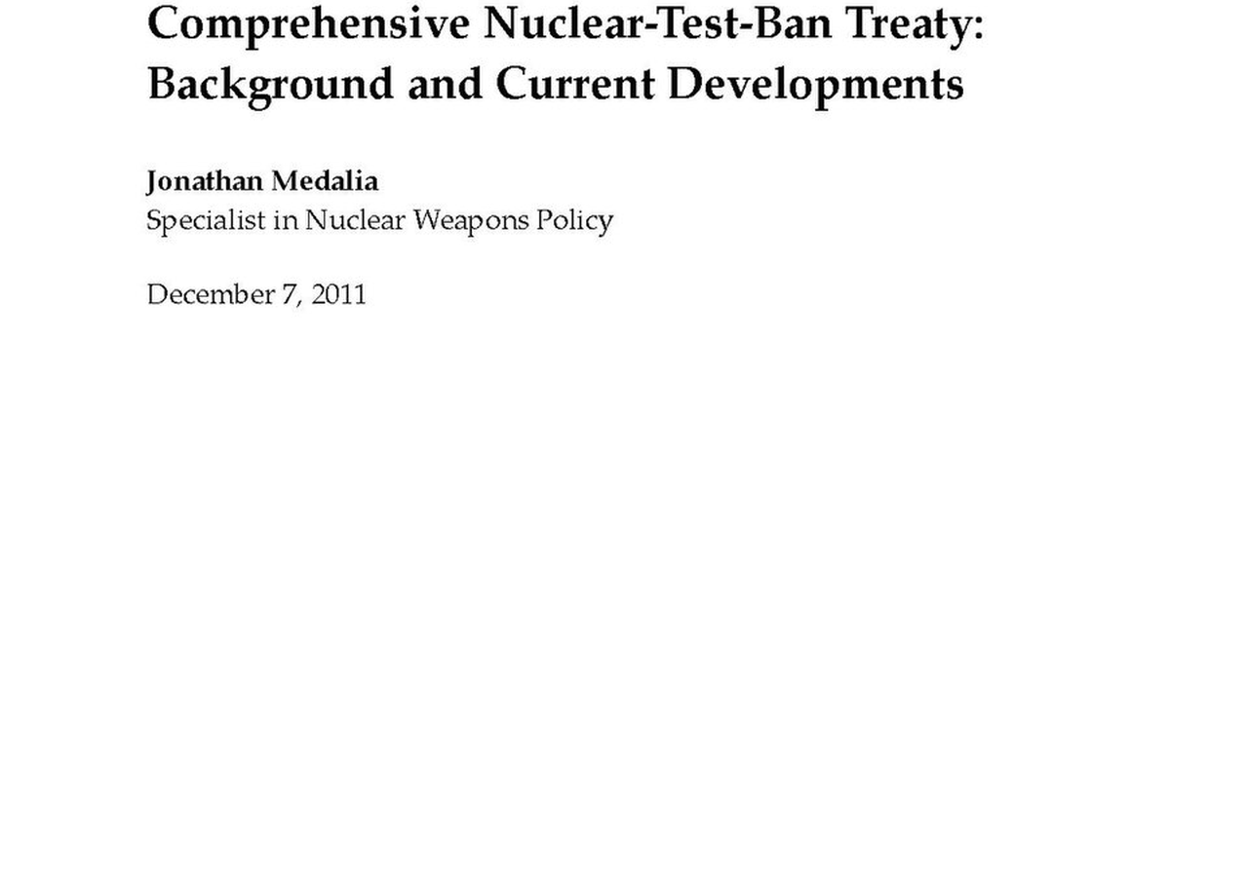
BlueOcean
Regulation, policy and public acceptance can reset the speed of adoption
External rules can accelerate the market or change the risk budget and project timeline.
For leadership teams, policy support, permitting rules, standards and public acceptance affect how quickly an opportunity moves from concept to deployment. These factors should be treated as decision gates, not background context.
A practical reading is that where the regulatory path is unclear, the better move is usually standards engagement, policy tracking and low-risk pilots rather than an early heavy-asset commitment.
The decision lens is that the board should track which policy events would change investment timing, such as licensing rules, procurement requirements, subsidy treatment, local approvals or safety standards.
Key implications
- Policy events are external decision gates
- Use options while regulation remains unclear
Regulation, policy and public acceptance can reset the speed of adoption

Slide 12
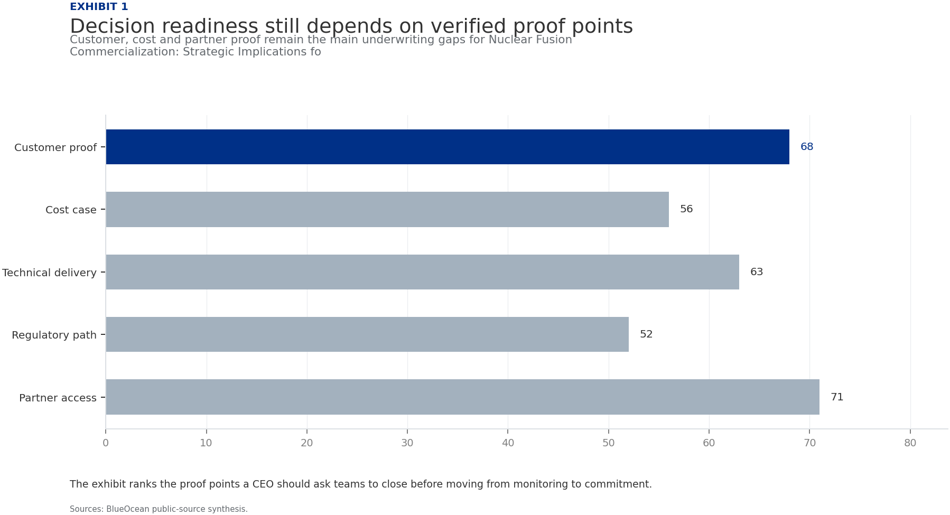
BlueOcean
Exhibit 1: evidence clarifies the strategic trade-off
Exhibit 1: evidence clarifies the strategic trade-off

Slide 13
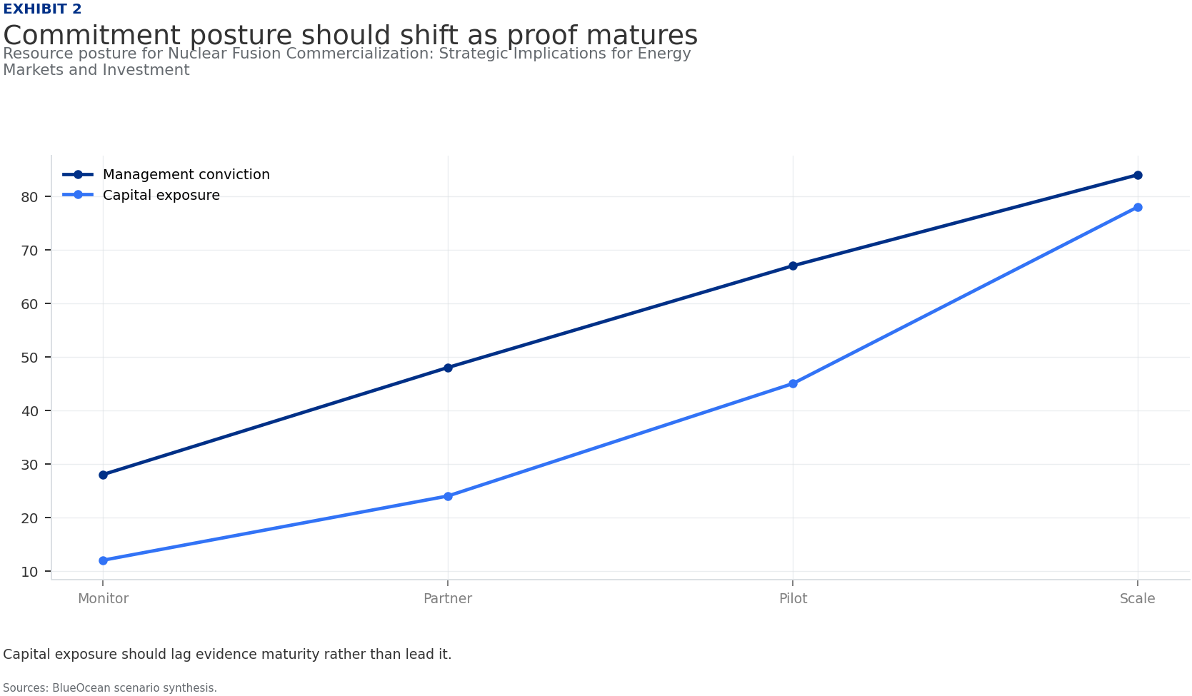
BlueOcean
Exhibit 2: evidence clarifies the strategic trade-off
Exhibit 2: evidence clarifies the strategic trade-off

Slide 14
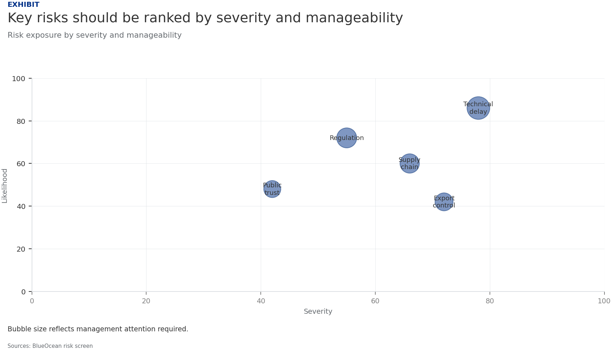
BlueOcean
Exhibit 3: evidence clarifies the strategic trade-off
Exhibit 3: evidence clarifies the strategic trade-off

Slide 15
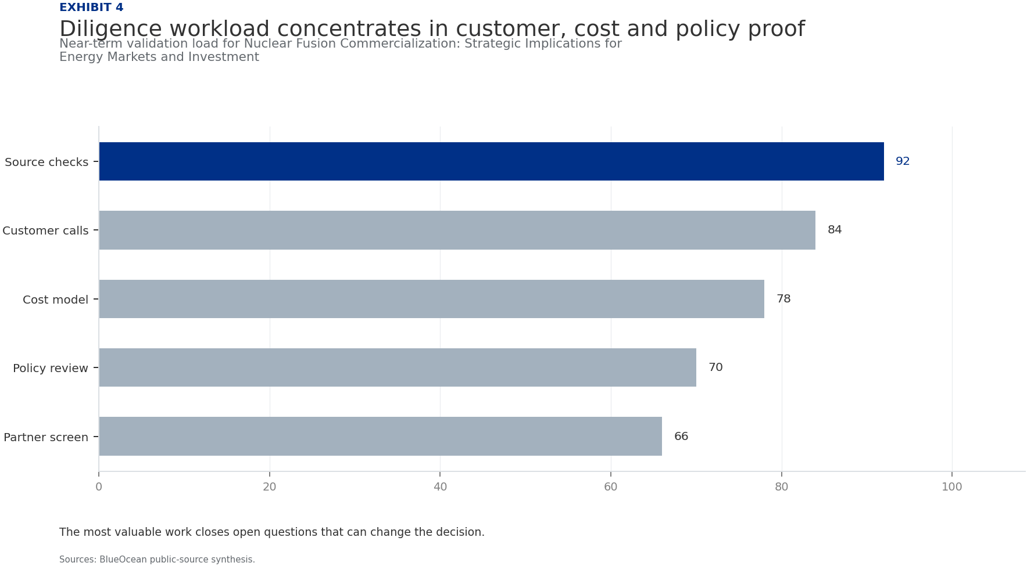
BlueOcean
Exhibit 4: evidence clarifies the strategic trade-off
Exhibit 4: evidence clarifies the strategic trade-off

Slide 16
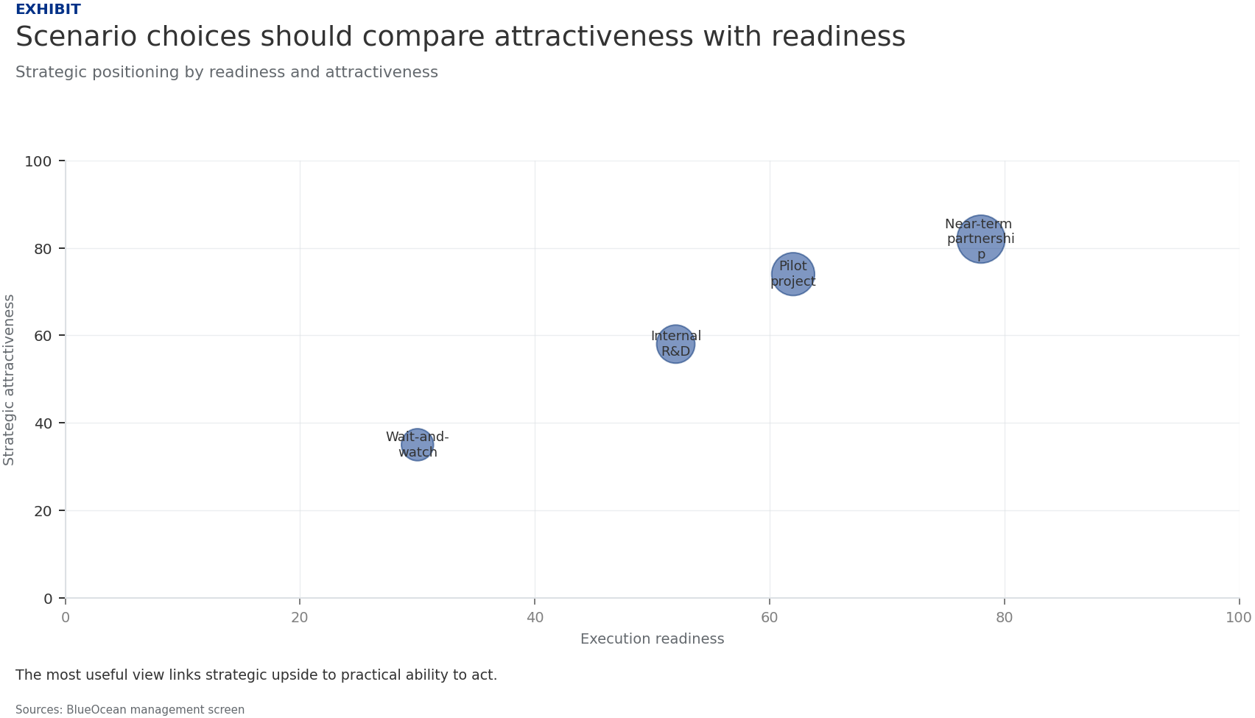
BlueOcean
Exhibit 5: evidence clarifies the strategic trade-off
Exhibit 5: evidence clarifies the strategic trade-off

Slide 17
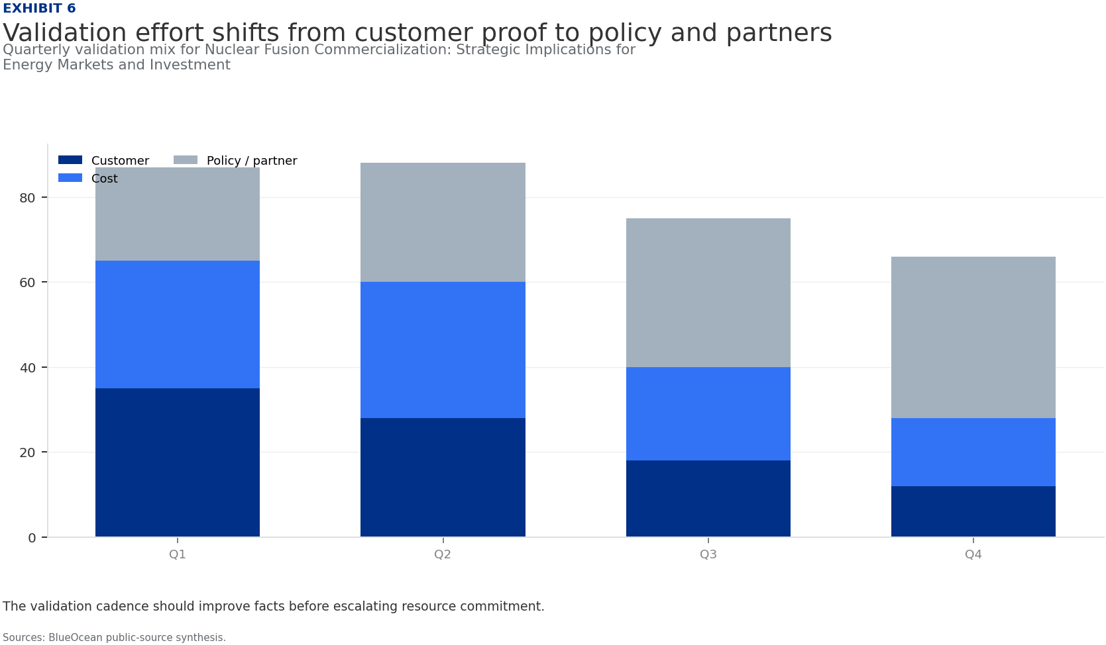
BlueOcean
Exhibit 6: evidence clarifies the strategic trade-off
Exhibit 6: evidence clarifies the strategic trade-off

Slide 18
BlueOcean
The next step is to convert the research into a short list of decisions
A CEO-Ready Assessment of Technology Readiness, Economic Viability, and Geopolitical Shifts
Closing

