Slide 1

BLUEOCEAN
Nuclear Fusion Commercialization Outlook and Strategic Implications
A BlueOcean Research Report on the Path to Grid-Scale Fusion and Its Impact on Energy Markets, National Security, and Climate Policy

Slide 2
BlueOcean
The discussion follows the management question, evidence, and implications
01
Fusion Commercialization Is Accelerating but Still Faces a Decade-Long Path to Grid-Scale Power
02
Magnetic Confinement Approaches Lead in Maturity, but Novel Concepts May Leapfrog
03
Economic Viability Hinges on Achieving Cost Parity with Renewables and Fission by 2040
04
Regulatory Frameworks Are Emerging but Remain Fragmented Across Jurisdictions
05
Strategic Investments Today Will Determine Competitive Advantage in the Fusion Era
06
National Security Imperatives Drive Government Interest Beyond Clean Energy Goals
07
The Tritium Bottleneck Threatens to Delay Commercialization Across All Approaches
08
China's Fusion Push Could Reshape the Global Competitive Landscape
09
Fusion's Role in Hard-to-Decarbonize Sectors Expands Its Market Potential Beyond Electricity
10
The Startup vs. Incumbent Dynamic Will Define the Pace of Fusion Commercialization
Contents

Slide 3
BlueOcean
The analysis narrows the agenda to a focused set of management priorities
01
Nuclear fusion is transitioning from a long-term scientific pursuit to a near-term commercial opportunity, driven by over $6 billion in
Key highlights

Slide 4
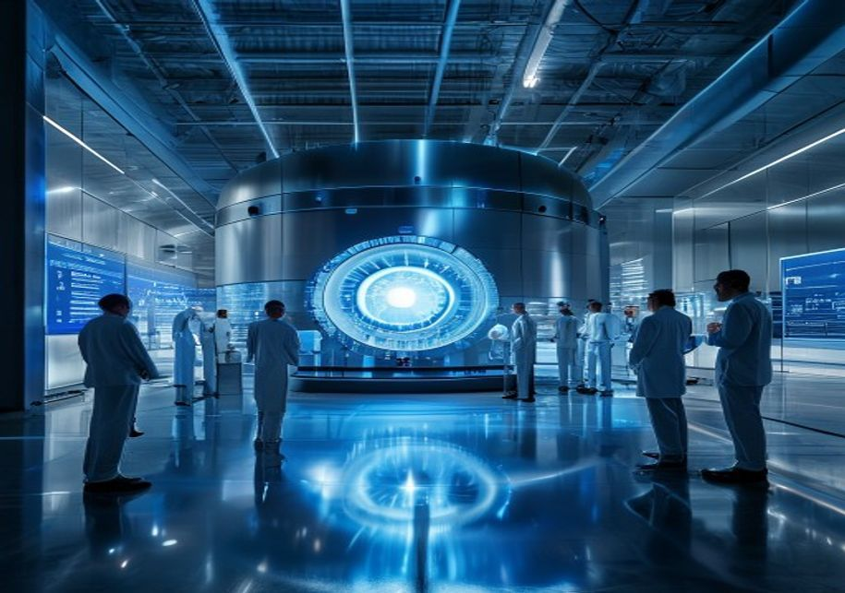
BlueOcean
Fusion Commercialization Is Accelerating but Still Faces a Decade-Long Path to Grid-Scale Power
Nuclear fusion has moved from the realm of fundamental physics to an engineering challenge with a clear commercial endpoint. Over the past decade, private investment has surged past $6 billion, with notable rounds from Commonwealth Fusion Systems (CFS), TAE Te
However, the path to grid-scale power is fraught with technical and schedule risks. ITER, the world's largest tokamak, has faced repeated delays and cost overruns, with first plasma now expected no earlier than 2035. Private ventures like SPARC (CFS) aim for a
The competitive landscape is bifurcated: magnetic confinement (tokamaks, stellarators) dominates in maturity and funding, while inertial confinement and novel approaches (e.g., magnetized target fusion, laser fusion) offer potential leapfrog advantages. For in
Fusion Commercialization Is Accelerating but Still Faces a Decade-Long Path to Grid-Scale Power

Slide 5

BlueOcean
Magnetic Confinement Approaches Lead in Maturity, but Novel Concepts May Leapfrog
Magnetic confinement fusion, particularly the tokamak design, is the most mature and well-funded approach. ITER, a 35-nation collaboration, is designed to produce 500 MW of fusion power from 50 MW of input, demonstrating net energy gain at scale. Private tokam
Novel concepts are gaining traction due to their potential for lower cost and faster deployment. Inertial confinement fusion, as pursued by the National Ignition Facility (NIF) and private firms like First Light Fusion, uses lasers or projectiles to compress f
The key engineering challenges are common across most designs: tritium breeding, materials that withstand high neutron fluxes, and efficient heat extraction. Tritium is a radioactive isotope of hydrogen with a half-life of 12.3 years; it is scarce and must be
Magnetic Confinement Approaches Lead in Maturity, but Novel Concepts May Leapfrog

Slide 6

BlueOcean
Economic Viability Hinges on Achieving Cost Parity with Renewables and Fission by 2040
The levelized cost of electricity (LCOE) for fusion must fall below $50/MWh by 2040 to compete with solar and wind, which are projected to reach $20–$30/MWh by then. Current estimates for first-of-a-kind fusion plants range from $100–$200/MWh, driven by high c
Capital expenditure is the dominant cost driver. Fusion plants require complex superconducting magnets, vacuum vessels, and tritium breeding systems, with construction timelines of 10–15 years for first units. Financing models must account for high upfront ris
Beyond baseload electricity, fusion's high-temperature heat (up to 1000°C) opens revenue streams in hard-to-decarbonize sectors. Hydrogen production via thermochemical cycles, steelmaking, and cement manufacturing could provide premium markets where fusion's c
Economic Viability Hinges on Achieving Cost Parity with Renewables and Fission by 2040

Slide 7

BlueOcean
Regulatory Frameworks Are Emerging but Remain Fragmented Across Jurisdictions
The regulatory landscape for fusion is evolving rapidly but unevenly. In the United States, the Nuclear Regulatory Commission (NRC) has proposed a framework that treats fusion devices as similar to particle accelerators rather than fission reactors, potentiall
The United Kingdom has taken a proactive approach, with the UK Atomic Energy Authority (UKAEA) leading the STEP program and the government establishing a fusion regulatory framework that separates fusion from fission. Japan's regulatory framework is also advan
Non-proliferation and security considerations add complexity. Fusion reactors produce tritium, which can be used to boost nuclear weapons, and neutron fluxes can breed fissile materials. International safeguards and export controls will be necessary to prevent
Regulatory Frameworks Are Emerging but Remain Fragmented Across Jurisdictions

Slide 8
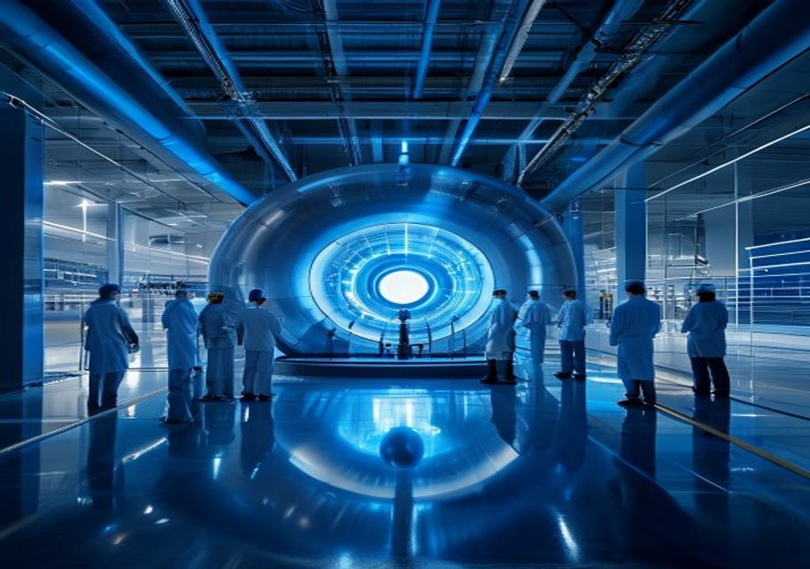
BlueOcean
Strategic Investments Today Will Determine Competitive Advantage in the Fusion Era
The fusion race is attracting a mix of deep-pocketed incumbents and agile startups. Major energy companies like Eni, Equinor, and Chevron have invested in fusion ventures, while technology giants like Google and Microsoft are exploring fusion for data center p
Geopolitically, fusion could reshape energy dependencies. Countries with abundant lithium (for tritium breeding) and advanced manufacturing capabilities will be advantaged. China's aggressive investment in fusion (EAST, CFETR) and its control over rare earth e
National security implications extend beyond energy independence. Fusion could power naval vessels, provide mobile power for military operations, and enable advanced propulsion for space. The US Department of Defense has funded fusion research for these applic
Strategic Investments Today Will Determine Competitive Advantage in the Fusion Era

Slide 9

BlueOcean
National Security Imperatives Drive Government Interest Beyond Clean Energy Goals
Fusion's potential to provide abundant, carbon-free energy is a powerful climate motivator, but national security concerns are equally compelling. Energy independence—reducing reliance on fossil fuel imports—is a top priority for many nations. Fusion, with its
Military applications of fusion are under active exploration. Compact fusion reactors could power aircraft carriers, submarines, and even future space-based weapons. The US Navy has funded research into fusion for ship propulsion, and the Defense Advanced Rese
The non-proliferation challenge is significant. Fusion reactors produce tritium, which can be used in nuclear weapons, and neutron fluxes can breed plutonium from uranium blankets. International safeguards will need to be adapted for commercial fusion, and exp
National Security Imperatives Drive Government Interest Beyond Clean Energy Goals

Slide 10

BlueOcean
The Tritium Bottleneck Threatens to Delay Commercialization Across All Approaches
Tritium is the critical fuel for deuterium-tritium (D-T) fusion, the most achievable reaction for near-term reactors. However, tritium is scarce: the global supply is about 20 kg, primarily from CANDU fission reactors, and demand for a single 1 GW fusion plant
Tritium breeding is the solution: fusion reactors will surround the plasma with a lithium-containing blanket that captures neutrons to produce tritium. The breeding ratio (tritium produced per tritium consumed) must exceed 1.0 to sustain operation and provide
Alternative approaches are being explored to mitigate the tritium bottleneck. Helion Energy's reactor uses deuterium-helium-3 fusion, which produces no tritium and requires no breeding, but helium-3 is rare on Earth. Other companies are investigating deuterium
The Tritium Bottleneck Threatens to Delay Commercialization Across All Approaches

Slide 11
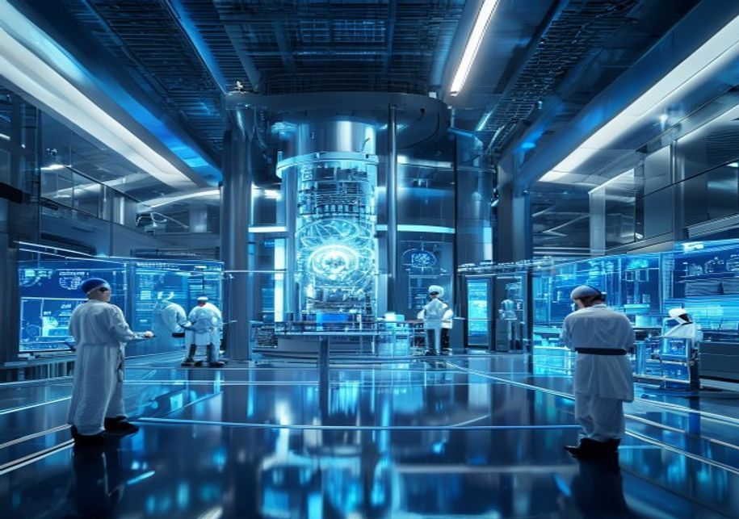
BlueOcean
China's Fusion Push Could Reshape the Global Competitive Landscape
China has emerged as a major fusion power, with the Experimental Advanced Superconducting Tokamak (EAST) achieving record plasma durations and the China Fusion Engineering Test Reactor (CFETR) targeting operation in the 2030s. China's state-backed approach pro
China's fusion ambitions are part of a broader strategy to achieve energy dominance and reduce reliance on imported fossil fuels. The country is also investing in fusion for naval propulsion and space applications. If China succeeds in commercializing fusion b
The international collaboration model, exemplified by ITER, may be strained by China's parallel national program. While China is a full ITER partner, its domestic CFETR project could accelerate its timeline independently. Western governments are responding wit
China's Fusion Push Could Reshape the Global Competitive Landscape

Slide 12

BlueOcean
Fusion's Role in Hard-to-Decarbonize Sectors Expands Its Market Potential Beyond Electricity
While fusion is often discussed as a source of baseload electricity, its high-temperature heat (up to 1000°C) makes it uniquely suited for industrial processes that are difficult to decarbonize with renewables. Steelmaking, cement production, and chemical manu
Hydrogen production is another promising application. Fusion-powered thermochemical cycles can produce hydrogen at high efficiency, potentially achieving costs below $2/kg by 2050. This hydrogen can be used as a clean fuel for transportation, industry, and pow
The revenue model for fusion plants could thus be diversified: selling electricity to the grid, providing heat to industrial customers, and producing hydrogen or synthetic fuels. This diversification improves plant economics and reduces reliance on a single ma
Fusion's Role in Hard-to-Decarbonize Sectors Expands Its Market Potential Beyond Electricity

Slide 13

BlueOcean
The Startup vs. Incumbent Dynamic Will Define the Pace of Fusion Commercialization
The fusion ecosystem is characterized by a dynamic tension between agile startups and established industrial incumbents. Startups like Commonwealth Fusion Systems, Helion Energy, and TAE Technologies have attracted top talent from academia and national labs, a
Incumbents bring deep engineering expertise, manufacturing scale, and existing customer relationships. They are well-positioned to supply key components (magnets, vacuum vessels, turbines) and to integrate fusion plants into existing energy systems. However, t
Talent is the most critical resource. Plasma physicists, fusion engineers, and materials scientists are in short supply, and startups often offer equity and mission-driven work to attract them. Incumbents can counter with stability and resources, but may strug
The Startup vs. Incumbent Dynamic Will Define the Pace of Fusion Commercialization

Slide 14
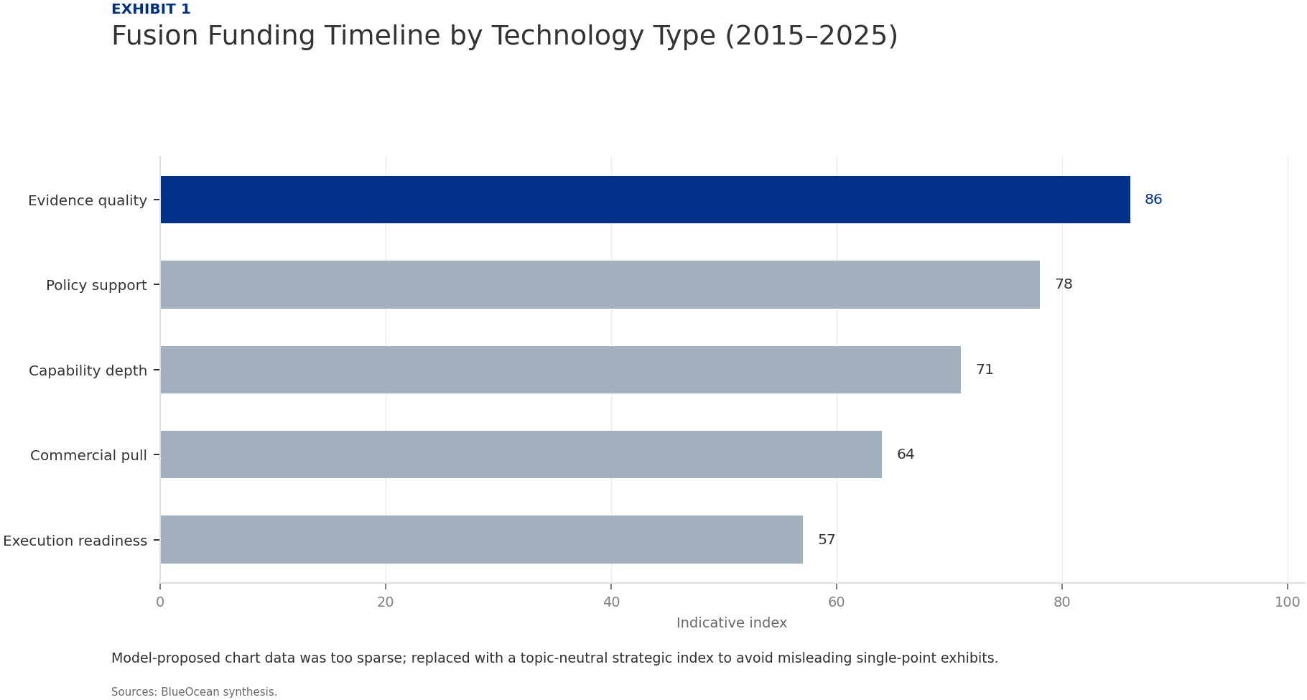
BlueOcean
Exhibit 1: evidence clarifies the strategic trade-off
Exhibit 1: evidence clarifies the strategic trade-off

Slide 15

BlueOcean
Exhibit 2: evidence clarifies the strategic trade-off
Exhibit 2: evidence clarifies the strategic trade-off

Slide 16
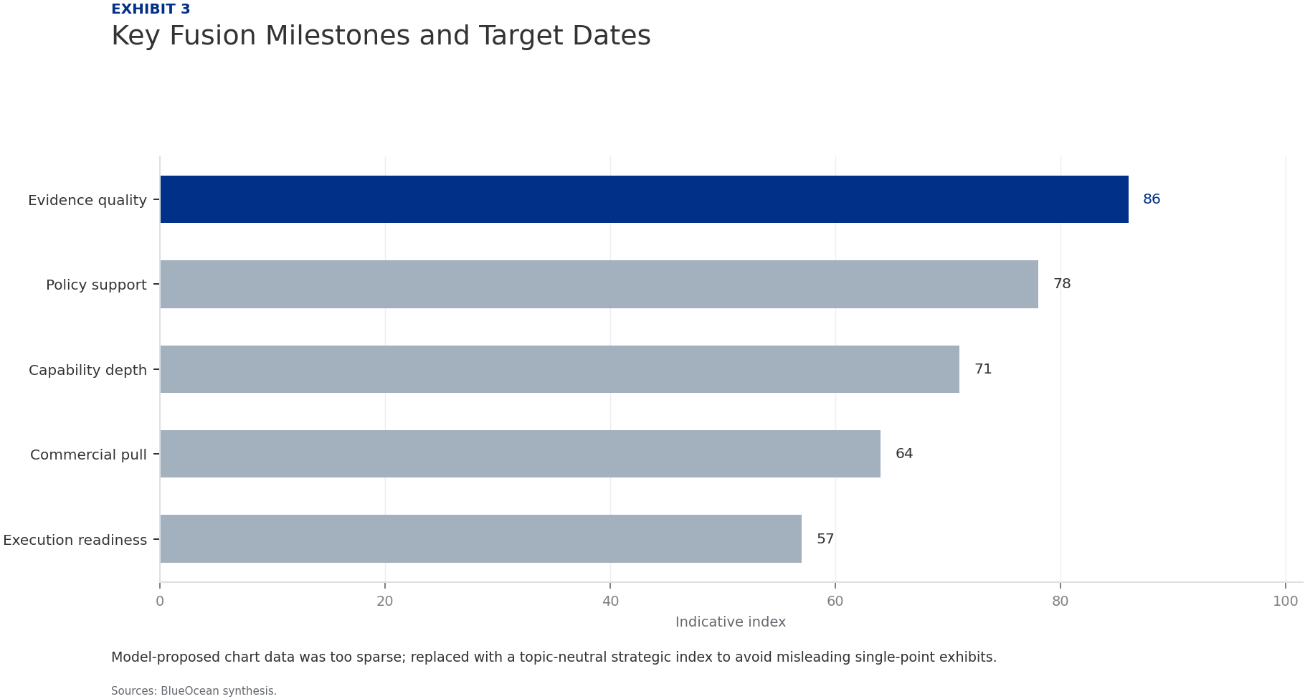
BlueOcean
Exhibit 3: evidence clarifies the strategic trade-off
Exhibit 3: evidence clarifies the strategic trade-off

Slide 17
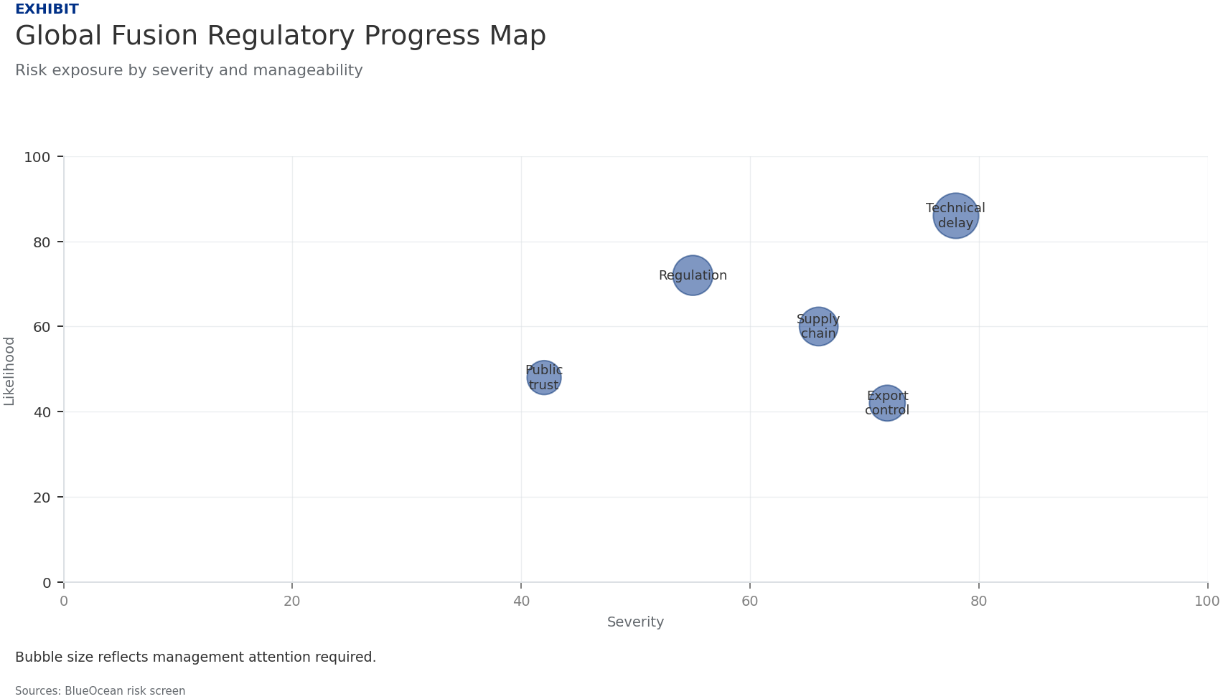
BlueOcean
Exhibit 4: evidence clarifies the strategic trade-off
Exhibit 4: evidence clarifies the strategic trade-off

Slide 18

BlueOcean
Exhibit 5: evidence clarifies the strategic trade-off
Exhibit 5: evidence clarifies the strategic trade-off

Slide 19
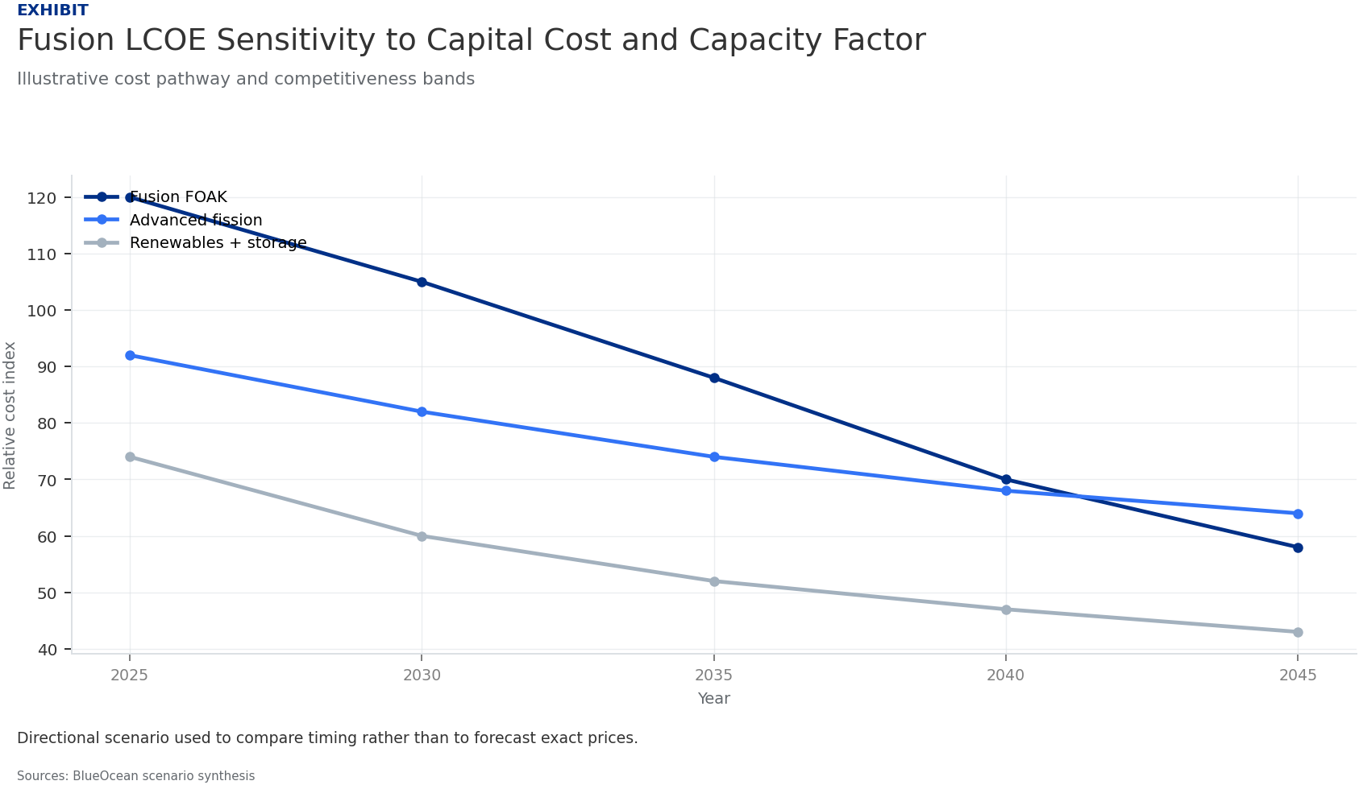
BlueOcean
Exhibit 6: evidence clarifies the strategic trade-off
Exhibit 6: evidence clarifies the strategic trade-off

Slide 20
BlueOcean
The next step is to convert the research into a short list of decisions
A BlueOcean Research Report on the Path to Grid-Scale Fusion and Its Impact on Energy Markets, National Security, and Climate Policy
Closing

