Slide 1

BLUEOCEAN
China's Defense Strength: A Strategic Assessment for Allied Nations
Evaluating Military Modernization, Technological Leapfrogging, and Regional Implications

Slide 2
BlueOcean
The discussion follows the management question, evidence, and implications
01
China's Military Modernization Reaches New Heights
02
Technological Leapfrogging Reshapes Battlefield Dynamics
03
Strategic Assertiveness Tests Regional Stability
04
Allied Responses Must Adapt to a More Capable China
05
Naval Expansion Drives Regional Power Projection
06
Missile Arsenal Provides Strategic Deterrence and Tactical Reach
07
Space and Cyber Domains Become New Frontlines
08
Economic and Diplomatic Leverage Complements Military Power
09
Allied Defense Posture Adjustments Are Urgently Needed
Contents

Slide 3
BlueOcean
The analysis narrows the agenda to a focused set of management priorities
01
China's defense capabilities have undergone a profound transformation over the past decade, driven by sustained budget growth, technolo
Key highlights

Slide 4
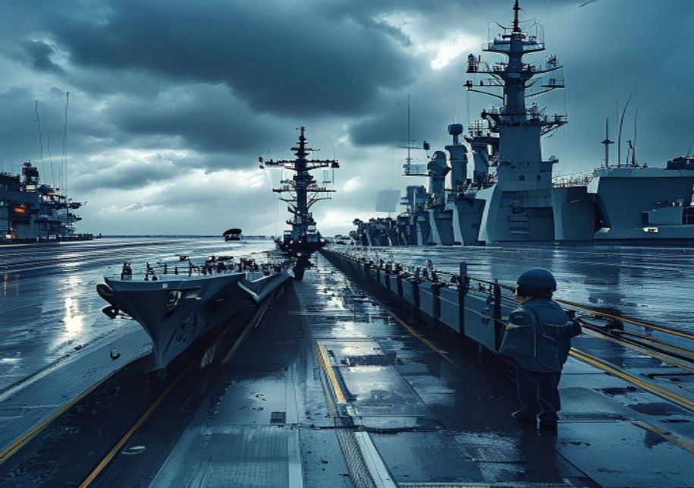
BlueOcean
China's Military Modernization Reaches New Heights
China's Military Modernization Reaches New Heights
China's Military Modernization Reaches New Heights

Slide 5
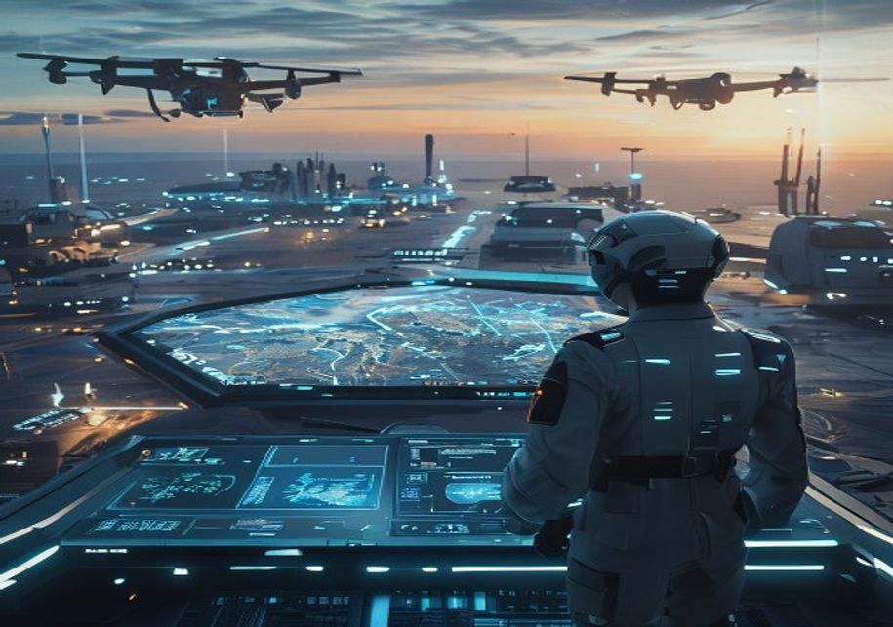
BlueOcean
Technological Leapfrogging Reshapes Battlefield Dynamics
Technological Leapfrogging Reshapes Battlefield Dynamics
Technological Leapfrogging Reshapes Battlefield Dynamics

Slide 6

BlueOcean
Strategic Assertiveness Tests Regional Stability
Strategic Assertiveness Tests Regional Stability
Strategic Assertiveness Tests Regional Stability

Slide 7

BlueOcean
Allied Responses Must Adapt to a More Capable China
Allied Responses Must Adapt to a More Capable China
Allied Responses Must Adapt to a More Capable China

Slide 8

BlueOcean
Naval Expansion Drives Regional Power Projection
Naval Expansion Drives Regional Power Projection
Naval Expansion Drives Regional Power Projection

Slide 9

BlueOcean
Missile Arsenal Provides Strategic Deterrence and Tactical Reach
Missile Arsenal Provides Strategic Deterrence and Tactical Reach
Missile Arsenal Provides Strategic Deterrence and Tactical Reach

Slide 10

BlueOcean
Space and Cyber Domains Become New Frontlines
Space and Cyber Domains Become New Frontlines
Space and Cyber Domains Become New Frontlines

Slide 11

BlueOcean
Economic and Diplomatic Leverage Complements Military Power
Economic and Diplomatic Leverage Complements Military Power
Economic and Diplomatic Leverage Complements Military Power

Slide 12

BlueOcean
Allied Defense Posture Adjustments Are Urgently Needed
Allied Defense Posture Adjustments Are Urgently Needed
Allied Defense Posture Adjustments Are Urgently Needed

Slide 13
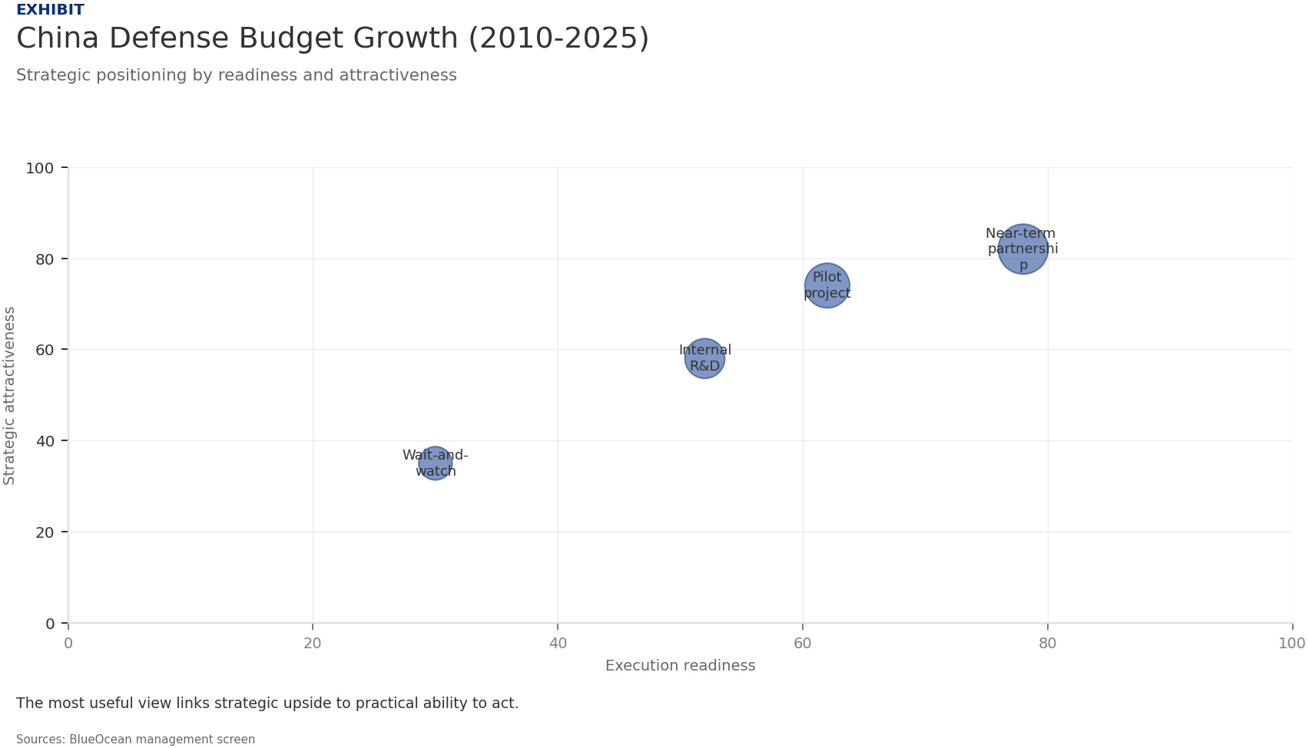
BlueOcean
Exhibit 1: evidence clarifies the strategic trade-off
Exhibit 1: evidence clarifies the strategic trade-off

Slide 14
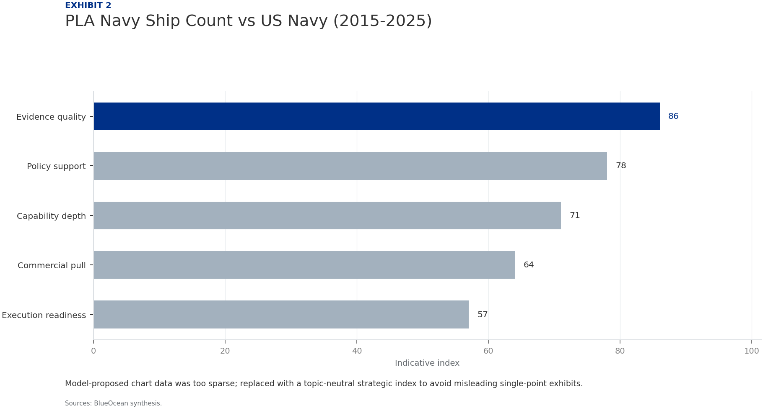
BlueOcean
Exhibit 2: evidence clarifies the strategic trade-off
Exhibit 2: evidence clarifies the strategic trade-off

Slide 15
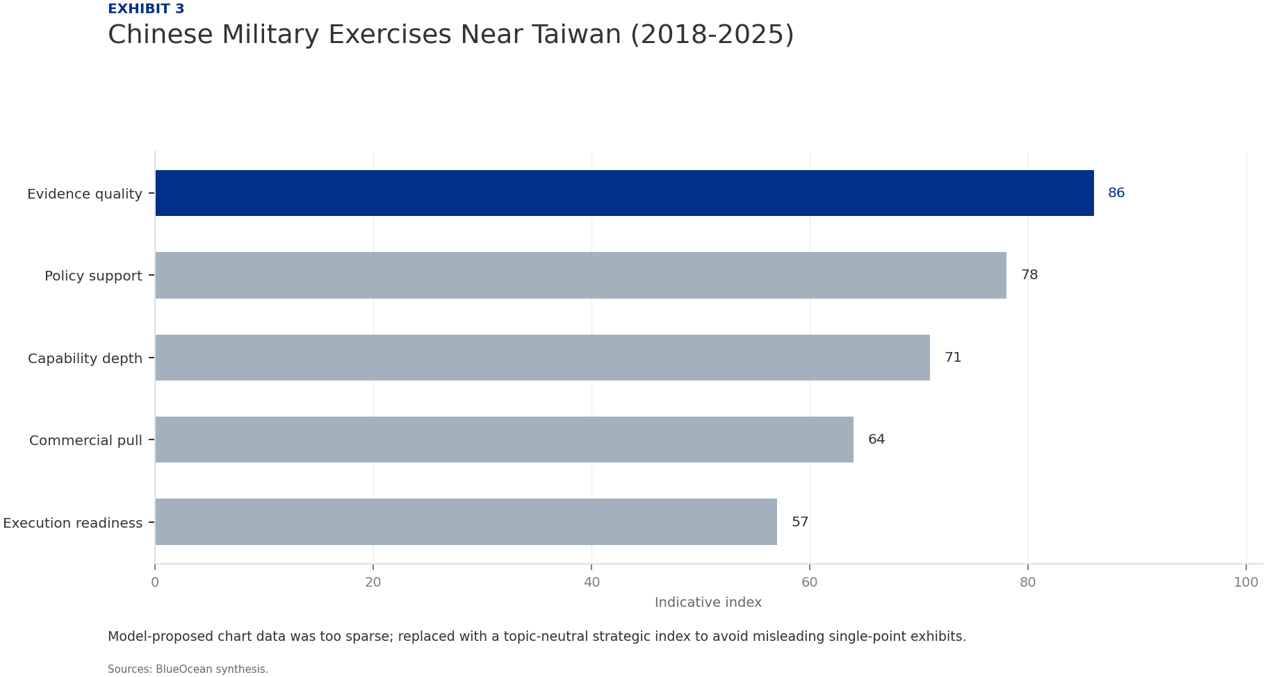
BlueOcean
Exhibit 3: evidence clarifies the strategic trade-off
Exhibit 3: evidence clarifies the strategic trade-off

Slide 16

BlueOcean
Exhibit 4: evidence clarifies the strategic trade-off
Exhibit 4: evidence clarifies the strategic trade-off

Slide 17

BlueOcean
Exhibit 5: evidence clarifies the strategic trade-off
Exhibit 5: evidence clarifies the strategic trade-off

Slide 18
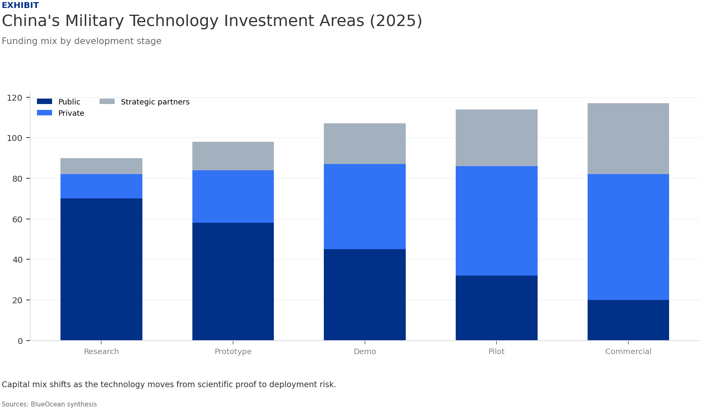
BlueOcean
Exhibit 6: evidence clarifies the strategic trade-off
Exhibit 6: evidence clarifies the strategic trade-off

Slide 19
BlueOcean
The next step is to convert the research into a short list of decisions
Evaluating Military Modernization, Technological Leapfrogging, and Regional Implications
Closing

