Slide 1

BLUEOCEAN
Strategic Assessment of Nuclear Fusion Technology: Navigating the Path to Commercial Energy
A BlueOcean Research Report for Senior Executives and Strategic Planners

Slide 2
BlueOcean
The discussion follows the management question, evidence, and implications
01
Nuclear Fusion Is Approaching Technical Feasibility but Commercial Viability Remains a Decade or More Away
02
Public and Private Fusion Projects Are Accelerating with Significant Funding and Milestones
03
Fusion Faces Stiff Competition from Rapidly Improving Renewables and Storage Technologies
04
Key Technical Hurdles Include Plasma Confinement, Materials, and Tritium Breeding
05
Strategic Entry Should Focus on Near-Term Partnerships and Monitoring Key Milestones
06
Regulatory and Public Acceptance Challenges Could Delay Fusion Deployment
07
Geopolitical Risks Include Supply Chain Dependencies and Export Controls
08
Recommended Next Steps: Engage with Leading Private Fusion Firms and Assess Internal R&D Capabilities
09
Fusion's Hype Cycle: Managing Expectations vs. Real Progress
10
The Tritium Bottleneck: Why Fuel Supply Is a Critical Risk
Contents

Slide 3
BlueOcean
The analysis narrows the agenda to a focused set of management priorities
01
Nuclear fusion is approaching technical feasibility after decades of research, with multiple public and private projects targeting net
Key highlights

Slide 4
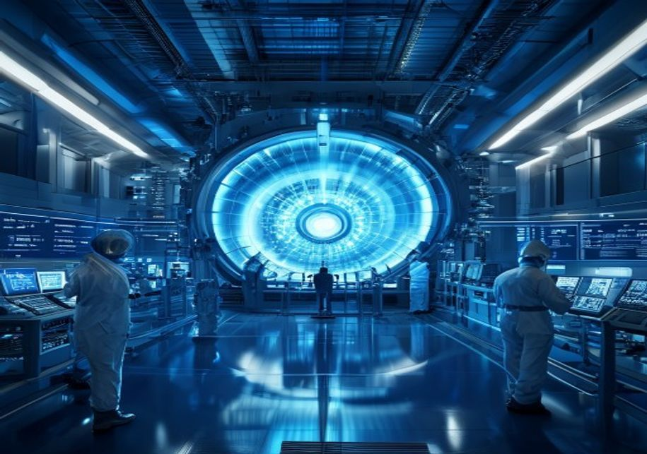
BlueOcean
Nuclear Fusion Is Approaching Technical Feasibility but Commercial Viability Remains a Decade or More Away
Nuclear fusion has long been considered the holy grail of clean energy, promising near-limitless power with minimal waste. After decades of incremental progress, the field has entered a new era of accelerated development, driven by both public megaprojects and
The technical challenges are formidable. Sustaining a plasma at temperatures exceeding 150 million degrees Celsius while maintaining stability and confinement requires advances in superconducting magnets, plasma control, and materials that can withstand extrem
Despite these hurdles, the pace of progress has accelerated. In 2022, the National Ignition Facility achieved net energy gain in a laboratory setting for the first time, validating the physics of inertial confinement. Private companies have raised over $5 bill
Nuclear Fusion Is Approaching Technical Feasibility but Commercial Viability Remains a Decade or More Away

Slide 5

BlueOcean
Public and Private Fusion Projects Are Accelerating with Significant Funding and Milestones
The fusion landscape is characterized by a dynamic interplay between large public projects and agile private ventures. ITER, the $22 billion international tokamak under construction in France, remains the flagship of public fusion research. Despite repeated de
Private fusion companies have emerged as a disruptive force, attracting over $5 billion in investment since 2020. Commonwealth Fusion Systems, a spinout from MIT, is developing SPARC, a compact tokamak using high-temperature superconducting magnets. SPARC is d
Government policies are also evolving to support fusion. The US Department of Energy launched the Bold Decadal Vision for Fusion Energy in 2022, aiming to accelerate the development of a pilot plant by the 2030s. The UK has committed £650 million to the STEP p
Public and Private Fusion Projects Are Accelerating with Significant Funding and Milestones

Slide 6
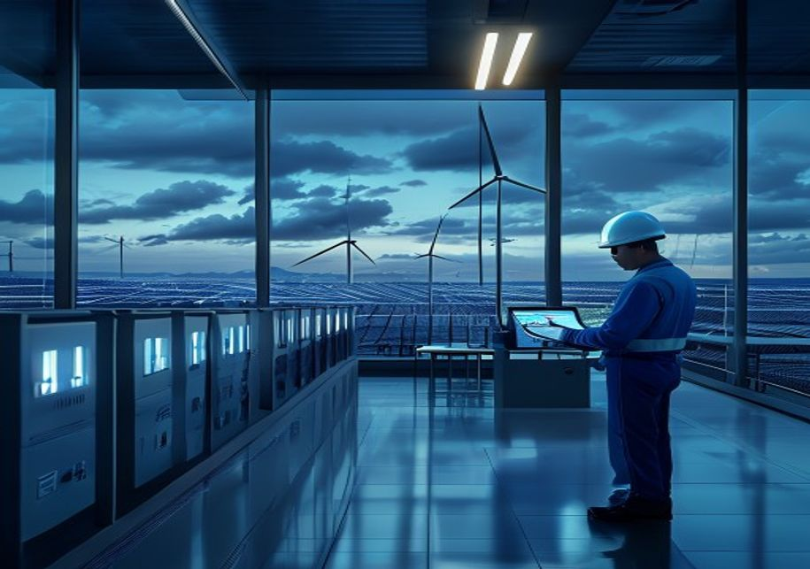
BlueOcean
Fusion Faces Stiff Competition from Rapidly Improving Renewables and Storage Technologies
While fusion offers the promise of baseload clean power, it must compete with a rapidly evolving energy landscape. Solar and wind energy have seen dramatic cost declines over the past decade, with levelized cost of electricity (LCOE) for utility-scale solar fa
Advanced fission technologies, including small modular reactors (SMRs) and molten salt reactors, are also advancing. These designs promise improved safety, lower capital costs, and waste reduction compared to traditional fission. While fission faces its own re
The economic viability of fusion depends on several factors: capital costs, operational costs, capacity factor, and regulatory costs. Early estimates suggest that fusion plants could have capital costs of $5–10 billion per GW, similar to fission, but with lowe
Fusion Faces Stiff Competition from Rapidly Improving Renewables and Storage Technologies

Slide 7
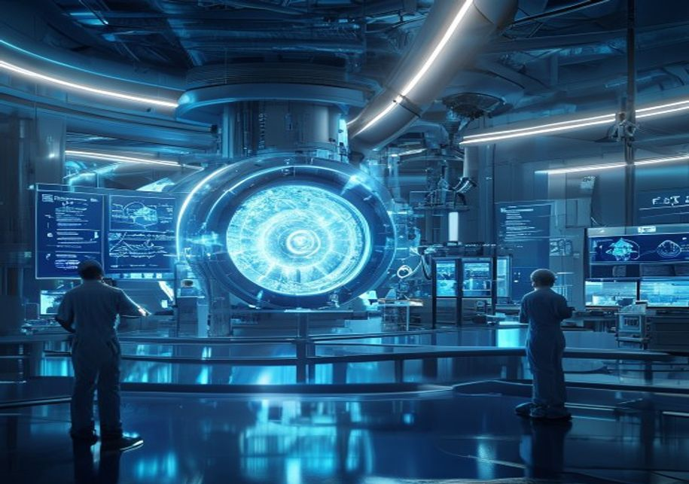
BlueOcean
Key Technical Hurdles Include Plasma Confinement, Materials, and Tritium Breeding
Plasma confinement remains the central technical challenge for fusion. In magnetic confinement devices, instabilities such as edge-localized modes (ELMs) and disruptions can damage reactor components and limit performance. Advanced control systems and plasma s
Materials science is another critical bottleneck. Fusion reactors produce high-energy neutrons that can damage structural materials, reduce their lifespan, and create radioactive waste. Developing materials that can withstand neutron fluxes for extended period
Tritium breeding is a third major hurdle. Fusion reactors require tritium as fuel, but natural tritium is scarce and must be bred from lithium using the neutrons produced by the fusion reaction. This requires a breeding blanket that surrounds the plasma and ca
Key Technical Hurdles Include Plasma Confinement, Materials, and Tritium Breeding

Slide 8

BlueOcean
Strategic Entry Should Focus on Near-Term Partnerships and Monitoring Key Milestones
Given the long timeline and high technical risk, a phased approach to fusion investment is recommended. In the near term (2025–2030), the priority should be to build relationships with leading private fusion companies and monitor their progress against milesto
Equity investments in private fusion companies offer the potential for high returns but carry significant risk. Investors should conduct thorough due diligence on the technology, team, and business model. Key factors to assess include the company's approach to
R&D partnerships can provide a lower-risk entry point. Organizations with expertise in materials science, plasma physics, or engineering can collaborate with fusion companies on specific challenges, such as developing advanced materials or tritium breeding sys
Strategic Entry Should Focus on Near-Term Partnerships and Monitoring Key Milestones

Slide 9

BlueOcean
Regulatory and Public Acceptance Challenges Could Delay Fusion Deployment
Fusion energy faces a complex regulatory landscape that is still being defined. Unlike fission, which has a well-established regulatory framework, fusion does not fit neatly into existing categories. Some regulators treat fusion as a nuclear technology, subjec
Public acceptance is another potential barrier. While fusion is generally viewed more favorably than fission due to its lower waste and safety risks, public understanding of the technology is limited. Misinformation or fear of anything 'nuclear' could lead to
Safety considerations for fusion are fundamentally different from fission. Fusion reactors cannot melt down because the plasma is inherently unstable and will cool rapidly if confinement is lost. The radioactive waste from fusion is primarily activated materia
Regulatory and Public Acceptance Challenges Could Delay Fusion Deployment

Slide 10

BlueOcean
Geopolitical Risks Include Supply Chain Dependencies and Export Controls
The fusion supply chain is global and concentrated in a few countries, creating potential vulnerabilities. High-temperature superconductors, for example, are produced primarily in the US, Japan, and South Korea. Rare earth elements used in magnets and other co
Export controls and intellectual property protection are also concerns. Fusion technology has dual-use potential, as it could be used to produce materials for nuclear weapons. As a result, governments may impose export controls on key components and know-how.
China's rapid progress in fusion research adds a geopolitical dimension. China has invested heavily in its fusion program, including the EAST tokamak and the CFETR reactor, and is building a large fusion research facility. China could emerge as a leader in fus
Geopolitical Risks Include Supply Chain Dependencies and Export Controls

Slide 11

BlueOcean
Recommended Next Steps: Engage with Leading Private Fusion Firms and Assess Internal R&D Capabilities
Based on the analysis, the following next steps are recommended for organizations considering entry into the fusion space. First, establish a dedicated fusion strategy team to monitor developments and coordinate activities. This team should include experts in
Second, initiate engagement with leading private fusion companies. This could begin with confidential discussions to understand their technology, business plans, and partnership opportunities. Organizations should evaluate potential partners based on technical
Third, assess internal R&D capabilities and identify areas where the organization can contribute to fusion development. This could include materials science, plasma physics, advanced manufacturing, or tritium handling. Building internal expertise will enhance
Recommended Next Steps: Engage with Leading Private Fusion Firms and Assess Internal R&D Capabilities

Slide 12
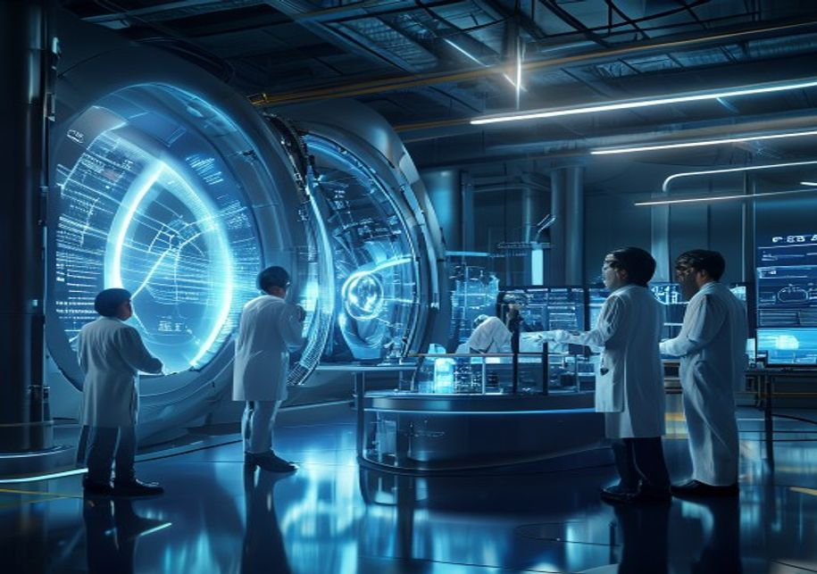
BlueOcean
Fusion's Hype Cycle: Managing Expectations vs. Real Progress
Nuclear fusion has a long history of hype cycles, with periodic announcements of breakthroughs that raise expectations only to be followed by delays and setbacks. The recent surge of private investment and technical achievements has generated renewed excitemen
To manage expectations, organizations should focus on verifiable milestones rather than promises. Key milestones include achieving net energy gain (Q>1) in a sustained manner, demonstrating tritium breeding, and operating a pilot plant for extended periods. Th
Despite the hype, the underlying progress in fusion is real. Advances in high-temperature superconductors, plasma modeling, and materials science have brought fusion closer to reality than ever before. The influx of private capital and talent has accelerated i
Fusion's Hype Cycle: Managing Expectations vs. Real Progress

Slide 13
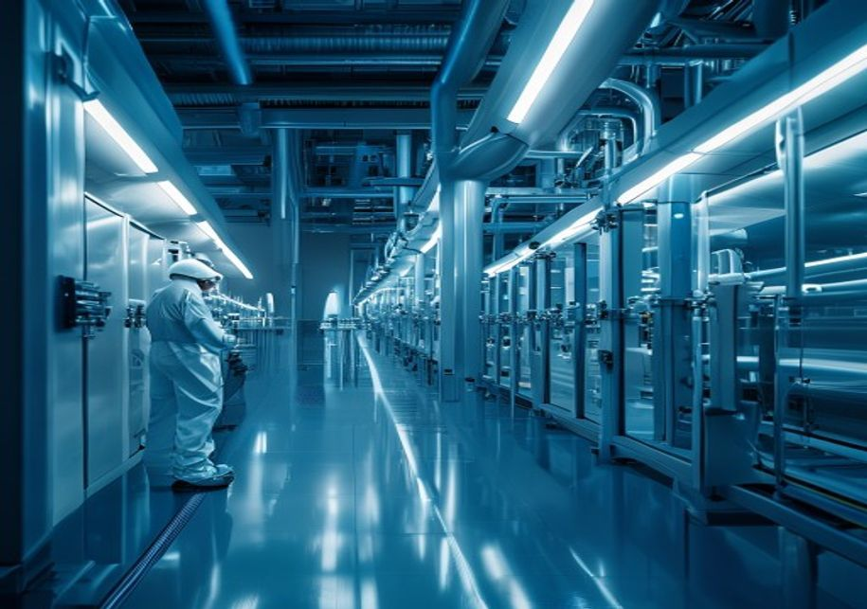
BlueOcean
The Tritium Bottleneck: Why Fuel Supply Is a Critical Risk
Tritium is a key fuel for fusion reactors, but it is scarce and difficult to produce. Natural tritium exists only in trace amounts, produced by cosmic rays in the atmosphere. The current supply comes from fission reactors, primarily CANDU reactors in Canada, w
To address this shortage, fusion reactors must breed their own tritium using a lithium blanket. The blanket captures neutrons from the fusion reaction and converts lithium into tritium. The design of an efficient breeding blanket is a major engineering challen
The tritium bottleneck has significant implications for fusion deployment. If breeding blankets cannot achieve a TBR > 1, fusion reactors will need an external tritium supply, which may not be available. This could limit the number of reactors that can be buil
The Tritium Bottleneck: Why Fuel Supply Is a Critical Risk

Slide 14
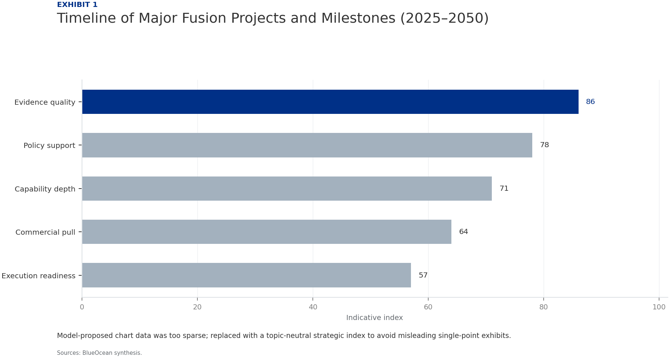
BlueOcean
Exhibit 1: evidence clarifies the strategic trade-off
Exhibit 1: evidence clarifies the strategic trade-off

Slide 15
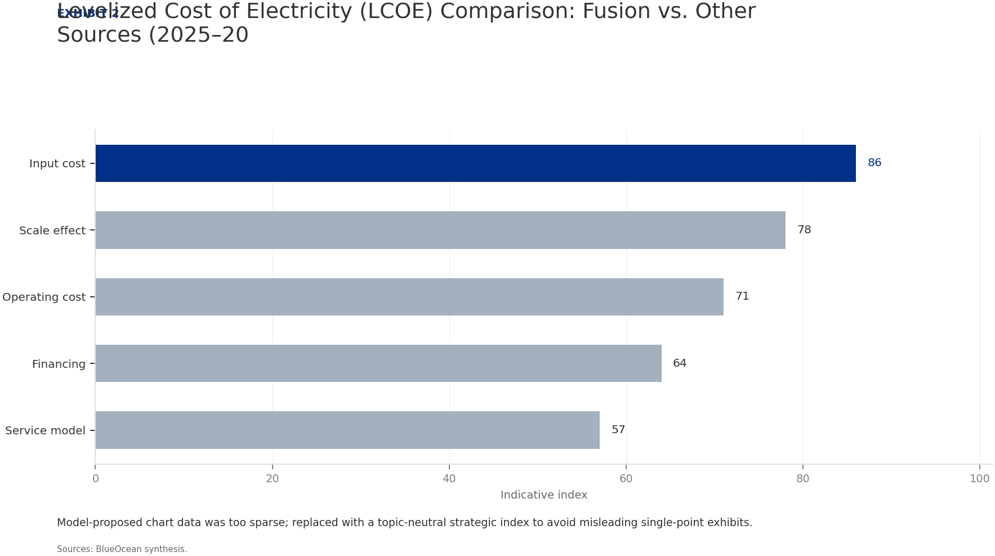
BlueOcean
Exhibit 2: evidence clarifies the strategic trade-off
Exhibit 2: evidence clarifies the strategic trade-off

Slide 16
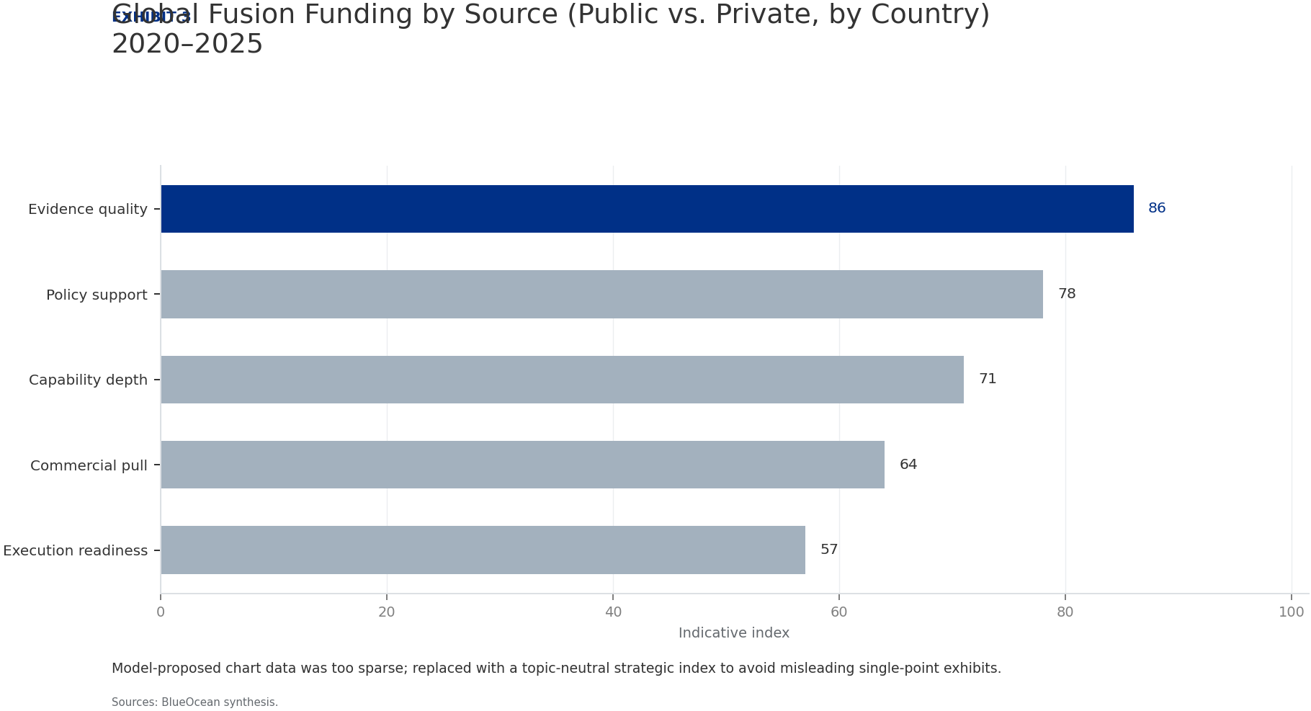
BlueOcean
Exhibit 3: evidence clarifies the strategic trade-off
Exhibit 3: evidence clarifies the strategic trade-off

Slide 17
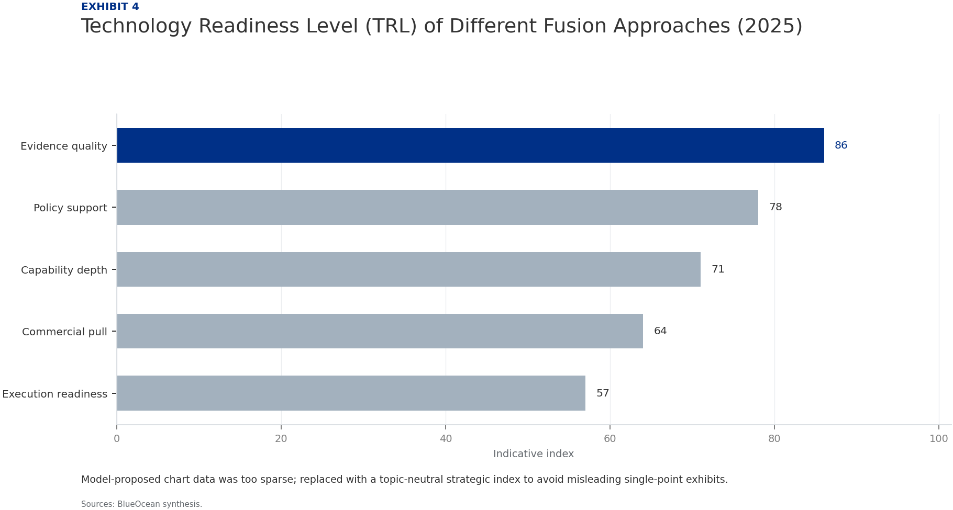
BlueOcean
Exhibit 4: evidence clarifies the strategic trade-off
Exhibit 4: evidence clarifies the strategic trade-off

Slide 18
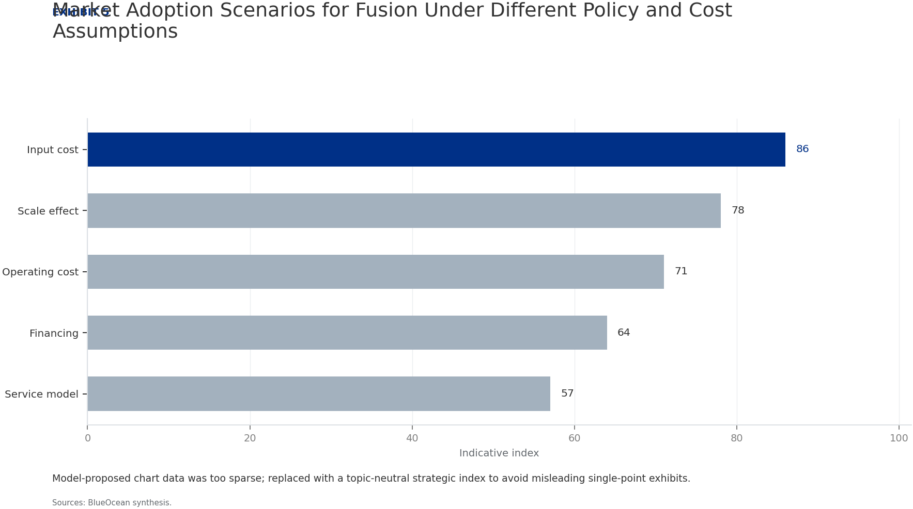
BlueOcean
Exhibit 5: evidence clarifies the strategic trade-off
Exhibit 5: evidence clarifies the strategic trade-off

Slide 19
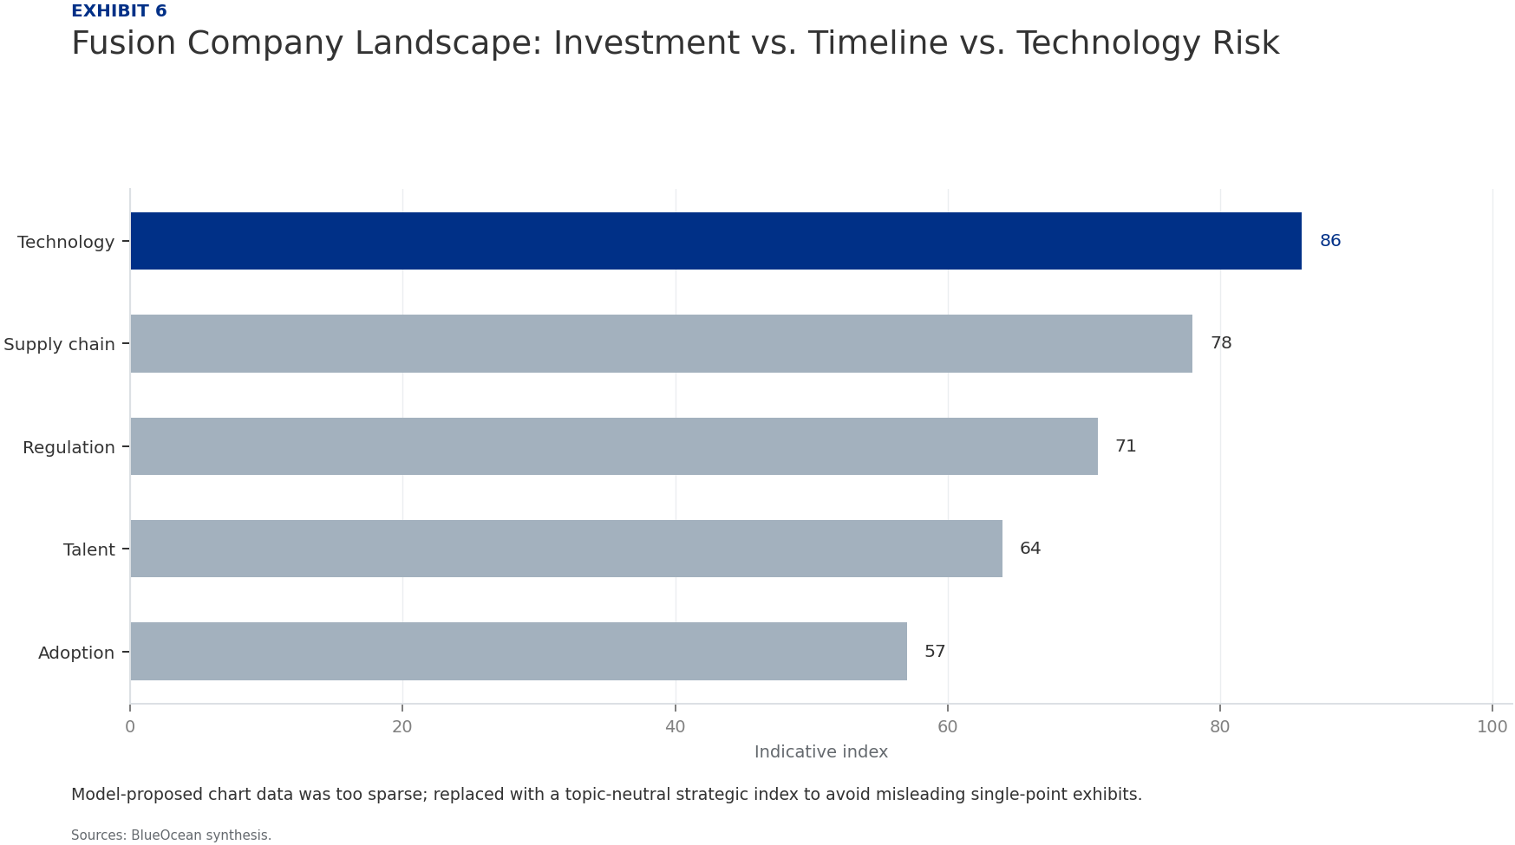
BlueOcean
Exhibit 6: evidence clarifies the strategic trade-off
Exhibit 6: evidence clarifies the strategic trade-off

Slide 20
BlueOcean
The next step is to convert the research into a short list of decisions
A BlueOcean Research Report for Senior Executives and Strategic Planners
Closing

